Slide 1



SPEECH THERAPY ASSISTANCE MOBILE APP
Student Details:
Name: Pedro Fabian Owono Ondo Mangue
TP Number: TP063251
Program: BEng (Hons) Computer Engineering
Supervisor: Assoc. Prof. Ts. Dr. Sathish Kumar Selvaperumal
University: Asia Pacific University of Technology & Innovation
Date: August 2025

Slide 2

TABLE OF CONTENTS
Research Problem
Results & Interface
Aims and Objectives
Testing and Performance
Literature Review Summary
Conclusion
Block Diagram
References
Working Principle
Demonstartion

Slide 3

RESEARCH PROBLEM
CURRENT LIMITATIONS IN SPEECH THERAPY:
MARKET NEED:
Traditional therapy: High costs, limited accessibility, requires in-person visits
Existing apps: Use outdated ML algorithms, lack real-time feedback
No AI-based personalization for individual therapy needs
Limited qualified therapists, especially in rural/underserved areas
Gap between controlled training and real-world deployment conditions
Millions are affected by speech disorders globally
Need for scalable, cost-effective, AI-powered solutions
Demand for accessible therapy tools with real-time feedback

Slide 4
AIMS AND OBJECTIVES
Aim:
To develop a mobile application that assists individuals with speech disorders, such as stuttering
Objectives:
AI Development: Create AI-powered algorithms for real-time speech analysis
UI/UX Design: Design a user-friendly mobile application interface
AI Integration: Integrate machine learning for speech pattern analysis
Evaluation: Test effectiveness and usability through a comprehensive evaluation

Slide 5
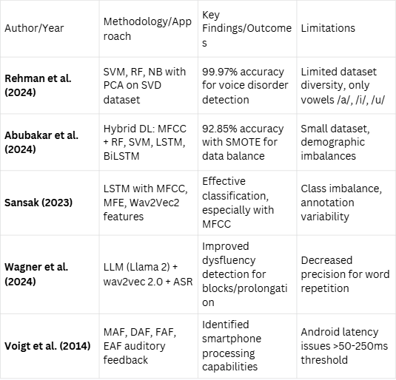
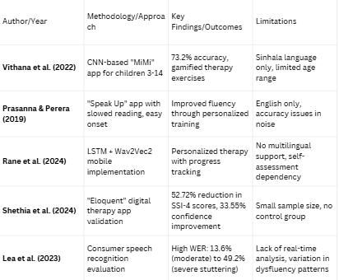
LITERATURE REVIEW SUMMARY TABLE
AI/ML Frameworks and Speech Processing Technologies
Mobile Speech Therapy Applications and Clinical

Slide 6
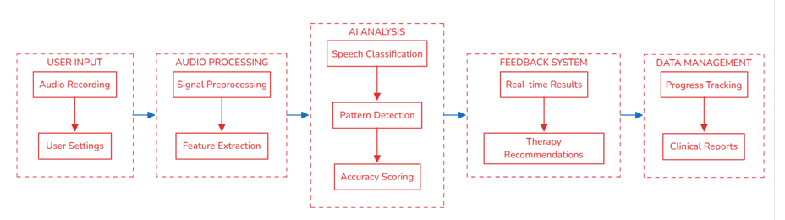
OVERALL BLOCK DIAGRAM

Slide 7
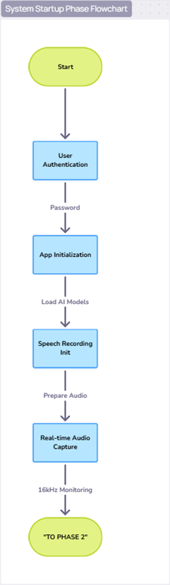
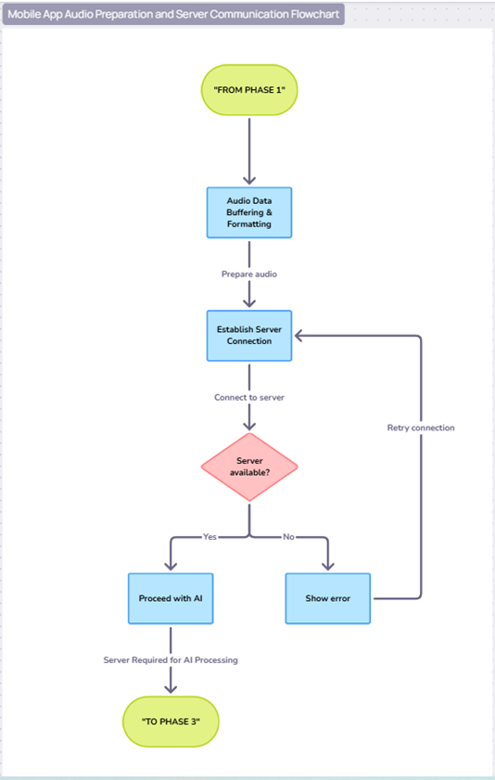
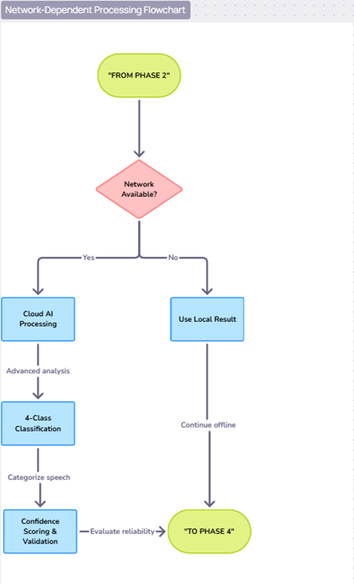
WORKING PRINCIPLE

Slide 8
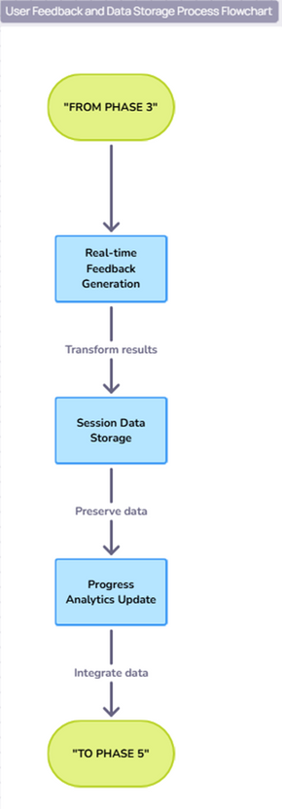
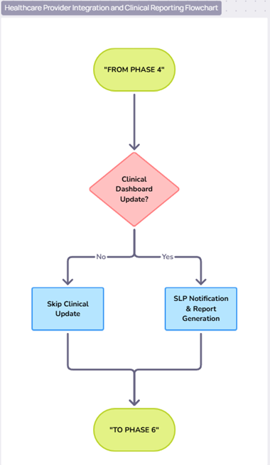
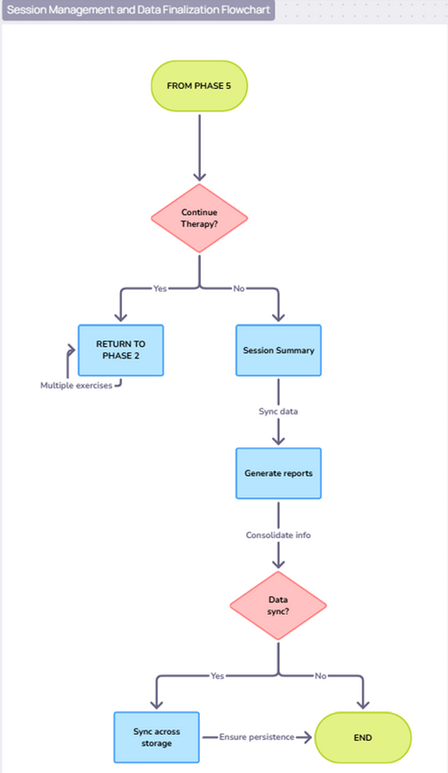
WORKING PRINCIPLE

Slide 9
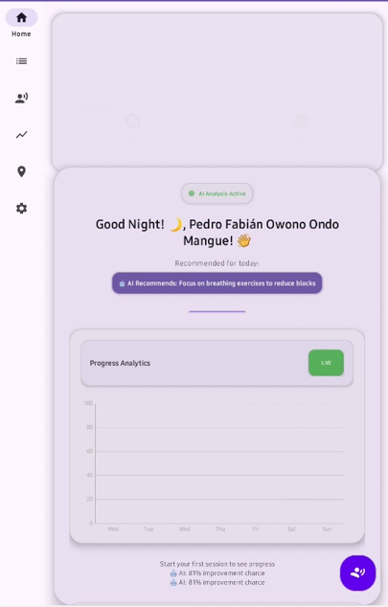
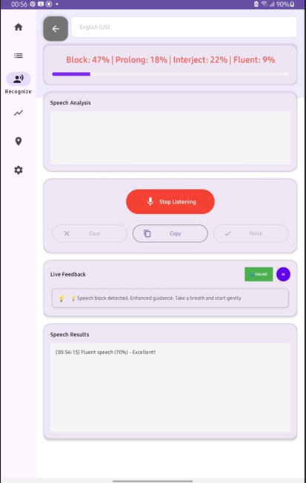
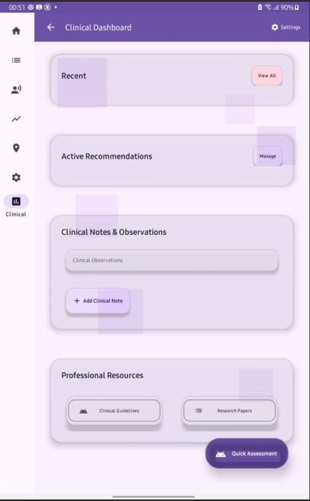
RESULT
Patient Dashboard
Real-Time Analysis Interface
Clinical Dashboard
Personalized user experience
AI monitoring status
Therapy recommendations
Progress tracking
Professional SLP interface
Clinical metrics and reporting
Patient management tools
Live speech classification
Confidence percentages for each stutter type
Instant feedback display

Slide 10
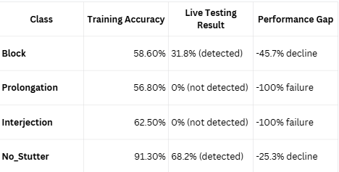
TESTING
Test 1: AI Classification Accuracy
Audio Spectrogram Transformer (AST) Model Performance
Key Results - Training vs Live
Test Setup:
Training Dataset: 4,000 balanced audio samples (1,000 per class)
Classes: Block, Prolongation, Interjection, No_Stutter
Training Accuracy: 67% overall
Live Testing: 22 real-time predictions
Critical Finding: Model degraded from 4-class to binary classification in real deployment

Slide 11
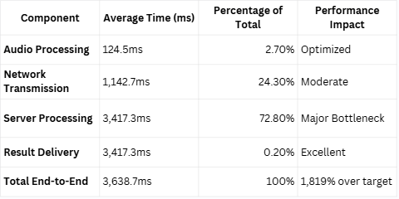
TESTING
Test 2: Real-Time Processing Latency
End-to-End Response Time Analysis
Latency Component Breakdown
Test Parameters:
Target: <200ms for real-time interaction
Industry Standard: 100-300ms for AI systems
Test Sessions: 3 sessions, 60 total measurements
Success Rate: 100% reliability
Key Insight: Server AI processing is the primary performance bottleneck requiring optimization

Slide 12
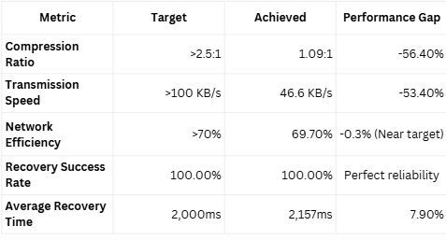
TESTING
Test 3: Network Efficiency & Data Optimization
System Communication and Data Management Performance
Network Performance Results:
Test Objectives:
Compression Ratio Target: >2.5:1
Transmission Speed Target: >100 KB/s
Network Efficiency Target: > 70%
Recovery Time Target: <2,000ms
Key Finding: Excellent reliability (100% recovery success), but compression and bandwidth limitations

Slide 13
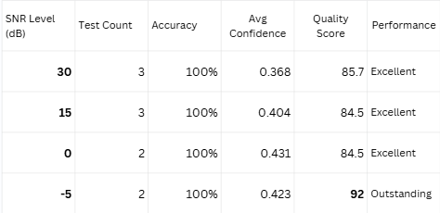
TESTING
Test 4: Audio Signal Processing Quality
Acoustic Robustness and Environmental Adaptability
Performance Results:
Test Coverage:
SNR Range: -5dB to +30dB (35dB total range)
Degradation Types: 7 acoustic distortions
Test Conditions: 20 comprehensive quality assessments
Processing: Real-time inference with quality validation
Key Finding: 100% classification accuracy across all 20 tests and entire SNR range Counterintuitive Finding: Best performance at most challenging conditions (-5dB SNR)

Slide 14
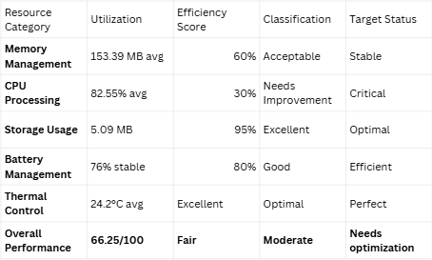
TESTING
Test 5: Resource Management Performance
Mobile Device System Resource Utilization
System Resource Analysis:
Test Environment:
Device: Samsung Galaxy Tab A 8.0 (Android 11)
Test Duration: 60 seconds, continuous monitoring
Measurements: 30 data points every 2 seconds
Conditions: Real-world clinical deployment simulation
Critical Issue: High CPU utilization (82.55% vs <30% target) is the primary performance constraint

Slide 15
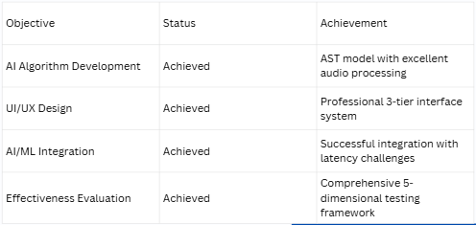
CONCLUSION
Objectives Achievement Status:
Project Impact:
Demonstrates the feasibility of AI-powered mobile speech therapy
Provides foundation for future clinical deployment optimization
Future Work: Edge computing, model optimization, clinical trials

Slide 16
REFERENCES
Abubakar, A., et al. (2024). Stutter Net: A hybrid deep-learning approach for stuttering detection
Vithana, R., et al. (2022). MiMi: A gamified voice-assistive mobile application for children with stuttering
Wagner, A., et al. (2024). Integrating large language models for dysfluency detection in stuttered speech
Rehman, K., et al. (2024). Machine learning techniques for voice disorder classification using SVM, RF, and PCA
Lea, R., et al. (2023). Challenges in consumer-grade speech recognition systems for stuttered speech
Prasanna, R., & Perera, S. (2019). Speak Up: A mobile speech therapy application for stuttering disorders
Furlong, L., et al. (2017). Mobile apps for treatment of speech disorders in children: Evidence-based analysis
Shethia, U., et al. (2024). Evaluating a digital speech therapy app for stuttering: A pilot validation study
Ogunsona, A. (2024). Android powered speech therapy applications for children with speech impairment
Baevski, A., et al. (2020). Wav2Vec 2.0: A framework for self-supervised learning of speech representations

Slide 17
THANK YOU

Slide 18
DEMO VIDEO LINK:
https://drive.google.com/file/d/1gkIxH5T_k5q0EaTMMMfQWBV71CoPqjk_/view?usp=sharing

