Slide 1
Plan merging project
Nils Bröcker, Daniel Schreitter Ritter von Schwarzenfeld, Jakob Westphal

Slide 2
Contents
Introduction
Basic Problems
Basic Solutions
Approaches
Layer
Plan extending
Virtual Robot
Final
Benchmarks
Evaluation

Slide 3
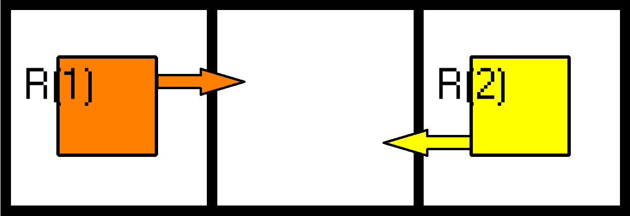
Basic Problems – Node Collision

Slide 4
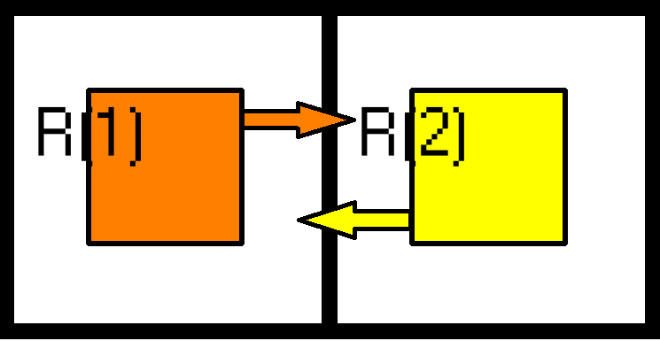
Basic Problems – EDge Collision

Slide 5
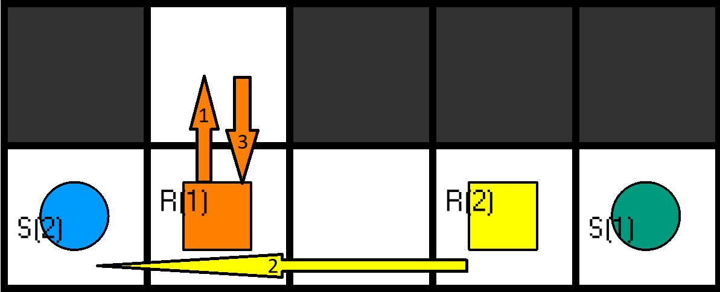
Basic Solutions – Evading

Slide 6
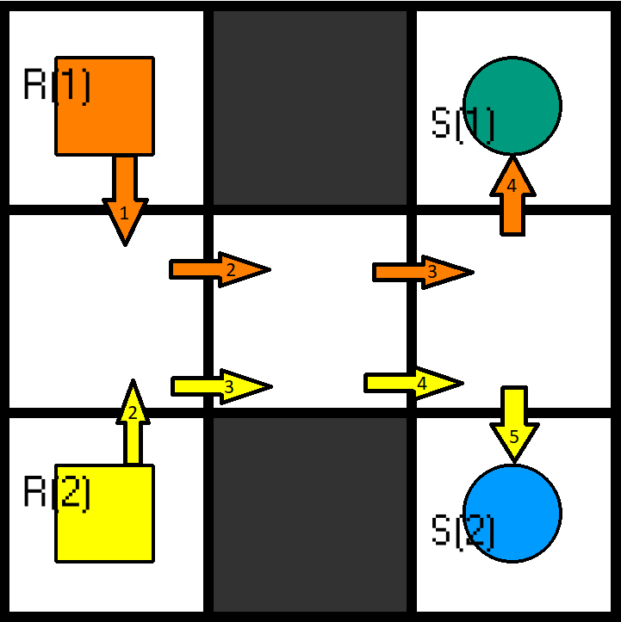
Basic Solutions – Waiting

Slide 7
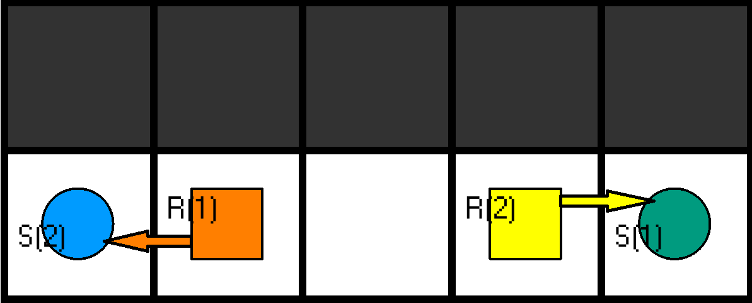
Basic Solutions – Plan switching

Slide 8
Layer Approach
„deterministic“, imperative approach:
Find first collision
Solve collision in predetermined way
Find next collision
…
Requires „layer“ concept to function
Notes:
Imperative approach (more suitable for “normal” programming languages)
Directly implementation of the basic problems and basic solutions
Collision detection -> look at the first collision found
Use one of the basic solutions to solve this collision
Repeat
Problem: it is not possible to remove atoms during execution but required to change the plans!
-> use layer concept: reconstruct all the plans but with changes in a new “layer” -> find collisions in new layer, solve them by creating another new layer etc.

Slide 9
Plan Extending Approach
Try to avoid collisions by using detaching “Problem Parts” of an input Plan and using mapfinding to fix them
Using the script iterative till no collision exist anymore
Problems: blow up by corridor like instances, uses iterations and mapfinding

Slide 10
Virtual Robot Approach
check for collisions + select one collision free robot (else pick random one)
robot is now the virtual robot
iterate over all robots
is it collision free with the v-robot? -> if yes, merge it into the v-robot
else solve collision + merge it into the v-robot
adv.: no new collisions generated, could be time efficient
disadv.: plan switching is hard if not impossible, no working implementation

Slide 11
Final Approach
More „non deterministic“, declarative approach
Split into seperate plan switching and waiting
Generate possible solutions randomly
Use constraints / optimization statements to find best solution
Notes:
Declarative approach (goal is to be more in line with the strengths of asp and clingo compared to original layer approach)
Separate problem into plan switching and waiting
Basic idea for both: - generate a random solution according to some specification
use constraints and optimization statements to find the best solution

Slide 12
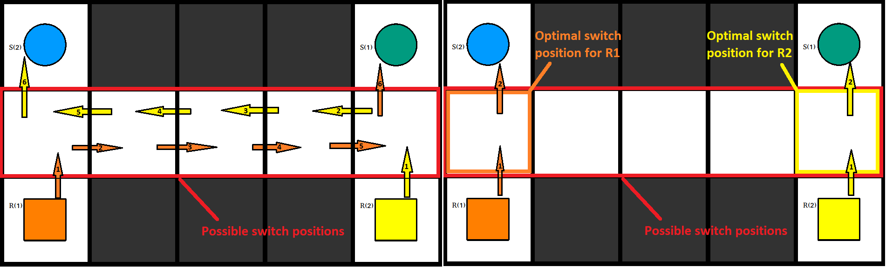
Final approach: plan switching
Find common nodes between robots
Find optimal switch position
Minimize timesteps to find optimal plans
Notes:
Where is a plan switch possible? -> common nodes
-> find all common nodes, choose optimal one for the planswitch
Perform random switches between eligible robots using optimal positions
Minimize over the timesteps every robot needs to reach his goal to find the optimal plan
Optimal plans reduce plan length and also complexity because many potential collisions with other robots can be avoided

Slide 13
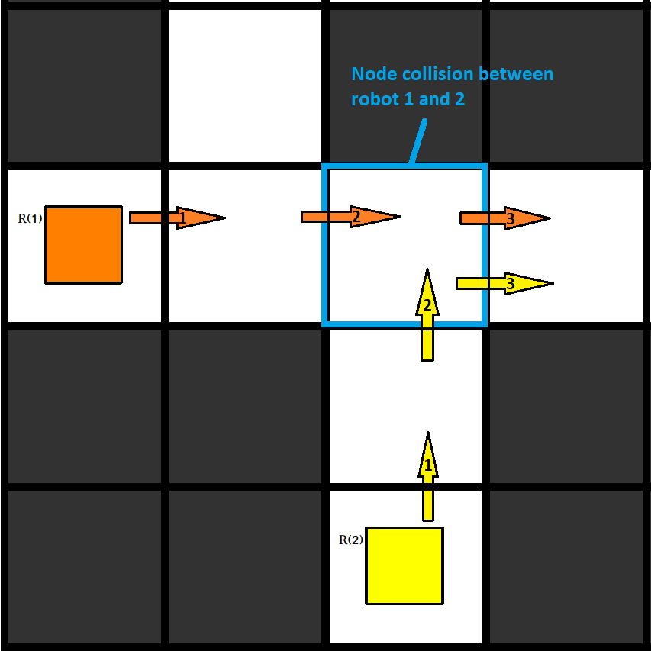
Final approach: waiting
Assign random wait times
Have robots wait at the starting position
Check if there are any collisions left
Minimize timesteps to avoid unnecessary waiting
Notes:
Assign a random wait time between 0 and the max wait parameter to every robot
Robots wait at their starting position until their wait time is over
Then execute their original plans
Eliminate solutions with collisions
Again minimize the timesteps to make sure no robot waits longer than necessary

Slide 14
Final approach: optimization
Number of possible models too high – scales bad
Reduce solving time by restricting possible solutions
Change to multi-shot
Introduce multiple encodings with differing complexity
Sacrifice optimality of solution for time performance
Notes:
Both encodings work very well but don’t scale well for bigger instances -> too many possible models!
-> more restrictions for generated solutions!
Plan switching: only robots with collisions can switch, multi-shot required for correct solution
Waiting: reduce max wait parameter and use multi shot (instead of 1 time maxwait 10, do 2 times maxwait 5) -> to the extreme with maxwait 1
Most of the solving time in first execution of planswitching: use encoding with only 1 collision first, then one with 2 collisions, then the one with 3 to even out the curve
Simpler encoding for waiting where only robots with collisions can wait possible but requires 2 executions of more complex encoding where every robot can wait first
Result: drastically increased time performance and scalability (linear?) but less optimal solutions!

Slide 15
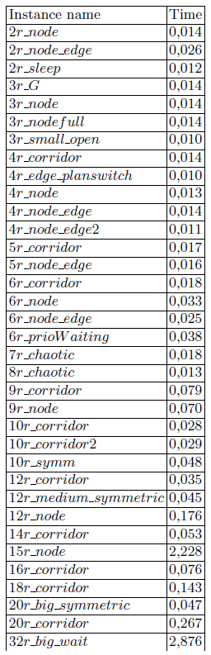
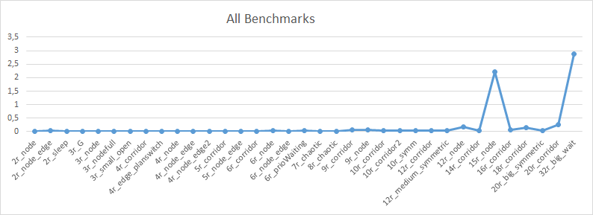
Benchmarks
Notes:
except 2 spikes, every tested instance was solved in under half a second
those two high spikes with 2-3 seconds computation time are instances where are especially many node collisions and no plan switching

Slide 16
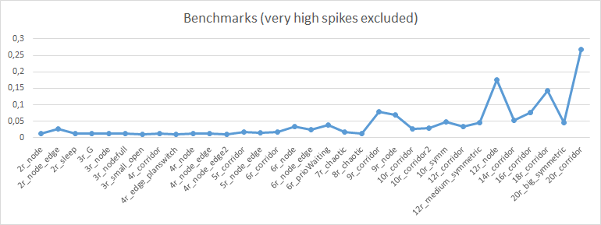
Benchmarks
Notes:
first instances (until 8r_chaotic) have pretty similar time (no real rise noticable)
on bigger instances a growing rise can be detected
may be an indicator of a non linear scaling

Slide 17
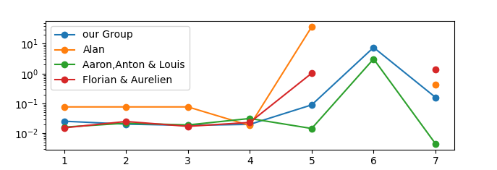
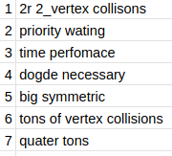
Benchmarks
plans quite similar to the ones of Aaron, Anton & Louis
similar concepts
plans different to the ones of Alan, Florian & Aurelien
different concepts
Notes:
these benchmarks are from the collective benchmarks, made on a different hardware than the benchmarks before
but all those benchmarks here on the same hardware
up to 10 seconds on benchmark 6 (was the last one with 32 robots in our benchmarks)
you can clearly see the hardware differences (3 seconds vs 10 seconds)
merged output plans look quite similar to the ones of Aaron, Anton & Louis, which should be because the use of similar concepts in the encodings
but our plans differ from the ones from Alan as well as the ones from Florian & Aurélien
missing points mean that there was no benchmark here from the specific group on this benchmark

Slide 18
Evaluation
tried out 4 different approaches
all benchmarks in under 3 seconds
not remarkable better or worse compared to the other groups benchmarks
plan switching problems very efficient
node collision problems far less efficient
efficient enough to solve 32 robots in a few seconds
most approaches couldn‘t solve 32 robots (or with more than 60s)
scaling may not be linear
no data beyond 32 robots

