Slide 1
Plan merging project
Nils Bröcker, Daniel Schreitter Ritter von Schwarzenfeld, Jakob Westphal

Slide 2
Contents
Introduction
Basic Problems
Basic Solutions
Approaches
  Layer
  Plan extending
  Virtual Robot
  Final
Benchmarks
Evaluation

Slide 3
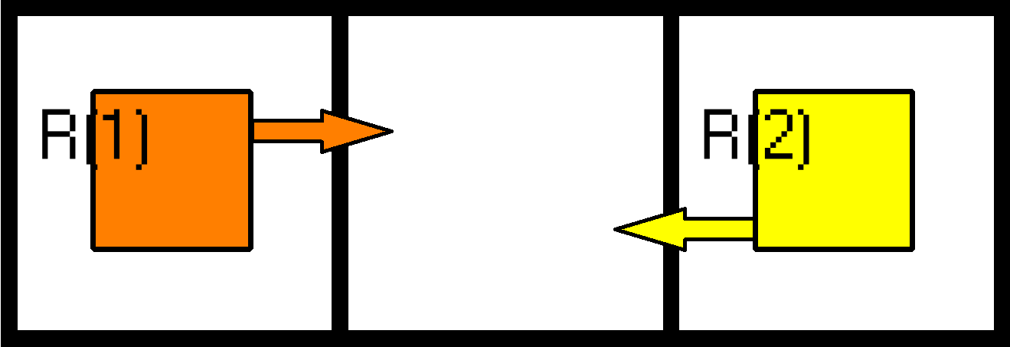
Basic Problems – Node Collision

Slide 4
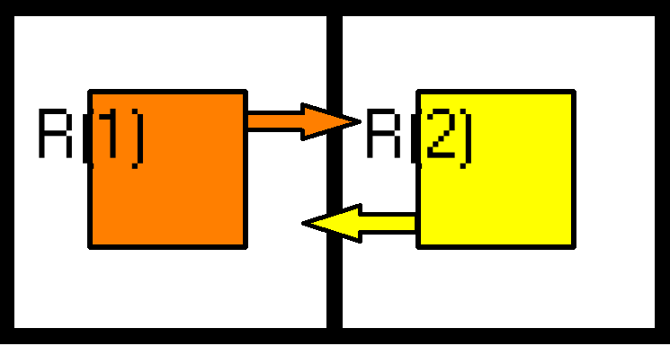
Basic Problems – EDge Collision

Slide 5
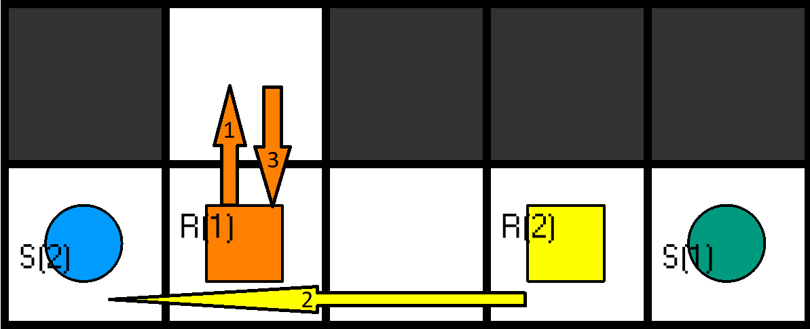
Basic Solutions – Evading

Slide 6
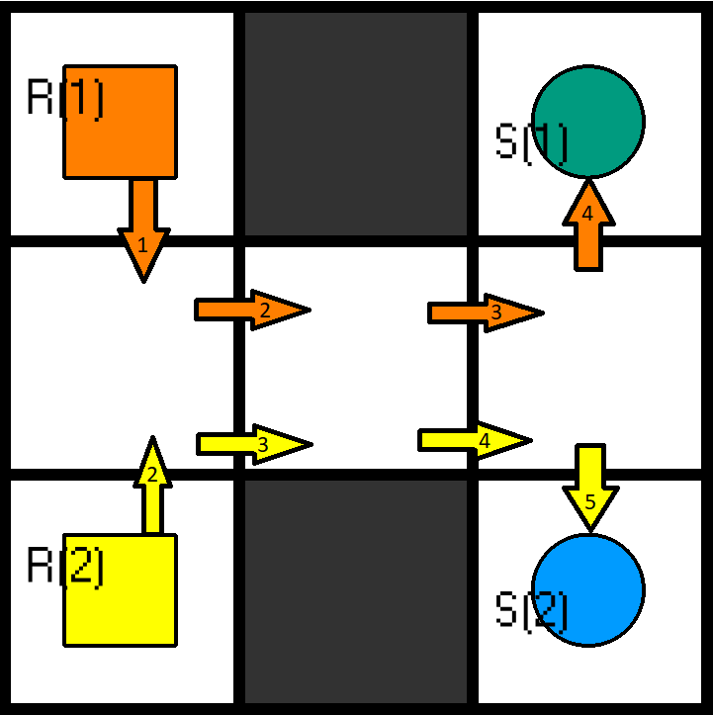
Basic Solutions – Waiting

Slide 7
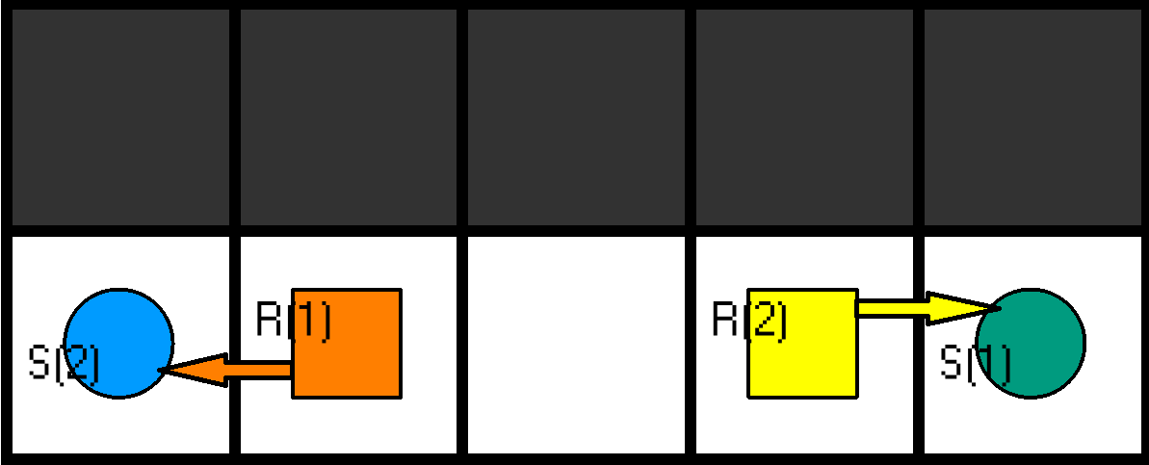
Basic Solutions – Plan switching

Slide 8
Layer Approach

Slide 9
Plan Extending Approach
Try to avoid collisions by using detaching “Problem Parts” of an input Plan and using mapfinding to fix them
Using the script iterative till no collision exist anymore
Problems: blow up by corridor like instances, uses iterations and mapfinding

Slide 10
Virtual Robot Approach
check for collisions + select one collision free robot (else pick one random)
robot is now the virtual robot
iterate over all robots
  is it collision free with the v-robot? -> if yes, merge it into the v-robot
  else solve collision + merge it into the v-robot

Slide 11
Final Approach

Slide 12
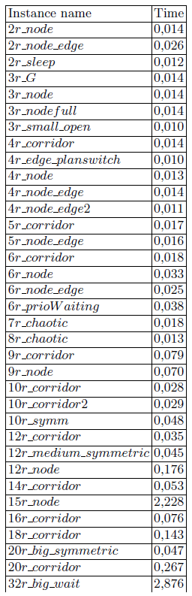
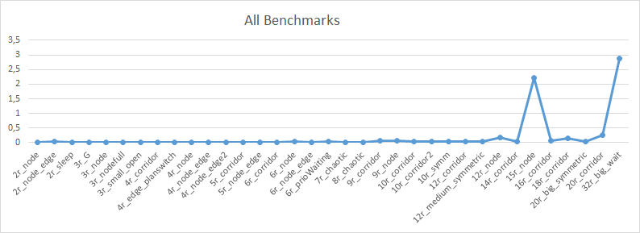
Benchmarks

Slide 13
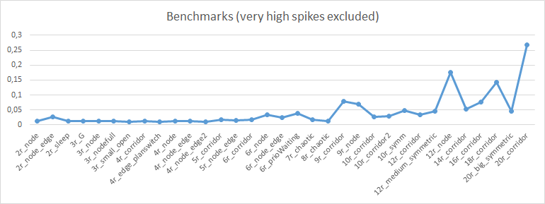
Benchmarks

Slide 14
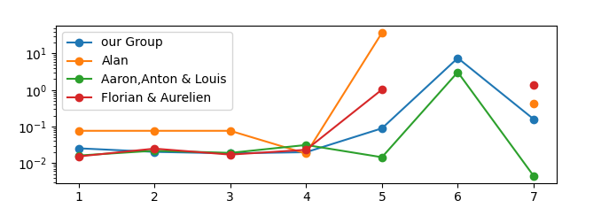
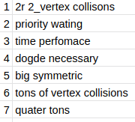
Benchmarks compared to all groups

Slide 15
Evaluation
all benchmarks in under 3 seconds
  not remarkable better or worse compared to the other groups benchmarks (see note)
plan switching problems very efficient
node collision problems far less efficient
  efficient enough to solve 32 robots in a few seconds
  most approaches couldn‘t solve 32 robots (or with more than 60s)
scaling may not be linear
  no clear data for many robots
  no data beyond 32 robots
(note: Benchmarks in presentation better than the „collective benchmarks“ that Aurelien/Florian have on their git repository; differences because of hardware => benchmarks on laptop vs high-end workstation)

