Slide 1
WALL STREET QUANTS | BOOTCAMP PROJECT | VERSION 2
Statistical Arbitrage in
Cryptocurrency Markets
Momentum and reversal on a survivorship-free 39-coin universe
0.20
0.52
-0.12
Hold-out Sharpe (x sqrt 252)
Hold-out alpha t-stat
Hold-out correlation to BTC
Research 2021-2023 (all decisions) | hold-out 2024-2026 (untouched) | net of 20 / 7 bps costs

Slide 2
EXECUTIVE SUMMARY
Hold-out first: a modest, market-neutral edge
- Hold-out (2024-2026): Sharpe 0.20, alpha 2.8%/yr with t = 0.52 - not significant.
- Research (2021-2023): Sharpe 0.93, alpha t 1.64. The gap is selection bias plus decay.
- Market-neutral: beta -0.03, correlation to BTC -0.12.
- What survived: time-series momentum switched off when implied vol (DVOL) is high.
- What faded: theme momentum and slow residual reversal.
- vs version 1: 1.02 (sqrt 365) = 0.85 at sqrt 252; hold-out 0.46 -> 0.20 after fixes.
HOLD-OUT SHARPE
HOLD-OUT ALPHA T
0.20
0.52
research 0.93
research 1.64
CORR TO BTC
HOLD-OUT MAX DD
-0.12
-26.7%
beta -0.03
BTC -53.1%
Sharpe = mean / std x sqrt(252). Momentum at 20 bps, reversal at 7 bps; all-at-20-bps results in the report.
2

Slide 3
VERSION 2
What changed from V1 to V2
V1
V2
Effect
Sharpe with sqrt(365)
mean / std x sqrt(252) everywhere
V1 1.02 -> 0.85
Exploration on full 2021-26 sample
Mechanical protocol on 2021-23 only
True hold-out: 0.20
Full sample first; no corr to BTC
Hold-out first; corr to BTC in all tables
alpha t 0.52, corr -0.12
16 coins alive in 2026
Top 40 by Jan-2021 market cap (39 with data)
FTT, EOS, MKR exits included
No rebuild or methodology guide
60-line rebuild + methodology explainer
Matches engine to 1e-12
3

Slide 4
DATA
A survivorship-free universe, fixed in January 2021
- Rule: the 40 largest coins on CoinMarketCap's 2021-01-03 snapshot, excluding stablecoins and wrapped tokens.
- Never updated with hindsight: coins stay in until their prices stop.
- Failures included: FTX Token (collapsed Nov-2022), EOS and MKR (history ends 2026).
- Sources: Coinbase, KuCoin, Gate.io, Bitfinex - the most complete history per coin; Bitfinex keeps delisted pairs.
- Missing: Revain (no free price history).
39
40
COINS TRADED
TOP BY MARKET CAP
3
4
EXITS DURING SAMPLE
DATA VENUES
UNIVERSE
BTC ETH LTC XRP DOT BCH ADA BNB LINK BSV XLM EOS XMR THETA TRX XEM VET XTZ CEL UNI LEO CRO DOGE ATOM NEO AAVE SNX HT FIL DASH IOTA ETC ZIL YFI MKR FTT COMP ZEC SUSHI
4

Slide 5
PRE-REGISTERED PROTOCOL
Every decision made on 2021-2023, mechanically
1
Signals
51 variants in 7 families: cross-sectional, time-series, theme, two residuals, high-vol, pairs
2
Direction
follow or fade each signal by the sign of its 2021-23 gross Sharpe
3
Candidates
cross with holding periods -> 167 candidates at 20 bps (momentum) / 7 bps (reversal)
4
Books
best variant per family if 2021-23 net Sharpe > 0; top three families per book
5
Execution + weights
chosen on 2021-23: no-trade band 2% / hold 3d (overlapping); inverse volatility
5

Slide 6
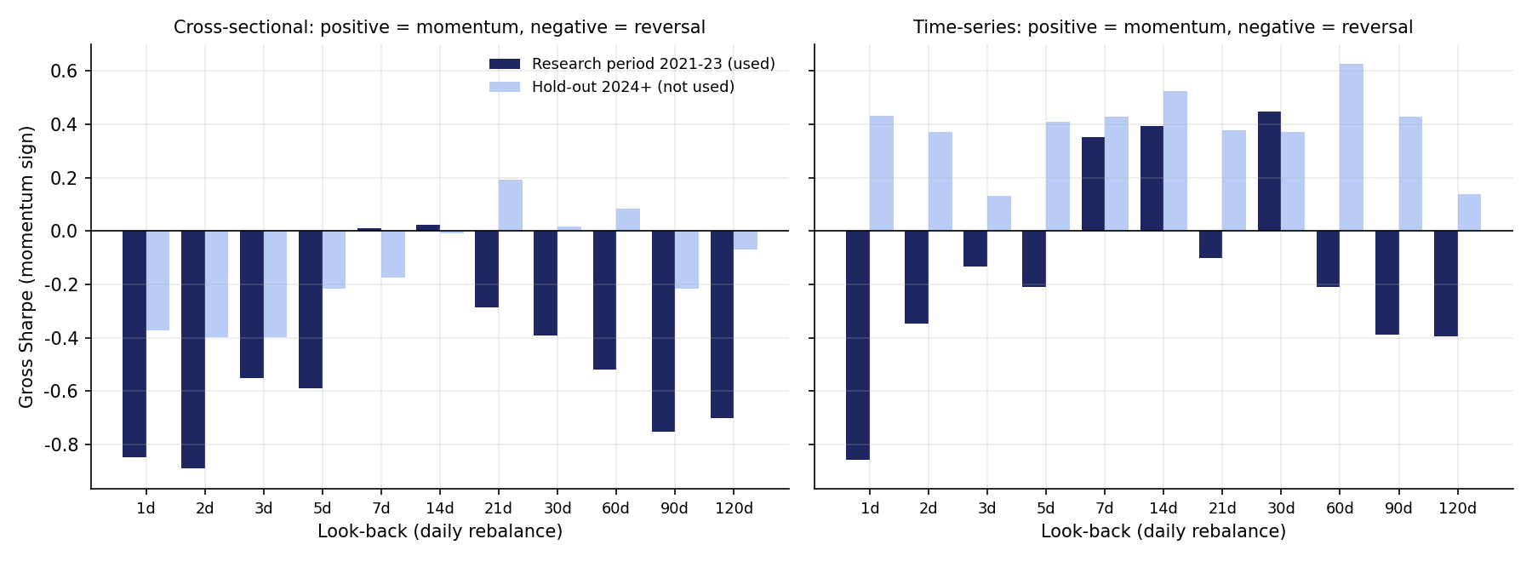
TIME HORIZON
Cross-section reverses; individual coins trend at 1-4 weeks
CS 1-DAY (RESEARCH)
-0.85
negative = reversal
TS 30-DAY (RESEARCH)
0.45
time-series momentum
1-HOUR CS (RESEARCH)
-8.99
reversal, partly bid-ask bounce
Dark bars drive decisions; light bars (hold-out) shown for transparency only. 1-day reversal loses money net: -2.36 at 7 bps.
6

Slide 7
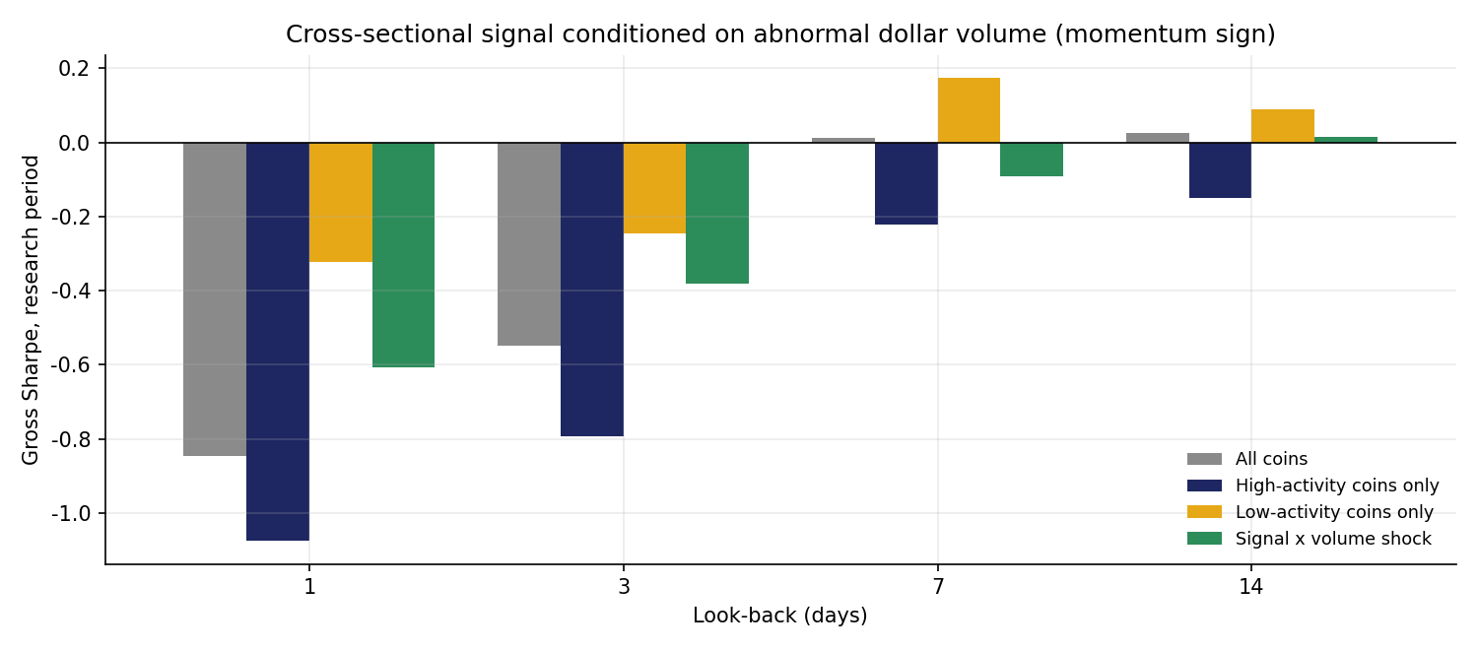
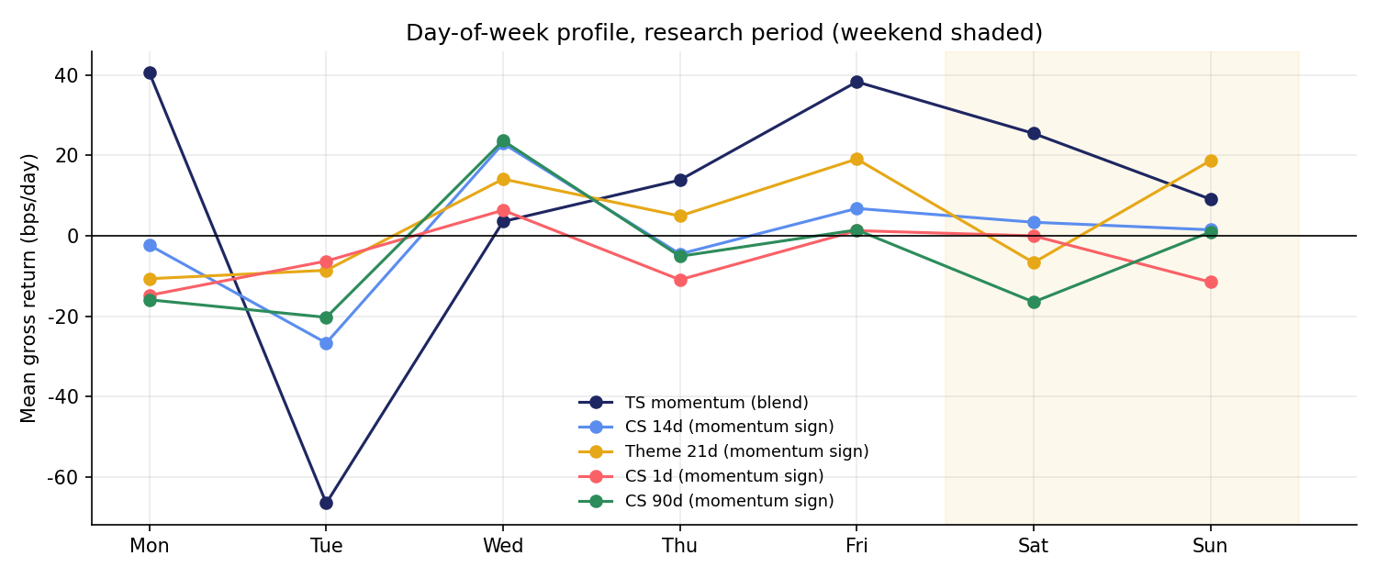
ACTIVITY AND SEASONALITY
Weekends favour trends; volume shocks mark retracing spikes
- 1-day reversal is stronger in high-activity coins (-1.07) than low-activity (-0.32) - the opposite of the uninformed-trading story.
- Volume-shock weighting tilts toward momentum but not enough to be profitable.
- TS momentum: weekend Sharpe 1.37 vs weekday 0.32.
- Tuesday is the worst day for trend-following in both versions.
7

Slide 8
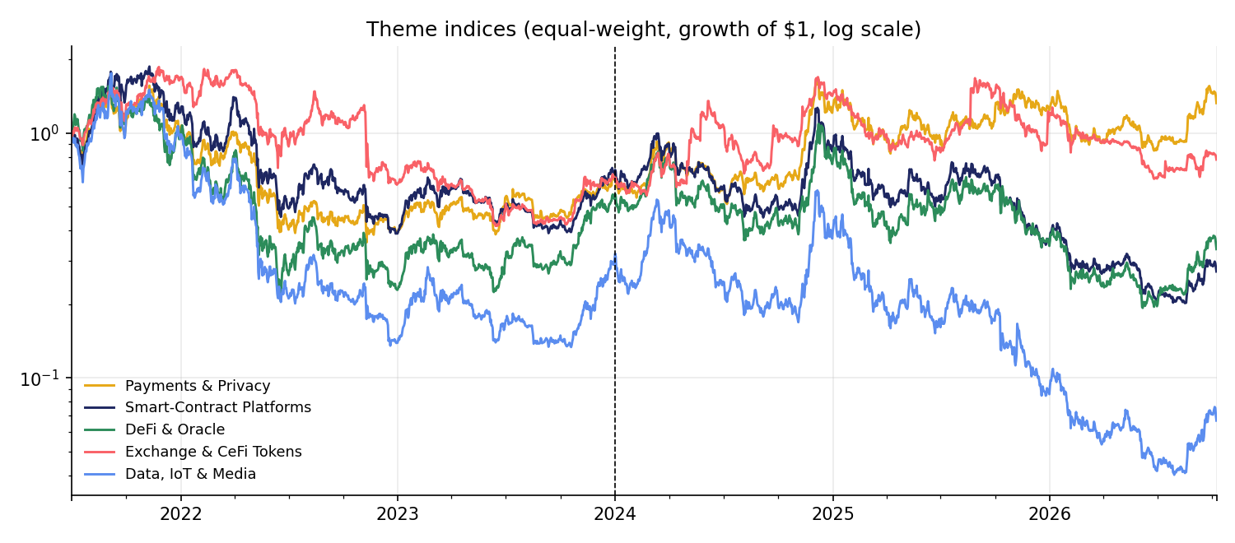
THEMES AND CORRELATION
What worked in 2021-23 did not all persist
Signal (momentum sign)
Research
Hold-out
Theme 14d, hold 7d
1.10
0.10
Residual vs market 60d
-0.55
0.18
Residual vs theme 60d
-0.76
-0.15
Residual vs theme 1d
-1.19
-0.52
Cointegrated pairs
-0.46
1.10
- Themes: theme momentum was the best research-period momentum signal, then flattened in the hold-out.
- Correlation: residuals reverse in 2021-23 (negative = reversal); pairs lost money then and worked later - unstable relationships.
8

Slide 9
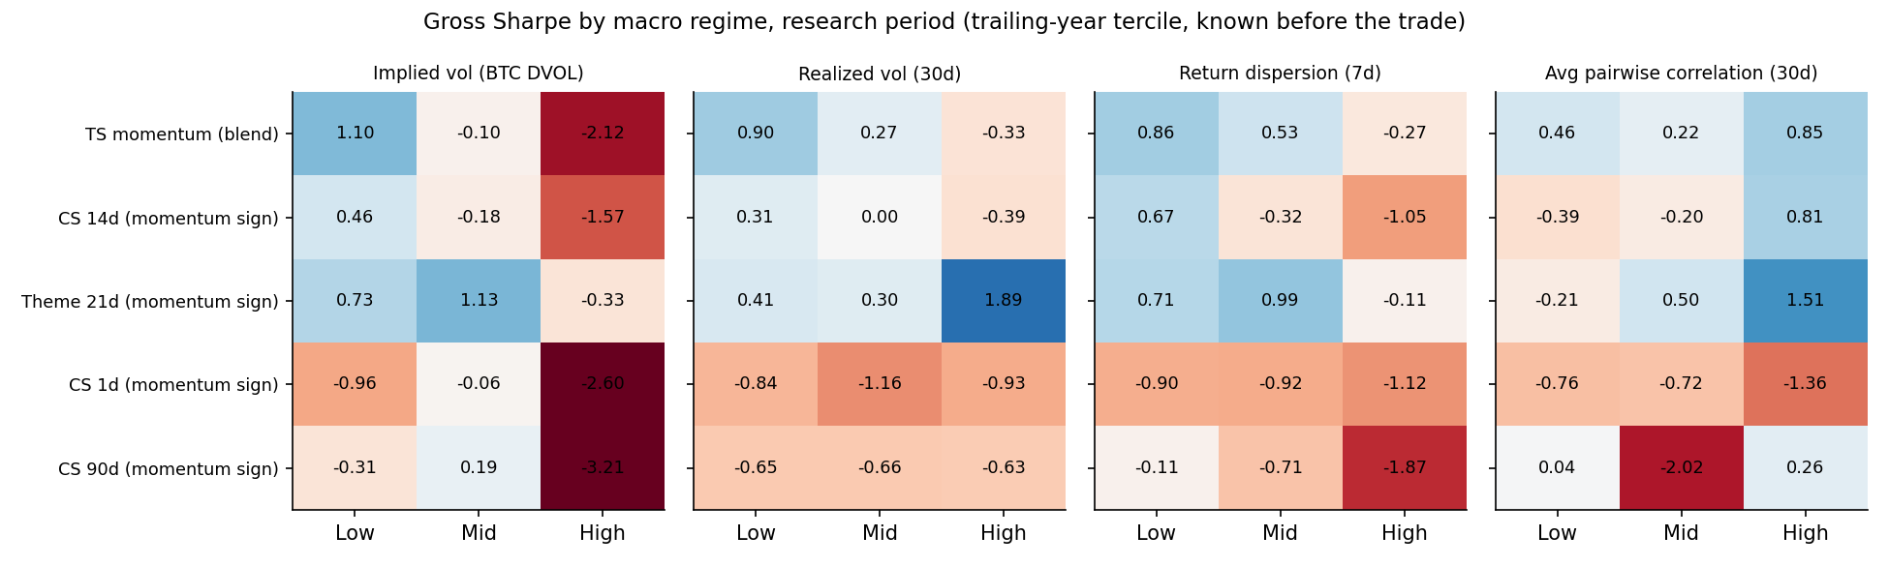
MACRO: VOLATILITY AND DISLOCATION
High implied vol breaks trends, in both periods
TS MOMENTUM, DVOL LOW / HIGH (RESEARCH)
SAME, HOLD-OUT
The DVOL filter (trend-following off in the top third of implied vol) was selected on 2021-23 and is the component that held up.
1.10 / -2.12
0.96 / -0.98
gross Sharpe
pattern repeats out of sample
9

Slide 10
MECHANICAL SELECTION
Family winners on 2021-23, and how they did after
Best candidate per family
Book
IS net
Hold-out net
Theme 14 momentum, hold 7
Momentum
0.57
-0.45
TS 7/14/28 blend + DVOL filter momentum, hold 1
Momentum
0.55
0.62
CS 14 momentum, hold 3
Momentum
-0.56
-0.20
Residual vs theme 60 reversal, hold 7
Reversal
0.81
0.05
CS 120 reversal, hold 7
Reversal
0.67
-0.07
Residual vs market 60 reversal, hold 7
Reversal
0.65
-0.26
TS 90 reversal, hold 1
Reversal
0.34
-0.48
Short-term (1d) in high-vol regime reversal, hold 2
Reversal
0.29
-0.66
Cointegrated pairs REV
Reversal
-0.58
0.94
Highlighted = selected (positive IS net Sharpe, top three families per book). Cross-sectional momentum never cleared 20 bps.
10

Slide 11
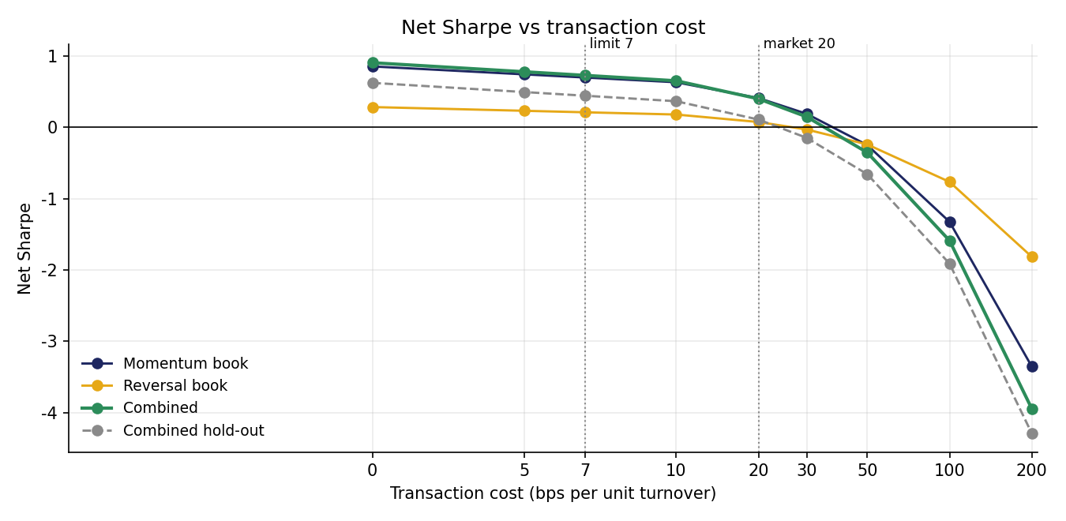
EXECUTION AND WEIGHTING
Costs bite hard; the books diversify each other
Weighting
IS
Hold-out
Equal weight
0.86
0.20
Inverse volatility
0.93
0.20
Risk parity (ERC)
0.93
0.20
Mean-variance (shrunk)
0.60
-0.01
- Execution: No-trade band 2% for momentum, hold 3d (overlapping) for reversal (chosen on 2021-23). Hold-out Sharpe falls to 0.11 if every trade costs 20 bps.
- Diversification: momentum and reversal books correlate -0.11; ensemble hold-out 0.20 vs single-best -0.24.
11

Slide 12
PERFORMANCE EVALUATION
Hold-out first, with alpha t and correlation to BTC
Strategy
Hold-out Sharpe
Research Sharpe
Hold-out return
Hold-out max DD
Hold-out alpha t
Beta
Corr BTC
Combined portfolio
0.20
0.93
2.1%
-26.7%
0.52
-0.03
-0.12
Momentum book (20 bps)
0.30
0.54
5.2%
-24.8%
0.80
-0.08
-0.18
Reversal book (7 bps)
-0.07
0.66
-1.0%
-35.4%
-0.16
0.01
0.03
Cointegrated pairs
0.64
-0.90
2.7%
-5.6%
1.20
0.01
0.06
Equal-weight crypto
0.19
-0.13
10.1%
-74.4%
-0.92
1.05
0.79
Buy & hold BTC
0.61
0.09
24.1%
-53.1%
0.33
1.00
1.00
Hold-out 2024-01-01 to 2026-10-08; research 2021-12-28 to 2023-12-31. Sharpe x sqrt(252). Alpha / beta / correlation vs daily BTC returns, Newey-West t.
12

Slide 13
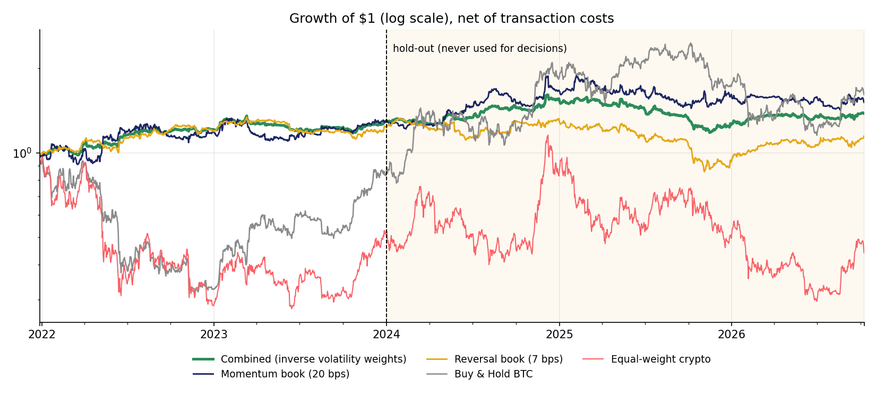
RESULTS
Growth of $1, and what the corrections changed
Combined Sharpe
V1
V1 @252
V2
Full backtest
1.02
0.85
0.50
Hold-out
0.55
0.46
0.20
Hold-out alpha t
0.90
0.90
0.52
Corr BTC (full)
-0.05
-0.05
-0.13
- Convention: sqrt(252) lowers every Sharpe by 17%.
- Universe + protocol: survivorship-free coins and decisions on 2021-23 only take the hold-out from 0.46 to 0.20. The lower number is the credible one.
13

Slide 14
CONCLUSION
How you select matters as much as what you select
- Patterns are real: cross-sectional reversal, 1-4 week trends, weekend and implied-vol effects.
- Most do not survive costs or an honest hold-out.
- One survivor: time-series momentum with a DVOL filter.
- Next: paper-trade it live; add funding costs and a liquidity screen.
0.20
0.52
-0.12
0.93
HOLD-OUT SHARPE
HOLD-OUT ALPHA T
CORR TO BTC
RESEARCH SHARPE
14

