Slide 1
RECON-BOT
Team Name: Cavemen
Presented by: Mahanth, Harsh, Harshal
Introducing the RECON-BOT, our autonomous, ground-based robotic vehicle designed to revolutionize reconnaissance and environmental monitoring in hazardous environments.

Slide 2
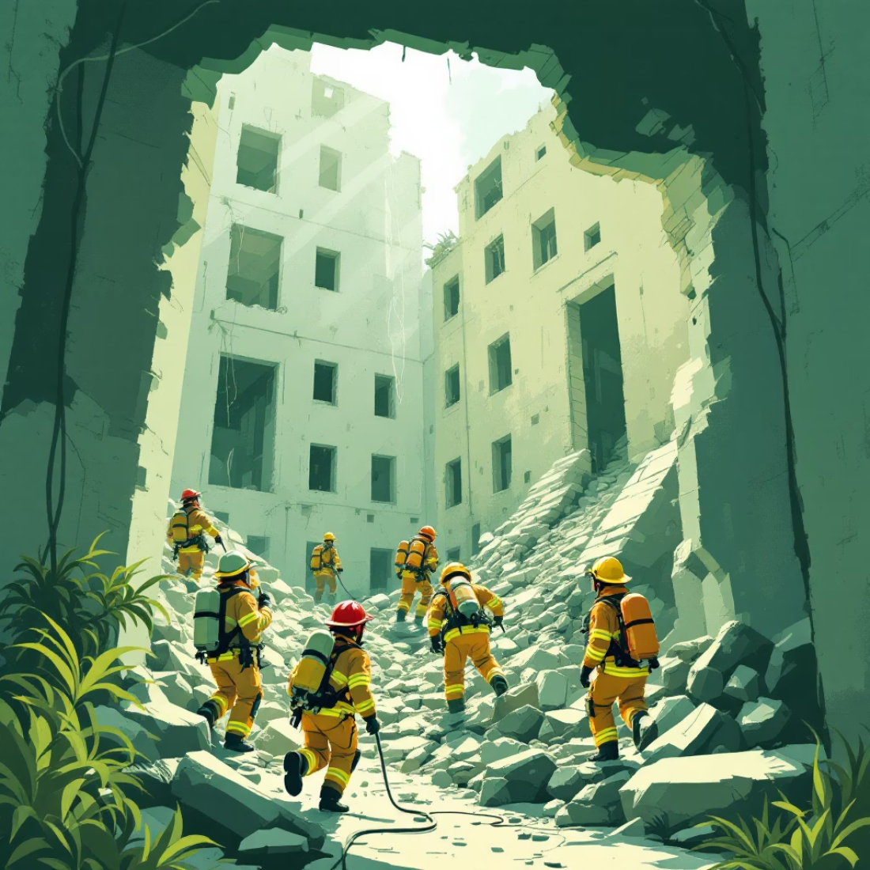
The Critical Problem: Protecting Human Rescuers
During critical disasters or hazardous incidents—such as structural collapses, industrial fires, or toxic gas leaks—human first responders face an extreme, often fatal, level of risk.
Immediate Threats
Rescuers are exposed to high concentrations of poisonous gases and unstable structures.
Information Gap
Teams lack real-time data on air quality and visibility inside inaccessible zones.
We need the RECON-BOT, an intelligent, remote presence, specifically a wheeled/tracked robotic vehicle designed for ground-based reconnaissance and environmental monitoring, that can gather vital intelligence without putting human lives in harm's way.

Slide 3




RECON-BOT: Our Core Objectives
Our primary goal is to deploy a compact, reliable, and sensor-equipped robotic ground vehicle that acts as the eyes and environmental monitor for human command centers, specifically designed for ground-based reconnaissance and data collection.
Hazard Detection
Environmental Monitoring
Accurately detect harmful gases including Carbon Monoxide (CO), Carbon Dioxide (CO₂), smoke, and volatile fuel vapors using a suite of MQ sensors.
Track critical environmental parameters like temperature and humidity using the DHT11 sensor to assess fire or explosion risk.
Live Video Telemetry
Instant Alert System
Stream real-time video footage via an integrated ESP module, providing operators with a critical visual overview of the environment.
Trigger immediate, high-priority alerts through an on-board buzzer and wirelessly transmit all collected data back to the base station.

Slide 4
Key Components: The Anatomy of RECON-BOT
1
2
Microcontrollers
Sensor Array
Arduino Mega (Main Control) and ESP8266 (Wireless Communication/Streaming).
DHT11 (Temp/Humidity) plus MQ-series (MQ3 for alcohol/gas, MQ135 for air quality/smoke, MQ7 for CO).
3
4
Mobility & Power
Safety & Structure
Four 12V DC motors controlled by motor drivers, powered by a temporary 3x 9V battery setup (for prototype) for ground-based movement.
Onboard buzzer for local alerts and a lightweight foam housing for structural protection and easy modification, forming a durable rover-like chassis.

Slide 5










How It Works: Operational Flow
The RECON-BOT follows a simple, yet robust, data-gathering and communication cycle for effective remote operation, primarily for environmental monitoring and ground-based reconnaissance.
Data Processing
Sensor Activation
Arduino Mega processes sensor readings and coordinates motor control for movement.
MQ and DHT11 sensors continuously sample the air and environment.
Visual Feed
ESP8266 manages live video streaming back to the human operator for reconnaissance.
Immediate Alert
Buzzer and telemetry alerts are triggered if gas levels exceed pre-set safety thresholds.
Wireless Telemetry
All environmental data is securely transmitted via the ESP module.

Slide 6
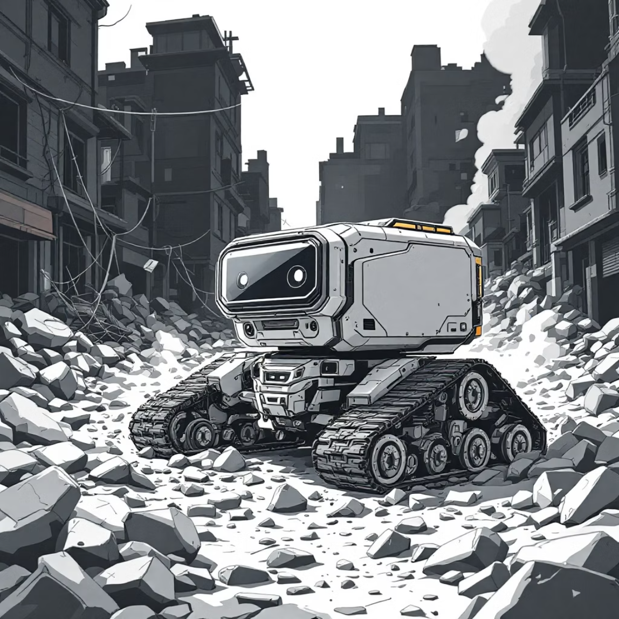

Real-World Applications
The RECON-BOT is designed as a versatile wheeled/tracked robotic vehicle for ground-based reconnaissance and environmental monitoring, applicable for both emergency response and preventative safety measures across multiple high-risk sectors.
1
Disaster Zones
Crucial for preliminary entry into earthquake-affected or burning structures to assess danger before human entry.
2
Industrial Safety
Regular, automated inspections inside chemical, fuel, and processing plants to detect invisible leaks.
3
Underground Exploration
Safe scouting in confined spaces like mines, sewer tunnels, or damaged infrastructure where air quality is uncertain.
4
Environmental Surveillance
Monitoring air quality and temperature in enclosed or highly polluted urban areas.

Slide 7





Future Vision: Scaling Up RECON-BOT Capabilities
Our prototype establishes the foundation for the RECON-BOT; the next phase involves significant upgrades to increase its autonomy, mobility, and utility in complex environments as a ground-based robotic vehicle.
Autonomous Intelligence
Integrate AI for self-navigation, obstacle avoidance, and machine learning-based victim detection, enhancing the RECON-BOT's operational independence.
Advanced Sensing
Adding thermal imaging capabilities to locate survivors through smoke or darkness, significantly improving the RECON-BOT's search efficiency.
Enhanced Utility
Incorporating a basic robotic arm onto the RECON-BOT for clearing small debris or delivering minor assistance packages (e.g., water, communications).
Rugged Mobility
Transitioning the RECON-BOT to tank-style tracks to traverse highly uneven, dangerous terrain and rubble more effectively, cementing its role as a robust ground vehicle.
Multi-Modal Platform
Designing a modular frame that allows for the RECON-BOT's quick conversion to a drone for aerial surveillance when necessary, expanding its reconnaissance capabilities beyond ground-level operations.

Slide 8
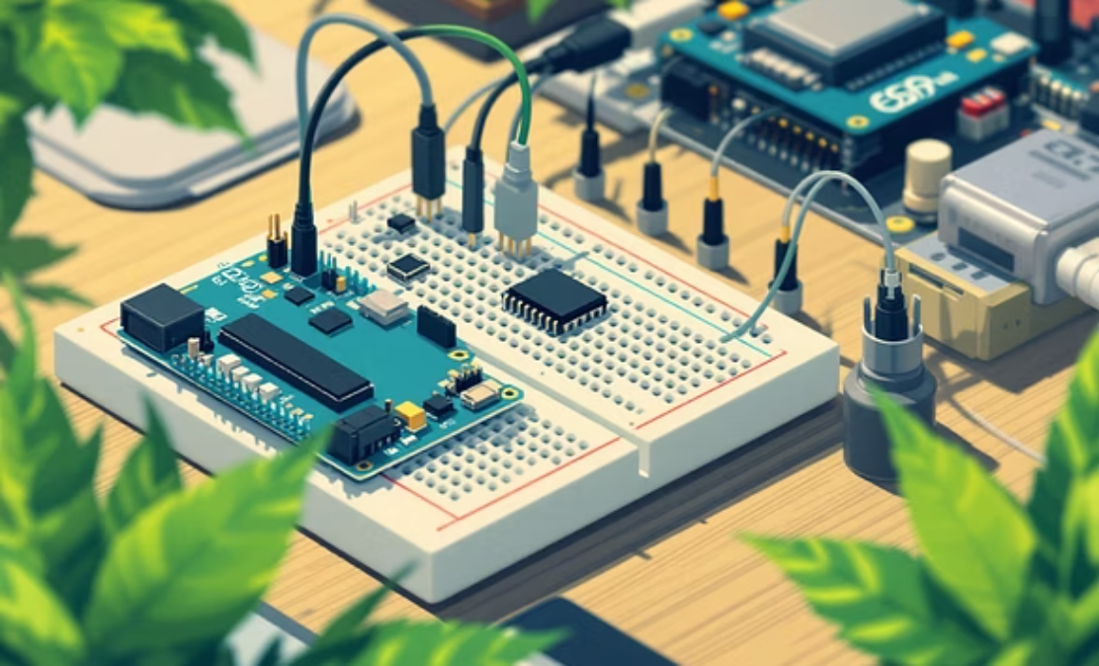
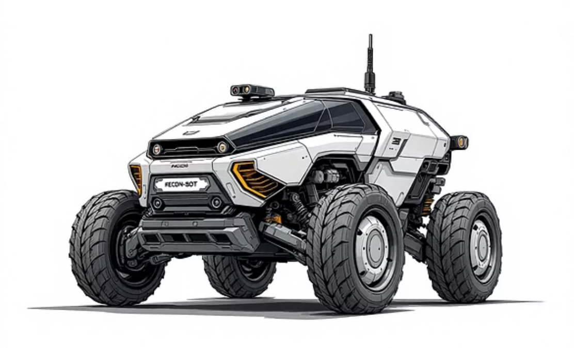
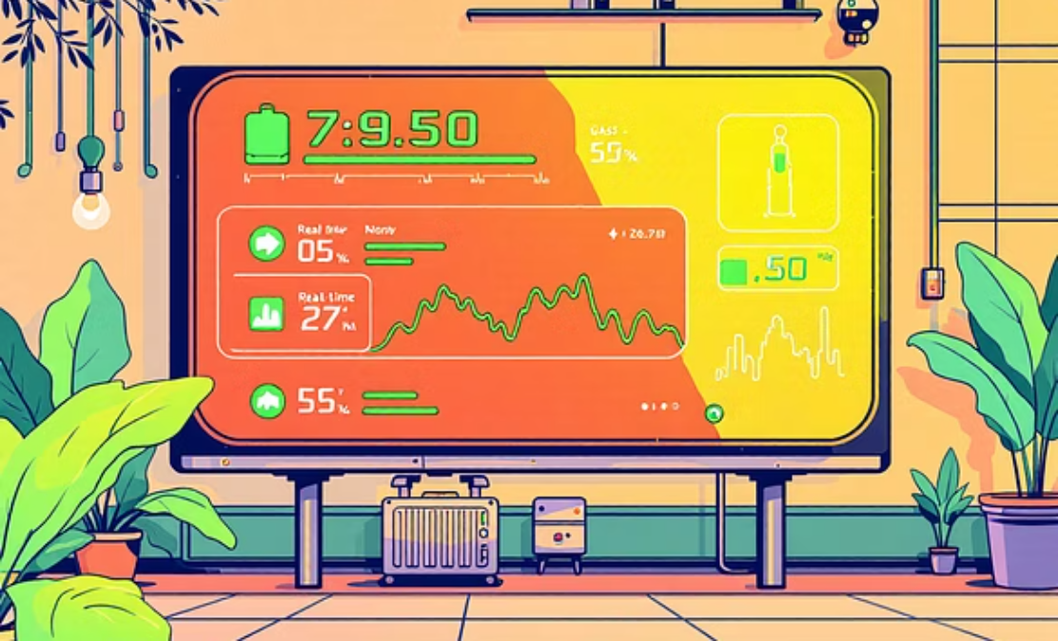
Prototype and Initial Testing Results
We have successfully demonstrated the core functionality of the RECON-BOT using off-the-shelf components and custom integration.
System Integrity Confirmed
Hazard Simulation Success
Real-Time Data Flow
Sonar data for distance sensing was successfully streamed alongside environmental readings, proving the telemetry pipeline.
The prototype's motor controls, sensor processing via Arduino, and wireless communication via ESP have been verified.
MQ sensors accurately detected simulated gas leaks (e.g., from alcohol vapor for MQ3) and environmental changes (DHT11).

Slide 9

RECON-BOT: The Future of Remote Disaster Response
The RECON-BOT project successfully validates the concept of a low-cost, sensor-equipped, ground-based robotic vehicle for reconnaissance in high-hazard environments. By merging IoT, robotics, and environmental sensing, we offer a tangible solution to enhance safety and efficiency in critical rescue missions.
This solution effectively assists human rescuers by remotely identifying safe paths and detecting invisible, life-threatening hazards.
Thank You to Our Hosts and Mentors
Team Cavemen extends sincere gratitude

