Slide 1

Flying 20 Flying Club
Garmin GNS 430 Training
IFR/Advanced Operations
Presented by: Brad Freeman

Slide 2

GNS 430 IFR/Advanced Operations
IFR Legal?
Flight Plans
STARS and SIDS
IFR Enroute Demo
KDXR → KGON
Deviations/ATC Vectoring/Amended Flight Plans
Intercepting Airways
Refreshment Break!
Basic Approach Operations
Approach Demos:
DXR VOR-A
DXR LOC RWY 8
OXC GPS RWY 18
STAR Demo: N66 → DXR RCA.NOBBI3

Slide 3

Are You IFR Legal?
Garmin 430 – TSO C-129 Certified for IFR Enroute and Approach – Handheld GPS are Not Certified!
Installation Must Also Be Certified! (AC 20-138)
AFM Supplement In Aircraft?
Database Current (Updated Every 28 Days)?
May Be Used in Lieu of ADF and DME (FAR 91.205) – Use GPS Distance from Active Waypoint
Review GPS NOTAMS and “All Available Information”
File /G – IFR RNAV-Capable Aircraft
Alternate Means of Navigation Required – FAR 91.205
A Non-GPS Approach Must Be Available at Alternate Airport (or VFR)

Slide 4
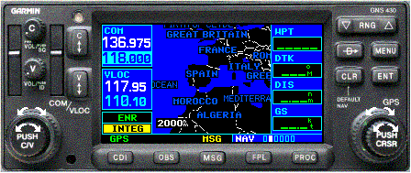
RAIM – Why Is It Important?
RAIM – Receiver Autonomous Integrity Monitoring
The “Off” Flag – Primary Means of Ensuring Receiver Integrity
Needs 5 Satellites in View
Required for IFR Operations – Handheld GPS Do Not Normally Have RAIM
Must Be Available at the FAF to Fly GPS Approach
RAIM Prediction Alerts You to RAIM Error at Destination Before You Fly!
RAIM - Not Available In-Flight
Enroute/Terminal – Revert to VOR or X-Check Every 15 min
Prior to FAWP – Fly to MAP, Execute Missed Approach
After FAWP – Expect 5 min of GPS Guidance, INTEG = Execute Missed

Slide 5
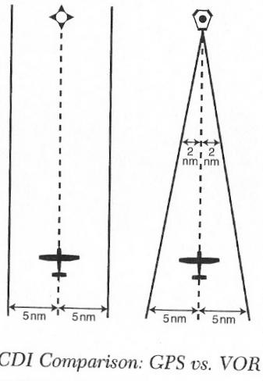
GPS Accuracy vs. VOR
1995: GPS Selective Availability – 330 to 990 feet
2000: SA Turned Off – 100 to 330 feet
2003: Wide Area Augmentation System (WAAS) Enabled
Accuracy < 23’ – Provides Vertical Guidance
WAAS Approaches Slightly Higher Minimums than Cat I ILS
GNS 430 – “Resolver-Type” Design
Resolver Course Indicator Coupled to CDI
OBS course selector must be set to DTK

Slide 6
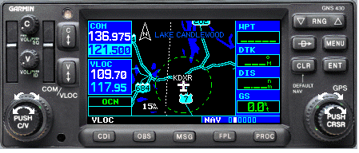
GNS 430 Key Functions
COM Power/Volume/Squelch
Frequency Windows
Map/Function/Data Fields
RANGE Zoom In/Out
Direct-To Navigation
Context-Sensitive MENU
COM Flip-Flop/ HOLD 121.5
VLOC Volume/Ident
CLEAR/Default NAV
ENTER/Confrm
VLOC Flip-Flop
LARGE CRSR Page Groups
LARGE KNOB MHz/SMALL KNOB KHz
SMALL CRSR Pages/ PUSH Toggle CRSR
PUSH Toggle COM/VLOC
CDI - Toggle Nav Source GPS/VLOC
OBS Mode/Waypoint Sequencing
MSG – View System Messages
FPL – Flight Plan
PROC – IFR Procedures

Slide 7
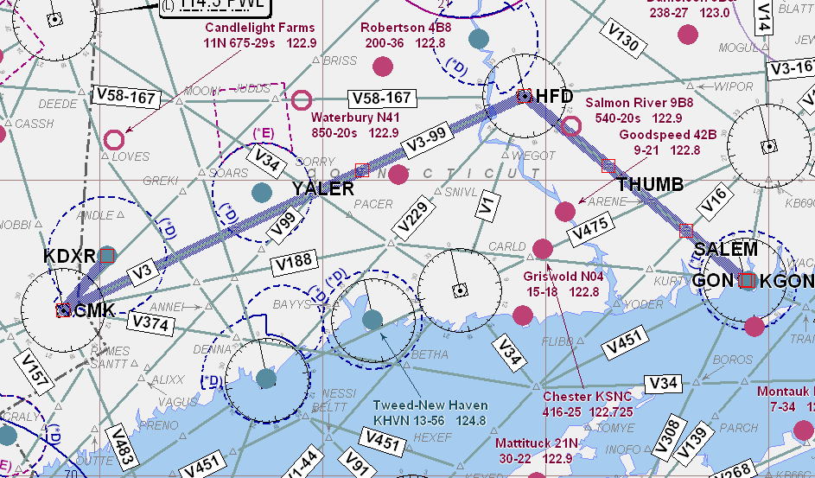
GPS Enroute: DXR → GON
KDXR CMK V3 HFD V58 GON KGON

Slide 8
GPS Approach Operations

Slide 9
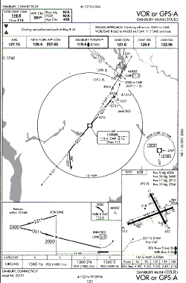
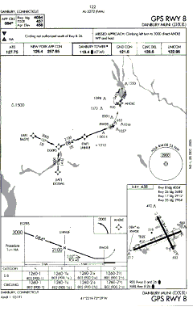
Intro to GPS Approaches
1st Generation – Non-Precision VOR/NDB Overlay Approaches (“or GPS”)
2nd Generation – “Stand-Alone” GPS Approaches
GPS/LOC/ILS Hybrid Approaches
  GPS Lateral Guidance for Initial Approach Segment
  VLOC Lateral/Vertical Guidance for Final Approach Segment
3rd Generation - WAAS GPS-Guided Precision Approaches

Slide 10
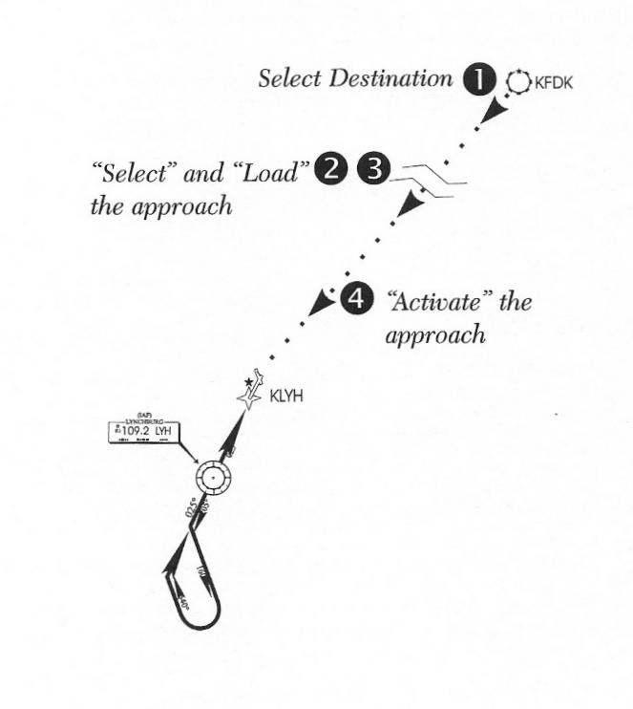
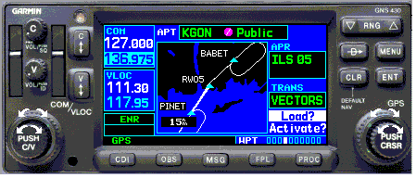
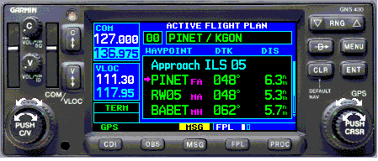
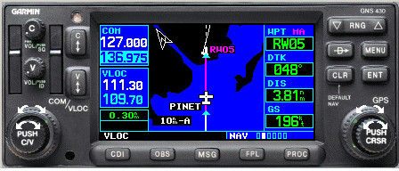
GPS Approach Modes
ENROUTE
TERMINAL
APPROACH

Slide 11
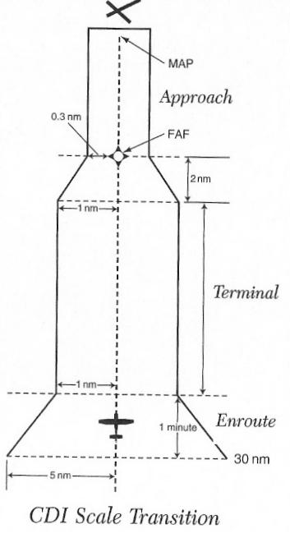
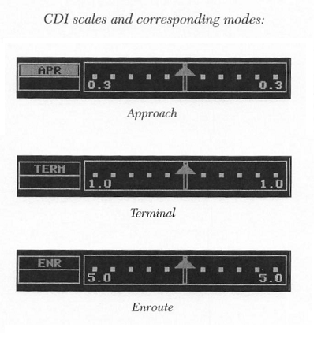
Approach Modes - CDI Scale Transitions

Slide 12
GPS Approach Demonstrations

Slide 13
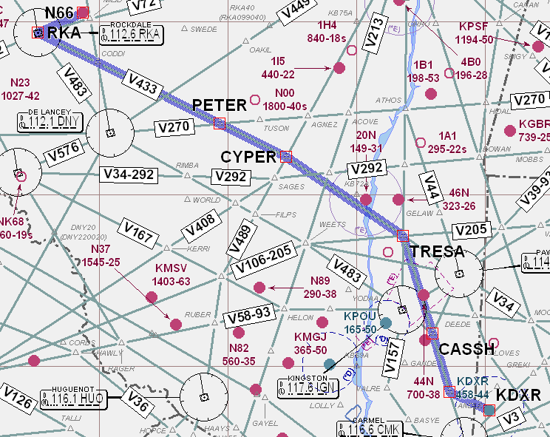
IFR Demo: STAR N66 → DXR
N66 RKA.NOBBI3 DXR

Slide 14



IFR Safety Tips
Practice in VMC with a Safety Pilot Before Using GPS In IMC!
Set Higher Personal Minimums Until Comfortable with Use
Check the GPS/VLOC CDI Indicator Often!
Check the Active VLOC Freq for ILS/LOC!
Always Set OBS (and Heading Bug) to DTK
Pay Attention to Suspended Waypoint Sequencing and Active Waypoint!
Check GPS Notams and “All Available Information…” FAR 91.103
Don’t Rely Solely on One Nav Source - “Shadow” GPS Nav with Other Nav Systems
Program on the Ground – Minimize “Head Down” Time in the Air
Watch for RAIM INTEG or Failure to Sequence to APR Mode prior to FAF.
RTFM and Use the PC Sim – Practice, Practice, PRACTICE!!

Slide 15
Wake Up – It’s Quiz Time!
When Can GPS NOT Be Used As Substitute for ADF?
NDB Approach (Not “or GPS” Overlay) or When Required For Alternate
True or False: That Alternate Is OK – It’s Got a VOR/DME Approach!
False – Our Airplanes Don’t Have DME and DME is Required For Alternate (see above)!
Common Mistakes When Setting Up For an ILS
Failure to Set CDI VLOC Mode, Switch and IDENT VLOC Freq
True or False: INTEG Indication In Flight = OK to Proceed To Destination IFR
True – Monitor VOR Enroute. Destination Must Have Non-GPS Approach
What Does RTFM Stand For?
Read The Fine Manual (Hey – This Is A Family Training Class!)
How Do You Get To Carnegie Hall & Garmin Proficiency?
Practice, Practice, PRACTICE!!

Slide 16
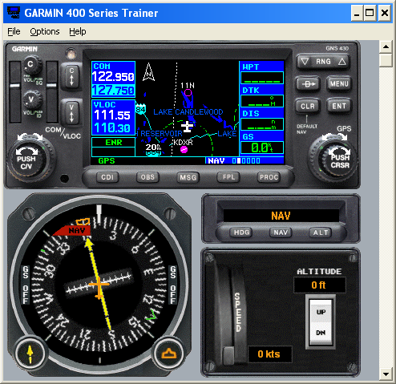
Garmin PC Simulator

Slide 17
GPS References
AIM – Section on GPS (Section 1-1-20)
AOPA Safety Advisor – GPS Technology
AVweb – Multiple Articles on GPS Safety
Garmin GNS 430 Pilots Reference Guide

