Slide 1

Flying 20 Flying Club
Garmin GNS 430 Training
VFR/Basic Operations
Presented By: Brad Freeman

Slide 2

GNS 430 VFR/Basic Operations
GPS and GNS 430 Overview
Power On Self Test/Satellite Status
Key and Knob Functions
NAVCOM - Tuning COM and VLOC Frequencies
Basic Navigation - Direct-To
GPS vs. VLOC Navigation
Data Field Display and Interpretation (DTK, TRK, CTS, etc.)
Refreshment Break!
Overview of the Main Page Groups (NAV, WPT, AUX, NRST)
Not-So-Stupid Garmin Tricks
Vertical Navigation
Airspace Alerts
OBS Mode/Runway Centerline
Scheduler/Flight Timers
Winds Aloft
Using the Garmin GNS430 PC Simulator
Q & A

Slide 3

The Global Positioning System (GPS)
Satellite-based Navigation System - 24 Satellites, 12,000 Miles Above Earth's Surface
Built by U.S. Department of Defense (Also Called NAVSTAR), Gov’t Operated
The First GPS Satellite Was Launched in 1978 - Full Constellation of 24 Satellites Was Achieved in 1994
Each Solar Powered Satellite Is Built to Last About 10 Years. Replacements Are Constantly Being Built and Launched Into Orbit
GPS Satellites Circle the Earth Twice a Day in a Very Precise Orbit and Transmit Signal Information to Earth
GPS Receivers Take This Information and Use Time-Based Triangulation to Calculate the User's Exact Location
Accurate to Within 15 Meters on Average

Slide 4
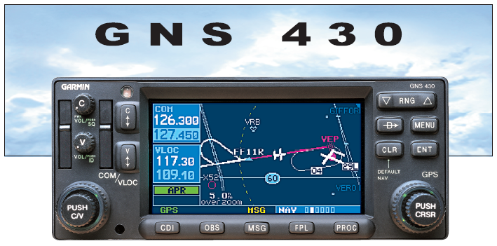
Fully Integrated IFR-certified GPS NAVCOM, VOR, LOC/Glide-Slope | Upgrade Paths for WAAS, TIS Traffic (with Garmin GTX 330), TAWS
Huge Jeppesen Database – All Airports, VOR, NDB, Intersections, FSS/ATC Freq, Airspace, Approaches, STARs, DPs, etc | Weather – Couples with Goodrich SKYWATCH™, STORMSCOPE® WX 500 and Garmin GDL 49 Data Link Transceiver (NEXRAD)
Advanced Technology Offering Enhanced Situational Awareness and Safety…

Slide 5
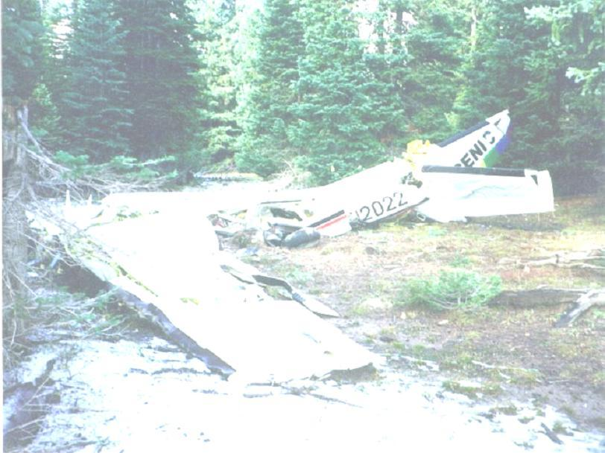
… But Beware!
FAA’s Safer Skies Initiative – Study of “Technically Advanced Airplanes”: TAAs offer more “available” safety, but without proper training for their pilots, they could be less safe than airplanes with less “available” safety.
-- Flying Magazine December 2003
Excerpt from an NTSB investigation of an accident involving a Garmin GNS 430-equipped Cirrus SR20:
"The pilot was in the process of selecting the approach in the airplane's global positioning satellite (GPS) receiver [GNS 430], when he noticed that the turn coordinator was "pegged to the left, with no flag," and that the airplane was losing altitude rapidly. The pilot disengaged the autopilot and attempted to stabilize the airplane."

Slide 6
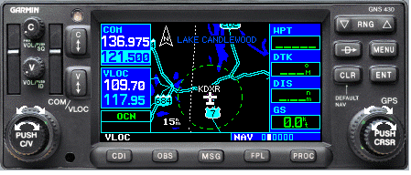
GNS 430 Key Functions
COM Power/Volume/Squelch
Frequency Windows
Map/Function/Data Fields
RANGE Zoom In/Out
Direct-To Navigation
Context-Sensitive MENU
COM Flip-Flop/ HOLD 121.5
VLOC Volume/Ident
CLEAR/Default NAV
ENTER/Confrm
VLOC Flip-Flop
LARGE CRSR Page Groups
LARGE KNOB MHz/SMALL KNOB KHz
SMALL CRSR Pages/ PUSH Toggle CRSR
PUSH Toggle COM/VLOC
CDI - Toggle Nav Source GPS/VLOC
OBS Mode/Waypoint Sequencing
MSG – View System Messages
FPL – Flight Plan
PROC – IFR Procedures

Slide 7
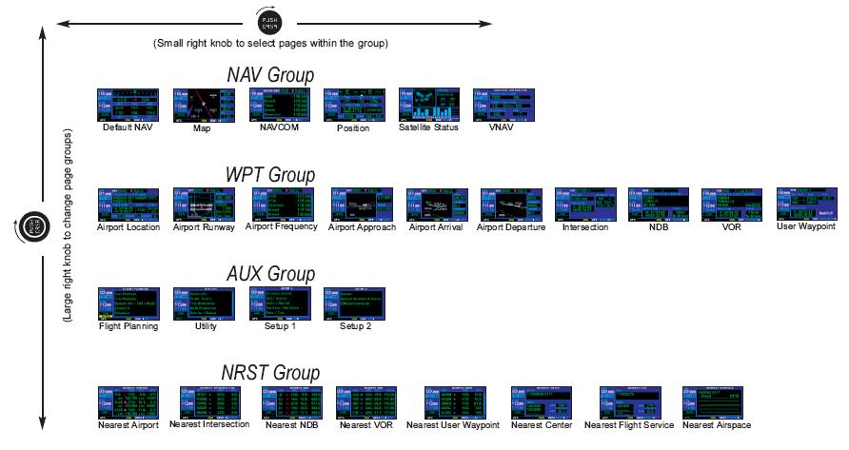
GNS 430 Page Navigation

Slide 8
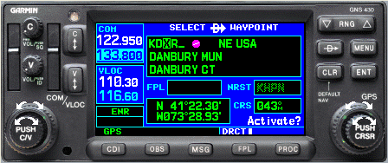
Entering Data
4
PRESS ENTER KEY TO CONFIRM ENTRY
1
PRESS ONCE TO ACTIVATE CURSOR, AGAIN TO DEACTIVATE
5
2
3
PRESS CLR KEY TO CANCEL ENTRY
TURN SMALL KNOB TO SELECT CHARACTERS
TURN BIG KNOB TO ADVANCE CURSOR OR CHANGE FIELDS (CURSOR OFF)

Slide 9
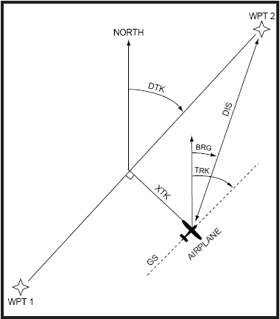
GPS Navigation Concepts
Data Fields
DTK | Desired Track
TRK | Ground Track
BRG | Bearing to Waypoint
CTS | Course To Steer
XTK | Cross-Track Distance
DIS | Distance (NM)
GS | Groundspeed
CTS

Slide 10
GNS 430 Data Fields
BRG – Bearing to Waypoint
CTS – Course To Steer
DIS – Distance to Waypoint
DTK – Desired Track
ESA – Enroute Safe Altitude
ETA – Estimated Time of Arrival
ETE – Estimated Time Enroute
GS – Ground Speed
MSA – Minimum Safe Altitude
TKE – Track Angle Error
TRK – Ground Track
VSR – Vertical Speed Required
WPT – Active Waypoint
XTK – Cross Track Error

Slide 11
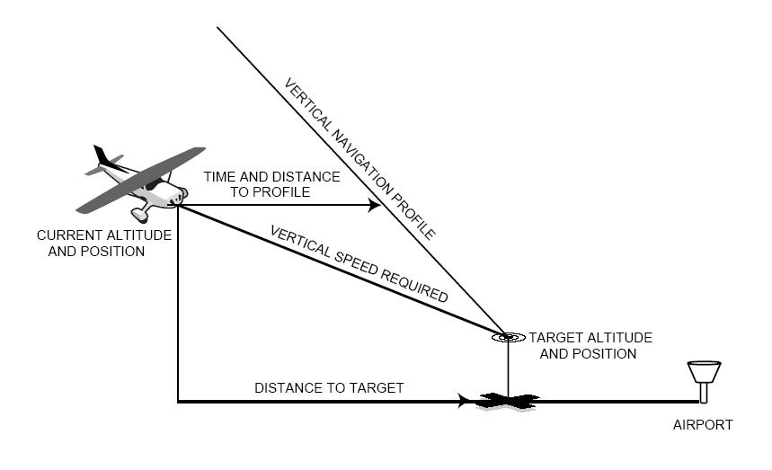
GNS 430 Vertical Navigation

Slide 12
Flight Simulator
Demonstration

Slide 13



Do
Don’t
Develop Skills in Stages (80/20 Rule)
Practice with PC Simulators
Program On the Ground
Delegate GNS 430 Operations to Co-Pilot
Fly the Airplane First!
Exceed VFR or “Personal Minimums”
Focus Inside the Cockpit/Forget to Scan
Rely Solely on GPS Map Display for Navigation - Use Current Charts and FSS Briefings!
Futz with it When Close to Airport or in High Workload Situations
Try New Features in Flight Until You Are Proficient in Their Use
GPS is Not a Substitute for Sound ADM!!
“Proper Prior Planning Prevents Poor Performance!”

Slide 14
Q & A
How do you set the time on the GNS 430?
What is the difference between HDG and TRK?
Define DTK, TRK, XTK and their relationship to each other
VLOC refers to what capability of the GNS 430?
What is the CDI key used for?
What is the OBS key used for?
How do you cancel a Direct-To course?

Slide 15
Appendix
MS Flight Simulator Add-Ons & Further Reading

Slide 16
MS Flight Simulator 2004 Add-Ons
Dreamfleet - makers of the Piper Archer Add-on (they are also working on a Dakota add-on, not released yet): http://www.dreamfleet2000.com. With it’s photo-realistic panel, this is one of the best aircraft add-ons available for FS 2004.
Order and download the Archer for $20 from Flight1 Software. Note there are special instructions for FS2004 – read the instructions carefully before installing!! http://www.flight1.com/products.asp?product=archer01
Reality XP makes the GNS 430 and GNS 530 Add-ons for MS Flight Simulator Order them from the Reality XP web site: http://www.reality-xp.com
The Reality XP package provides the Garmin CDI head accessory and a Garmin GMA 340 audio panel. It basically uses the internal functionality of the free Garmin PC Simulator, but wraps it in a different "skin" that integrates with FS2004. It's a really cool product and great for VFR or IFR training.
You will also need the free Garmin GNS 430/530 PC Simulator. Download it from Garmin: http://www.garmin.com/products/gns430

Slide 17
Further Reading
Garmin Web Site - http://www.garmin.com
  Garmin GNS 430 and GMA 340 Manuals (Download PDF or Order Hard Copy)
  GNS 430 PC Simulator
  Garmin Training Syllabus
AOPA Air Safety Foundation – http://www.aopa.org/asf
  ASF Safety Advisor – GPS Technology
  GPS: Beyond Direct-To Seminar
AVweb – http://avweb.com, Avionics Articles
  Gems in the GPS Attic
  GPS and Beyond: The SatNav Transition
  GPS – From VFR to IFR

