Slide 1




Introduction to Unit Testing
with Python and GitHub
@OxfordRSE
rse@cs.ox.ac.uk
www.rse.ox.ac.uk
Fergus Cooper
Oxford Research Software Engineering
Notes:
Quick intro to me coming up

Slide 2
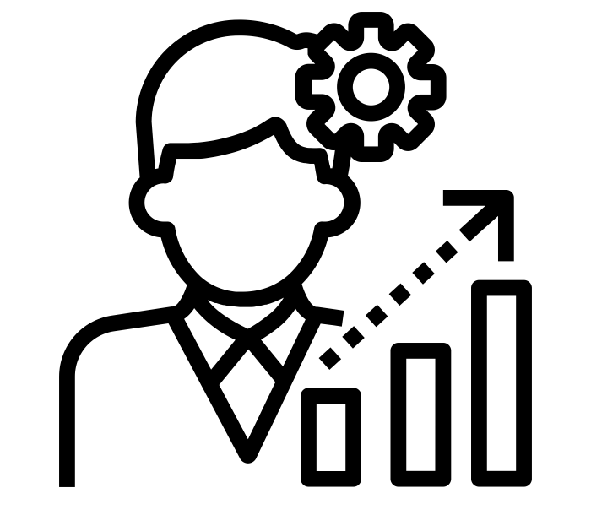

Who are we?
Enable your research by
developing bespoke software
Facilitate your research by helping you to improve your software and software engineering practice

Slide 3
Why should we test software?
Being able to demonstrate that a process generates the right results is important in every field of research.
Does the code we develop work the way it should do?
Can we (and others) verify this correctness?
To what extent are we confident in the results that appear in publications?
If we are unable to demonstrate that our software fulfils these criteria, why would anyone use it?

Slide 4
But I don’t write code with errors in!
If each line we write has a 99% chance of being right, then a 70-line program is more likely than not to be wrong.
We need to do better than that, which means we need to test our software to catch these mistakes.
Even if you write some perfect code the first time around, you (or someone else) will later modify it: does it still behave the way you expect?

Slide 5
Manual testing
We can often look at the output of code, for example:
a plot showing convergence with timestep
running an analysis pipeline on an existing dataset with known output
visually inspecting that a simulation “does the right thing”

Slide 6
Manual testing
These are important ways of testing during development, but have drawbacks:
they only test a subset of expected behaviour
you have to run them manually

Slide 7
Automated testing
Since computers are very good and efficient at automating repetitive tasks, we should take advantage of this wherever possible.
Unit tests are tests for fairly small and specific units of functionality
Functional or integration tests work at a higher level, and test functional paths through your code
Regression tests make sure that your program’s output hasn’t changed
For the purposes of this course, we’ll focus on unit tests.

Slide 8
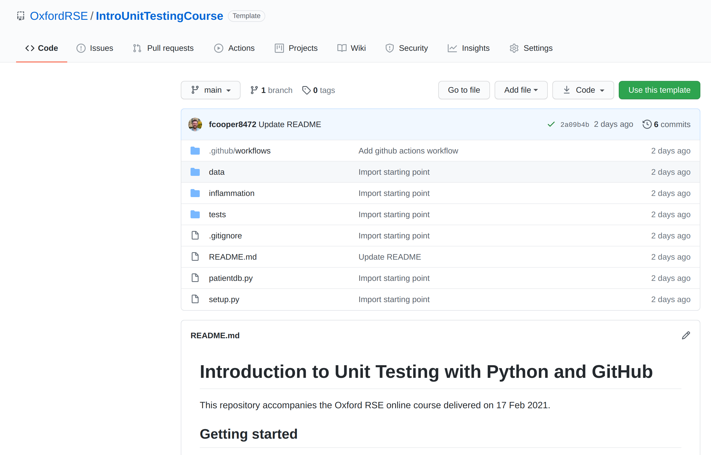
An example dataset and application (link)
Follow along exercise

Slide 9
First attempt
As an example, we’ll start by testing our code directly using `assert`.
Create a file “sandbox.py” and paste the following code:
from inflammation.models import daily_mean
import numpy as np
assert np.array_equal(np.array([0, 0]), daily_mean(np.array([[0, 0], [0, 0]])))
assert np.array_equal(np.array([3, 4]), daily_mean(np.array([[1, 2], [3, 4], [5, 6]])))

Slide 10
First attempt
So far so good. But now let’s add a failing line at the front:
What are the problems with this?
from inflammation.models import daily_mean
import numpy as np
assert np.array_equal(np.array([2, 0]), daily_mean(np.array([[2, 0], [4, 0]])))
assert np.array_equal(np.array([0, 0]), daily_mean(np.array([[0, 0], [0, 0]])))
assert np.array_equal(np.array([3, 4]), daily_mean(np.array([[1, 2], [3, 4], [5, 6]])))
Traceback (most recent call last):
File "/home/fergus/GitRepos/fcooper8472/UnitTestingCourse/sandbox.py", line 4, in <module>
assert np.array_equal(np.array([2, 0]), daily_mean(np.array([[2, 0], [4, 0]])))
AssertionError

Slide 11
Using a testing framework
Most people don’t enjoy writing tests, so if we want them to actually do it, it must be easy to:
Add or change tests,
Understand the tests that have already been written,
Run those tests, and
Understand those tests’ results

Slide 12
Using a testing framework
There are many unit testing frameworks in different languages
Python: pytest, unittest, nose2
C++: Catch2, GoogleTest, ...
Java: JUnit
Fortran: FRUIT
...

Slide 13
Testing daily_mean
Let’s add some tests for our library function, `daily_mean`:
def test_daily_mean_zeros():
"""Test that mean function works for an array of zeros."""
from inflammation.models import daily_mean
test_array = np.array([[0, 0],
[0, 0],
[0, 0]])
# Need to use Numpy testing functions to compare arrays
npt.assert_array_equal(np.array([0, 0]), daily_mean(test_array))

Slide 14
Testing daily_mean
Let’s add some tests for our library function, `daily_mean`:
Run: pytest tests/test_models.py
def test_daily_mean_integers():
"""Test that mean function works for an array of positive integers."""
from inflammation.models import daily_mean
test_array = np.array([[1, 2],
[3, 4],
[5, 6]])
# Need to use Numpy testing functions to compare arrays
npt.assert_array_equal(np.array([3, 4]), daily_mean(test_array))

Slide 15
Exercise
Add tests for the library functions `daily_min` and `daily_max`.

Slide 16
What about testing for errors?
Some functions do not support all inputs.
In compiled languages you often get help from the type system (but not so much in Python).
Even then, a function might expect, say, a strictly positive argument and throw an error of some kind if it does not.
How can we test this?
All unit testing frameworks have this functionality built in.

Slide 17
What about testing for errors?
def test_daily_min_string():
"""Test for TypeError when passing strings"""
from inflammation.models import daily_min
from pytest import raises
with raises(TypeError):
daily_min([['Cannot', 'min'], ['string', 'arguments']])

Slide 18
Why should we test invalid input data?
Testing the behaviour of inputs, both valid and invalid, is a good idea and is known as data validation.
Even if you are developing command-line software that cannot be exploited by malicious data entry, testing behaviour against invalid inputs prevents generation of erroneous results that could lead to serious misinterpretation.
It’s generally best not to assume your user’s inputs will always be rational.

Slide 19
Exercise
Add some tests for errors with invalid input.

Slide 20
Parameterise tests to run over many test cases
We’re starting to build up a number of tests that test the same function, but just have different parameters.
Instead of writing a separate function for each different test, we can parameterise the tests with multiple test inputs.
For example, we could rewrite the test_daily_mean_zeros() and test_daily_mean_integers() into a single test function:

Slide 21
Parameterise tests to run over many test cases
@pytest.mark.parametrize(
"test, expected",
[
([[0, 0], [0, 0], [0, 0]], [0, 0]),
([[1, 2], [3, 4], [5, 6]], [3, 4]),
])
def test_daily_mean(test, expected):
"""Test mean function works for array of zeroes and positive integers."""
from inflammation.models import daily_mean
npt.assert_array_equal(np.array(expected), daily_mean(np.array(test)))
Why is this preferable?

Slide 22
Exercise
Re-write your tests for mean, min and max to be parameterised.

Slide 23
Commit your changes to test_models.py
First, check that running `pytest` run as expected.
Then:
git add tests/test_models.py
git commit -m “Added more tests”
git push

Slide 24
Recap where we’re up to
We are making use of a unit testing framework (pytest).
We have written tests that verify normal functional behaviour of three specific units.
We have tested that some common cases of function misuse fail in the way we expect them to fail.
We have parameterised tests to cut down on code duplication.
What are the problems we still have with our current setup?

Slide 25
Running tests automatically
It’s critical to not rely on running the tests ourselves.
We’re simply too unreliable to run the tests every time we make changes.
Fortunately, it’s very easy!
>> Demo of using GitHub actions

Slide 26
Exercise
Add the GitHub status badge to your README.md file.

Slide 27
Next steps
Write some unit tests!
Once you have set up the infrastructure it’s very easy, especially for the majority of testing.
There is complexity: how to test random functions, for instance.
Don’t fall into the trap of thinking “I could be using this time to write more features”. Code worthless if you aren’t certain it’s correct!
Encourage others in your research group to start testing their code.

Slide 28
That’s all for today
Any questions?

