Slide 1
Introduction to Python
Steve Crouch
Software Sustainability Institute
s.crouch@software.ac.uk
Notes:
So welcome to the Introduction to Python session, where we'll be taking a look at the Python programming language.
We'll look at what kind of language it is, what it's been used for, and why you may want to use it in your own projects.
Python's been around since 1991, when it was first released.
It was developed initially by a lone developer, Guido van Rossum,
So why did he call it Python?
Well, it was named after 'Monty Python's Flying' Circus', an offbeat but very popular 1970's UK comedy television show.
About its naming, Guido said he was 'In an irreverent mood'

Slide 2
Why Python?
Free, well-documented, runs almost everywhere
Good for novices and experts
Simple, readable
Flexible, powerful
Large (and growing) user base among researchers and scientists
Great for team working
Python aim - only one way to do something
Programs look very similar, easy for others to read
Want to teach basic programming concepts that can be applied to other programming languages
Excellent third-party library support
Notes:
So why would you consider using Python?
Well firstly, it's free, well-documented, runs almost everywhere; from your desktop PC to embedded systems.
It's also a good language both for novices and experts
Whilst it's designed to have a simple and readable syntax which is good for novices (and very helpful for experts too), it's also designed to be very flexible and powerful.
It also has a large (and growing) user base among researchers and scientists; in domains from biomolecular science, to social science, to astronomy.
It's also great for team working and collaboration
One of Python's key design principles is that there is only one way to do something
And programs written by different people tend to look very similar, which makes them much easier to understand - which is very useful in a team environment
And because of Python's simplicity, it's a very good vehicle to illustrate and learn about general best practices in developing software that can be applied to other languages
Another very compelling reason is that Python has excellent third-party library support. If you think about something you want to write in Python, there is very likely a library that can help you.

Slide 3
Established libraries
NumPy: scientific/math computing, stats, linear algebra, matrix math, …
Matplotlib: visualisation
Pandas: data manipulation, analysis
Scikit-learn: machine learning
Requests: http library
Scrapy: web scraping
Pillow: image manipulation
Pygame: sprites, sound, music, controllers
…
Notes:
And here are some example libraries, just to show you the breadth of support Python has for a wide range of tasks.
We have NumPy, a very commonly used library for scientific and mathematical computation,
And also Matplotlib, used to generate graphs and plots from data,
and we'll be looking at using these two libraries later in the course.
There's also Pandas, one of the most widely used libraries in data science. It builds on NumPy, but provides higher-level views and methods to interact with data
And for machine learning, there's Scikit-learn, that enables you to do predictive data analysis and other machine learning tasks, which also builds on NumPy as well as Matplotlib
There's also library support for accessing web resources, scraping, image manipulation, games … the list goes on.

Slide 4
The 'Zen' of Python
Principles that influenced its design
https://en.wikipedia.org/wiki/Zen_of_Python
Includes aphorisms such as
Beautiful is better than ugly
Explicit is better than implicit
Simple is better than complex
Complex is better than complicated
Flat is better than nested
Readability counts
There should be one – and only one – obvious way to do it
…
Notes:
Python is a language that has taken on board a lot of the lessons learned since the 1960's in language design.
In 1999, almost a decade after Python was first invented, a software engineer named Tim Peters wrote a set of principles of writing in Python, and posted it to the Python mailing list. To give you an idea, some of these were as follows.
Beautiful is better than ugly
So Python's been designed so you can write readable, simple code
Try and make use of Python's syntax that enables this, and you (and others) will be less likely to question what you wrote six months later
Explicit is better than implicit
it's important for code to be verbose and explicit; magical side effects should be avoided
Simple is better than complex & Complex is better than complicated
Essentially, a simple solution is better than a complex one
Flat is better than nested
Organising things hierarchically can be helpful, but taking it too far can lead to confusion and makes things difficult to find
For example, organising a library's modules into heavily nested module/sub-module/sub-sub-module namespaces
Sparse is better than dense
How things work should be clear
Writing impressive one liners may be challenging and appear clever, but often they're much harder to understand
Readability counts
This is perhaps the most important of these principles
Highly readable code means it's easier to understand
And 6 months down the line, there's a greater chance you'll understand it too
And slightly further down the list, although certainly worth mentioning:
There should be one—and preferably only one—obvious way to do something in the language
The idea is that, in Python, two different programmers who approach the same coding problem will write similar Python programs
This makes others' code easier to understand, read, and use
This is in contrast to another language called Perl, whose motto is "There's more than one way to do it." Whilst more flexible in this way, collaborating in development teams using Perl can be difficult, since so many coding styles can exist
You'll notice 'simple' came up quite a bit here. Keep your code simple wherever you can. Simple may be longer, but it is also easier to write, read, and understand

Slide 5
Notable Python characteristics & features
Indentation denotes code blocks
Dynamically typed, strongly typed
Multi-paradigm language, permits several programming styles
e.g. structured, object oriented, functional, aspect oriented
An interpreted language, not compiled
Notes:
Let's have a look at a few of Python's notable characteristics and features.
Unlike most other languages, like C, C++, C#, Fortran, or Java, Python doesn't use braces or encapsulating statements like begin and end to denotes code blocks. It uses indentation instead.
Python is both a dynamically typed and strongly typed language.
It's dynamically typed because whilst values do have a type (such as integer, float, string), variables don't - a value's type is decided at run-time.
It is also strongly typed, in that types don't change once decided. For example, string of digits don't become a number when you do an addition between two strings (actually in Python, the adding of two strings concatenates them).
Another aspect of Python is that it is a multi-paradigm language which permits several programming styles
For example, it supports structured programming, which is common to nearly every modern language in some way, where you introduce basic modularity through functional blocks of code
Building on this, Python also supports object oriented programming, where software design is organised around data, or objects that represent data and the functional operations you perform on them
And also functional programming, building a program by composing functions, with no shared state and side effects
We'll be looking more at structured programming, object oriented, and functional programming in Python later in the course.
And there's also aspect oriented programming which you can do in Python, where you define cross-cutting concerns, like how to manage logging or security, separately to the main code

Slide 6
What sort of language?
Compiled
Interpreted
Explicitly compiled to machine code
Explicitly compiled to byte code
Implicitly compiled to byte code
Purely interpreted
C, C++, Fortran
Java, C#
Python
Bash, Perl
Notes:
So where does Python fall on the compiled / interpreted scale compared with other languages?
[Click]
So on the compiled end of the spectrum, where source code is explicitly compiled to run direct on the computer's CPU, you have C, C++ and Fortran.
[Click]
Moving further along towards interpreted, you have Java and C#, where the source code is explicitly compiled into an intermediate bytecode representation for a virtual CPU, which is then emulated on the system it's run on.
[Click]
At the far end, you have fully interpreted languages, like Bash and Perl, where the language is executed statement by statement as they are encountered in the program.
[Click]
And Then there’s Python - implicitly compiled to byte code
In this case, Python compiles the code behind the scenes for faster execution later, you don’t have to do anything yourself, nor even be aware of it
This means you get the convenience of an interpreted language and some of the performance benefits of a compiled language, without the compilation hassle of a compiled language

Slide 7
We'll be teaching Python 3
Python 2 is no longer supported
Python 3 is currently the standard version
Python 3 has many advantages over Python 2
Many consistency improvements - removing redundancy
In places, simply more sensible e.g. integer division
'Short version: Python 2.x is legacy, Python 3.x is the present and future of the language'
TL;DR: don't develop anything in Python 2, use Python 3
Notes:
So in your Python travels you may well come across two versions of Python: 2 and 3.
However, don't be tempted to develop under Python 2. The key reasons being:
It's essentially no longer supported, so you won't get any updates or bugfixes, including for security issues
Python 3 also has many advantages over Python 2
Short version: Use Python 3

Slide 8

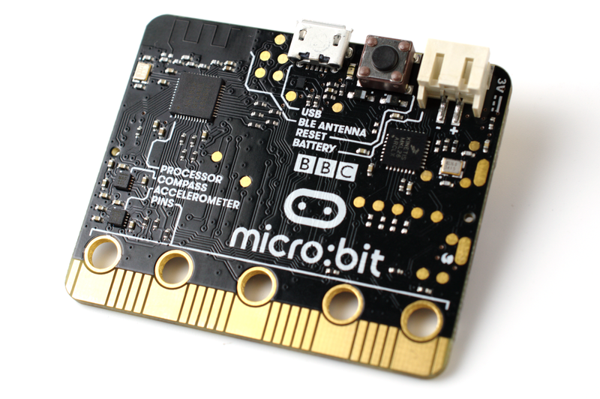
What is Python used for? A few examples
Games: EVE Online, Sims 4, Battlefield 2, …
3D modelling: Blender
Science: ProtoMS, Data Science
Web: Django, Reddit, Quora
Embedded: BBC Micro:bit
Blender
Micro:bit
Notes:
Python's flexibility has meant it's been applied to many software projects in a range of areas.
Games, web development, applications, science, embedded systems, …
Here's a few examples...
In terms of games, there's EVE Online, a Massively Multiplaer Online Role Playing Game, with around 300,000 active users a month. EVE servers use a 'stackless' Python, a highly efficient version that allows hundreds of thousands of small-scale tasks to run within a single thread. And in Sims 4, players can code Python 'mods' that change or enhance the behaviour of the game
For 3D modelling, there's Blender - a free, popular, open source 3D graphics modelling package
Just one example from science is ProtoMS - biomolecular free energy simulation software, but it's also used a lot in data science for research data analysis
Web: Django, web development framework used to host many professionally developed web sites like Quora, a Q&A platform, and Reddit.
It's also been used in an embedded setting.
The Micro:bit – designed for computer education in the UK by the BBC
- According to the BBC, more than 2 million have been distributed worldwide
- ARM Cortex-M0 processor
- Accelerometer and magnetometer sensors
- Bluetooth, USB, edge connector
- 25 LED display
- Two programmable buttons
- Powered by USB or external battery
- Uses MicroPython, a full reimplementation of Python that runs on the micro:bit
Also: Industrial Light and Magic, Google, Facebook, Instagram, Netflix, Reddit, ...

Slide 9
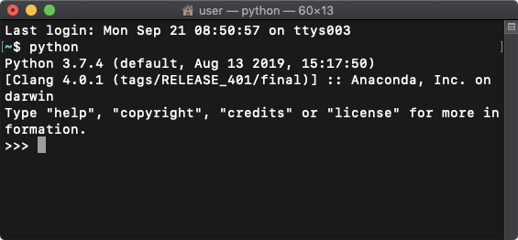
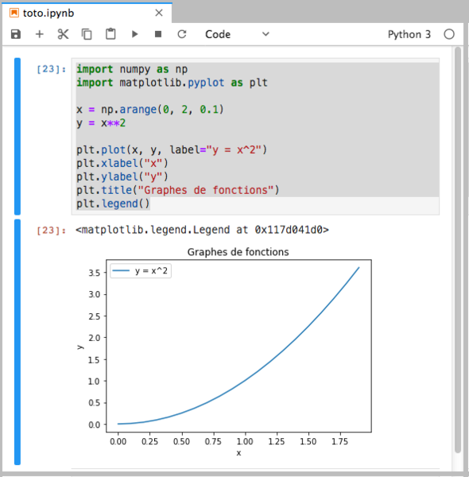
Many different kinds of Python
Python via command line
Python interpreter
via the command line
Python scripts
A 'program' in a file to run
Integrated Development Environment (IDE)
e.g. VSCode, PyCharm
Edit, run, and debug Python scripts
Jupyter Notebook
Mix code, commentary, and results
Python Jupyter Notebook
Image author: Cdang, CC-BY-SA
Notes:
Python itself is also provided and usable in a number of different ways.
At the lowest level, you have the Python interpreter being run on the command line
You run a program - the Python interpreter - on the command line, type Python commands into the interpreter, and get responses as you go
You can also write Python scripts - essentially Python programs as files - which the interpreter can run
These script files have the extension .py
Then there's the Integrated Development Environment, or IDE
These are code editors to write code that also allow you to run Python scripts from within it
They support things like context-sensitive help, which helps you find the commands and functions you're after as you type
Another is syntax highlighting, which shows you in the editor where your code contains certain types of basic errors
They may also support in-editor debugging, so you can run programs and execute them a statement at a time in a controlled way to test behaviour and look for problems
Some examples IDEs you can use with Python are VSCode, and PyCharm
VSCode is a great way to get started with a lightweight IDE, PyCharm is more heavyweight but has many more features
And finally, another option is via a Jupyter Notebook
This is a kind of an IDE, in that they have features like context sensitive help, but they act differently to IDEs like VSCode and PyCharm
It's like the interpreter in that you can type in commands and get responses
But you can also edit previously entered commands and the following commands are recalculated taking these changes into account
Images that are created as results from commands - like graphs - are shown as part of the output
And notebooks can also be saved and rerun later, like scripts
And you can also mix code with commentary and results, which makes them great for writing what is essentially an executable paper, with discussion, code that is actually executed, and displayed results from executing that code
This makes them excellent for research, demonstrating ideas, and exploratory data analysis
…
So we've taken a high-level look at the Python language, what it can do for us and how we can use it. Now head over to the self learning materials which will lead you through the language of Python and how to use it within VSCode - an Integrated Development Environment which can help you develop Python programs (also known as Python scripts).

