Slide 1
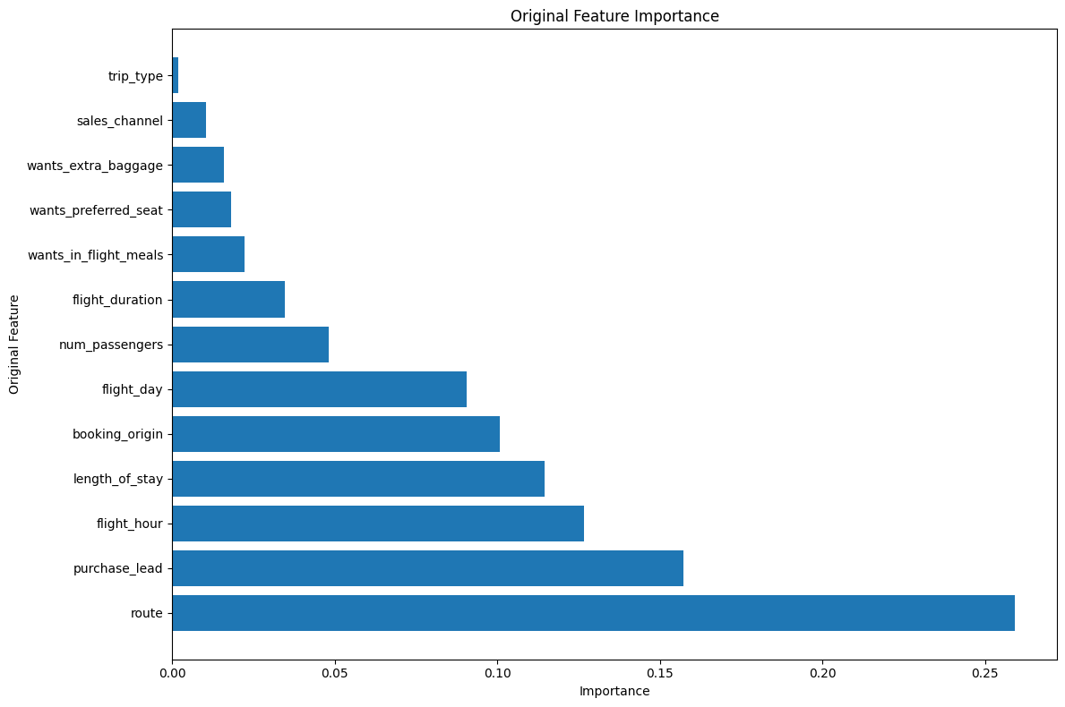
The most important feature for predicting customer bookings is 'route' with an importance value of 0.259. This suggests that the specific flight route plays a significant role in determining whether a customer will make a booking or not.
'purchase_lead' and 'flight_hour' are also relatively important features with importance values of 0.157 and 0.127, respectively. This indicates that the time between purchase and flight and the hour of the flight are significant factors in predicting bookings.
'length_of_stay' and 'booking_origin' are moderately important features with importance values of 0.115 and 0.101, respectively. These variables contribute moderately to the model's predictive power.
Other features like 'flight_day', 'flight_duration', 'wants_in_flight_meals', 'wants_preferred_seat', 'num_passengers', and 'wants_extra_baggage' have relatively lower importance values, suggesting that they have a lesser impact on predicting bookings.
The features 'sales_channel', 'trip_type' have the lowest importance values, indicating that they might have very little impact on the model's predictions and could potentially be further examined or excluded from the model.

