Slide 1
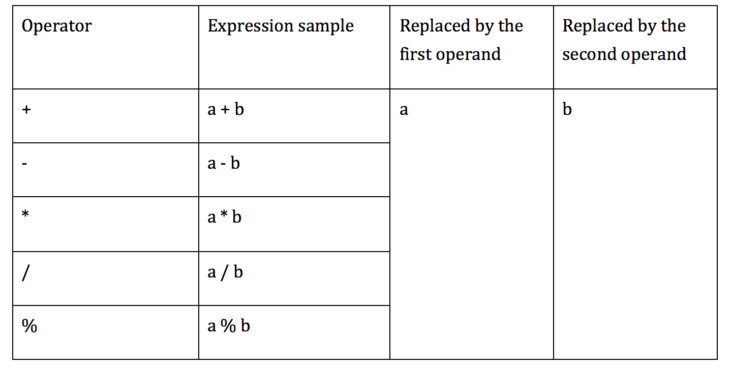
AOD implementation
AOD is replaces an arithmetic expression by each one of the operand

Slide 2
AOD implementation
First operand replacement
- remove the first parameter from the stack of JVM which is associated with the second operand in the expression
- int, float stored in 1 stack slot : POP
- double, long stored in 2 stack slots: POP2

Slide 3
AOD implementation
Second operand replacement
- int, float:
+ using SWAP
+ becomes the first operand replacement

Slide 4
AOD implementation
Second operand replacement
- double, long:
+ SWAP2 doesn’t exist
+ Alternative:
DUP2_X2
POP2
POP2

Slide 5
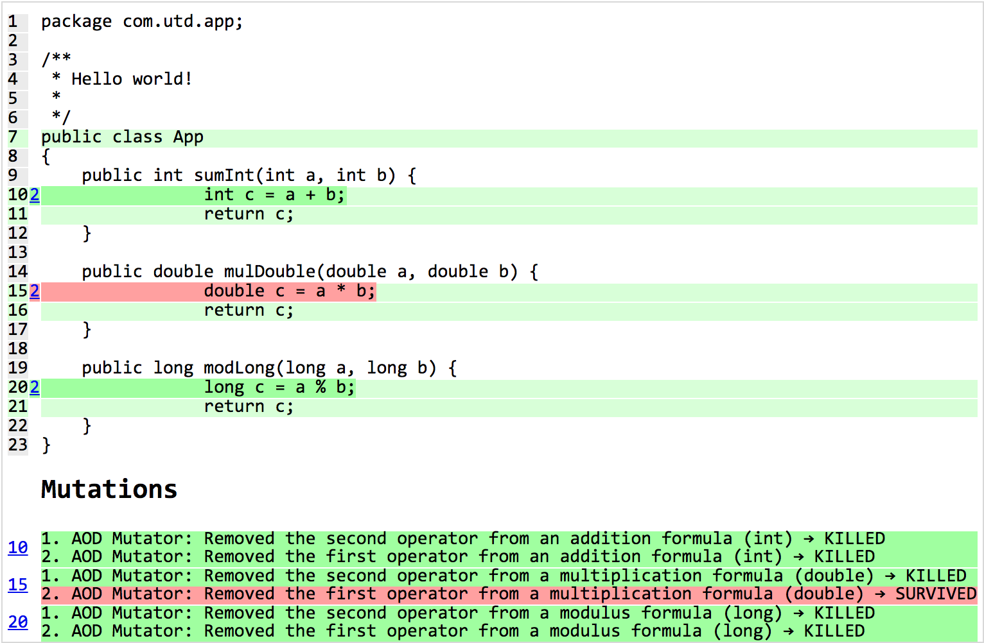
Example

Slide 6
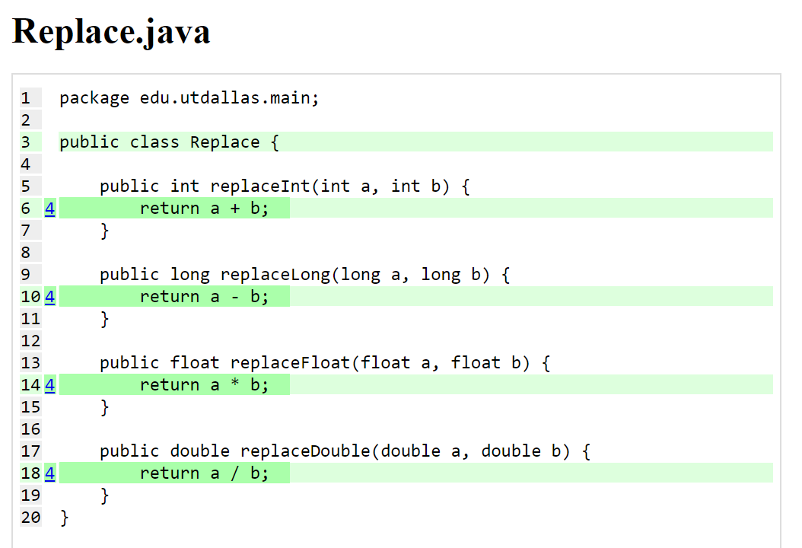
AOR implementation

Slide 7
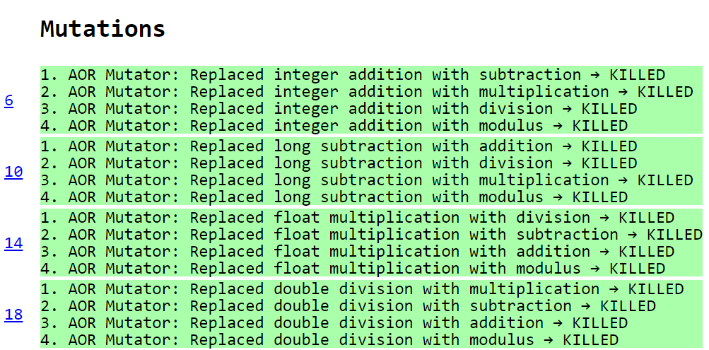
AOR implementation

Slide 8
ROR Implementation
The implementation of the relational operator replacement required for each relational operator to be replaced by every other one.
== | != | >= | > | <= | <
!= | >= | > | <= | < | ==
>= | > | <= | < | == | !=
> | <= | < | == | != | >=
<= | < | == | != | >= | >
< | == | != | >= | > | <=
We used the same approach as the mutators dealing with relational operators such as Conditional Boundary Mutator.

Slide 9
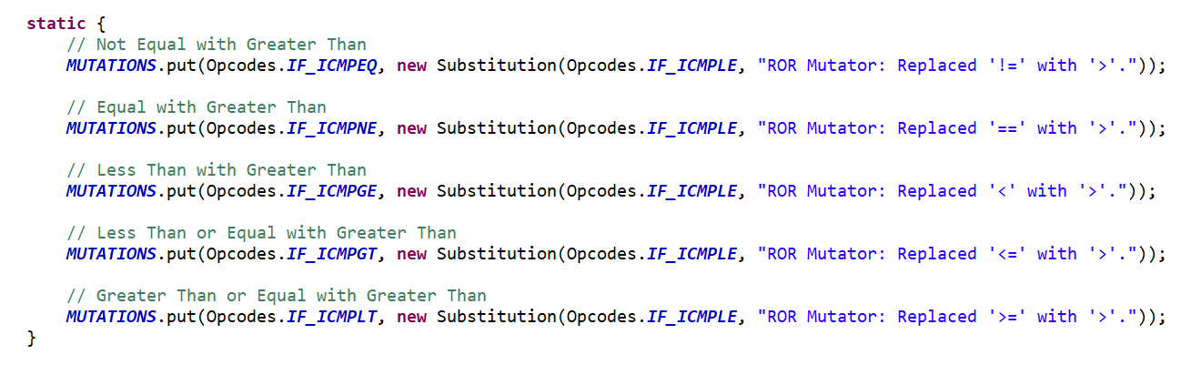
ROR Implementation
Created a class containing six enum types, each implementing the MethodMutatorFactory.
Each enum created a MethodVisitor that handled a certain case.
Each method visitor extended AbstractJumpMutator which contain the Substitution class used for replacement.
Snippet of the method visitor that handled the replacement of operators to ‘>‘.
Note operators are flipped.

Slide 10
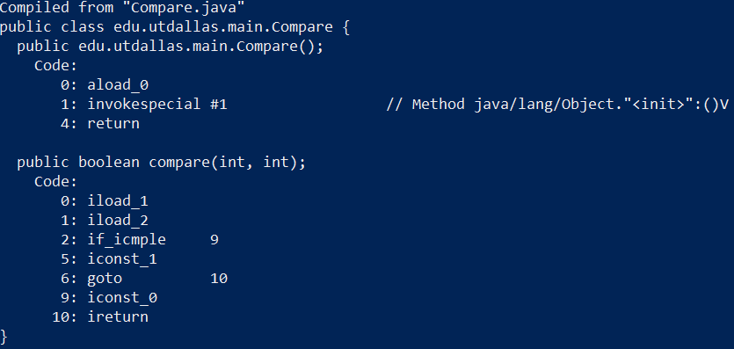
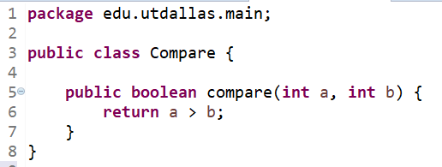
ROR Implementation
Operators are flipped because JVM compares <b with a> not <a with b>.
JVM first pushes a in the stack then b.
Then check if value b is less then or equal than value of a.

Slide 11
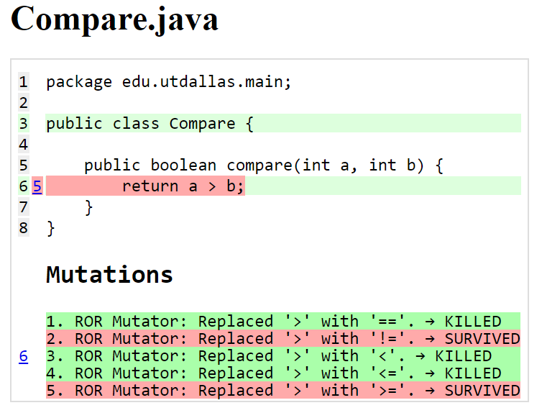
ROR Implementation

Slide 12
Add to Final

Slide 13
Real world projects
Project | Number of Class | Line Coverage |  | Mutation Coverage |  | Running Time | Number of Threads
 |  | percentage | coverage line | percentage | killed/numberOfMutation
zt-exec,305172eaed27aa71a6f4de970d20c73cefe6291e,https://github.com/zeroturnaround/zt-exec | 13 | 59% | 404/689 | 29% | 202/699 | 18:16 min | 4
aho-corasick,25eeef5168846d50dc343c1f224a24745f925f5b,https://github.com/robert-bor/aho-corasick | 12 | 94% | 322/341 | 70% | 481/686 | 0:46 min | 4
GoogleAuth,7051a9a23913c9ef3808467b1c647cab7ada82cf,https://github.com/wstrange/GoogleAuth | 4 | 73% | 187/256 | 50% | 286/576 | 02:54 min | 4
RestFixture,bb4c7071c4edfd9f4aac8c6dd3aee1b196ffa0f1,https://github.com/smartrics/RestFixture | 28 | 78% | 1290/1655 | 53% | 806/1513 | 02:08 min | 4
pollexor,0255b9bbd0163dc2e3c86b3bfc9127ecf3a01cfc,https://github.com/square/pollexor | 3 | 90% | 262/292 | 80% | 756/945 | 0:38 min | 4
rtree,e406cff766740b117898d6777c094ed494220fa5,https://github.com/davidmoten/rtree | 71 | 80% | 1868/2349 | 66% | 1243/1874 | 36:16 min | 4
Project given by TA
commons-codec | 51 | 92% | 3592/3906 | 78% | 14955/19122 | 18:24 min | 4
commons-lang | 106 | 95% | 13894/14563 | 73% | 35563/48766 | 02:23 h | 4
jfreechart | Got crash after running more than 2 hours |  |  |  |  |  | 4
joda-time |  |  |  |  |  |  | 4

Slide 14
Running in MultiThreads
By defult (1 thread):
mvn org.pitest:pitest-maven:mutationCoverage
By n-Threads:
mvn –T n org.pitest:pitest-maven:mutationCoverage
Where, n denotes number of the thread
Example for 4 threads:
mvn -T 4 org.pitest:pitest-maven:mutationCoverage

Slide 15
Mutators
RMutator.MutantType.ADD (x by x + 1)
RMutator.MutantType.SUB (x by x-1)
RMutator.MutantType.NEGATE (x by -x)
RMutator.MutantType.REPLACE_ONE (x by 1)
RMutator.MutantType.REPLACE_ZERO (x by 0)
AODMutator.AODMutator1.AOD_MUTATOR
AODMutator.AODMutator2.AOD_MUTATOR
RORMutator.Type.NE
RORMutator.Type.EQ
RORMutator.Type.GE
RORMutator.Type.GT
RORMutator.Type.LE
RORMutator.Type.LT
AORMutator.MathMutator1.AOR_MUTATOR
AORMutator.MathMutator2.AOR_MUTATOR
AORMutator.MathMutator3.AOR_MUTATOR
AORMutator.MathMutator4.AOR_MUTATOR
UORMutator.Type.DECREMENT
UORMutator.Type.INCREMENT
UORMutator.Type.REMOVE
UORMutator.Type.REVERSE

Slide 16
CR Mutator
Mutation operator | Expression | Mutant
CRMutator.MutantType.ADD | X | X + 1
CRMutator.MutantType.SUB | X | X - 1
CRMutator.MutantType.NEGATE | X | -X
CRMutator.MutantType.REPLACE_ONE | X | 1
CRMutator.MutantType.REPLACE_ZERO | X | 0

Slide 17
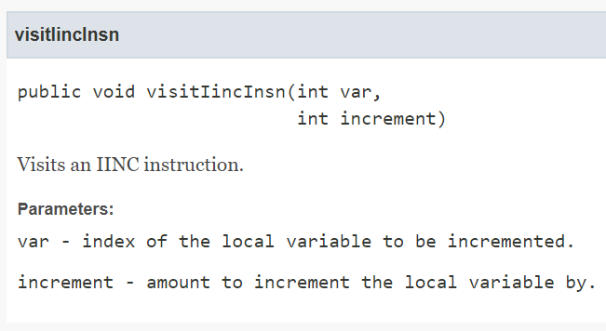
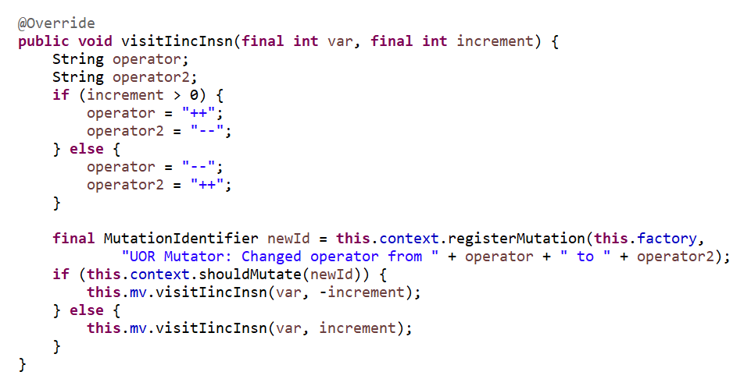
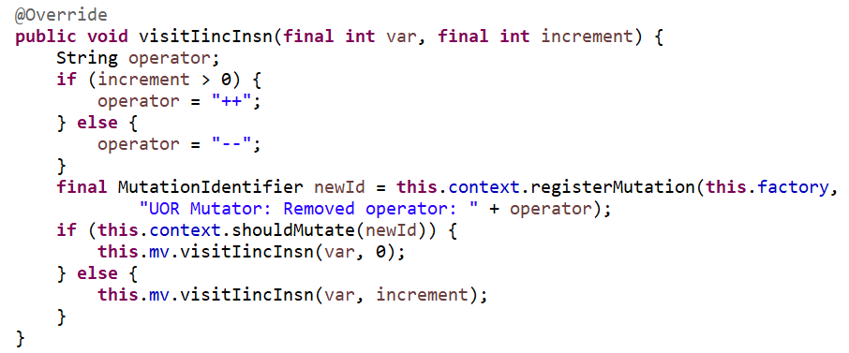
UOR Mutator
Unary Operator Replacement:
Decrement
Increment
Remove
Reverse

Slide 18
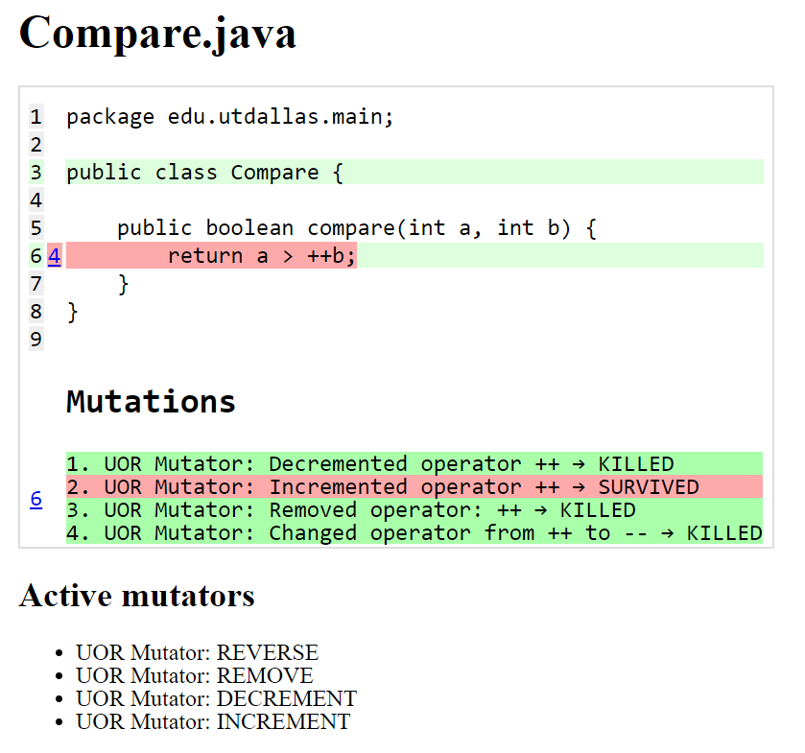
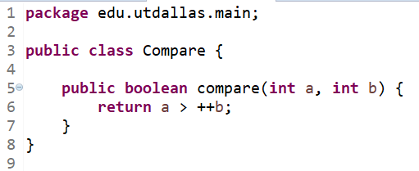
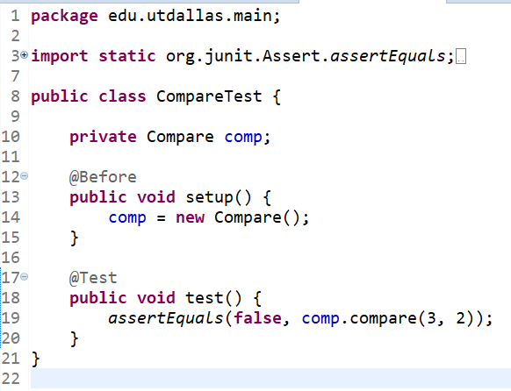
UOR Mutator

