Slide 1
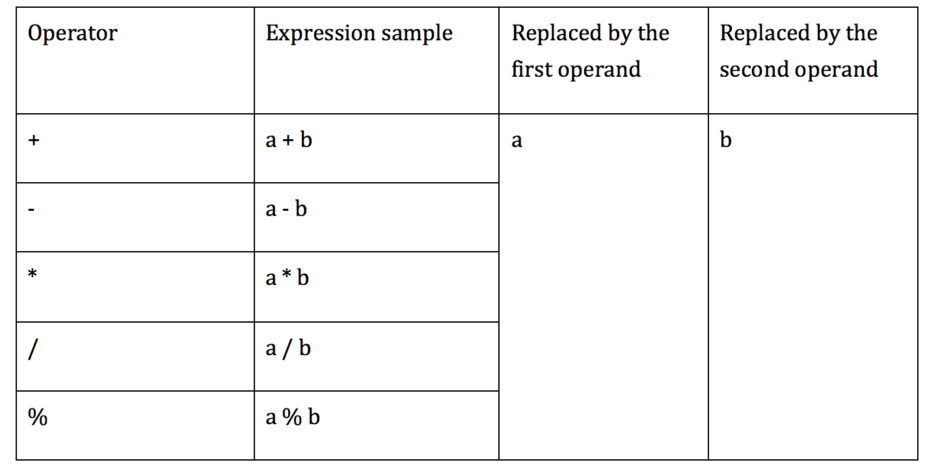
AOD implementation
AOD is replaces an arithmetic expression by each one of the operand

Slide 2
AOD implementation
First operand replacement
- remove the first parameter from the stack of JVM which is associated with the second operand in the expression
- int, float stored in 1 stack slot : POP
- double, long stored in 2 stack slots: POP2

Slide 3
AOD implementation
Second operand replacement
- int, float:
+ using SWAP
+ becomes the first operand replacement

Slide 4
AOD implementation
Second operand replacement
- double, long:
+ SWAP2 doesn’t exist
+ Alternative:
DUP2_X2
POP2
POP2

Slide 5
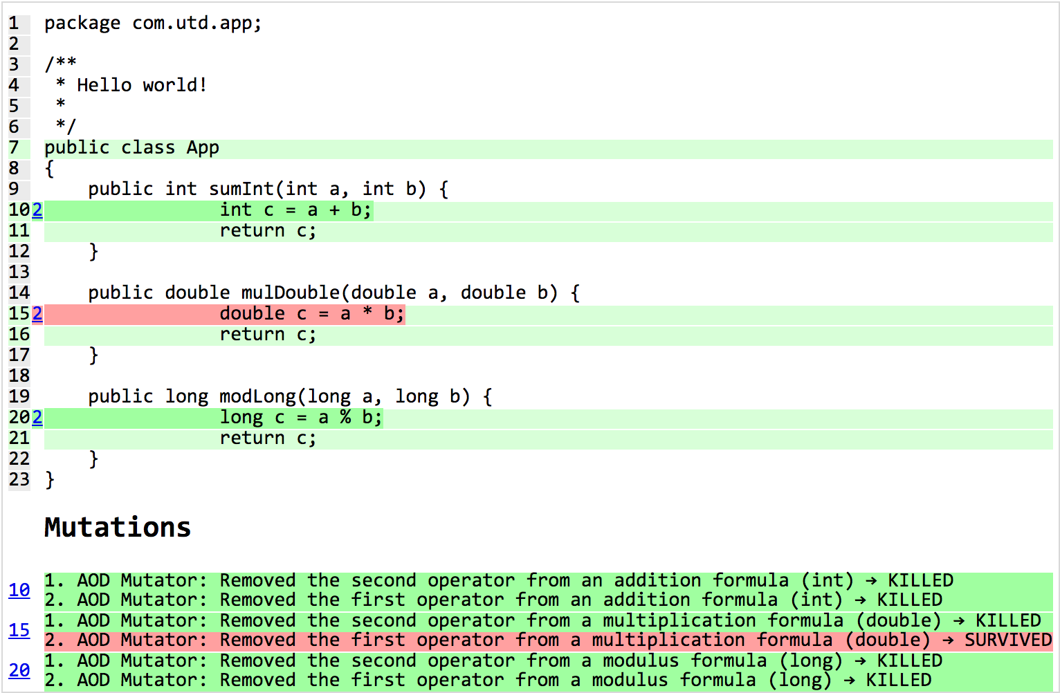
Example

