Slide 1
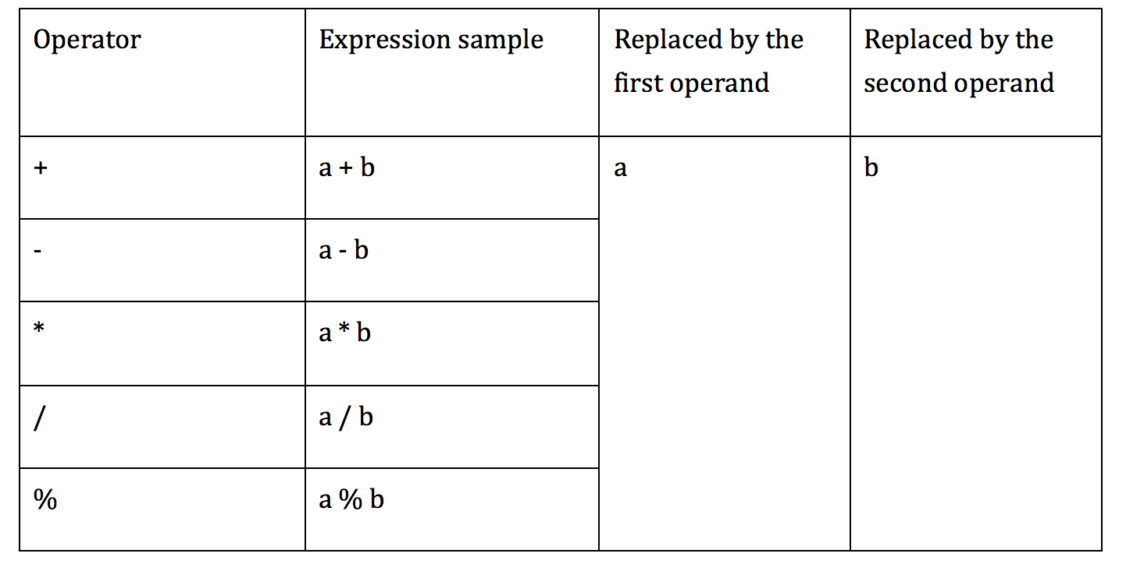
AOD implementation
AOD is replaces an arithmetic expression by each one of the operand

Slide 2
AOD implementation
First operand replacement
- remove the first parameter from the stack of JVM which is associated with the second operand in the expression
- int, float stored in 1 stack slot : POP
- double, long stored in 2 stack slots: POP2

Slide 3
AOD implementation
Second operand replacement
- int, float:
+ using SWAP
+ becomes the first operand replacement

Slide 4
AOD implementation
Second operand replacement
- double, long:
+ SWAP2 doesn’t exist
+ Alternative:
DUP2_X2
POP2
POP2

Slide 5
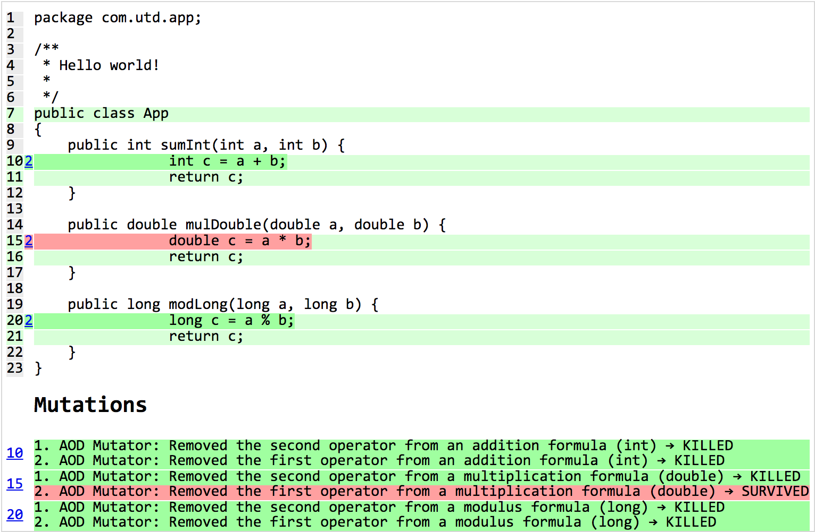
Example

Slide 6
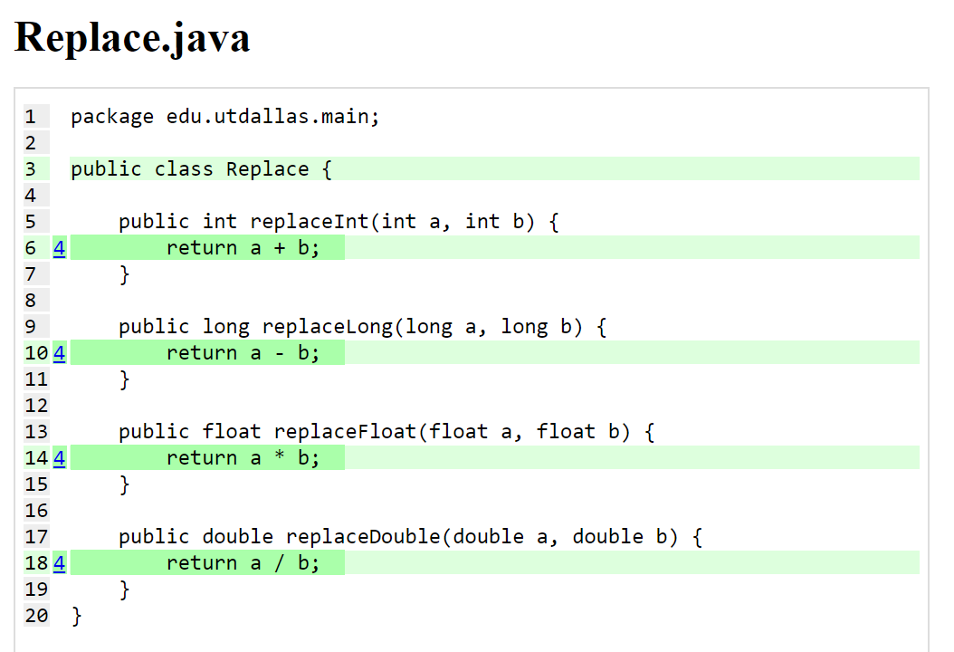
AOR implementation

Slide 7
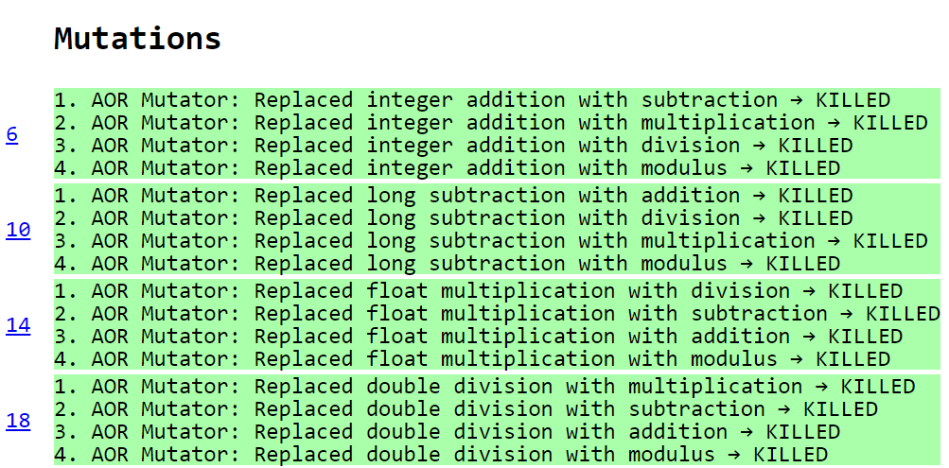
AOR implementation

Slide 8
ROR Implementation
The implementation of the relational operator replacement required for each relational operator to be replaced by every other one.
== | != | >= | > | <= | <
!= | >= | > | <= | < | ==
>= | > | <= | < | == | !=
> | <= | < | == | != | >=
<= | < | == | != | >= | >
< | == | != | >= | > | <=
We used the same approach as the mutators dealing with relational operators such as Conditional Boundary Mutator.

Slide 9
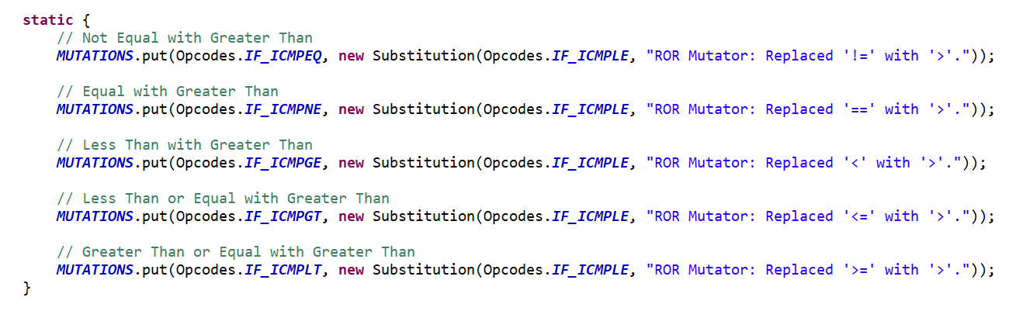
ROR Implementation
Created a class containing six enum types, each implementing the MethodMutatorFactory.
Each enum created a MethodVisitor that handled a certain case.
Each method visitor extended AbstractJumpMutator which contain the Substitution class used for replacement.
Snippet of the method visitor that handled the replacement of operators to ‘>‘.
Note operators are flipped.

Slide 10
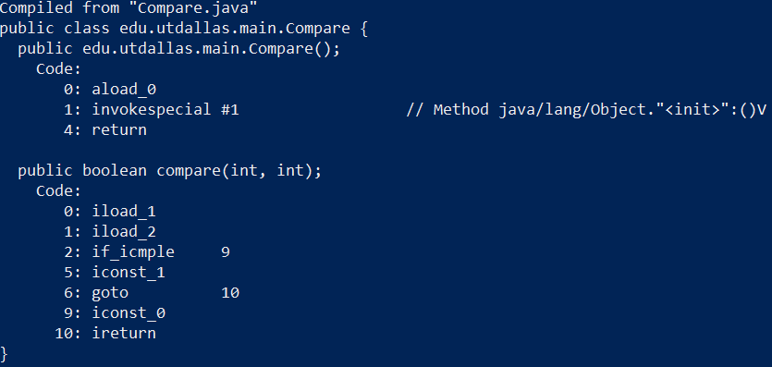
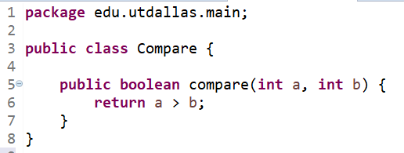
ROR Implementation
Operators are flipped because JVM compares <b with a> not <a with b>.
JVM first pushes a in the stack then b.
Then check if value b is less then or equal than value of a.

Slide 11
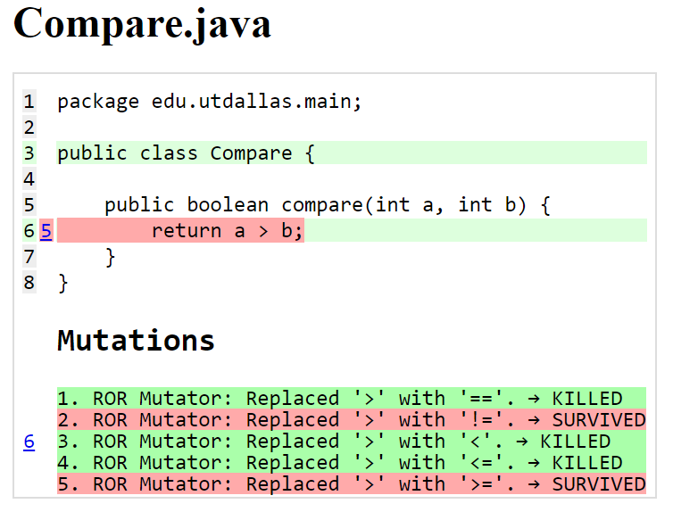
ROR Implementation

