Slide 1
Lab 2
DATA130008 《人工智能导论》
2022年10月16日

Slide 2
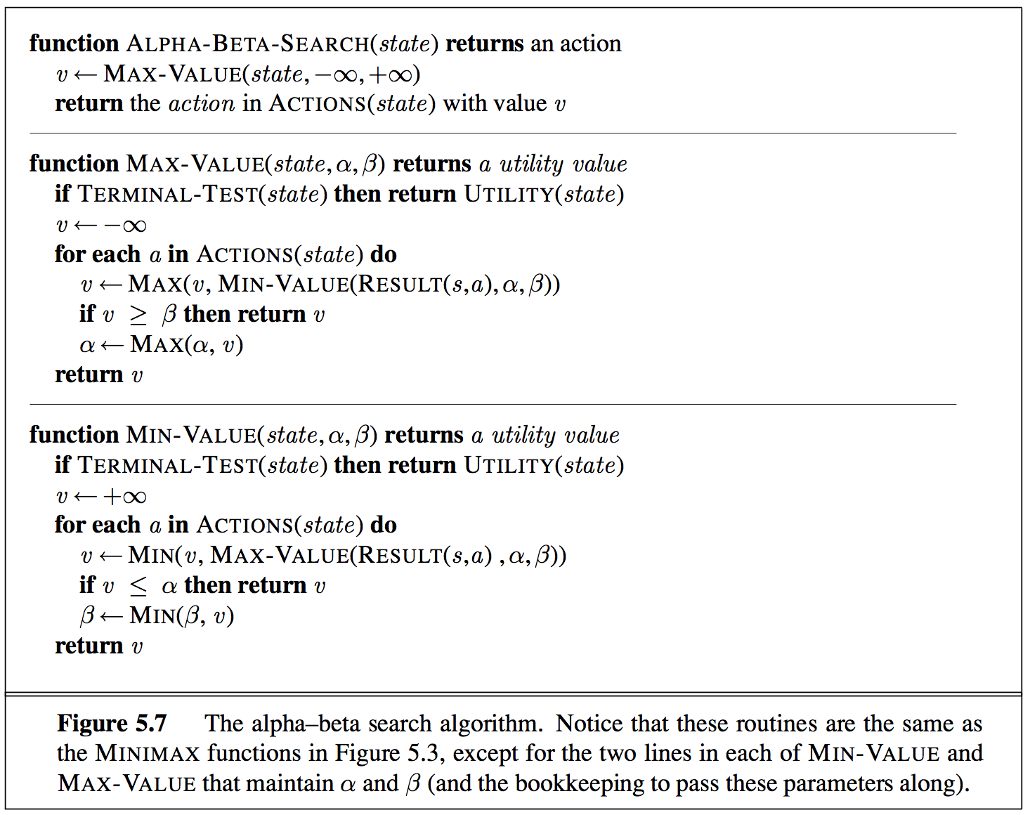
Lab2: Adversarial Search (Minimax)
Minimax values: computed recursively
max
5
min
2
5
8
2
5
6
Terminal values: part of the game
Notes:
一个确定的零和博弈。有以下两个部分组成。
围棋，象棋。其中一个玩家要最大化自己的收益，另外一个则要最小化它。
我们可以构造出右边的这个图。下棋的双方是轮流交换行棋权的。
一个回合之后比赛结束。我们对于MAX的所得会给出评估。那么在这样一颗完整的树上，我们可以进行极大极小值算法的操作。从而为MAX节点计算出一个最大的效用值。
极小化极大算法缺点：数据冗余——①极大值冗余；②极小值冗余。alpha剪枝用来解决极大值冗余问题，beta剪枝则用来解决极小值冗余问题
每一个节点都会由 alpha 和 beta 两个值来确定一个范围 [alpha, beta]，alpha 值代表的是下界，beta 代表的是上界。每搜索一个子节点，都会按规则对范围进行修正。
Max 以beta为标准更新alpha（当前最大值）
Min 以alpha为标准更新beta（当前最小）

Slide 3
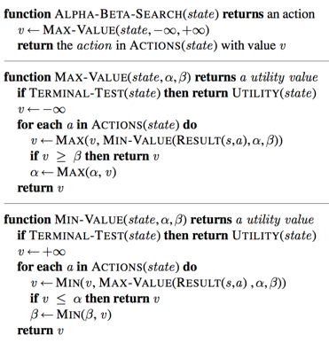
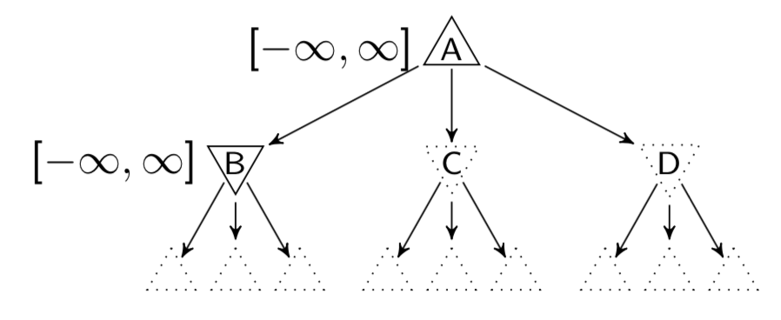
Alpha-Beta Example
For MAX node
β is fixed as β_{parent}
v is used to update α initialized as α_{parent}
For MIN node
α is fixed as α_{parent}
v is used to update β initialized as β_{parent}
Notes:
Min，比alpha大， 更新beta=min（beta，v）
1. Max 节点进行递归搜索，传递 alpha 和 beta值

Slide 4
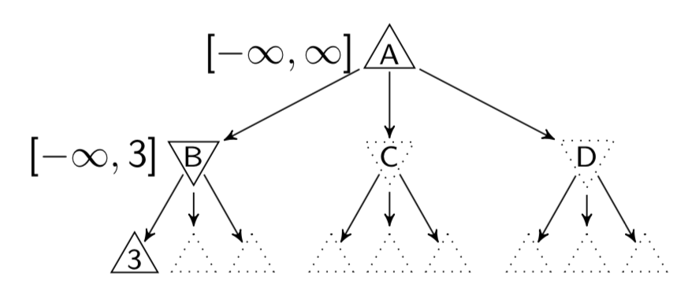
Alpha-Beta Example
For MAX node
β is fixed as β_{parent}
v is used to update α initialized as α_{parent}
For MIN node
α is fixed as α_{parent}
v is used to update β initialized as β_{parent}
Notes:
Min，比alpha大， 更新beta=min（beta，v）

Slide 5
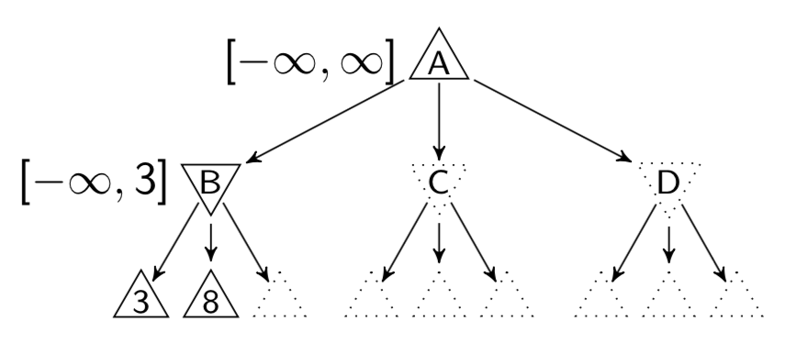
Alpha-Beta Example
For MAX node
β is fixed as β_{parent}
v is used to update α initialized as α_{parent}
For MIN node
α is fixed as α_{parent}
v is used to update β initialized as β_{parent}
Notes:
Min，比alpha大， 更新beta=min（beta，v）

Slide 6
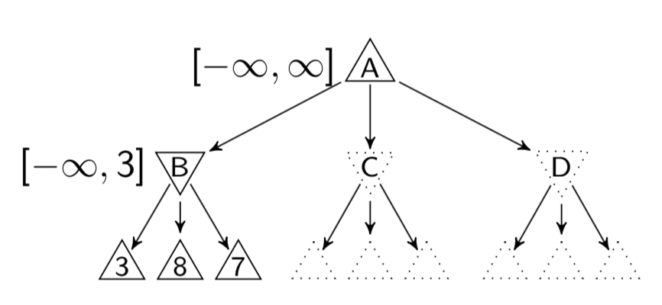
Alpha-Beta Example
For MAX node
β is fixed as β_{parent}
v is used to update α initialized as α_{parent}
For MIN node
α is fixed as α_{parent}
v is used to update β initialized as β_{parent}
Notes:
Min，比alpha大， 更新beta=min（beta，v）

Slide 7
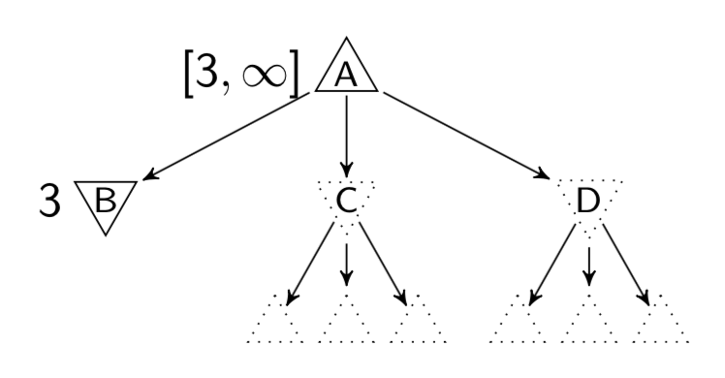
Alpha-Beta Example
For MAX node
β is fixed as β_{parent}
v is used to update α initialized as α_{parent}
For MIN node
α is fixed as α_{parent}
v is used to update β initialized as β_{parent}
Notes:
Beta，对于根节点更新alpha

Slide 8
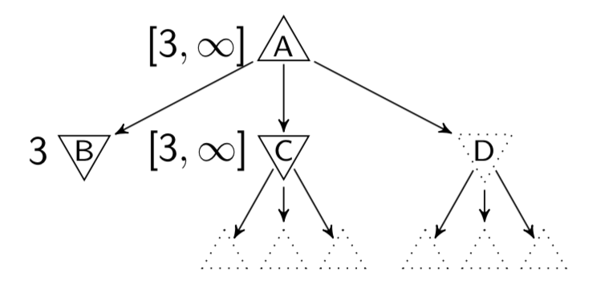
Alpha-Beta Example
For MAX node
β is fixed as β_{parent}
v is used to update α initialized as α_{parent}
For MIN node
α is fixed as α_{parent}
v is used to update β initialized as β_{parent}
Notes:
Min，比alpha大， 更新beta=min（beta，v）

Slide 9
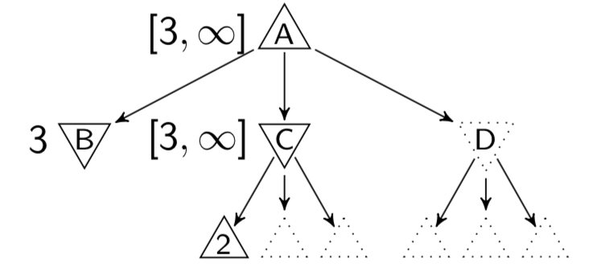


Alpha-Beta Example
For MAX node
β is fixed as β_{parent}
v is used to update α initialized as α_{parent}
For MIN node
α is fixed as α_{parent}
v is used to update β initialized as β_{parent}
$$≥3$$
Conflict!!
$$≤2$$
Notes:
比alpha小，减支

Slide 10
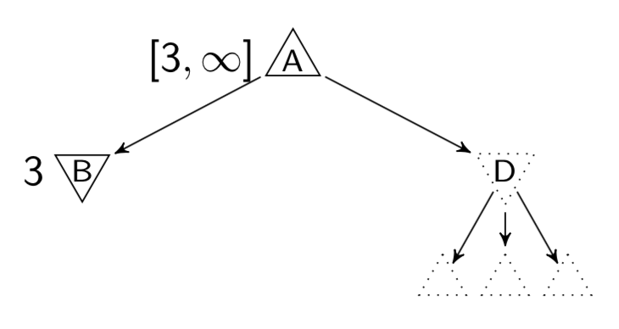
Alpha-Beta Example
For MAX node
β is fixed as β_{parent}
v is used to update α initialized as α_{parent}
For MIN node
α is fixed as α_{parent}
v is used to update β initialized as β_{parent}
Notes:
回顾一下alpha-beta的过程

Slide 11
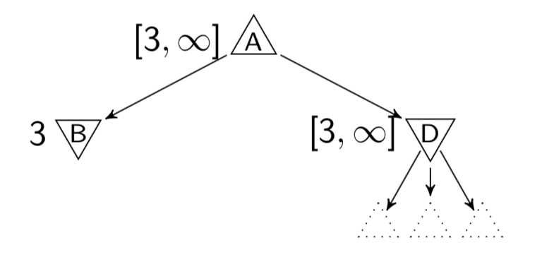
Alpha-Beta Example
For MAX node
β is fixed as β_{parent}
v is used to update α initialized as α_{parent}
For MIN node
α is fixed as α_{parent}
v is used to update β initialized as β_{parent}
Notes:
回顾一下alpha-beta的过程

Slide 12
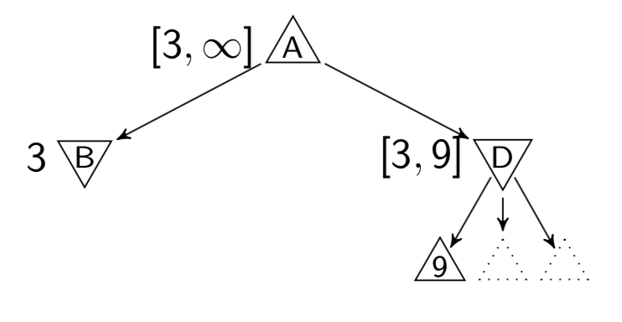
Alpha-Beta Example
For MAX node
β is fixed as β_{parent}
v is used to update α initialized as α_{parent}
For MIN node
α is fixed as α_{parent}
v is used to update β initialized as β_{parent}
Notes:
Min，比alpha大， 更新beta=min（beta，v）

Slide 13
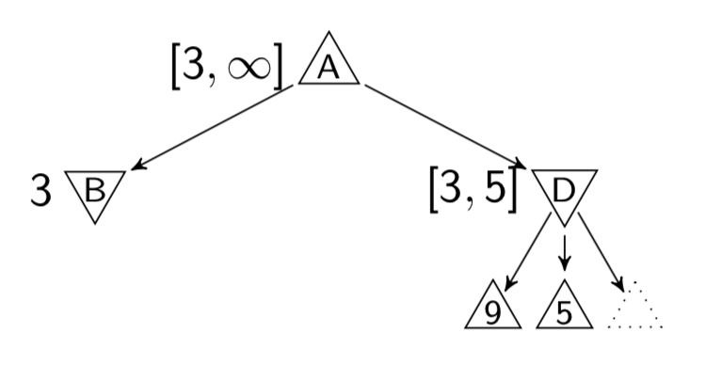
Alpha-Beta Example
For MAX node
β is fixed as β_{parent}
v is used to update α initialized as α_{parent}
For MIN node
α is fixed as α_{parent}
v is used to update β initialized as β_{parent}
Notes:
回顾一下alpha-beta的过程

Slide 14
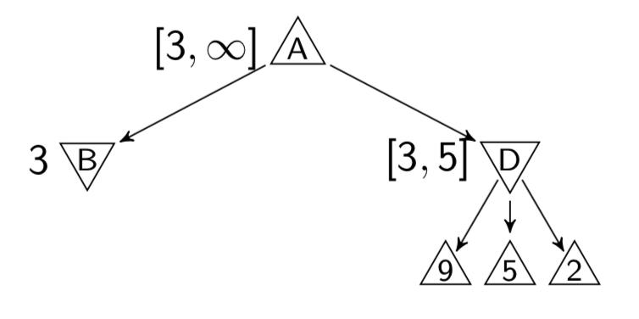
Alpha-Beta Example
For MAX node
β is fixed as β_{parent}
v is used to update α initialized as α_{parent}
For MIN node
α is fixed as α_{parent}
v is used to update β initialized as β_{parent}
Notes:
比alpha小，减支

Slide 15
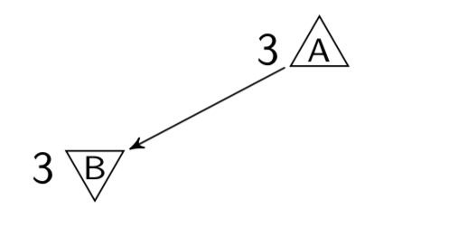
Alpha-Beta Example
For MAX node
β is fixed as β_{parent}
v is used to update α initialized as α_{parent}
For MIN node
α is fixed as α_{parent}
v is used to update β initialized as β_{parent}
Notes:
回顾一下alpha-beta的过程

Slide 16
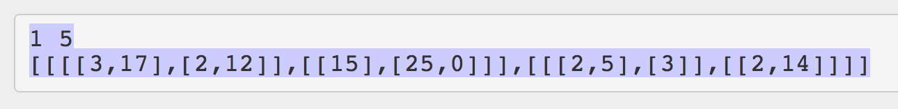
Practice for Alpha-beta Pruning
Input Example:
Square represents MAX node while circle stands for MIN node. For each test case, it contains two lines. The first line consists of two integers, the role of the root node ( 1 for MAX node and 0 for MIN node) and the depth of the tree. The second line is a nested list which stands for the game tree.
Notes:
这次lab就是要实现这个过程。以这棵树为例子，方块是max，圆圈是min，我们输入有两行，第一行有两个数，分别代表根节点的类型，MAX或者MIN，和树的深度。
第二行是一个嵌套数组，代表树结构，可以直接用eval来解析。

Slide 17
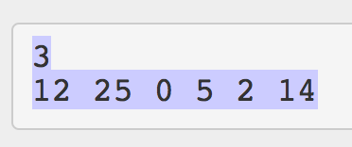
Practice for Alpha-beta Pruning
For each test case, the output should include two lines. The first line contains the result for minimax search. The second line should consist of pruned nodes in order.
Notes:
希望输出两行，第一行是根节点搜索结果，第二行是没有访问过的叶子节点（减枝）的值。

Slide 18
Alpha-Beta Pruning Template
rule, n = map(int, input().strip().split()) tree = eval(input().strip()) root_node = construct_tree(n-1, tree, rule) print(get_value(root_node, float('-inf'), float('inf'))) # print out unvisited nodes print(' '.join( [str(node) for node in get_unvisited_nodes(root_node)]))
def get_value(node, alpha, beta)
Choose which function to call
def max_value(node, alpha, beta)
def min_value(node, alpha, beta)
Notes:
具体的代码框架已经给出，大家只需要填充这三个函数实现算法就可以了。
首先解析第一行，得到根节点的类型rule，和层数n，然后输入第二行得到tree。
接着根据tree构造出树，构造方法之后会说。
然后输出这棵树的根节点的值和被剪掉的节点的值。
在计算过程中大家需要填写这三个函数。

Slide 19
What You Need to Do for Alpha-Beta Pruning
Implement the following 3 functions:
def get_value(node, alpha, beta)
Choose which function to call
def max_value(node, alpha, beta)
def min_value(node, alpha, beta)
Notes:
有了数，我们希望通过把root节点传入get_value这个函数得到他的值，这个函数根据节点类型的不同选择调用下面这两个函数。大家需要实现这三个函数。

