Slide 1
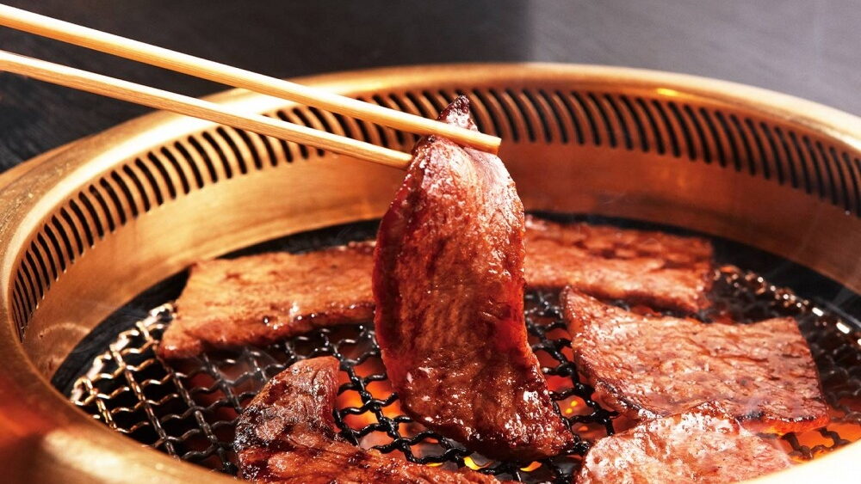

2022.07 – 2023.06 Sales & Member Analysis
Kabu Pass 1.0
Presented by Kabu IT
Version 4.2 - 02.07.2023
INTERNAL USAGE ONLY

Slide 2








A. Objective & Background
Follow 9 Brands are covered
GKK
GKB
The following measurements would be covered in this report:
Member Trend (Per Month)
Net Sales (Per Month)
Spending per Member (2 Months Rolling)
Spending per Visit (2 Months Rolling)
Member Sales Participation & Visit Frequency Trend (2 Months Rolling)
Brands Visiting (2 Months Rolling)
Party Size (2 Months Rolling)
MMC
GKJ
OYS
HAP
永華
日常
和平飯店
* Wording near the logo is Brand Code
KABU INTERNAL USAGE ONLY

Slide 3
A. Member Trend
Remarks:
Member No. = Total No. of members that are in different tiers, Silver and Gold, at the end of the period
Active Member = Members who have contained ANY transaction in the period, referring to the members who at least patronize once (i.e. at least one sales activity) in a period
Active Member Ratio = Total No. of Active Members/ Total No. of Members

Slide 4
Member Base Trend (Silver VS Gold at the end of Month) & Active Ratio
Member Active Ratio
As per UCR definition.

Slide 5
B. Net Sales
Remarks:
Net Sales = Sum of All Sale Items of All Transactions
Member Sales Ratio = Net Sales of Member Transactions / Net Sales of Overall Transactions

Slide 6
Net Sales (Silver Member VS Gold Member VS Non-Member)
Member Sales (HKD – K)
Member Sales Ratio

Slide 7
Sales Tree Analysis – YTD June 2023 (VS 2019) – GKK (ALC)
Visit Frequency: -20.1%
2023: 2.27
2019: 2.84
Spending Per Member: +7.3%
2023: $ 1,545
2019: $ 1,440
Members Sales: +34.6%
2023: $ 65,273,543
2019: $ 48,511,285
Spending Per Visit: +33.9%
2023: $ 680
2019: $ 508
Total Active Member: +25.4%
2023: 42,247
2019: 33,688
Total Sales: +0.59%
2023: $ 128,323,002 (10)
2019: $ 127,569,907 (10)
*Comparable Stores:
Included:
GKK-(LCX), GKK-(CW), GKK-(VC), GKK-(WG),
GKK-(WH), GKK-(TFP), GKK-(YL), GKK-(TPM),
GKK-(EPC), GKK-(FW)
Excluded:
GKK-(KHP), GKK-(IRM), GKK-(PCN)
*() is no. of shop
Non-members Sales: -20.3%
2023: $
2019: $
Remarks:​
Members sales = No. of Active Members x Average Spending Per Member (Members sales include Gold and Silver members.)​
Spending per Member = Average Visit Frequency x Average Spending Per Visit (Average Transaction Value)​
Active member refers to the members who at least patronize once (i.e. at least one sales activity) in a period. (Under this definition, non-sales activities aren't counted, e.g. opening the app to browse content without spending / opening the app to queue/reserving table without spending / buying pre-sale cash vouchers without using the vouchers/use points to redeem coupons without using the coupons)​
Visit frequency = Transaction count in a period divided by Active Members.​
Spending per visit = Members Sales divided by Transaction Count.

Slide 8
Sales Tree Analysis – YTD June 2023 (VS 2019) – GKB
Visit Frequency: -19.5%
2023: 1.57
2019: 1.95
Spending Per Member: +1.14%
2023: $ 1,820
2019: $ 1,841
Members Sales: +41.3%
2023: $ 22,471,548
2019: $ 15,902,162
Spending Per Visit: +25.0%
2023: $ 1,157
2019: $ 926
Total Active Member: +40.2%
2023: 12,349
2019: 8,806
Total Sales: -5.25%
2023: $ 38,518,176 (1)
2019: $ 40,654,127 (1)
Non-members Sales: -35.2%
2023: $
2019: $
*Comparable Stores:
Included:
GKB–(GP)
Excluded:
GKB-(MIRA), GKK-(YMS), GKK-(LTA),
GKB-(MP), GKK-(LKP)
*() is no. of shop
Remarks:​
Members sales = No. of Active Members x Average Spending Per Member (Members sales include Gold and Silver members.)​
Spending per Member = Average Visit Frequency x Average Spending Per Visit (Average Transaction Value)​
Active member refers to the members who at least patronize once (i.e. at least one sales activity) in a period. (Under this definition, non-sales activities aren't counted, e.g. opening the app to browse content without spending / opening the app to queue/reserving table without spending / buying pre-sale cash vouchers without using the vouchers/use points to redeem coupons without using the coupons)​
Visit frequency = Transaction count in a period divided by Active Members.​
Spending per visit = Members Sales divided by Transaction Count.

Slide 9
Sales Tree Analysis – YTD June 2023 (VS 2019) – GKK (AYCE)
Visit Frequency: -11.6%
2023: 1.99
2019: 2.25
Spending Per Member: +22.7%
2023: $ 1,860
2019: $ 1,516
Members Sales: +56.2%
2023: $ 28,228,723
2019: $ 18,071,464
Spending Per Visit: +41.8%
2023: $ 933
2019: $ 658
Total Active Member: +27.3%
2023: 15,176
2019: 11,922
Total Sales: +13.25%
2023: $ 49,932,424 (3)
2019: $ 44,089,448 (3)
Non-members Sales: -18.4%
2023: $
2019: $
*Comparable Stores:
Included:
GKK-(TMT), GKK-(AC), GKK-(OC)
Excluded:
GKK-(VW), GKK-(LG), GKK-(MKK)
*() is no. of shop
Remarks:​
Members sales = No. of Active Members x Average Spending Per Member (Members sales include Gold and Silver members.)​
Spending per Member = Average Visit Frequency x Average Spending Per Visit (Average Transaction Value)​
Active member refers to the members who at least patronize once (i.e. at least one sales activity) in a period. (Under this definition, non-sales activities aren't counted, e.g. opening the app to browse content without spending / opening the app to queue/reserving table without spending / buying pre-sale cash vouchers without using the vouchers/use points to redeem coupons without using the coupons)​
Visit frequency = Transaction count in a period divided by Active Members.​
Spending per visit = Members Sales divided by Transaction Count.

Slide 10
Sales Tree Analysis – YTD June 2023 (VS 2019) – GKJ
Visit Frequency: +7.95%
2023: 1.63
2019: 1.51
Spending Per Member: -10.9%
2023: $ 278
2019: $ 312
Members Sales: -12.7%
2023: $ 964,293
2019: $ 1,104,163
Spending Per Visit: -17.8%
2023: $ 171
2019: $ 208
Total Active Members: -1.84%
2023: 3,473
2019: 3,538
Total Sales: -7.96%
2023: $ 6,827,218 (1)
2019: $ 7,417,562 (1)
Non-members Sales: -13.9%
2023: $
2019: $
*Comparable Stores:
Included:
GKJ-(TWP)
Excluded:
GKJ-(AP), GKJ-(CG)
*() is no. of shop
Remarks:​
Members sales = No. of Active Members x Average Spending Per Member (Members sales include Gold and Silver members.)​
Spending per Member = Average Visit Frequency x Average Spending Per Visit (Average Transaction Value)​
Active member refers to the members who at least patronize once (i.e. at least one sales activity) in a period. (Under this definition, non-sales activities aren't counted, e.g. opening the app to browse content without spending / opening the app to queue/reserving table without spending / buying pre-sale cash vouchers without using the vouchers/use points to redeem coupons without using the coupons)​
Visit frequency = Transaction count in a period divided by Active Members.​
Spending per visit = Members Sales divided by Transaction Count.

Slide 11
Sales Tree Analysis – YTD June 2023 (VS 2019) – OYS
Visit Frequency: -10.1%
2023: 2.05
2019: 2.28
Spending Per Member: +3.84%
2023: $ 1704
2019: $ 1641
Members Sales: +33.8%
2023: $ 25,733,303
2019: $ 19,237,804
Spending Per Visit: +15.9%
2023: $ 833
2019: $ 719
Total Active Members: +27.5%
2023: 14,947
2019: 11,724
Total Sales: -8.45%
2023: $ 46,717,586 (4)
2019: $ 51,026,902 (4)
Non-members Sales: -33.2%
2023: $
2019: $
*Comparable Stores:
Included:
OYS-(CP), OYS-(CWB), OYS-(FW), OYS-(LCX)
*() is no. of shop
Remarks:​
Members sales = No. of Active Members x Average Spending Per Member (Members sales include Gold and Silver members.)​
Spending per Member = Average Visit Frequency x Average Spending Per Visit (Average Transaction Value)​
Active member refers to the members who at least patronize once (i.e. at least one sales activity) in a period. (Under this definition, non-sales activities aren't counted, e.g. opening the app to browse content without spending / opening the app to queue/reserving table without spending / buying pre-sale cash vouchers without using the vouchers/use points to redeem coupons without using the coupons)​
Visit frequency = Transaction count in a period divided by Active Members.​
Spending per visit = Members Sales divided by Transaction Count.

Slide 12
C. Spending Per Member
Remarks:
Spending Per Member = Net Sales of Member Transaction / Total No. of Active Member

Slide 13
Spending Per Member – Kabu Pass
Spending Per Member (HKD)

Slide 14
Spending Per Member – GKK, GKB, GKJ, OYS
Spending Per Member (HKD)

Slide 15
Spending Per Member – MMC, HAP, WWA, PC
Spending Per Member (HKD)

Slide 16
D. Spending Per Visit
Remarks:
Visiting = Transactions
Spending Per Visit (Member) = Net Sales of Member Transactions/ Total No. of Member Transactions
Spending Per Visit (Overall) = Net Sales of All Transactions/ Total No. of Transactions

Slide 17
Spending Per Visit (Member VS Overall) & Member Visiting Frequency – Kabu Pass
Spending Per Visit (HKD)
Member Visiting Freq.

Slide 18
Spending Per Visit (Member VS Overall) & Member Visiting Frequency – GKK
Spending Per Visit (HKD)
Member Visiting Freq.

Slide 19
Spending Per Visit (Member VS Overall) & Member Visiting Frequency – GKB
Spending Per Visit (HKD)
Member Visiting Freq.

Slide 20
Spending Per Visit (Member VS Overall) & Member Visiting Frequency – GKJ
Spending Per Visit (HKD)
Member Visiting Freq.

Slide 21
Spending Per Visit (Member VS Overall) & Member Visiting Frequency – MMC
Spending Per Visit (HKD)
Member Visiting Freq.

Slide 22
Spending Per Visit (Member VS Overall) & Member Visiting Frequency – OYS
Spending Per Visit (HKD)
Member Visiting Freq.

Slide 23
Spending Per Visit (Member VS Overall) & Member Visiting Frequency – HAP
Spending Per Visit (HKD)
Member Visiting Freq.

Slide 24
Spending Per Visit (Member VS Overall) & Member Visiting Frequency – WWA
Spending Per Visit (HKD)
Member Visiting Freq.

Slide 25
Spending Per Visit (Member VS Overall) & Member Visiting Frequency – PC
Spending Per Visit (HKD)
Member Visiting Freq.

Slide 26
E. Member Sales Participation & Visiting Frequency Trend
Remarks:
Member Sales Participation = Total Net Sales of All Member Transactions/ Total Net Sales of All Transactions
Visiting Frequency = Total No. of Member Transactions / Total No. of Active Member

Slide 27
Member Sales Participation & Member Visiting Frequency Trend – Kabu Pass
Member Sales %
Member Visiting Freq.

Slide 28
Member Sales Participation & Member Visiting Frequency Trend - GKK
Member Sales %
Member Visiting Freq.

Slide 29
Member Sales Participation & Visiting Frequency Trend - GKB
Spending Per Visit (HKD)
Member Visiting Freq.

Slide 30
Member Sales Participation & Visiting Frequency Trend - GKJ
Spending Per Visit (HKD)
Member Visiting Freq.

Slide 31
Member Sales Participation & Visiting Frequency Trend - MMC
Spending Per Visit (HKD)
Member Visiting Freq.

Slide 32
Member Sales Participation & Visiting Frequency Trend - OYS
Spending Per Visit (HKD)
Member Visiting Freq.

Slide 33
Member Sales Participation & Visit Frequency Trend - HAP
Spending Per Visit (HKD)
Member Visiting Freq.

Slide 34
Member Sales Participation & Visiting Frequency Trend - WWA
Spending Per Visit (HKD)
Member Visiting Freq.

Slide 35
Member Sales Participation & Visiting Frequency Trend - PC
Spending Per Visit (HKD)
Member Visiting Freq.

Slide 36
F. Brands Visiting
Remarks:
No. of Brands Members Visiting = No of Members contains Transactions in 1 brand, 2 brands……
Cross Brands Visiting = Total No. of Members that go to Other Brands with Certain Brands

Slide 37
KABU Pass Members Cross Brand Behavior
(67.91%)
(66.20%)
(65.10%)
(67.22%)
(68.20%)
(68.46%)
(68.45%)
(67.65%)
(68.4%)
(68.63%)
(68.04%)
(68.64%)
(22.86%)
(23.35%)
(23.81%)
(22.89%)
(22.34%)
(22.36%)
(22.52%)
(22.68%)
(22.05%)
(21.94%)
(22.23%)
(21.83%)
(6.71%)
(7.16%)
(7.61%)
(7.09%)
(6.69%)
(6.58%)
(6.45%)
(6.84%)
(6.77%)
(6.72%)
(6.86%)
(6.69%)
(1.93%)
59.24%
(2.41%)
(2.52%)
(2.03%)
(2.05%)
(1.92%)
(1.95%)
(2.13%)
(2.06%)
(2.05%)
(2.07%)
(2.04%)
57.50%
58.80%
57.69%
(0.46%)
(0.7%)
(0.71%)
(0.59%)
(0.54%)
(0.54%)
(0.49%)
(0.54%)
(0.52%)
(0.52%)
(0.6%)
(0.59%)
(0.11%)
(0.15%)
(0.19%)
(0.15%)
(0.14%)
(0.12%)
(0.11%)
(0.13%)
(0.16%)
(0.12%)
(0.15%)
(0.17%)
(0.02%)
(0.03%)
(0.05%)
(0.03%)
(0.02%)
(0.02%)
(0.02%)
(0.03%)
(0.02%)
(0.02%)
(0.03%)
(0.04%)
(0%)
(0%)
(0.01%)
(0.01%)
(0.01%)
(0%)
(0%)
(0%)
(0.01%)
(0%)
(0.01%)
(0%)
(0%)
(0%)
(0%)
(0%)
(0%)
(0%)
(0%)
(0%)
(0%)
(0%)
(0%)
(0%)

Slide 38
Cross Brands Visiting – GKK, GKB & GKJ
2 Months Rolling
Jun 2023

Slide 39
Cross Brands Visiting – MMC, OYS & HAP
2 Months Rolling
Jun 2023

Slide 40

Cross Brands Visiting – 永華日常 & 和平飯店
2 Months Rolling
Jun 2023
GKK
GKB
GKJ
WWA
OYS
MMC
HAP
PC

Slide 41
G. Member Party Size
Remarks:
Member Party Size = Average Person of All Member Transactions

Slide 42
Member Party Size (Dine-in) – Kabu Pass

Slide 43
Member Party Size (Dine-in) – GKK, GKB, GKJ & OYS

Slide 44
Member Party Size (Dine-in) – MMC, HAP

Slide 45
Member Party Size (Dine-in) – WWA, PC

