Slide 1


Slide 2
Summary Review
What is Amazon Redshift?
Data Warehouse System Architecture
Performance
Columnar Storage
Internal Architecture and System Management
Workload Management

Slide 3
What is Amazon Redshift?
An Amazon Redshift data warehouse is an enterprise-class relational database query and management system.
Amazon Redshift supports client connections with many types of applications, including business intelligence (BI), reporting, data, and analytics tools.
When you execute analytic queries, you are retrieving, comparing, and evaluating large amounts of data in multiple-stage operations to produce a final result.
Amazon Redshift achieves efficient storage and optimum query performance through a combination of massively parallel processing, columnar data storage, and very efficient, targeted data compression encoding schemes. This section presents an introduction to the Amazon Redshift system architecture.

Slide 4
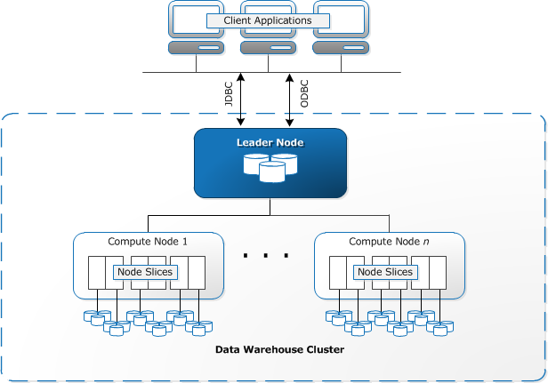
Data Warehouse System Architecture
The components of Amazon Redshift architecture are as follows
Client applications
Connections
Clusters
Leader Node
Node Slices
Internal Network
Databases

Slide 5
Amazon Redshift Components
Client Applications-
Amazon Redshift integrates with various data loading and ETL (extract, transform, and load) tools and business intelligence (BI) reporting, data mining, and analytics tools. Amazon Redshift is based on industry-standard PostgreSQL, so most existing SQL client applications will work with only minimal changes.
Connections-
Amazon Redshift communicates with client applications by using industry-standard JDBC and ODBC drivers for PostgreSQL.
Clusters
The core infrastructure component of an Amazon Redshift data warehouse is a cluster.
A cluster is composed of one or more compute nodes.
If a cluster is provisioned with two or more compute nodes, an additional leader node coordinates the compute nodes and handles external communication.
Your client application interacts directly only with the leader node. The compute nodes are transparent to external applications.

Slide 6
Amazon Redshift Components
Leader node
The leader node manages communications with client programs and all communication with compute nodes.
It parses and develops execution plans to carry out database operations, in particular, the series of steps necessary to obtain results for complex queries.
Based on the execution plan, the leader node compiles code, distributes the compiled code to the compute nodes, and assigns a portion of the data to each compute node.
The leader node distributes SQL statements to the compute nodes only when a query references tables that are stored on the compute nodes.
All other queries run exclusively on the leader node. Amazon Redshift is designed to implement certain SQL functions only on the leader node. A query that uses any of these functions will return an error if it references tables that reside on the compute nodes.

Slide 7
Amazon Redshift Components
Compute nodes
The leader node compiles code for individual elements of the execution plan and assigns the code to individual compute nodes.
The compute nodes execute the compiled code and send intermediate results back to the leader node for final aggregation.
Each compute node has its own dedicated CPU, memory, and attached disk storage, which are determined by the node type.
As your workload grows, you can increase the compute capacity and storage capacity of a cluster by increasing the number of nodes, upgrading the node type, or both.
Amazon Redshift provides two node types; dense storage nodes and dense compute nodes. Each node provides two storage choices.
You can start with a single 160 GB node and scale up to multiple 16 TB nodes to support a petabyte of data or more.

Slide 8
Amazon Redshift Components
Node slices
A compute node is partitioned into slices.
Each slice is allocated a portion of the node's memory and disk space, where it processes a portion of the workload assigned to the node.
The leader node manages distributing data to the slices and apportions the workload for any queries or other database operations to the slices.
The slices then work in parallel to complete the operation.
The number of slices per node is determined by the node size of the cluster. For more information about the number of slices for each node size.
When you create a table, you can optionally specify one column as the distribution key. When the table is loaded with data, the rows are distributed to the node slices according to the distribution key that is defined for a table.
Choosing a good distribution key enables Amazon Redshift to use parallel processing to load data and execute queries efficiently
Internal network
Amazon Redshift takes advantage of high-bandwidth connections, close proximity, and custom communication protocols to provide private, very high-speed network communication between the leader node and compute nodes.
The compute nodes run on a separate, isolated network that client applications never access directly.

Slide 9
Amazon Redshift Components
Databases
A cluster contains one or more databases. User data is stored on the compute nodes.
Your SQL client communicates with the leader node, which in turn coordinates query execution with the compute nodes.
Amazon Redshift is a relational database management system (RDBMS), so it is compatible with other RDBMS applications.
Although it provides the same functionality as a typical RDBMS, including online transaction processing (OLTP) functions such as inserting and deleting data, Amazon Redshift is optimized for high-performance analysis and reporting of very large datasets.
Amazon Redshift is based on PostgreSQL 8.0.2. Amazon Redshift and PostgreSQL have a number of very important differences that you need to take into account as you design and develop your data warehouse applications.

Slide 10
Performance
Amazon Redshift achieves extremely fast query execution by employing these performance features:
Massive Parallel Processing
Columnar Data Storage
Data Compression
Query Optimizer
Result Caching
Compiled Code
https://docs.aws.amazon.com/redshift/latest/dg/c_challenges_achieving_high_performance_queries.html

Slide 11
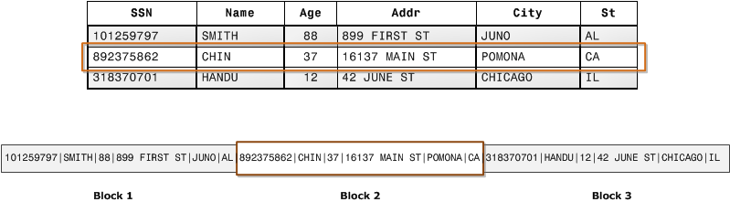
Columnar Storage
Columnar storage for database tables is an important factor in optimizing analytic query performance because it drastically reduces the overall disk I/O requirements and reduces the amount of data you need to load from disk.
The following series of illustrations describe how columnar data storage implements efficiencies and how that translates into efficiencies when retrieving data into memory.
This first illustration shows how records from database tables are typically stored into disk blocks by row.
https://docs.aws.amazon.com/redshift/latest/dg/c_columnar_storage_disk_mem_mgmnt.html
Notes:
.

Slide 12
Workload Management
Amazon Redshift workload management (WLM) enables users to flexibly manage priorities within workloads so that short, fast-running queries won't get stuck in queues behind long-running queries.
Amazon Redshift WLM creates query queues at runtime according to service classes, which define the configuration parameters for various types of queues, including internal system queues and user-accessible queues. From a user perspective, a user-accessible service class and a queue are functionally equivalent. For consistency, this documentation uses the term queue to mean a user-accessible service class as well as a runtime queue.
When you run a query, WLM assigns the query to a queue according to the user's user group or by matching a query group that is listed in the queue configuration with a query group label that the user sets at runtime.
By default, Amazon Redshift configures one queue with a concurrency level of five, which enables up to five queries to run concurrently, plus one predefined Superuser queue, with a concurrency level of one. You can define up to eight queues. Each queue can be configured with a maximum concurrency level of 50. The maximum total concurrency level for all user-defined queues (not including the Superuser queue) is 50.
The easiest way to modify the WLM configuration is by using the Amazon Redshift Management Console. You can also use the Amazon Redshift command line interface (CLI) or the Amazon Redshift API.
Notes:
.

Slide 13

End of Module

