Slide 1

Deliver Centralized Security Administration, Authorization and Audit services to Hadoop Components

Slide 2
Summary Review
HDP Security Overview
Centralized Security/Administration with Ranger
What is Ranger, What does it do and Ranger Architecture
Authorization using Ranger
Ranger Administration Console
Configuring Resource Based policies
Hive policy creation
Add Row level filter in Hive using Apache Ranger

Slide 3
HDP Security Overview
Hortonworks uses a holistic approach based on five core security features:
Administration
Authentication and perimeter security
Authorization
Audit
Data protection

Slide 4
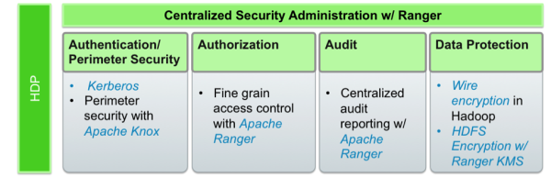
Centralized Security Administration with Ranger
To deliver consistent security administration and management, Hadoop administrators require a centralized user interface they can use to define, administer and manage security policies consistently across all of the Hadoop stack components.

Slide 5
What is Ranger?
Apache Ranger™ is a framework to enable, monitor and manage comprehensive data security across the Hadoop platform.
Centralized authorization and auditing across Hadoop components
Access authorization based on resources
Policy based behavior like column masking
Extensible architecture

Slide 6
What Does Ranger Do?
Apache Ranger supports fine grained authorization and auditing for following Apache projects:
Apache Hadoop
Apache Hive
Apache HBase
Apache Storm
Apache Knox
Apache Solr
Apache Nifi
Apache Kafka
YARN
Ranger also provides security administrators with deep visibility into their Hadoop environment through a centralized audit location that tracks all the access requests in real time and support multiple destination sources including HDFS and Solr.

Slide 7
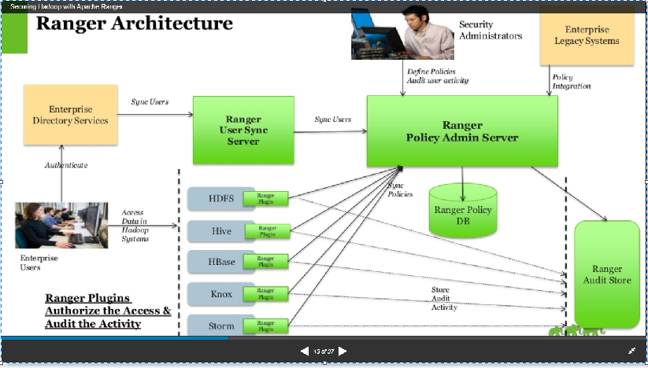
Ranger Architecture

Slide 8
Authorization Using Ranger
Once a user has been authenticated, their access rights must be determined. Authorization defines user access rights to resources. For example, a user may be allowed to create a policy and view reports, but not allowed to edit users and groups. You can use Ranger to set up and manage access to Hadoop services.
Ranger enables you to create services for specific Hadoop resources (HDFS, HBase, Hive, etc.) and add access policies to those services. You can also create tag-based services and add access policies to those services. Using tag-based policies enables you to control access to resources across multiple Hadoop components without creating separate services and policies in each component.

Slide 9
How does Apache Ranger provide authorization?
Apache Ranger at the core has a centralized web application, which consists of the policy administration, audit and reporting modules. Authorized users will be able to manage their security policies using the web tool or using REST APIs. These security policies are enforced within Hadoop ecosystem using lightweight Ranger Java plugins, which run as part of the same process as the namenode (HDFS), Hive2Server(Hive), HBase server (Hbase), Nimbus server (Storm) and Knox server (Knox) respectively. Thus there is no additional OS level process to manage.
Apache Ranger will enforce the security policies available in the policy database. Users can create a security policy for a specific set of resources (one or more folders and/or files) and assign specific set of permissions (e.g: read, write, execute) to a specific set of users and/or groups. The security policies are stored in the policy manager and are independent from native permissions.

Slide 10
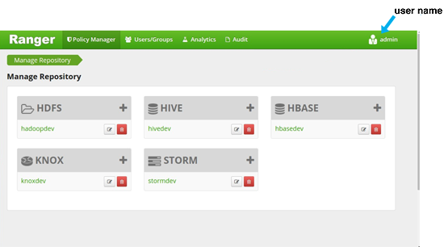
Ranger Administration Console
The Ranger console controls five types of functions:
The Repository Manager (visible upon user login, as shown above) adds and administers service repositories.
The Policy Manager tab creates and administers repository policies.
The Users/Groups tab assigns policy permissions to users and groups.
The Analytics tab is used to perform analytics on one or more HDFS, Hive, HBase or Knox policies.
The Audit tab monitors user activity at the resource level, and conditional auditing based on users, groups or time.

Slide 11
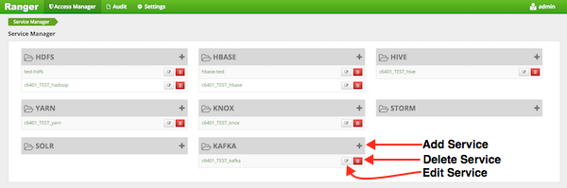
Configuring Resource-Based Services
Select Access Manager > Resource Based Policies. You can use this page to create services for Hadoop resources (HDFS, HBase, Hive, etc.) and add access policies to those resources.
To add a new resource-based service, To edit a resource-based service, and To delete a resource-based service, click the appropriate buttons to enable the specific request

Slide 12
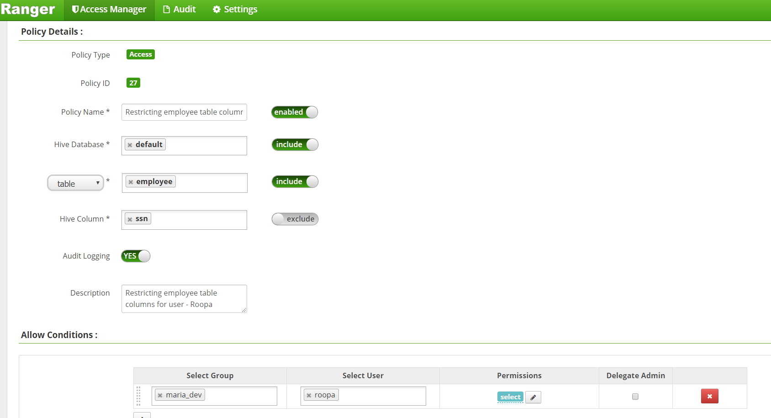
Hive Policy Creation
You can create policies in Hive at the Database Name, Table Name, and Column Name level.
To add a policy to a Hive repository, use the Hive Add Policy form.

Slide 13
Hive Policy Creation - Continued
Hive Add Policy Form
Complete the Hive Add Policy Form as follows:
Select Column Name
For the selected database and table(s), select columns for the which the policy will be applicable.
Audit Logging
Specify whether this policy is audited. (De-select to disable auditing.)
User and Group Permissions
Specify the group to which this policy applies. Specify a particular user to which this policy applies
Include/Exclude
Flags particular fields (table names or column names) as being included or excluded from consideration in the policy.
Enable/Disable
Policies are enabled by default. To restrict user or group access for the policy, select Disable

Slide 14
​Row-level Filtering in Hive with Ranger Policies
By moving the access restriction logic down into the Hive layer, Hive applies the access restrictions every time data access is attempted.
Typical use cases where row-level filtering can be beneficial include:
A hospital can create a security policy that allows doctors to view data rows only for their own patients, and that allows insurance claims administrators to view only specific rows for their specific site.
A bank can create a policy to restrict access to rows of financial data based on the employee's business division, locale, or based on the employee's role (for example: only employees in the finance department are allowed to see customer invoices, payments, and accrual data; only European HR employees can see European employee data).
A multi-tenant application can create logical separation of each tenant's data so that each tenant can see only their own data rows.

Slide 15
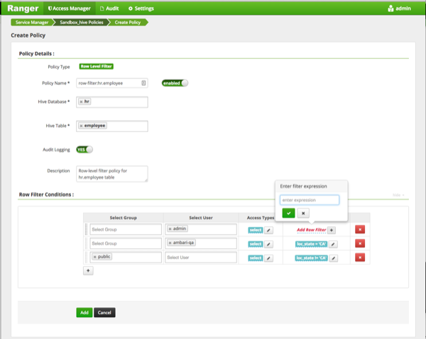
Add Row level filter using Apache Ranger

Slide 16
Add Row level filter using Apache Ranger
To create a row filter for the specified users and groups, Click Add Row Filter, then type a valid WHERE clause in the Enter filter expression box.
To allow Select access for the specified users and groups without row-level restrictions, do not add a row filter (leave the setting as "Add Row Filter").
Filters are evaluated in the order listed in the policy. The filter at the top of the Row Filter Conditions list is applied first, then the second, then the third, and so on.

Slide 17
References
References:
https://hortonworks.com/apache/ranger/#section_1
http://pivotalhd.docs.pivotal.io/docs/ranger-user-guide.html
http://crazyadmins.com/how-to-integrate-ranger-with-ldap/
http://ranger.apache.org

Slide 18

End of Module

