Slide 1
Introduction to Apache Spark
.
Week 13

Slide 2
Agenda
Introduction to Spark
Spark Features and Components
Introduction to Spark RDD
Transformations and Actions

Slide 3
Why use Spark?
Processing larger scale of data with Hadoop’s processing framework i.e. MapReduce (MR) is far better than our traditional system but still not good enough for organizations to take all its decision on time, because Hadoop operates on batch processing of data leading to high latency.
Several other shortcomings of Hadoop are:
Adherence to its MapReduce programming model
Limited programming language API options
Not a good fit for iterative algorithms like Machine Learning Algorithms
Pipelining of tasks is not easy
Apache spark was developed as a solution to the above mentioned limitations of Hadoop.

Slide 4
Spark - Introduction
Apache Spark is a fast, in-memory data processing engine which allows data workers to efficiently execute streaming, machine learning or SQL workloads that require fast iterative access to datasets.
Spark programs are more concise and often run 10-100 times faster than Hadoop MapReduce jobs
Spark maintains the intermediate results in memory rather than writing every intermediate output to disk. This hugely cuts down the execution time of the operation, resulting in faster execution of task, as more as 10-100 time a standard MapReduce job.
Apache Spark can also hold data onto the disk. When data crosses the threshold of the memory storage it is spilled to the disk. This way spark acts as an extension of MapReduce.

Slide 5
Spark - Introduction
Spark doesn’t execute the tasks immediately but maintains a chain of operations as meta-data of the job called DAG. The action on the DAG happens only when an action operation is called on to the transformation DAG. This process is called as lazy evaluation. This allows optimized execution of the queries on Big Data.

Slide 6
Features and Compatibility
Supports wide variety of operations, compared to Map and Reduce functions.
Provides concise and consistent APIs in Scala, Java and Python.
Spark is written in Scala Programming Language and runs in JVM.
It currently has support in the following programming languages to develop applications in Spark:
Scala
Java
Python
R
Features interactive shell for Scala and Python. This is not available in Java yet.
It runs on top of existing Hadoop cluster and access Hadoop data store (HDFS), it can also process data stored by HBase structure. It can also run without Hadoop with apache Mesos or alone in standalone mode.
In addition to Map and Reduce operations, it supports SQL like queries, streaming data, machine learning and data processing in terms of graph.

Slide 7
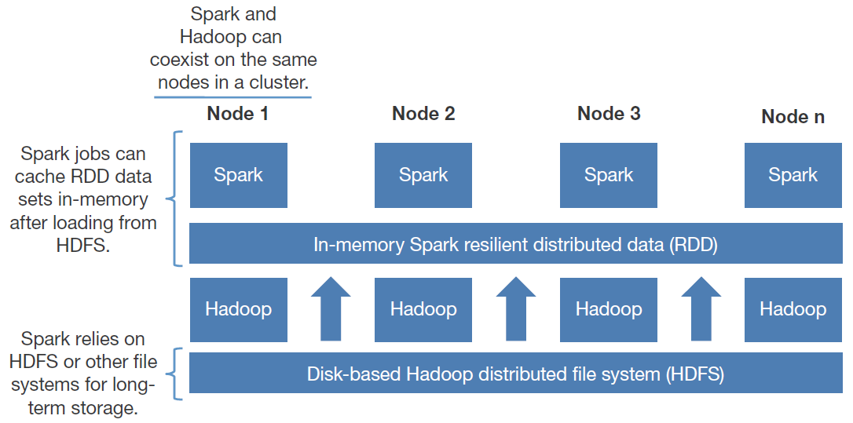
Hadoop and Apache Spark
Spark can run on top of Hadoop’s distributed file system Hadoop Distributed File System (HDFS) to leverage the distributed replicated storage. Spark can be used along with MapReduce in the same Hadoop cluster or can be used alone as a processing framework. Apache Spark is an alternative to Hadoop MapReduce rather than a replacement of Hadoop. It’s not intended to replace Hadoop but it can regarded as an extension to it. In many use cases MapReduce and Spark can be used together where MapReduce job can be used for batch processing and spark can be used for real-time processing.

Slide 8
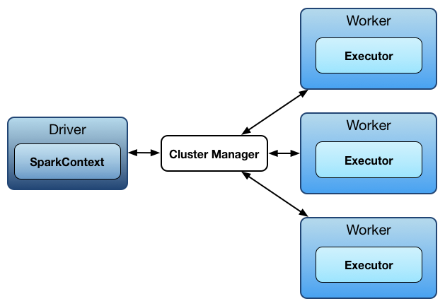
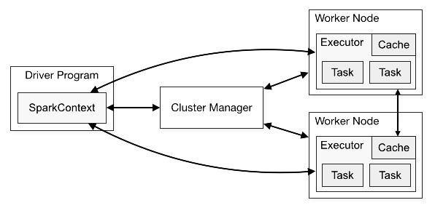
Apache Spark Components and Architecture
SparkContext: is an independent process through which spark application runs over a cluster. It gives the handle to the distributed mechanism/cluster so that you may use the resources of the distributed machines in your job. Your application program which will use SparkContext object would be known as driver program. Specifically, to run on a cluster, the SparkContext connects to several types of cluster managers (like Spark’s own standalone cluster manager, apache Mesos or Hadoop's YARN), which allocate resources across applications. Once connected, Spark takes over executors on distributed nodes in the cluster, which are processes in the distributed nodes that run computations and store data for your application. Next, it sends your application code to the executors through SparkContext. Finally tasks are sent to the executors to run and complete it.

Slide 9
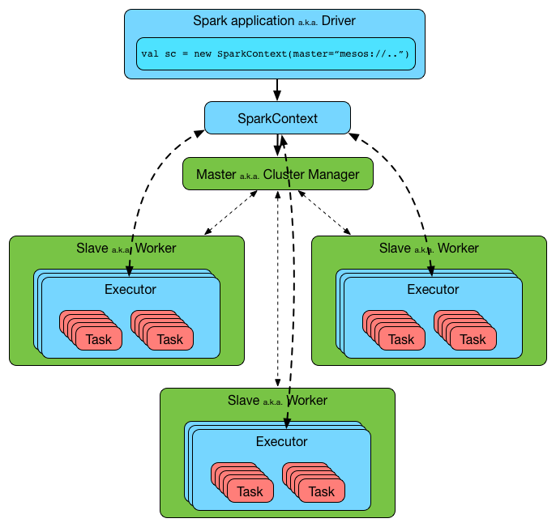
Apache Spark Components and Architecture
The driver and the executors run in their own Java processes. You can run them all on the same (horizontal cluster) or separate machines (vertical cluster) or in a mixed machine configuration.

Slide 10
Apache Spark Components and Architecture
Following are most important takeaways of the architecture:
Each application gets its own executor processes, which remains in memory up to the duration of the complete application and run tasks in multiple threads. This means each application is independent from the other, on both the scheduling side since each driver schedules its own tasks and executor side as tasks from different applications run in different JVMs.
Spark is independent of cluster managers that implies, it can be coupled with any cluster manager and then leverage that cluster.
Because the driver schedules tasks on the cluster, it should be run as close to the worker nodes as possible.

Slide 11
Spark RDD
RDDs can contain any types of objects, including user-defined classes.
An RDD is simply a capsulation around a very large dataset. In Spark all work is expressed as either creating new RDDs, transforming existing RDDs, or calling operations on RDDs to compute a result.
Under the hood, Spark will automatically distribute the data contained in RDDs across your cluster and parallelize the operations you perform on them.

Slide 12
Spark RDD
Resilient Distributed Datasets
Dataset = Collection of Data (Strings, Integers, Objects, etc)
Declared like a Collection (ie: JavaRDD<String> for an RDD of Strings)
RDD encapsulate large datasets
Spark automatically distributes data contained in RDDs across cluster
RDD Operations
Transformations – Apply a function to each “row” of an RDD, returns new RDD
Actions – Compute a result based on data in an RDD
General Spark Workflow
Generate RDDs from data
Apply transformations
Get desired results from actions

Slide 13
Creating Spark RDDs
Take an existing collection in your program and pass it to SparkContext’s parallelize method
Initialize JavaSparkContext, using a SparkConf object
Use JavaSparkContext to generate RDD in one of two ways:
Transform a collection into an RDD (used for testing purposes)
Generate an RDD from a file
Note: Unless otherwise specified, path starts at project root
Note: External Data can be stored on the network (ie: on the HDFS Server)

Slide 14
What can we do with RDDs
RDDs use for following two purposes.
Transformations
Action

Slide 15
Transformations
Transformations
Transformations is a function that produces new RDD from the existing RDDs. It takes RDD as input and produces one or more RDD as output. Each time it creates new RDD when we apply any transformation
How the data a changed into a usable form
Return a new RDD with the transformation applied
One of the most common transformation is filter which will return a new RDD with a subset of the data in the original RDD.
E.g: In the Following code we used filter to create a new RDDs holding just strings that contain the word “Friday”
Example uses:
Reformat data
map(), filter(), union(dataset), Intersection(), distinct(), groupByKey() and etc

Slide 16
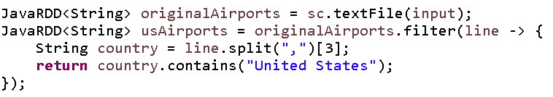
Example Transformations (Filter())
JavaRDD.filter()
Returns a JavaRDD containing elements based on given filter
Takes a lambda, which must return a Boolean
Returned Boolean determines whether or not element in kept in new RDD
Example:
Explanation:
Creates an RDD based on a given File
Filters that RDD to only include entries where the 4th column is “United States”
Notes:
Takes in a function and returns an RDD formed by selecting those
elements which pass the filter function.
• Can be used to remove some invalid rows to clean up the input RDD
or just get a subset of the input RDD based on the filter function.

Slide 17
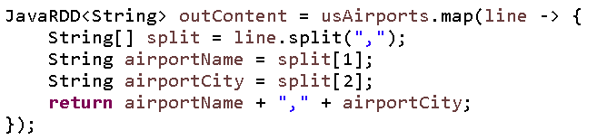
Example Transformations (map())
JavaRDD.map()
Returns a JavaRDD containing newly mapped elements
Elements are mapped based on given lambda
Lambda must return a single line of data, in the same format as the generic
ie: Lambda returns a String, RDD declared as JavaRDD<String>
Example:
Explanation
Modifies the RDD from the previous slide
Outputs a new RDD with only the 2nd and 3rd columns
Notes:
Takes in a function and passes each element in the input RDD through the function, with the result of the function being the new value of each element in the resulting RDD.
• It can be used to make HTTP requests to each URL in our input RDD, or it can be used to calculate the square root of each number.

Slide 18
Actions
How the data is used.
Transformations create RDDs from each other, but when we want to work with the actual dataset, at that point action is performed. When the action is triggered after the result, new RDD is not formed like transformation. Thus, Actions are Spark RDD operations that give non-RDD values. The values of action are stored to drivers or to the external storage system. It brings laziness of RDD into motion.
An action is one of the ways of sending data from Executer to the driver. Executors are agents that are responsible for executing a task. While the driver is a JVM process that coordinates workers and execution of the task. Some of the actions of Spark are: count(), collect(), take(n), top, countByValue(), reduce(), fold(), aggregate(), foreach()
When called, will force all transformations to be evaluated
Example uses:
Performing a calculation on data and returning a final value
Saving (persisting) data to an external storage system

Slide 19
Hands-On Activity
Download this dataset about cars
Note: This dataset is separated by semi-colons (;) not commas (,)
Create an RDD using this dataset
Filter for all cars made in the US (9th column)
Map the dataset to only have Car Name and MPG (1st and 2nd columns)
Print your results to the console!
yourRDD.foreach(println)

Slide 20
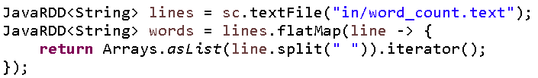
Transformations flatMap()
JavaRDD.flatMap()
Returns a JavaRDD containing newly mapped elements
Like map, but given lambda returns an iterator
flatMap usually used when you want to get a single list, rather than a table
Example:
Explanation
Takes in an RDD of lines (ie: Tweets from Twitter)
Transforms into an RDD of individual words

Slide 21
Transformations sample()
The sample operation will create a random sample from an RDD.
Useful for testing purpose.
JavaRDD.sample()
Returns a JavaRDD containing a sample of the previous RDD
Takes in a Boolean and a Double
Boolean is whether or not sample should be done With Replacement
Concept of replacement explained here
Double is the size of the sample to be taken
0.1 = 10%
0.0592 = 5.92%
Example:

Slide 22
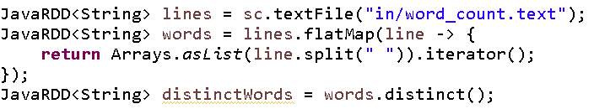
Transformations distinct()
JavaRDD.distinct()
Returns a JavaRDD containing only the distinct elements of the previous RDD
Takes in no parameters
Should be used after most filtering is done, as it requires a lot of resources
Example:

Slide 23
Transformations (Multiple RDDs)
Set operations which are performed on two RDDs and produce one resulting RDD:
– union
– intersection
– subtract
– cartesian product

Slide 24
Transformations (Multiple RDDs)
JavaRDD.union()
Returns JavaRDD containing all data from two RDDs
Takes in second RDD as parameter
Can contain duplicates
Example:

Slide 25
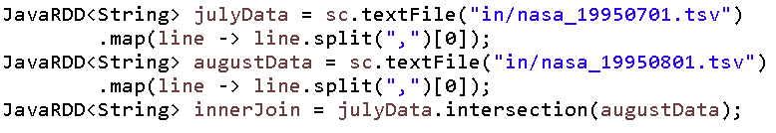
Transformations (Multiple RDDs)
JavaRDD.intersection()
Returns only the data contained in both of two RDDs
Think of it like an INNER JOIN
Takes in second RDD as parameter
Removes all duplicates from given RDDs
Example:

Slide 26
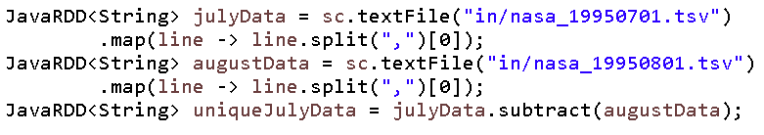
Transformations (Multiple RDDs)
JavaRDD.subtract()
Returns an RDD containing data only present in the first of two RDDs
ie: firstRDD.subtract(secondRDD)
Result only contains data from firstRDD
Example:

Slide 27
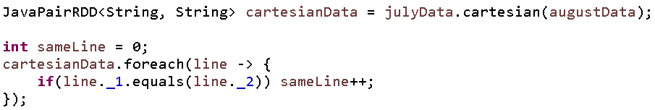
Transformations (Multiple RDDs)
JavaRDD.cartesian()
Cartesian transformation can be very handy if we want to compare the similarity between all possible pairs.
Returns a JavaPairRDD Cartesian product of two RDDs
Think of CROSS JOIN
Good for comparing each line of the first RDD to each line of the second
Example:

Slide 28

Questions ?
28
Notes:
Address any questions students have from reviewing THIS MODULE, having JUST SEEN IT PRESENTED.

Slide 29
Actions
JavaRDD.collect()
Returns a List of the same type as the RDD
List contains all elements in the RDD
Useful when
Spark has filtered RDD to a very small size
You want to deal with data locally
Ex: Used when Unit Testing to compare the contents of RDD to expected values
NOTE: Data must be small enough to fit in memory (RAM) on your machine

Slide 30
Actions
JavaRDD.count()
Returns an Integer, which is the count of the elements (rows)
Relatively quick, low memory usage
JavaRDD.countByValue()
Returns a map of unique values to how many times that value occurs
Useful when:
RDD has duplicate rows (especially as a result of using flatMap())
You want to count how many times duplicates appear
Ex: Getting the most common words from a series of tweets

Slide 31
Actions
JavaRDD.take()
Returns N elements of an RDD
Takes in an integer, N, to specify how many elements
Remember that Hadoop can work on multiple machines at once
Elements may not be returned in expected order
Returned collection may be biased due to factors such as connectivity
Useful for using data locally without worrying about memory

Slide 32
Actions
JavaRDD.saveAsTextFile()
Void method
Takes in a String, the destination for where the file should be saved
Writes the data in the given RDD to the specified destination
Can be used to write data to:
Distributed systems like Hadoop
Remote servers on your network
Cloud storage like AWS S3
Cloud servers like AWS EC2
The local filesystem

Slide 33
Actions
JavaRDD.reduce()
Returns a single value, the result of applying the given function to all elements
Takes in a lambda expression:
Uses 2 elements from the RDD
Returns a single new element based on the operations used
The lambda expression will be applied until only 1 element remains
Generally used to perform aggregations

Slide 34
Actions
JavaRDD.reduce()
Example: Summing all entries in RDD
Example: Obtaining product of all entries in RDD
Example: Obtaining average of all entries in RDD

Slide 35
Questions ?
35
Notes:
Address any questions students have from reviewing THIS MODULE, having JUST SEEN IT PRESENTED.

Slide 36
Summary Review
Introduction to Spark
Large-scale data processor
Spark Features and Components
10-100x faster than Hadoop MapReduce
Driver (Application) can run workers on multiple nodes simultaneously
Handles data both in memory and on cluster
Introduction to Spark RDD
RDD = Resilient Distributed Datasets
Resilient = Immutable
Distributed = Can exist on memory across nodes
Transformations and Actions
Transformations change the format and reduce the quantity of data
Actions process data and return results

Slide 37

End of Module
37
Notes:
I’ve included several “End” Signs. Mix them up as you build your deck (to keep it from getting boring).

