Slide 1

Spark SQL
Spark introduces a programming module for structured data processing called Spark SQL.
Week 13

Slide 2
Overview
Introduction to Spark SQL
Important Spark SQL Concepts
Spark SQL in Action

Slide 3
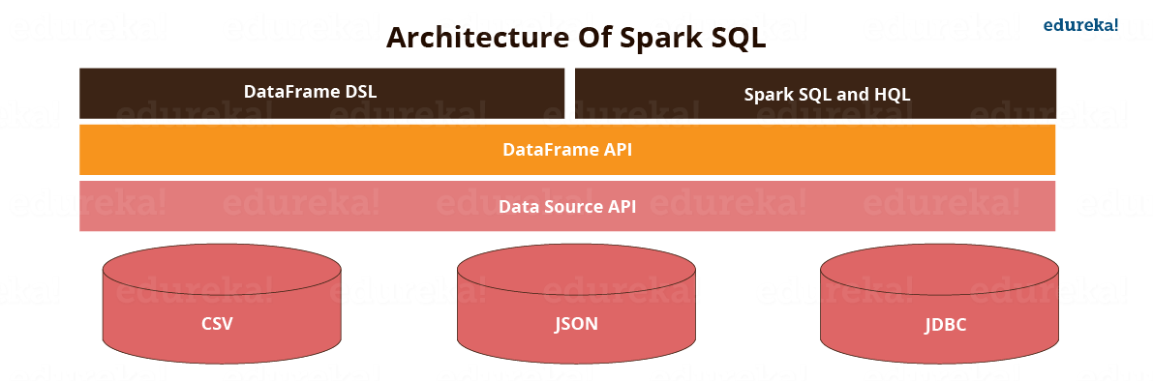
Spark SQL - Introduction
Spark SQL is a new module in Spark which integrates relational processing with Spark’s functional programming API. It supports querying data either via SQL or via the Hive Query Language. For those of you familiar with RDBMS, Spark SQL will be an easy transition from your earlier tools where you can extend the boundaries of traditional relational data processing.
Spark SQL integrates relational processing with Spark’s functional programming. Further, it provides support for various data sources and makes it possible to weave SQL queries with code transformations thus resulting in a very powerful tool.
The following are the four libraries of Spark SQL.
Data Source API
Data Frame API
Interpreter & Optimizer
SQL Service

Slide 4
Spark SQL - Introduction
Spark SQL has the following four libraries which are used to interact with relational and procedural processing:
1: Data Source API (Application Programming Interface):
This is a universal API for loading and storing structured data.
It has built in support for Hive, Avro, JSON, JDBC, Parquet, etc.
Supports third party integration through Spark packages
Support for smart sources.

Slide 5
Spark SQL - Introduction
2: DataFrame API:
A DataFrame is a distributed collection of data organized into named column. It is equivalent to a relational table in SQL used for storing data into tables.
It is a Data Abstraction and Domain Specific Language (DSL) applicable on structure and semi structured data.
DataFrame API is distributed collection of data in the form of named column and row.
It is lazily evaluated like Apache Spark Transformations and can be accessed through SQL Context and Hive Context.
It processes the data in the size of Kilobytes to Petabytes on a single-node cluster to multi-node clusters.
Supports different data formats (Avro, CSV, Elastic Search and Cassandra) and storage systems (HDFS, HIVE Tables, MySQL, etc.).
Can be easily integrated with all Big Data tools and frameworks via Spark-Core.
Provides API for Python, Java, Scala, and R Programming.

Slide 6
Spark SQL - Introduction
3: SQL Interpreter And Optimizer:
SQL Interpreter and Optimizer is based on functional programming constructed in Scala.
It is the newest and most technically evolved component of SparkSQL.
It provides a general framework for transforming trees, which is used to perform analysis/evaluation, optimization, planning, and run time code spawning.
This supports cost based optimization (run time and resource utilization is termed as cost) and rule based optimization, making queries run much faster than their RDD (Resilient Distributed Dataset) counterparts.
e.g. Catalyst is a modular library which is made as a rule based system. Each rule in framework focuses on the distinct optimization.

Slide 7
Spark SQL - Introduction
4: SQL Service:
SQL Service is the entry point for working along structured data in Spark. It allows the creation of Data Frame objects as well as the execution of SQL queries.

Slide 8
Spark SQL - Introduction
Structured data is any data that has a schema — that is, a known set of fields for each record.
Spark SQL provides a dataset abstraction that simplifies working with structured datasets. Dataset is similar to tables in a relational database.
More and more Spark workflow is moving towards Spark SQL.
Dataset has a natural schema, and this lets Spark store data in a more efficient manner and can run SQL queries on it using actual SQL commands.
Spark introduces a programming module for structured data processing called Spark SQL. It provides a programming abstraction called DataFrame and can act as distributed SQL query engine.

Slide 9
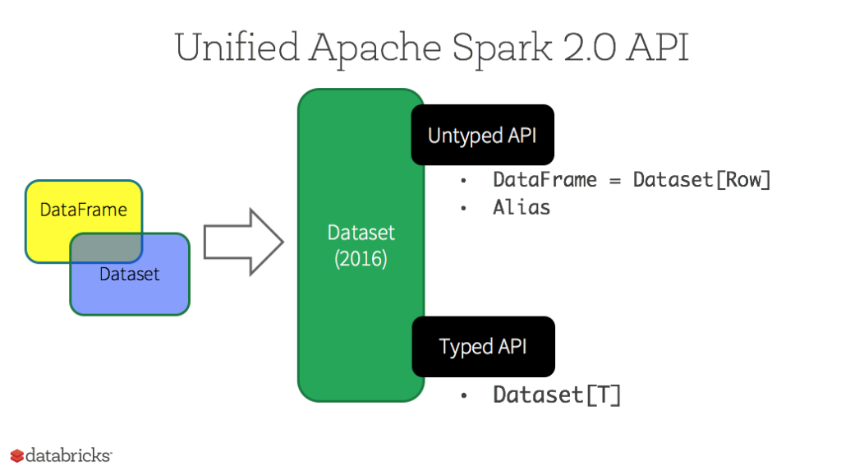
Important Spark SQL Concept
Dataset
DataFrame

Slide 10
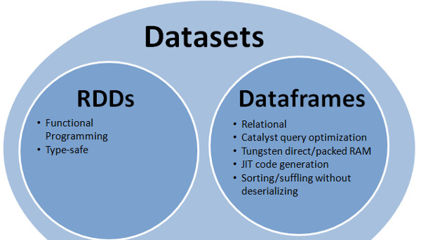
Datasets
Dataset (JavaDataset<T> )
The Dataset API, released since Spark 1.6, it provides:
– the familiar object-oriented programming style
– compile-time type safety of the RDD API
– the benefits of leveraging schema to work with structured data
A Dataset is a strongly typed collection of domain-specific objects that can be transformed in parallel using functional or relational operations. Each Dataset also has an untyped view called a DataFrame, which is a Dataset of Row.
A dataset is a set of structured data, not necessarily a row but it could be of a particular type.
Java and Spark will know the type of the data in a dataset at compile time.
A Dataset is a distributed collection of data. A Dataset can be constructed from JVM objects and then manipulated using functional transformations (map, flatMap, filter, etc.). The Dataset API is available in Scala and Java.

Slide 11
Datasets Explanation
Operations available on Datasets are divided into transformations and actions. Transformations are the ones that produce new Datasets, and actions are the ones that trigger computation and return results. Example transformations include map, filter, select, and aggregate (groupBy). Example actions count, show, or writing data out to file systems.
Datasets are "lazy", i.e. computations are only triggered when an action is invoked. Internally, a Dataset represents a logical plan that describes the computation required to produce the data. When an action is invoked, Spark's query optimizer optimizes the logical plan and generates a physical plan for efficient execution in a parallel and distributed manner. To explore the logical plan as well as optimized physical plan, use the explain function.
To efficiently support domain-specific objects, an Encoder is required. The encoder maps the domain specific type T to Spark's internal type system. For example, given a class Person with two fields, name (string) and age (int), an encoder is used to tell Spark to generate code at runtime to serialize the Personobject into a binary structure. This binary structure often has much lower memory footprint as well as are optimized for efficiency in data processing (e.g. in a columnar format). To understand the internal binary representation for data, use the schema function.
There are typically two ways to create a Dataset. The most common way is by pointing Spark to some files on storage systems, using the read function available on a SparkSession.
Dataset<Person> people = spark.read().parquet("...").as(Encoders.bean(Person.class)); // Java

Slide 12
Datasets Explanation
Datasets can also be created through transformations available on existing Datasets. For example, the following creates a new Dataset by applying a filter on the existing one:
Dataset<String> names = people.map((Person p) -> p.name, Encoders.STRING));
Dataset operations can also be untyped, through various domain-specific-language (DSL) functions defined in: Dataset (this class), Column, and functions. These operations are very similar to the operations available in the data frame abstraction in Java, R or Python.
To select a column from the Dataset, use apply method col in Java.
Column ageCol = people.col("age");
Note that the Column type can also be manipulated through its various functions. For instance the following creates a new column that increases everybody's age by
people.col("age").plus(10);

Slide 13
Datasets Explanation
A more concrete example in Java
To create Dataset<Row> using SparkSession
Dataset<Row> people = spark.read().parquet("...");
Dataset<Row> department = spark.read().parquet("...");
people.filter("age".gt(30))
.join(department, people.col("deptId") .equalTo(department("id")))
.groupBy(department.col("name"), "gender")
.agg(avg(people.col("salary")), max(people.col("age")));

Slide 14
DataFrame
Spark SQL introduces a tabular data abstraction called DataFrame since Spark 1.3
A DataFrame is a data abstraction or a domain-specific language for working with structured and semi-structured data.
A DataFrame is a Dataset organized into named columns. It is conceptually equivalent to a table in a relational database or a data frame in R/Python, but with richer optimizations under the hood. DataFrames can be constructed from a wide array of sources such as: structured data files, tables in Hive, external databases or existing RDDs.
It uses the immutable, in-memory, resilient, distributed and parallel capabilities of RDD, and applies a structure called schema to the data, allowing Spark to manage the schema and only pass data between nodes, in a much more efficient way than using java serialization.
Unlike an RDD, data is organized into named columns, like a table in a relational database.
Spark SQL Also provide new operation not available RDDs such as run SQL queries
A DataFrame is a distributed collection of data, which is organized into named columns. Conceptually, it is equivalent to relational tables with good optimization techniques.
A DataFrame can be constructed from an array of different sources such as Hive tables, Structured Data files, external databases, or existing RDDs. This API was designed for modern Big Data and data science applications taking inspiration from DataFrame in R Programming and Pandas in Python

Slide 15
Features of DataFrame
Ability to process the data in the size of Kilobytes to Petabytes on a single node cluster to large cluster.
Supports different data formats (Avro, csv, elastic search, and Cassandra) and storage systems (HDFS, HIVE tables, mysql, etc).
State of art optimization and code generation through the Spark SQL Catalyst optimizer (tree transformation framework).
Can be easily integrated with all Big Data tools and frameworks via Spark-Core.
Provides API for Python, Java, Scala, and R Programming.

Slide 16
When should I use DataFrames or Datasets?
Starting in Spark 2.0, DataFrame APIs merge with Dataset APIs.
Dataset takes on two distinct APIs characteristics: a strongly-typed API and an untyped API.
Consider DataFrame as untyped view of a Dataset, which is a Dataset of Row where a Row is a generic untyped JVM object.
Dataset, by contrast, is a collection of strongly-typed JVM objects.
Conceptually, consider DataFrame as an alias for a collection of generic objects Dataset[Row], where a Row is a generic untyped JVM object. Dataset, by contrast, is a collection of strongly-typed JVM objects, dictated by a case class you define in Scala or a class in Java.
If you want rich semantics, high-level abstractions, and domain specific APIs, use DataFrame or Dataset.
If your processing demands high-level expressions, filters, maps, aggregation, averages, sum, SQL queries, columnar access and use of lambda functions on semi-structured data, use DataFrame or Dataset.

Slide 17

Questions?
17
Notes:
This slide is meant to address any questions students had from reviewing the UPCOMING slides, having reviewed them the PREVIOUS NIGHT.
DO NOT answer the questions at this time, just make a mental note of them, knowing that those slides may take longer.
Hopefully, however, without questions from the review, all other slides can proceed quickly.

Slide 18


Spark SQL in Action
Reading Data
Start by creating a SparkSession (very similar to SparkConf)
Use the SparkSession to create a DataFrameReader
Set up any additional options in the DataFrameReader
In this case, we’re specifying that this file will have a header line
Use the DataFrameReader to read a CSV file and save it to memory as a DataSet

Slide 19
Spark SQL in Action
Selecting and Printing Data
Dataset.select()
Takes in a vararg of Column objects
This means any number of Columns can be passed to this method
Column can be created with the col function from org.apache.spark.sql.functions
Takes in the column name (header) as argument
Returns a new Dataset containing only the specified columns

Slide 20
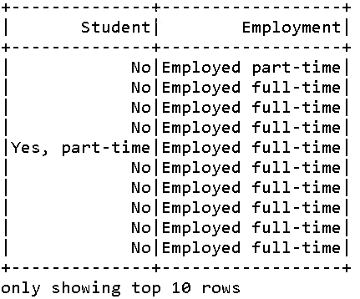
Spark SQL in Action
Selecting and Printing Data
Dataset.show()
Takes in an Integer, the number of rows to be displayed
If no argument is given, 20 rows will be displayed
Output:

Slide 21
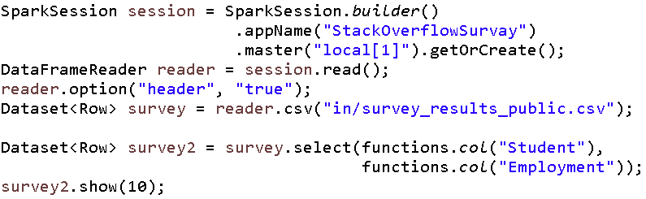
Spark SQL in Action
Code so far:

Slide 22
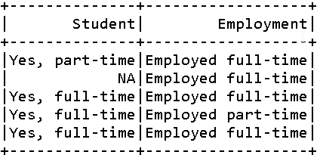
Spark SQL in Action
Filtering Data
DataSet.filter()
Takes in a single Column object
A filtering method from the Column object should be applied to itself
equalTo() – Filters where column entry equals given object
notEqual() – Opposite of equalTo()
MANY more methods are available
Output:

Slide 23
Spark SQL in Action
Filtering Data
Note that data can also be filtered in numeric ways
Ex. Salaries greater than 70,000
Ex. Salaries less than or equal to 80,000

Slide 24
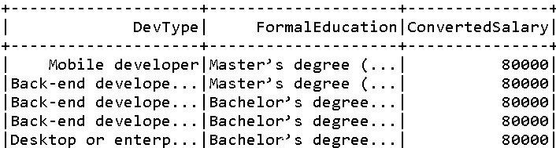
Spark SQL in Action
Sorting Data
Dataset.sort()
Takes in a vararg of Column objects
Each Column object should have a sorting method applied to itself
Column.desc() – Orders column in descending order
Column.asc() – Orders column in ascending order
Columns will be sorted in the order they were input
Output:

Slide 25
Spark SQL in Action
Grouping Data
Dataset.groupBy()
Returns a RelationalGroupedDataset Object
Takes in the Column you wish to group by
RelationalGroupedDataset
Contains methods to perform aggregate functions
RelationalGroupedDataset.count()
RelationalGroupedDataset.sum(String… colNames)
RelationalGroupedDataset.avg(String… colNames)
All aggregate functions return a Dataset

Slide 26
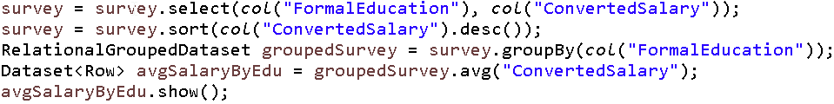
Spark SQL in Action
Grouping Data
Getting the average salary for different levels of FormalEducation
PROBLEM!!!

Slide 27
Spark SQL in Action
Changing Column Data Type
Dataset.withColumn()
Takes in a String, which is the Column’s name
Takes in a Column, with the Column.cast() method applied to itself
Takes in a String, the name of the datatype being casted to
Will cast all column data to that type
Any data unable to convert will not be included
Method will add or replace the specified column to the returned Dataset

Slide 28
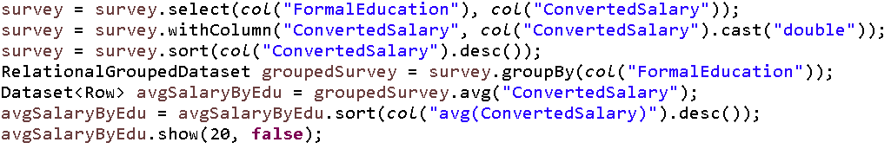
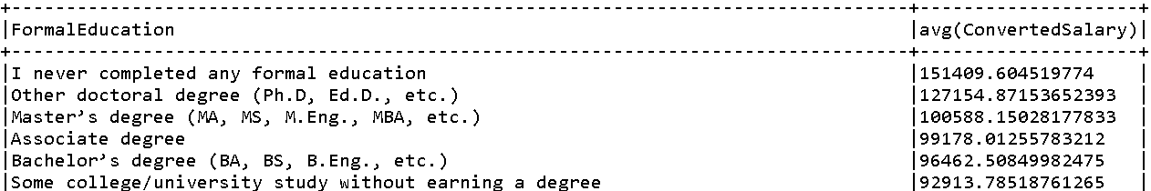
Spark SQL in Action
Grouping Data
Getting the average salary for different levels of FormalEducation
Output

Slide 29
Questions?
29
Notes:
This slide is meant to address any questions students had from reviewing the UPCOMING slides, having reviewed them the PREVIOUS NIGHT.
DO NOT answer the questions at this time, just make a mental note of them, knowing that those slides may take longer.
Hopefully, however, without questions from the review, all other slides can proceed quickly.

Slide 30
Hands-On Activity
Download the CSV dataset of the StackOverflow 2018 survey
Using Spark SQL, create datasets which filter for the following:
Average ConvertedSalary by JobSatisfaction
Top 5 countries by number of participants

Slide 31
Spark SQL in Action
JOINs with Spark SQL
Dataset.join()
First parameter: Dataset to be joined with
Second parameter: Column to join on
Specified with functions.col() method
Third parameter: String representing the type of join
“inner” – Joins where values match for both fields
“left_outer” – Same as inner, but includes all of the original Dataset
“right_outer” – Same as inner, but includes all of the given Dataset (first parameter)
“full” – Includes all data from both Datasets

Slide 32
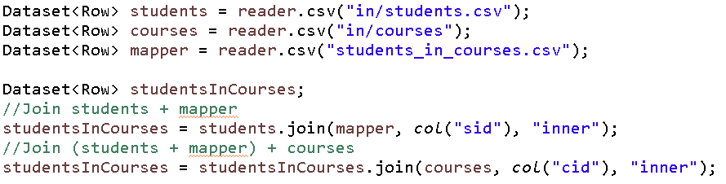
Spark SQL in Action
JOINs with Spark SQL
Example:

Slide 33
Summary Review
Introduction to Spark SQL
Can use Hive, SQL Database, or Files as Data Source
Many formats supported
Catalyst automatically optimizes Spark SQL
Important Spark SQL Concepts
Dataset & Dataframe store data for Spark SQL
Dataset can be strongly typed (ie: Dataset<Person>)
Doesn’t have to be (ie: Dataset<Row>)
Dataframe cannot be strongly typed (only allows Dataframe<Row>)
In Spark 2.0, Dataset API merged with Dataframe API

Slide 34
Summary Review
Spark SQL in Action
Individual columns specified with functions.col()
Filter data with Dataset.filter(Column.filteringMethod())
Aggregate functions can only be performed on RelationalGroupedDataset
Create with Dataset.groupBy(Column)

Slide 35
References
https://spark.apache.org/docs/2.1.0/api/java/org/apache/spark/sql/Dataset.htm
https://databricks.com/blog/2016/07/14/a-tale-of-three-apache-spark-apis-rdds-dataframes-and-datasets.html l
https://www.youtube.com/watch?v=QaoJNXW6SQo
35
Notes:
A “Mash-Up” between the Summary Slide (Notes on the Skill) and the Objective of the “Hands-On” exercise.
Leave this slide up until the end of the “Hands-On” assignment.
If it’s a brief “Hands-On”, stay in the room and offer support. Work 1 side of the room while your TA works the other.
If the “Hands-On” will take longer than an hour, please leave the room and let your TA1 & TA2 handle the Exercise.
(They can accumulate, summarize, and likely restate the question better than the confused students they were helping).
MONITOR YOUR TIME! STAY ON SCHEDULE! When about 50% of the class thinks they “Have It”, have a student share his screen to show/present his solution.
(Every student will need this skill.. Best that they learn it now).
Once Presented, leave the working code on the screen. Students that are close can modify their code. Others should Rip & Replace to match what’s on the screen.
Let them know how long they have to get their code functional (MAX 10 minutes).
We DO NOT want to move to the next module until everyone has this module working!! (Otherwise, they’ll never get this piece, or ignore the next one while working on this one).

Slide 36

End of Module
36
Notes:
I’ve included several “End” Signs. Mix them up as you build your deck (to keep it from getting boring).

