Slide 1


DIGITAL
MEDIA REPORT

Slide 2
YOUTUBE

Slide 3
Report For: 01 April 2025
SENTIMENT ANALYSIS - YOUTUBE
94% positive narratives reflecting trust and admiration, 5% neutral mentions revolving around technical seminars, and 1% miscellaneous observations.
27
4
3
20
Highly positive narratives celebrating professional achievements, influential mentorship sessions, and an inspiring journey from educator to Deputy Vice-Chancellor.

Slide 4
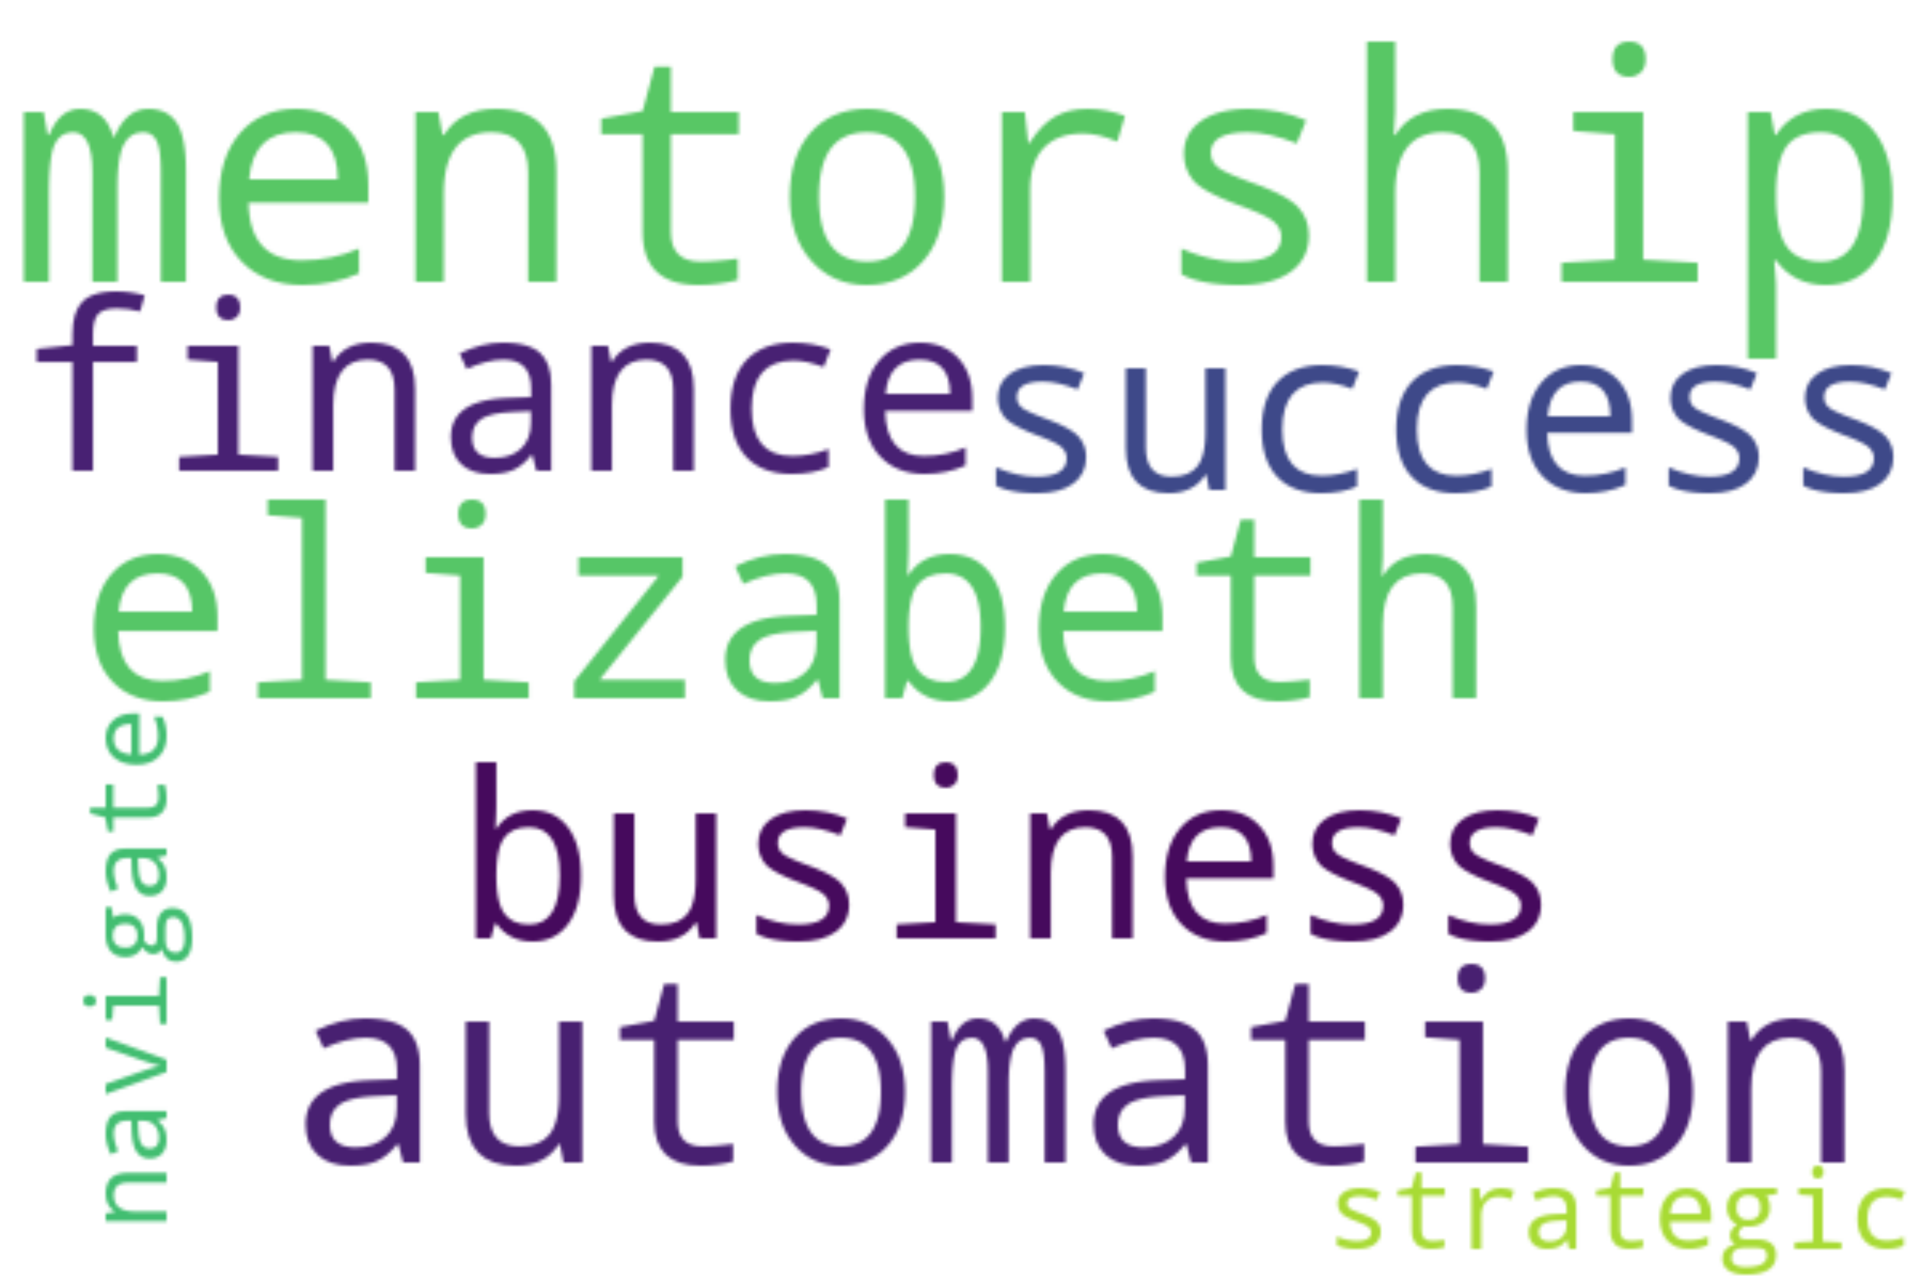
Report For: 01 April 2025
TRENDING TOPICS AND KEYWORDS - YOUTUBE
Trending videos feature transformative seminars, rural-to-global mentoring impacts, proactive AI shifts, and economically charged panel symposia aligned with empowering professions like finance and accounting.

Slide 5









Report For: 01 April 2025
TOP INFLUENCERS - YOUTUBE
Citizen TV Kenya
Joshua Aura
ZionPearl Global Network
@/@kenyacitizentv
@/@joshuaaura4340
@/@ZionPearlGlobalNetwork
followers
followers
followers
Icpak Kenya
Women summit online
RCM ONLINE COLLEGE
@/@icpakkenya3468
@/@womensummitonline4704
@/@rcmonlinecollege3043
followers
followers
followers
Susan Wanjiku
RADIO MARIA KENYA
DMMEDIA OFFICIAL
@/@susan.wanjiku_
@/@RadioMariaKenya
@/@DMMEDIA-OFFICIAL
followers
followers
followers

Slide 6
LINKEDIN

Slide 7
Report For: 01 April 2025
VOLUME OF MENTIONS - LINKEDIN
Mentions fluctuate around highlighting KASNEB leadership, advancing ICPAK action plans, women empowerment initiatives, AI-driven finance evolutions, and collaborative professional growth.
Mentions emphasize discussions hosted by Kalunda on professional development, her new position as KASNEB Chair, and her impact in shaping accounting practices globally.

Slide 8
Report For: 01 April 2025
SENTIMENT ANALYSIS - LINKEDIN
88% positive sentiments focusing on leadership growth and mentorship, 9% neutral sentiments on technical shifts like AI's impact, and 3% minor neutral discussion threads.
100
86
4
10
Majority positive sentiments reflect themes of leadership, mentorship, empowerment, and impactful transitions within accounting and finance professions amid technological advancements.

Slide 9
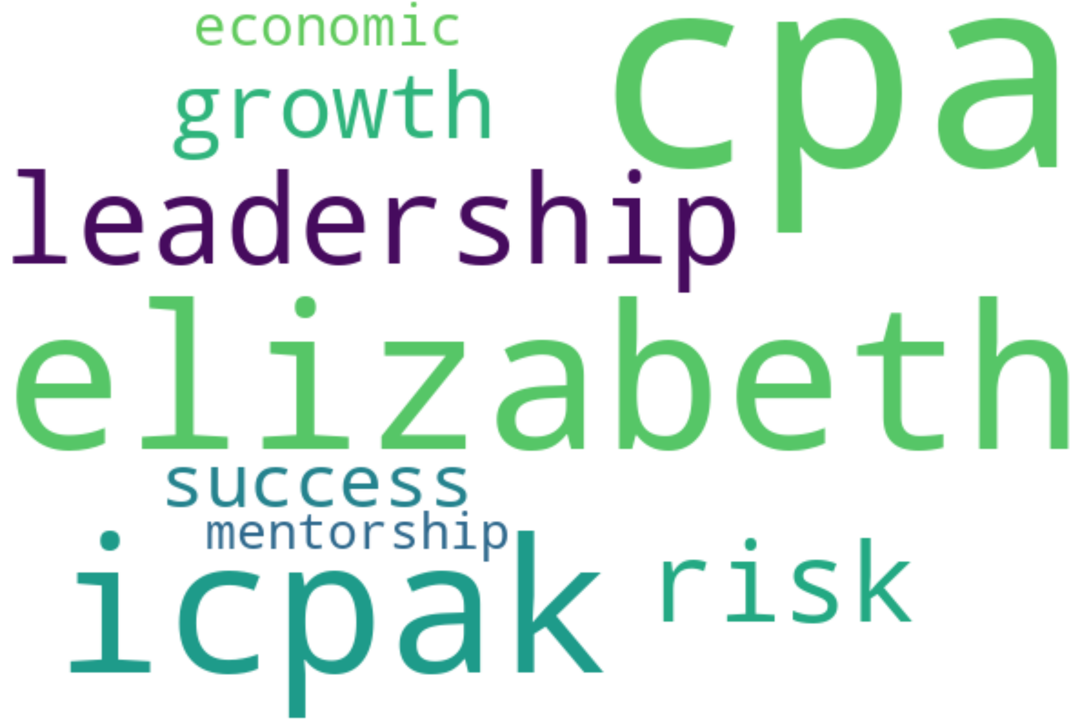
Report For: 01 April 2025
TRENDING TOPICS AND KEYWORDS - LINKEDIN
Trending topics involve risk-taking strategies, women’s empowerment conferences, advancements in financial reporting, AI in accounting, and mentoring the next generation of finance professionals.

Slide 10



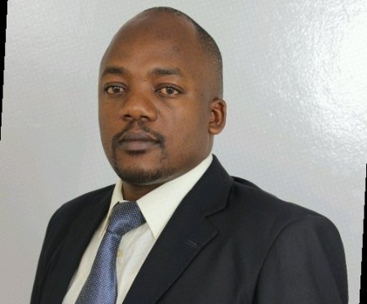

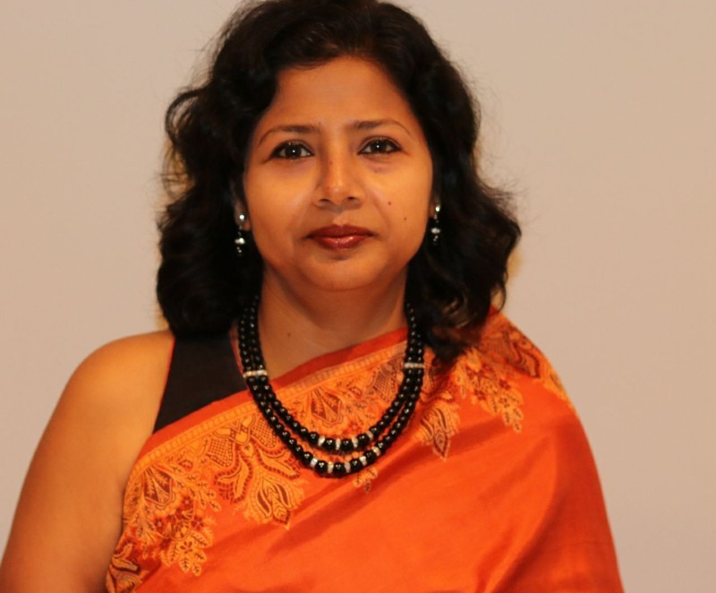
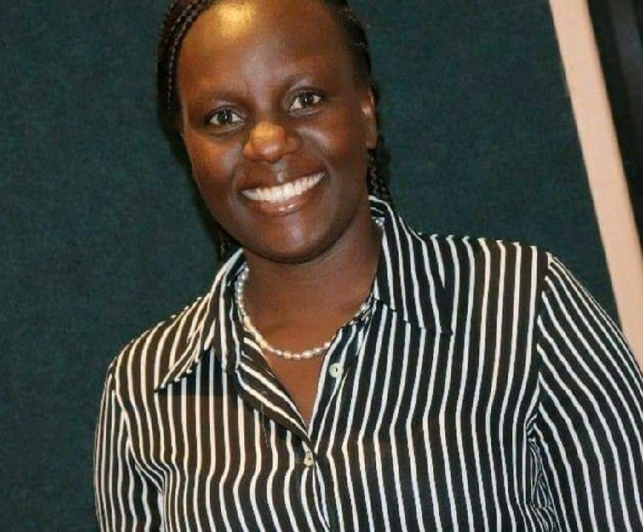
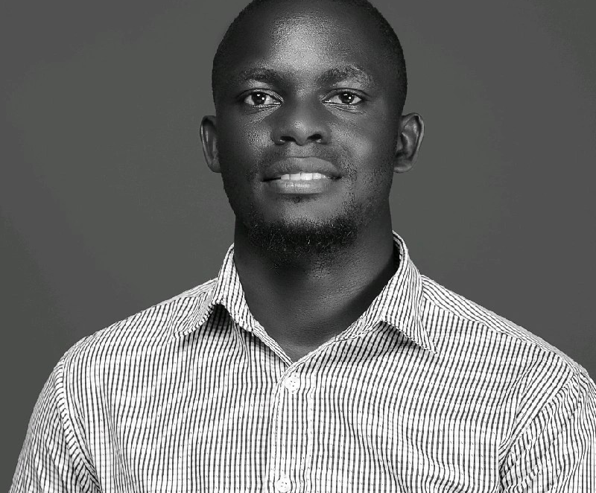
Report For: 01 April 2025
TOP INFLUENCERS - LINKEDIN
Prof. CPA. Elizabeth Kalunda M.
Association of Women Accountants of Kenya - AWAK
ICPAK (Institute of Certified Public Accountants of Kenya)
@prof-cpa-elizabeth-kalunda-m-1b722235
@awak-kenya
@icpakkenya
followers
followers
followers
ZionPearl Publishers
CPA Umeme Steve
Start Up Shujaa
@zionpearl-publishers
@umemesteve
@start-up-shujaa
followers
followers
followers
Ananya Pal
Priscilla Kerebi
CPA Dauglas Muhati, MKIM, MIHRM
@ananya-d-pal
@priscilla-kerebi-18a40558
@daggy
followers
followers
followers

Slide 11
TWITTER

Slide 12
Report For: 01 April 2025
VOLUME OF MENTIONS - TWITTER
Mentions range frequently around debates on housing, judiciary governance, political integrity, and evolving public leadership initiatives focused on reforms.
The volume data hints heavily at Kenya's socio-economic discussions, key governance roles, and evolving agendas involving public trust and leadership accountability.

Slide 13
Report For: 01 April 2025
SENTIMENT ANALYSIS - TWITTER
41% positive sentiments, 39% critical/emotional reactions on governance issues, and 20% neutral mentions tied to economic and judiciary discussions.
24
14
7
3
Mixed sentiments emerge with critical engagements on housing levy debates and emotional reactions to governance, suggesting vigorous conversations about economy, politics, and societal challenges.

Slide 14
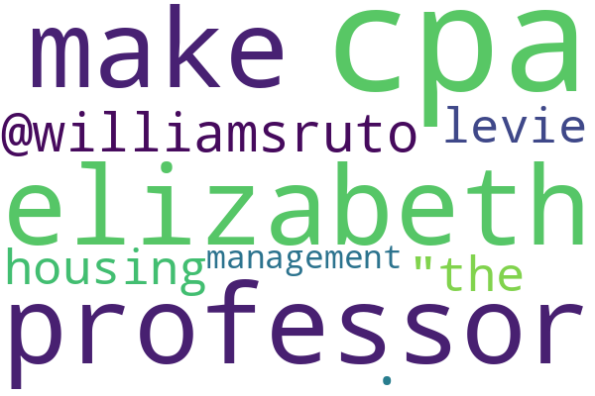
Report For: 01 April 2025
TRENDING TOPICS AND KEYWORDS - TWITTER
Trending conversations revolve around CPA Kalunda’s policy insights, governance reflections on housing levies, political dynamics, and accountability narratives attracting wide public interest.

Slide 15


Report For: 01 April 2025
TOP INFLUENCERS - TWITTER
ICPAK
VisionONE Access
@ICPAK_Kenya
@visiononeaccess
followers
followers

Slide 16
TIKTOK

Slide 17
Report For: 01 April 2025
VOLUME OF MENTIONS - TIKTOK
Volume mentions highlight steady interest in motivational talks, SDA church teachings, mentorship sessions, and minor controversy-driven moments from public discussions.
Volumes include varied mentions on personal reflections, community insights, motivational initiatives, and minor controversies surrounding certain policy-driven conversations.

Slide 18
Report For: 01 April 2025
SENTIMENT ANALYSIS - TIKTOK
81% positive sentiments with themes of growth and mentorship, 12% neutral sentiments reflecting emotionally charged conversations, and 7% minor negative trends stemming from debated statements.
100
17
7
76
Positive sentiments dominate, with themes of inspiration, personal growth, mentorship, and leadership; scattered negative sentiments stem from topical controversies or provocative statements.

Slide 19
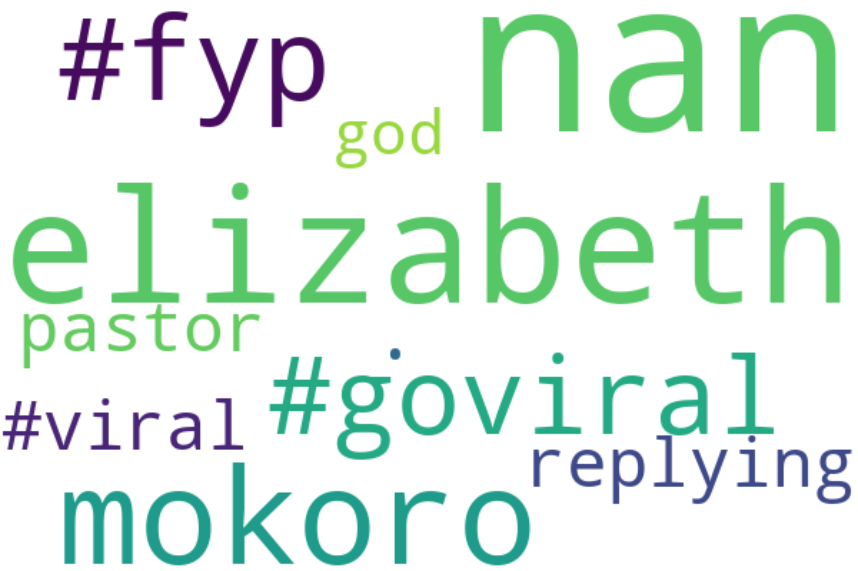
Report For: 01 April 2025
TRENDING TOPICS AND KEYWORDS - TIKTOK
Trending themes capture motivational clips, mentorship advice, SDA talks, lifestyle hacks, and family connection sermons, resonating across communities seeking inspiration or professional advice.

Slide 20
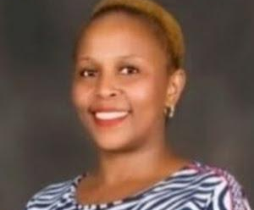

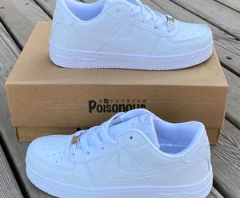
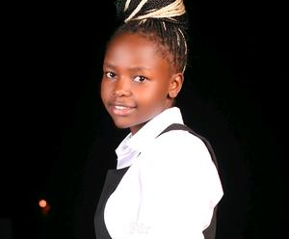
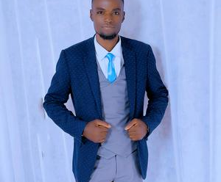


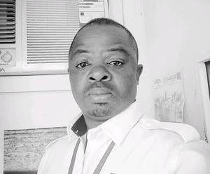

Report For: 01 April 2025
TOP INFLUENCERS - TIKTOK
@lizkalunda
@getthepointmedia
@phyllismotangi
followers
followers
followers
@milla2641
@levisobare5
@mc_adektatu
followers
followers
followers
@brevictwine
@sir.niagah.com
@elizabethkaundula391
followers
followers
followers

Slide 21
FACEBOOK

Slide 22
Report For: 01 April 2025
VOLUME OF MENTIONS - FACEBOOK
Steady volume centered around professional achievements like ICPAK updates, East African finance recognition, leadership forums, mentorship programs, and academic initiatives.
Mentions center on her leadership in ICPAK, milestones in her career, and her impactful role as Deputy Vice Chancellor in finance sponsorships and events.

Slide 23
Report For: 01 April 2025
SENTIMENT ANALYSIS - FACEBOOK
76% positive sentiments reflecting leadership, 20% neutral sentiments related to events like memorials, and 4% minor neutral/critical mentions.
17
14
0
3
Predominantly positive sentiments highlight Elizabeth Kalunda’s achievements, leadership roles, and recognitions within finance and accounting, alongside some neutral mentions of events like memorials.

Slide 24
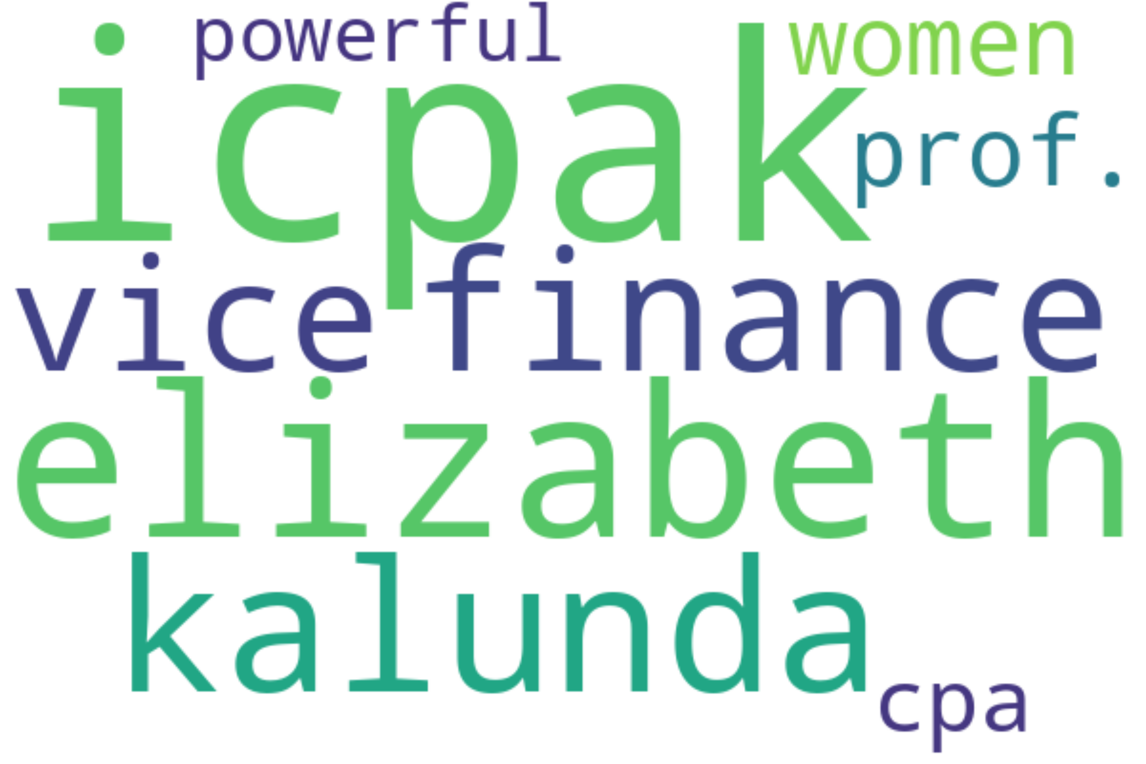
Report For: 01 April 2025
TRENDING TOPICS AND KEYWORDS - FACEBOOK
Trending topics include ICPAK leadership updates, her recognition in East Africa finance, collaborative platforms, mentorship initiatives, and involvement in high-profile professional events and seminars.

Slide 25

Report For: 01 April 2025
TOP INFLUENCERS - FACEBOOK
Elizabeth Kalunda
@
followers

