Slide 1

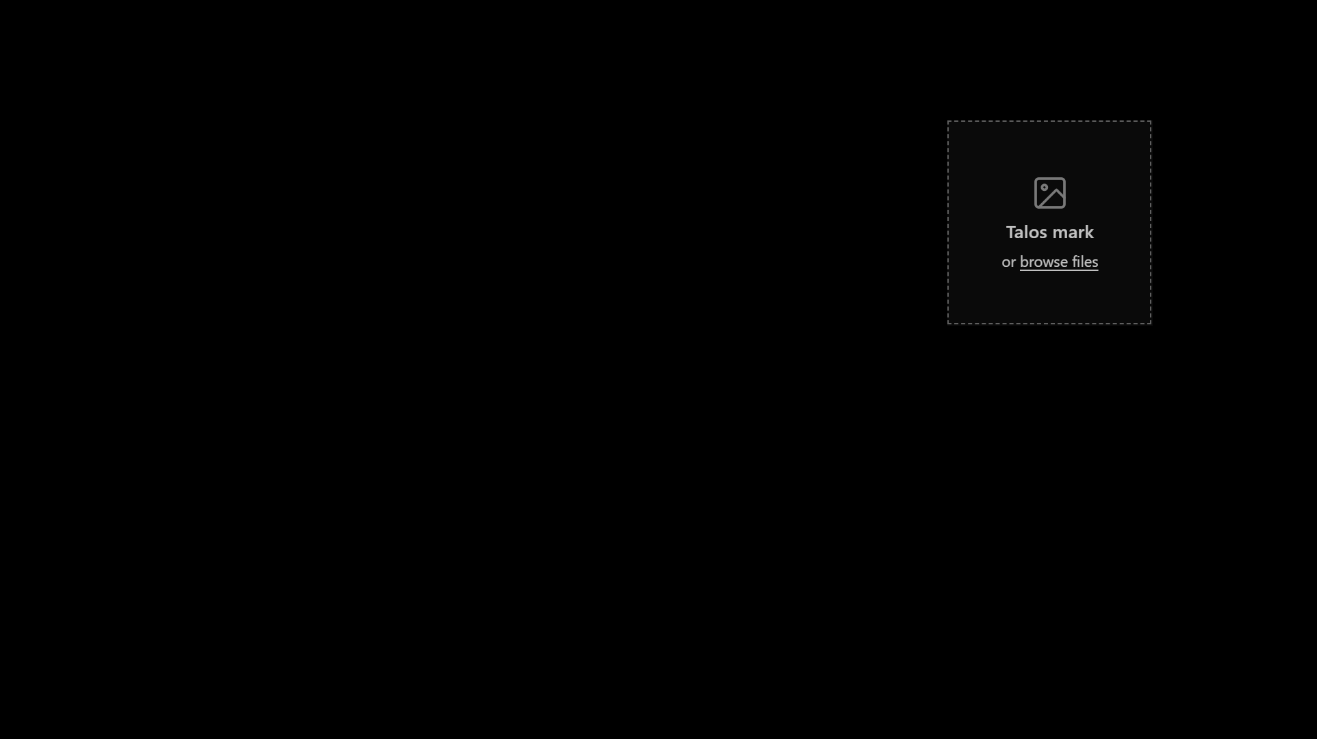
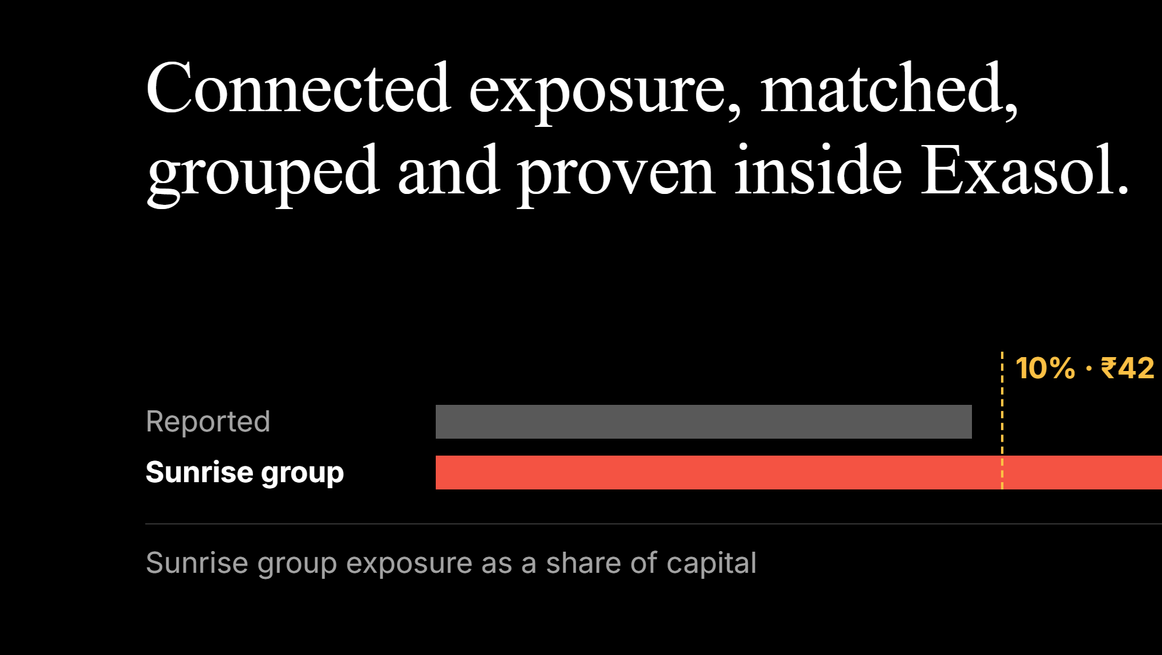
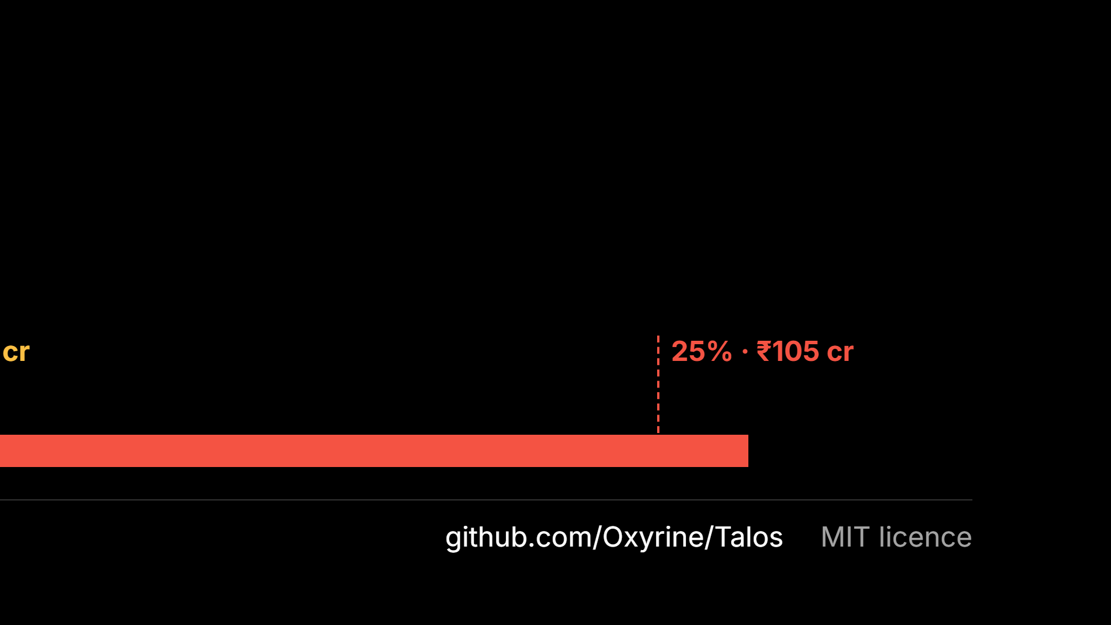
Notes:
One sentence: “We find the borrower groups a bank’s own systems can’t see, and show what they owe against the RBI limit.”

Slide 2
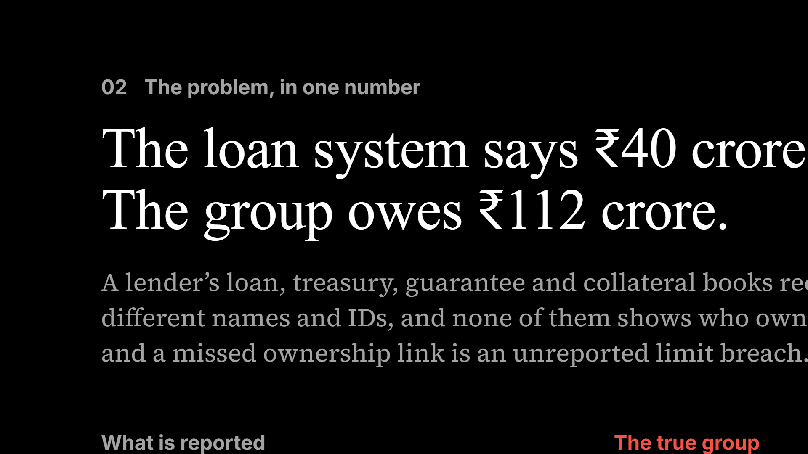
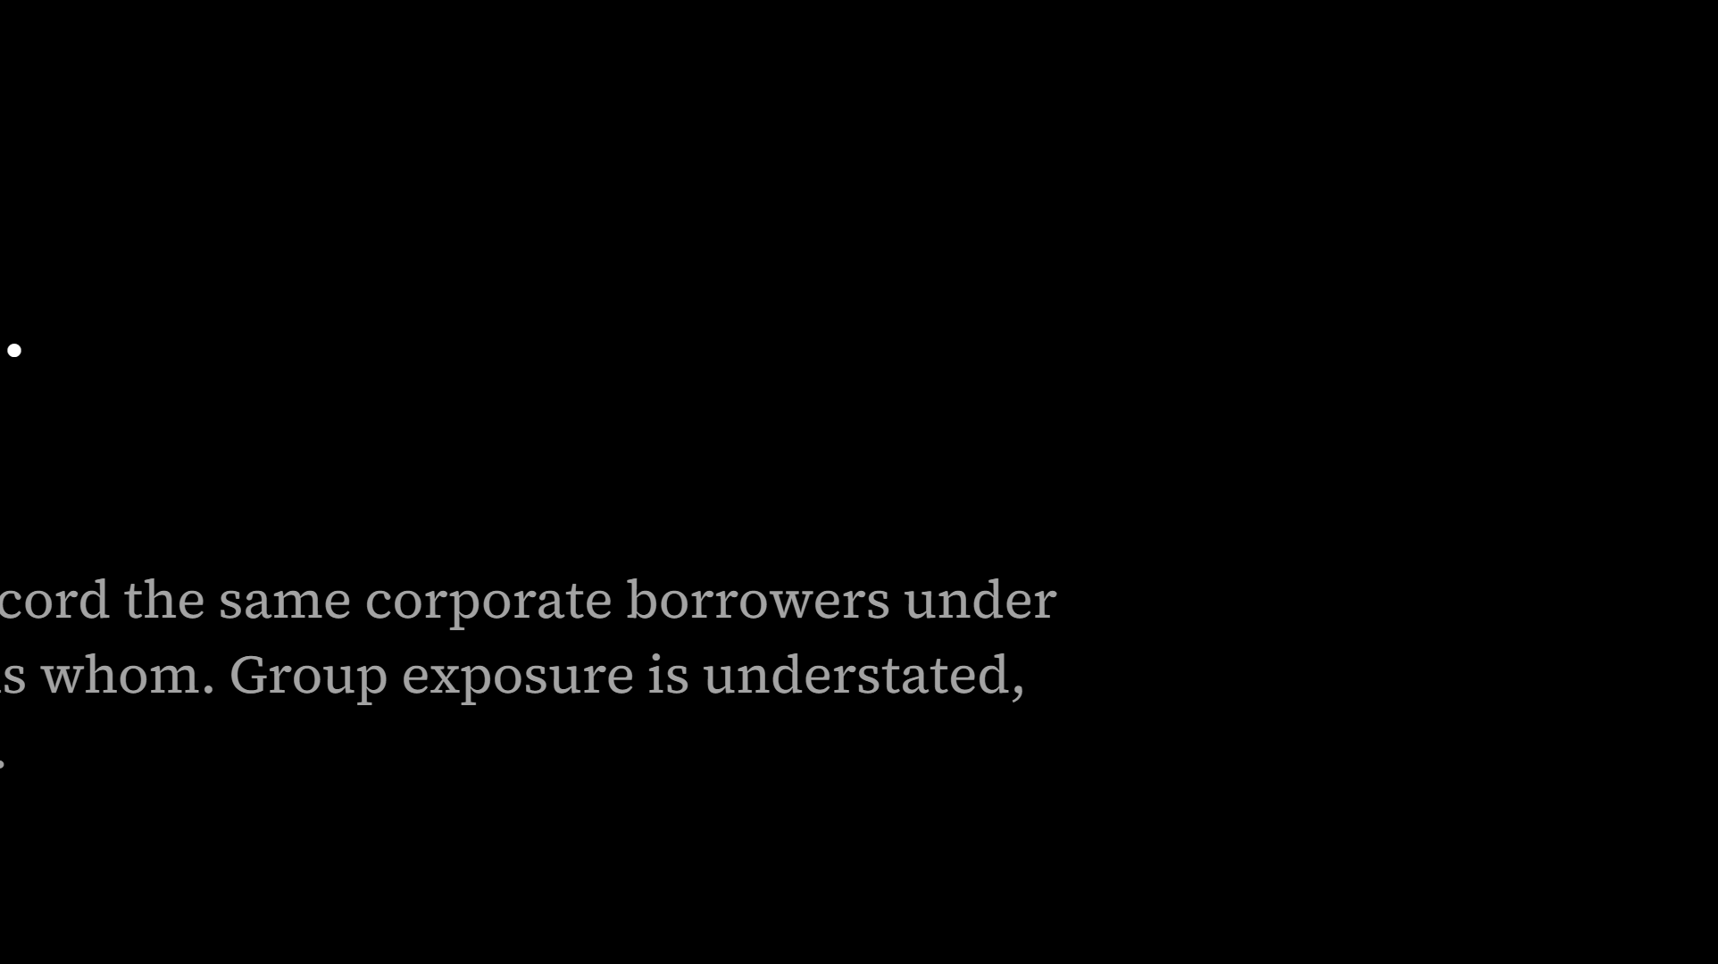
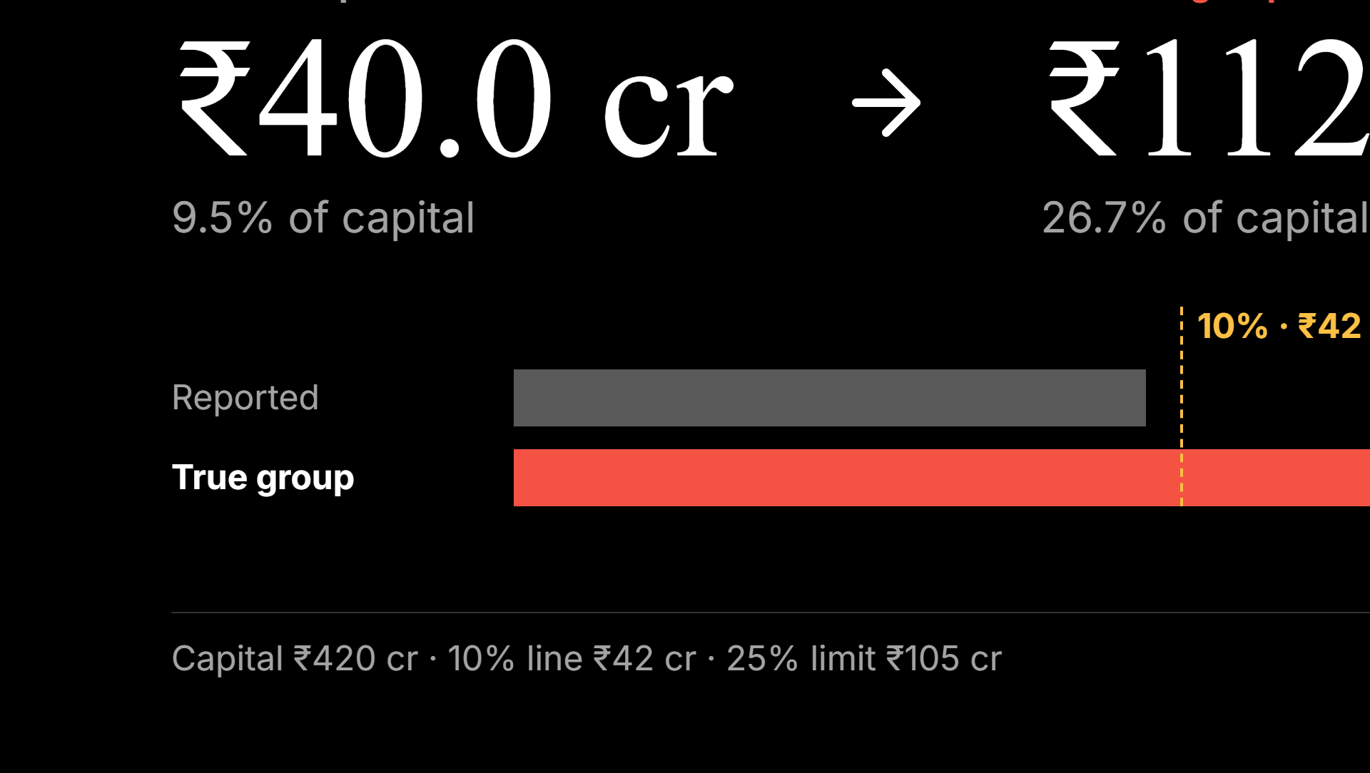
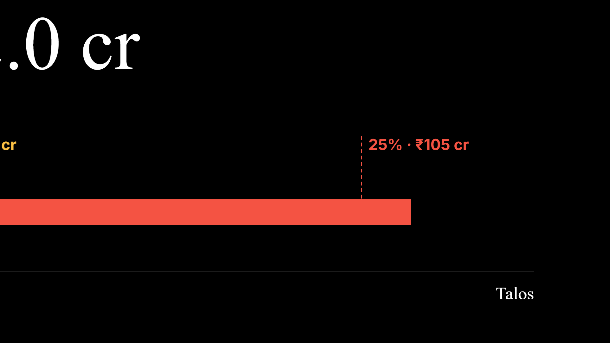
Notes:
Sunrise is a synthetic company in our benchmark world, and the numbers are exact: the generator asserts them to the paisa. The point is that nobody lied. Every system’s number is correct for the records it can see.

Slide 3
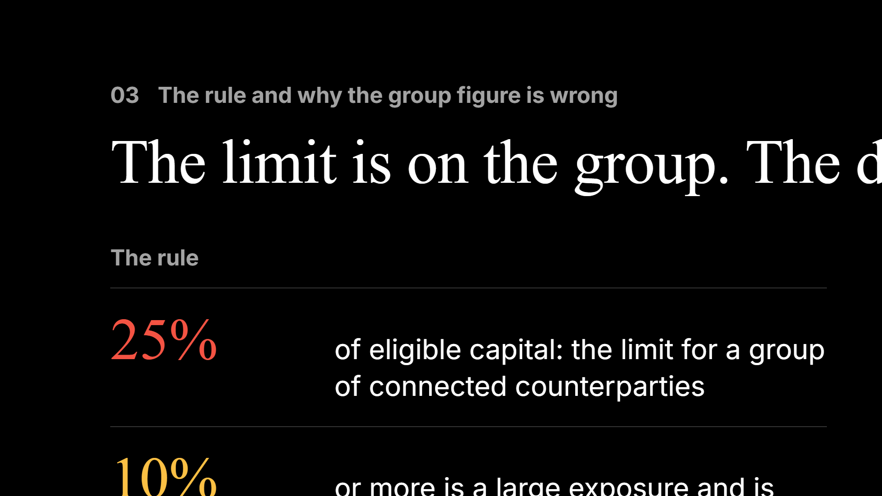
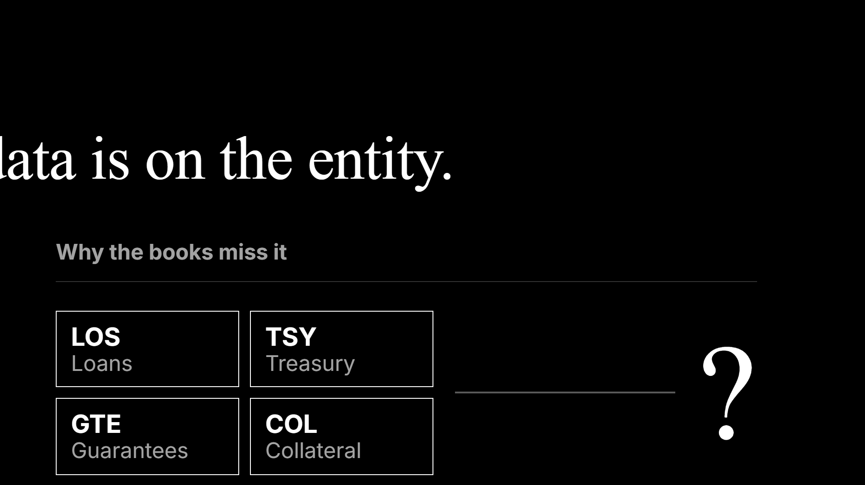
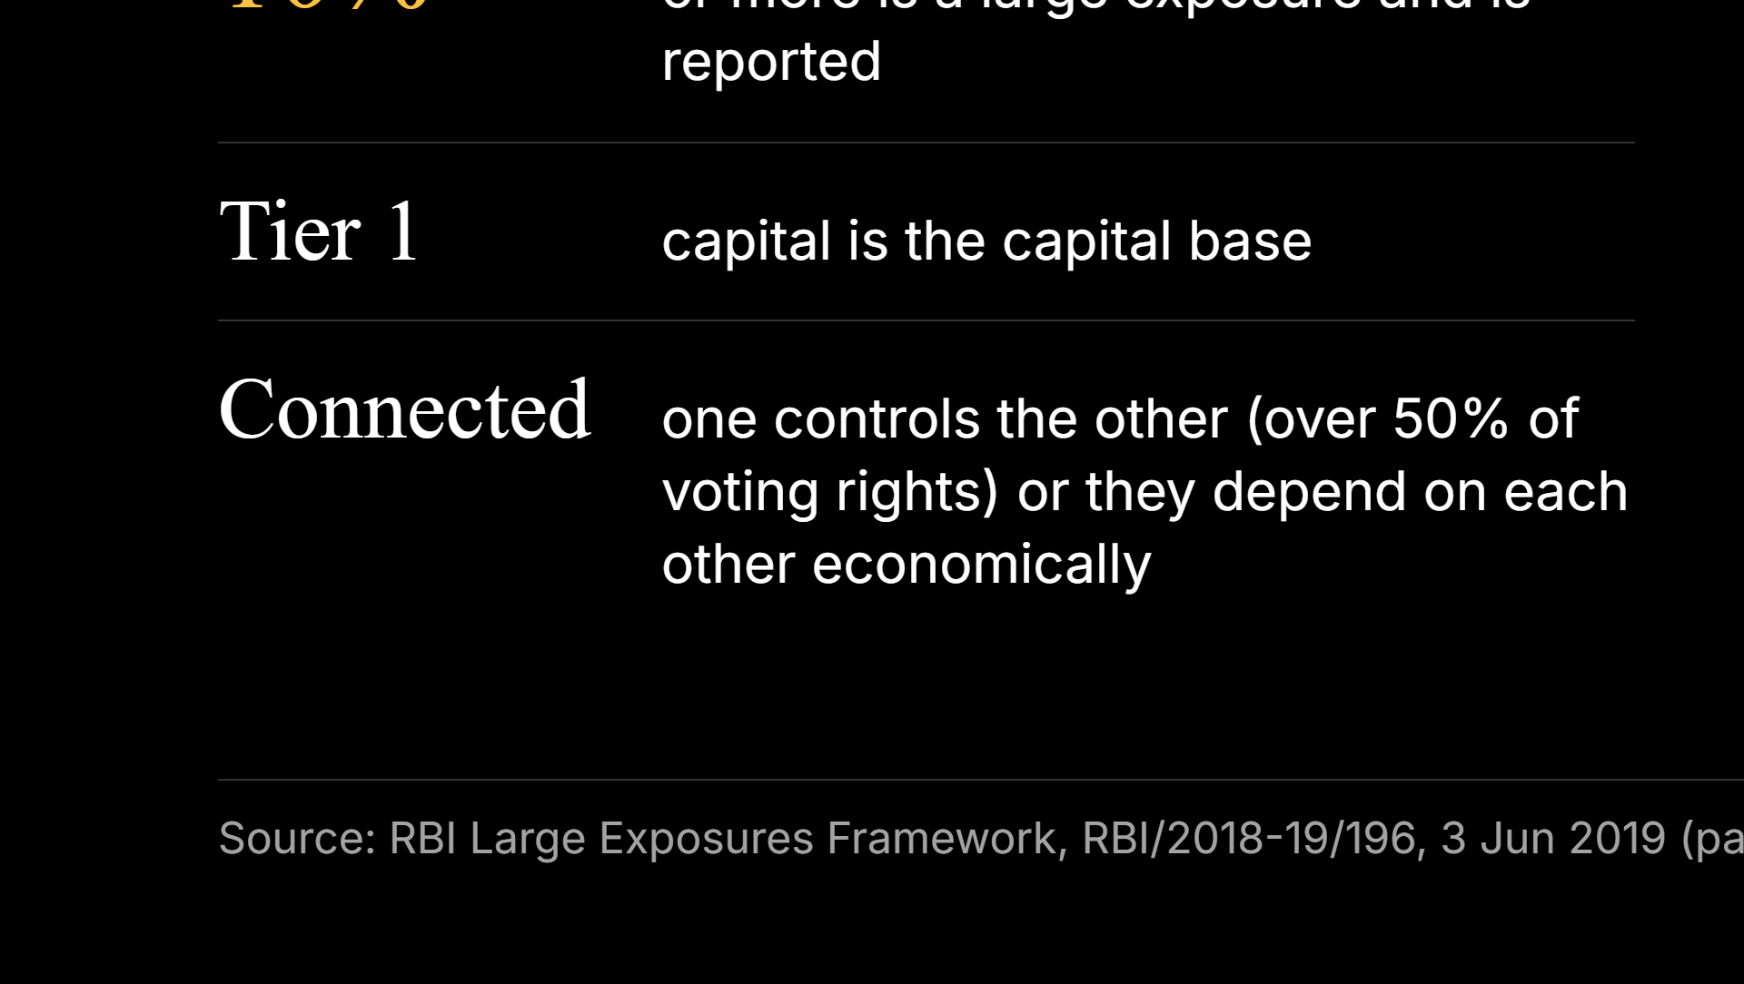
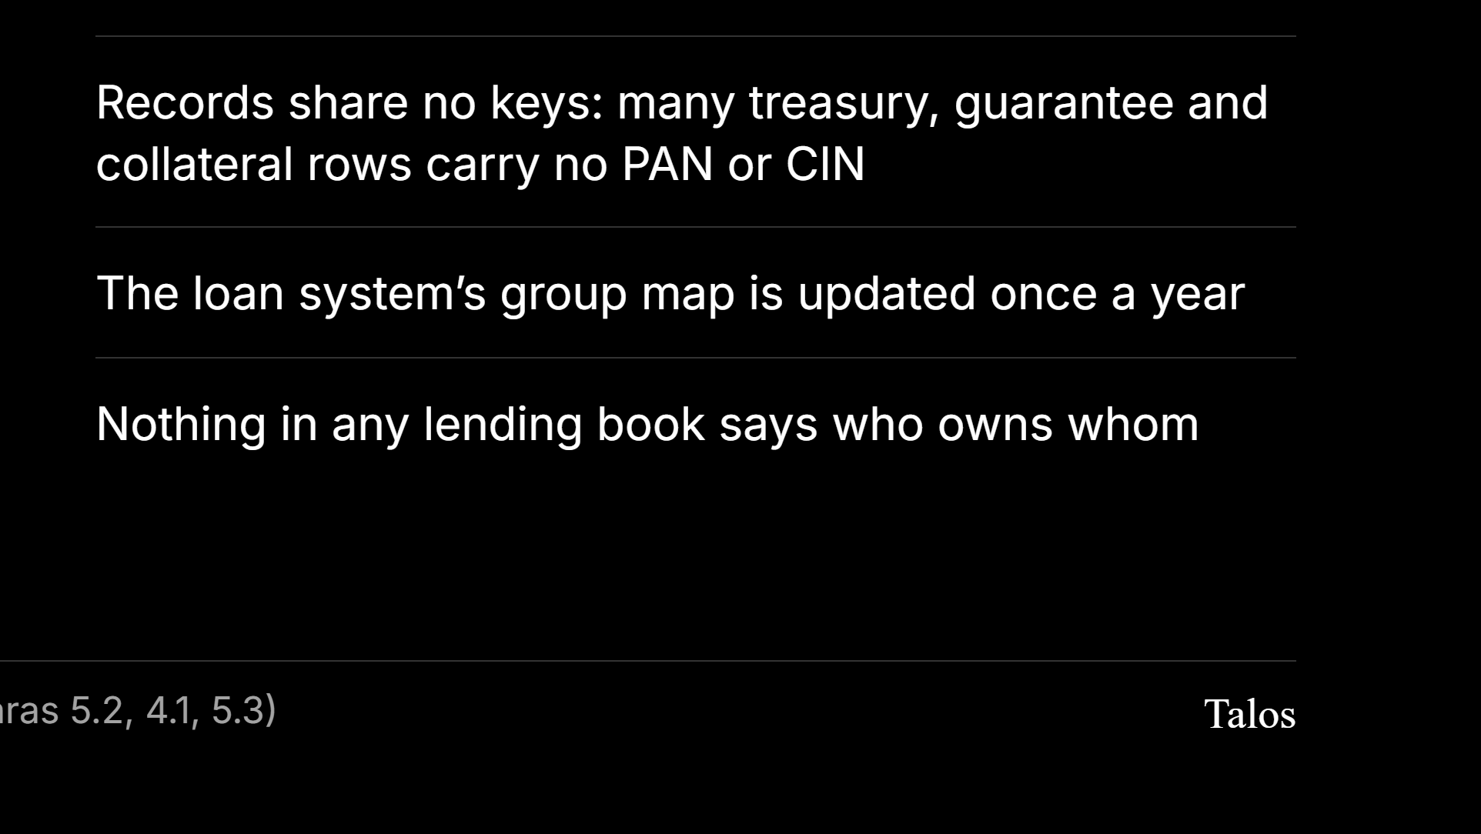
Notes:
Re-check the paragraph numbers against the circular PDF before presenting. The 20% single-counterparty limit and the interdependence tests are in the same circular if a judge asks.

Slide 4
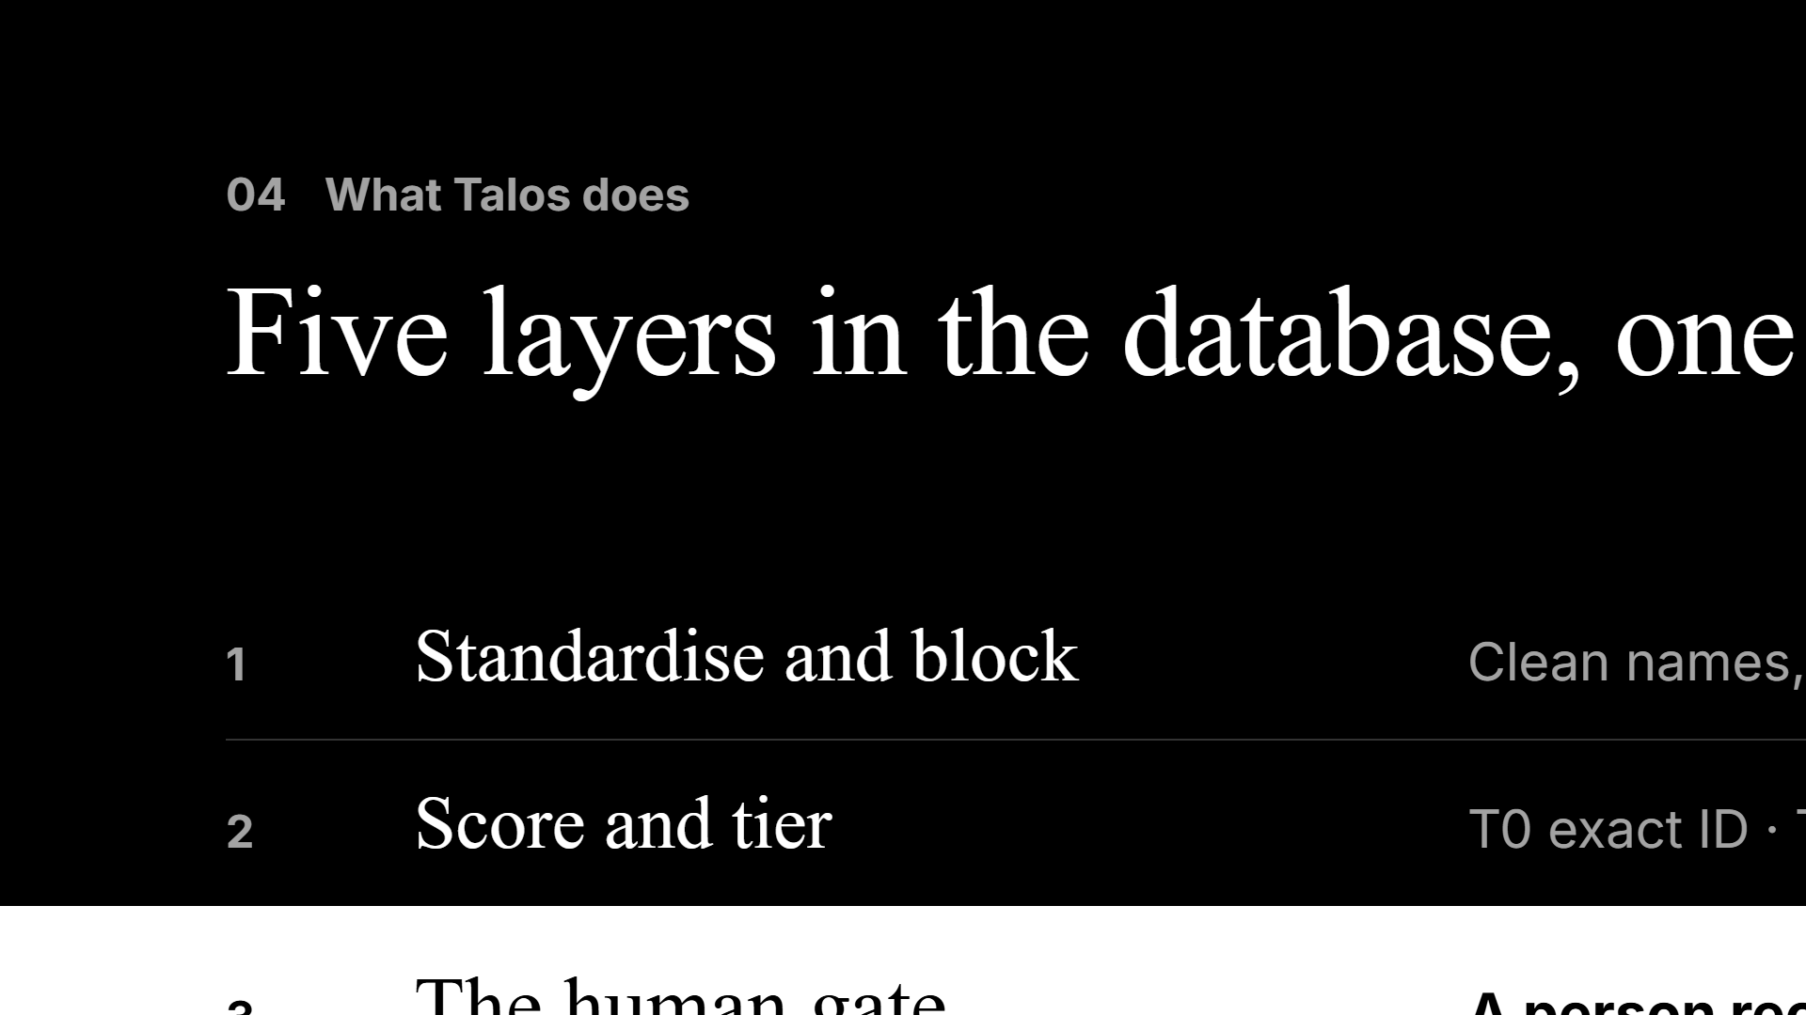
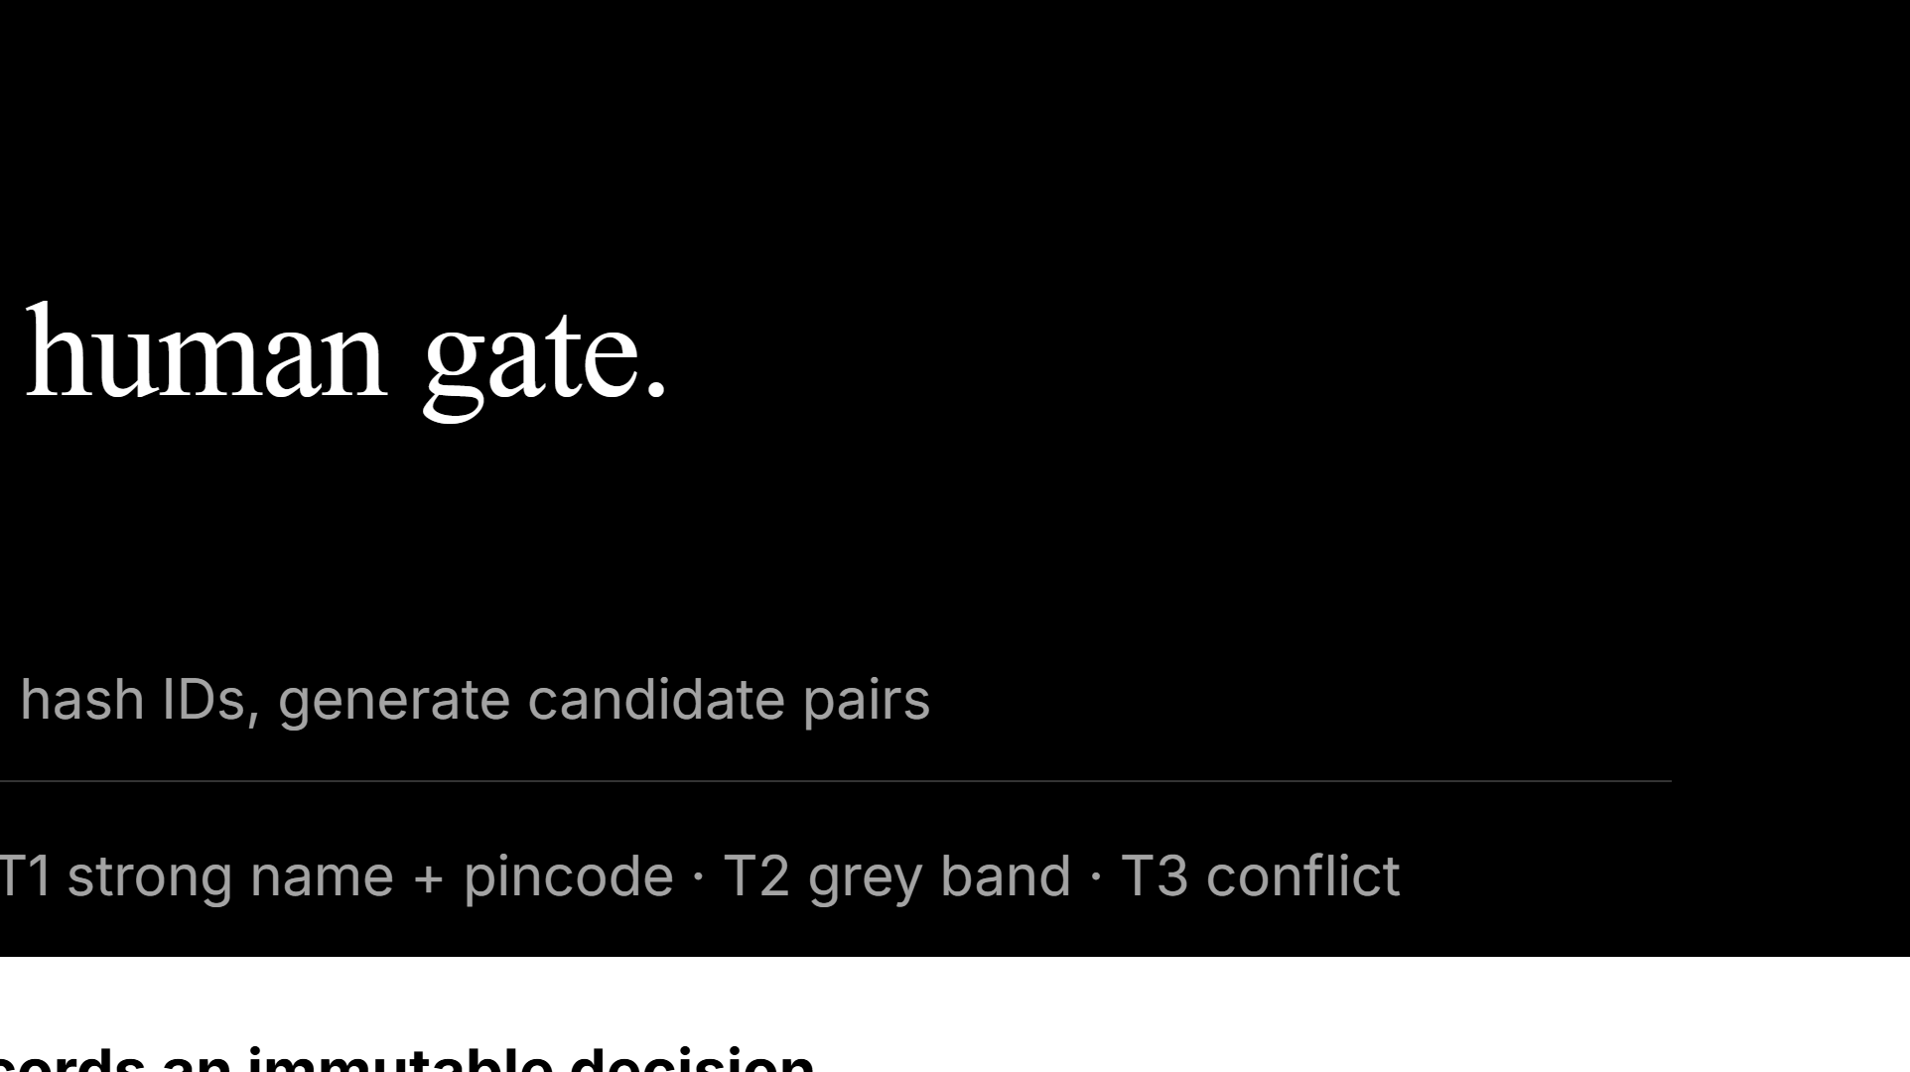
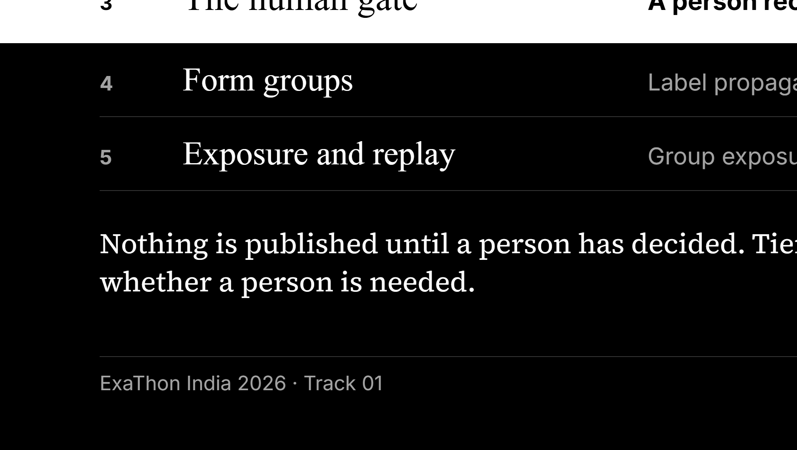
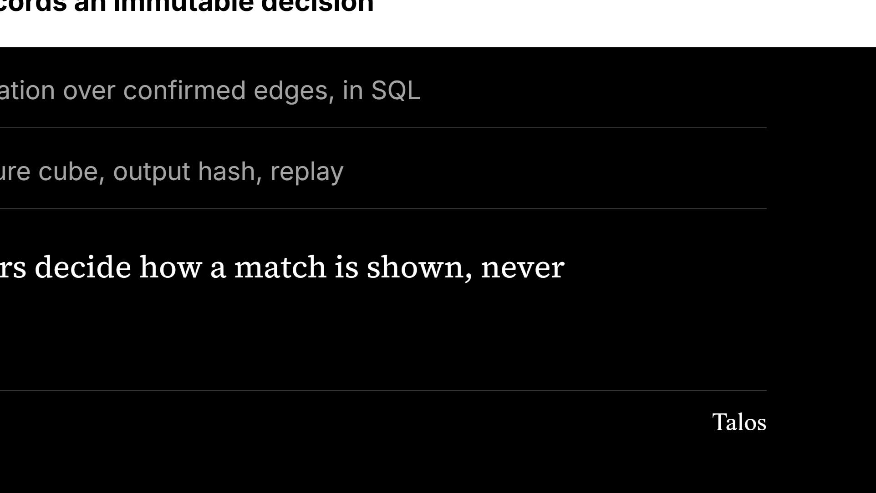
Notes:
The gate is the product. The matching is fast; trust is the hard part.

Slide 5
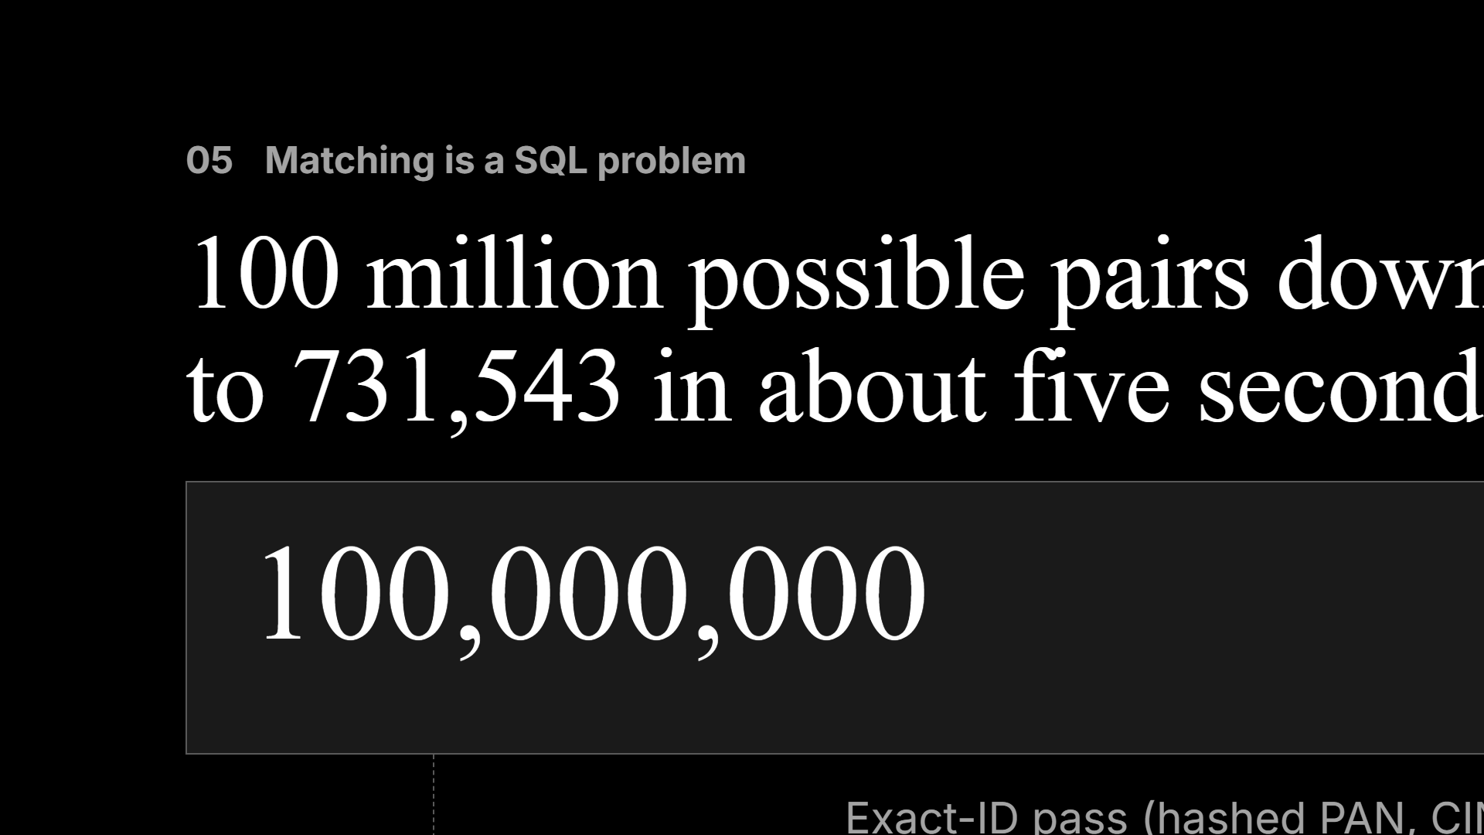
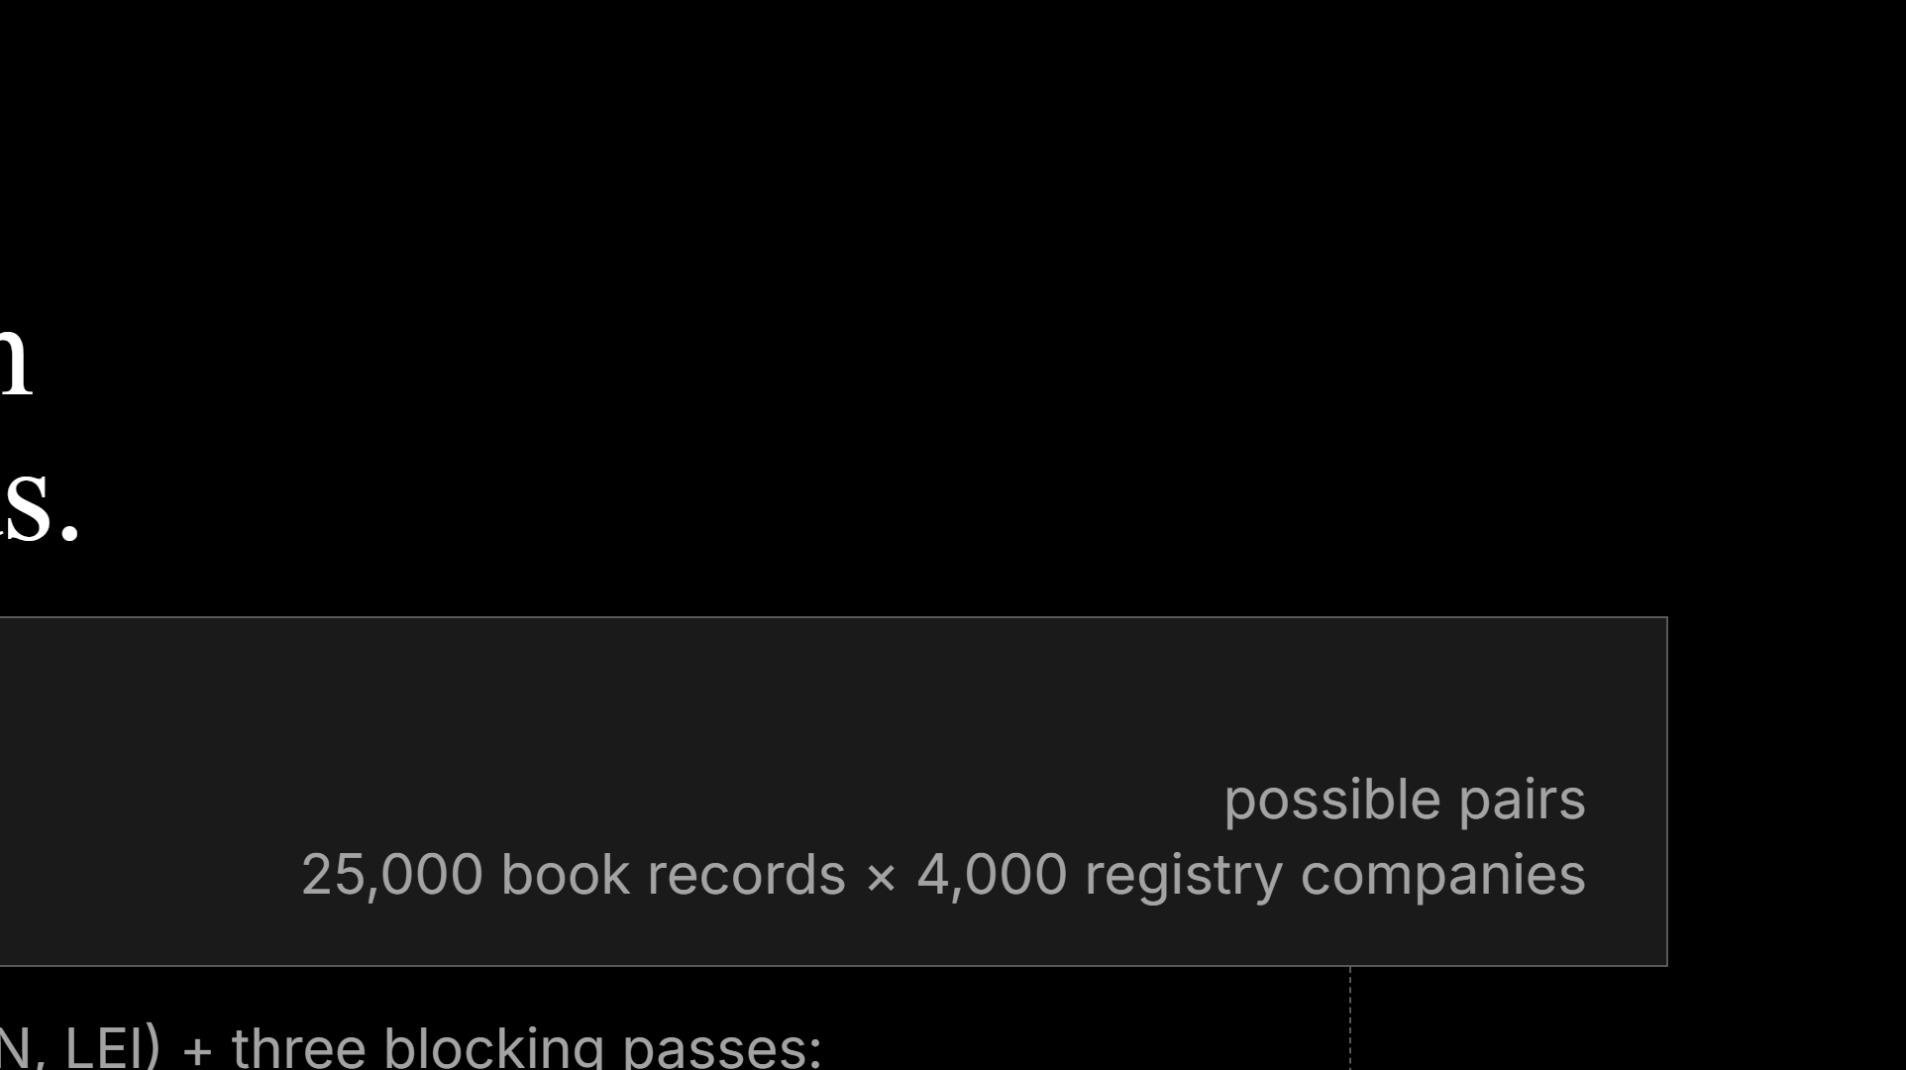
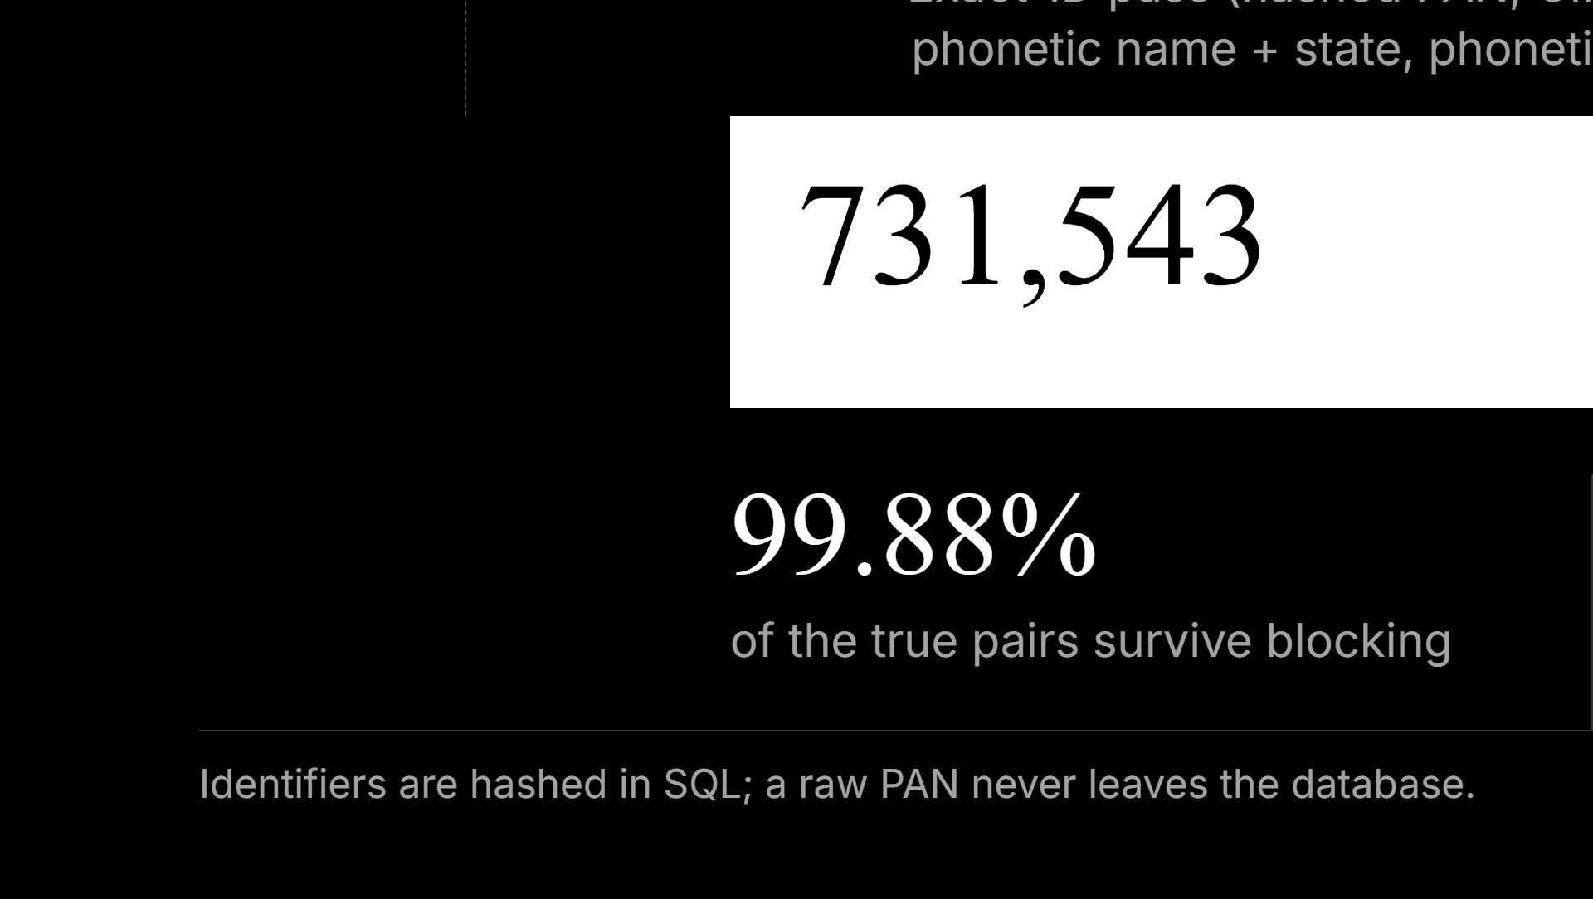
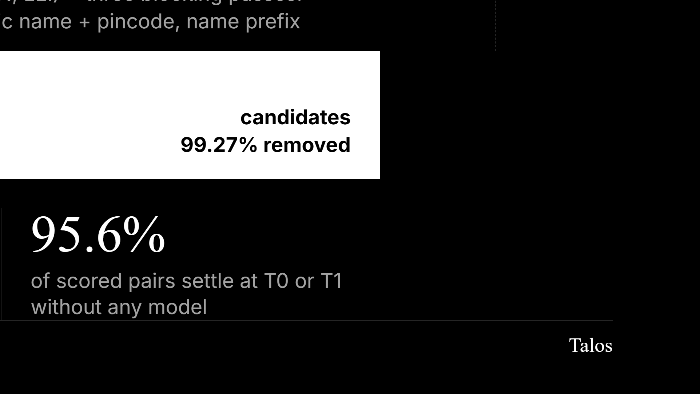
Notes:
Blocking timing is about 5 to 6 seconds on Nano on a laptop (dev data; see the pipeline screen). Scoring uses EDIT_DISTANCE, SOUNDEX and COLOGNE_PHONETIC inside Exasol.

Slide 6
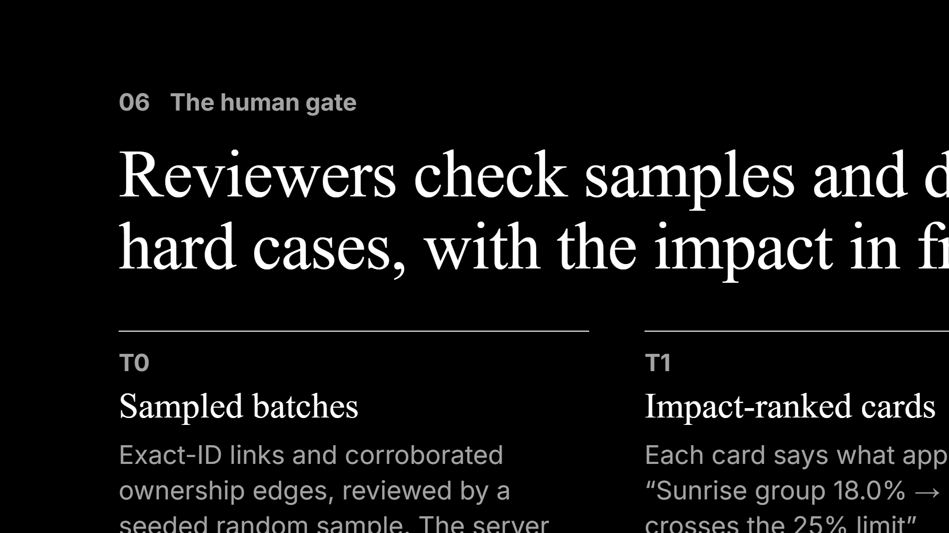
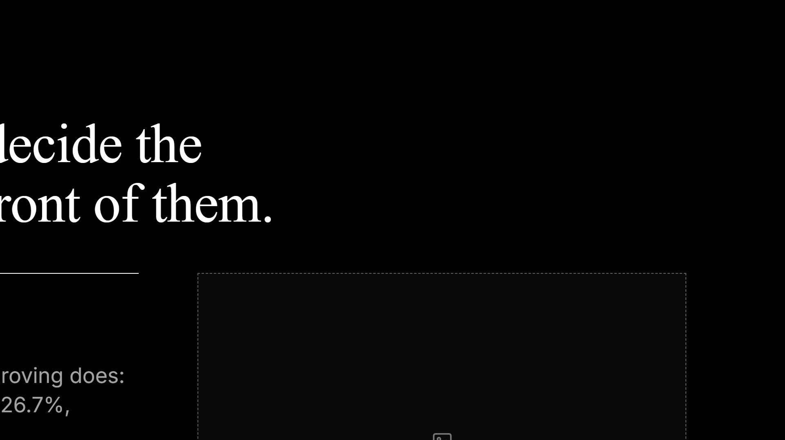
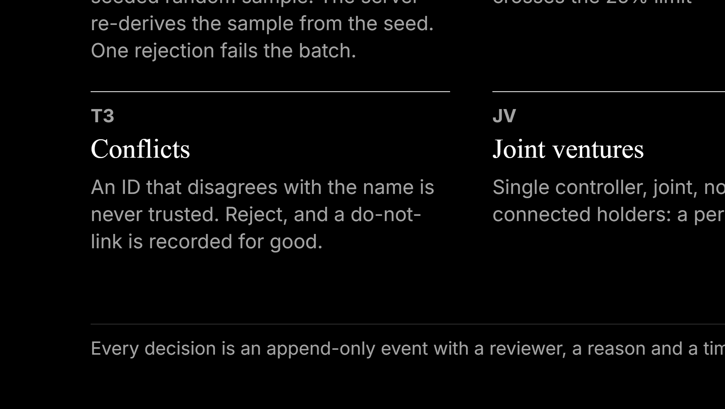
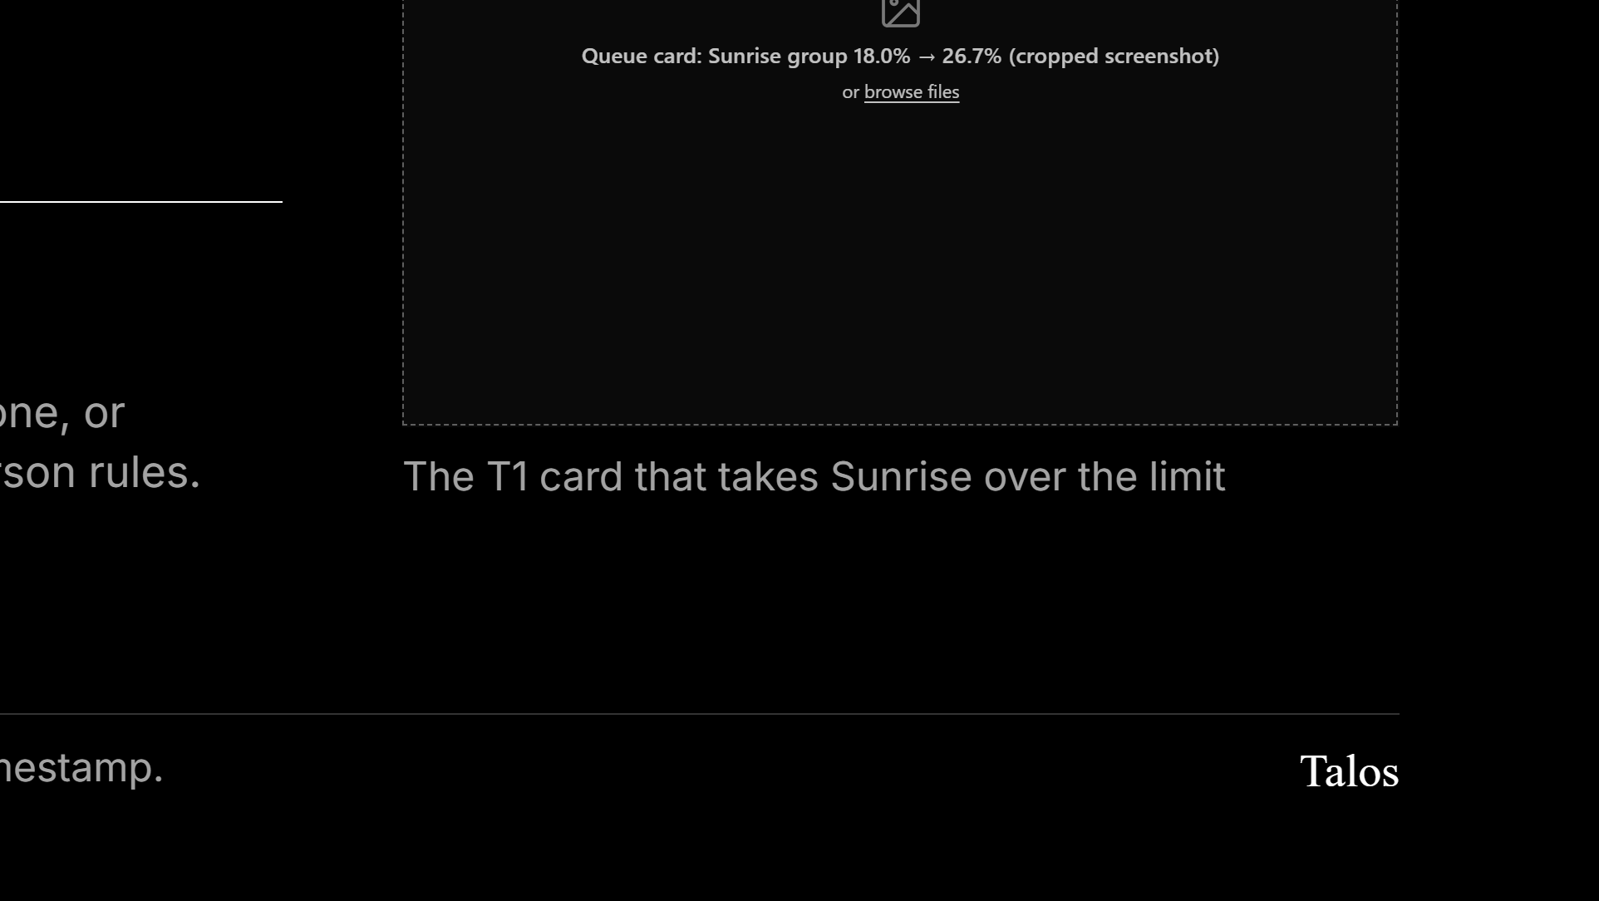
Notes:
The batch screen has an “Approve all in this sample” button that pre-ticks every pair, and the reviewer can flip any to Reject. The form still posts one verdict per sampled pair. Say this yourself before a judge asks.

Slide 7
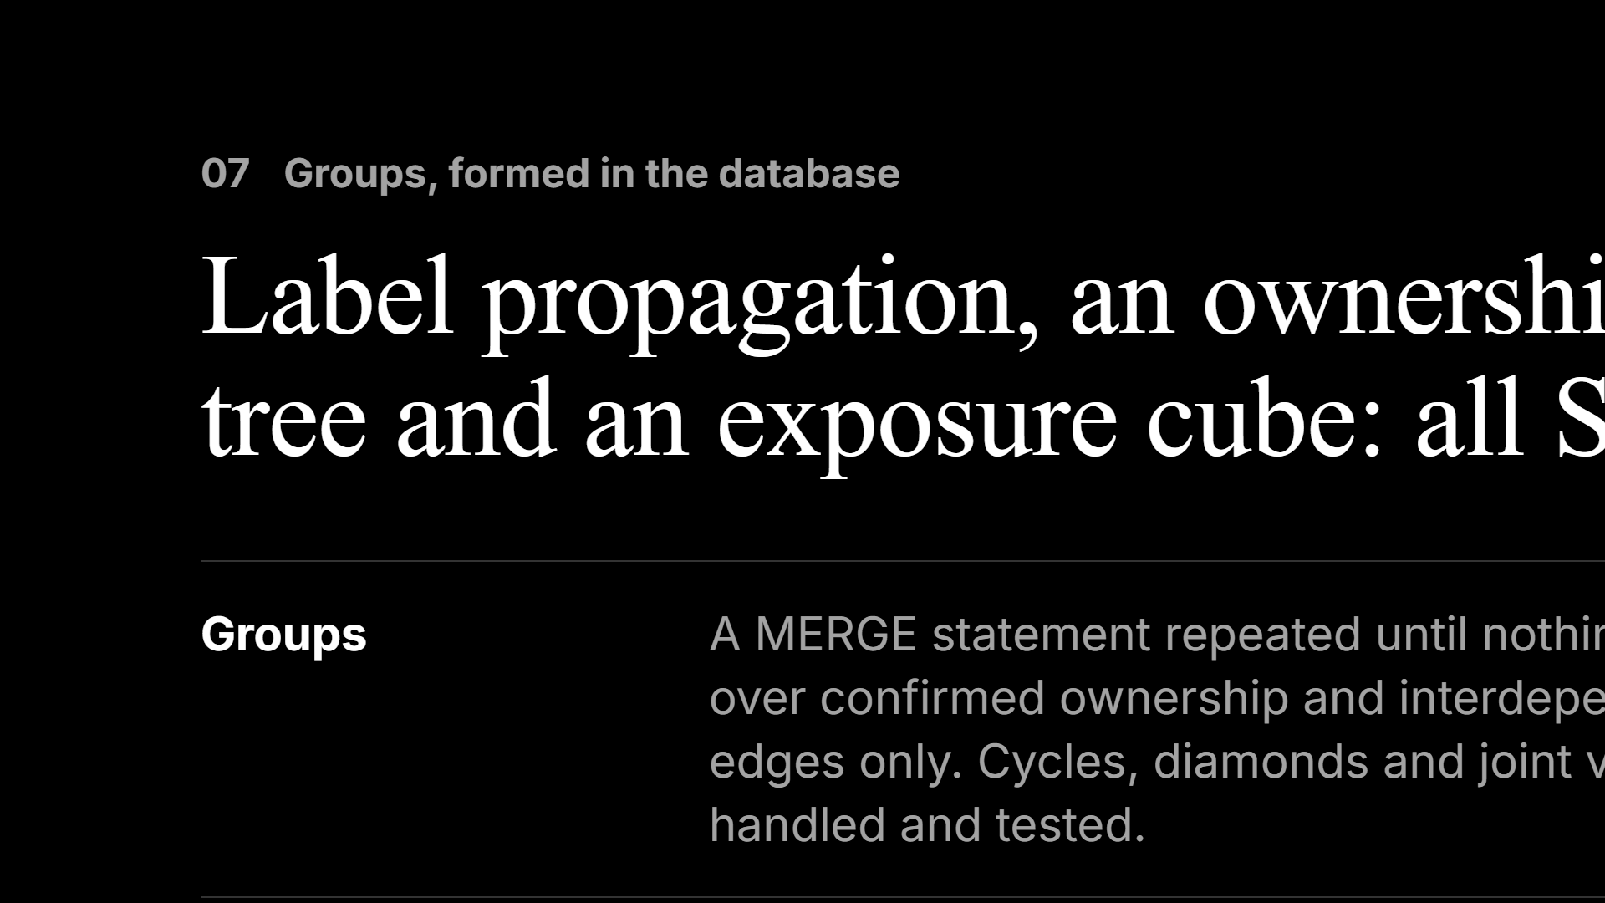
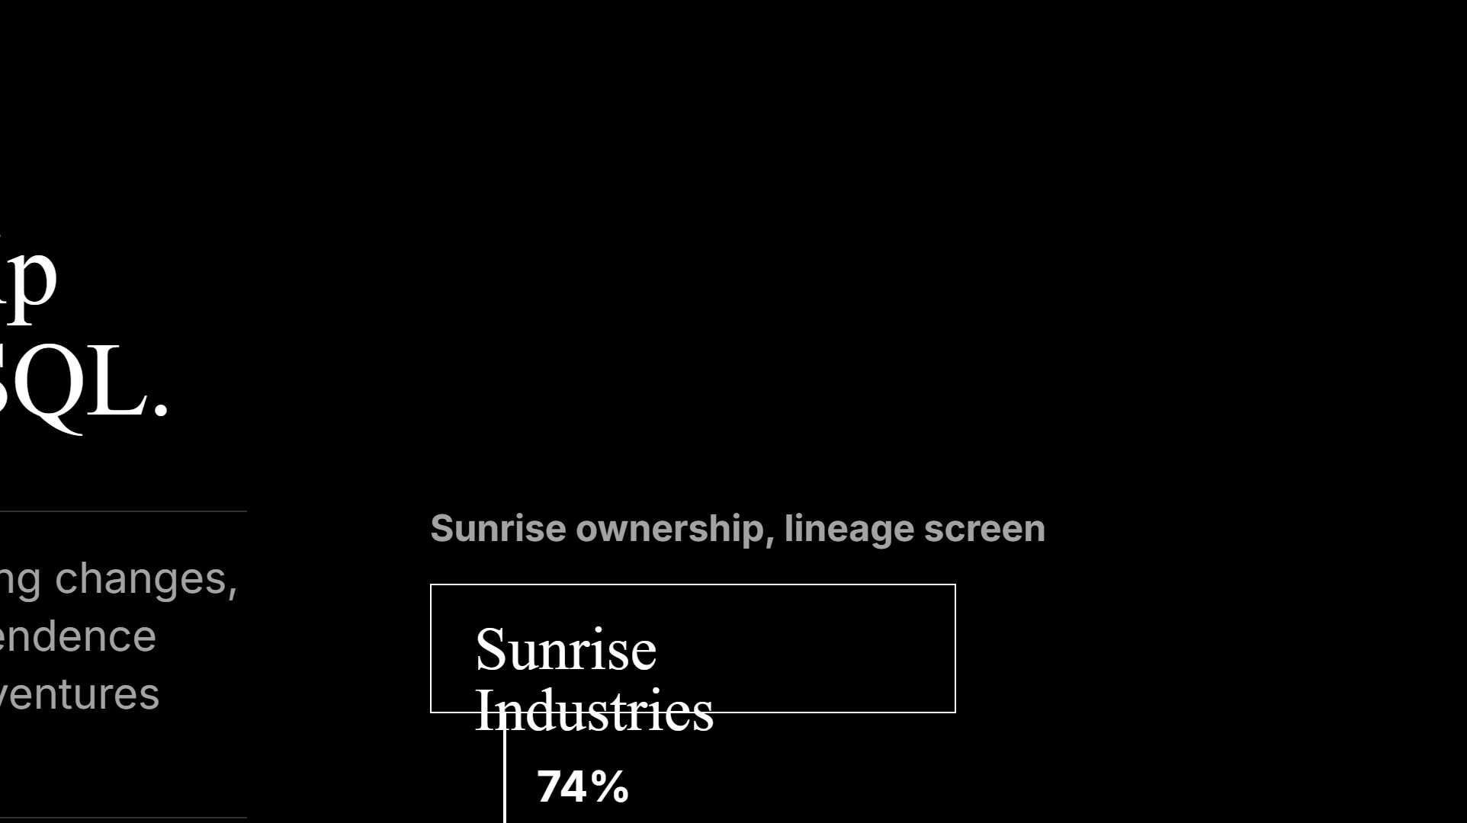
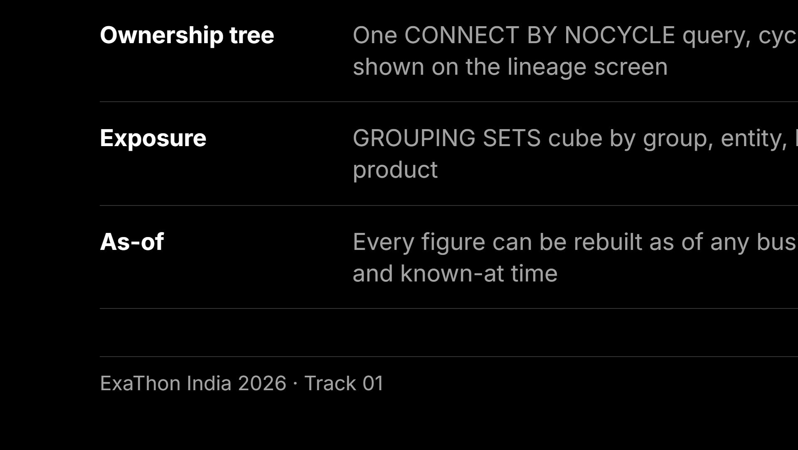
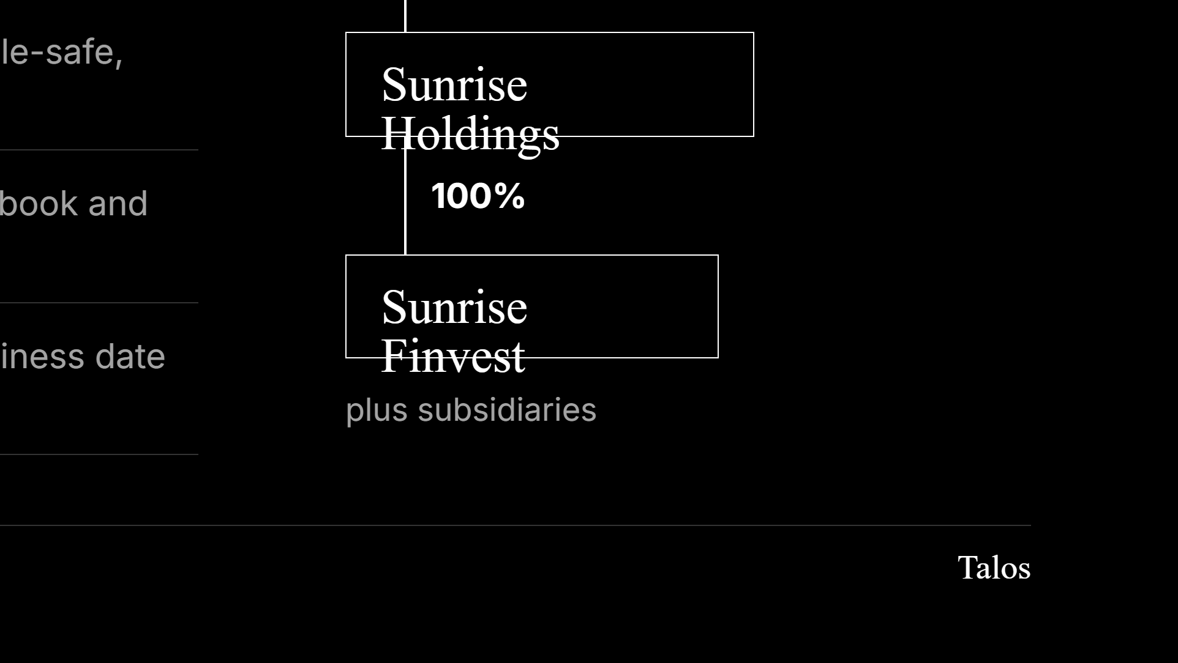
Notes:
Collateral carries zero exposure by policy and is used only for its identifiers. Python UDFs failed the probe on Nano, so all of this is plain SQL.

Slide 8
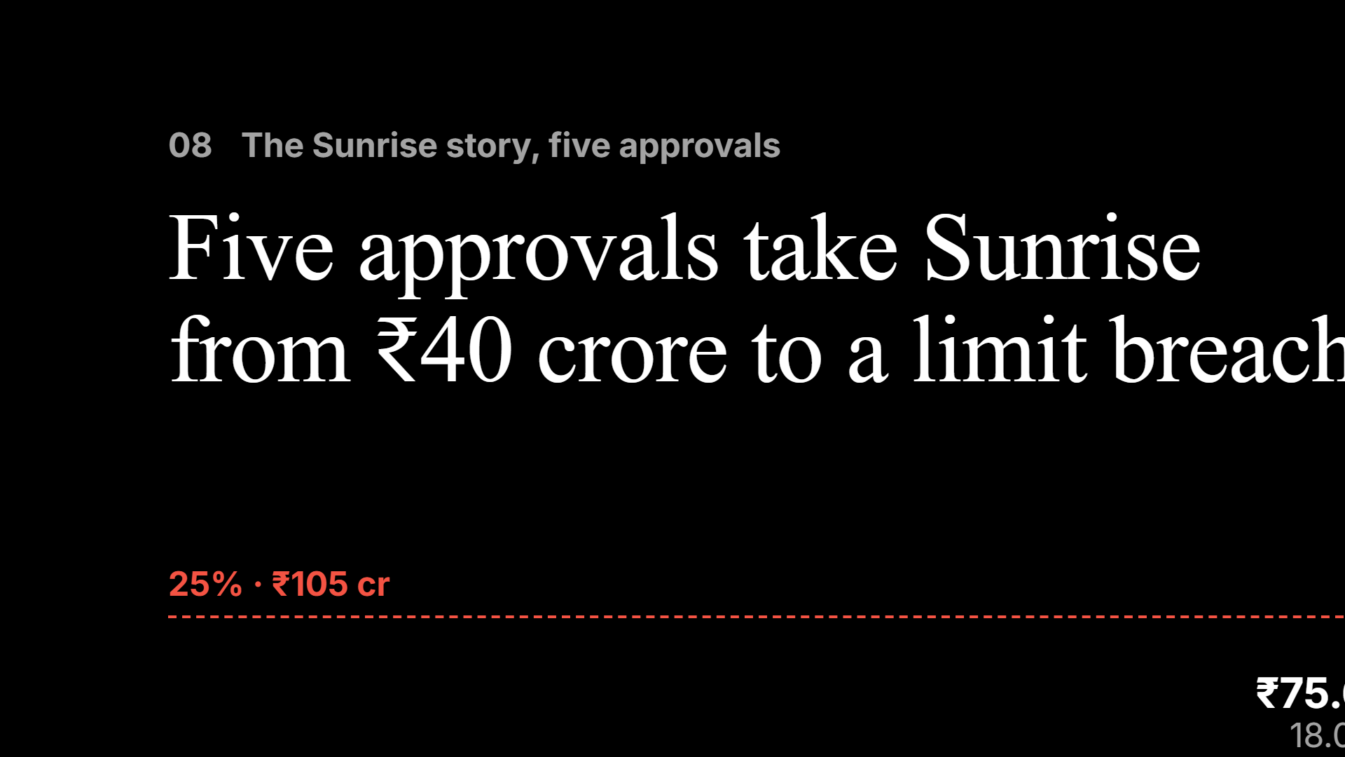
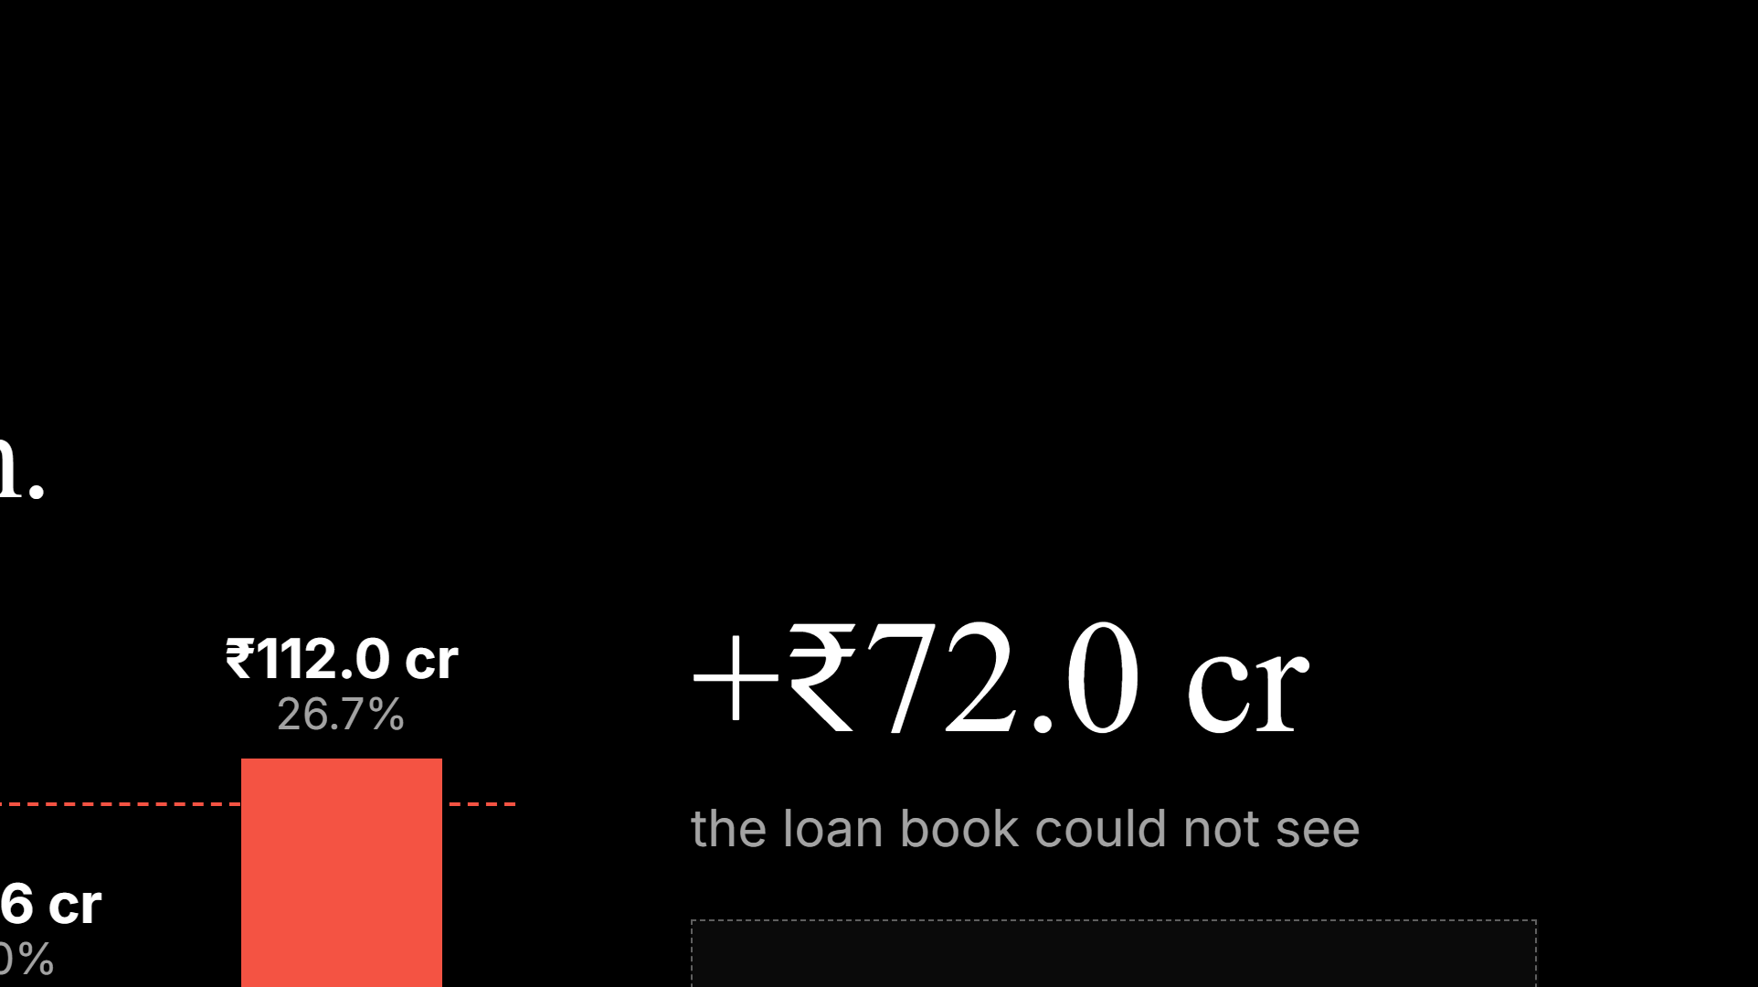
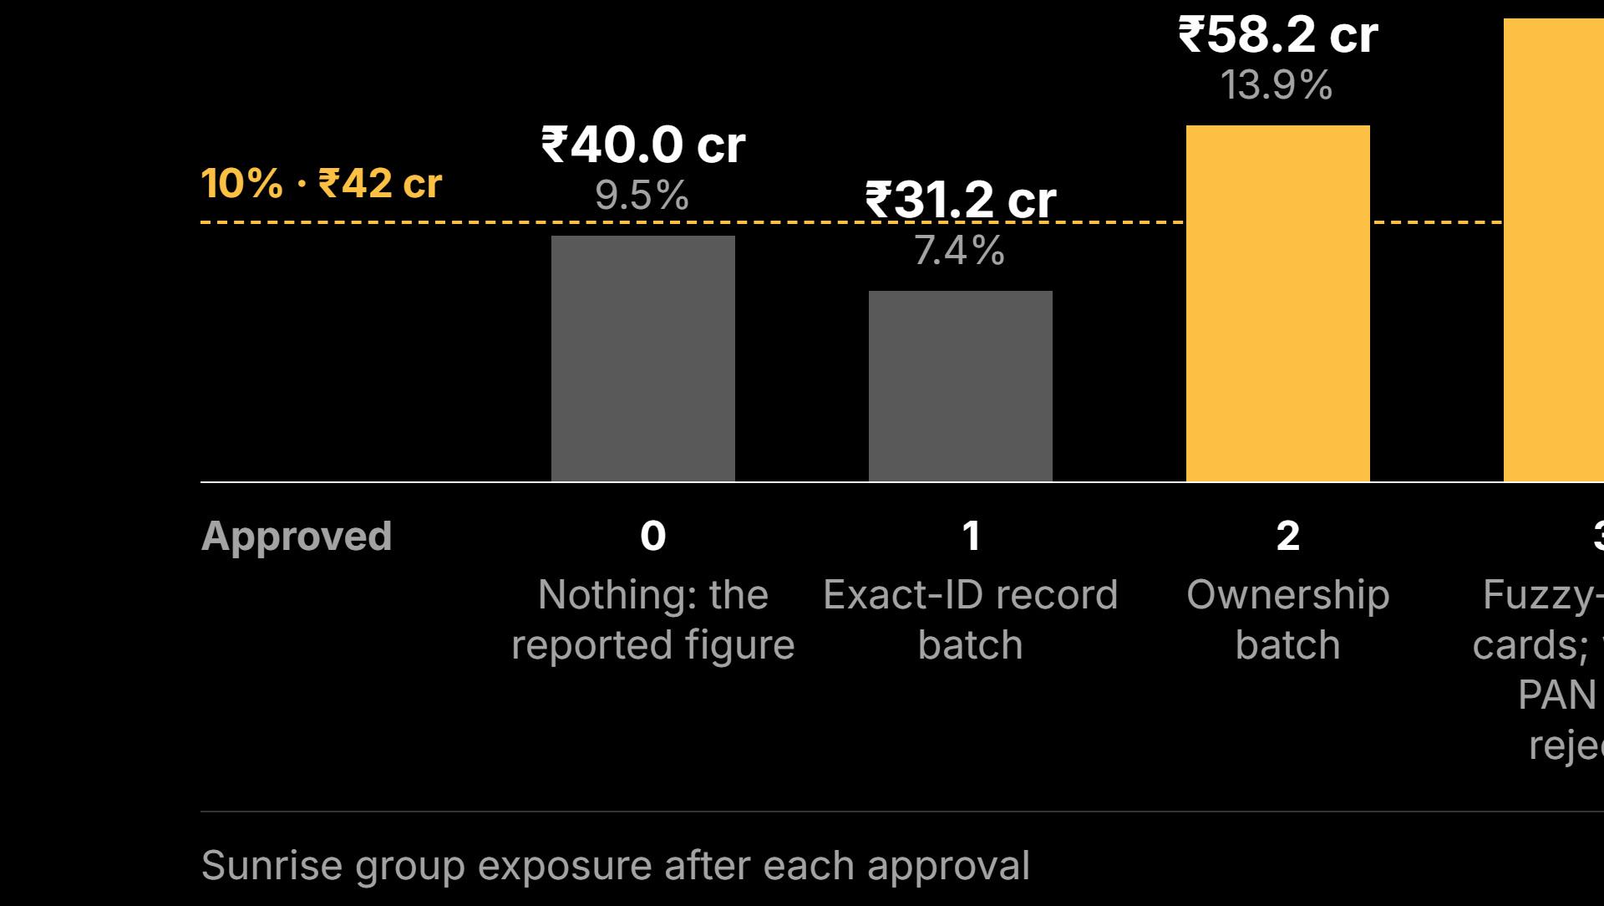
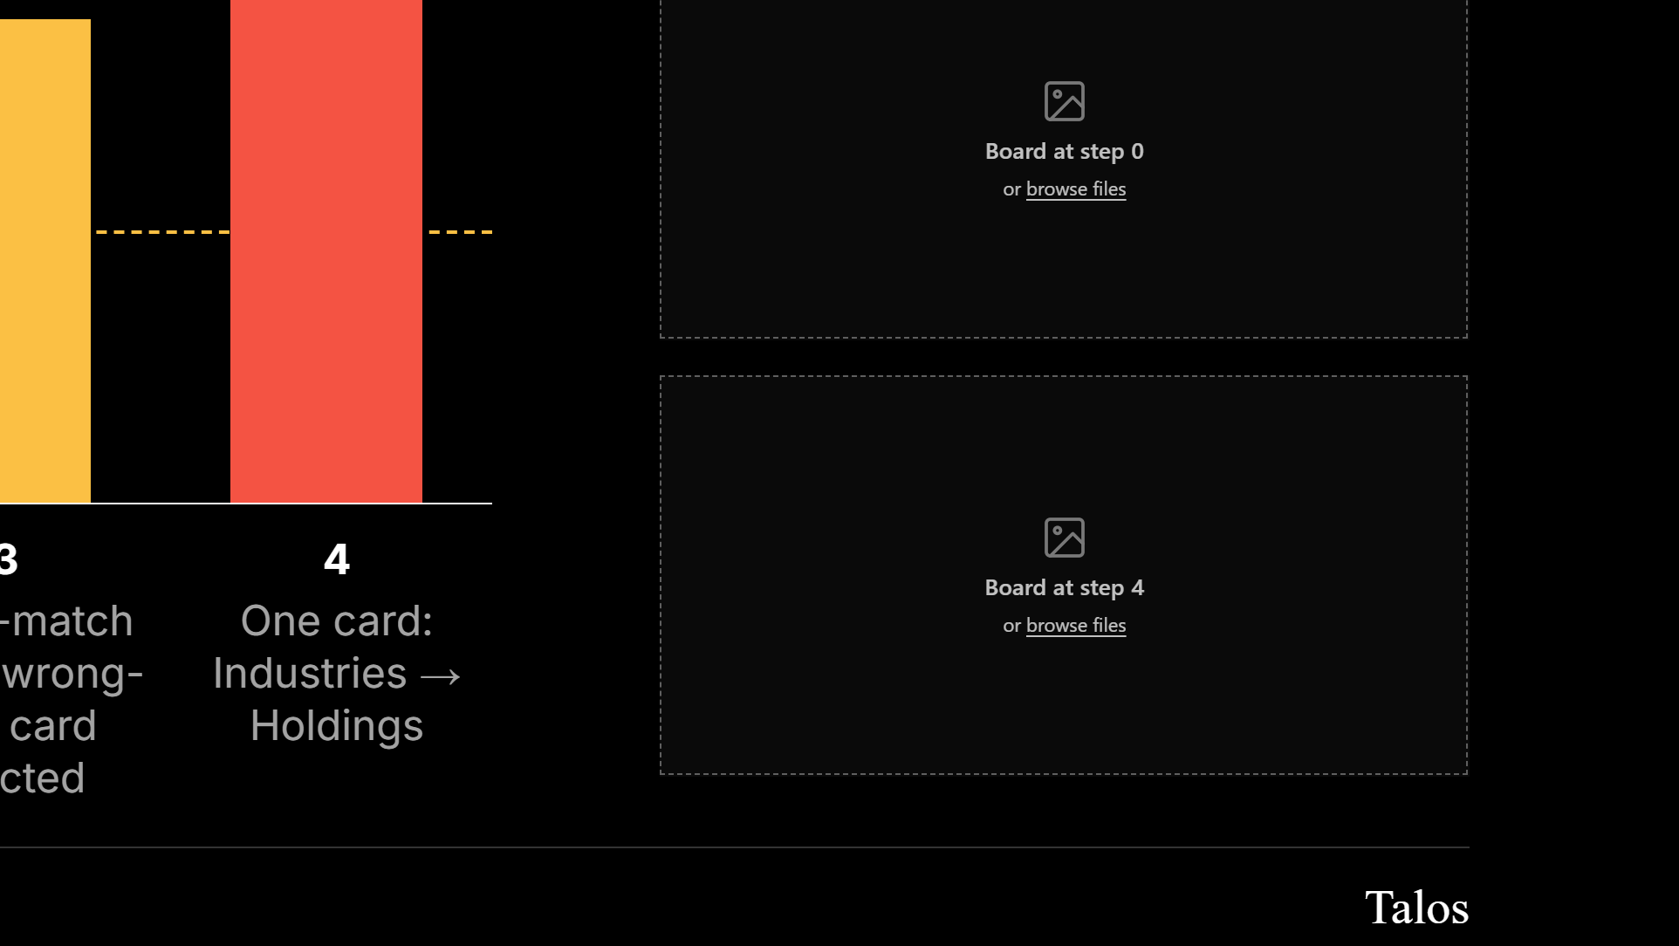
Notes:
Step 1 is lower than reported because only the head company’s own exposure is linked yet; Talos can show less than the loan book as well as more. The holding company group (₹36.4 cr, 8.7%) looked compliant on its own until step 4.

Slide 9
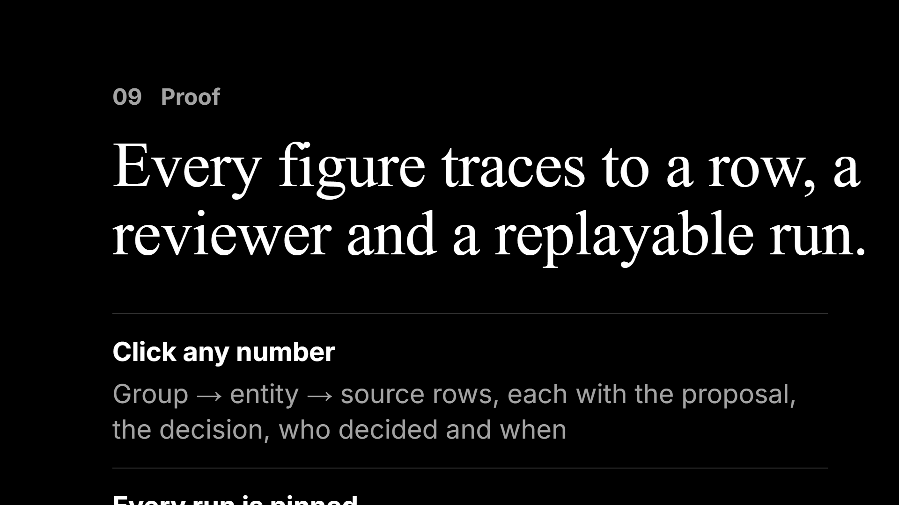

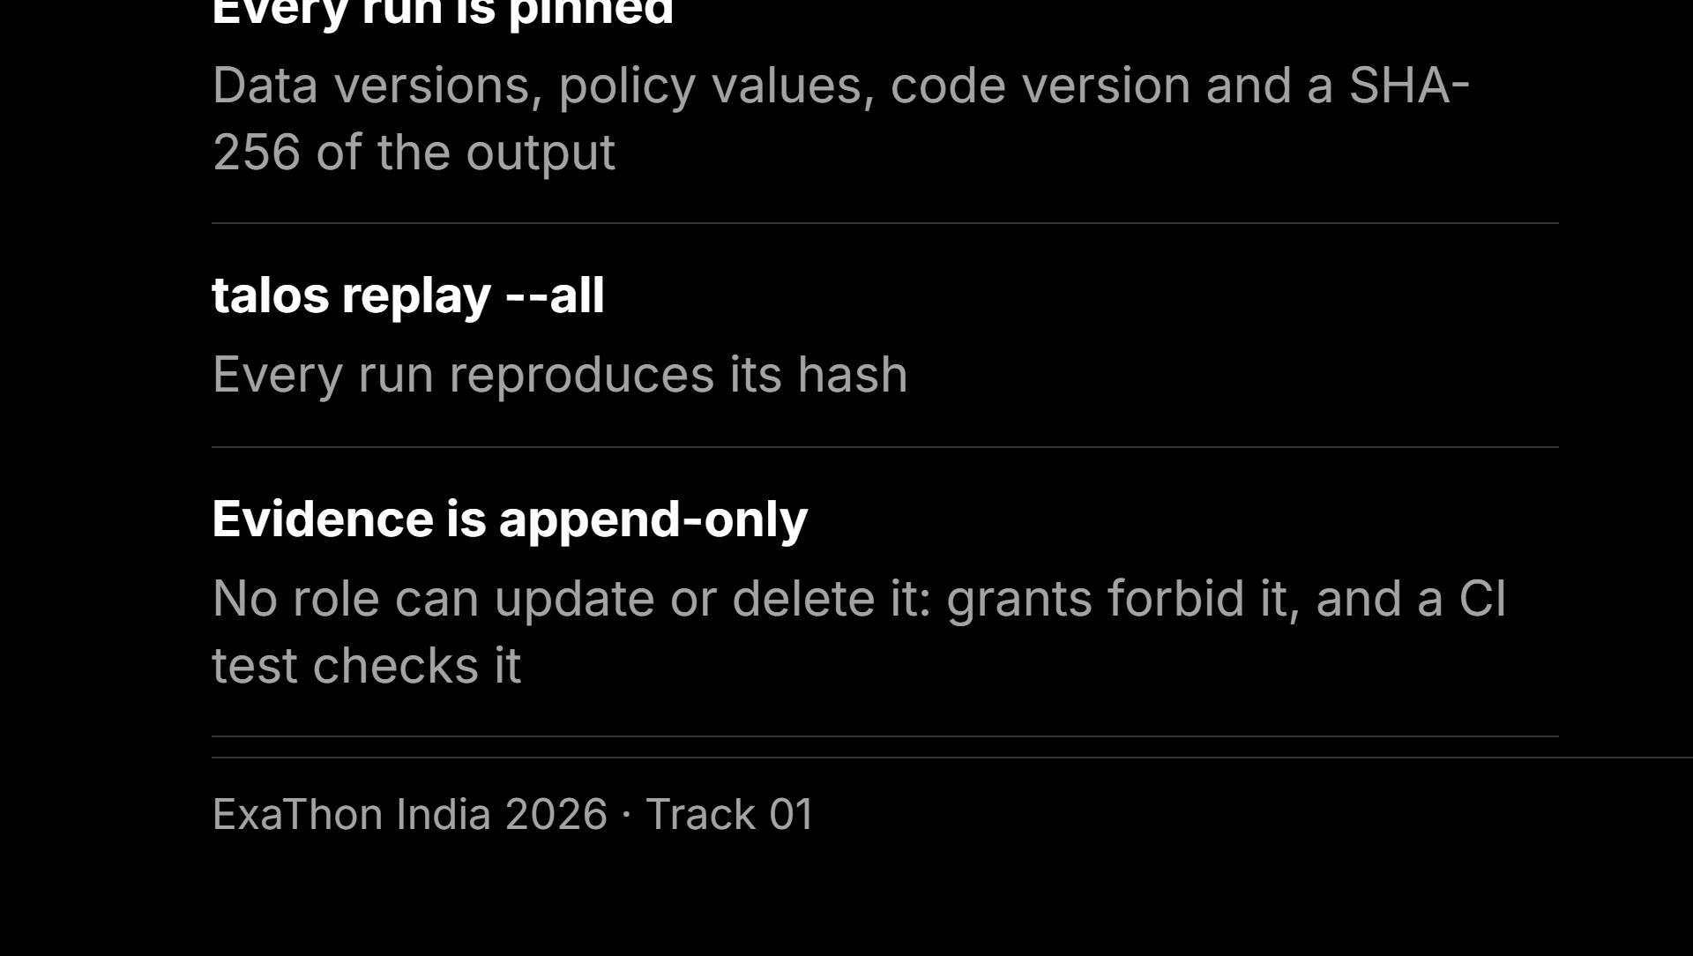
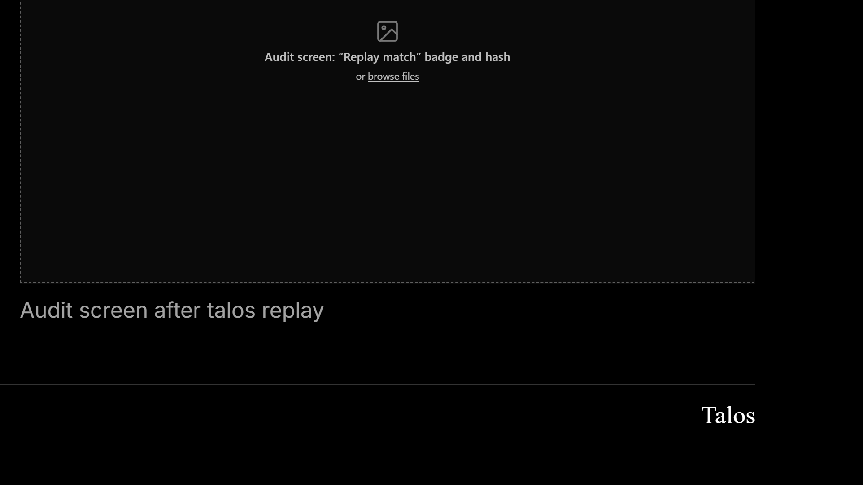
Notes:
An auditor can ask “what did you know on the quarter-end date” and get the same answer, because the “as of” rule is part of the SQL.

Slide 10
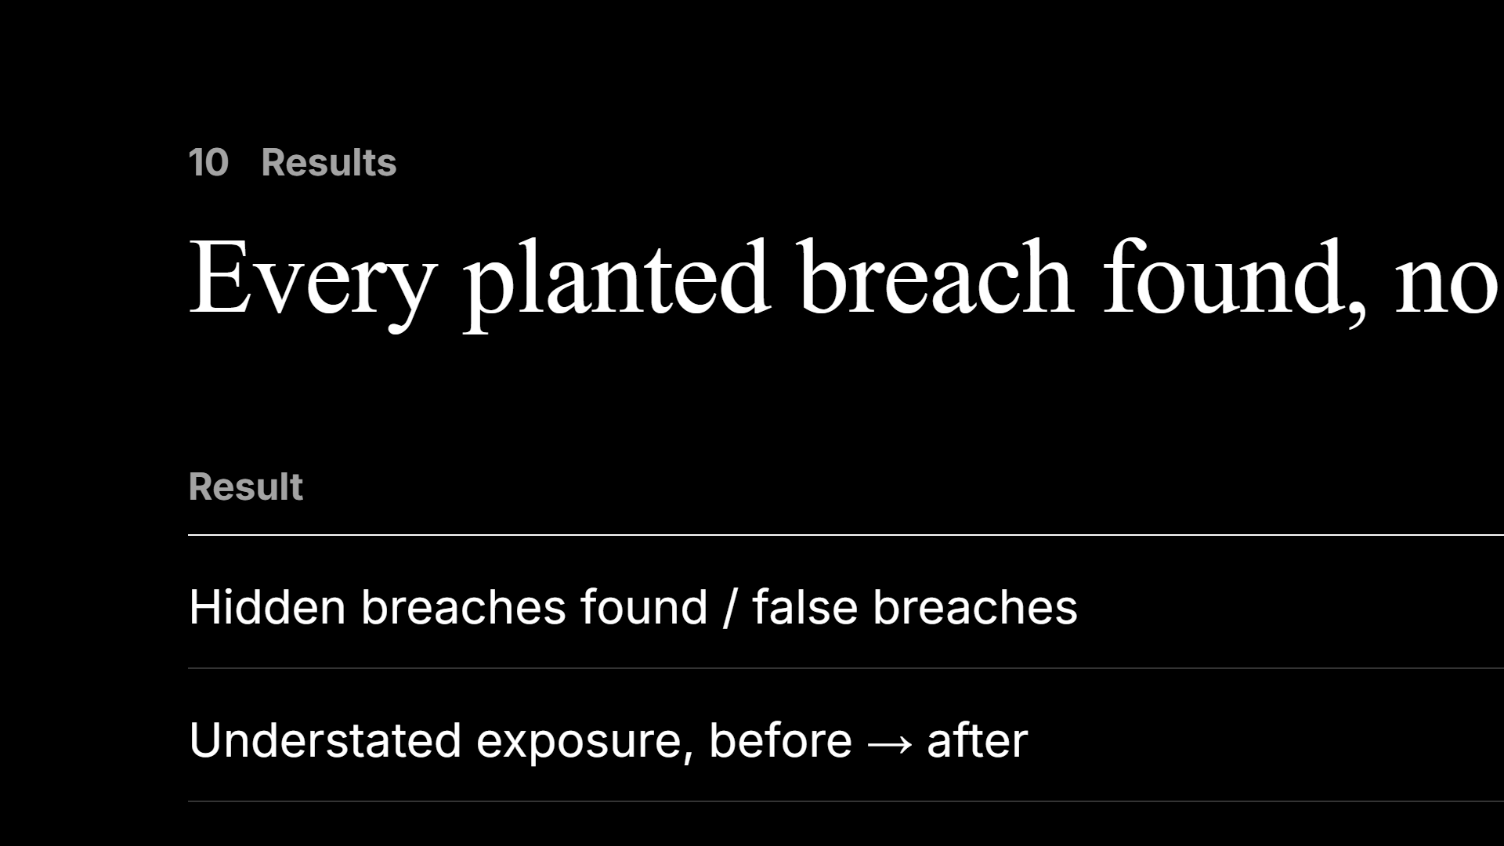
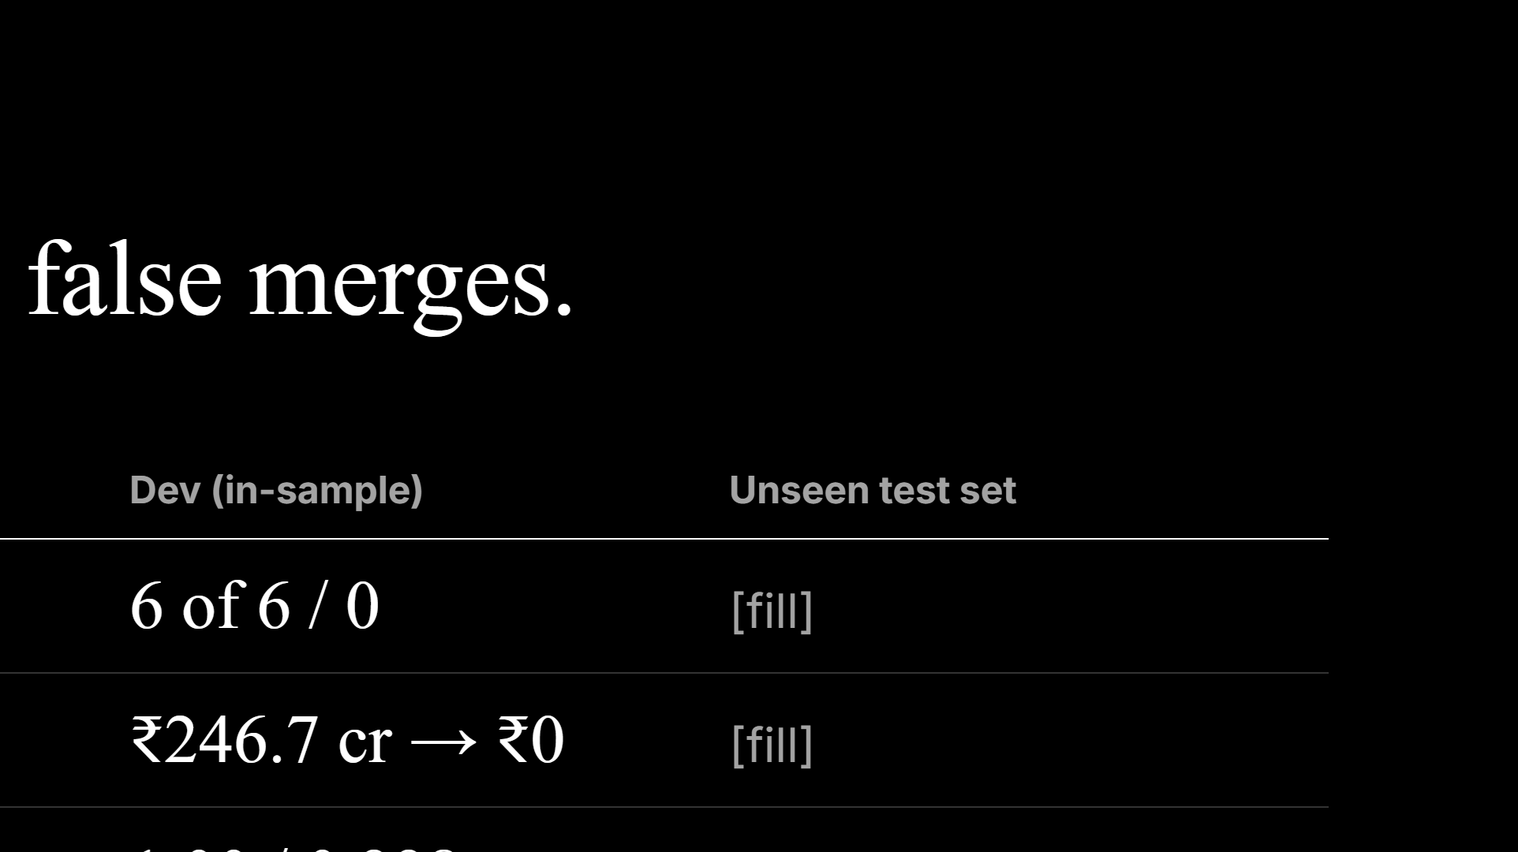
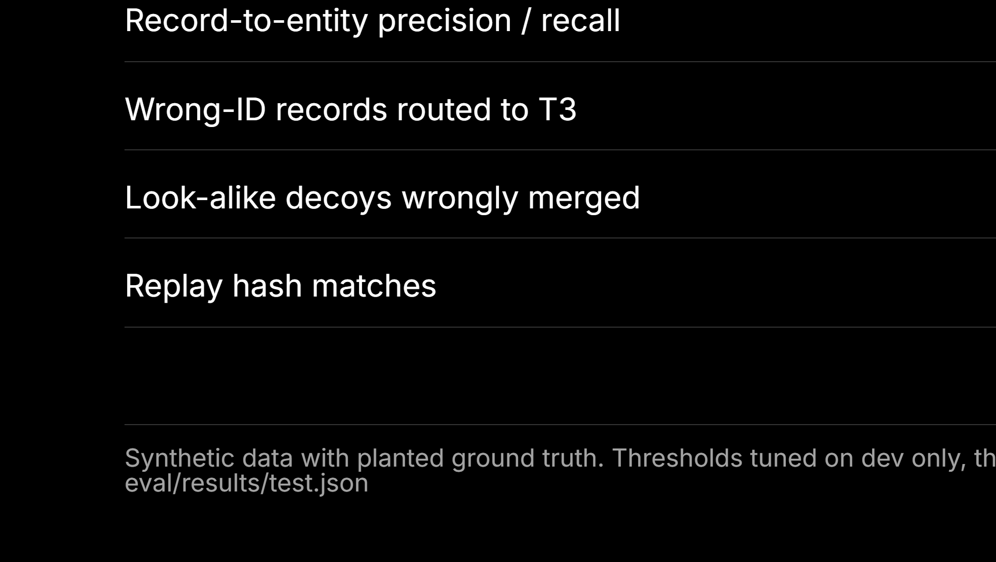
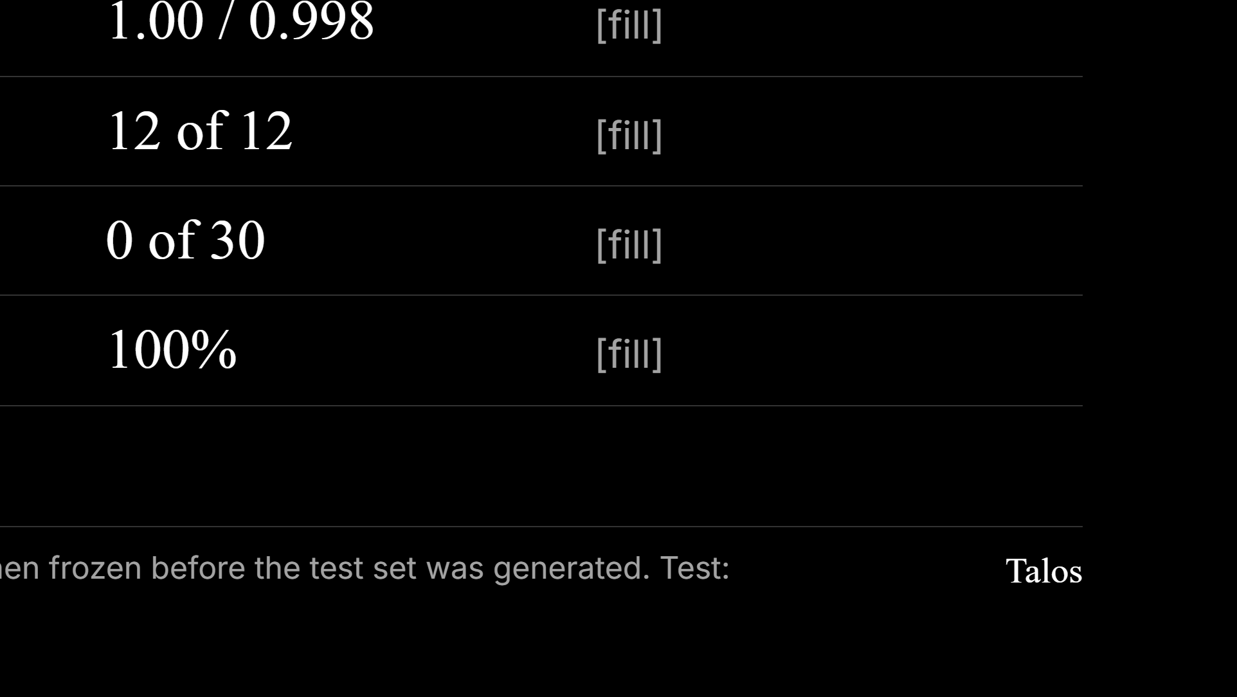
Notes:
Say that dev numbers are in-sample. If the test numbers are worse, show them anyway; judges trust a team that reports its own misses (misses_test.md). Live timings (dev): board 1.8 s, a decision 4 to 6 s (it waits for a fresh run), the ownership batch of 3,535 edges about 7 s.

Slide 11
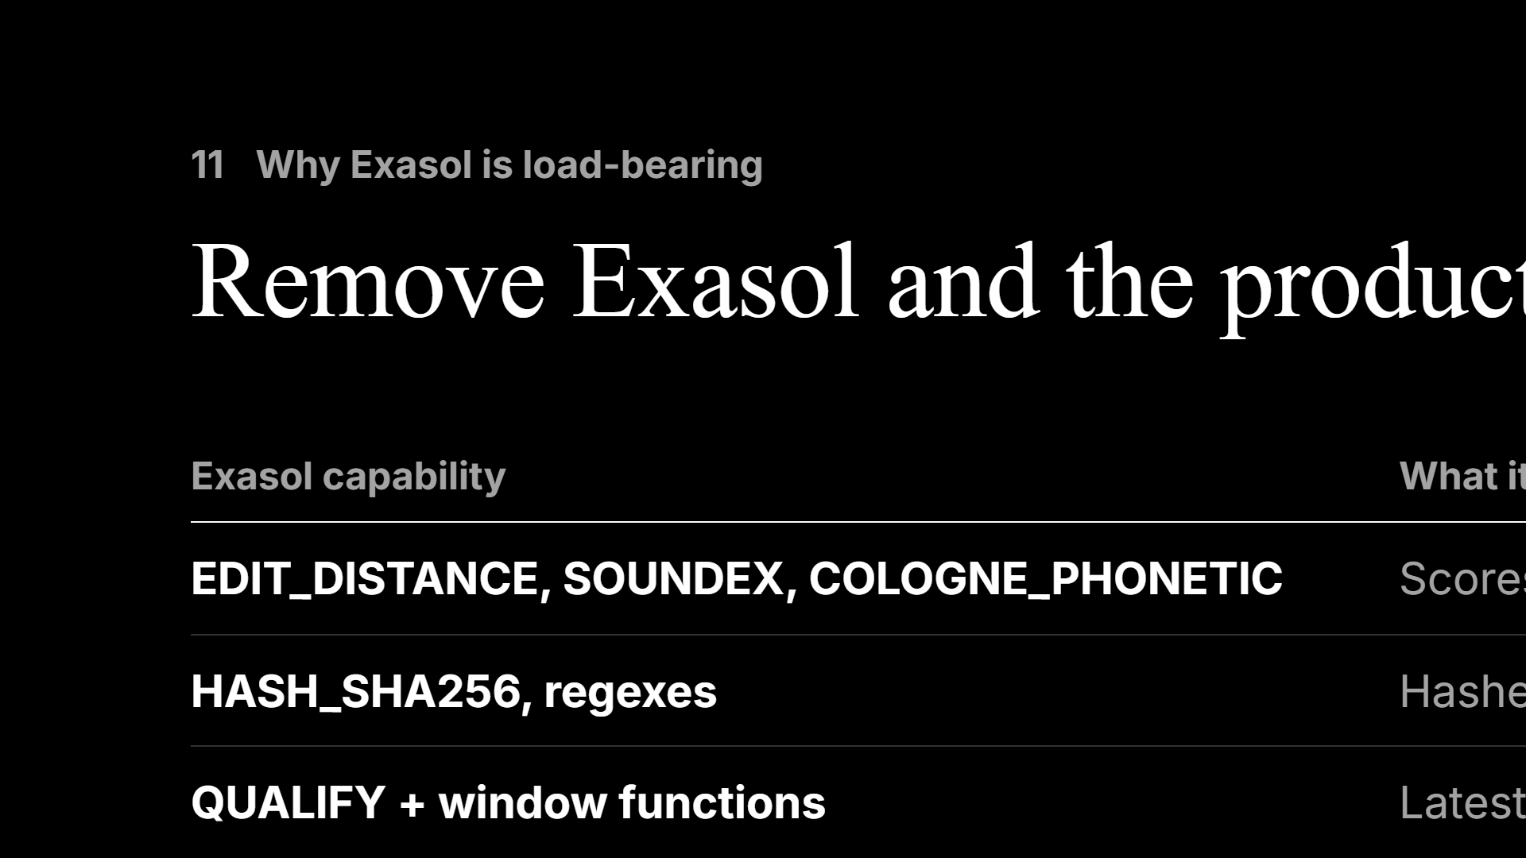
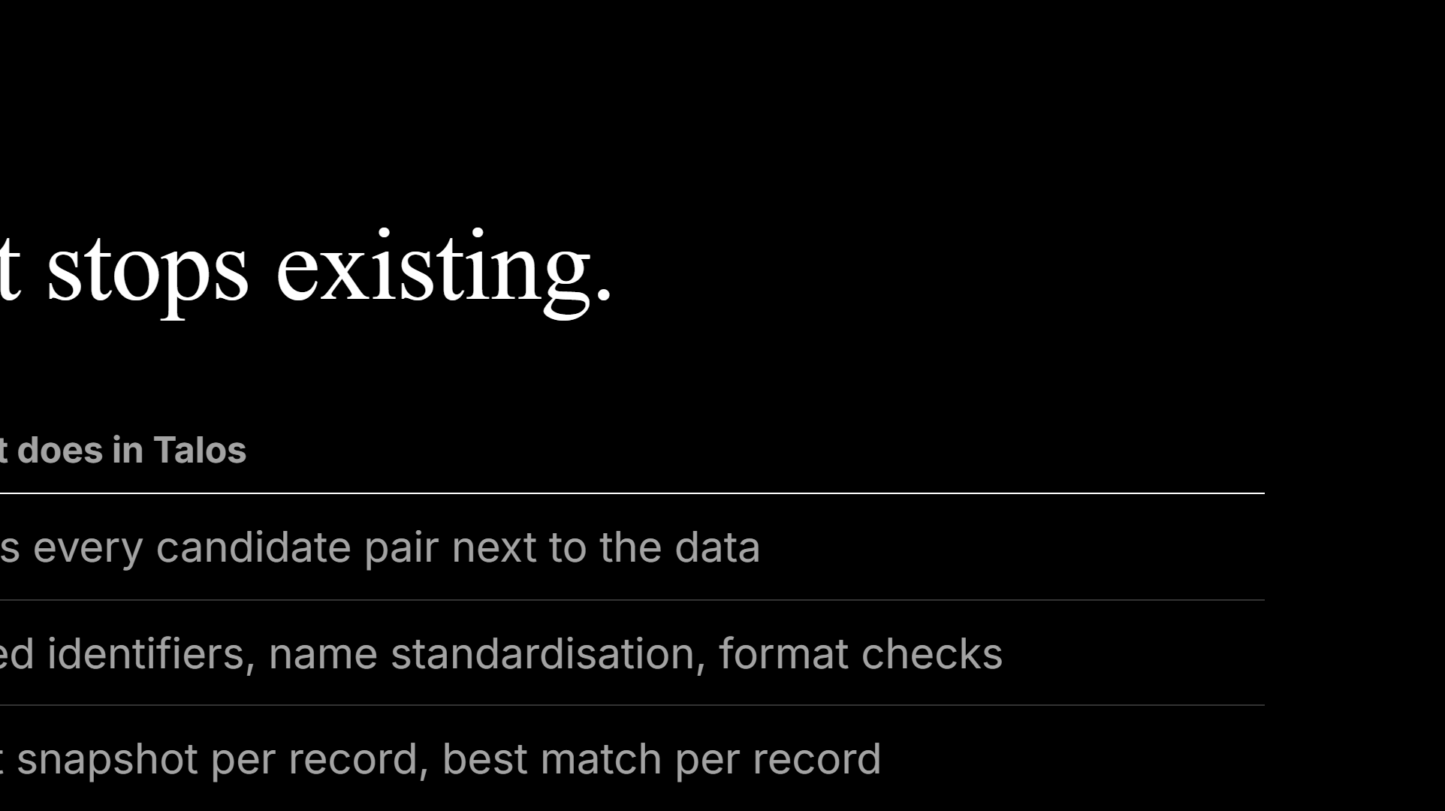
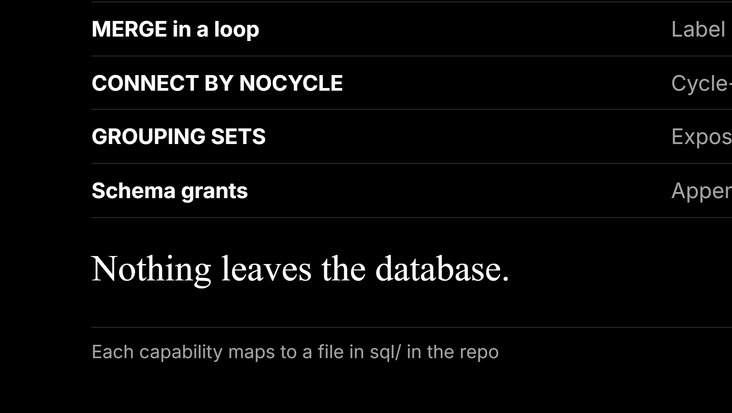
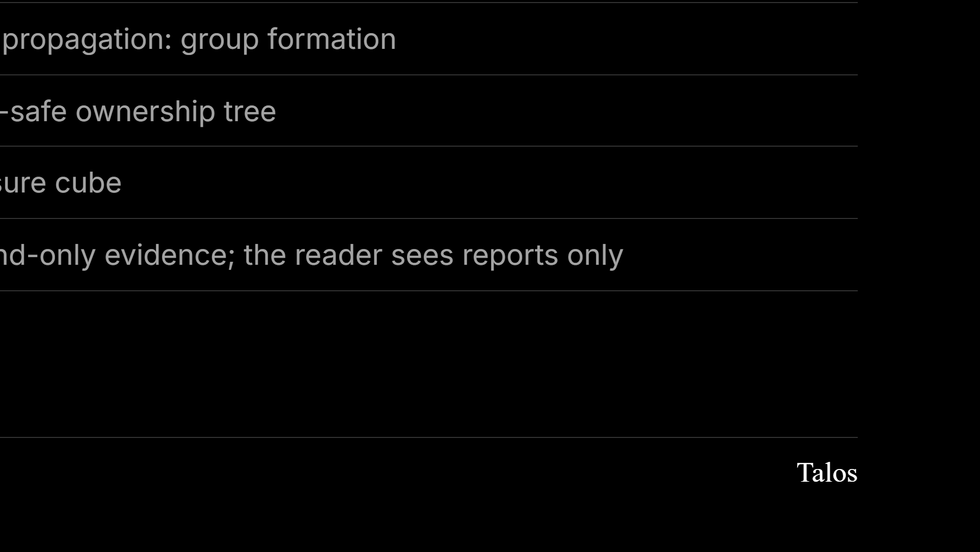
Notes:
If asked “why not a graph database”: non-public borrower data stays inside; the bitemporal as-of rule is plain SQL over append-only events; and the heavy steps are set operations the engine already parallelises.

Slide 12
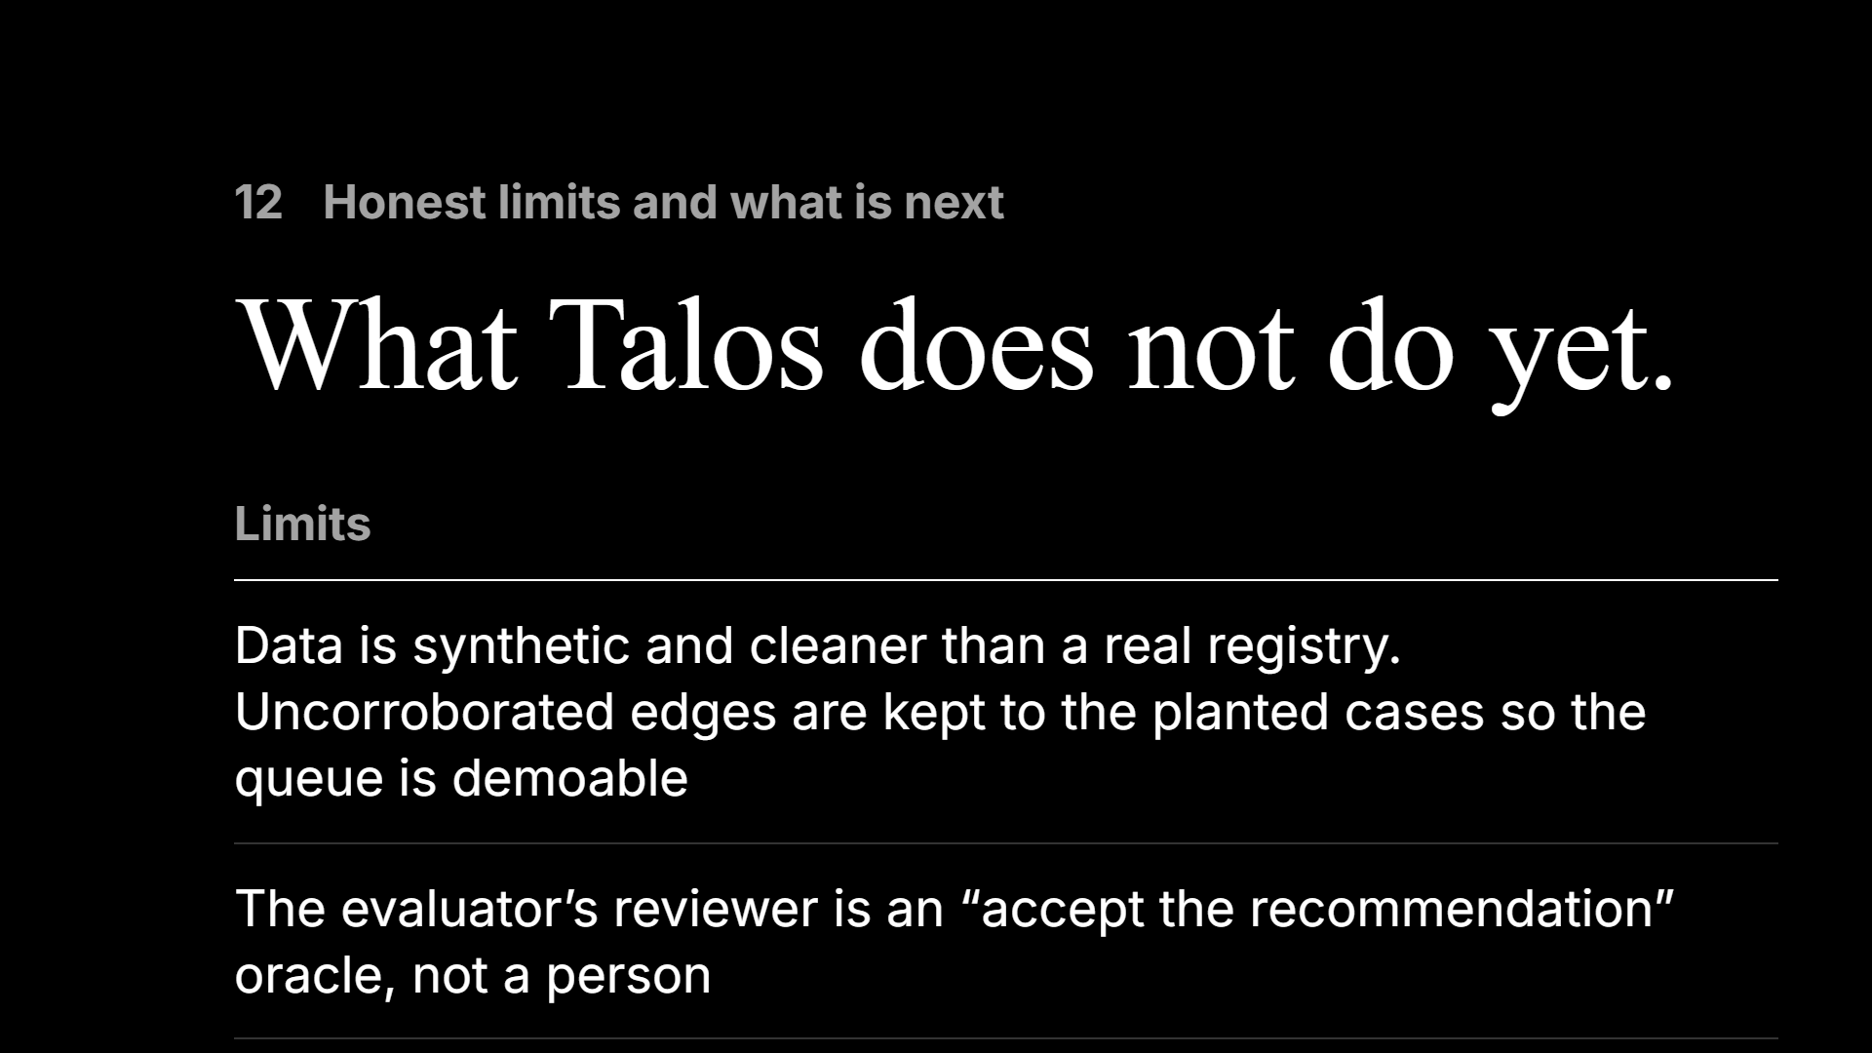
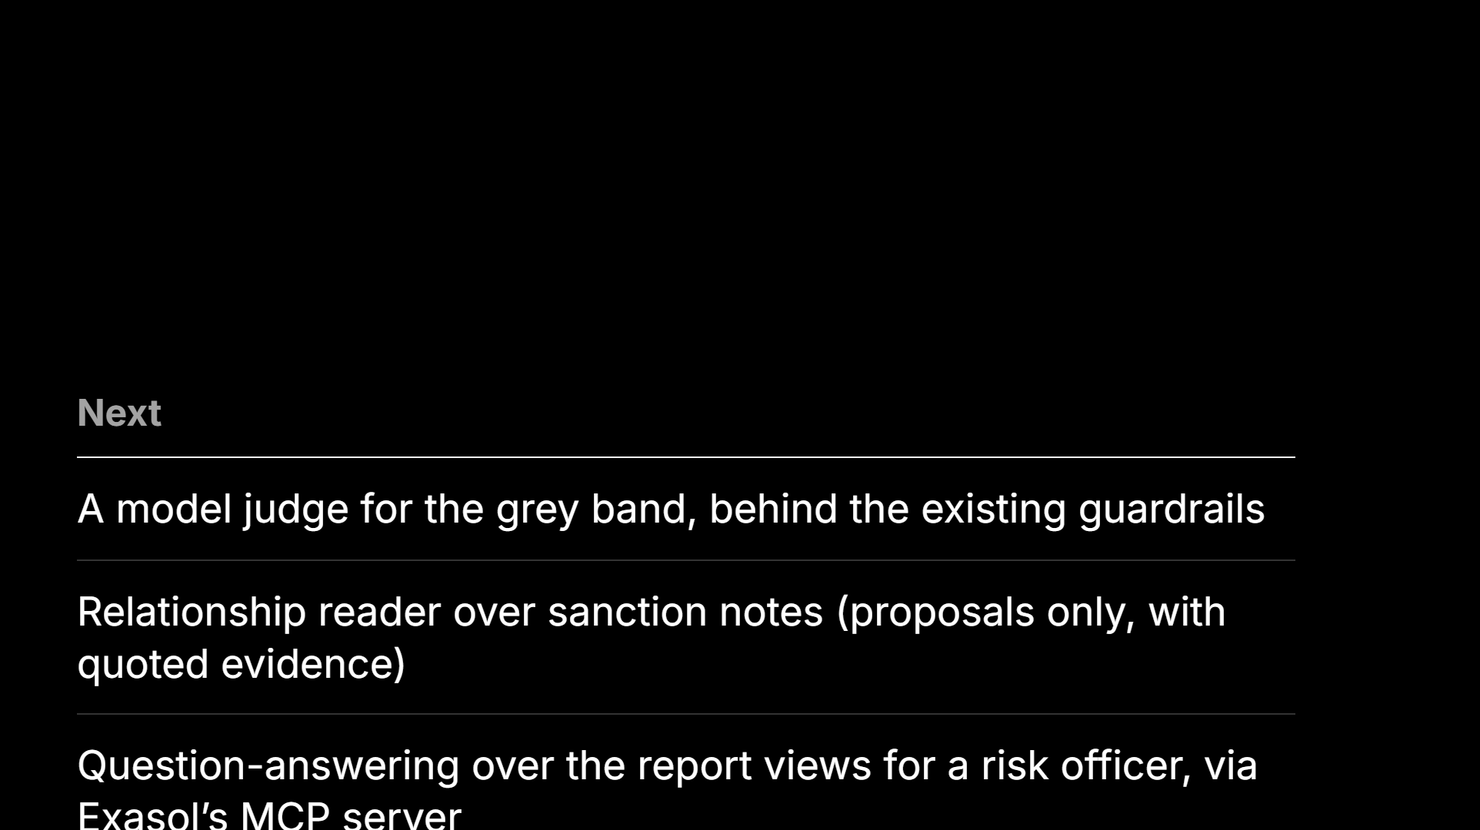
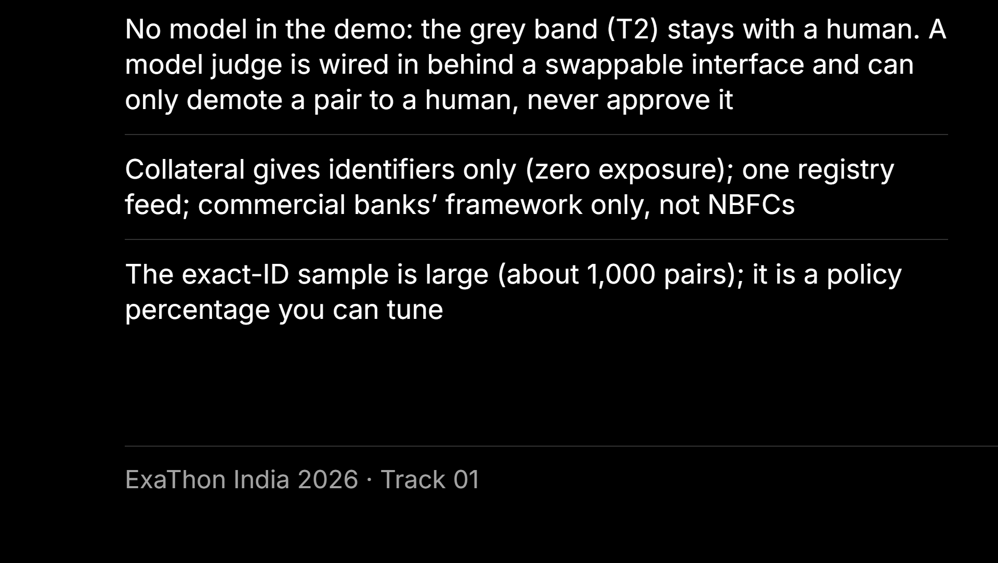
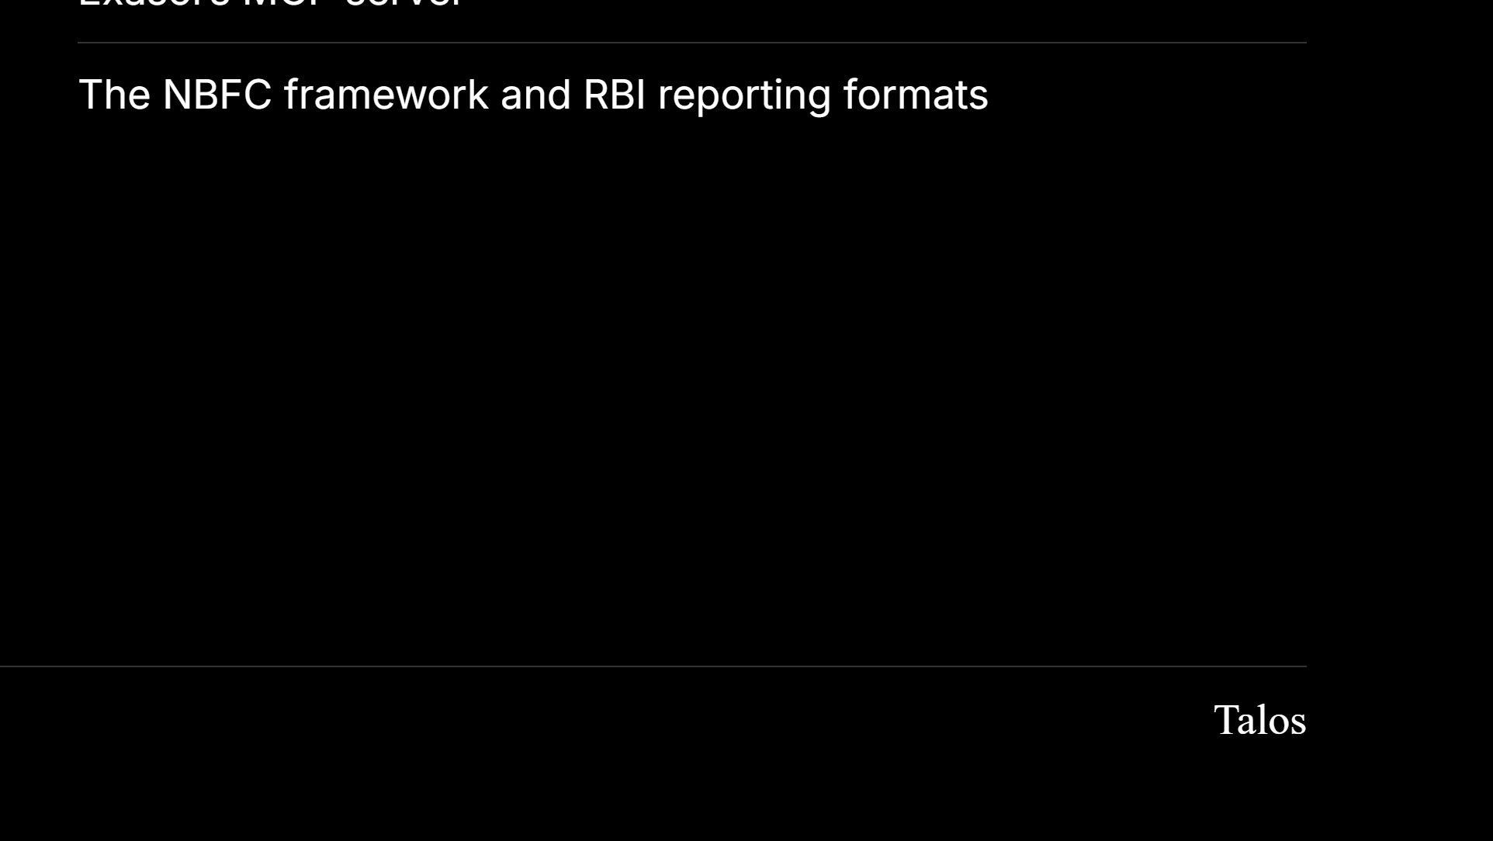
Notes:
Read the limits aloud. This slide is where the Q&A gets easier.

Slide 13
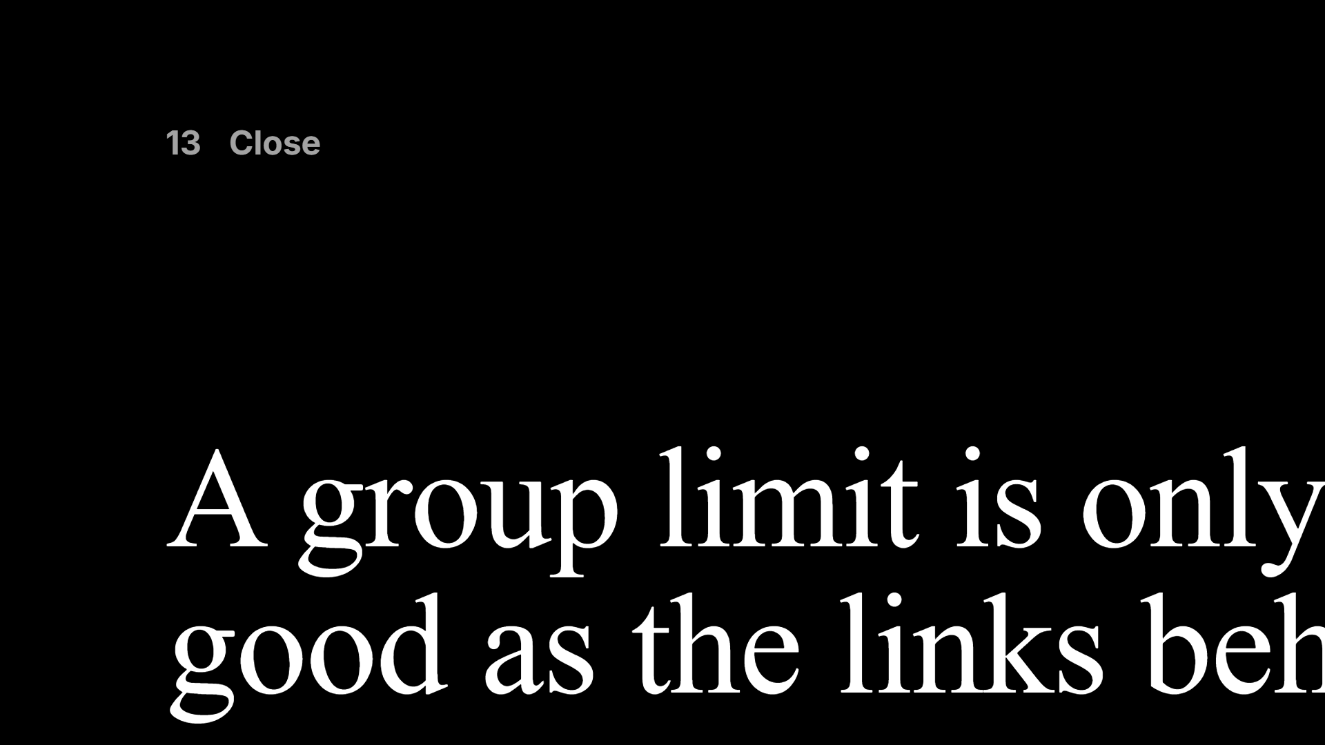
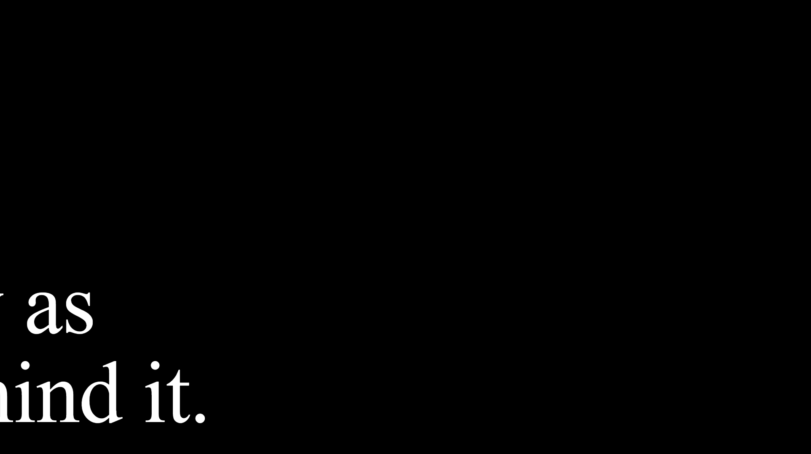
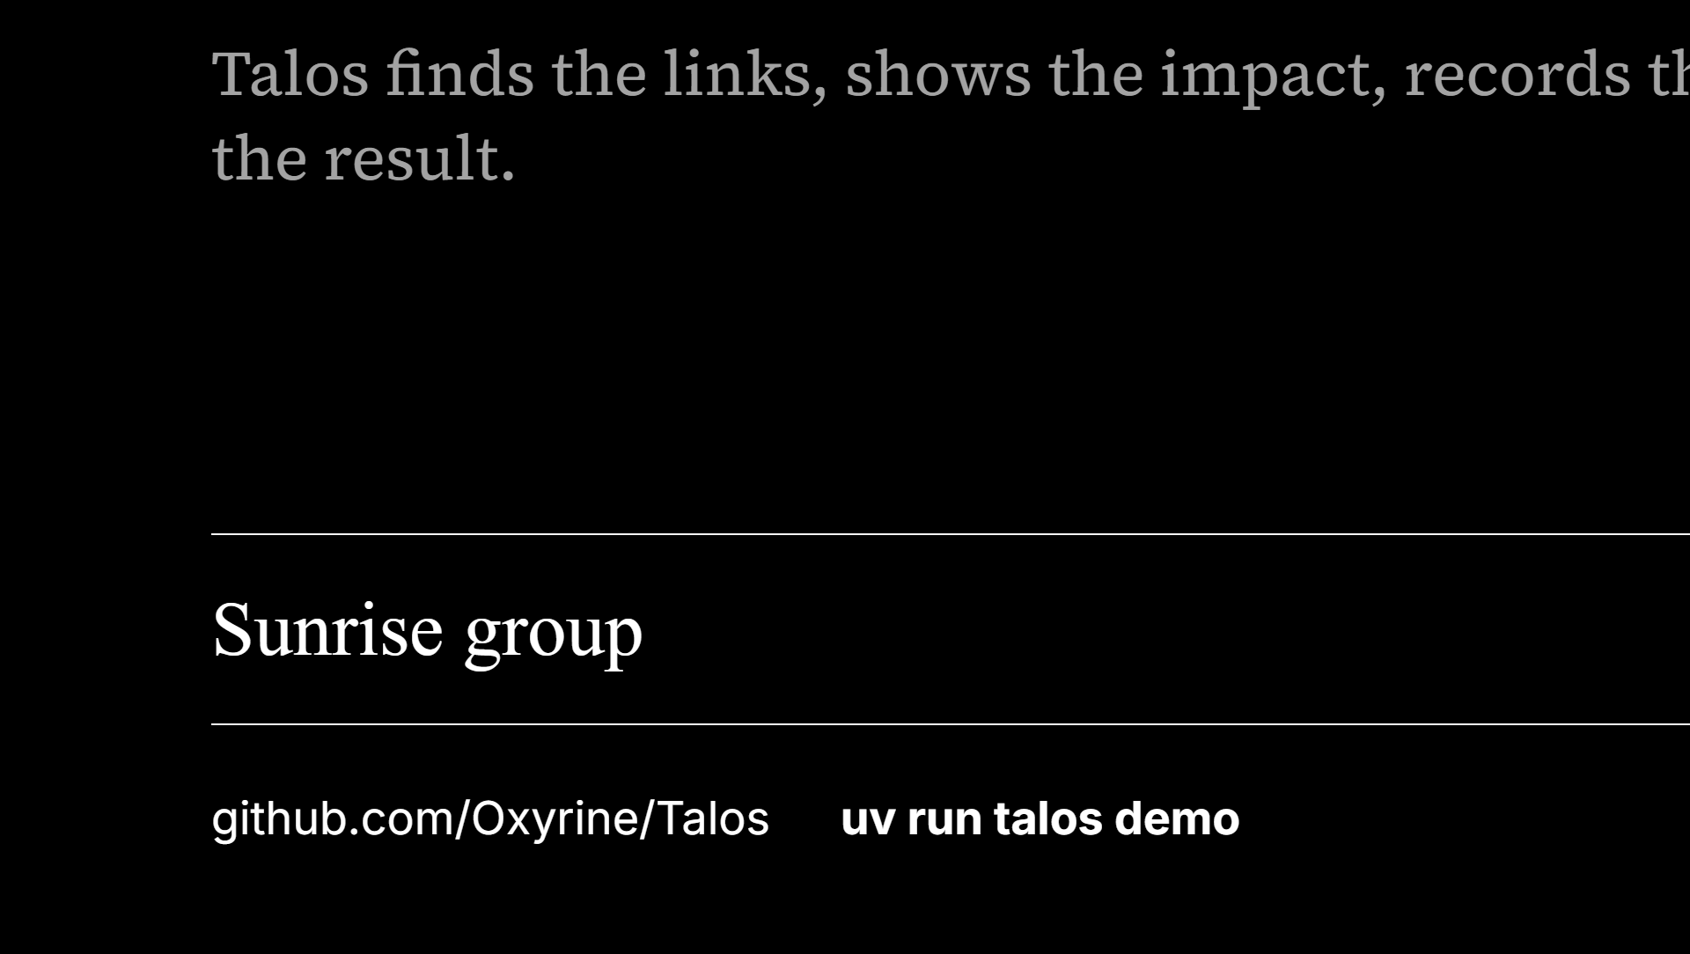
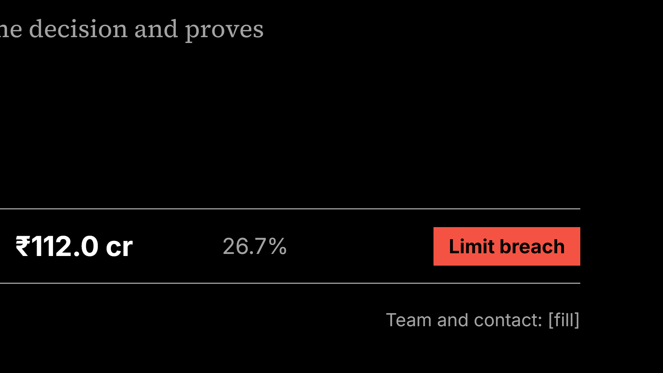
Notes:
End on the breach. Then stop talking.

Slide 14




Notes:
Backup slides. Use only when a question calls for them.

Slide 15




Notes:
Map each judging criterion to where the evidence lives.

Slide 16




Notes:
Walk the schemas left to right, then the five database roles and who can write where.

Slide 17




Notes:
Source: docs/PROBE.md. The one failure is Python UDFs on Nano, which is why the whole product is plain SQL.

Slide 18




Notes:
docs/VOICEOVER.md quotes about 11.5 million candidate pairs and under 2.5 minutes for blocking, scoring and grouping at scale. Confirm that against a real scale run before saying it.

Slide 19




Notes:
Full list: docs/DEMO_SCRIPT.md part 2 and docs/QA.md.

