Slide 1
Modeling Personal Finance Credit Usage Characteristics of Credit Card Holders
Yeşim Demir, Bahar Öztürk, Oya Suran, Fırat Tamur, Merve Sena Taşcı

Slide 2
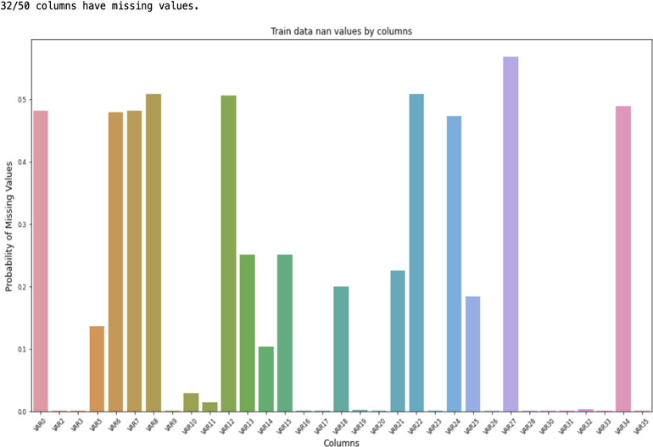
Analysis of Data
Figure 1 shows there are missing values in 32 columns and in some columns the missing value amount is more than 50%.
To tackle missing values different methods of imputation were tested (ex: filling missing values with mean, median, or mode). Missing values can be predicted as well by K-nearest Neighbor (KNN) or iterative approaches. There are also Tree methods like XGBoost, LightGBM.
Figure1: Showing missing data amount in test data set.

Slide 3
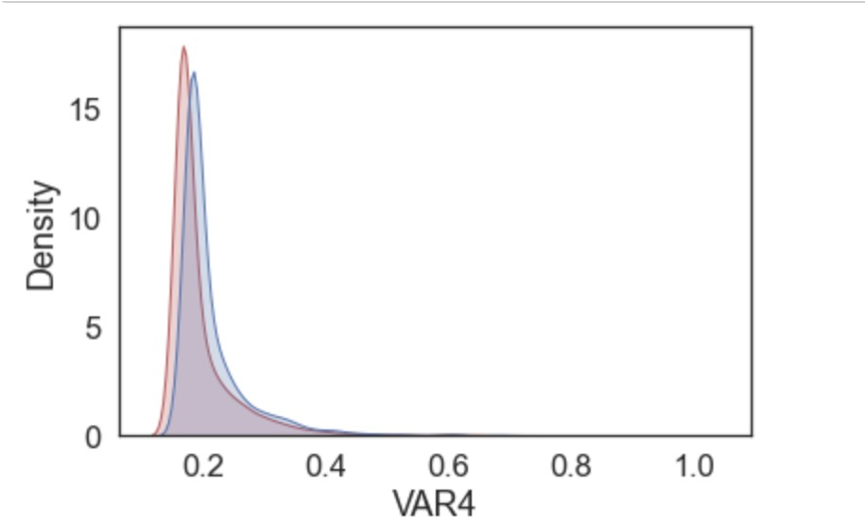
Analysis of Data
Figure2: Showing distributions of VAR1 and VAR2

Slide 4
Literature Review
There are several different ways to handle imbalance data:
Synthetic Minority Over-sampling Technique (SMOTE):
If data is synthetically generated for the less crowded class
Better results in non continuous data sets
Random Undersampling : removing random samples from the majority class
Random Oversampling: adding the same random data from the minority class to the minority class over and over again
similar to tuning class_weigth parameters in many Machine Learning algorithms in Python
Combinaton of undersampling and oversampling:
Can get better results
Used for credit card fraudulent transactions

Slide 5
Literature Review
There are also several different techniques to handle missing-value imputations:
Filling missing values with mean, median or mode
predicting values by K-nearest Neighbor (KNN) or iterative approaches.
Tree methods like XGBoost,, LightGBM which can handle missing values automatically without preprocessing
There are also several machine learning classifiers:
Support Vector Machine (SVM)s,
Decision trees,
Random forests,
KNN
Combining different classifiers like boostering algorithms

Slide 6
Literature Review
The Multilayer Perceptron Neural Network (MLP) has one or more layers of neurons. Data is given to the base (input) layer and prediction is made on the output layer. Between input and output layers there could be hidden levels as well. MLP is a supervised learning technique that trains on a data set to learn a function that represents data.
Decision Trees: the goal is to learn decision rules from data features to predict the value of a target variable. Decision trees are a non-parametric supervised learning method that can be used for classification and regression problems.
Random Forest algorithms are meta estimators that employ averaging to increase predicted accuracy and control over-fitting by fitting several decision tree classifiers on various sub-samples of the data set.
KNN is a neighbors-based classification is a kind of instance-based learning, also known as non-generalizing learning, in which no attempt is made to build a general internal model, instead of storing samples of the training data. Classification is determined by a simple majority vote of each point's nearest neighbors: a query point is assigned to the data class having the most representatives among the point's nearest neighbors.

Slide 7
Literature Review
Boosting algorithms: built from a set of weak classifiers that output a single strong classifier.
Gradient boosting refers to a class of ensemble machine learning algorithms that can be used for classification or regression predictive modeling problems.
The AdaBoost classifier: a meta-estimator that begins by fitting a classifier on the original data set and then fits additional copies of the classifier on the same data set but where the weights of incorrectly classified instances are adjusted such that subsequent classifiers focus more on difficult cases.
The LightGBM: GBDT open-source framework that enables for highly efficient training over huge data sets while consuming little memory. Gradient-based One-Side Sampling (GOSS) and Exclusive Feature Bundling (EFB) LightGBM can train each tree with only a small portion of the complete data set thanks to GOSS.
handles high-dimensional sparse features significantly better than EFB
supports GPU-accelerated distributed training with reduced communication costs
XGBoost: a scalable tree boosting technique commonly used by data scientists that produces cutting-edge outcomes on a variety of challenges. theoretically justified weighted quantile sketch for approximate learning and an unique sparsity aware technique for handling sparse data.
uses cache access patterns, data compression, and sharding for developing a scalable end-to-end system with tree boosting,

Slide 8
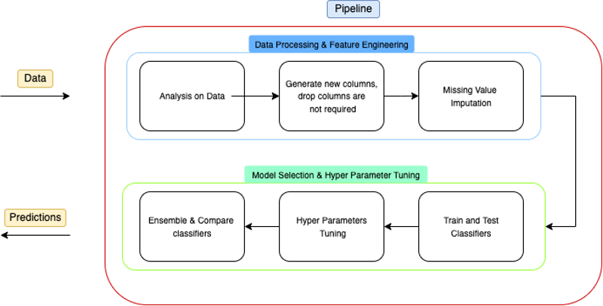
System Design
Figure3: Showing our pipeline for the project

Slide 9
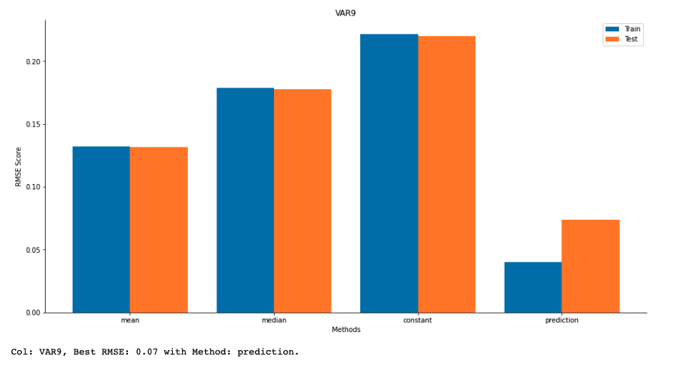
Handling problems in Reprocessing
To find the best method we looked at RMSE-scores of each column imputed by different methods.
Figure. 4 shows an example of our results from imputation:
For VAR9 and all other variable columns we tried imputing by using mean value of the column, median of the column, a constant value and by predicting the what value would be by training on filled rows of that column.
Figure4: Imputation methods RMSE score for VAR9

Slide 10
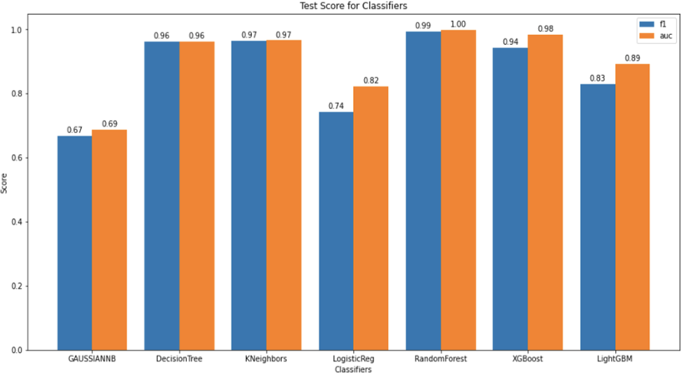
Consideration of Alternatives
Figure5: Showing Area under ROC, F₁-Score

Slide 11
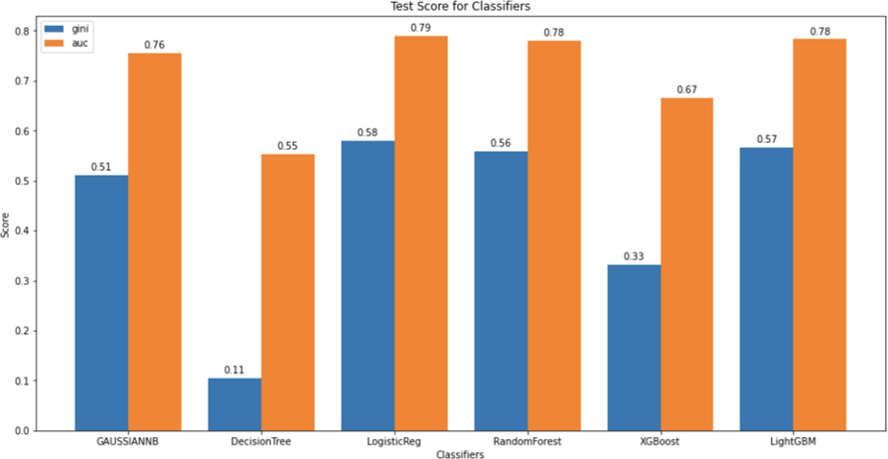
Implementation
Figure6: Showing test score for initial case (imputed with 0) test size 0.2

Slide 12
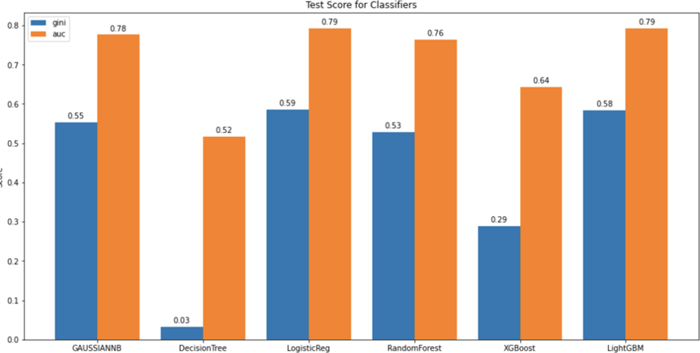
Implementation
Figure7: Showing test score for 40 selected feature for each classifier initial test size 0.2

Slide 13
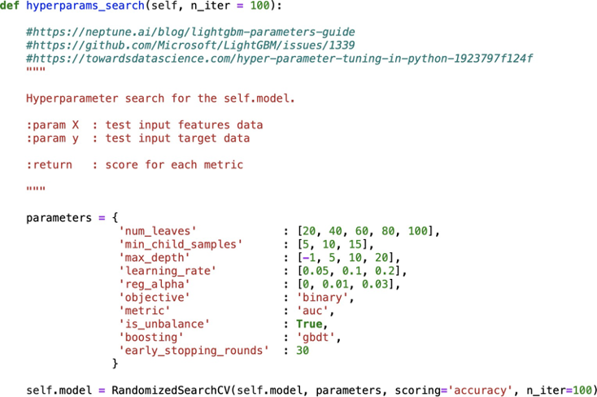
Implementation
Figure8: Showing alterations in hyperparams_seacrh function for LightGBM

Slide 14
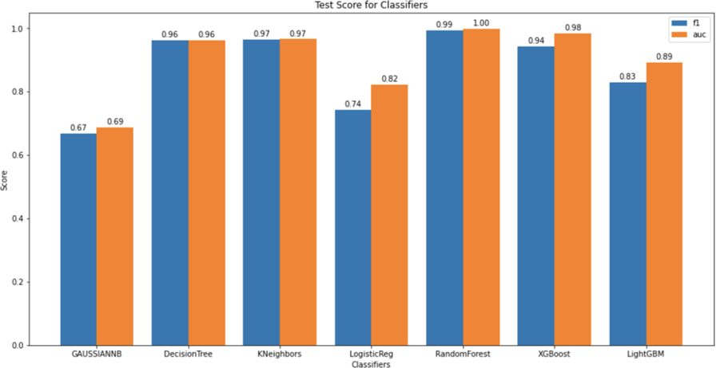
Implementation
Figure9: Showing test score for oversampling for selected models

Slide 15
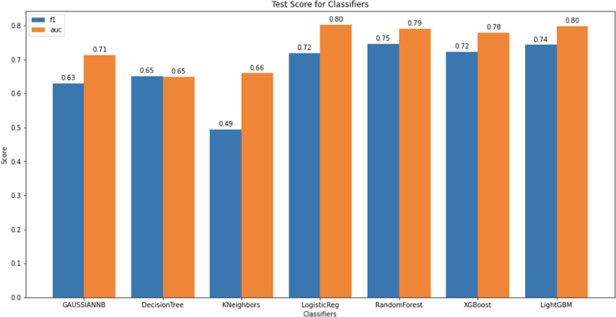
Implementation
Figure10: Showing test score for undersampling for selected models

Slide 16
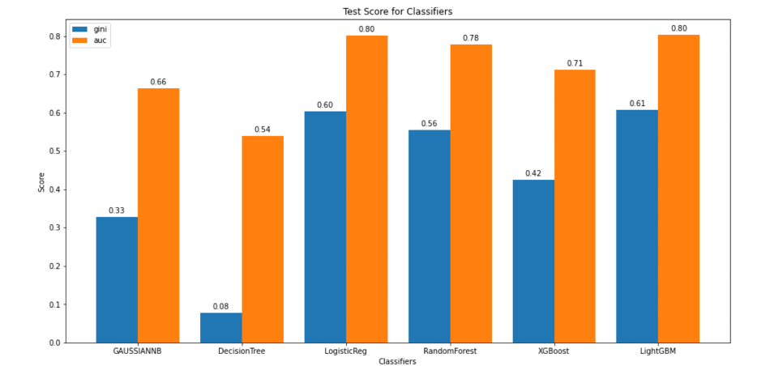
Implementation
Figure11: Showing test score (auc,gini index) where models adjusted with class weight

Slide 17
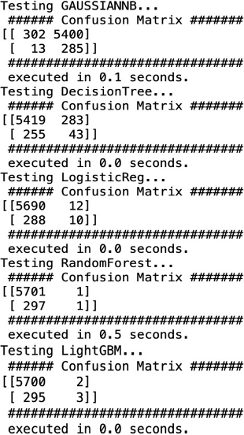
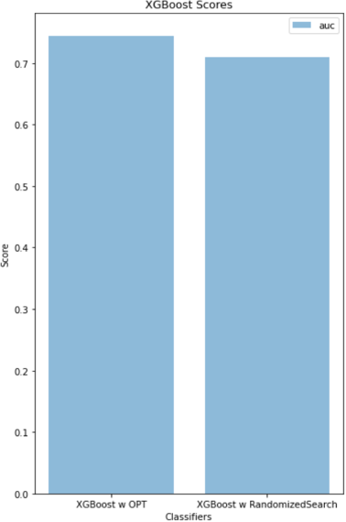
Implementation
Figure12:Confusion matrix for test set for all models
Figure 13: Showing results of XGBoost

Slide 18
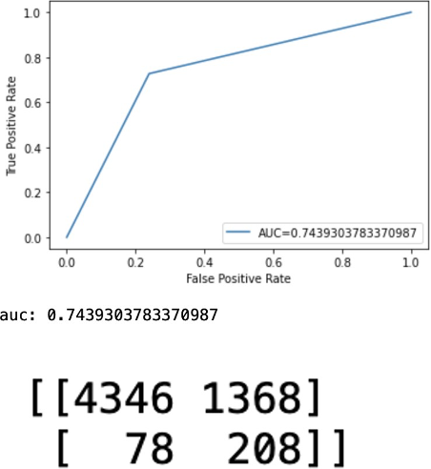
Implementation
Figure14: Showing auc score when XGBoost’s hyperparameters are tuned with optimizer

Slide 19
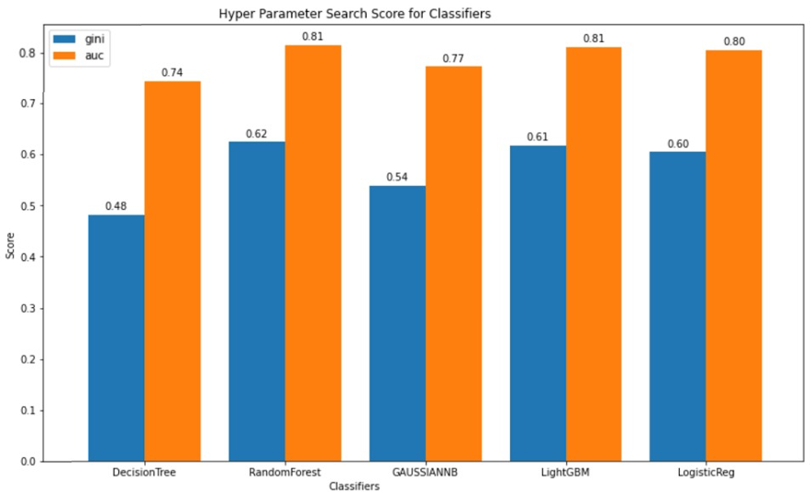
Implementation
Figure15: Showing test score when model’s hyperparameters are tuned

