Slide 1


Intra-Student Faculty Communication System
A college project presented by Manoj Bhosale

Slide 2

Introduction

Slide 3

Social Media sites allow users to communicate with people, share ideas, ac5vi5es, events, and interests within their networks. Social Media sites such as Twitter have attracted millions of users, many of whom have integrated these sites into their daily practices. There are hundreds of Social Networking Sites, with various technological affordances, supporting a wide range of interests and practices. Sites also vary in the extent to which they incorporate new informa5on and communication tools, such as mobile connectivity, blogging, and photo sharing.
The purpose behind implementing social media with this project is to build such a system through which job seekers i.e. students can stay updated about their jobs posts who are in a search of job

Slide 4

Existing System
Traditionally, there was no such web-based application where students could communicate with the recruiter company via writing an article or adding a post.
The student used to prefer the newspapers to search for a job of their choice.
Colleges may fail to produce the invitation from the recruiter company or any student may also have left behind by not sharing the information.
Companies were not able to filter out the students who aren’t eligible for a specific job.
A printed pamphlet could take more time for processing till it received by the student.
Less exposure to the world in the era of technology.

Slide 5




PROPOSED SYSTEM
Web application intends to provide a well-established web-based Social Network system between a job seeker and a recruiter. This documents a networking system scope, functionalities, requirements and feasibility. This project aims to develop a website that provides Communication among people on the network, which works quite similar to Social Media Site.
This website also provides the features of writing and posting a post or any event all at one place. The main idea behind it is to share the job-related details posted by the placement officer via adding a post that can be read by all the students as well as faculty using the website. This web application can be handled by the admin and manage student as well as faculty.

Slide 6
Modules
PLACEMENT OFFICER
ADMIN / PRINCIPLE
STUDENTS
STAFF
Register
Post
Update details
Create List
View Profiles
Add Post
View Profiles
Post an Event
Add Faculty
Approve Post
View / Delete Students
Approve Students
View / Delete Faculty

Slide 7
Requirements
HARDWARE
SOFTWARE
i3 Processor-Based Computer
1 GB RAM
256 GB Hard Disk Maximun
Monitor
Internet Connection
Windows 7 or higher.
WAMP Server
Notepad++.
My SQL 5.6.

Slide 8
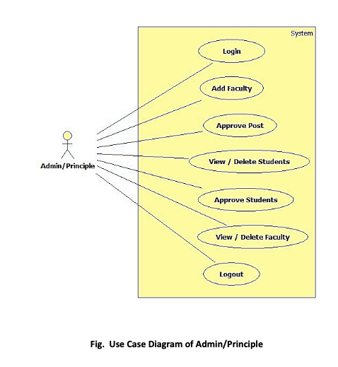
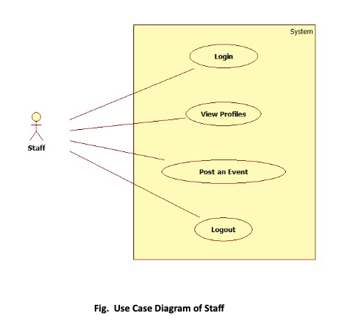
UML DIAGRAMS
USE CASE DIAGRAMS

Slide 9
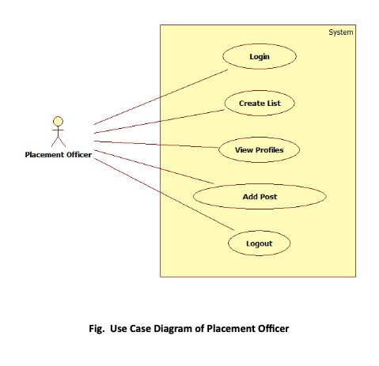
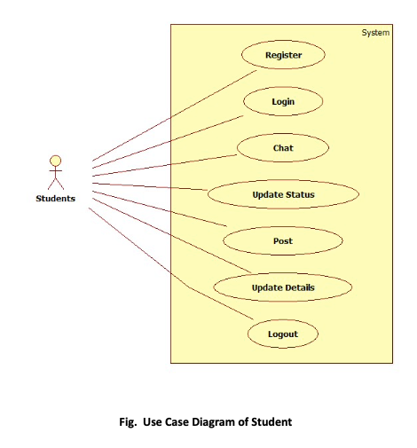
UML DIAGRAMS
USE CASE DIAGRAMS

Slide 10
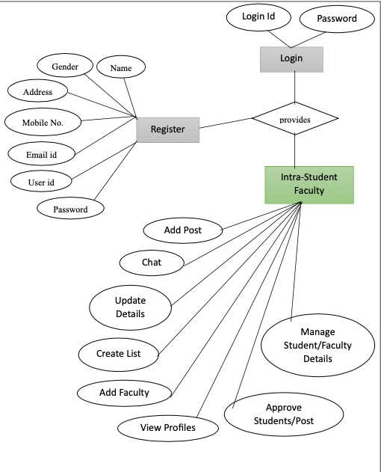
UML DIAGRAMS
ENTITY-RELATIONSHIP DIAGRAM

Slide 11
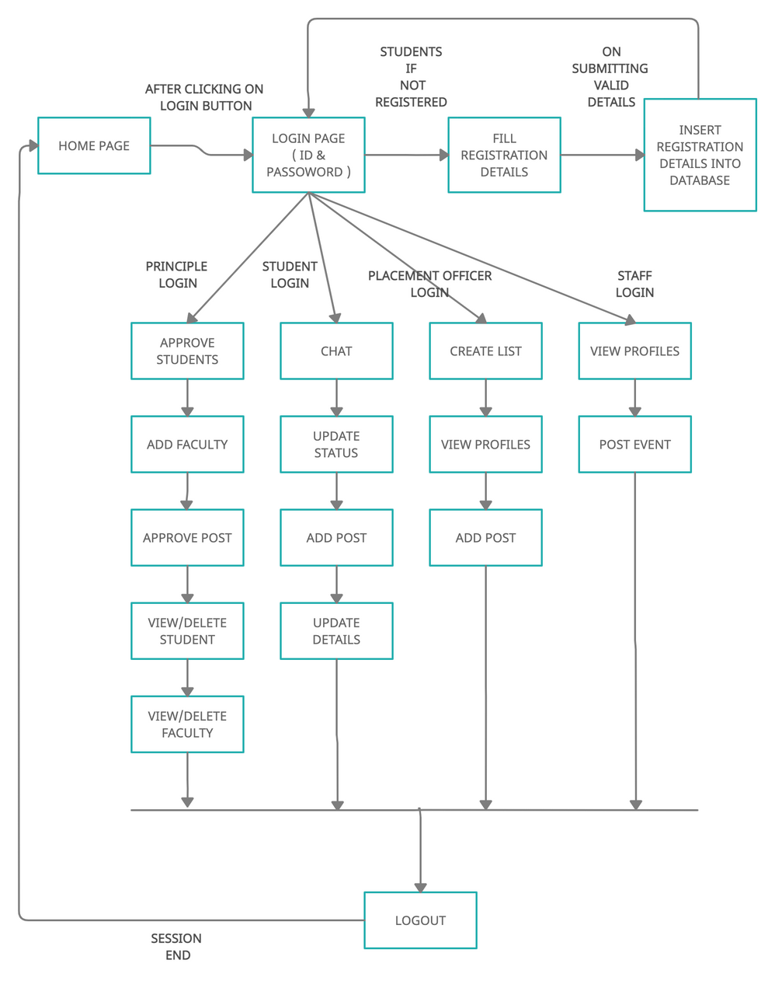
System
Architecture

Slide 12
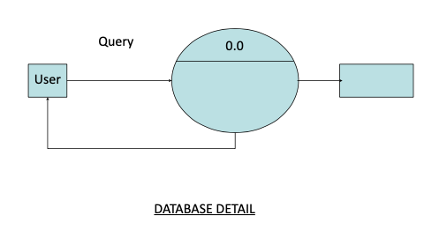
Data Flow Diagrams(Levels -0)

Slide 13
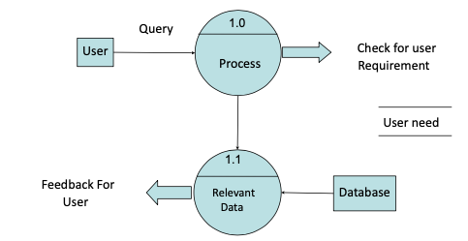
Data Flow Diagrams(Levels -1)

Slide 14
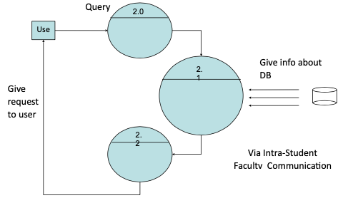
Data Flow Diagrams(Levels -2)

Slide 15

Screenshots

Slide 16
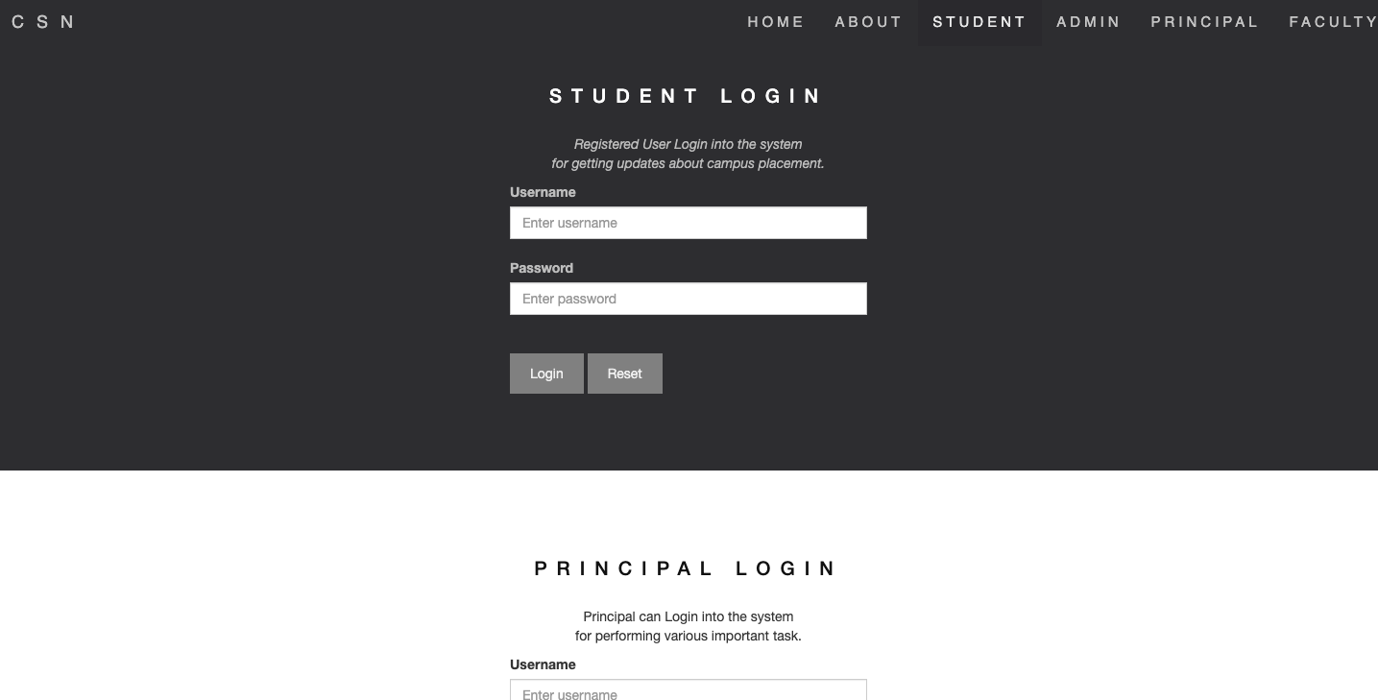
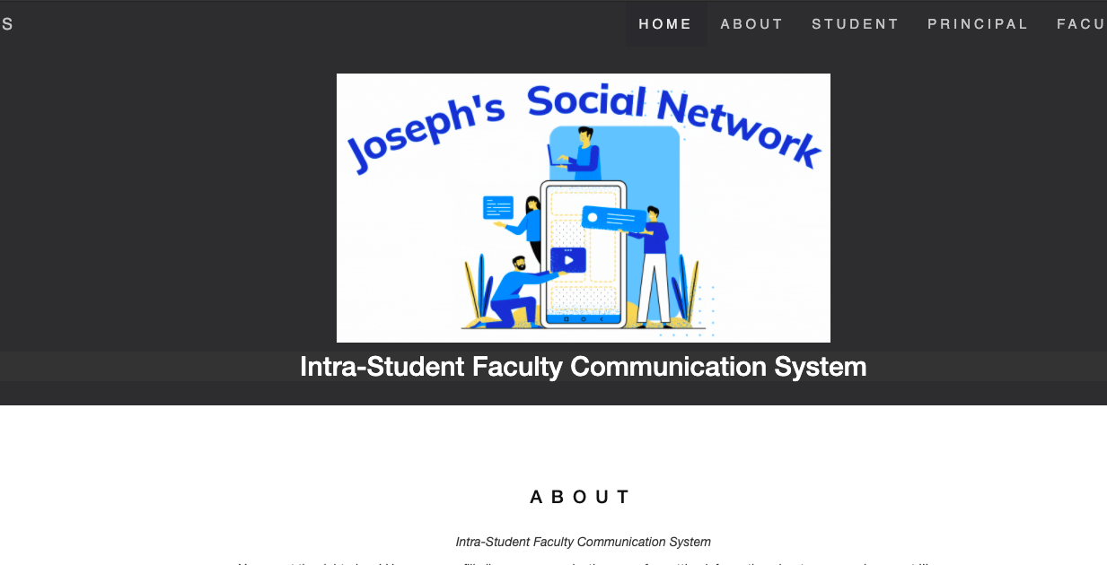


Slide 17
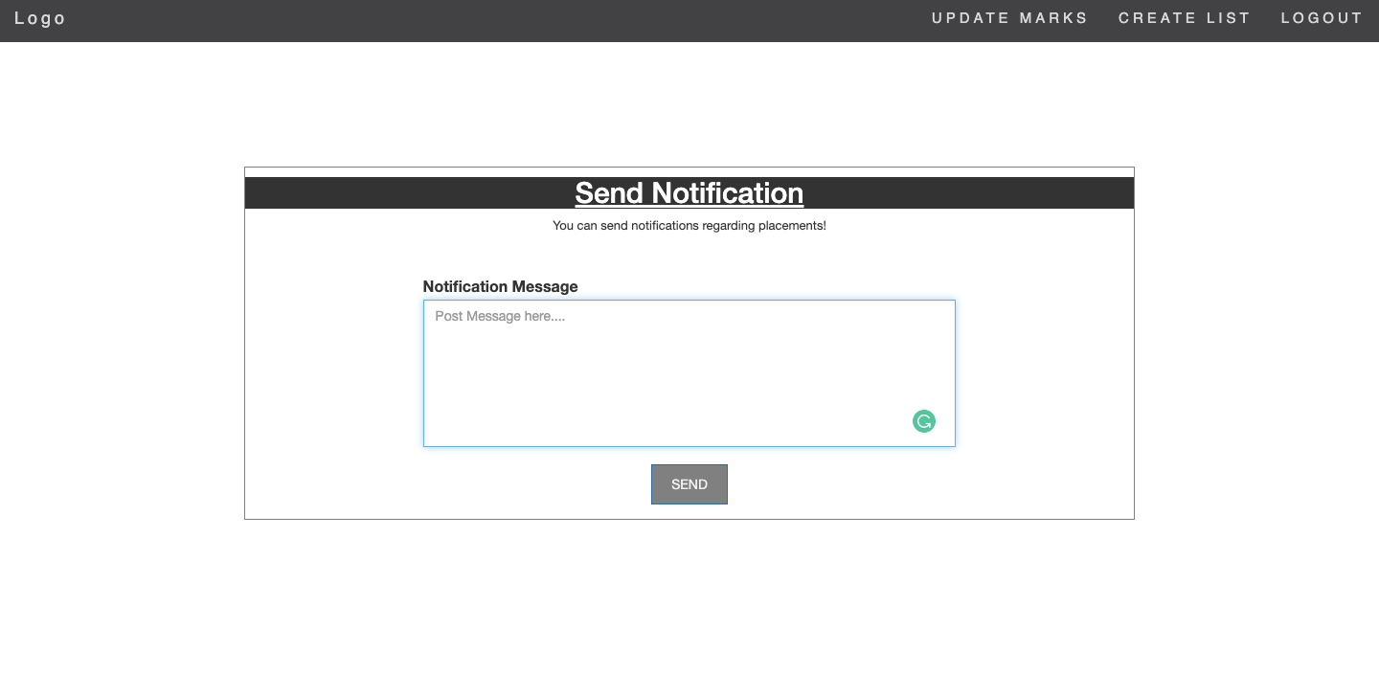
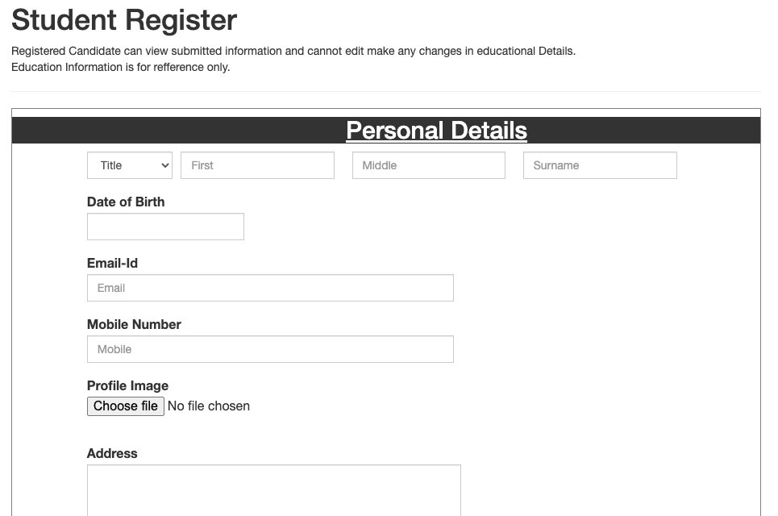


Slide 18
CONCLUSION
However, the effort to develop and maintain a Social Network website is usually far less than that expended for a real-life system. In some respects, this approach makes sense for making people communicate on the web. The identification of clear-cut interfaces is a standard structured programming technique, which reduces software maintenance costs. The only controversy might be over the particular choice of structure (i.e. social networking). In general, whenever an organizational site is likely to outlive its hardware, this web application approach warrants consideration. This is because of the high redevelopment costs. Now, when such a social network is easily approachable to the user via a website, it is easy and convenient for them to communicate with the concerned person through an article. It gives further opportunity to the coming students to enhance the IT technologies

Slide 19

Thank You

