Slide 1

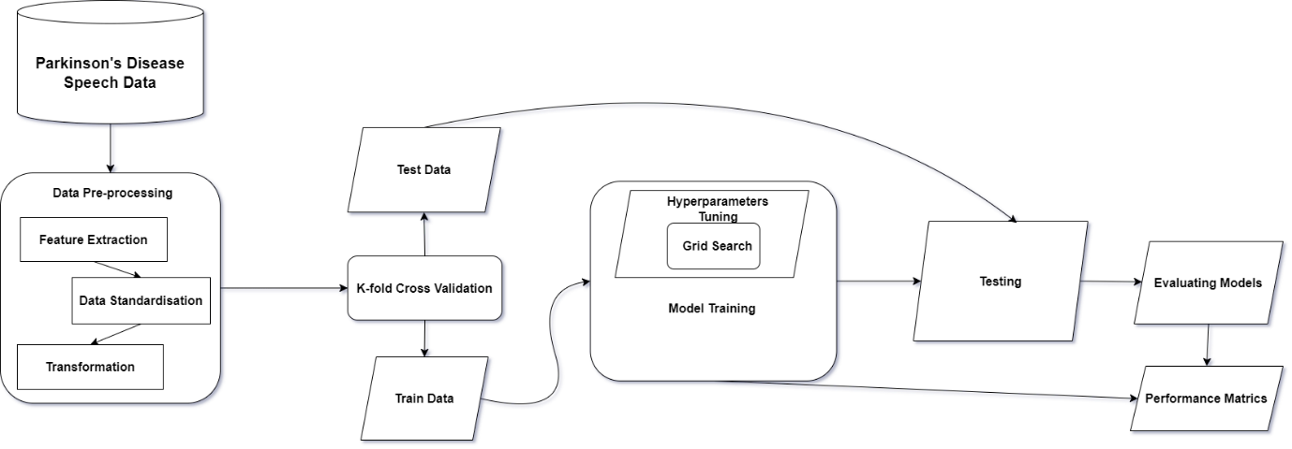
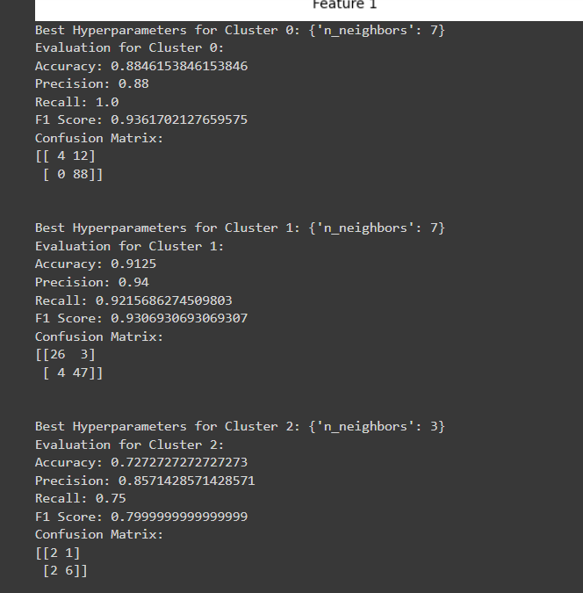
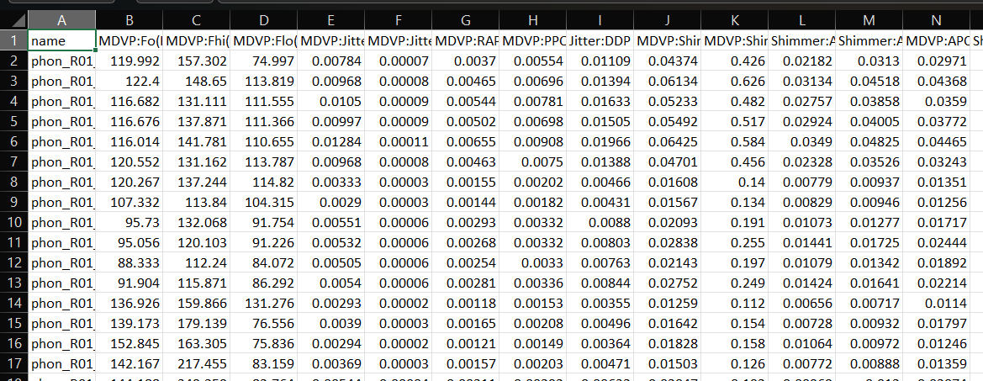
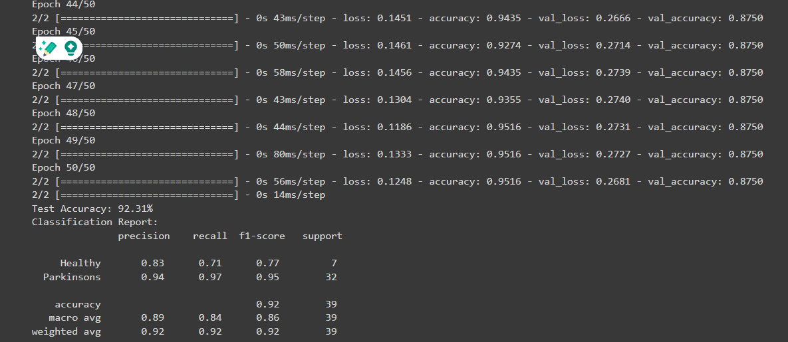
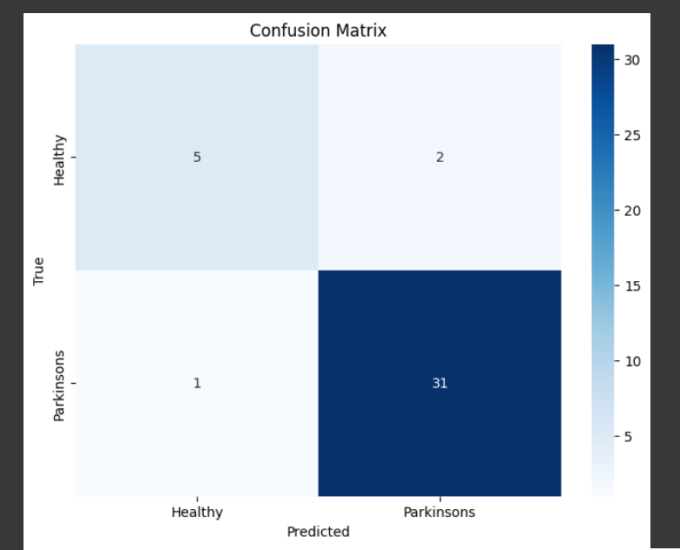
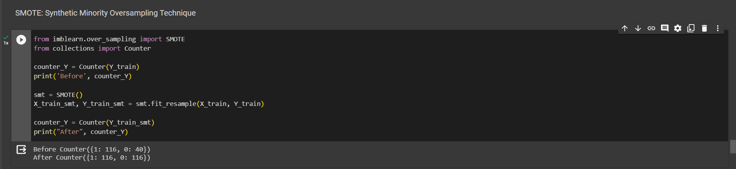
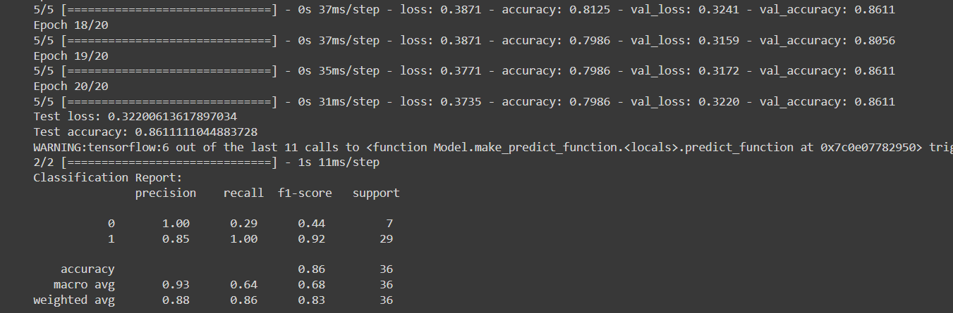
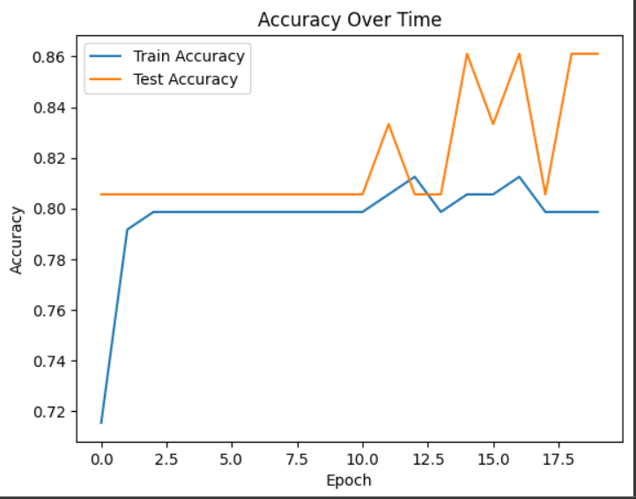
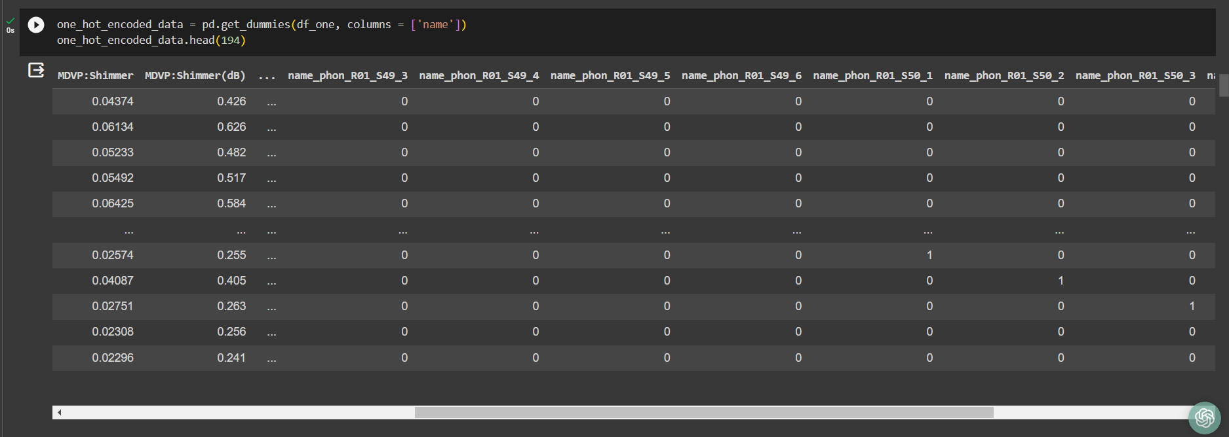
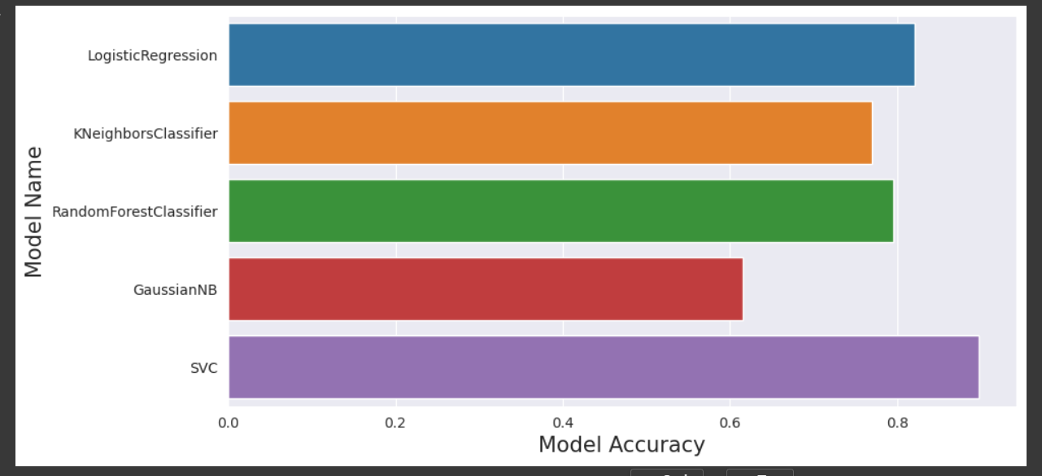
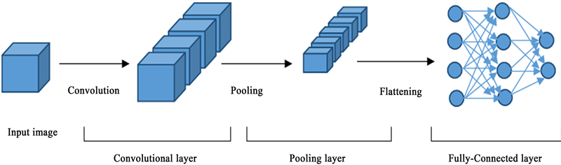
Parkinson’s Disease Detection Using Machine Learning
Zarak Jahan., Amrita Vishwa Vidyapeetham
(A) GOAL & CONTRIBUTIONS
(G) Hyper Parameters CNN
Our goal is to identify Parkinson’s Disease using voice measurement and detection:
Early Detection: Machine learning models can help in the early detection of Parkinson's disease by analysing various data sources, such as patient demographics, medical history, and sensor data
Accurate Diagnosis: ML algorithms can provide more accurate and reliable diagnoses by analyzing complex patterns and relationships within the data. This can help reduce misdiagnosis rates and improve overall patient outcomes.
S.NO | HYPERPARAMETERS | CNN
1. | Training and Validation Ratio | 80:20
2. | Optimization Algorithm | Adam
3. | Learning Rate | 0.001
4. | Activation Function | ReLU, Softmax
5. | Number Of Epochs | 10
6. | Accuracy | 91.25%
7. | Precision | 0.94
8. | Recall | 0.92
9. | F1 Score | 0.93
Keywords: Parkinson’s Disease, Algorithms, Machine Learning, Misdiagnose rate
(B) Model Diagram
(C) Dataset Description
(H) Hyper Parameters AlexNet
This dataset comprises a range of biomedical voice measurements from 31 people, 23 with Parkinson's disease (PD). Each column in the table is a particular voice measure, and each row corresponds to one of 195 voice recordings from these individuals ("name" column). The main aim of the data is to discriminate healthy people from those with PD, according to the "status" column which is set to 0 for healthy and 1 for PD.
S. No | Parameters | Value
1 | Epochs | 50
2 | Accuracy | 92.31%
3 | Training Loss | 0.12
4 | Validation Accuracy | 87%
5 | Validation Loss | 0.26
6 | Testing Accuracy | 92.31%
7 | Batch Size | 64
8 | Learning Rate | 0.001
9 | Dropout | 0.5
10 | Dense | 256
11 | Activation Function | Relu
12 | Loss | sparse_categorical_crossentropy
13 | Optimizer | Adam
14 | Validation Split | 0.2
15 | Test size | 0.2
Dataset Link: https://www.kaggle.com/datasets/vikasukani/parkinsons-disease-data-set
(D)Noise Removal (SMOTE)
(I) Hyper Parameters GRU
Synthetic Minority Oversampling Technique - SMOTE is an oversampling technique where the synthetic samples are generated for the minority class. This algorithm helps to overcome the overfitting problem posed by random oversampling. It focuses on the feature space to generate new instances with the help of interpolation between the positive instances that lie together.
S. No | Parameters | Value
1 | Epochs | 20
2 | Accuracy | 79.86%
3 | Training Loss | 0.37
4 | Validation Accuracy | 86.11%
5 | Validation Loss | 0.32
6 | Testing Accuracy | 77.77%
7 | Test Loss | 0.32
8 | Batch Size | 32
9 | Loss | binary_crossentropy
10 | Optimizer | adam
11 | Activation Function | Sigmoid
12 | GRU Unit | 100
13 | Learning rate | 0.001
14 | Test size | 0.2
(E)One Hot Encoding
It represents categorical variables as numerical values in a machine-learning model. Before performing One hot encoding the dataset has a categorical column called Name which has string values and we need to change them to numerical value.
(J) Accuracy
S.No. | Model | Epochs | Validation Accuracy
1. | CNN(Convolutional Neural Network) | 10 | 91.25%
2. | AlexNet | 50 | 92.31%
3. | GRU | 20 | 79.86%
(F)CNN Architecture
(K)References
[1] I. Nissar, W. A. Mir, Izharuddin, and T. A. Shaikh, “Machine learning approaches for detection and diagnosis of Parkinson’s disease - A review
[2] R. Lamba, T. Gulati, H. F. Alharbi, and A. Jain, “A hybrid system for Parkinson’s disease diagnosis using machine learning techniques,” Int. J. Speech Technol., vol. 25, no. 3, pp. 583–593, 2022..
[3] S. Tadse, M. Jain, and P. Chandankhede, “Parkinson’s detection using machine learning,” in 2021 5th International Conference on Intelligent Computing and Control Systems (ICICCS), 2021

