Slide 1
Parkinson’s Disease Detection Using Machine Learning
By
Zarak Jahan
CB.SC.P2AIE23005

Slide 2
CONTENTS
Conference Papers
Journal Details
Model Diagram
Noise Removal (SMOTE Algorithm)
One Hot Encoding
Linear regression
Logistic regression
Lasso Regression
Ridge Regression
Comparison of Regression models
K-means with KNN
Fuzzy C-means with K-means
K-means with SVM
Baysian Classifier
Naïve Bayes Classifier
Decision tree
Comparison Table for Classifiers
K-means with CNN
AlexNet
LSTM
GRU
Model Evaluation for Parkinson’s Model
References

Slide 3
Conference Papers
Paper Name | Conference Name | Citation
Machine Learning Approaches for Detection and Diagnosis of Parkinson’s Disease- A Review | 2021 7th International Conference on Advanced Computing & Communication Systems (ICACCS) | I. Nissar, W. A. Mir, Izharuddin, and T. A. Shaikh, “Machine learning approaches for detection and diagnosis of Parkinson’s disease - A review,” in 2021 7th International Conference on Advanced Computing and Communication Systems (ICACCS), 2021.
Parkinson's Detection Using Machine Learning | Proceedings of the Fifth International Conference on Intelligent Computing and Control Systems (ICICCS 2021) | S. Tadse, M. Jain, and P. Chandankhede, “Parkinson’s detection using machine learning,” in 2021 5th International Conference on Intelligent Computing and Control Systems (ICICCS), 2021
A Deep Learning Based Method for Parkinson’s Disease Detection Using Dynamic Features of Speech | IEEE Access (Volume: 9) | C. Quan, K. Ren, and Z. Luo, “A deep learning based method for Parkinson’s disease detection using dynamic features of speech,” IEEE Access, vol. 9, pp. 10239–10252, 2021.

Slide 4
JOURNAL
Paper Name | Journal Name | Citation
A hybrid system for Parkinson’s disease diagnosis using machine learning techniques | International Journal of Speech Technology (2022) | R. Lamba, T. Gulati, H. F. Alharbi, and A. Jain, “A hybrid system for Parkinson’s disease diagnosis using machine learning techniques,” Int. J. Speech Technol., vol. 25, no. 3, pp. 583–593, 2022.
A Comparative Study of Existing Machine Learning Approaches for Parkinson's Disease Detection | IETE Journal of Research | G. Pahuja and T. N. Nagabhushan, “A comparative study of existing machine learning approaches for Parkinson’s disease detection,” IETE J. Res., vol. 67, no. 1, pp. 4–14, 2021.
Machine Learning for the Diagnosis of Parkinson’s Disease: A Review of Literature | Front. Aging Neurosci., 06 May 2021 | Mei J, Desrosiers C and Frasnelli J (2021) Machine Learning for the Diagnosis of Parkinson’s Disease: A Review of Literature. Front. Aging Neurosci. 13:633752. doi: 10.3389/fnagi.2021.633752

Slide 5
JOURNAL
Machine learning models for Parkinson’s disease detection and stage classification based on spatial-temporal gait parameters | www.elsevier.com/locate/gaitpost | M. I. A. S. N. Ferreira, F. A. Barbieri, V. C. Moreno, T. Penedo, and J. M. R. S. Tavares, “Machine learning models for Parkinson’s disease detection and stage classification based on spatial-temporal gait parameters,” Gait Posture, vol. 98, pp. 49–55, 2022.
Machine Learning Approaches in Parkinson’s Disease | Current Medicinal Chemistry, Volume 28, Number 32, 2021 | A. Landolfi et al., “Machine Learning approaches in Parkinson’s disease,” Curr. Med. Chem., vol. 28, no. 32, pp. 6548–6568, 2021.
Mining imaging and clinical data with machine learning approaches for the diagnosis and early detection of Parkinson’s disease | www.nature.com/npjparkd | J. Zhang, “Mining imaging and clinical data with machine learning approaches for the diagnosis and early detection of Parkinson’s disease,” NPJ Parkinsons Dis., vol. 8, no. 1, 2022.

Slide 6
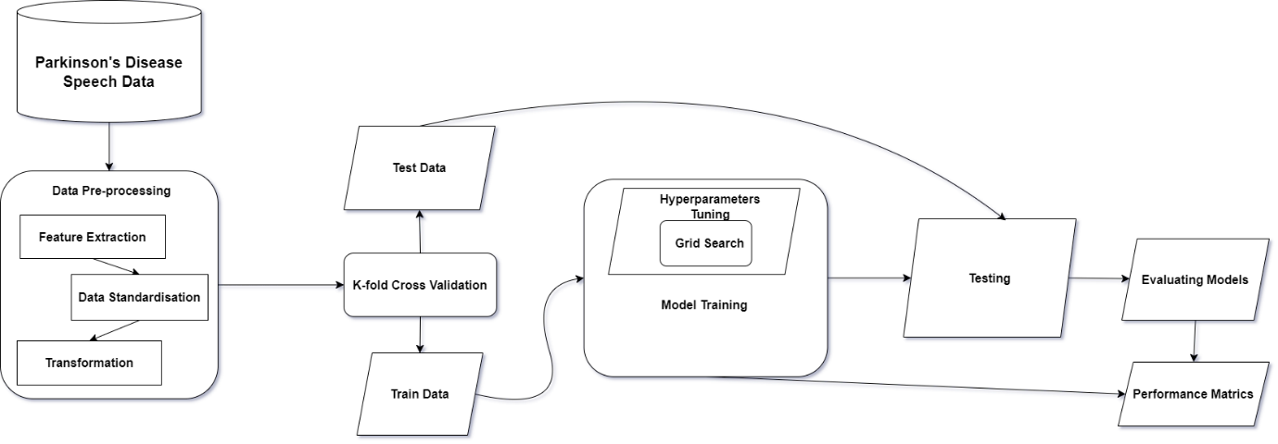
MODEL DIAGRAM

Slide 7
MODEL DIAGRAM
In the realm of machine learning, data standardization emerges as a crucial technique to ensure a fair playing field for diverse features. Its primary goal is to prevent attributes with larger numerical values from exerting undue influence on the model compared to those with smaller values. Z-score standardization, a specific approach, transforms attribute values into standard scores, thereby centring the data around a mean of 0 and a standard deviation of 1. This normalization process sets the stage for unbiased model training and ensures that all features contribute equally to the learning process. To robustly assess the model's performance, I employ K-fold Cross Validation. This technique involves partitioning the dataset into k subsets, iteratively training the model on k-1 subsets, and testing it on the remaining subset. For model training, I explore various classification algorithms such as Support Vector Machines (SVM), Logistic Regression, and k-nearest Neighbors (KNN). Each algorithm brings unique strengths to the table, contributing to a well-rounded and versatile predictive model. To gauge the effectiveness of the trained model, I utilize a range of performance metrics, including accuracy, recall, and validation accuracy. This multifaceted evaluation provides a comprehensive understanding of the model's proficiency in different aspects of classification.

Slide 8
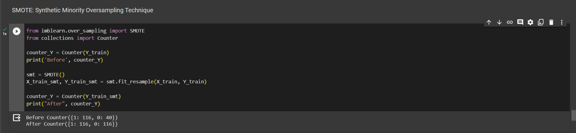
Noise Removal (SMOTE Algorithm)
Synthetic Minority Oversampling Technique - SMOTE is an oversampling technique where the synthetic samples are generated for the minority class. This algorithm helps to overcome the overfitting problem posed by random oversampling. It focuses on the feature space to generate new instances with the help of interpolation between the positive instances that lie together.
Before performing SMOTE, the number of values of each category [1,0] in Y_train is 1: 116 and 0: 40 but after performing SMOTE algorithm on Y_train, the number of values changes to 1: 116, 0: 116.

Slide 9
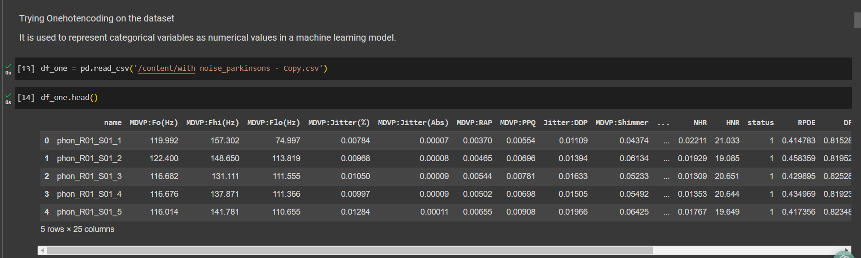
One Hot Encoding
It is used to represent categorical variables as numerical values in a machine-learning model. Before performing One hot encoding the dataset has a categorical column called Name which has string values and we need to change them to numerical value.

Slide 10
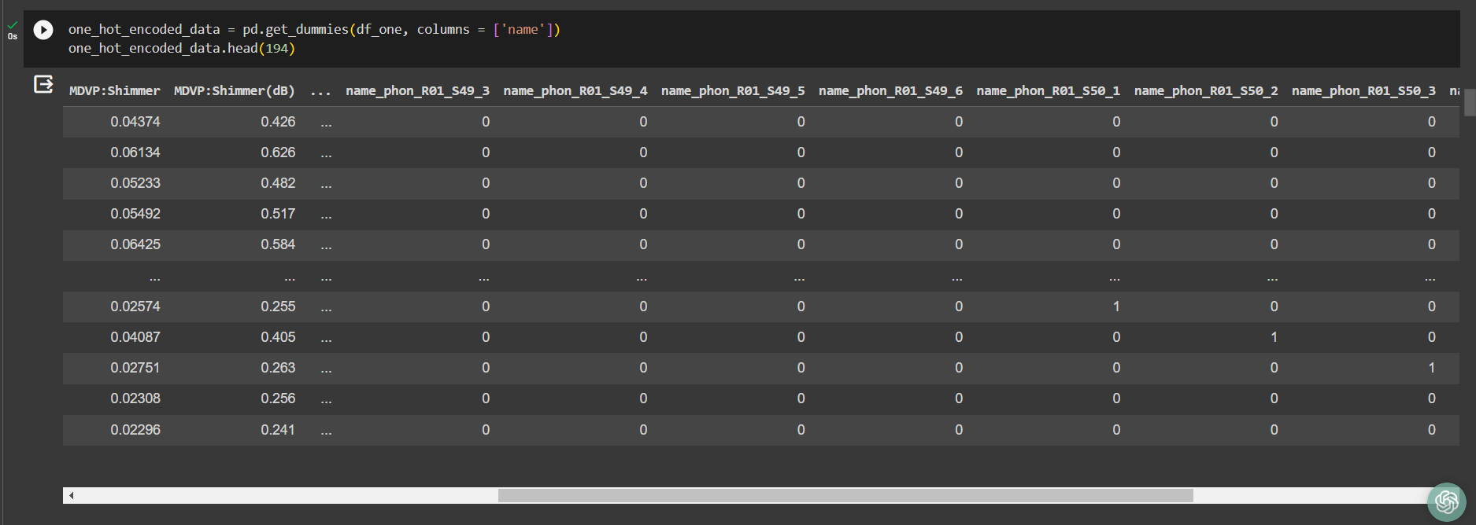
One Hot Encoding
After Performing Onehotencoding the string values of the column [Name] are transformed to categorical value [1,0].

Slide 11
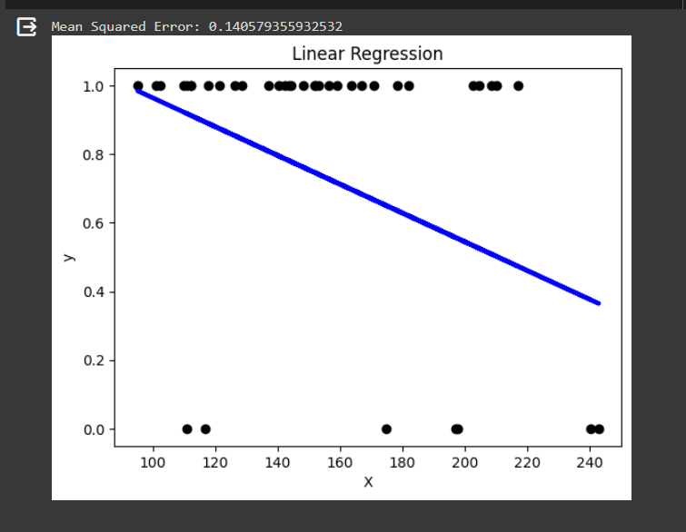
Linear Regression
Parameter Name | Purpose | Value
Test size | To split the dataset into training and testing in a ratio | 0.2
Random State | This parameter sets the seed for the random number generator used by the data splitter. By using a fixed seed, the random splitting process becomes deterministic, allowing for result reproducibility. | 42

Slide 12

Logistic Regression
Parameter Name | Purpose | Value
Test size | To split the dataset into training and testing in a ratio | 0.2
Random State | This parameter sets the seed for the random number generator used by the data splitter. By using a fixed seed, the random splitting process becomes deterministic, allowing for result reproducibility. | 42
Grid Search | The grid search explores various alpha values using 5-fold cross-validation. | 0.001, 0.01, 0.1, 1, 10, 100, 1000

Slide 13
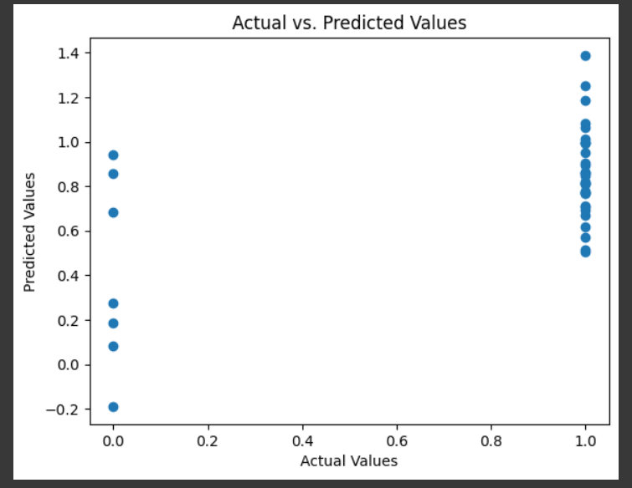
Lasso Regression
Parameter Name | Purpose | Value
Test size | To split the dataset into training and testing in a ratio | 0.2
Random State | This parameter sets the seed for the random number generator used by the data splitter. By using a fixed seed, the random splitting process becomes deterministic, allowing for result reproducibility. | 42
Alpha | The regularization parameter controls the amount of shrinkage applied to the coefficients of the model | 0.01
Grid Search | The grid search explores various alpha values using 5-fold cross-validation. | 0.001, 0.01, 0.1, 1, 10, 100, 1000

Slide 14
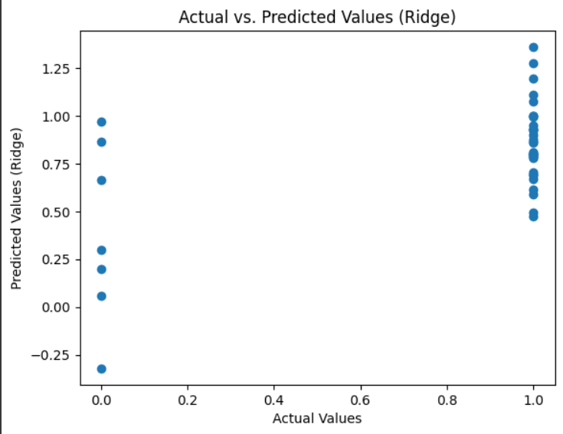
Ridge Regression
Parameter Name | Purpose | Value
Test size | To split the dataset into training and testing in a ratio | 0.2
Random State | This parameter sets the seed for the random number generator used by the data splitter. By using a fixed seed, the random splitting process becomes deterministic, allowing for result reproducibility. | 42
Alpha | The regularization parameter controls the amount of shrinkage applied to the coefficients of the model | 0.01
Grid Search CV | The grid search explores various alpha values using 5-fold cross-validation. | 0.001, 0.01, 0.1, 1, 10, 100, 1000

Slide 15
Comparison of Regression Models
 | Parameter -1 (Test Size) | Parameter -2 (Random State) | Parameter -3 (Alpha) | Parameter -4 (Grid Search CV)
Linear without Hyperparameter | 0.2 | 42 | - | -
Linear with Hyperparameter | 0.2 | 42 | - | 0.001, 0.01, 0.1, 1, 10, 100, 1000
Logistic without Hyperparameter | 0.2 | 42 | - | -
Logistic with Hyperparameter | 0.2 | 42 | 0.01 | 0.001, 0.01, 0.1, 1, 10, 100, 1000
Lasso without Hyperparameter | 0.2 | 42 | 0.01 | -
Lasso with Hyperparameter | 0.2 | 42 | 0.01 | 0.001, 0.01, 0.1, 1, 10, 100, 1000
Ridge without Hyperparameter | 0.2 | 42 | 0.01 | -
Ridge with Hyperparameter | 0.2 | 42 | 0.01 | 0.001, 0.01, 0.1, 1, 10, 100, 1000

Slide 16
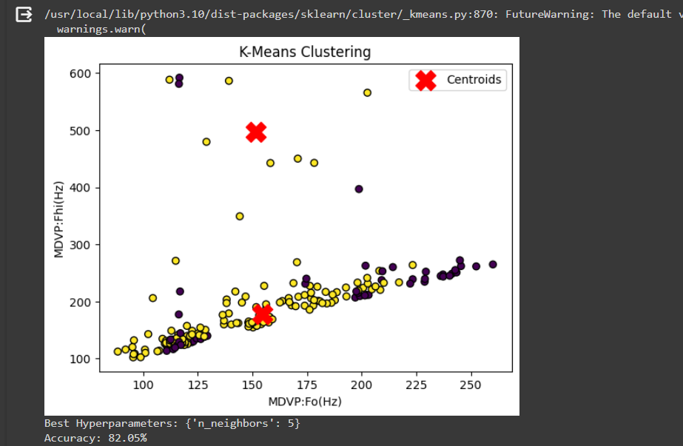
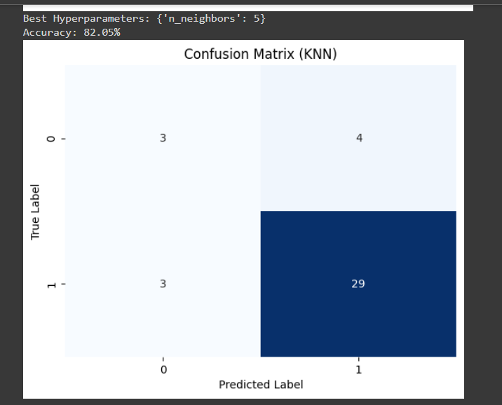
K-means with KNN
Hyperparameter Tuning approach used: Grid Search CV
Parameter Name | Purpose | Value
Test size | To split the dataset into training and testing in a ratio | 0.2
Random State | This parameter sets the seed for the random number generator used by the data splitter. By using a fixed seed, the random splitting process becomes deterministic, allowing for result reproducibility. | 42
No. of Clusters | Number of the centroid which will be formed | 2
Grid Search CV | The grid search explores various alpha values using 5-fold cross-validation. | n_neighbors: 3, 5, 7, 9

Slide 17
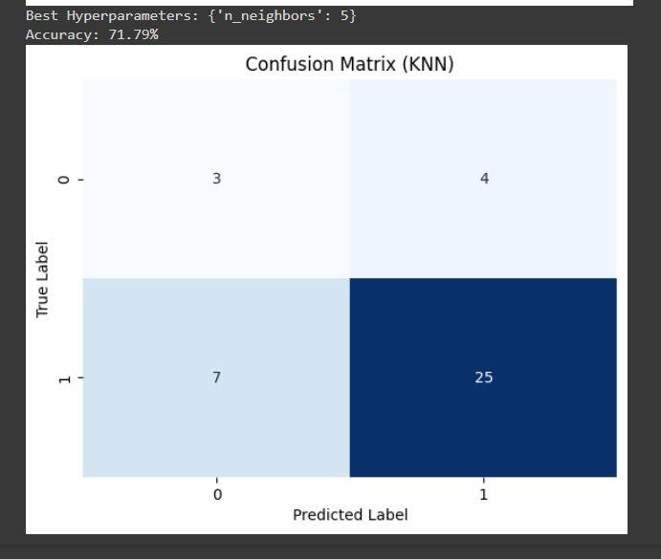
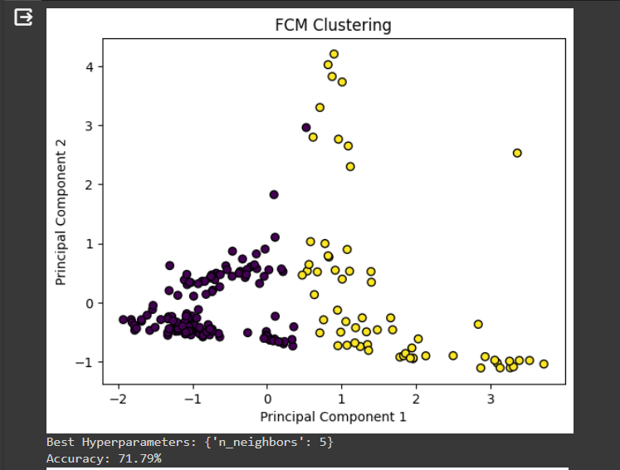
Fuzzy C-means with k-means
Hyperparameter Tuning approach used: Grid Search CV
Parameter Name | Purpose | Value
Test size | To split the dataset into training and testing in a ratio | 0.2
Random State | This parameter sets the seed for the random number generator used by the data splitter. By using a fixed seed, the random splitting process becomes deterministic, allowing for result reproducibility. | 42
No. of Clusters | Number of the centroid which will be formed | 2
Grid Search CV | The grid search explores various alpha values using 5-fold cross-validation. | n_neighbors: 3, 5, 7, 9

Slide 18
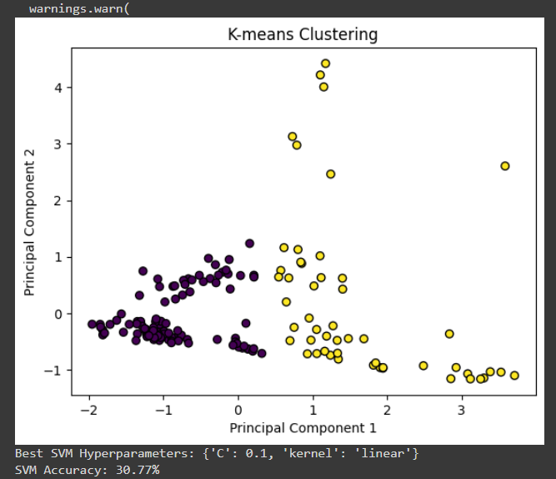
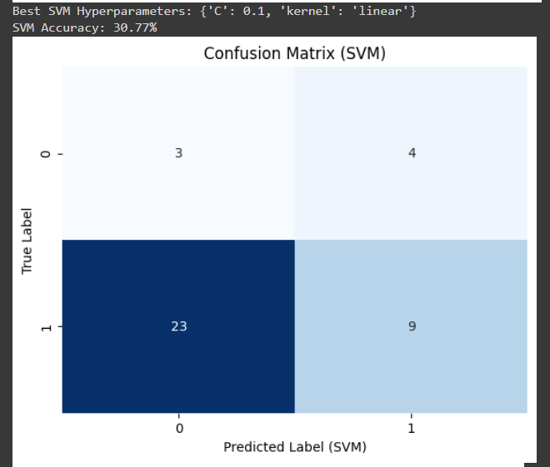
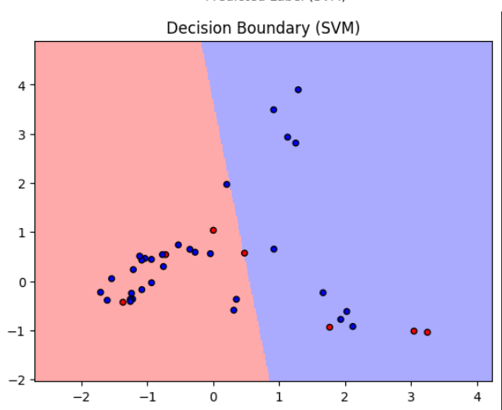
K-means with SVM
Parameter Name | Purpose | Value
Test size | To split the dataset into training and testing in a ratio | 0.2
Random State | This parameter sets the seed for the random number generator used by the data splitter. By using a fixed seed, the random splitting process becomes deterministic, allowing for result reproducibility. | 42
Kernel | kernel is a function that computes the dot product of two data points in a transformed feature space. | Linear
Grid Search CV | The grid search explores various alpha values using 5-fold cross-validation. | 0.1, 1, 10

Slide 19
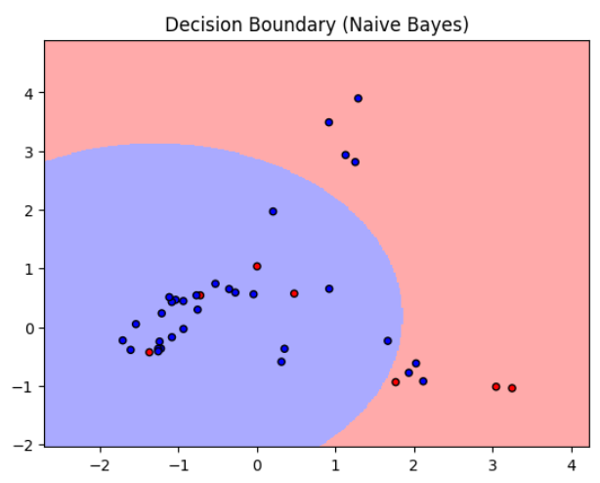
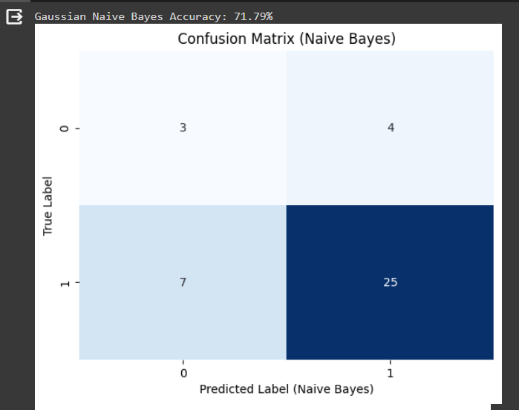
Bayesian Classifier
Parameter Name | Purpose | Value
Test size | To split the dataset into training and testing in a ratio | 0.2
Random State | This parameter sets the seed for the random number generator used by the data splitter. By using a fixed seed, the random splitting process becomes deterministic, allowing for result reproducibility. | 42
Grid Search CV | The grid search explores various alpha values using 5-fold cross-validation. | np.logspace(0, -9, num=100)

Slide 20
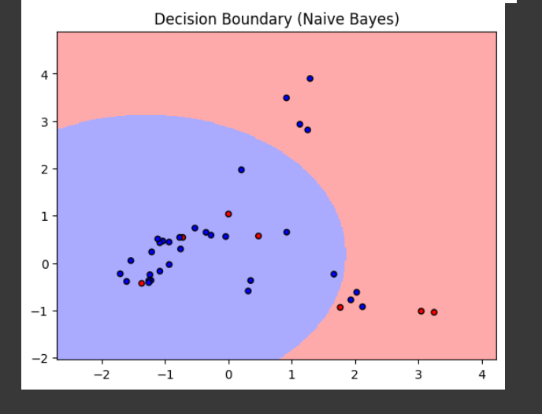
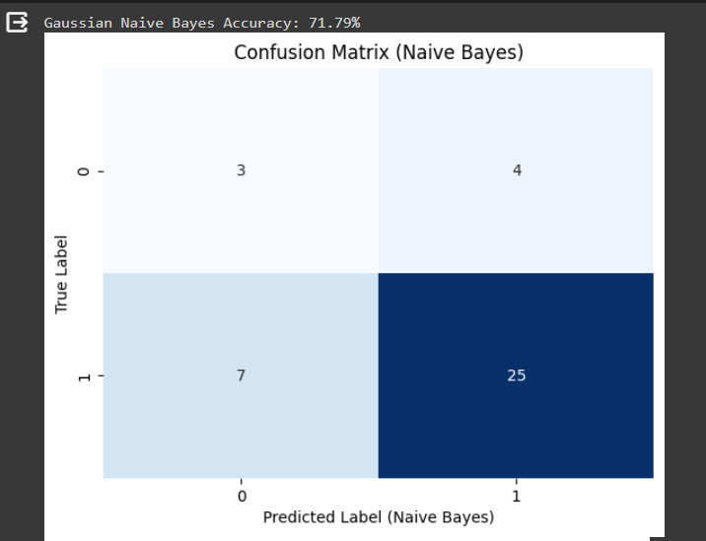
Naïve Bayes Classifier
Parameter Name | Purpose | Value
Test size | To split the dataset into training and testing in a ratio | 0.2
Random State | This parameter sets the seed for the random number generator used by the data splitter. By using a fixed seed, the random splitting process becomes deterministic, allowing for result reproducibility. | 42
Grid Search CV | The grid search explores various alpha values using 5-fold cross-validation. | np.logspace(0, -9, num=100)

Slide 21
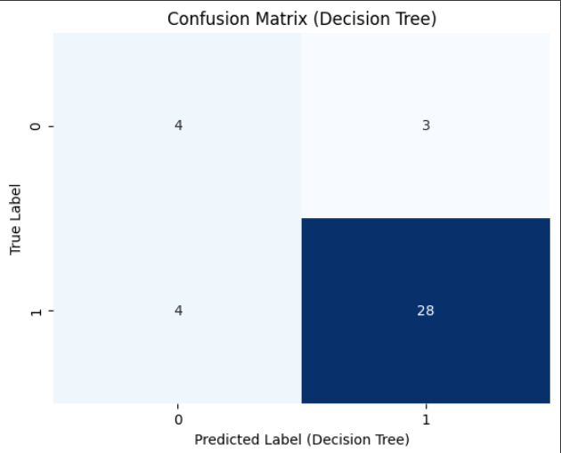
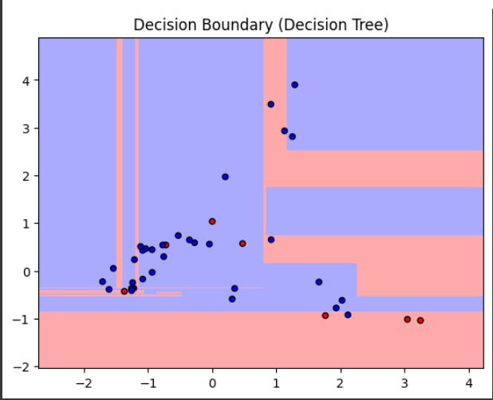
Decision Tree
Parameter Name | Purpose | Value
Test size | To split the dataset into training and testing in a ratio | 0.2
Random State | This parameter sets the seed for the random number generator used by the data splitter. By using a fixed seed, the random splitting process becomes deterministic, allowing for result reproducibility. | 42
Grid Search CV | The grid search explores various alpha values using 5-fold cross-validation. | 'criterion': ['gini', 'entropy'], 'max_depth': [None, 10, 20, 30, 40, 50], 'min_samples_split': [2, 5, 10], 'min_samples_leaf': [1, 2, 4]

Slide 22
Comparison Table for Classifiers
S.No | Algorithm name | Test Size | Random State | Grid Search CV | Accuracy
1 | KMeans with KNN | 0.2 | 42 | n_neighbors: 3, 5, 7, 9 | 82.05%
2 | Fuzzy C-Means with KNN | 0.2 | 42 | n_neighbors: 3, 5, 7, 9 | 71.79%
3 | KMeans with SVM | 0.2 | 42 | 0.1, 1, 10 | 30.77%
4 | Bayesian Classifier | 0.2 | 42 | np.logspace(0, -9, num=100) | 71.79%
5 | Naïve Bayes Classifier | 0.2 | 42 | np.logspace(0, -9, num=100) | 71.79%
6 | Decision Tree | 0.2 | 42 | 'criterion': ['gini', 'entropy'], 'max_depth': [None, 10, 20, 30, 40, 50], 'min_samples_split': [2, 5, 10], 'min_samples_leaf': [1, 2, 4] | 82.05%

Slide 23
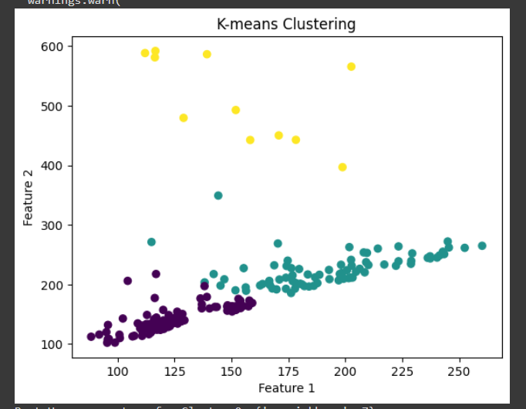
K-means with CNN
S. No | Parameter Name | Value
1 | Epochs | 10
2 | Accuracy | 91.25%
3 | Precision | 0.94
4 | Recall | 0.92
5 | F1 Score | 0.93
6 | Confusion Matrix | [[26 3] [ 4 47]]
7 | Grid Search CV | n_neighbors': [3, 5, 7, 9, 11]

Slide 24
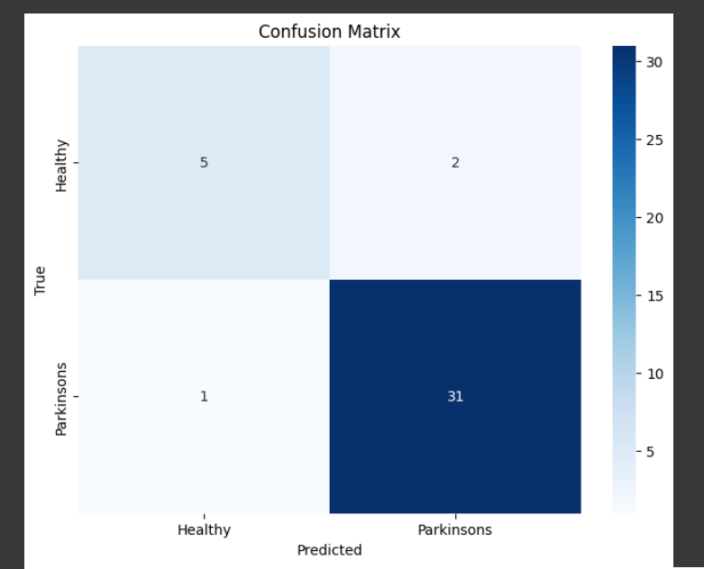
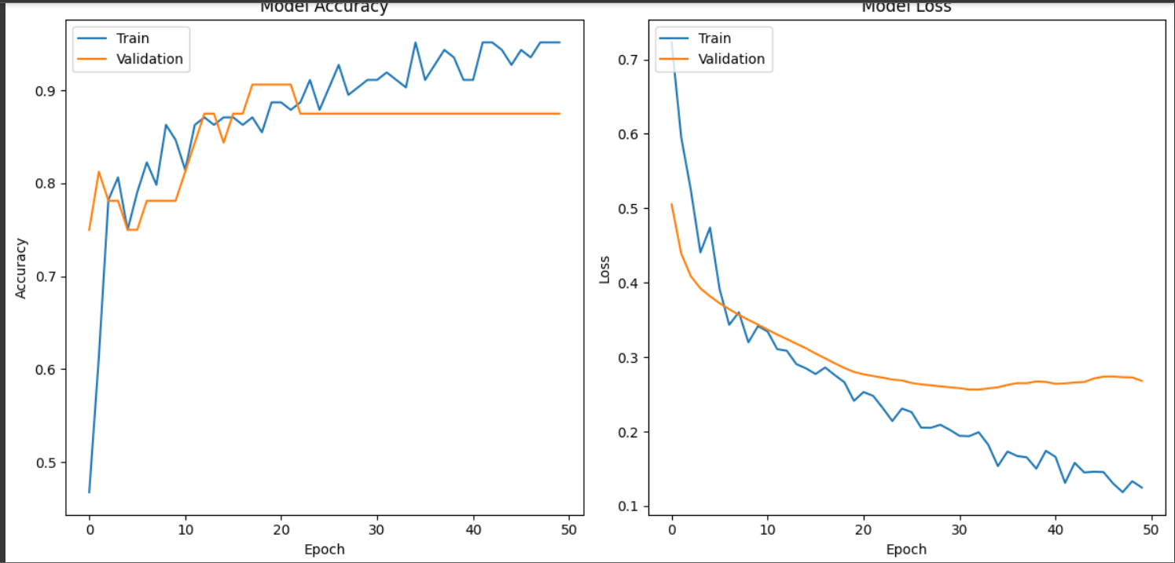
AlexNet
S. No | Parameters | Value
1 | Epochs | 50
2 | Accuracy | 92.31%
3 | Training Loss | 0.12
4 | Validation Accuracy | 87%
5 | Validation Loss | 0.26
6 | Testing Accuracy | 92.31%
7 | Batch Size | 64
8 | Learning Rate | 0.001
9 | Dropout | 0.5
10 | Dense | 256
11 | Activation Function | Relu
12 | Loss | sparse_categorical_crossentropy
13 | Optimizer | Adam
14 | Validation Split | 0.2
15 | Test size | 0.2

Slide 25
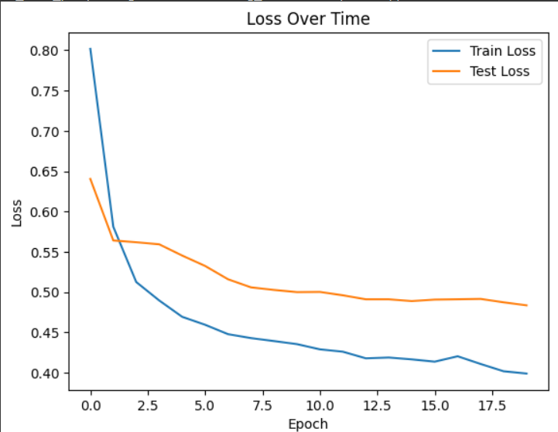
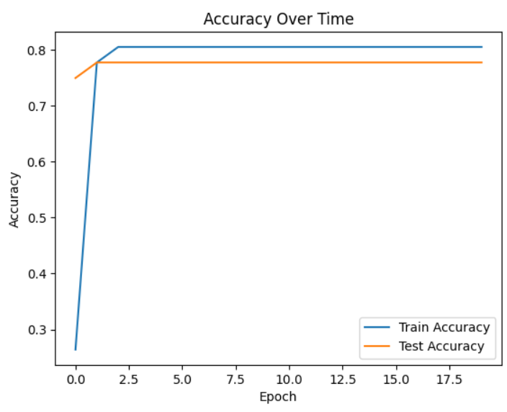
LSTM
S. No | Parameters | Value
1 | Epochs | 20
2 | Accuracy | 80.56%
3 | Training Loss | 0.39
4 | Validation Accuracy | 77.78%
5 | Validation Loss | 0.48
6 | Testing Accuracy | 77.77%
7 | Batch Size | 32
8 | Loss | binary_crossentropy
9 | Optimizer | adam
10 | Activation Function | Sigmoid
11 | LSTM Unit | 100
12 | Learning rate | 0.001
13 | Test size | 0.2

Slide 26
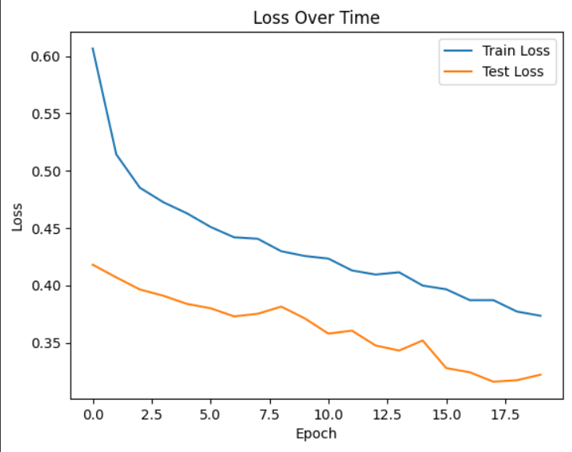
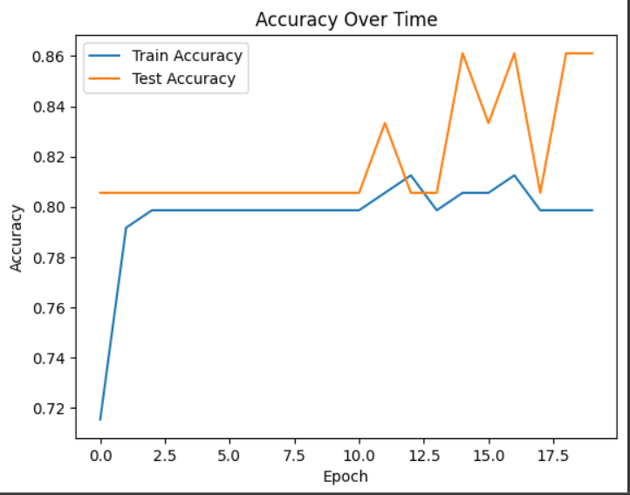
GRU
S. No | Parameters | Value
1 | Epochs | 20
2 | Accuracy | 79.86%
3 | Training Loss | 0.37
4 | Validation Accuracy | 86.11%
5 | Validation Loss | 0.32
6 | Testing Accuracy | 77.77%
7 | Test Loss | 0.32
8 | Batch Size | 32
9 | Loss | binary_crossentropy
10 | Optimizer | adam
11 | Activation Function | Sigmoid
12 | GRU Unit | 100
13 | Learning rate | 0.001
14 | Test size | 0.2

Slide 27
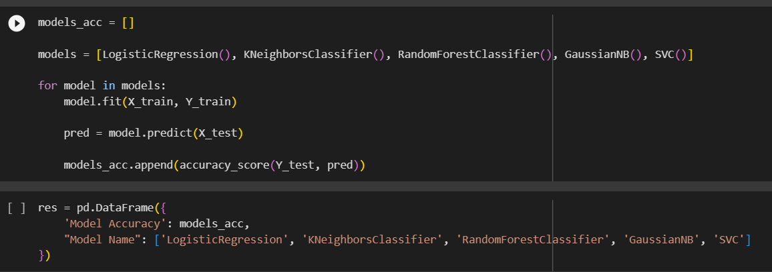
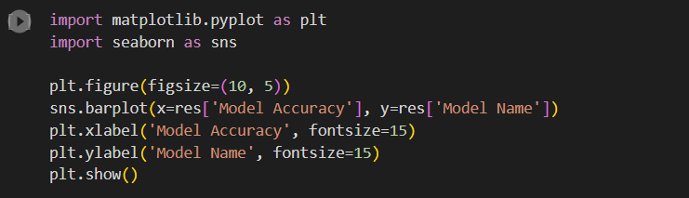
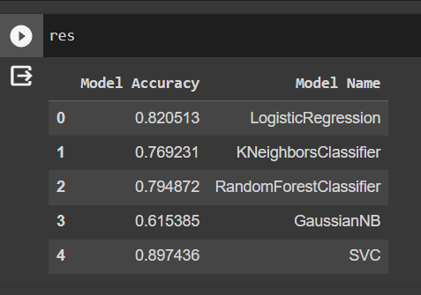
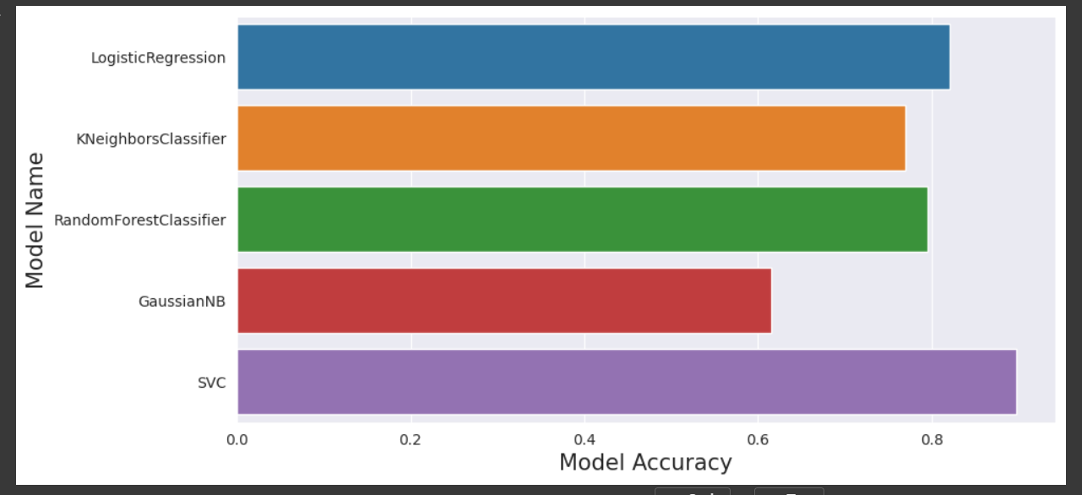
Model Evaluation

Slide 28
References
I. Nissar, W. A. Mir, Izharuddin, and T. A. Shaikh, “Machine learning approaches for detection and diagnosis of Parkinson’s disease - A review,” in 2021 7th International Conference on Advanced Computing and Communication Systems (ICACCS), 2021.
R. Lamba, T. Gulati, H. F. Alharbi, and A. Jain, “A hybrid system for Parkinson’s disease diagnosis using machine learning techniques,” Int. J. Speech Technol., vol. 25, no. 3, pp. 583–593, 2022.
S. Tadse, M. Jain, and P. Chandankhede, “Parkinson’s detection using machine learning,” in 2021 5th International Conference on Intelligent Computing and Control Systems (ICICCS), 2021.
G. Pahuja and T. N. Nagabhushan, “A comparative study of existing machine learning approaches for Parkinson’s disease detection,” IETE J. Res., vol. 67, no. 1, pp. 4–14, 2021.
C. Quan, K. Ren, and Z. Luo, “A deep learning based method for Parkinson’s disease detection using dynamic features of speech,” IEEE Access, vol. 9, pp. 10239–10252, 2021.
M. I. A. S. N. Ferreira, F. A. Barbieri, V. C. Moreno, T. Penedo, and J. M. R. S. Tavares, “Machine learning models for Parkinson’s disease detection and stage classification based on spatial-temporal gait parameters,” Gait Posture, vol. 98, pp. 49–55, 2022.
A. Landolfi et al., “Machine Learning approaches in Parkinson’s disease,” Curr. Med. Chem., vol. 28, no. 32, pp. 6548–6568, 2021.
J. Zhang, “Mining imaging and clinical data with machine learning approaches for the diagnosis and early detection of Parkinson’s disease,” NPJ Parkinsons Dis., vol. 8, no. 1, 2022.
L. Sahu, R. Sharma, I. Sahu, M. Das, B. Sahu, and R. Kumar, “Efficient detection of Parkinson’s disease using deep learning techniques over medical data,” Expert Syst., vol. 39, no. 3, 2022.
J. Dhar, “An adaptive intelligent diagnostic system to predict early stage of parkinson’s disease using two-stage dimension reduction with genetically optimized lightgbm algorithm,” Neural Comput. Appl., vol. 34, no. 6, pp. 4567–4593, 2022.
M. Hoq, M. N. Uddin, and S.-B. Park, “Vocal feature extraction-based artificial intelligent model for Parkinson’s disease detection,” Diagnostics (Basel), vol. 11, no. 6, p. 1076, 2021.
I. M. El-Hasnony, S. I. Barakat, and R. R. Mostafa, “Optimized ANFIS model using hybrid metaheuristic algorithms for Parkinson’s disease prediction in IoT environment,” IEEE Access, vol. 8, pp. 119252–119270, 2020.

Slide 29


