Slide 1

Some notes of system formulation of LFM
Fall 2021
Øyvind Wiig Petersen, PhD

Slide 2
Some useful sources on the topic:
Optimal State Estimation -Kalman, H infinity, and Nonlinear Approaches, p 111
Optimal and Robust Estimation, p 85
Recursive Bayesian inference on stochastic differential equations, p 43
Introduction to Random Signals and Applied Kalman Filtering, p 204

Slide 3
Mechanical system, LFM and augmented system
Mechanical response model: linear system subject to wind loads p(t) and additional white noise ε(t)
Latent force model for the wind load input:
Augmented system model:

Slide 4
Solution to ODE
Optimal and Robust Estimation, p 85
Solution of state evolution by integration factor (see reference for details):
Time discretization: subscript k for t=kΔt
What is covariance matrices for the two last terms in discrete time?

Slide 5
Covariance
Optimal and Robust Estimation, p 85
NB! typo in Eq. 2.106?
Covariance expressed as an integral:
The expression in the middle has a dirac-delta representation:
The integral is then reduced to one variable:
Final result by change of variables (τ’= τ-kΔt):

Slide 6
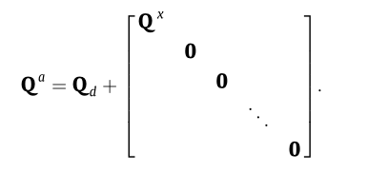
Covariance
Result for both w(t) and ε(t) (same approach but different block-structure of the matrix inside the integral)
«It is worth noting that even if Q [continuous] is diagonal, Qs [discrete] need not be. Sampling can destroy independence among the components of the process noise»
The results above are consistent with Nayek (2019), although not all details are shown in that paper

Slide 7
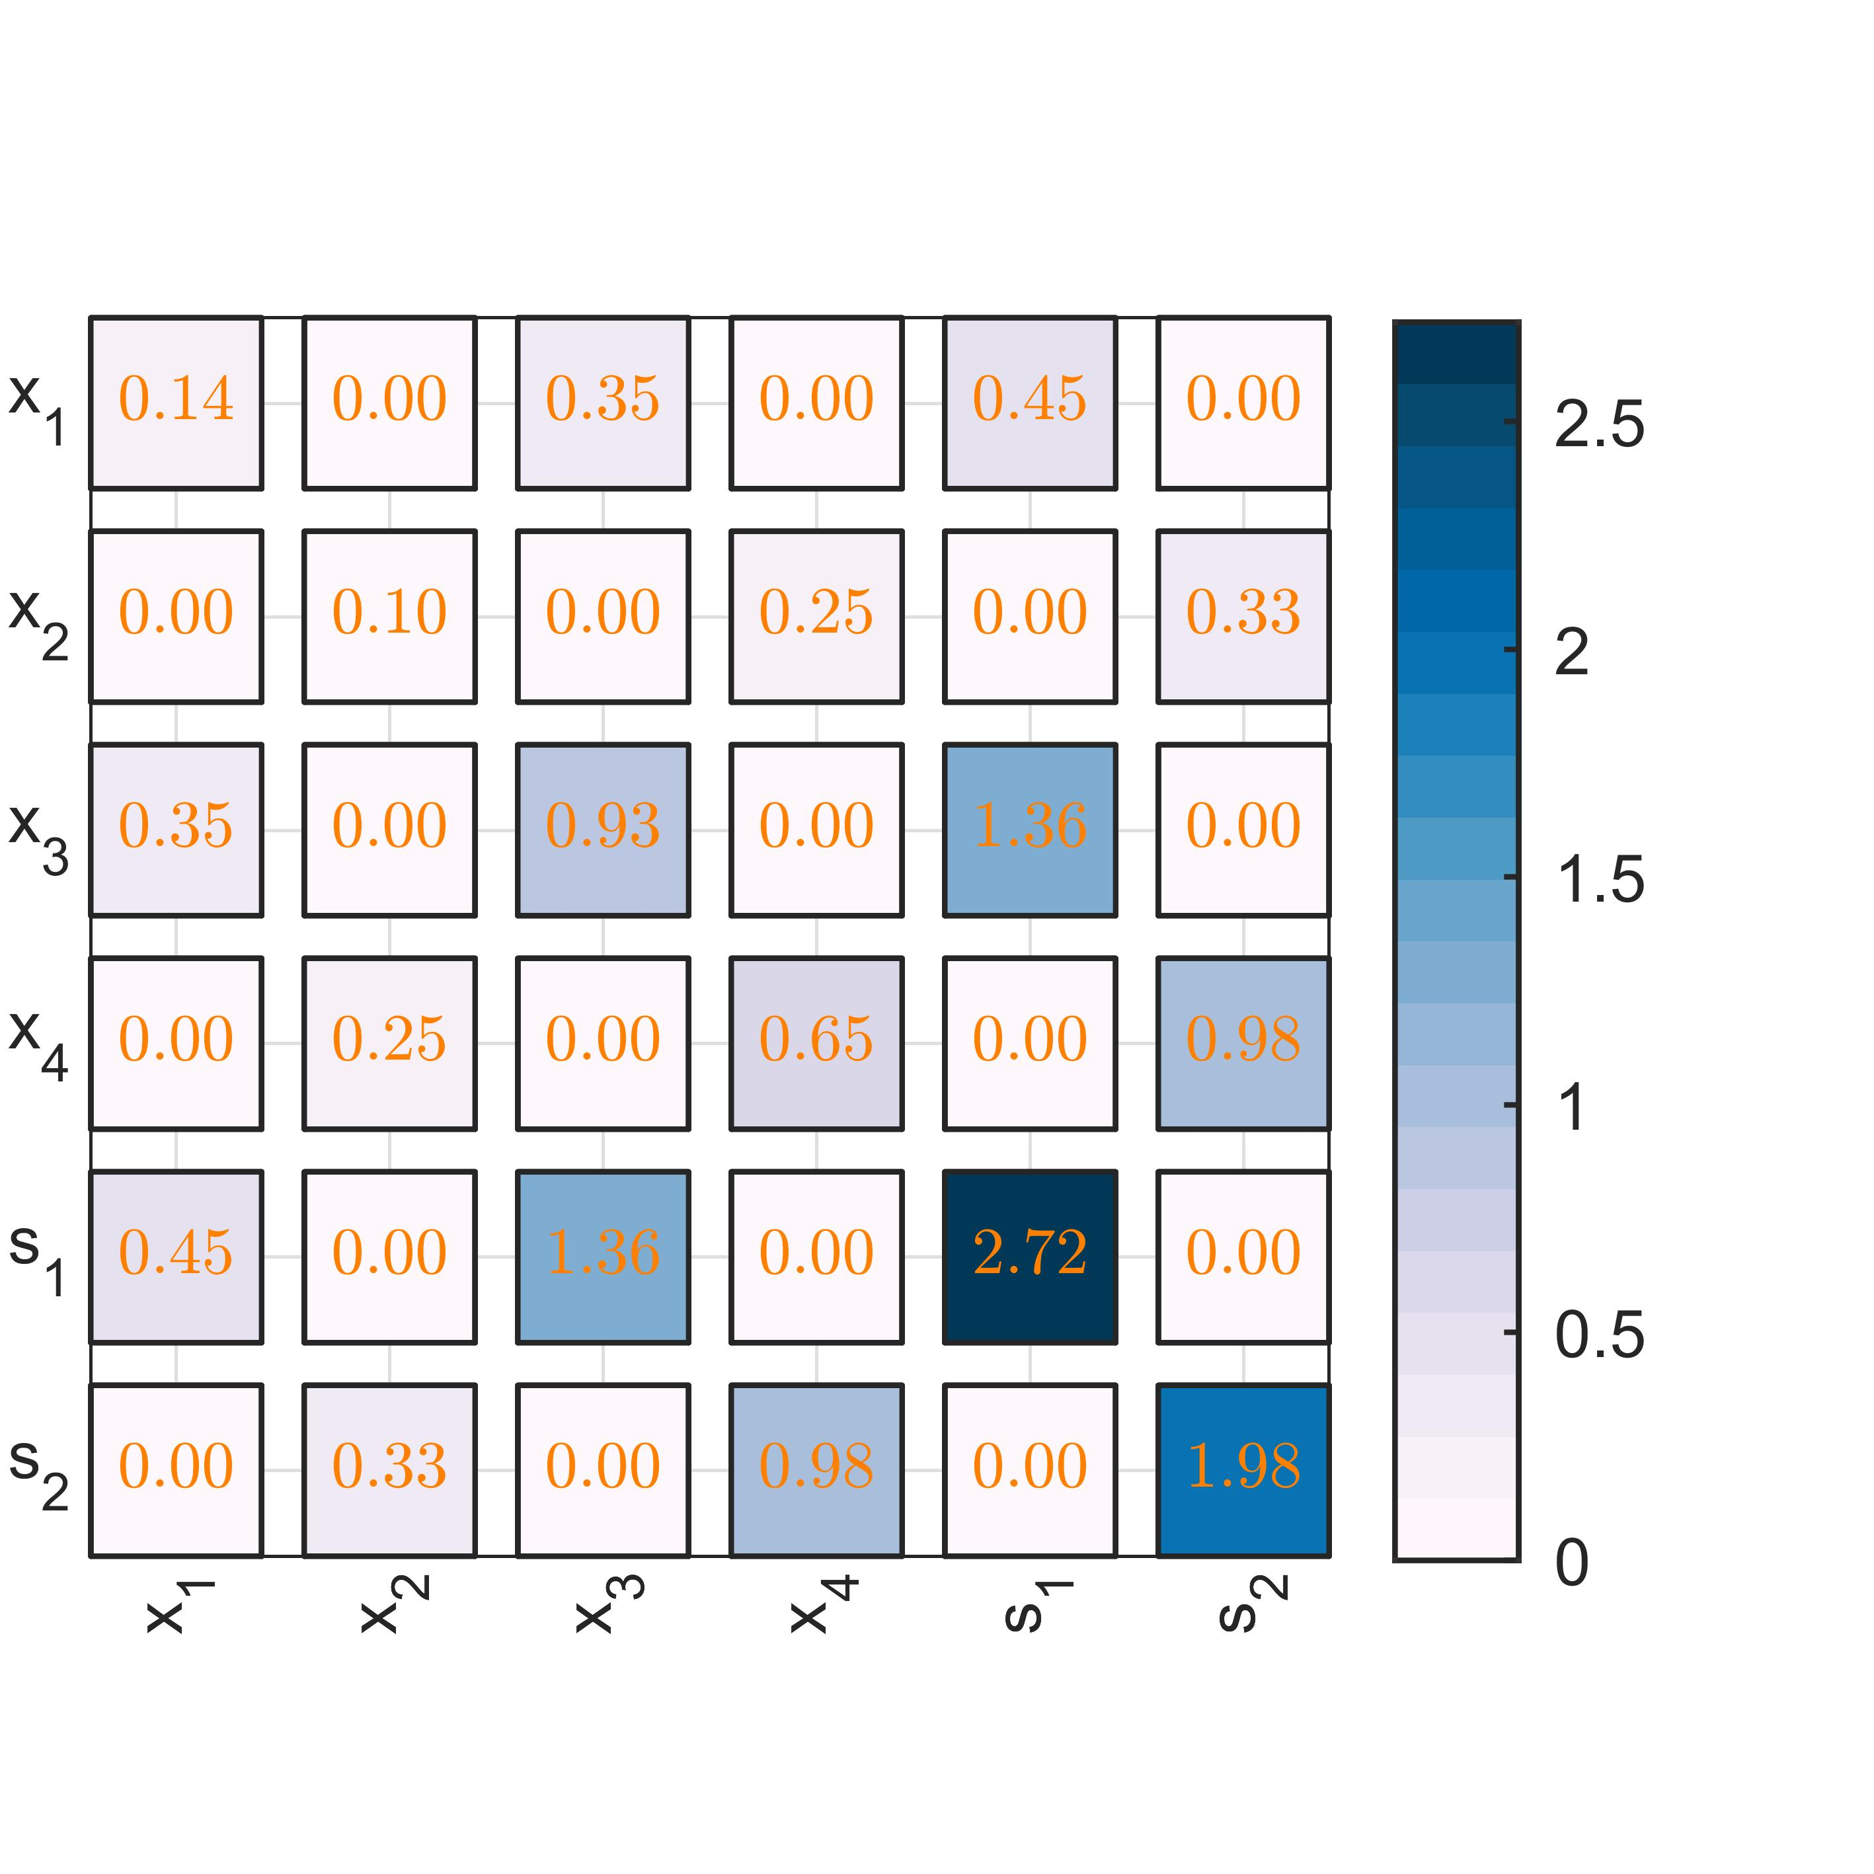
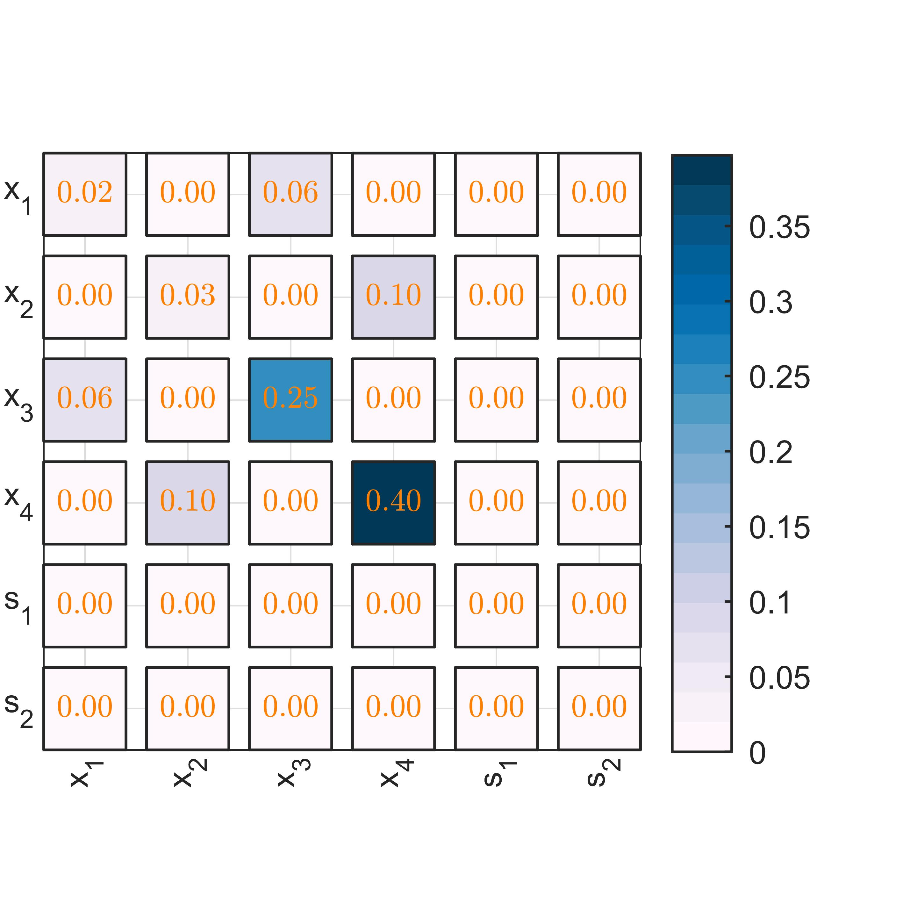
Example: system with two modes (4 states) and two latent states
In the discretized system we observe:
The white noise ε(t) directly influences only the modal states x(t)
The white noise w(t) mainly influences the latent states s(t), but also minorly x(t)

Slide 8
Next, how to actually calcuate the covariance matrix?
Recursive Bayesian inference on stochastic differential equations, p 43
My take: direct numerical integration is usually easy and accurate, but not neccessary: matrix fraction decomposition (Särkkä) is also possible:
The augmented states is a GP with covariance:
Note that if we set t=Δt and P(0)=0, this is the same integral expression for the covariance Q

Slide 9
Covariance calculation
Here is how I do it:
The same producedure can be repeated for the covariance for ε(t), and the two summed:

Slide 10
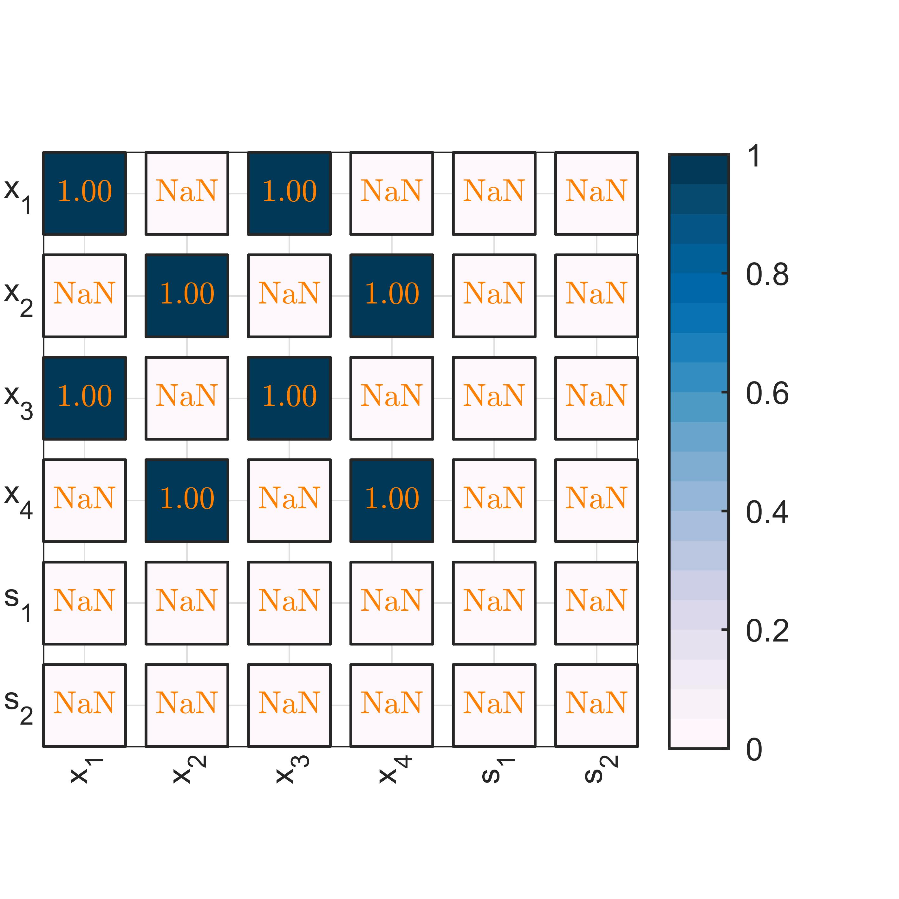
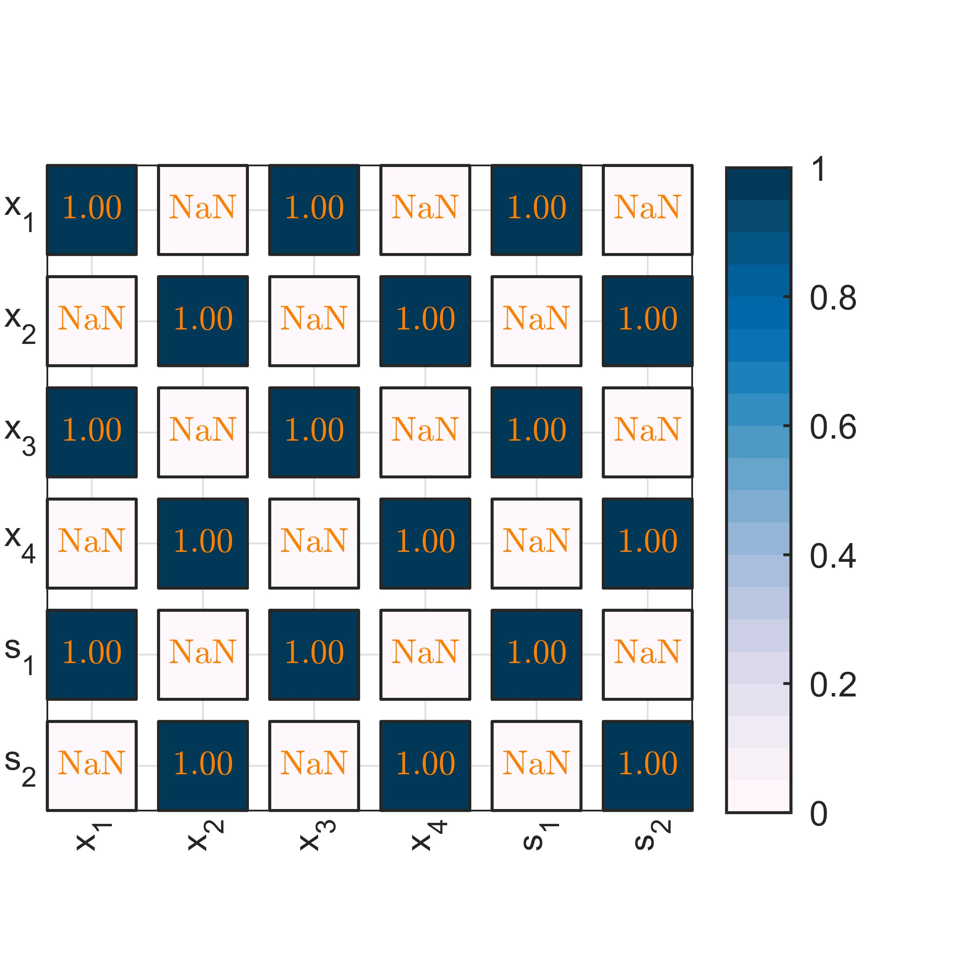
Numerical comparison of the two approaches
For the covariance example two slides back: figure below shows the ratio of Q for the matrix fraction decomposition (Särkkä) vs direct numerical integration
Exact same result is produced (except for numerical errors and roundoff)

Slide 11
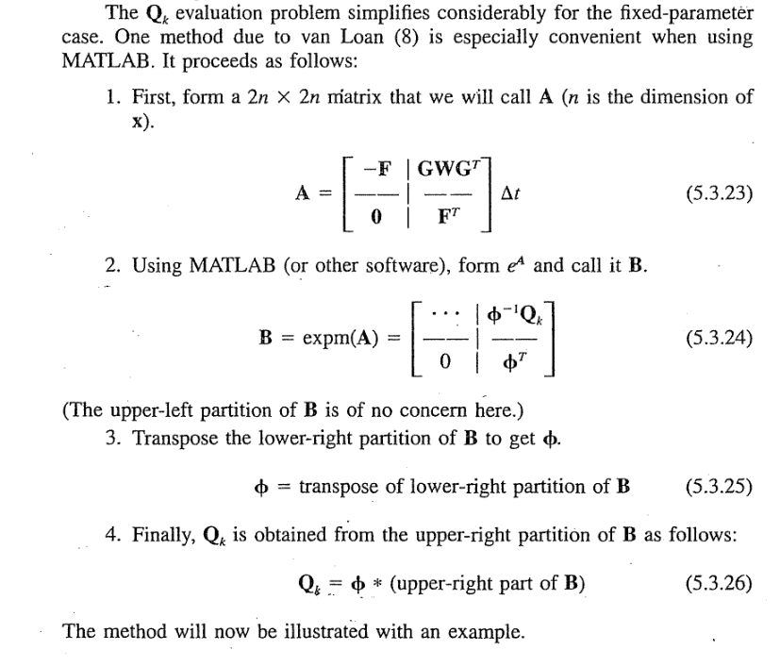
Another similar formulation
Introduction to Random Signals and Applied Kalman Filtering, p 204

Slide 12
Output equation
Optimal State Estimation -Kalman, H infinity, and Nonlinear Approaches, p 248
We also have the output equation:
Reformulated to augmented states:
Discrete time:
Note that we have correlated noise:

