Slide 1
Some notes of system formulation of LFMs, augmentation, and discretization

Slide 2
Some useful sources on the topic:
Optimal State Estimation - Kalman, H infinity, and Nonlinear Approaches, p 111
Optimal and Robust Estimation, p 85
Recursive Bayesian inference on stochastic differential equations, p 43
Introduction to Random Signals and Applied Kalman Filtering, p 204

Slide 3
Mechanical system, LFM and augmented system
Mechanical model: linear system subject to wind loads p(t) and (possibly) additional white noise ε(t)
Latent force model for the wind load input:
Augmented system model:

Slide 4
Solution to ODE
Optimal and Robust Estimation, p 85
Solution of state evolution by integration factor (see reference for details):
Time discretization: subscript k for t=kΔt
What are the covariance matrices for the two noise terms in discrete time?

Slide 5
Covariance
Optimal and Robust Estimation, p 85
NB! typo in Eq. 2.106?
Covariance expressed as an integral:
The expression in the middle has a dirac-delta representation:
The integral is then reduced to one variable:
Final result by change of variables:

Slide 6
Covariance
Result for both w(t) and ε(t) (same approach but different block-structure of the matrix inside the integral)
«It is worth noting that even if Q [continuous] is diagonal, Qs [discrete] need not be. Sampling can destroy independence among the components of the process noise»

Slide 7
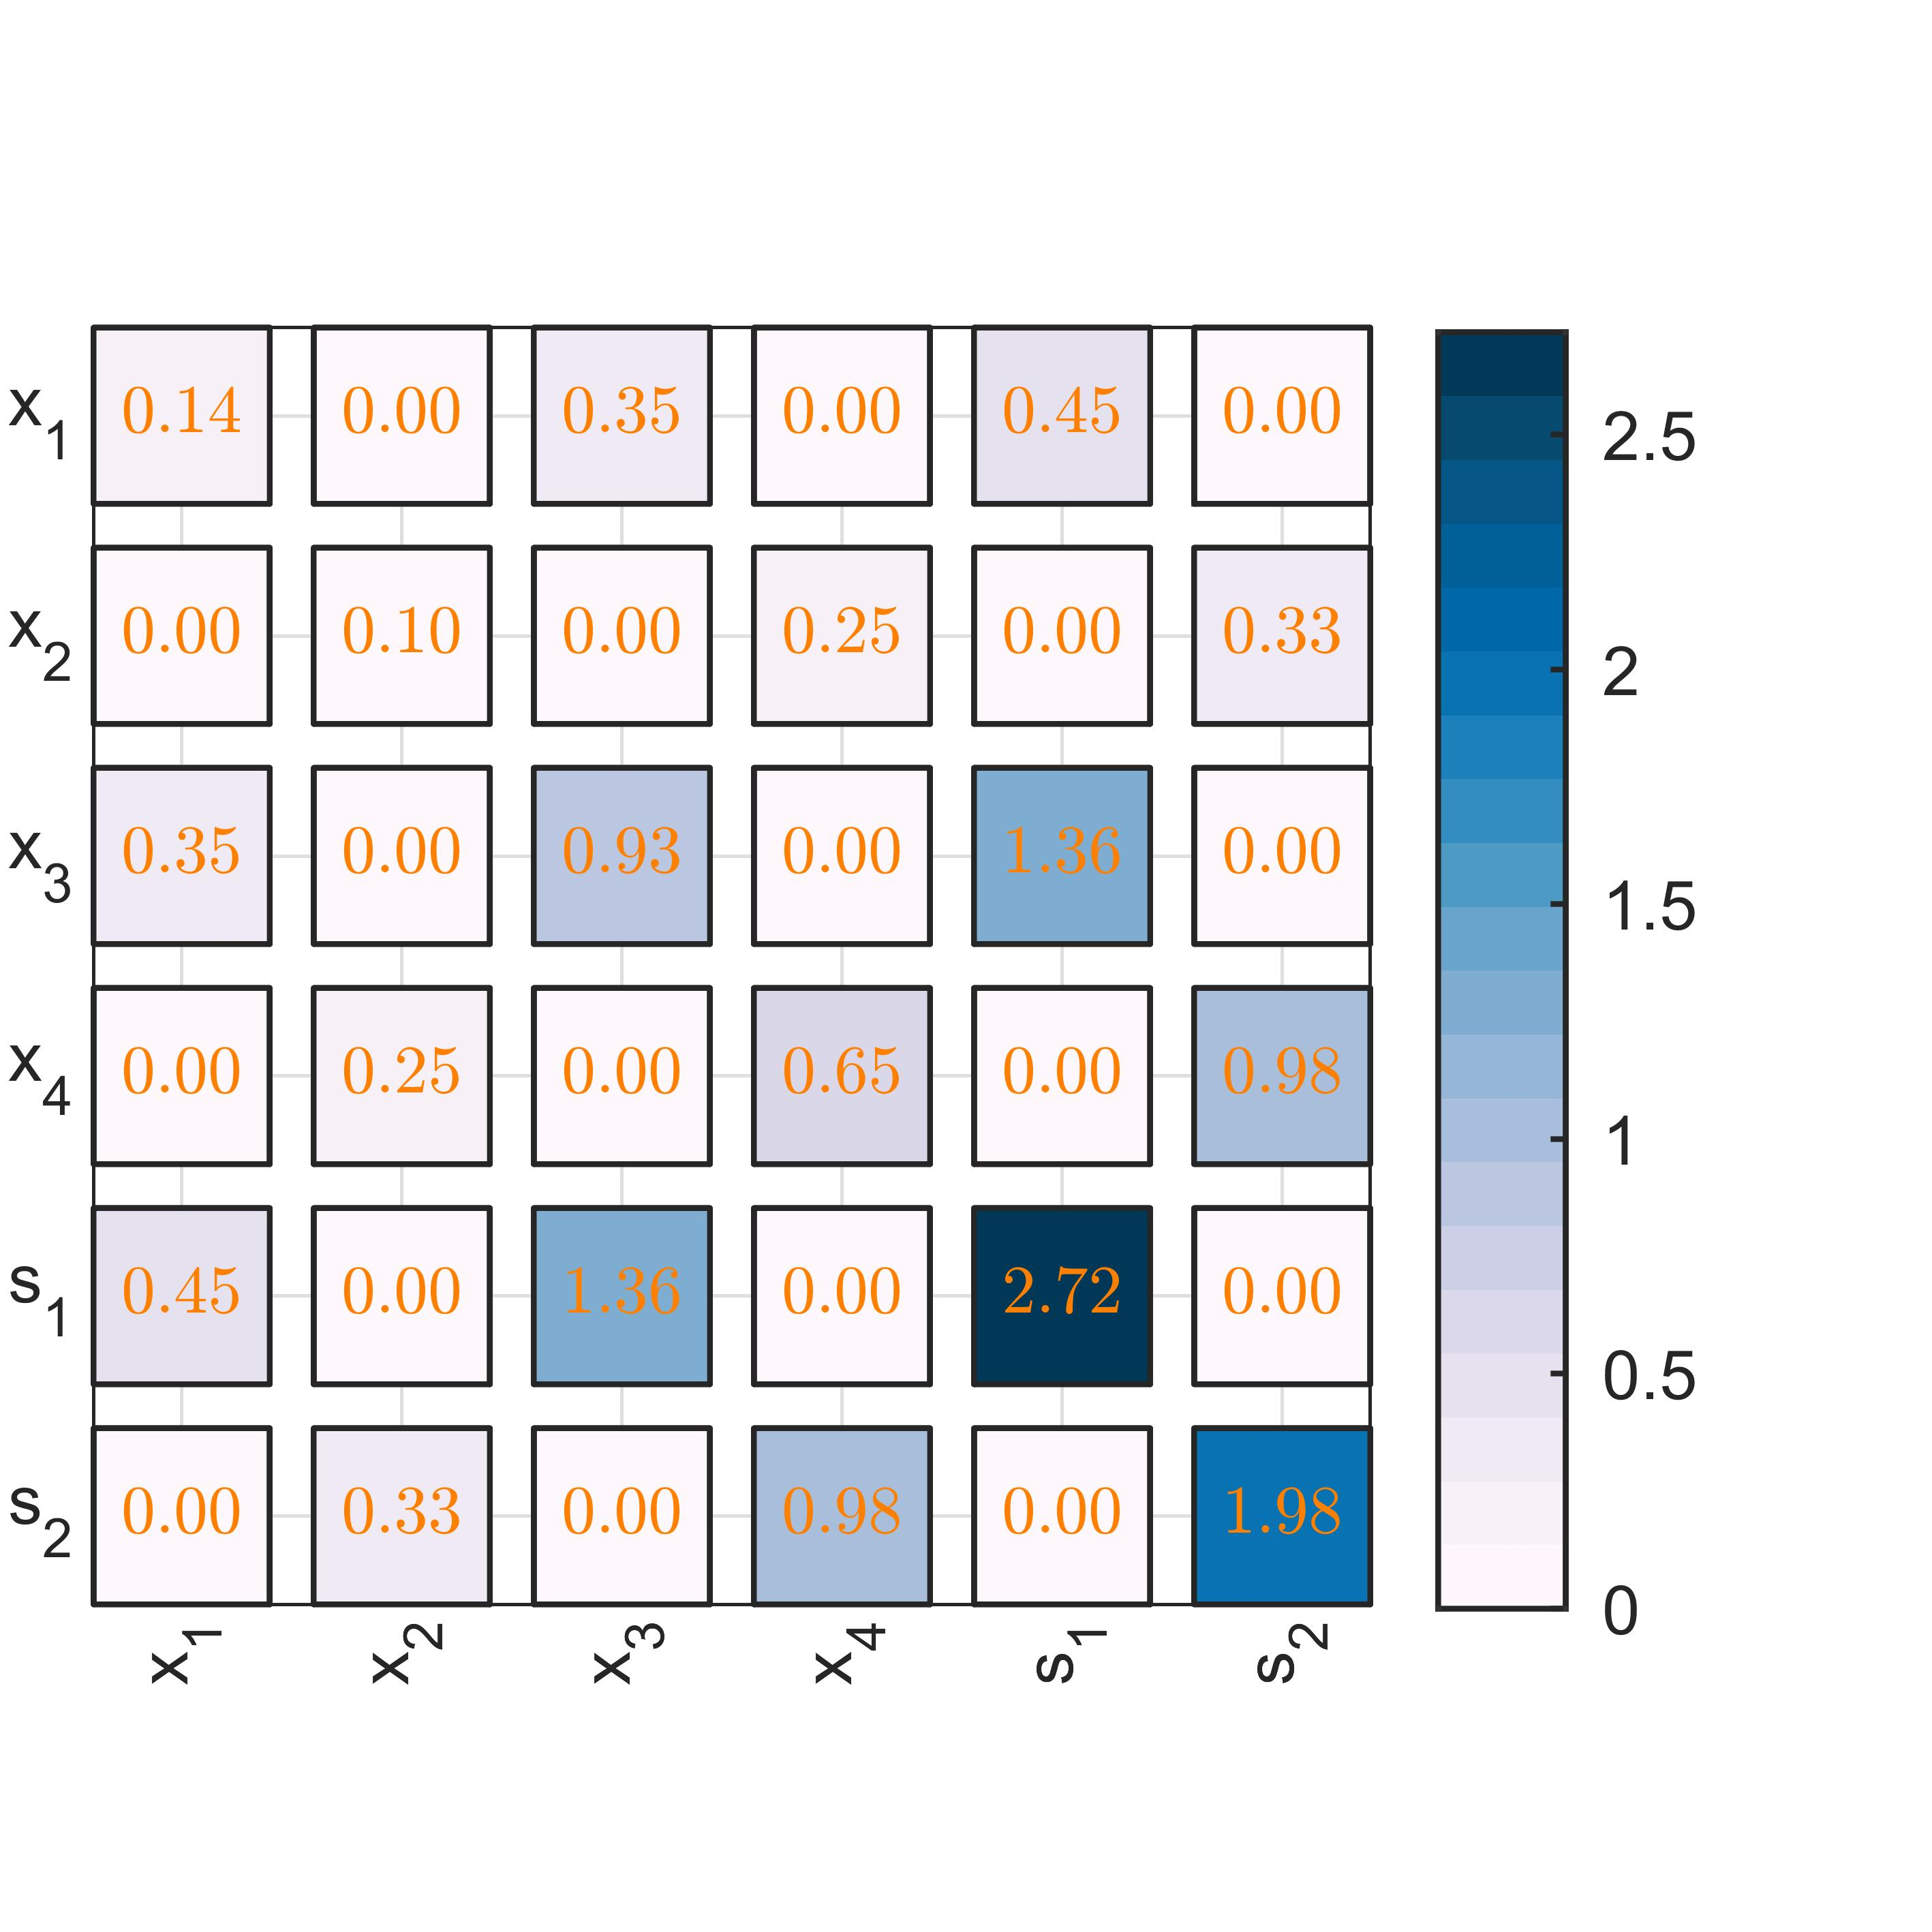
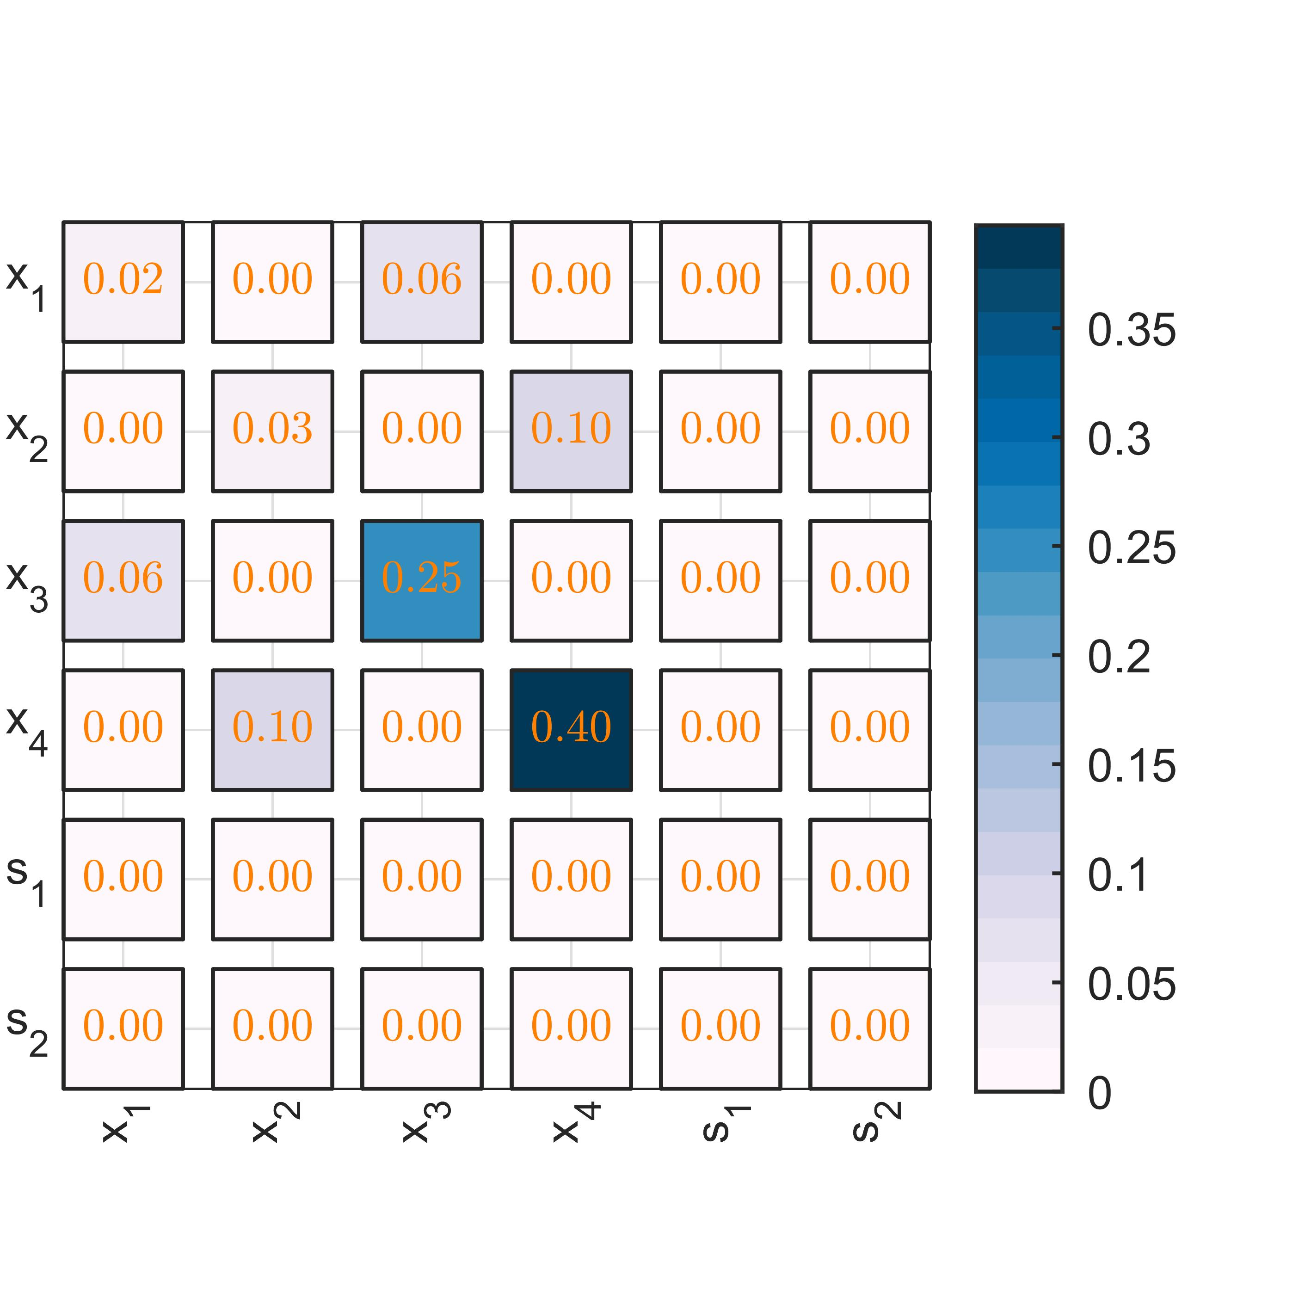
Example: system with two modes (4 states) and two latent states
In the discretized system we observe:
The white noise ε(t) directly influences only the modal states x(t)
The white noise w(t) mainly influences the latent states s(t), but also minorly x(t)

Slide 8
Next, how to actually calcuate the covariance matrix?
Recursive Bayesian inference on stochastic differential equations, p 43
My take: direct numerical integration is usually easy and accurate, but not neccessary: matrix fraction decomposition (Särkkä) is also possible
The augmented state is a GP with covariance:
Note that if we set t=Δt and P(0)=0, this is the same integral expression for the covariance Q

Slide 9
Covariance calculation
Summary:
The same producedure can be repeated for the covariance for ε(t), and the two contributions are summed:

Slide 10
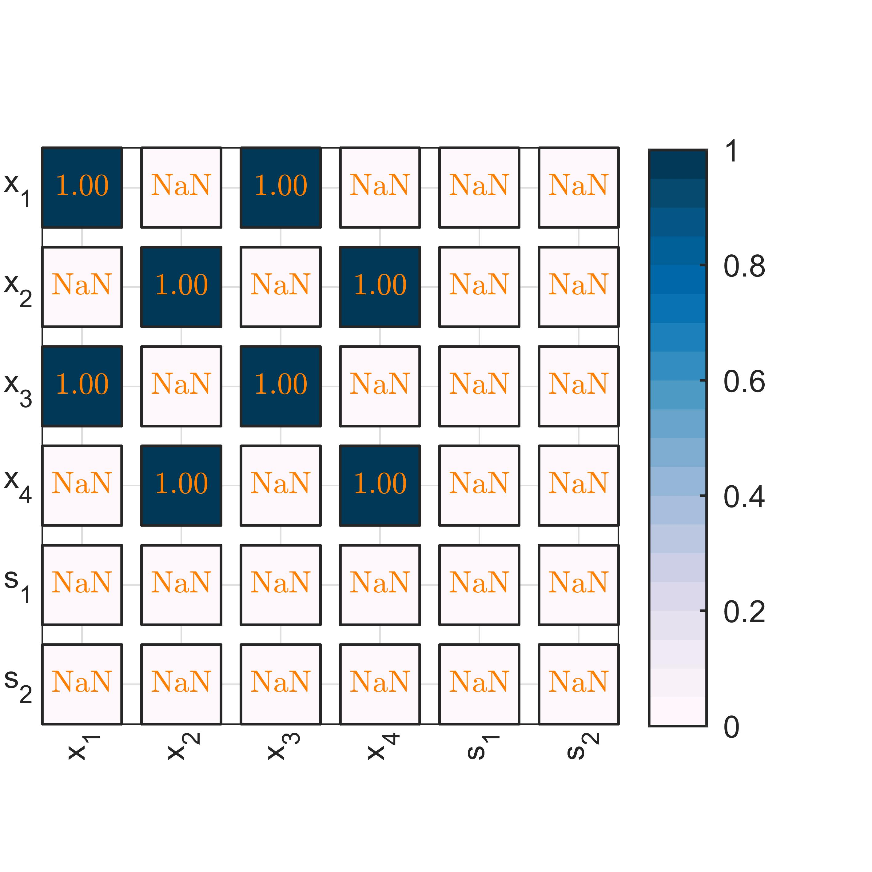
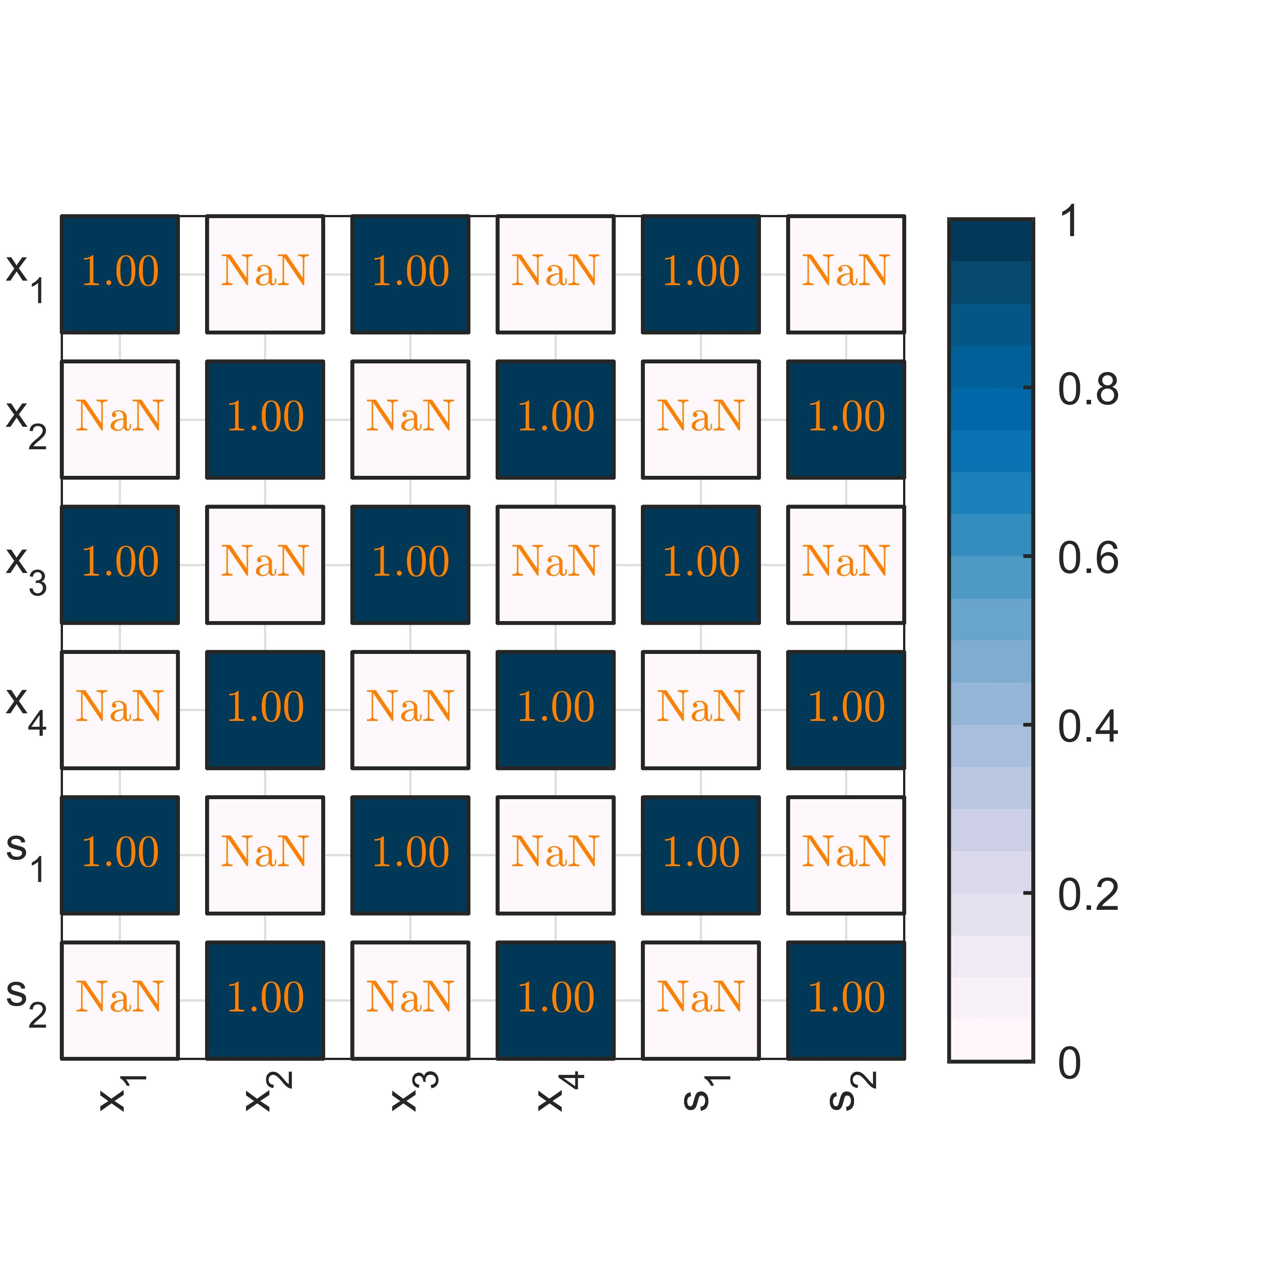
Numerical comparison of the two approaches
For the covariance example two slides back: figure below shows the ratio of Q for matrix fraction decomposition (Särkkä) vs direct numerical integration
Exact same result is produced (ratio=1.00, except for numerical errors and roundoff)

Slide 11
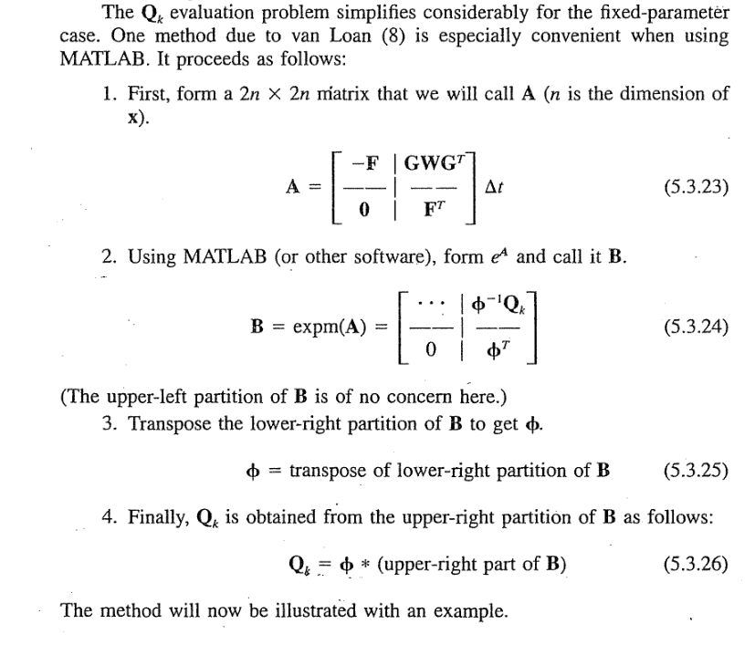
Another similar formulation
Introduction to Random Signals and Applied Kalman Filtering, p 204

Slide 12
Output equation
Optimal State Estimation -Kalman, H infinity, and Nonlinear Approaches, p 248
(is this correct reference)?
We also have the output equation:
Reformulated to augmented states:
Discrete time:

Slide 13
Covariance transformation

