Slide 1
计算机体系结构
GPGPU

Slide 2
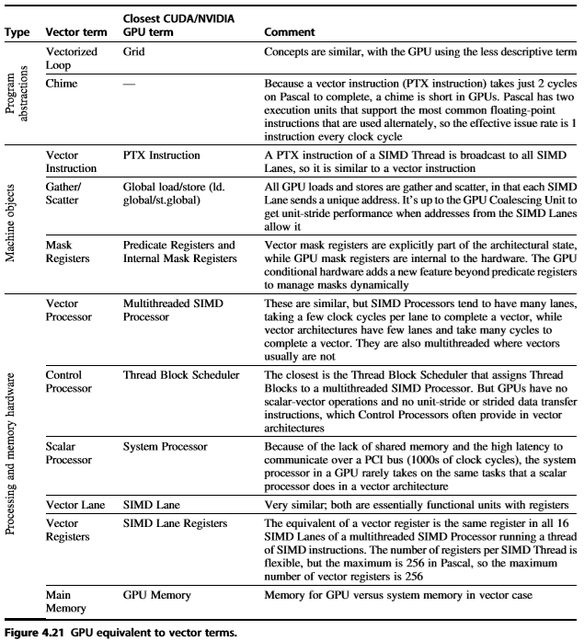

Slide 3
Global Memory
Global memory is the “main” memory of the GPU. It has global scope and lifetime of the allocating program (or until cudaFree is called).
Global memory is similar to the heap in a C program.
Global memory is separate hardware from the GPU core (containing SM’s,
caches, etc). The vast majority of memory on GPU is global memory. If data doesn’t fit into global memory, you are going to process it in chunks that do fit in globalmemory.
GPUs have .5 - 24GB of global memory, with most now having ~2GB. Global memory latency is ~300ns on Kepler and ~600ns on Fermi

Slide 4
Global Memory Access
Each thread issues memory accesses to data types of varying sizes, perhaps as small as 1 byte entities
Given an address to load or store, memory returns/updates “segments” of either 32 bytes, 64 bytes or 128 bytes
Maximizing bandwidth:
Operate on an entire 128 byte segment for each memory transfer

Slide 5
Understanding Global Memory Access
Start with memory request by smallest numbered thread.
Find the memory segment that contains the address (32, 64 or 128 byte segment, depending on data type)
Find other active threads requesting addresses within that segment and coalesce
Reduce transaction size if possible
Access memory and mark threads as “inactive”
Repeat until all threads in half-warp are serviced
(Includes Tesla and GTX platforms)

Slide 6
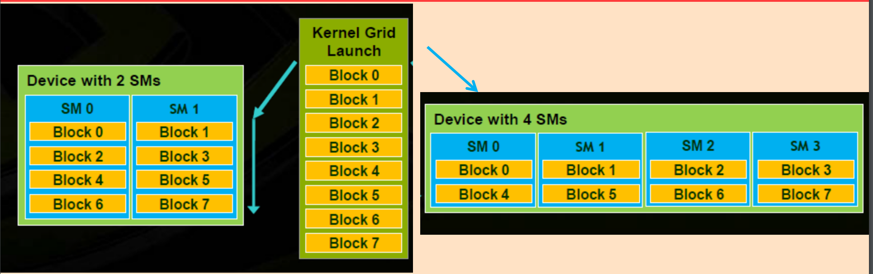
Thread Block Scheduling
• Each TB allocated to an SM; Multiple TBs in a SM
• Threads in a thread block may need to cooperate
– Load/Store from memory together
– Share results (through shared memory)
– Synchronize with each other
• Thread Blocks can execute in any order

Slide 7
Resident Thread Blocks
• No. of thread blocks allocated to SM is limited by
– Maximum Thread blocks
– Maximum number of threads
– Registers (Registers per thread * Threads per Block * # Blks)
– Shared Memory (Shared Memory per Block * # Blks)
• Warps of resident threadblocks are context switched to hide (long) latency

Slide 8
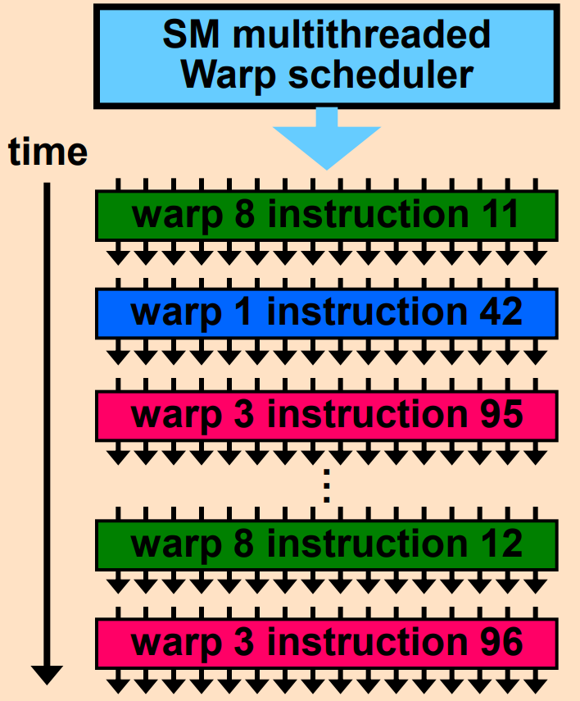
SM Warp Scheduling
• Each SM launches Warps of
Threads
– 2 levels of parallelism
– Shared instruction fetch per 32
threads (warps)
• SM hardware implements zero overhead Warp scheduling
– Warps whose next instruction has
its operands ready for consumption
are eligible for execution
– Eligible Warps are selected for
execution on a prioritized
scheduling policy
– All threads in a Warp execute the
same instruction when selected

Slide 9
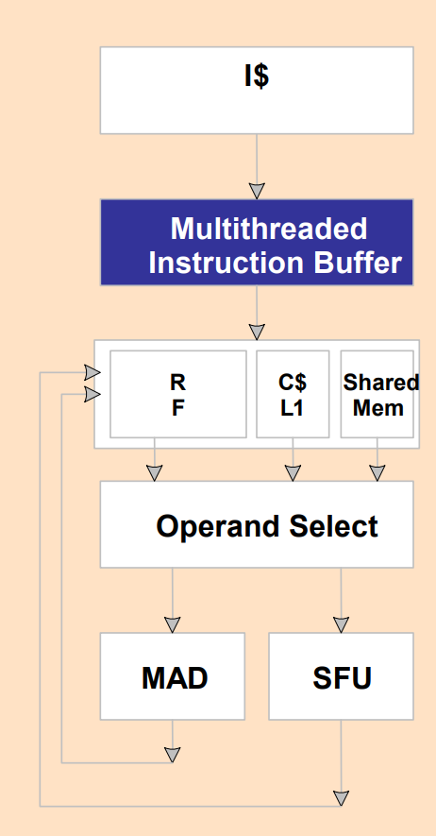
SM Instruction Buffer – Warp Scheduling
• Fetch one warp instruction/cycle
– from instruction cache
– into any instruction buffer slot
• Issue one “ready-to-go” warp instruction/cycle
– from any warp - instruction buffer slot
– operand scoreboarding used to prevent hazards
• Issue selection based on round robin or age of warp
• SM broadcasts the same instruction to 32 threads of a Warp

Slide 10
Scoreboarding
• How to determine if a thread is ready to execute?
• A scoreboard is a table in hardware that tracks
– instructions being fetched, issued, executed
– resources (functional units and operands) they need
– which instructions modify which registers
• Old concept from CDC 6600 (1960s)

Slide 11
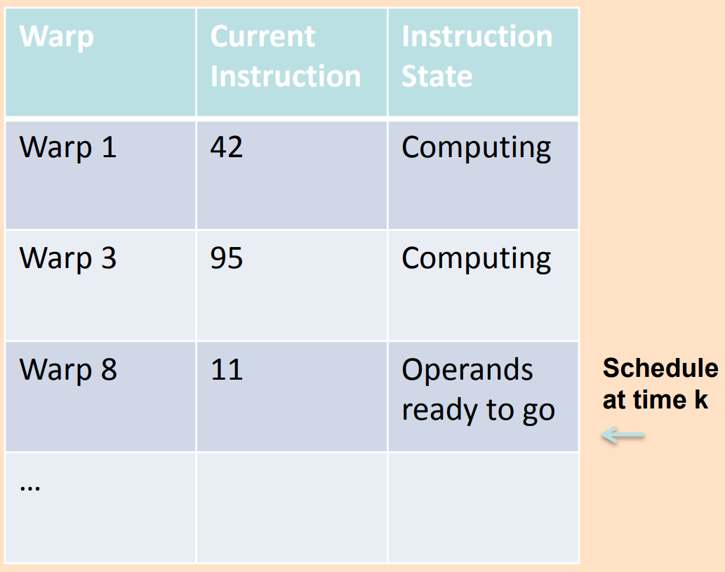
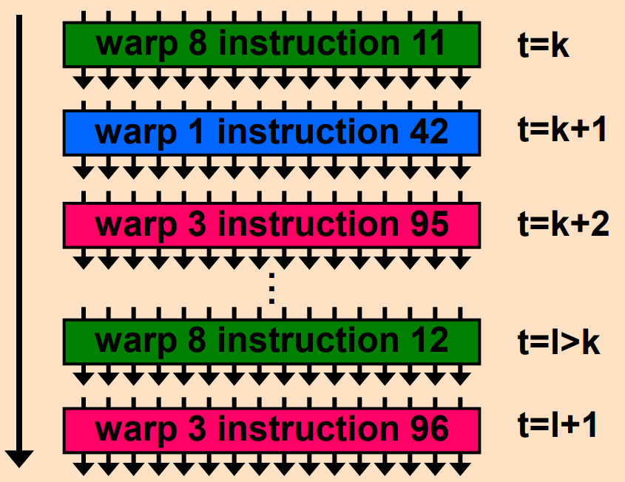
Scoreboarding Example
Consider three separate instruction streams: warp1,
warp3 and warp8

Slide 12
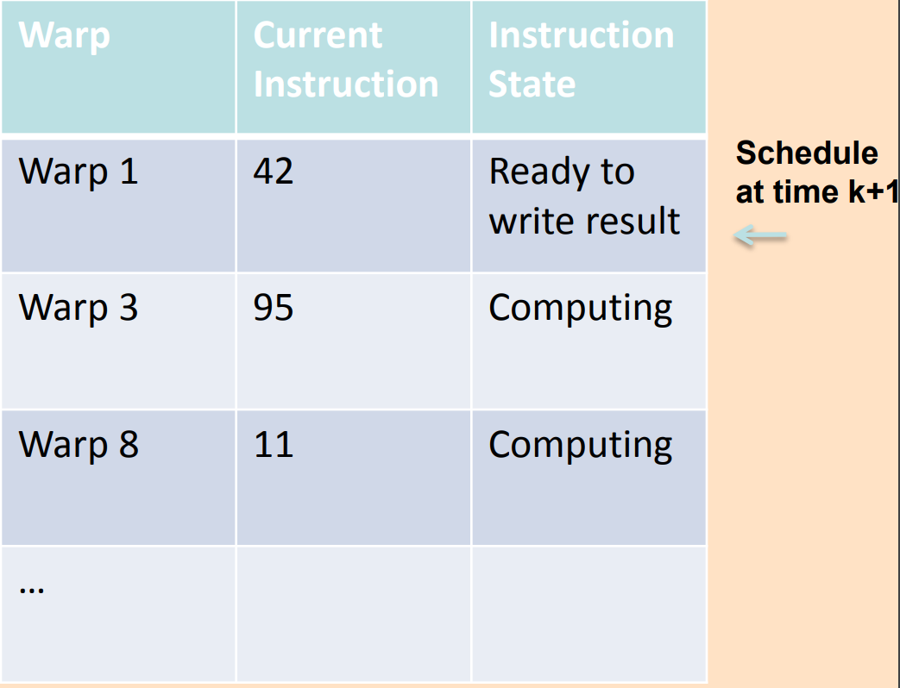
Scoreboarding Example
Consider three separate instruction streams: warp1,
warp3 and warp8

Slide 13
Threads Can Take Different Paths in Warp-based SIMD
每个线程可以包含控制流指令
这些线程可以执行不同的控制流路径
A
Thread Warp
Common PC
B
Thread
1
Thread
2
Thread
3
Thread
4
C
D
F
E
G
Slide credit: Tor Aamodt

Slide 14
Control Flow Problem in GPUs/SIMT
GPU 控制逻辑使用 SIMD流水线 以节省资源
这些标量线程构成warp
当一个WARP中的线程分支到不同的执行路径时，产生分支发散（Branch divergence）
Branch
Branch
Path A
Path A
Path B
Path B
与向量处理机模型的条件执行类似
（Vector Mask and Masked Vector Operations?）

Slide 15
Conditional Branching
与向量结构类似, GPU 使用内部的屏蔽字(masks)
还使用了 （SIMT-Stack）
分支同步堆栈
保存分支的路径地址
保存该路径的SIMD lane 屏蔽字(mask)
即指示哪些车道可以提交结果
指令标记(instruction markers）
管理何时分支（divergence）到多个执行路径，何时路径汇合(converge)
PTX层
CUDA线程的控制流由PTX分支指令(branch、call、return and exit）控制 以及
由程序员指定的每个线程车道的1-bit谓词寄存器
GPU硬件指令层,控制流包括：
分支指令(branch,jump call return)
特殊的指令用于管理分支同步栈
GPU硬件为每个SIMD thread 提供堆栈 保存分支的路径
GPU硬件指令带有控制每个线程车道的1-bit谓词寄存器

Slide 16
Branch divergence
硬件跟踪各µthreads转移的方向（判定哪些是成功的转移，哪些是失败的转移）
如果所有线程所走的路径相同，那么可以保持这种 SIMD 执行模式
如果各线程选择的方向不一致，那么创建一个屏蔽（mask） 向量来指示各线程的转移方向（成功、失败）
继续执行分支失败的路径，将分支成功的路径压入硬件堆栈（分支同步堆栈），待后续执行
SIMD 车道何时执行分支同步堆栈中的路径?
通过执行pop操作，弹出执行路径以及屏蔽字，执行该转移路径
SIMD lane完成整个分支路径执行后再执行下一条指令 称为converge(汇聚）
对于相同长度的路径，IF-THEN-ELSE 操作 的 效率平均为50%

Slide 17
Example
if (X[i] != 0)
X[i] = X[i] – Y[i];
else X[i] = Z[i];
ld.global.f64 RD0, [X+R8] ; RD0 = X[i]
setp.neq.s32 P1, RD0, #0 ; P1 is predicate register 1
@!P1, bra ELSE1, *Push ; Push old mask, set new mask bits
; if P1 false, go to ELSE1
ld.global.f64 RD2, [Y+R8] ; RD2 = Y[i]
sub.f64 RD0, RD0, RD2 ; Difference in RD0
st.global.f64 [X+R8], RD0 ; X[i] = RD0
@P1, bra ENDIF1, *Comp ; complement mask bits
; if P1 true, go to ENDIF1
ELSE1: ld.global.f64 RD0, [Z+R8] ; RD0 = Z[i]
st.global.f64 [X+R8], RD0 ; X[i] = RD0
ENDIF1: <next instruction>, *Pop ; pop to restore old mask

Slide 18
Branch Divergence Handling
A;
if (some condition) {
B;
} else {
C;
}
D;
One per warp
Control Flow Stack
Next PC
Recv PC
Active Mask
TOS
A
D
--
--
1111
1111
B
D
1110
A
C
C
D
0001
Execution Sequence
B
C
A
C
B
D
1
1
1
1
0
0
0
1
1
1
1
0
1
1
1
1
D
Time

Slide 19
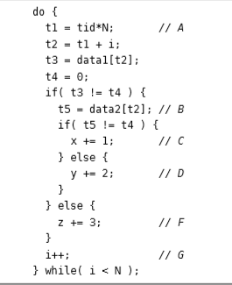
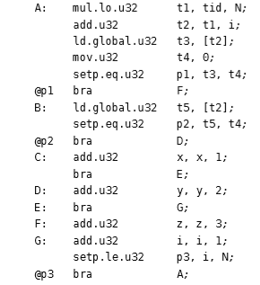
SIMT stack operation
Example CUDA C source code for illustrating SIMT stack operation
Example PTX assembly code for illustrating SIMT stack operation.

Slide 20
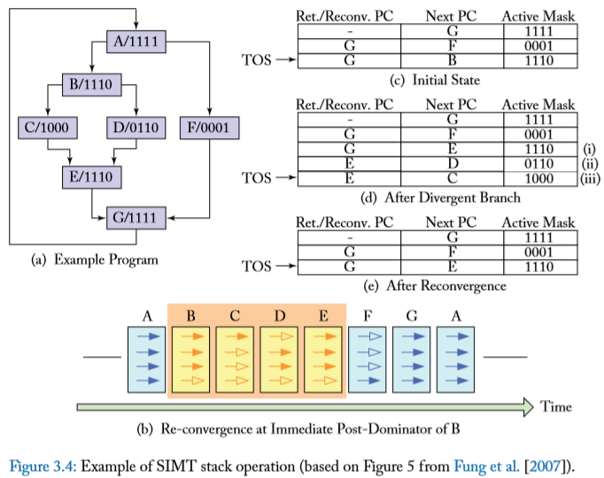

Slide 21
Remember: Each Thread Is Independent
SIMT 主要优点：
可以独立地处理线程,即每个线程可以在任何标量流水线上单独执行（ MIMD 处理模式）
可以将线程组织成warp，即可以将执行相同指令流的线程构成warp，形成SIMD 处理模式, 以充分发挥SIMD处理的优势
如果有许多线程，对具有相同PC值的线程可以将它们动态组织到一个warp中
这样可以减少“分支发散” →提高SIMD 利用率
SIMD 利用率: 执行有用操作的SIMD lanes的比例 (即, 执行活动线程的比例）

Slide 22
Dynamic Warp Formation/Merging
Idea: 分支发散之后，动态合并执行相同指令的线程
从那些等待的warp中形成新的warp
足够多的线程分支到每个路径，有可能创建完整的新warp
Warp X
Warp Z
Warp Y

Slide 23
Dynamic Warp Formation/Merging
Idea:
分支发散之后，动态合并执行相同指令的线程
Fung et al., “Dynamic Warp Formation and Scheduling for Efficient GPU Control Flow,” MICRO 2007.
Branch
Branch
Path A
Path A
Path B

Slide 24
Dynamic Warp Formation Example
A
x/1111
y/1111
Legend
B
A
A
x/1110
y/0011
Execution of Warp x
Execution of Warp y
at Basic Block A
at Basic Block A
C
x/1000
D
x/0110
F
x/0001
y/0010
y/0001
y/1100
D
E
A new warp created from scalar threads of both Warp x and y executing at Basic Block D
x/1110
y/0011
G
x/1111
y/1111
A
A
B
B
C
C
D
D
E
E
F
F
G
G
A
A
Baseline
Time
Dynamic
Warp
Formation
A
A
B
B
C
D
E
E
F
G
G
A
A
Time

Slide 25
Hardware Constraints Limit Flexibility of Warp Grouping
Functional Unit
Registers
for each
Thread
Registers for thread IDs
0, 4, 8, …
Registers for thread IDs
1, 5, 9, …
Registers for thread IDs
2, 6, 10, …
Registers for thread IDs
3, 7, 11, …
Can you move any thread
flexibly to any lane?
Lane
Memory Subsystem

Slide 26
When You Group Threads Dynamically
存储器访问如何处理？
固定模式的存储器访问相对简单，当动态构成warp时，使得访问模式具有随机性，使得问题变得复杂。→ 降低存储器访问的局部性
→ 导致存储器带宽利用率的下降

Slide 27
What About Memory Divergence?
现代 GPUs 包括高速缓存，减少对存储器的访问
Ideally: 一个warp中的所有线程的存储器访问都命中 (互相没有冲突）
Problem: 一个Warp中有些命中，有些失效
Problem: 一个线程的stall导致整个warp停顿
需要有相关技术来解决存储器发散访问问题

Slide 28
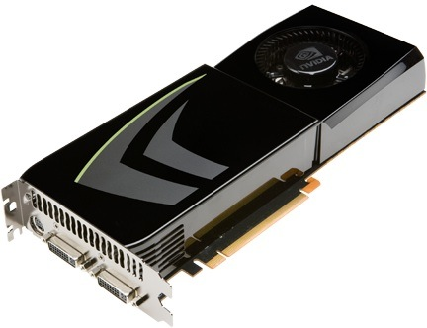
NVIDIA GeForce GTX 285
NVIDIA-speak:
240 stream processors
“SIMT execution”
Generic speak:
30 cores
8 SIMD functional units per core

Slide 29
NVIDIA GeForce GTX 285 “core”
64 KB of storage
for thread contexts (registers)
…
= SIMD functional unit, control
shared across 8 units
= instruction stream decode
= multiply-add
= execution context storage
= multiply
Notes:
30 * 32 * 32 = 30 * 1024 = 30K fragments
64KB register file = 16 32-bit registers per thread = 64B (1/32 that of LRB)
16KB of shared scratch
80KB / core available to software

Slide 30
NVIDIA GeForce GTX 285 “core”
64 KB of storage
for thread contexts (registers)
…
Groups of 32 threads share instruction stream (each group is a Warp)
Up to 32 warps are simultaneously interleaved
Up to 1024 thread contexts can be stored
Notes:
To get maximal latency hiding:
Run 1/32 of the time
16 words per thread = 64B

Slide 31
NVIDIA GeForce GTX 285
Tex
Tex
…
…
…
…
…
…
Tex
Tex
…
…
…
…
…
…
Tex
Tex
…
…
…
…
…
…
Tex
Tex
…
…
…
…
…
…
Tex
Tex
…
…
…
…
…
…
30 cores on the GTX 285: 30,720 threads
Notes:
If you’re running a CUDA program, and your not launching 30K threads, you are certainly not getting full latency hiding, and you might not be using the GPU well

Slide 32
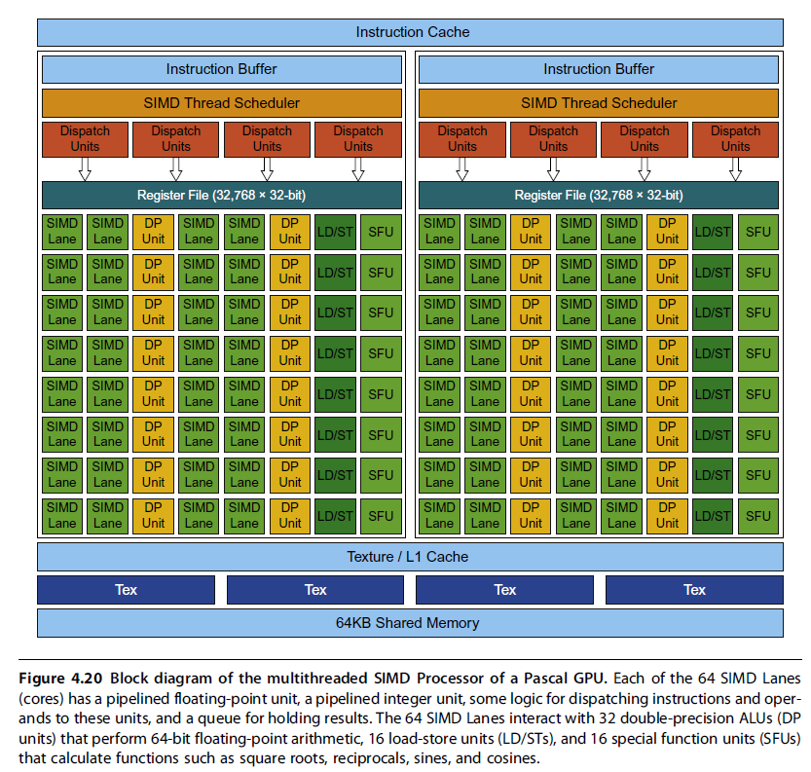
GP100 GPU
56 SMs
64 Lanes/SM
Or
3584
Stream Processors

Slide 33
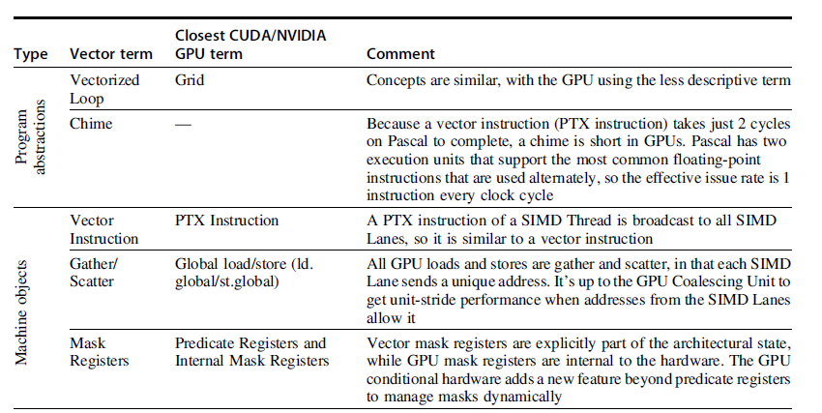
Summary- 向量处理机 vs. GPU
不同层次相近的术语比较

Slide 34
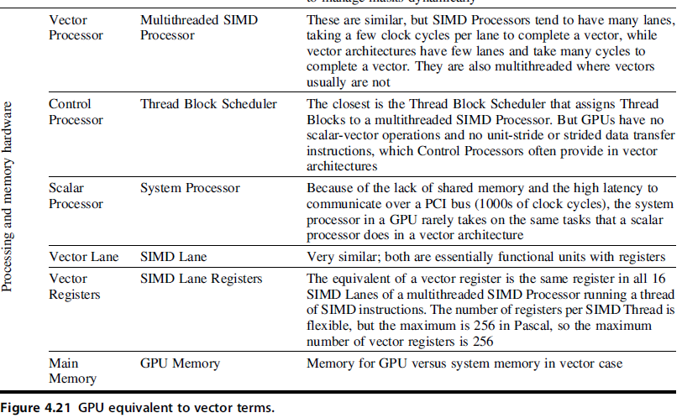
Summary-向量处理机 vs. GPU

Slide 35
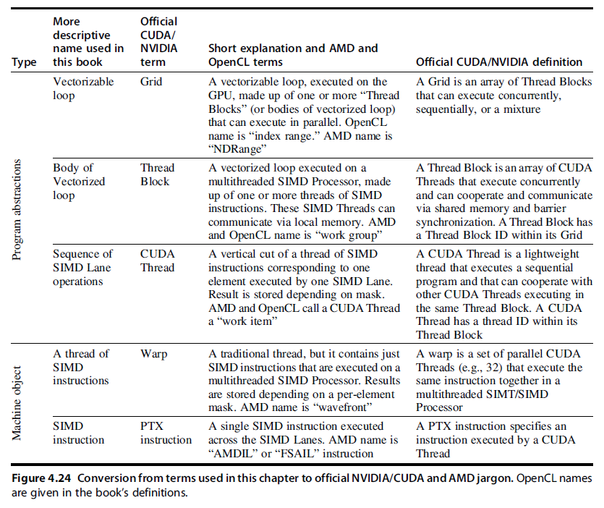

Slide 36
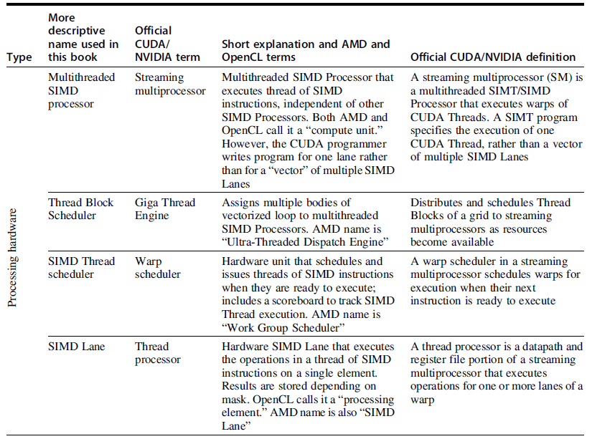

Slide 37
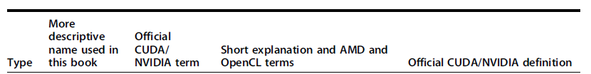
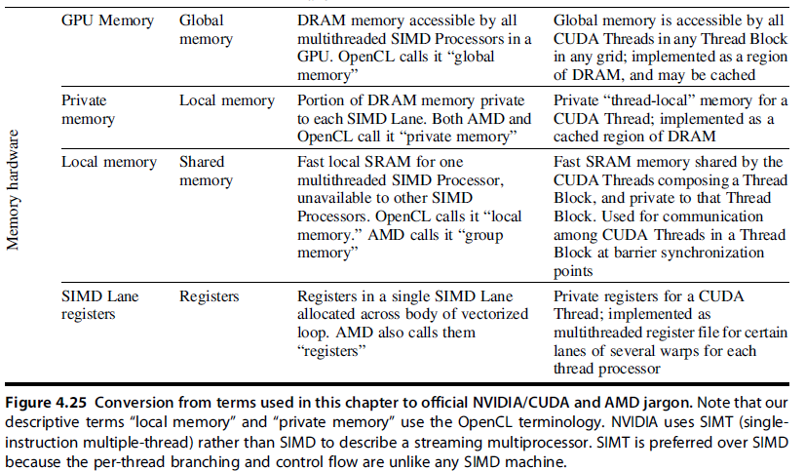

Slide 38
GPU Readings
Lindholm et al., "NVIDIA Tesla: A Unified Graphics and Computing Architecture," IEEE Micro 2008.
Fatahalian and Houston, “A Closer Look at GPUs,” CACM 2008.
Narasiman et al., “Improving GPU Performance via Large Warps and Two-Level Warp Scheduling,” MICRO 2011.
Fung et al., “Dynamic Warp Formation and Scheduling for Efficient GPU Control Flow,” MICRO 2007.
Jog et al., “Orchestrated Scheduling and Prefetching for GPGPUs,” ISCA 2013.

Slide 39
Acknowledgements
These slides contain material developed and copyright by:
John Kubiatowicz (UCB)
Krste Asanovic (UCB)
John Hennessy (Standford)and David Patterson (UCB)
Chenxi Zhang (Tongji)
Muhamed Mudawar (KFUPM)
UCB material derived from course CS152、CS252、CS61C
KFUPM material derived from course COE501、COE502
CMU Introduction to Computer Architecture
http://www.ece.cmu.edu/~ece447/

