Slide 1
DevOps & Cloud Infrastructure
SEIS 615
Software Delivery Pipelines
Hannah’s Infrastructure Training.
Adapted by Damian Marquez and based
Jason Baker’s - Adjunct Instructor Syllabus for
Graduate Programs in Software of the
University of St. Thomas
St. Paul, MN

Slide 2
Agenda
Delivery Pipelines

Slide 3
Deployment Pipeline
A deployment pipeline is used to manage the deployment and testing of software using a set of validation stages whenever there is a code change.
Commit
Linting
Build
Test
Deploy

Slide 4
Pipeline Benefits
Software is automatically built and tested.
  Ready to go to production at any time.
Making changes to software is much easier.
  Every change is tested the same way
  Easier to automatically deploy changes versus using manual methods
  Reinforces practice of using small batch sizes
Compliance and governance tasks are easier.
  Traceability improved and tests are enforced.
  Reduces need for heavy change control tasks.

Slide 5
Real World Pipeline Development
Some companies hire people to focus exclusively on pipeline development work.
  CI/CD engineers
  Software Delivery engineers
  DevOps Engineer
  Release Engineer
  Build Engineer
Software engineers today have to know how to build pipelines.

Slide 6
Basic Pipeline Design
Local development stage
  Developers run and test software on their local workstation
    Natively, virtual machine (vagrant), container
  Linting: a static code analysis process which identifies common syntax and style defects using a linter application.
  Unit testing: functional tests performed at a small, modular level.

Slide 7
Basic Pipeline Design
Build stage
  Usually triggered when a developer checks new code into a VCS
  Linting process
  Code compilation (when necessary)
  Unit tests
  Possible local execution tests
  Package code and store in an artifact repository

Slide 8
Basic Pipeline Design
Testing stage
  Code artifact is deployed to a testing environment
  Automated API and/or GUI tests are run against environment
    Both integration and end-to-end testing
    May leverage a grid-based testing solution
  Non-functional testing (service resiliency)
  Performance testing
  Manual testing (pipeline is stopped and manually retriggered)

Slide 9
Basic Pipeline Design
Production deployment stage/ release
  Code artifact is deployed to production environment
    May be first applied to a staging environment for further testing before production
  Automated smoke tests are run against deployment to validate application working properly.

Slide 10
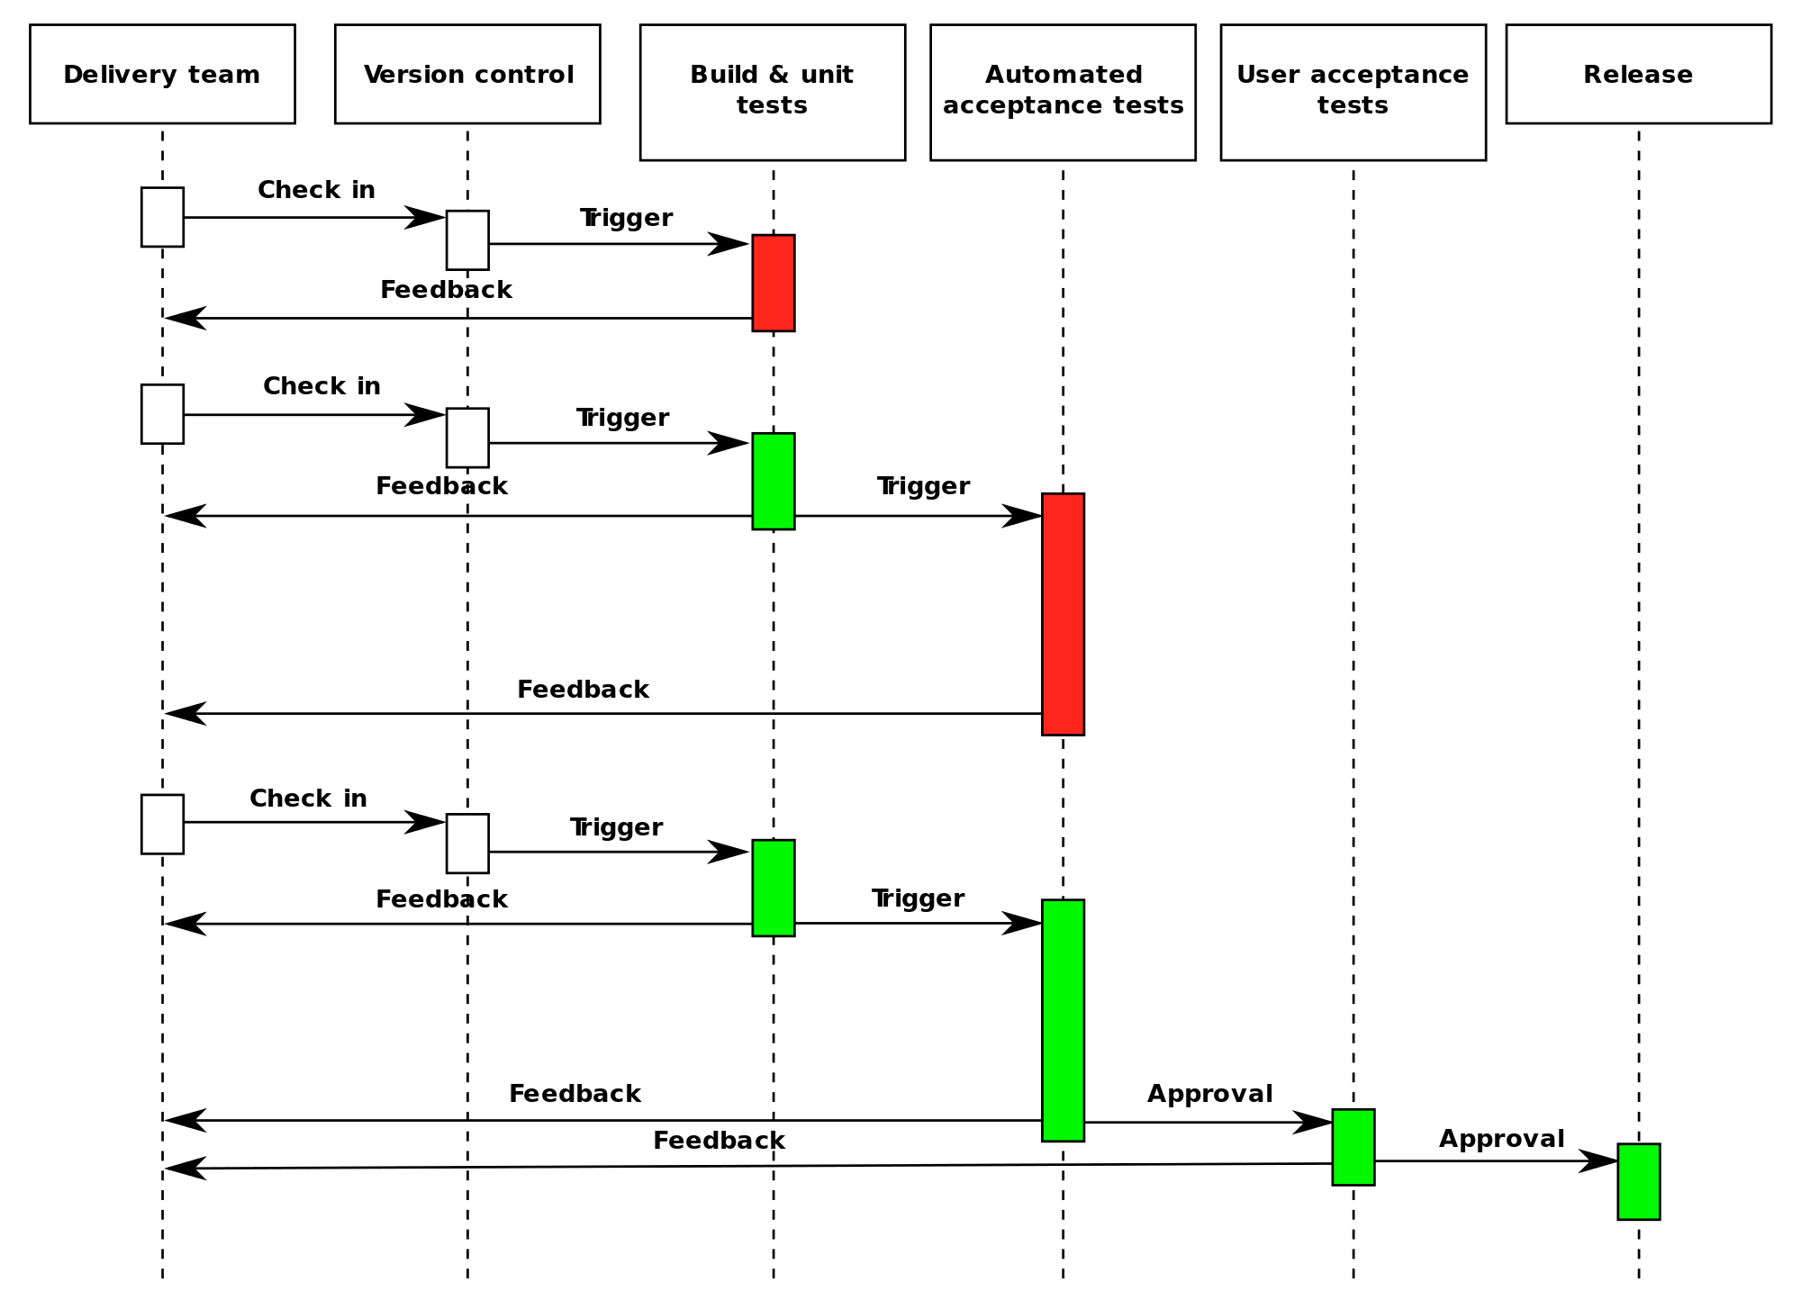

Slide 11
Deployment Pipeline Practices
Prove production-readiness for every change
  All changes are potential releasable.
Only build your binaries once.
  Don’t keep re-compiling or packaging app at each stage to minimize introduction of configuration inconsistencies.
  Store application artifacts in a repository (example: Artifactory)
Deploy the same way to every environment.
  Use the same script to deploy to a dev laptop, a test virtual machine, and a public cloud instance.
  Store environment-specific configurations in separate files.
If any part of the pipeline fails, stop the line.
  If a deployment to an environment fails, the whole team owns that failure and every effort should be taken to fix it.

Slide 12
Fan-in Pipeline Pattern
Multiple pipelines may feed a single assembly or deployment pipeline.

Slide 13
Infrastructure Pipelines
CI/CD pipelines aren’t just used to build software, we also use them to build infrastructure.
Two general use cases:
  Automate testing of our infrastructure.
    A change to a configuration management or infrastructure definition script triggers a pipeline.
  Automate deployment of infrastructure and our software.

Slide 14
Infrastructure Pipeline
CloudFormation template pipeline example:
  Lint CloudFormation template to validate syntax
  Deploy CloudFormation template
    Wait for AWS resources to be built
  Test AWS resources to verify that required resources are installed and working properly
  Terminate AWS resources
  Publish new template

Slide 15

Pipeline Hands-on
Let’s do: https://learn.microsoft.com/en-us/azure/devops/pipelines/create-first-pipeline?view=azure-devops&tabs=java%2Cbrowser

