Slide 1
DevOps & Cloud Infrastructure SEIS 615 Virtualization
Hannah’s Infrastructure Training.
Adapted by Damian Marquez and based
Jason Baker’s - Adjunct Instructor Syllabus for
Graduate Programs in Software of the
University of St. Thomas
St. Paul, MN

Slide 2
Agenda
Virtualization
Cloud Computing
Amazon Web Services (Azure)
IAM
Blob Storage
VM

Slide 3
Virtualization
A stack: combination of infrastructure, OS, and applications required to support a service.
Before early 2000’s, a stack = 1 server + 1 OS
Software applications
Operating System
Compute/Storage

Slide 4
Virtualization
We can create software which emulates hardware.
Each emulated virtual system can have its own OS and set of applications.
Multiple stacks are logically partitioned from a process, memory, and networking perspective.

Slide 5
Virtualization solves problems
Servers become as easy to maintain as software.
It’s easier to move software around than physical servers.
No need to purchase a separate server for each user or team because virtualization provides partitioning.

Slide 6
Virtualization definitions
First, some definitions:
Host machine: physical server that supports multiple virtual machines.
Virtual machine: virtualized server instance running on a host machine (also known as an instance or a workload).
Host OS: operating system running on a bare-metal server.
Guest OS: operating system running on a virtual machine.
Hypervisor: Software that emulates and manages the communication between virtual machines and the physical server.

Slide 7
Virtualization Types
Hardware virtualization
Part of physical server dedicated to a specific stack.
Big expensive mainframe-type systems

Slide 8
Virtualization Types
Software virtualization
Two types available:
Type 1 Hypervisor
Runs on top of the bare-metal server and sits between hardware and operating systems in the stacks.
Examples: VMWare ESX, Microsoft Virtual Server, Xen
Type 2 Hypervisor
Runs on top of an operating system.
Easy installation (no special hypervisor or storage required).
Example: Oracle VirtualBox, VMWare Fusion

Slide 9
Type 1 vs. Type 2 Hypervisor

Slide 10
Virtualization Types
OS Partitioning
Host (or guest) operating system can partition out processes, memory, and scheduling to emulate a separate OS environment.
Separate OS environments all use same kernel.
If host is Linux then all “guests” are Linux.
Example: Docker containers
We will cover this later in the course. ☺

Slide 11
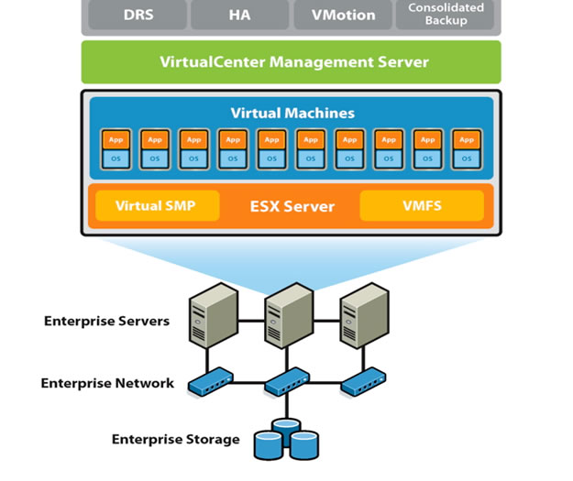
Virtualization infrastructure
Server virtualization is the predominant form of virtualized infrastructure.
Most servers in enterprises are now virtualized.
Gartner estimates up to 75% of workloads are virtualized.
New virtualization software licenses have declined for first time in over a decade!

Slide 12
Cloud Computing
What is cloud computing?
Cloud computing is a model for enabling convenient, on-demand network access to a shared pool of configurable computing resources (e.g., networks, servers, storage, applications, and services) that can be rapidly provisioned and released with minimal management effort or service provider interaction.
National Institute of Standards and Technology
NIST SP 800-145

Slide 13
Cloud Computing Characteristics
On-demand
Infrastructure available as needed via a self-service interface
Network access
Infrastructure accessed via a broad network (generally Internet)
Resource pooling
Infrastructure aggregated into large resource pools which are subsequently partitioned to support specific functions
Elasticity
Utility service
Ability to rapidly provision and de-provision services as needed
Pay-for-usage pricing model with no minimum commitments

Slide 14
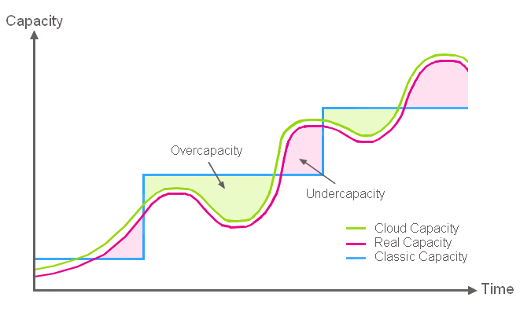
Cloud Computing Benefits
Align infrastructure capacity with current IT demand to achieve cost savings.

Slide 15
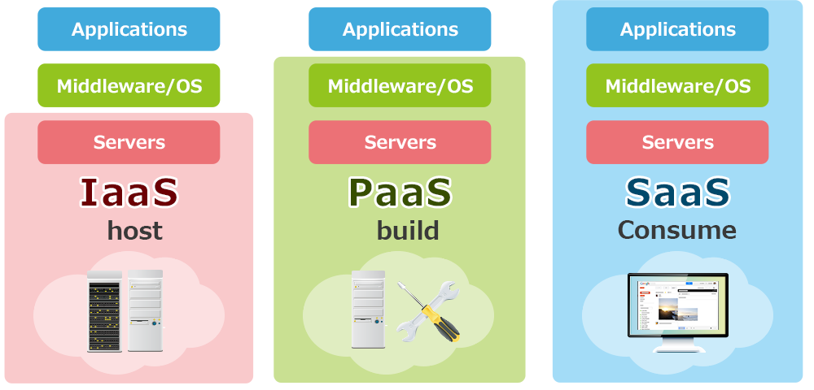
Cloud Computing Service Models
Infrastructure-as-a-Service
Platform-as-a-Service
Software-as-a-Service

Slide 16
Cloud Deployment Models

