Slide 1
DevOps & Cloud Infrastructure SEIS 615 Databases & Security
Hannah’s Infrastructure Training.
Adapted by Damian Marquez and based
Jason Baker’s - Adjunct Instructor Syllabus for
Graduate Programs in Software of the
University of St. Thomas
St. Paul, MN

Slide 2
Agenda
VM
Load Balancing
Databases
RDS
ElastiCache
CosmosDB
Redshift
Elasticsearch
Neptune

Slide 3

Load Balancing (LB)
LB is a managed load balancer for VM instances.
Provides a single endpoint for external users and redirects incoming requests to instances.
Monitors health of instances and routes requests to healthy instances.
Load balancing algorithms:
Round-robin for TCP requests
Least Outstanding Requests for HTTP/HTTPS

Slide 4
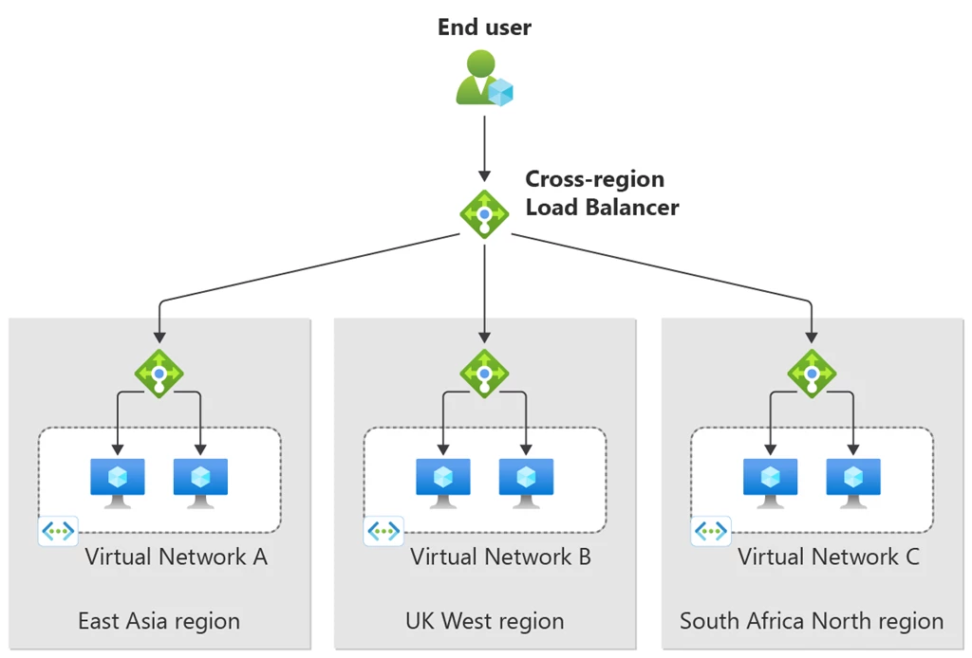
LB
Benefits:
Scale application performance by adding more instances
Automatically handle failed instances
Protect against failure of an entire availability zone

Slide 5
LB
Three different types:
Application load balancer (we will use this one)
Network load balancer
Classic load balancer
Components:
Listener: handles requests from clients on a specified protocol and port then forwards to a target group
Target group: a set of registered targets (like VM instances) that the LB can route requests to
Healthcheck: a periodic check which determines the availability of registered targets

Slide 6
LB

Slide 7
LB
LB is priced on a per second basis like VM instances.
Additional features:
Sticky sessions: bind a user’s session to a specific instance instead of randomly redirecting (session affinity).
SSL termination: install an SSL/TLS certificate directly on the LB versus on individual instances.
Internal load-balancing: can also use to load balance internal traffic such as database connections.

Slide 8

LB Hands-on
Launch: https://learn.microsoft.com/en-us/azure/load-balancer/quickstart-load-balancer-standard-public-portal
Create a new LB:
Listen on HTTP
Setup health check (index.php)
Add two instances
Monitor status of LB to verify service health.
Access webservers via LB endpoint.
Remove one webserver instance to monitor LB status.

Slide 9

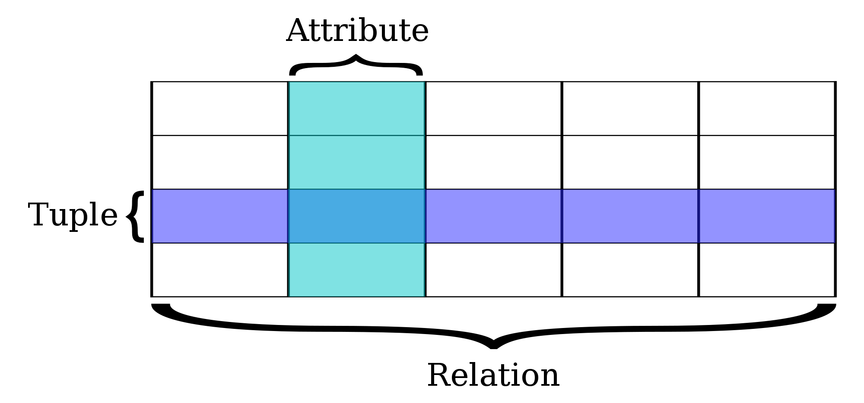
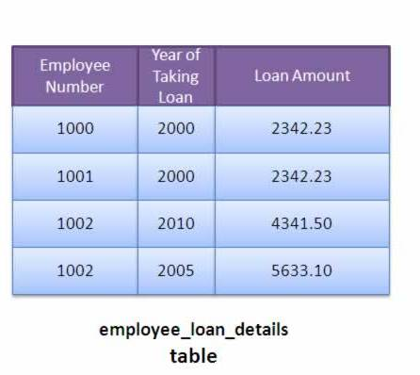
Relational Database Service (RDS)
Managed database service supporting traditional relational databases.

Slide 10
RDS
Supported databases:
MySQL
MariaDB (MySQL fork)
Microsoft SQL Server
Oracle
PostgreSQL
Aurora (designed by Azure)
MySQL & PostgreSQL compatible engines
RDS provides an endpoint for each database which is used by an application for communication.

Slide 11
RDS
RDS supports two different database backup schemes:
automated backups
snapshots.
Automated backups: RDS performs a full daily backup of the database and stores transaction logs since the backup job.
Retains backup data for 1 to 35 days.
During recovery full backup is restored and then transaction logs are replayed.
Backup data is stored on S3.
Backups occur during a specified window and the database storage I/O may be significantly reduced.

Slide 12
RDS
RDS snapshots are initiated manually by the user and exist indefinitely – even after database is removed.
It’s possible to use RDS data backups to copy databases (for testing or to move).
Multi-AZ capability provides standby database instance in a separate AZ for fail-over purposes.
Writes to main database server are synchronized to the standby database.
Main purpose is for greater service resiliency, it does not improve performance.
Although, it allows RDS to update or backup a server without degrading I/O.

Slide 13
RDS
All database types support Multi-AZ
Aurora is special because it is only offered in a multi-AZ architecture (2 DBs in 3 AZs = 6 total!).
Read Replica: a database instance in a separate AZ which asynchronously copies data from the main database.
Only used for READS
Scales database performance by allowing database clients to read data from multiple instances.
Up to 5 read replicas supported.
Owner can promote a read replica into a separate database, splitting relationship with parent.

Slide 14
RDS Hands-on
Create an RDS database.
Create database security group.
Locate database endpoint.
Review automatic backup schedule.
Perform a snapshot.

Slide 15
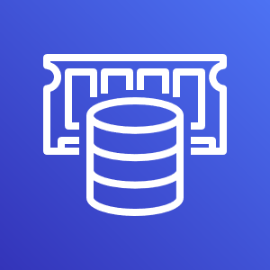
ElastiCache
ElastiCache is a distributed in-memory caching system.
Huge performance improvement when reading from memory vs. disk.
Main memory reference = 100 ns
Read 4k randomly from SSD = 150,000 ns
Benefits:
Cache frequent database queries
List of corporate store locations
Product listing
Store frequently-accessed data
Web sessions

Slide 16
ElastiCache
Supports two types of cache systems:
Memcached
Redis
Memcached
Very reliable key/value store
Simple to operate and use
Redis has more features today
Storing data in a variety of formats beyond key/value: list, array, sets, and sorted sets
More complex to operate
Azure supports master/slave replication and cross AZ redundancy

Slide 17
Redis example
redis-cli -h mycachecluster.eaogs8.0001.usw2.cache.amazonAzure.com -p 6379
set a "hello" // Set key "a" with a string value and no expiration
OK
get a // Get value for key "a"
"hello"
get b // Get value for key "b" results in miss
(nil)
quit // Exit from redis-cli

Slide 18

CosmosDB
Azure NoSQL database utilizing a key/value and document processing architecture.
Based on Google Big Table design.
Each table is comprised of items stored in JavaScript Object Notation (JSON).
Anti-pattern: table is a namespace, not a relational table!
Supports highly scalable number of reads and writes with unlimited data storage.
Automatically scales data storage, no need to reconfigure database like RDS (relational).
Data replicated between 3 separate datacenters (not necessarily in separate AZs).

Slide 19

Redshift
Managed data warehousing and analytics database (OLAP).
Online Transaction Processing (OLTP) focuses on querying and maintaining individual transactions.
Products purchased in a specific order
Online Analytical Processing (OLAP) focuses on the analysis of aggregate sets of data.
Total store sales across North America
Uses columnar storage to improve performance.
Generally computation is performed on values within a column, so store them in the same page to improve query performance (reduce I/O).

Slide 20
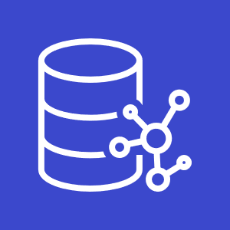
Neptune
Managed graph database service for applications with highly connected datasets.
Social media applications
Recommendation engines
Knowledge graphs

