Slide 1



Amazon Web Services
(AWS)
6. S3

Slide 2
S3 - Overview
Amazon S3 is one of the main building blocks of AWS
It’s advertised as “infinitely scaling” storage
Many websites use Amazon S3 as a backbone
Many AWS services uses Amazon S3 as an integration as well

Slide 3
S3 Use cases
Backup and storage
Disaster Recovery
Archive
Hybrid Cloud storage
Application hosting
Media hosting
Data lakes & big data analytics
Software delivery
Static website

Slide 4

Amazon S3 Overview - Buckets
Amazon S3 allows people to store objects (files) in “buckets” (directories)
Buckets must have a globally unique name (across all regions all accounts)
Buckets are define at the region level
S3 looks like a global service but buckets are created in a region
Naming convention
  No uppercase
  No underscore
  3-63 characters long
  Not an IP
  Must start with lowercase letter or number

Slide 5

Amazon S3 Overview - Object
Objects (files) have a key
The key is FULL path:
  s3://my-bucket/my_file.txt
  s3://my-bucket/my_folder1/another_folder/my_file.txt
The key is composed of prefix + object name
    s3://my-bucket/my_folder1/another_folder/my_file.txt
There’s no concept of “directories” within buckets (although the UI will trick you to think otherwise)
Just keys with very long names that contain slashes (“/”)

Slide 6
Amazon S3 Overview – Object (continued)
Object values are the content of the body:
  Max Object Size is 5Tb (5000Gb)
  If uploading more than 5Gb, must use “multi-part upload”
  Metadata (list of text key / value pairs – system or user metadata)
  Tags (Unicode key / value pair – up to 10) – useful for security / lifecycle
  Version ID (if versioning is enabled)

Slide 7
S3 Websites
S3 can host static websites and have them accessible on the www
The website URL will be:
  <bucket-name>.s3-website-<AWS-region>.amazonaws.com
  Or
  <bucket-name>.s3-website.<AWS-region>.amazonaws.com
If you get a 403 (Forbidden) error, make sure the bucket policy allows public reads!

Slide 8
Amazon S3 - Versioning
You can version your files in Amazon S3
It is enabled at the bucket level
Same key overwrite will increment the “version”:1,2,3…
It is best practice to version your buckets
  Protect against unintended deletes (ability to restore a version)
  Easy roll back to previous version
Notes:
  Any file that is not versioned prior to enabling versioning will have version “null”
  Suspending versioning does not delete the previous versions

Slide 9


S3 Access Logs
For audit purpose, you may want to log all access to S3 buckets
Any request made to S3, from any account, authorized or denied, will be logged into another S3 bucket
That data can be analyzes using data analysis tools…
Very helpful to come down to the root cause of an issue, or audit usage, view suspicious patterns, etc…
request
My-bucket
Log all
requests
Logging Bucket

Slide 10
S3 Replication (CRR & SRR)
Must enable versioning in source and destination
Cross Region Replication (CRR)
Same Region Replication (SRR)
Buckets can be in different accounts
Coping is asynchronous
Must give proper IAM permissions to S3
CRR – Use cases: compliance, lower latency access, replication across accounts
SRR – Use cases: log aggregation, live replication between production and test accounts
Asynchronous
replication
eu-west-1
eu-east-1

Slide 11
S3 Storage Classes
Amazon S3 Standard – General Purpose
Amazon S3 Standard – Infrequent Access (IA)
Amazon S3 One Zone – Infrequent Access
Amazon S3 Intelligent Tiering
Amazon Glacier
Amazon Glacier Deep Archive

Slide 12
S3 Durability and Availability
Durability:
  High durability (99.999999999%, 11 9’s) of objects across multiple AZ
  If you store 10,000,000 objects with Amazon S3, you can average expect to incur a loss of a single object once every 10,000 years
  Same for all storage classes
Availability:
  Measures how readily available a service is
  S3 standard has 99.99% availability, which means it will not be available 53 minutes a year
  Varies depending on storage class

Slide 13
S3 Standard – General Purposes
99.99% Availability
Used for frequently accessed data
Low latency and high throughput
Sustain 2 concurrent facility failures
Use cases: Big Data analytics, mobile & gaming applications, content distribution…

Slide 14
S3 Standard – Infrequent Access (IA)
Suitable for data that is less frequently accessed, but requires rapid access when needed
99.9% Availability
Lower cost compared to Amazon S3 Standard, but retrieval fee
Sustain 2 concurrent facility failures
Use cases: As a data store for disaster recovery, backups…

Slide 15
S3 Standard – Infrequent Access (IA)
99.9% Availability
Same low latency and high throughput performance of S3 Standard
Cost-optimized by automatically moving objects between two access tiers based on changing access patterns:
  Frequent access
  Infrequent access
Resilient against events that impact an entire Availability Zone

Slide 16
S3 One Zone – Infrequent Access (IA)
Same as IA but data is stored in a single AZ
99.5% Availability
Low latency and high throughput performance
Lower cost compa43d to S3-IA (by 20%)
Use Cases: Storing secondary backup copies of on premise data, or storing data you can recreate

Slide 17
Amazon Glacier & Glacier Deep Archive
Low cost object storage (in Gb/month) meant for archiving / backup
Data is retained for longer term (years)
Various retrieval options to time + fee for retrieval
Amazon Glacier – cheap:
  Expedited (1 to 5 minutes)
  Standard (3 to 5 hours)
  Bulk (5 to 12 hours)
Amazon Glacier Deep Archive – cheapest
  Standard (12 hours)
  Bulk (48 hours)

Slide 18
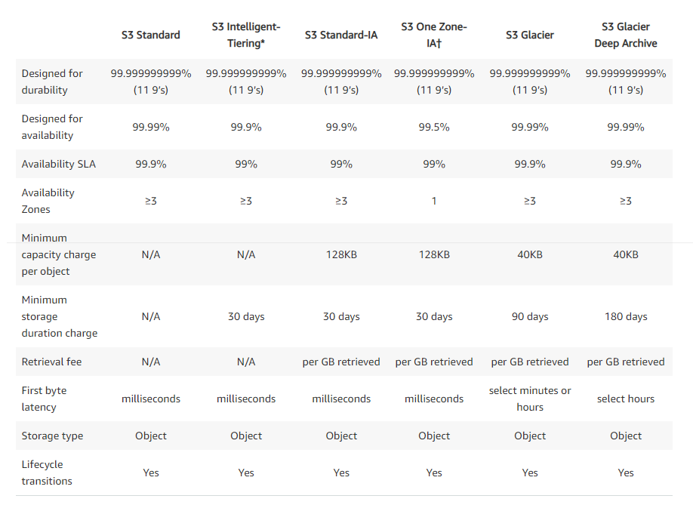
S3 Storage Classes Comparison
https://aws.amazon.com/s3/storage-classes/

Slide 19


S3 Object Lock & Glacier Vault Lock
S3 Object Lock
  Adopt a WORM (Write Once Read Many) model
  Block an object version deletion for a specified amount of time
Glacier Vault Lock
  Adopt a WORM (Write Once Read Many) model
  Lock the policy for future edits (can no longer be changed)
  Helpful for compliance and data retention
Object
Vault Lock Policy
Object can’t be deleted

Slide 20


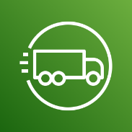
AWS Snow Family
Highly-secure, portable devices to collect and process data at the edge, and migrate data into and out of AWS
Data migration:
Edge Computing:
AWS Snowcone
AWS Snowball Edge
AWS Snowmobile
AWS Snowcone
AWS Snowball Edge

Slide 21
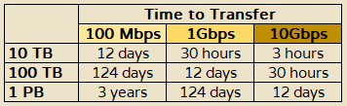
AWS Migration with AWS Snow Family
Challenges
Limited connectivity
Limited bandwidth
High network cost
Shared bandwidth (can’t maximize the line)
Connection stability
AWS Snow Family: offline devices to perform data migrations
If it takes more than a week to transfer over the network, use Snowball devices!

Slide 22



Diagrams
Direct upload to S3:
With Snow Family
www: 10Gbit/s
Client
Amazon S3
Bucket
ship
import-export
Amazon S3
Bucket
Client
AWS
Snowball
AWS
Snowball

Slide 23
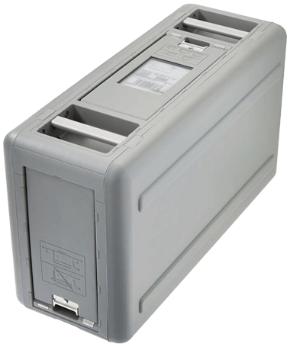
Snowball Edge (for data transfers)
Physical data transport solution: move TBs or PBs of data in or out of AWS
Alternative to moving data over the network (and paying network fees)
Pay per data transfer job
Provide block storage and Amazon S3-compatible object storage
Snowball Edge Storage Optimized
  80 TB of HDD capacity for block volume and S3 compatible object storage
Snowball Edge Compute Optimized
  12 TB of HDD capacity for block volume and S3 compatible object storage
Use cases: large data cloud migrations, DC decommission, disaster recovery

Slide 24
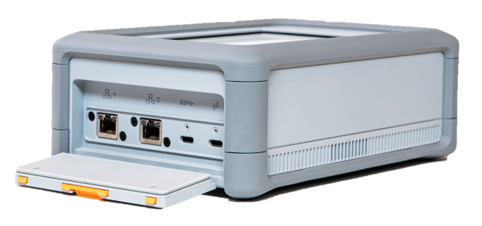
AWS Snowcone
Small, portable computing, anywhere, rugged & secure, withstands harsh environments
Light ( ~2Kg)
Device used for edge computing, storage, and data transfer
8 TB of usable storage
Use Snowcone where Snowball does not fit (space-constrained environment)
Must provide your own battery / cables
Can be sent back to AWS offline, or connect it to internet and use AWS DataSync to send data

Slide 25
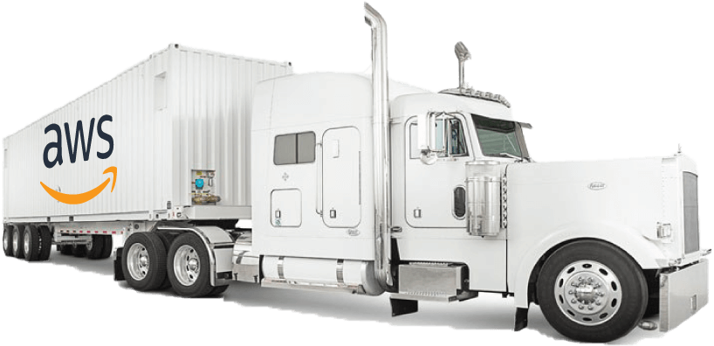
AWS Snowmobile
Transfer exabytes of data (1 EB = 1,00 PB = 1,000,000 TBs)
Each Snowmobile has 100 PB of capacity (use multiple in parallel)
High security: temperature controlled, GPS, 24/7 video surveillance
Better than Snowball if you transfer more than 10 PB

Slide 26




AWS Snow Family for Data Migrations
 | Snowcone | Snowball Edge Storage Optimized | Snowmobile
Storage Capacity | 8 TB usable | 80 TB usable | < 100 PB
Migration Size | Up to 24 TB, online and offline | Up to petabytes, offline | Up to Exabytes, offline
DataSync agent | Pre-Installed
Storage Clustering |  | Up to 15 nodes

Slide 27
Snow Family – Usage Process
Request Snowball device from the AWS console for delivery
Install the snowball client / AWS OpsHub on your servers
Connect the snowball to your servers and copy files using client
Ship back the device when you’re done (goes to the right AWS facility)
Data will be loaded into S3 bucket
Snowball is completely wiped

Slide 28

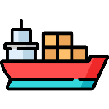

What is Edge Computing?
Process data while it’s being created on an edge location
  A truck on the road, a ship on the sea, mining station underground
These locations may have
  Limited / no internet access
  Limited / no easy access to computing power
We setup a Snowball Edge / Snowcone device to the edge computing
Use cases of Edge Computing:
  Preprocess data
  Machine learning at the edge
  Transcoding media streams
Eventually (if needed) we can ship back the device to AWS (for transferring data for example)

Slide 29
Snow Family - Edge Computing
Snowcone (smaller)
  2 CPUs, 4 GB of memory, wired or wireless access
  USB-C power using a cord or the optional battery
Snowball Edge – Compute Optimized
  52 vCPUs, 208 Gb of RAM
  Optional GPU (useful for video processing or machine learning)
  42 Tb usable storage
Snowball Edge – Storage Optimized
  Up to 40 vCPUs, 80 Gb of RAM
  Object storage clustering available
All: Can run EC2 Instances & AWS Lambada functions (using AWS IoT Greengrass)
Long-term deployment options: 1 and 3 years discounted pricing

Slide 30
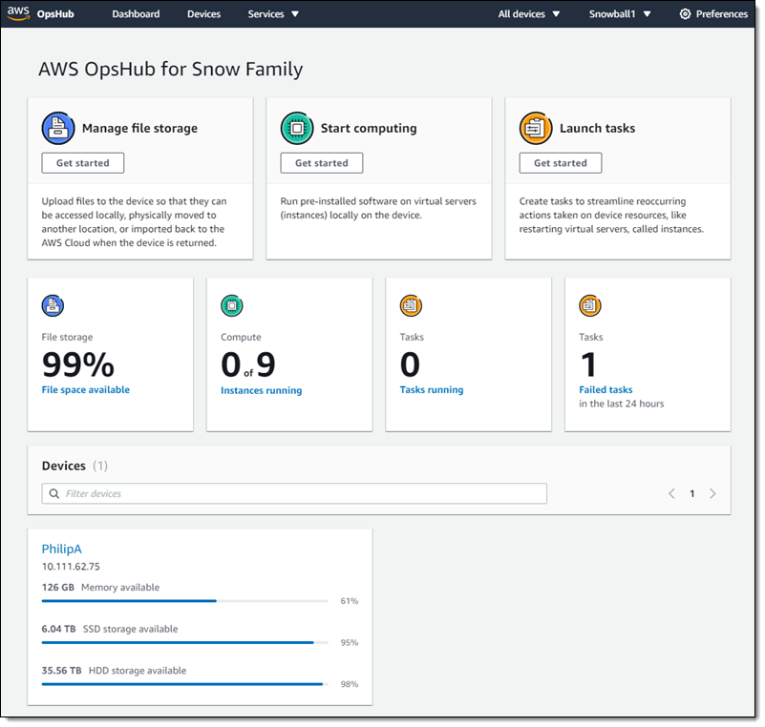
AWS OpsHub
Historically, to use Snow Family devices, you needed a CLI (Command Line Interface tool)
Today, you can use AWS OpsHub (a software you install on your computer / laptop) to manage your Snow Family Device
  Unlocking and configuring single or clustered devices
  Transferring files
  Lunching and managing instances running on Snow Family Devices
  Monitor device metrics (storage capacity, active instances on your device)
  Launch compatible AWS services on you devices (ex: Amazon EC2 instances, AWS DataSync, Network File System – NFS)

Slide 31
Hybrid Cloud for Storage
AWS is pushing for “hybrid cloud”
  Part of you infrastructure is on-premises
  Part of you infrastructure is on the cloud
This can be due to
  Long cloud migrations
  Security requirements
  Compliance requirements
  IT strategy
S3 is proprietary storage technology (unlike EFS / NFS), so how do you expose the S3 data on premise?
AWS Storage Gateway!

