Slide 1



YouTube Competitive Intelligence

Slide 2
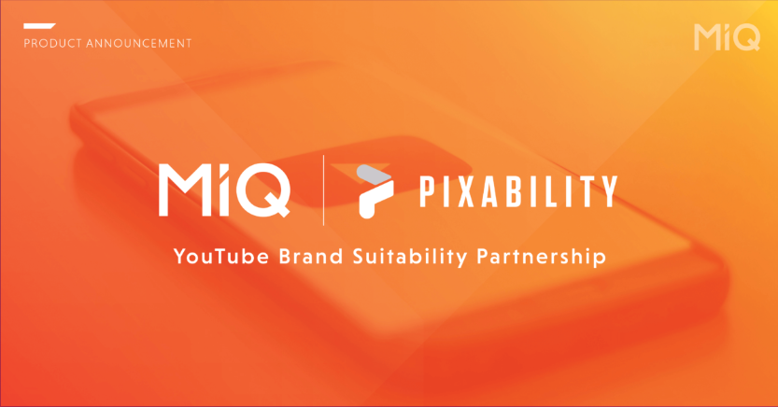

Slide 3


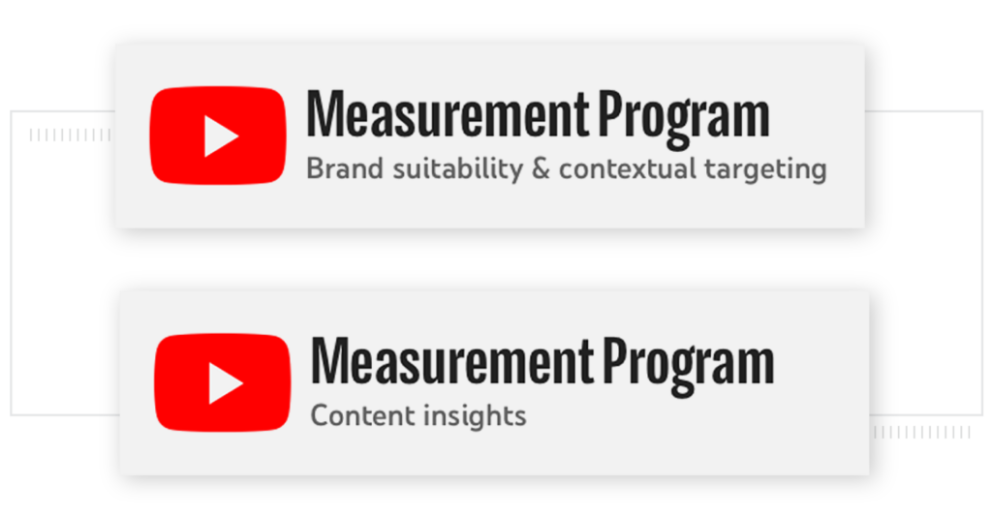
MiQ and Pixability’s Expanded Partnership
MiQ is the only partner to receive raw, log-level data from Pixability to help us service client’s YouTube campaigns.
Leading provider of Brand Safety and Suitability on YouTube
Offer Data and Managed Services media solutions
Large database of YouTube channels, videos, and Brand Insights
Pixability is the only company Certified by Google to provide both contextual targeting and content insights on YouTube
Part of the YouTube Measurement Program
Certified for Brand Suitability and Contextual Targeting and content insights on YouTube: classifying over 2B videos and 20m channels monthly
MiQ is the only partner to receive raw, log-level data from Pixability to help us service client’s YouTube campaigns.
Competitor conquesting, brand insights and much more
PIXABILITY OVERVIEW
CERTIFIED BY GOOGLE
MiQ x PIXABILITY

Slide 4
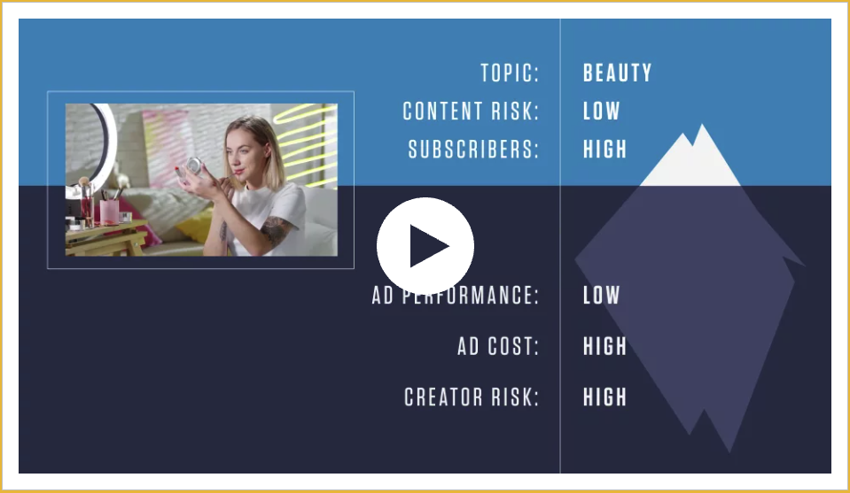

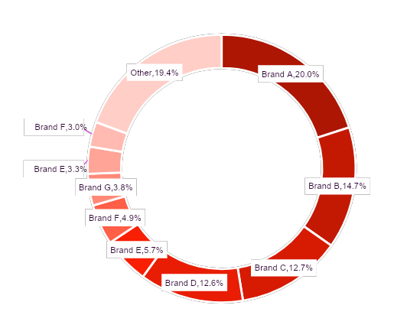

MiQ Capability Enhancements
Rich Insights and Contextual Recommendations
Competitor Share of Voice
Share of voice on YouTube vs. industry, or against key competitors.
Temporal Analysis
Understand how spend and share of voice changes over time for key competitors.
Vertical Scorecard
Analysis of top advertisers on YouTube within target category.
Industry Benchmarks
Performance benchmarks by category and ad-format. (Coming soon!)
Channel Analysis
Rich meta-data on competitors’ channels, including top videos, paid vs. earned views, subscribers, and more.
Video/Channel Recommendations
Brand suitability and contextual targeting down to the individual video-level, powered by Pixability’s machine learning technology.
YouTube Share of Voice - Insurance Category - Brand A

Slide 5






Channel Intelligence
NESCAFE India has the maximum number of subscribers
Brand | Subscribers | Videos | Organic Views | Paid Views | Total Views
Pureit India | 25,700 | 389 | 1,58,18,049 | 17,80,73,130 | 19,38,91,179
Eureka Forbes | 62,300 | 1,001 | 8,35,06,363 | 23,36,13,976 | 31,71,20,339
KENT RO Systems | 40,900 | 228 | 1,47,11,637 | 90,32,020 | 2,37,43,657
Livpure Smart | 11,100 | 91 | 94,71,443 | 1,36,46,142 | 2,31,17,585
Notes:
The organic views and paid views are modelled numbers based on Pixability models. Only Trueview spends are considered.

Slide 6

Video and Subscriber Share of Voice
NESCAFE India has the highest following with 442K Subscribers and Rage Coffee is the most active on their channel with 480 videos.
NESCAFE India, with a 19.19% Video Count Share and 93.82% Subscribers Share, indicates highly engaged audience.
Despite a substantial video count, Rage Coffee's YouTube channel has only 1.41% of total subscribers.
Insight

Slide 7
How much are competitors spending for channel views?
Nescafe India is the most active channel on YouTube compared to its competitros.
Despite this high spend, NESCAFE India also leads in terms of view share at 94.23%, indicating a strong correlation between advertising expenditure and viewership.
Competitors hold smaller shares in both spend and view categories, indicating the significant lead NESCAFE India has established in the YouTube advertising landscape.
Insight

Slide 8
Recent YouTube Spends
Nescafe India is currently spending much on YouTube whereas competitors are spending lesser volumes
There's a significant spike in ad spending for NESCAFE India on 3rd April and 7th April, suggesting a targeted campaign or special promotion during these days
BRU India also maintains a steady presence with moderate ad spends, indicating a competitive market.
Rage Coffee and Tata Coffee Grand have relatively lower ad spends compared to NESCAFE and BRU, possibly indicating different marketing strategies or market positioning
Insight

Slide 9
Recent YouTube Views
A sudden spike in views can be seen for Nescafe India in their views on YouTube channel
NESCAFE India consistently garners the highest number of YouTube views across all observed dates, indicating a strong online presence and potentially effective marketing campaigns
Tata Coffee Grand and Country Bean have relatively lower views compared to NESCAFE and BRU, suggesting a smaller reach or less impactful content strategy
Insight

Slide 10
Distribution share between Paid and Organic views
NESCAFE India has nearly equal balance between paid views and organic views
NESCAFE India maintains a relatively balanced distribution between organic(55.46%) and paid views(44.54%), indicating a well-rounded approach to viewer engagement and brand promotion
BRU India and Tata Coffee Grand rely heavily on paid views, suggesting a stronger emphasis on paid advertising to drive viewership
Rage Coffee and Country Bean have a higher proportion of organic views, indicating potentially strong organic reach
Insight

Slide 11
What are competitors talking about in their channel videos?
NESCAFE India can use this information to add new genre of videos dependent on competitor behaviour
Brand | Categories | Views
Pureit India | Healthy Living | 49.05%
 | Hobbies & Interests | 39.34%
Eureka Forbes | Hobbies & Interests | 62.54%
 | Television | 13.5%
KENT RO Systems | News and Politics | 32.5%
 | Home & Garden | 28.9%
Livpure Smart | Home & Garden | 56.04%
 | Hobbies & Interests | 43.96%
NESCAFE India, Rage Coffee, Tata Coffee Grand, and Country Bean predominantly cater to audiences interested in Food & Drink content, with percentages ranging from 90.47% to 96.45%
Besides Coffee, other categories that appear are Hobbies & Interests, News and Politics, Video Gaming and Music and Audio.
Insight
Notes:
The categories here are categories of the videos that these brands are posting.

Slide 12
Deep Dive into the video content of Ambuja Cement and competitors
Ambuja Cement’s laser focus on Home Improvement content on YouTube has yielded significant results, making them a leader in the category
Brand | Sub-categories | Videos | Views Share
Pureit India | Diseases and Conditions | Pureit Copper RO – Immunity boosting Copper infused in RO water (HINDI) | 33.99%
 | Hobbies & Interests | Pureit Copper RO – Immunity boosting Copper infused in RO water (ENGLISH) | 33.37%
Eureka Forbes | Home Utilities | Invisitron - Under the Sink Water purifier from Aquaguard - HINDI | 31.05%
 | Healthy Living | Paani Ka Doctor from Dr.Aquaguard - HINDI | 10.39%
KENT RO Systems | Cooking | Homemade Gluten-Free Bread Recipe with KENT Atta Maker and Bread Maker | 15.97%
 |  | KENT Super Electric Egg Boiler – How to Boil Eggs To Perfection Without Any Hassle | 9.14%
Livpure Smart | Home Utilities | FREE RO Water Purifier For Home | Lifetime Free Service & Maintenance | Best Water Purifier in 2022 | 39.24%
 |  | Best Water Purifier in India 2023 | Water Purifier For Home | Livpure RO Water Purifier | 34.71%
Insight
Notes:
The categories here are categories of the videos that these brands are posting.

Slide 13
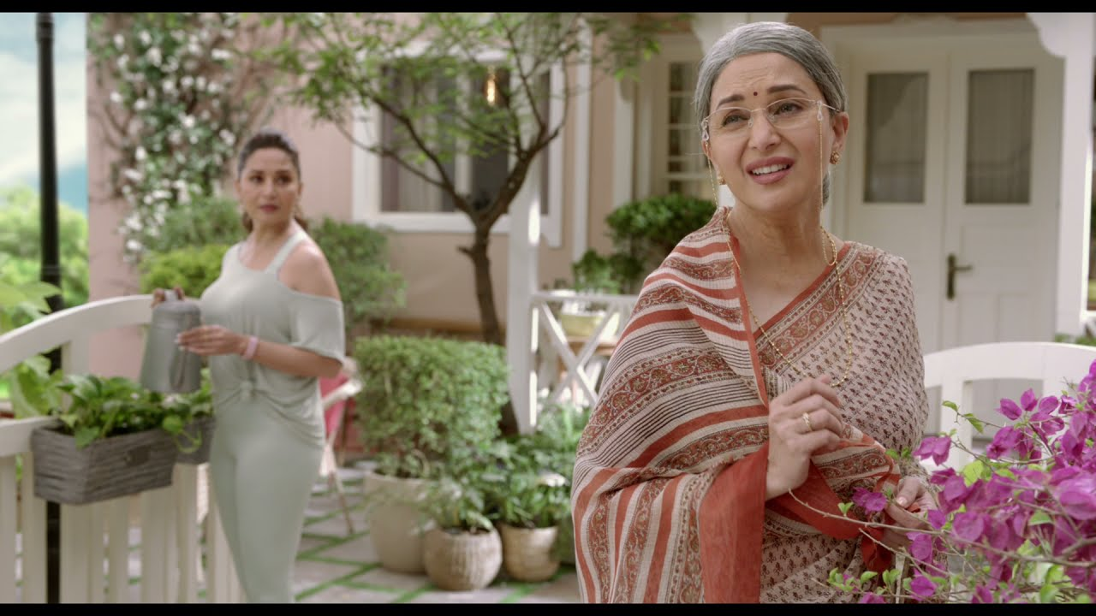
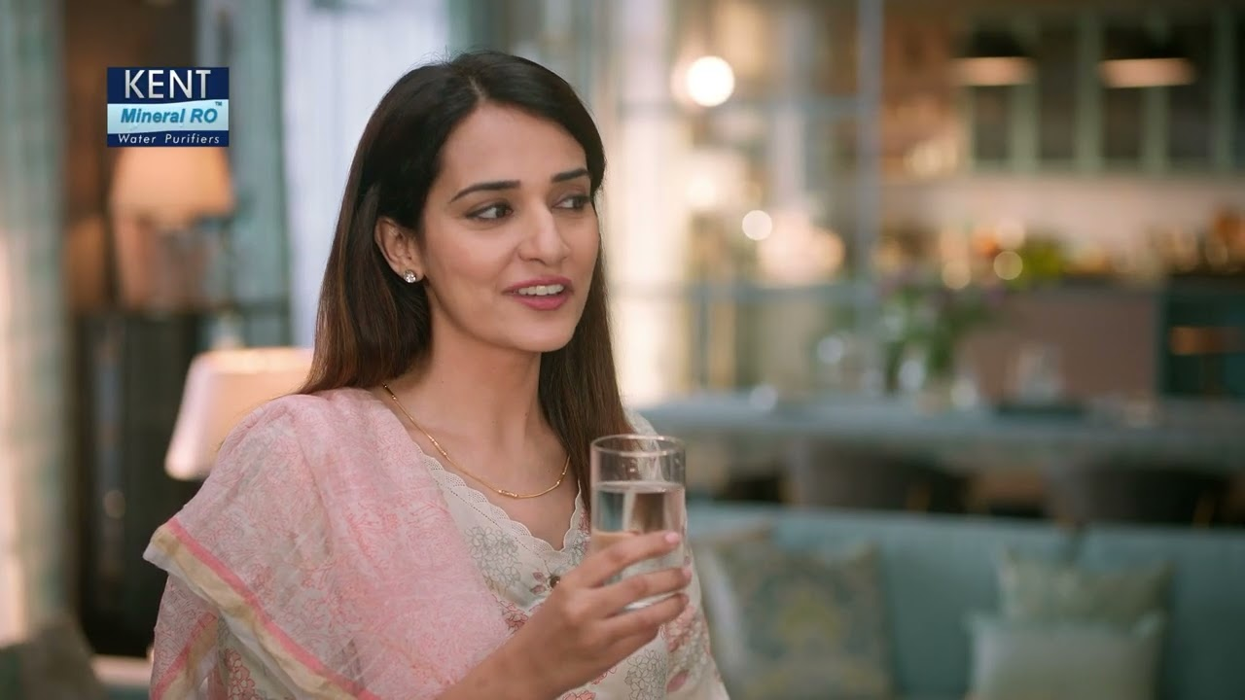
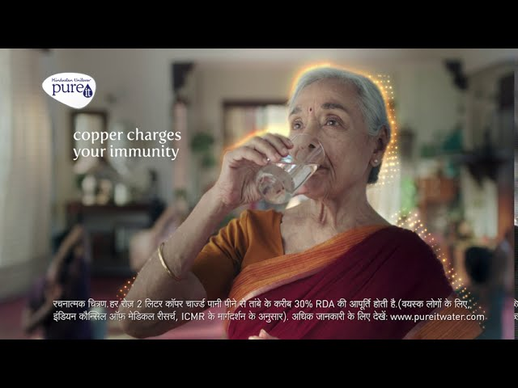

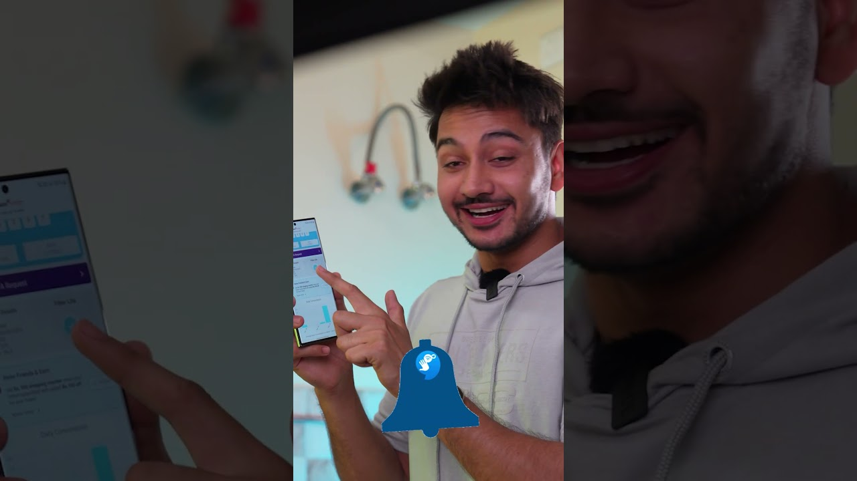

Best performing video per YouTube brand channel
NESCAFE India Competitors
45.0M Views
18.4M Views
3.4M Views
22.1M Views
2.7M Views
ABC
NESCAFE’s top videos showcase their coffee products, emphasizing superior quality and expertise in coffee cultivation, thereby enhancing engagement in advertising
Competitors are skillfully showcasing the delightful coffee moments across diverse places and times in their ads, cleverly catering to audience needs and occasions with strategic precision
Insight

Slide 14

THANK YOU

