Slide 1
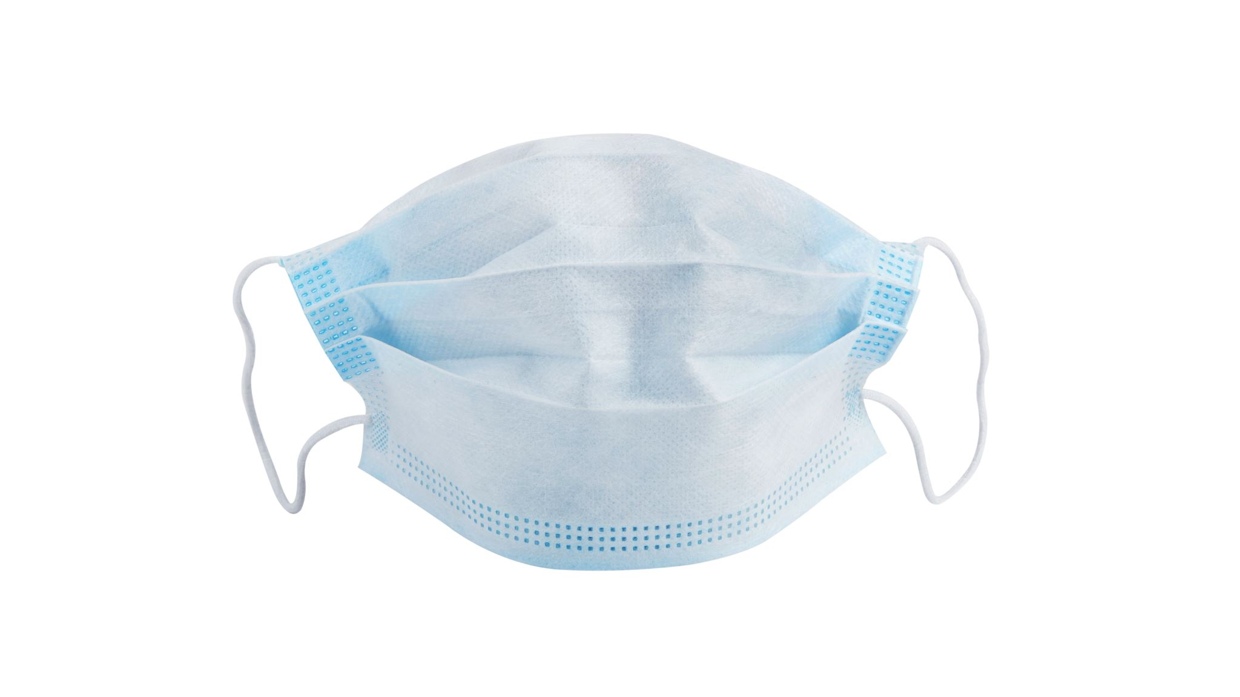
Face Mask Detection
Rhichard Koh, Ozair Rahman, Caleb McAnuff

Slide 2
Inference Process
WebCam
Pretrained Facial Detection
Convolutional Neural Net

Slide 3
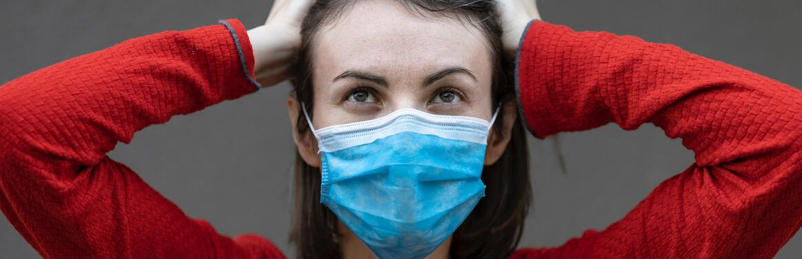
Dataset
Face Mask Detection Dataset [Kaggle]

Slide 4
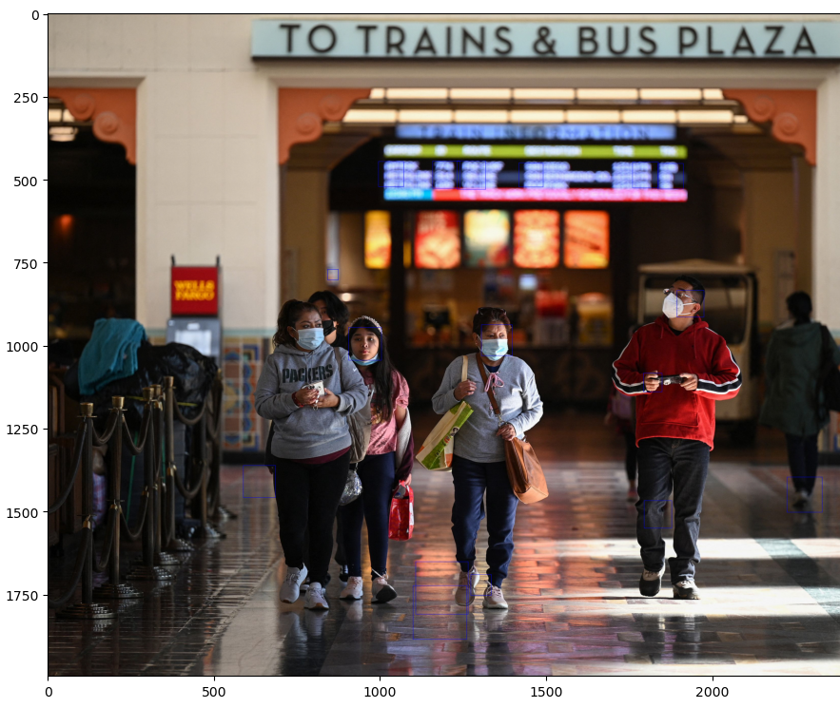
Data preprocessing

Slide 5
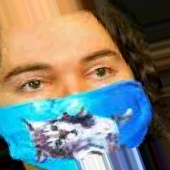
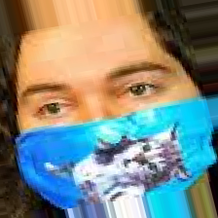
Data preprocessing
Image zoom, shear and flips are applied to the images

Slide 6
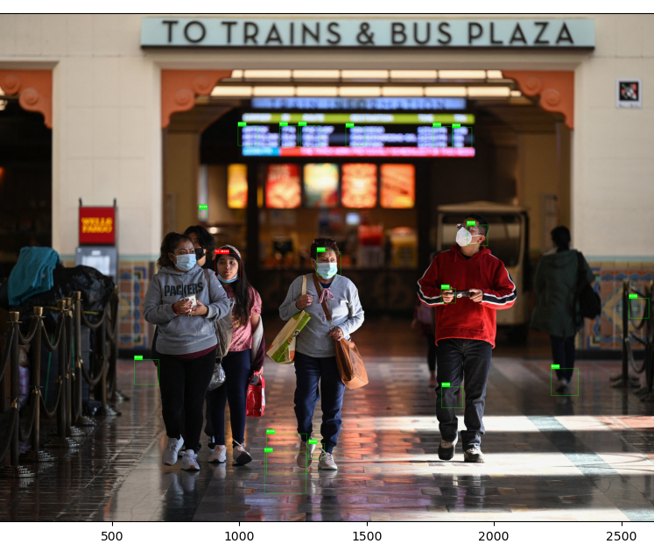
Data preprocessing

Slide 7
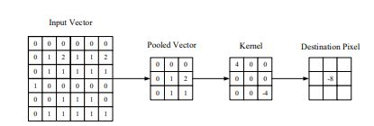
Model Building
Convolutional Neural Network

Slide 8
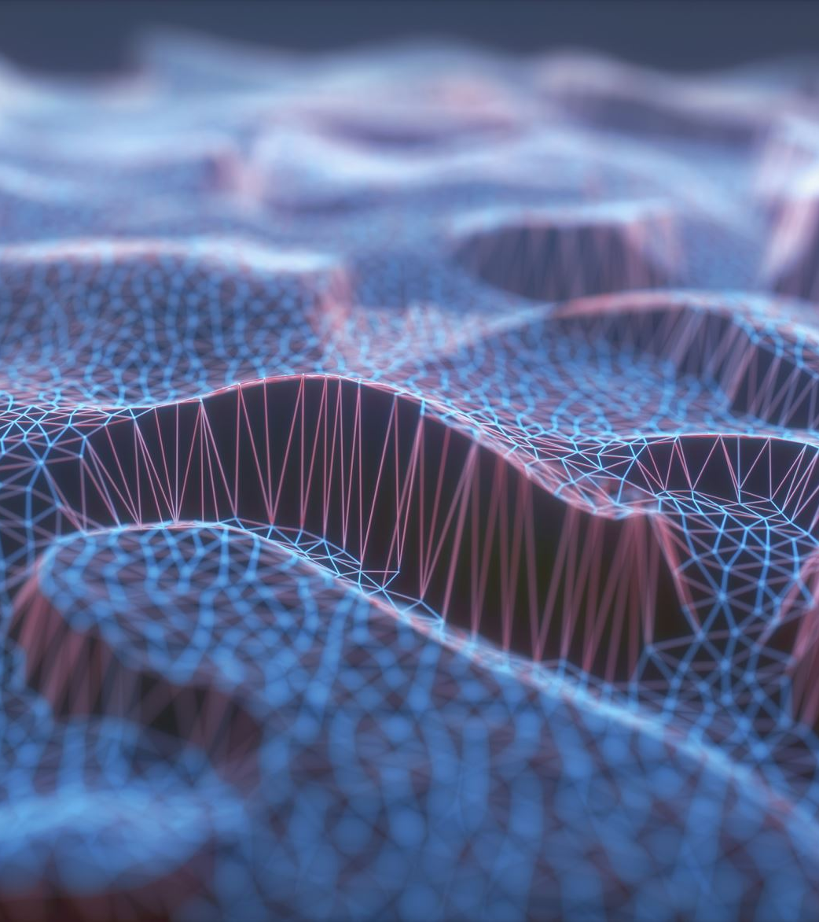
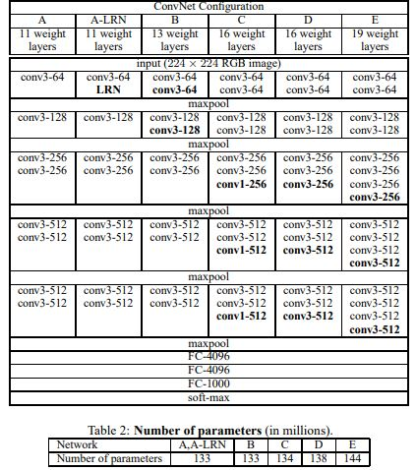
VGG19
Very Deep Convolutional Networks for Large-scale Image Recognition (19 layers)

Slide 9
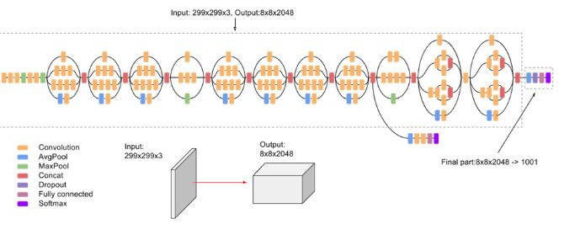
InceptionV3

Slide 10

Performance Metric

Slide 11
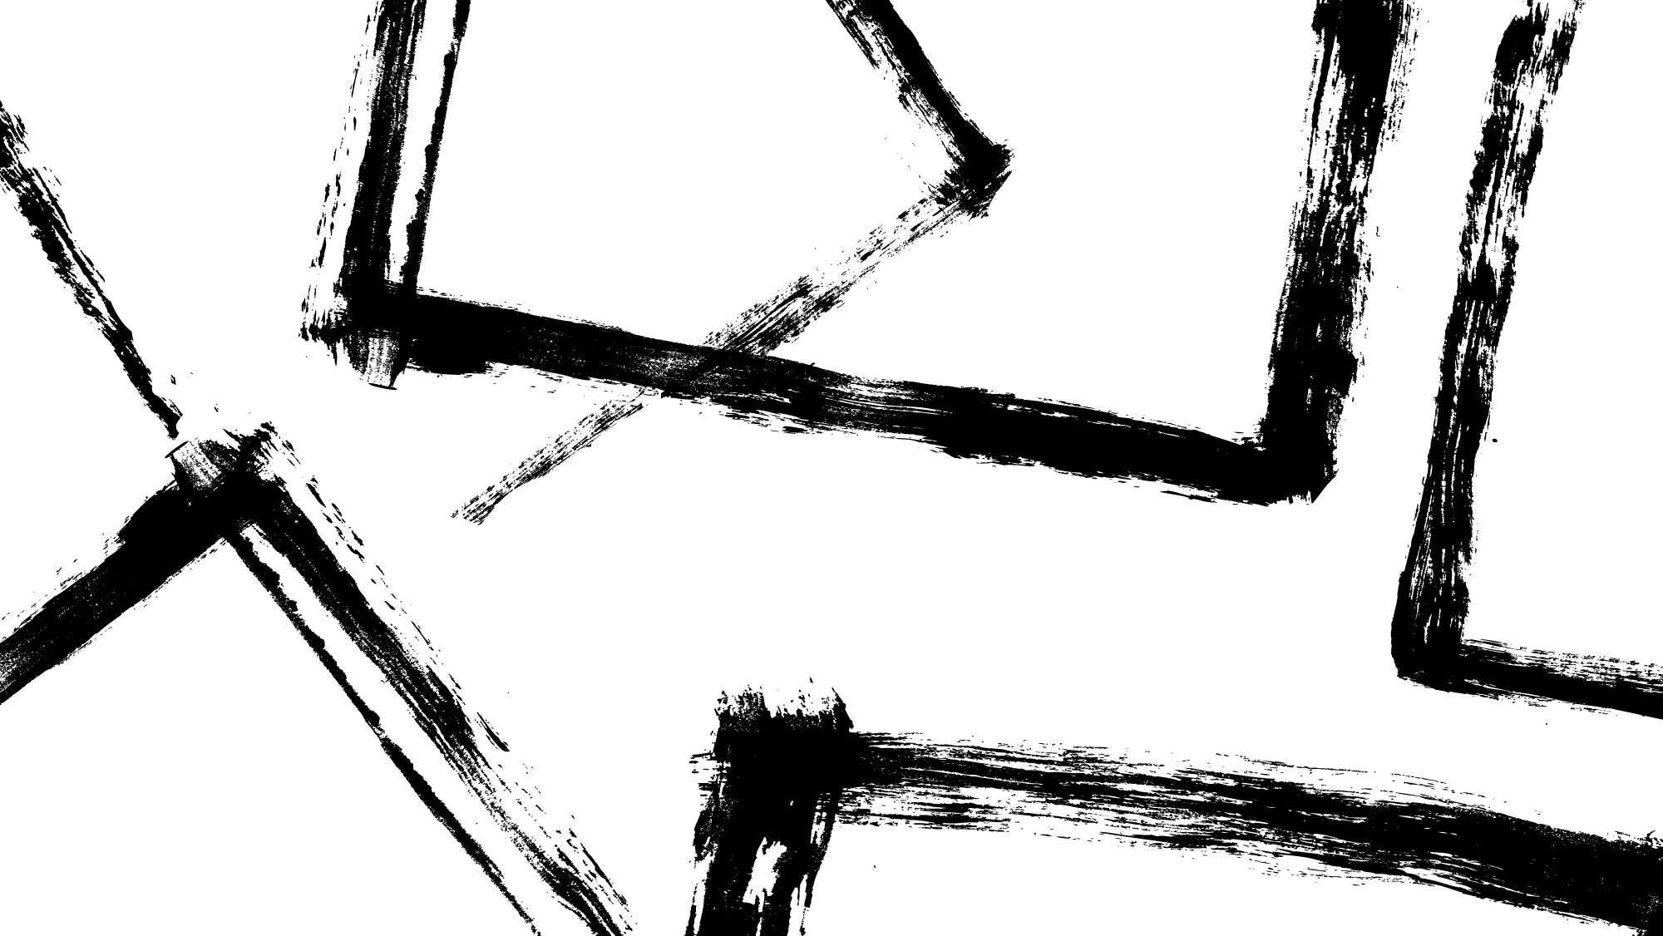
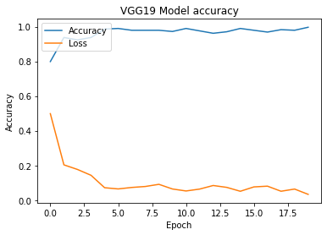
Hyperparameter Tuning

Slide 12
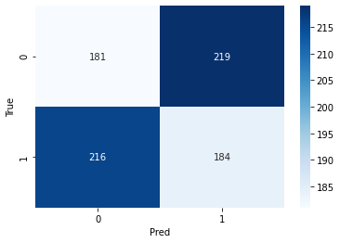
VGG-19 Confusion Matrix

Slide 13
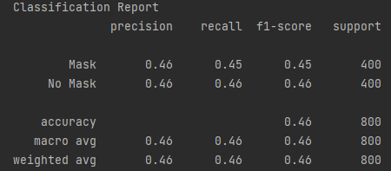
VGG-19 Classification Report

Slide 14
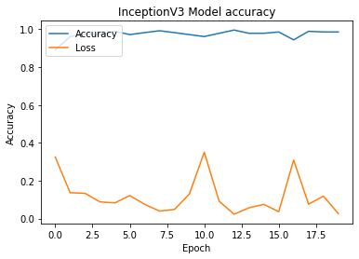
Hyperparameter Tuning

Slide 15
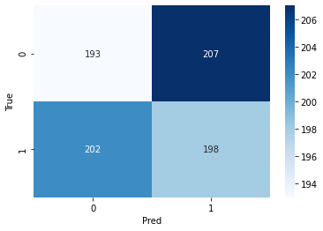
InceptionV3 Confusion Matrix

Slide 16
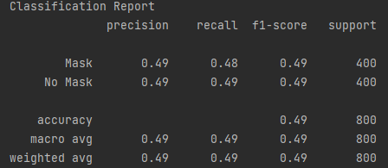
InceptionV3 Classification Report

Slide 17
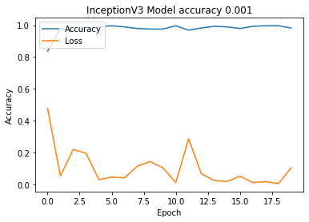
Hyperparameter Tuning

Slide 18
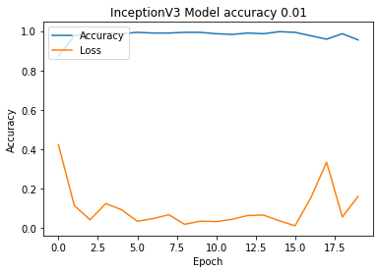
Hyperparameter Tuning

Slide 19
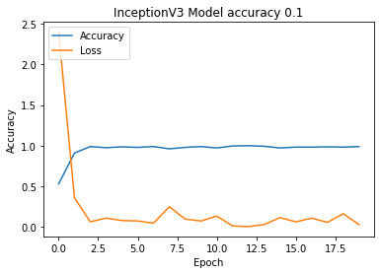
Hyperparameter Tuning

Slide 20
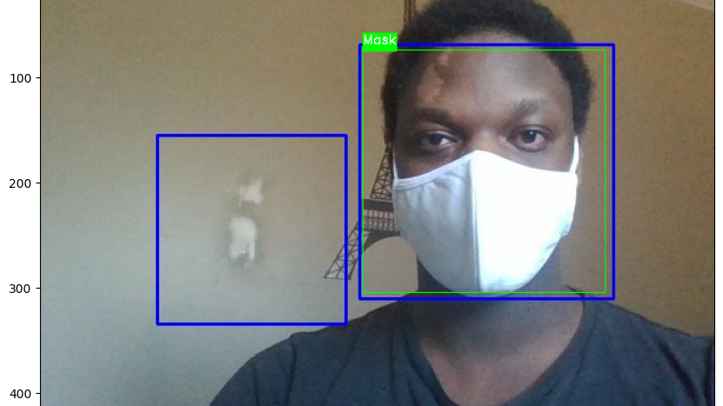
Demonstration

Slide 21
Links
https://www.kaggle.com/datasets/andrewmvd/face-mask-detection
https://github.com/Ozair-Rahman/INFT-Final-Project-Object-Detection

