Slide 1




MNIST pairwise comparison classification system based on residual networks and mixed-precision training
Team Leader and Primary Contributor: 李松峪(Songyu Li）
Other Contributors: 肖骋宇,徐浩博,李卓霖,马鸣禧,邓仁杰,刘科言,薛钰泷(PPT Making and Opinion Guiding)
Presentation Time：2025/10

Slide 2
Group Division
-李松峪：Main Programming, Experiment Analysis, Debugging, Testing, Presentation
-肖骋宇：PPT Preparation
-徐浩博: Ideal Providing
-李卓霖: Opinion Guidance
-马鸣禧: Opinion Guidance
-邓仁杰: Opinion Guidance
-刘科言: Opinion Guidance
-薛钰泷: Opinion Guidance

Slide 3

01.
Project Background and Task Introduction
02.
Methodology: Model Architecture
03.
Training Strategy and Optimization
CONTENTS
04.
Loss Function and Evaluation
05.
Experimental results
06.
Error Analysis

Slide 4
07.
Model efficiency and resource usage
08.
AI Tool Instructions
09.
Summary and Future Work
CONTENTS

Slide 5
01
Project Background and Task Introduction

Slide 6

Dataset characteristics
Task objective
Task constraints
Input is a MNIST digit image spliced ​​left and right, and determine whether the left digit is larger than right digit
28×56 grayscale image, excluding the case where a=b
The model needs to be robust to disturbances such as rotation, noise, and occlusion
End-to-end model, prohibiting the use of multi-stage recognition + comparison strategies

Slide 7

Baseline bottlenecks and improvement targets
01
02
Baseline model performance
Improvement goals
The simple CNN+linear classifier has an accuracy of only 69% in the public test set, which makes it difficult to capture fine-grained numerical differences in images, and there is much room for performance improvement.
While maintaining end-to-end features and a lightweight model, the accuracy is increased by more than 7 percentage points to 76% or higher through deeper encoders, enhanced feature learning, and training strategies.

Slide 8
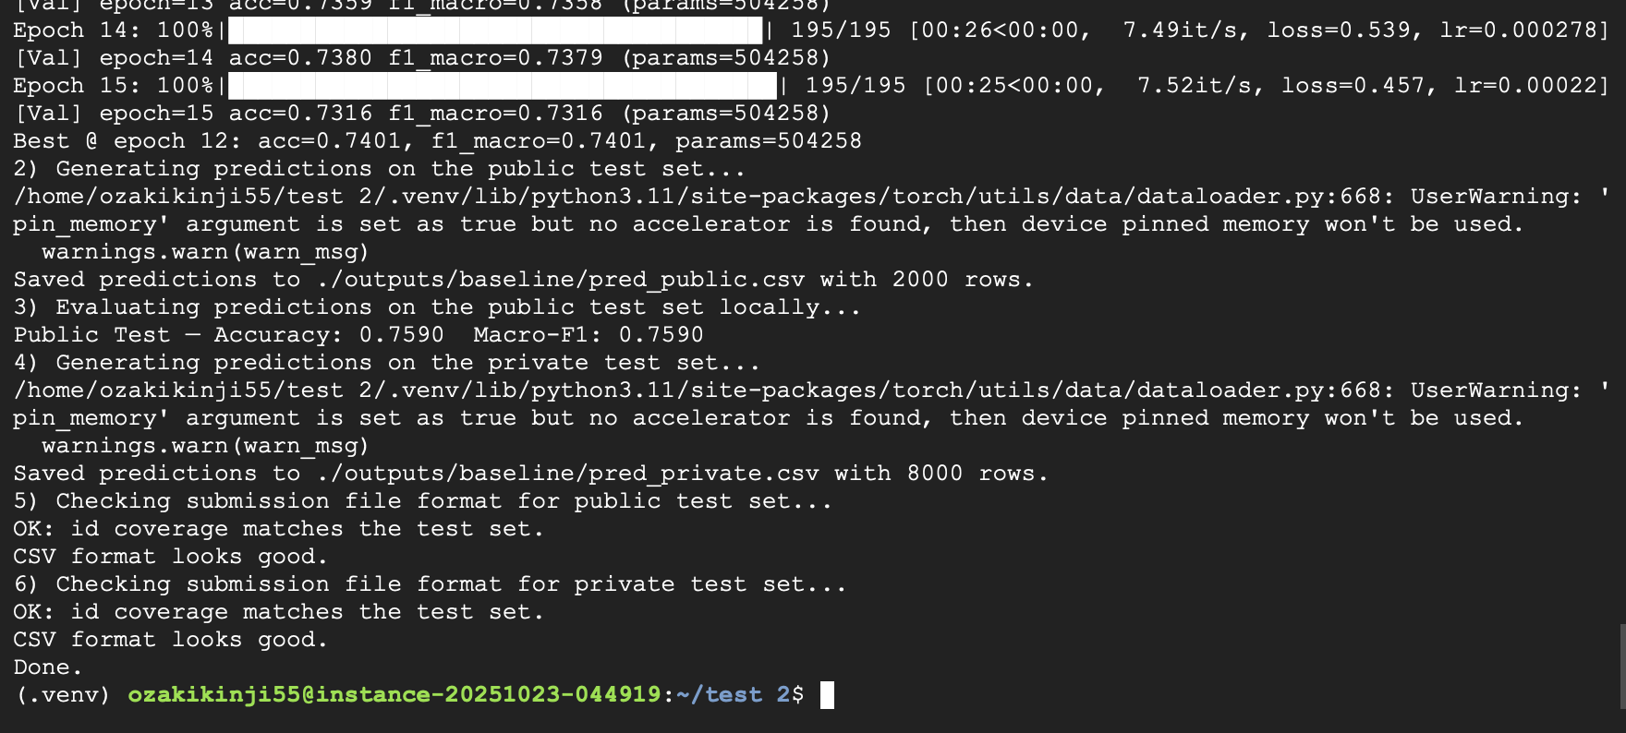

Slide 9
Experiment Results
Param number: 504,258
Public test accuracy: 0,7590
Performance on validation set: 0,7401
Performance on training set: Around 0,75 (Estimated)

Slide 10
02
Model architecture upgrade

Slide 11

Residual Encoder Design
Residual block structure
Encoder advantages
A deeper encoder is built using stacked ResBlocks. Each block adopts a pre-activation structure, combined with 3×3 convolution and skip connections, which effectively alleviates the gradient vanishing problem and enhances feature reuse capabilities.
With only 500,000 parameters, the network can be stacked up to 13 layers, significantly expanding the receptive field, providing highly discriminative features for subsequent comparison modules, and improving model performance.

Slide 12
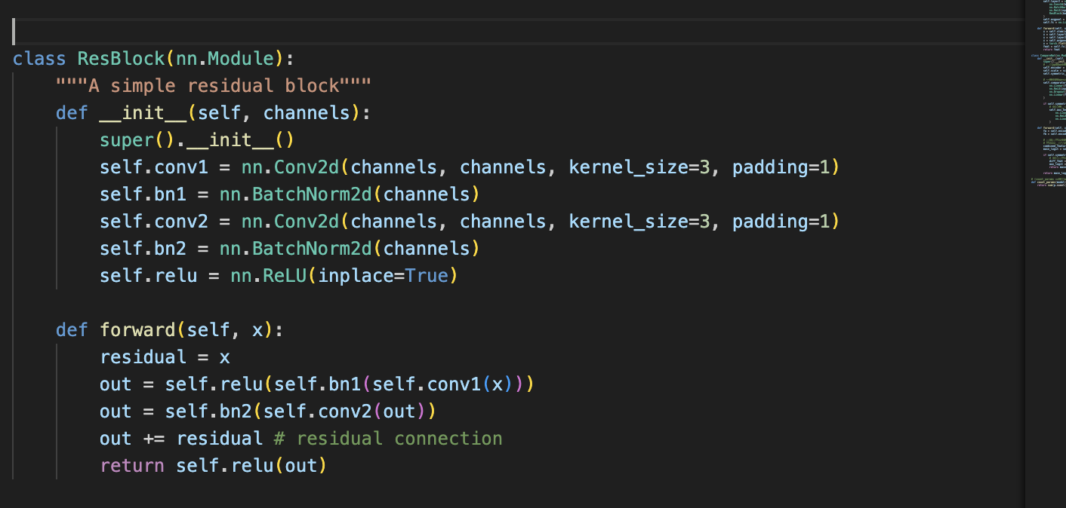

Slide 13
Comparison module and auxiliary head
01
02
Comparing module designs
Auxiliary head function
The comparison module uses a two-layer MLP+Dropout to directly perform difference mapping on the encoded double-digit features and output single-value logits. It has a simple and efficient structure and can directly complete the comparison task.
The symmetric auxiliary classifier simultaneously predicts the left and right digit categories during the training phase to strengthen feature learning. It can be discarded during the inference phase without adding additional computational burden, effectively improving model performance.

Slide 14
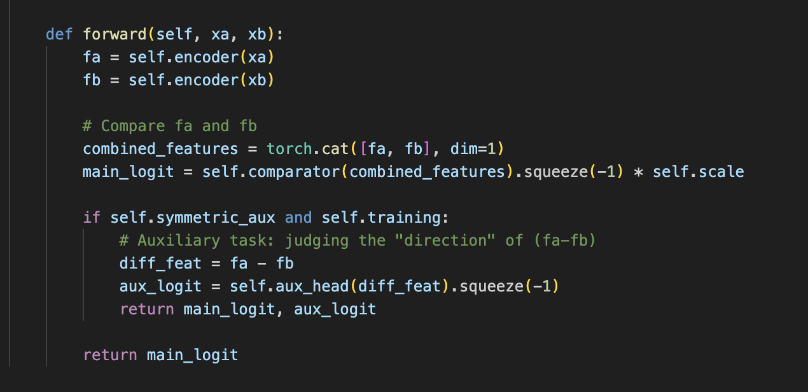

Slide 15
03
Training strategy optimization

Slide 16
Mixed Precision and Cosine Annealing
Mixed Precision Training
Enabling PyTorch AMP, combined with FP16 forward and FP32 master weights, increases training speed by approximately 30%, significantly reduces graphics memory usage, and effectively accelerates the model training process.
Cosine annealing learning rate
By using CosineAnnealingLR, the learning rate decreases smoothly within the cycle, helping the model to converge stably to the optimal verification point within 13 epochs without manual parameter adjustment, improving training stability.

Slide 17
Regularization and data augmentation
Regularization techniques
01
The gradient clipping upper limit is 1.0 to prevent gradient explosion, and label smoothing ε=0.05 reduces the risk of model overfitting and improves the generalization ability of the model.
Data augmentation strategy
02
The core is to randomly swap the left and right images and flip the labels, which is equivalent to doubling the number of samples. Brightness, contrast, Gaussian noise, and rotation are not yet online due to dimensional alignment issues and will be further optimized later.

Slide 18
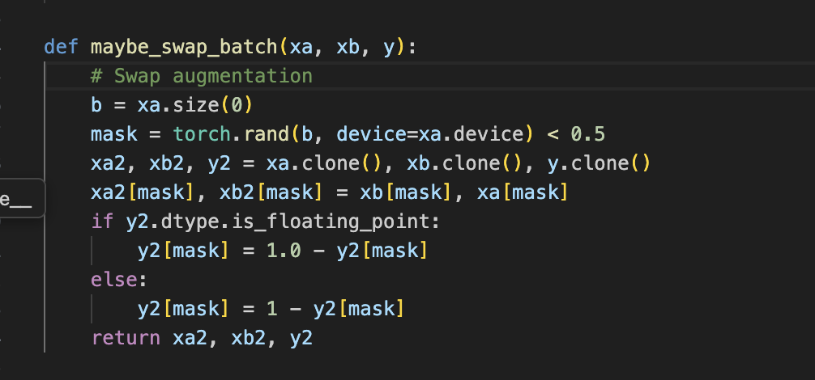

Slide 19
04
Losses and Assessments

Slide 20
Main and auxiliary loss combination
Main loss function
Auxiliary loss function
The main loss uses BCE loss with positive sample weights, which effectively alleviates the problem of uneven sample classification in the dataset and improves the model's ability to handle imbalanced data.
The auxiliary loss is the sum of the left and right digit cross entropy, and the weight is set to 0.3. Through joint back propagation, the digital feature extraction is strengthened and the model performance is improved.

Slide 21
Early Stopping
-Increase the epochs limits from 10 to 15
-Set up the patient to 5

Slide 22

Evaluation indicator setting
Evaluation metric selection
Accuracy and Macro-F1 are used to comprehensively measure model performance. Since the dataset categories are balanced, the trends of the two are consistent. At the same time, the confusion matrix is ​​recorded to locate easily confused digital pairs.
Learning curve monitoring
The learning curve simultaneously monitors training/validation loss and indicators, which are used as a basis for early stopping and parameter adjustment, helping to promptly detect problems such as overfitting and optimize the training process.

Slide 23
05
Results and Insights

Slide 24
Performance leap and curve
Performance improvements
01
The improved model achieved an accuracy of 76% in the public test set, 7 percentage points higher than the baseline, and the best verified F1 reached 0.7466, significantly improving model performance.
Training curve analysis
02
The training loss dropped from 0.96 to 0.54, and the validation loss also dropped and leveled off, with no obvious overfitting. Early stopping was triggered after 13 epochs, proving the effectiveness of the training strategy.

Slide 25
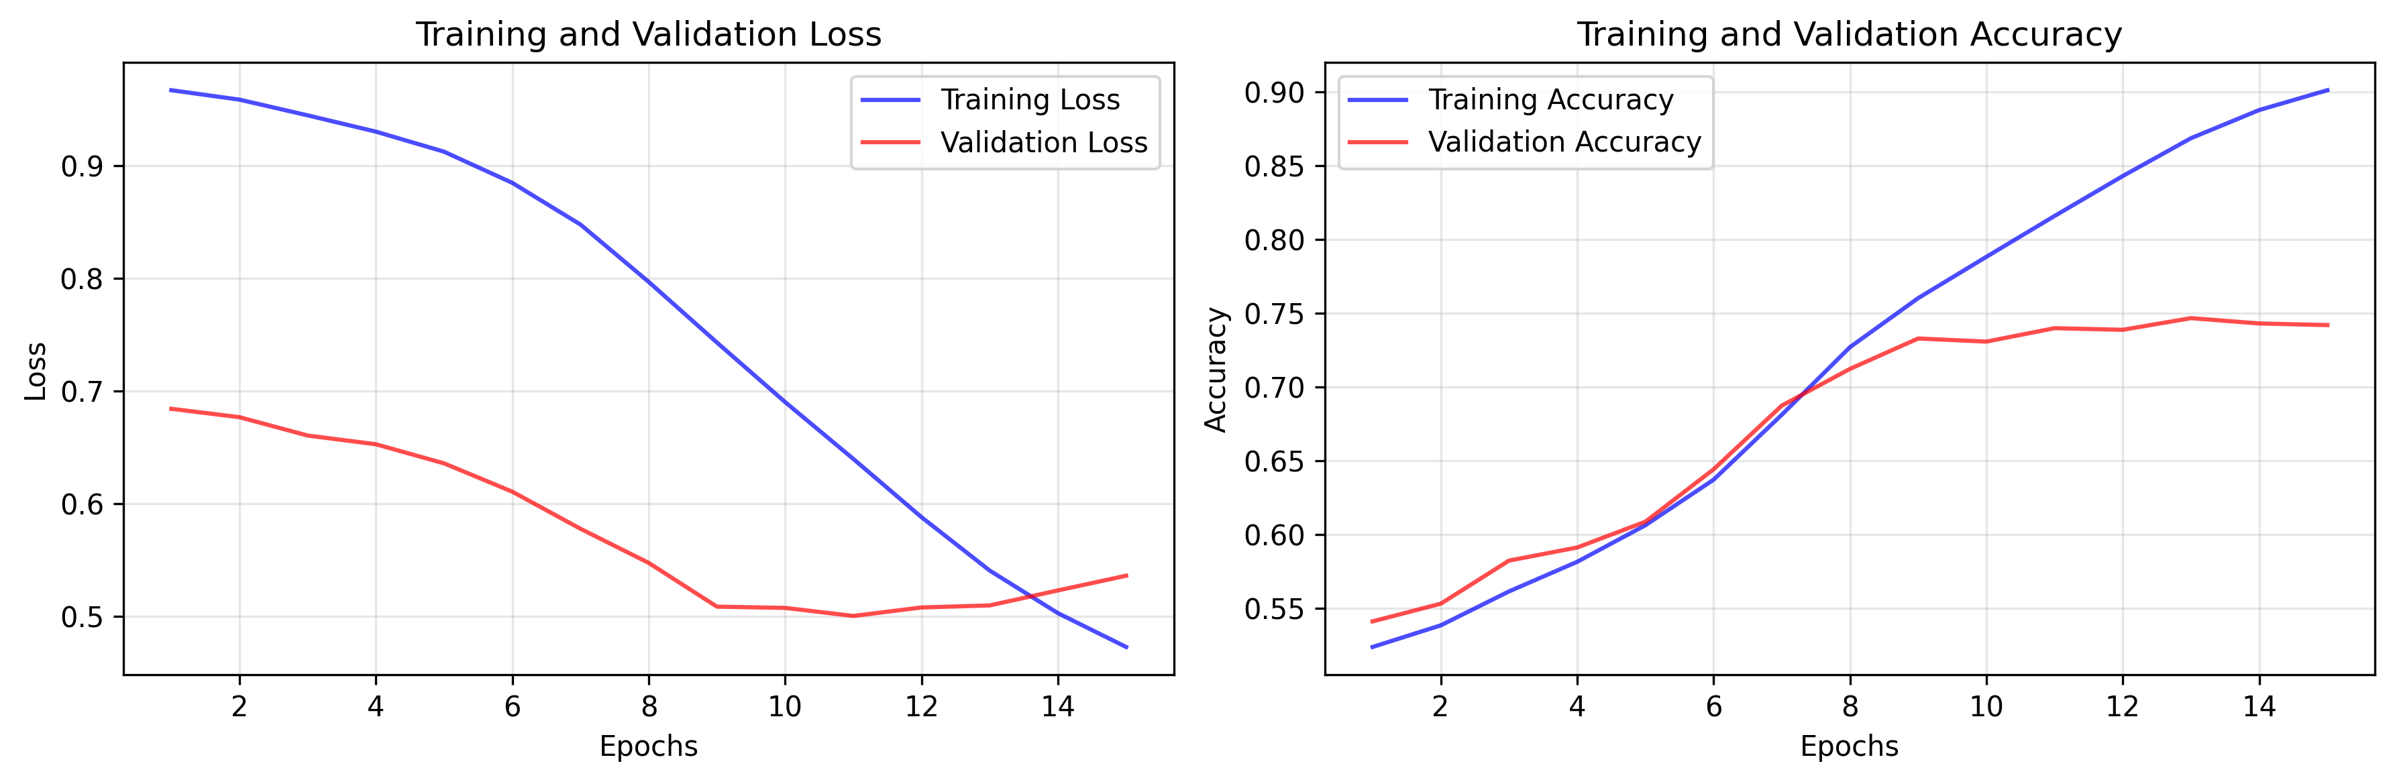

Slide 26
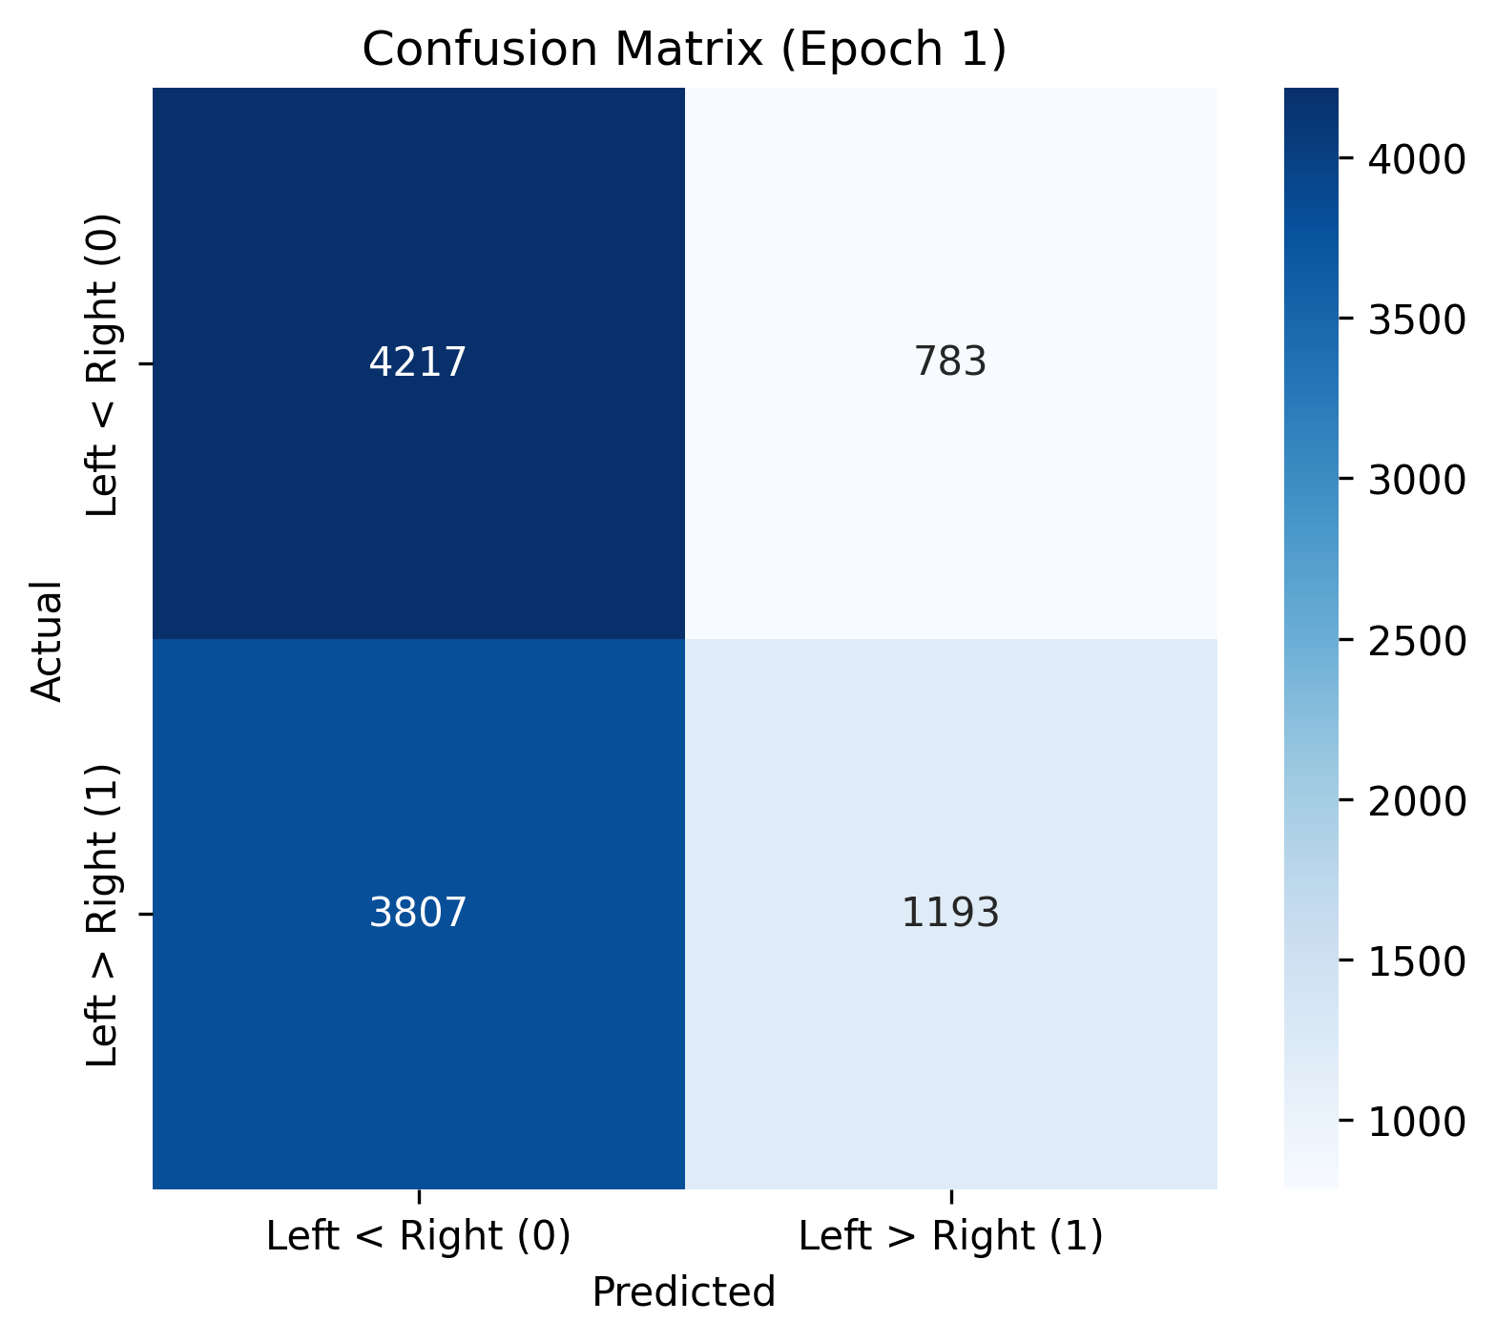

Slide 27
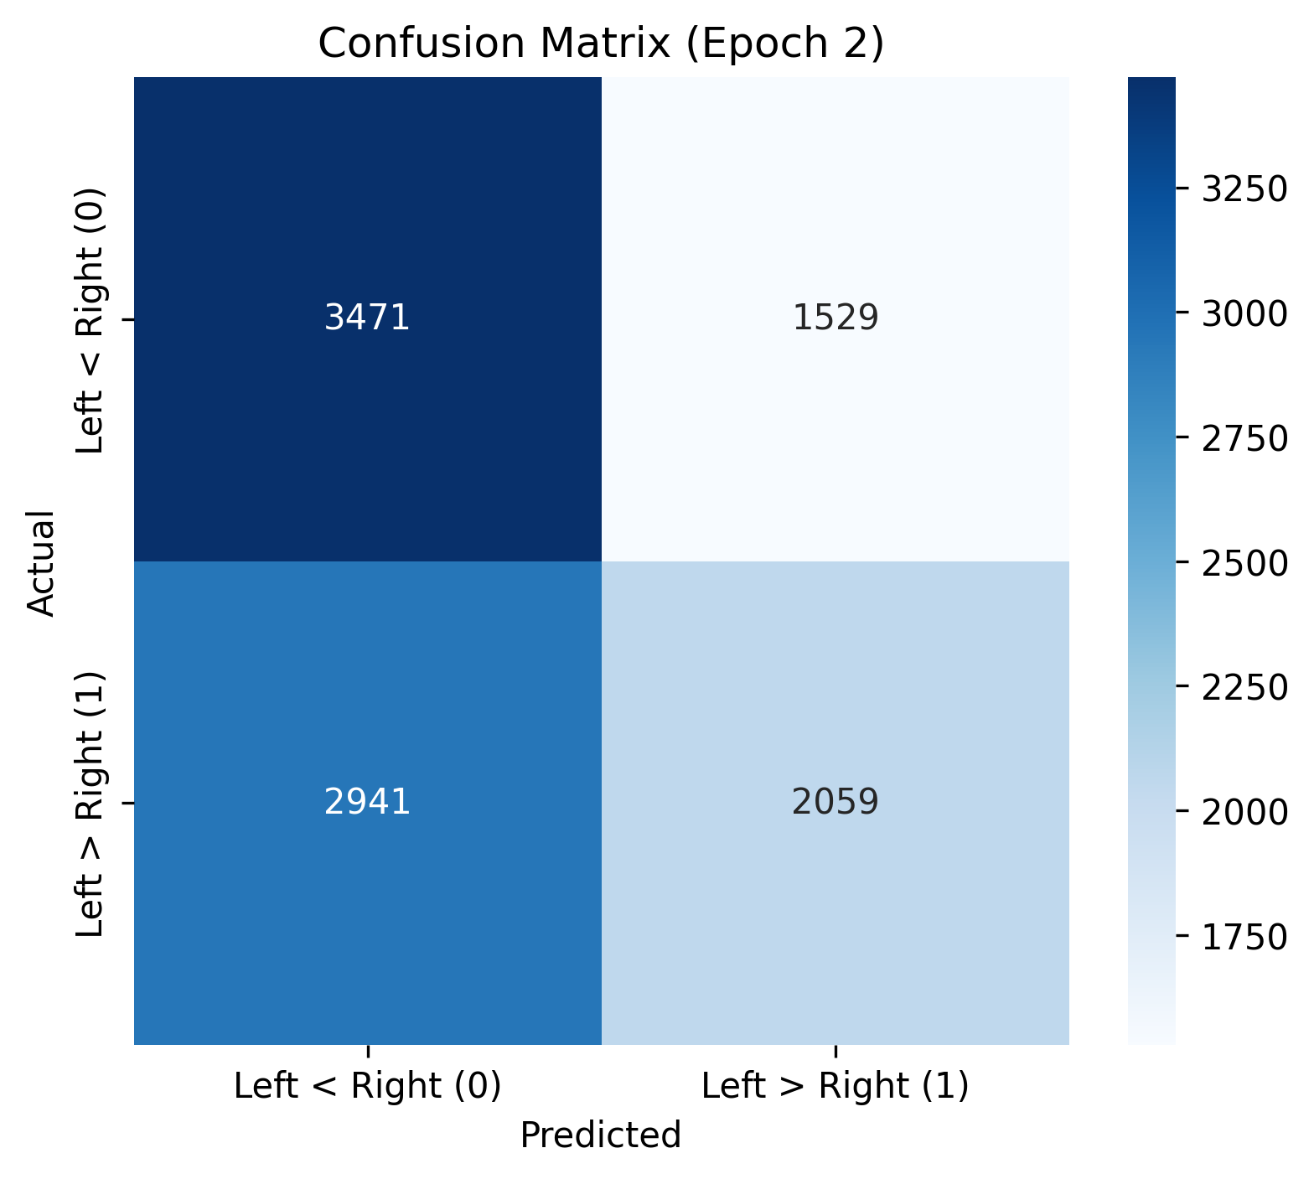

Slide 28
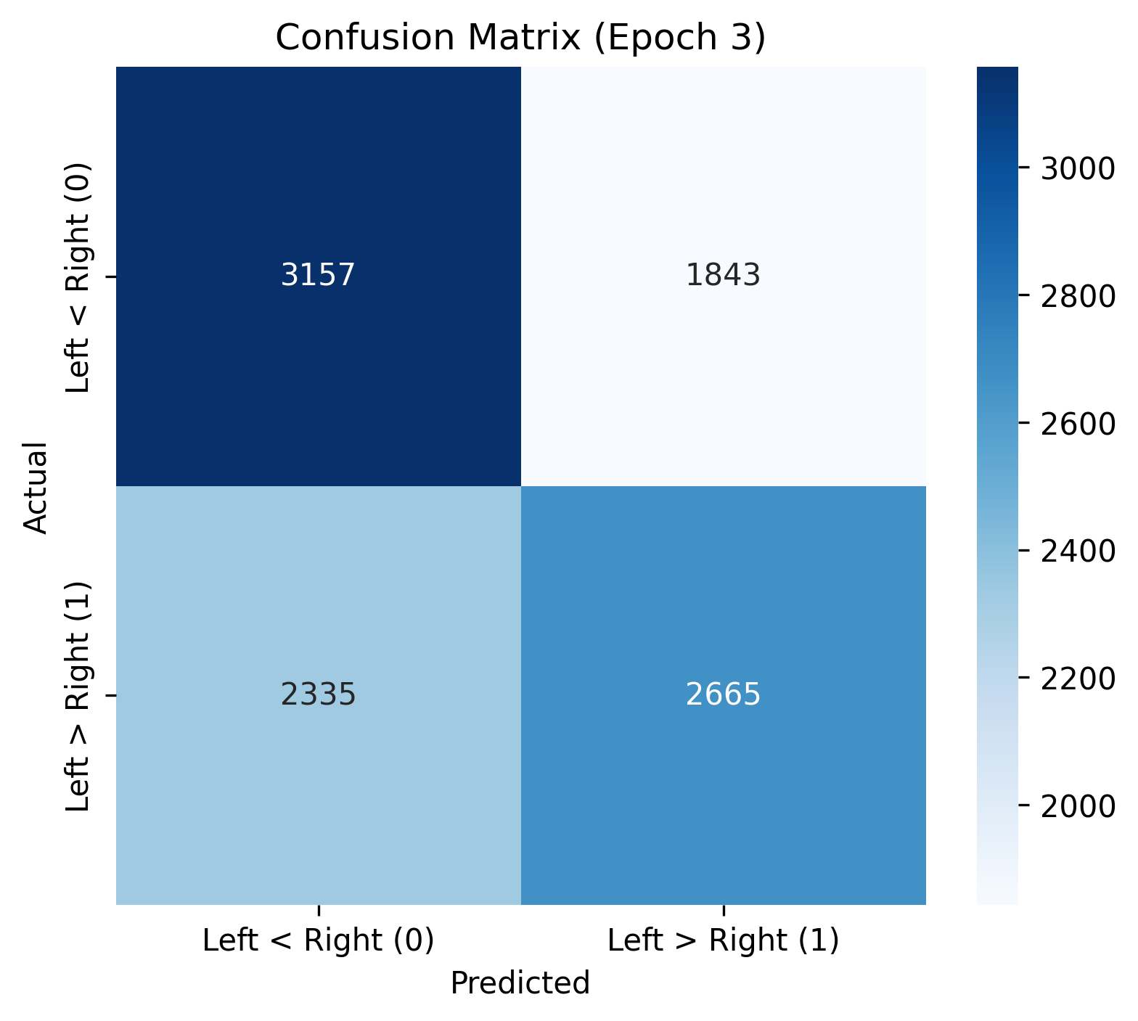

Slide 29
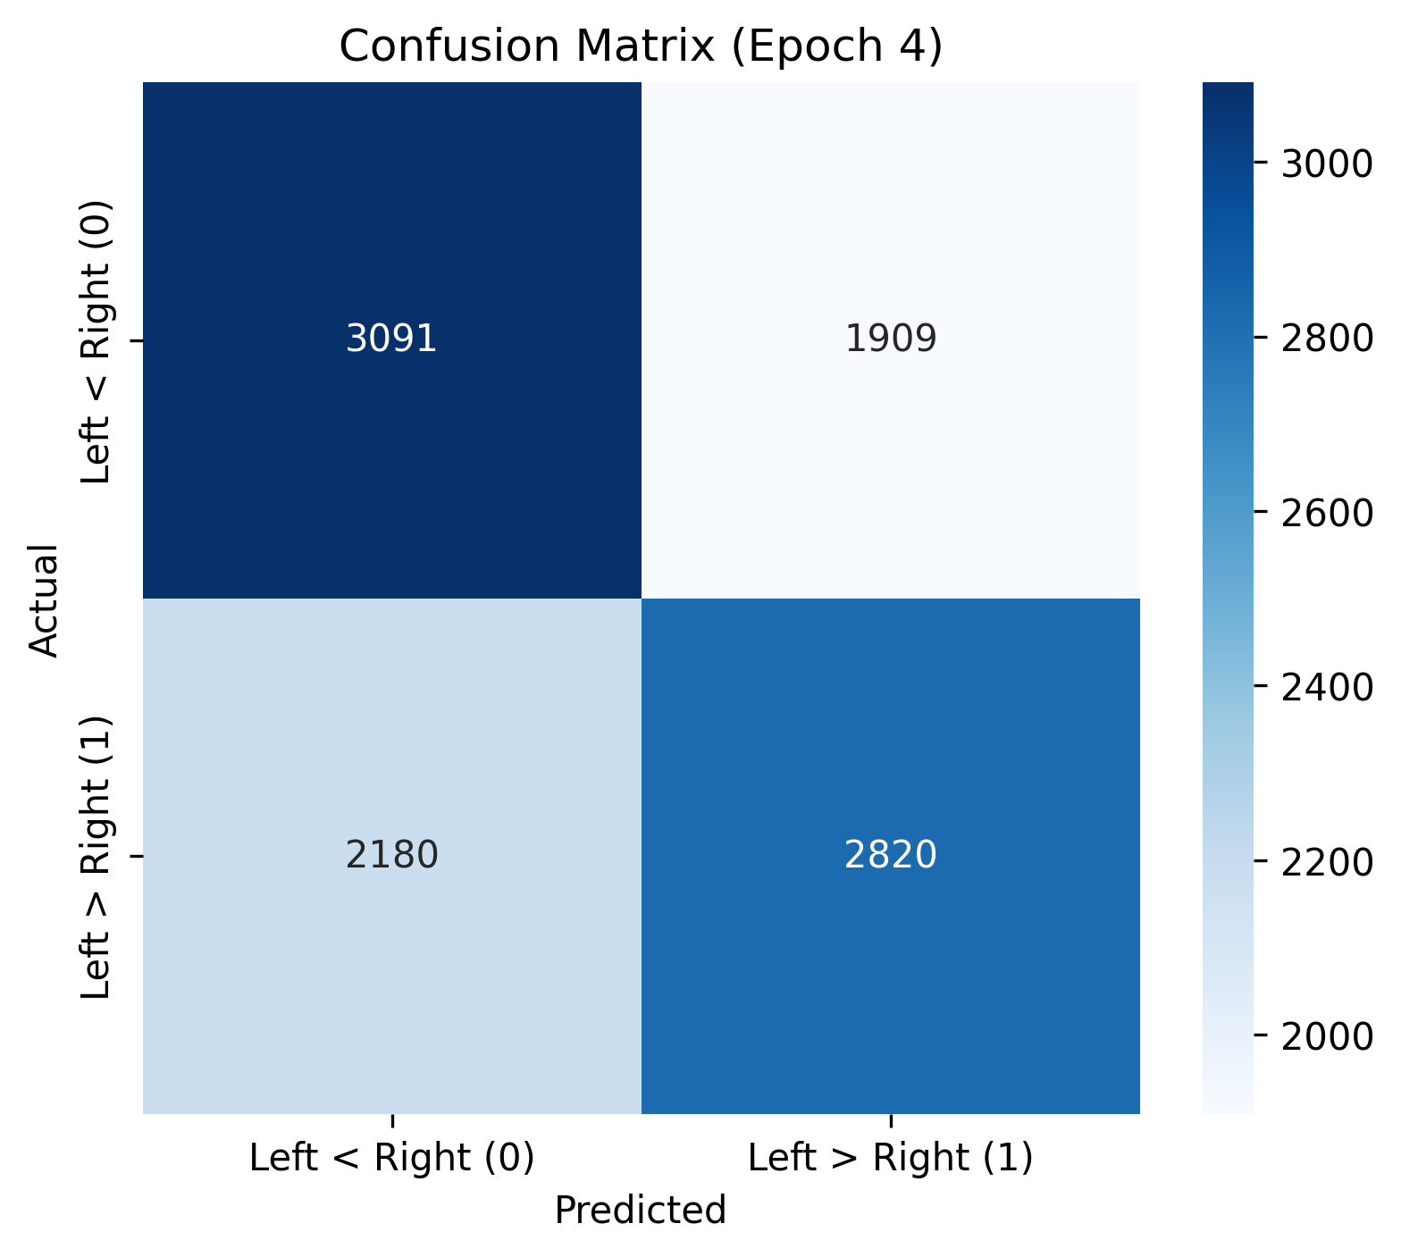

Slide 30
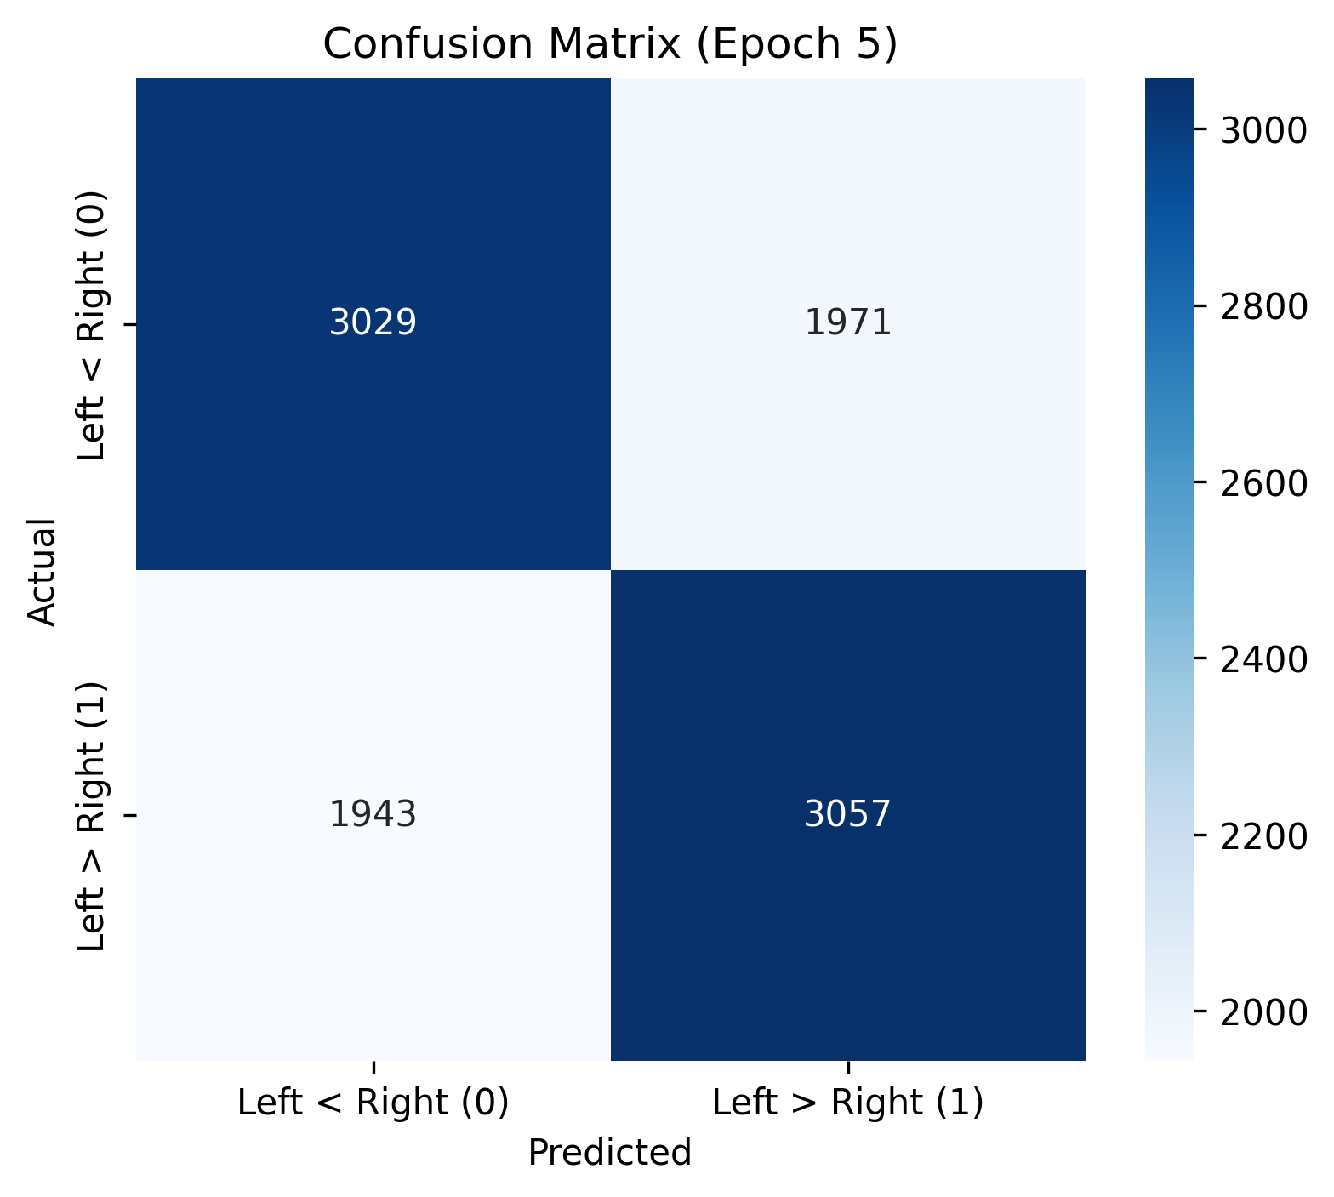

Slide 31
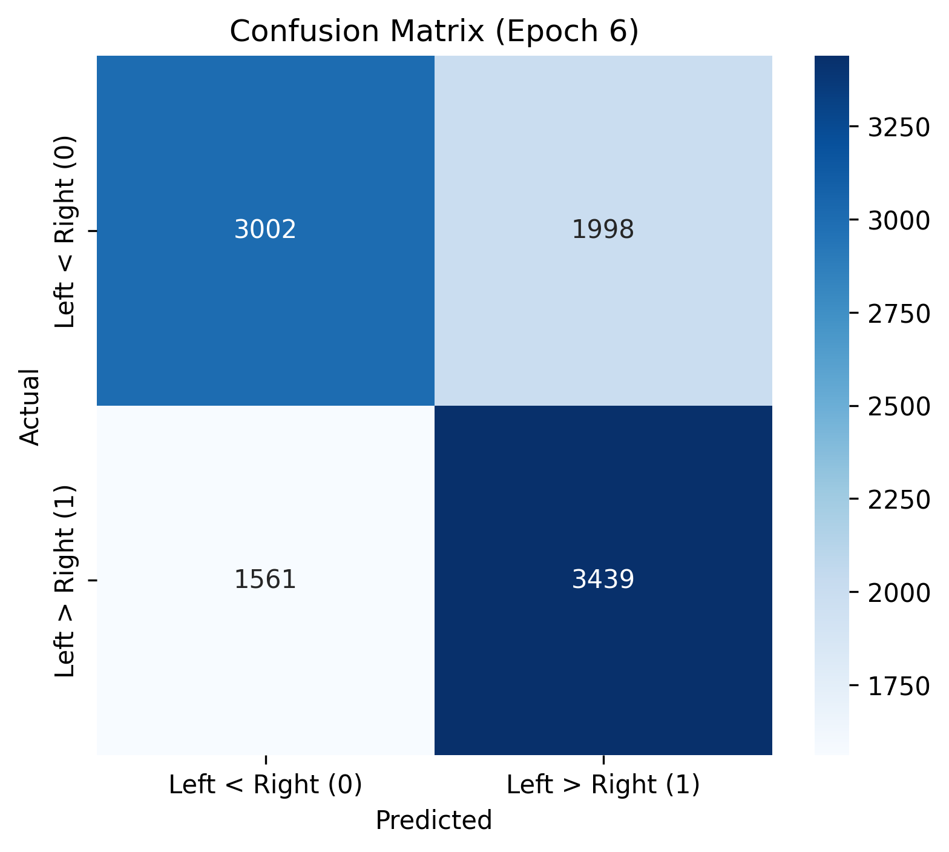

Slide 32
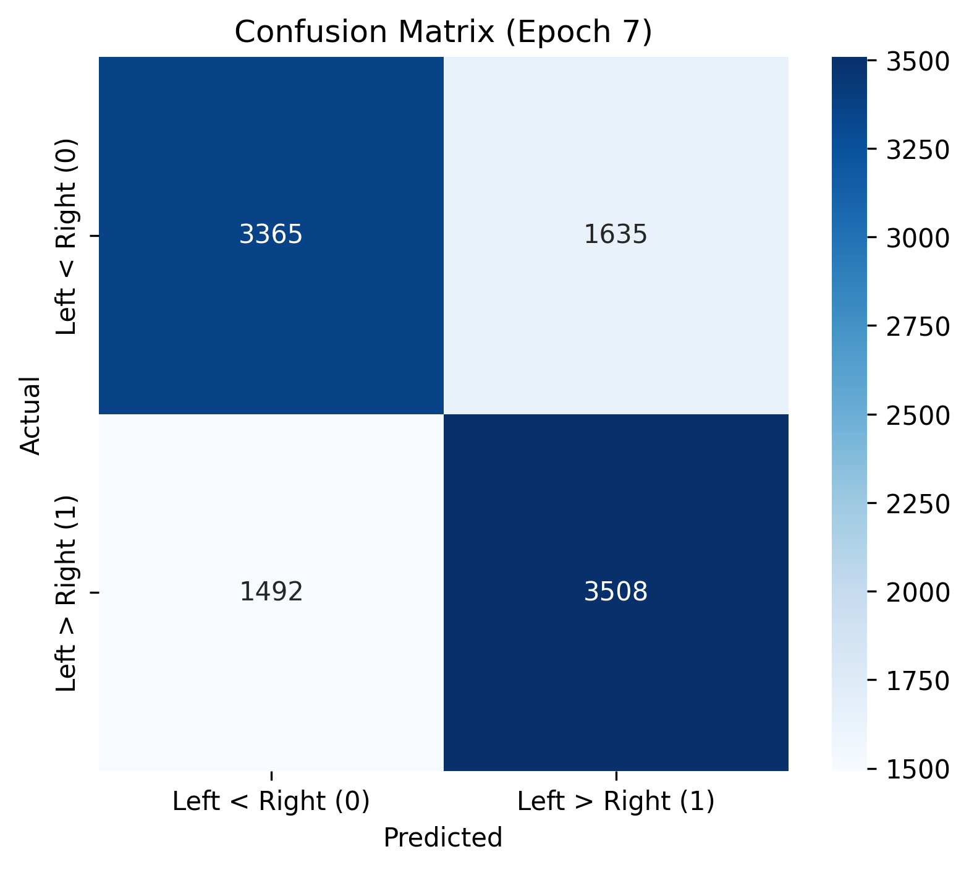

Slide 33
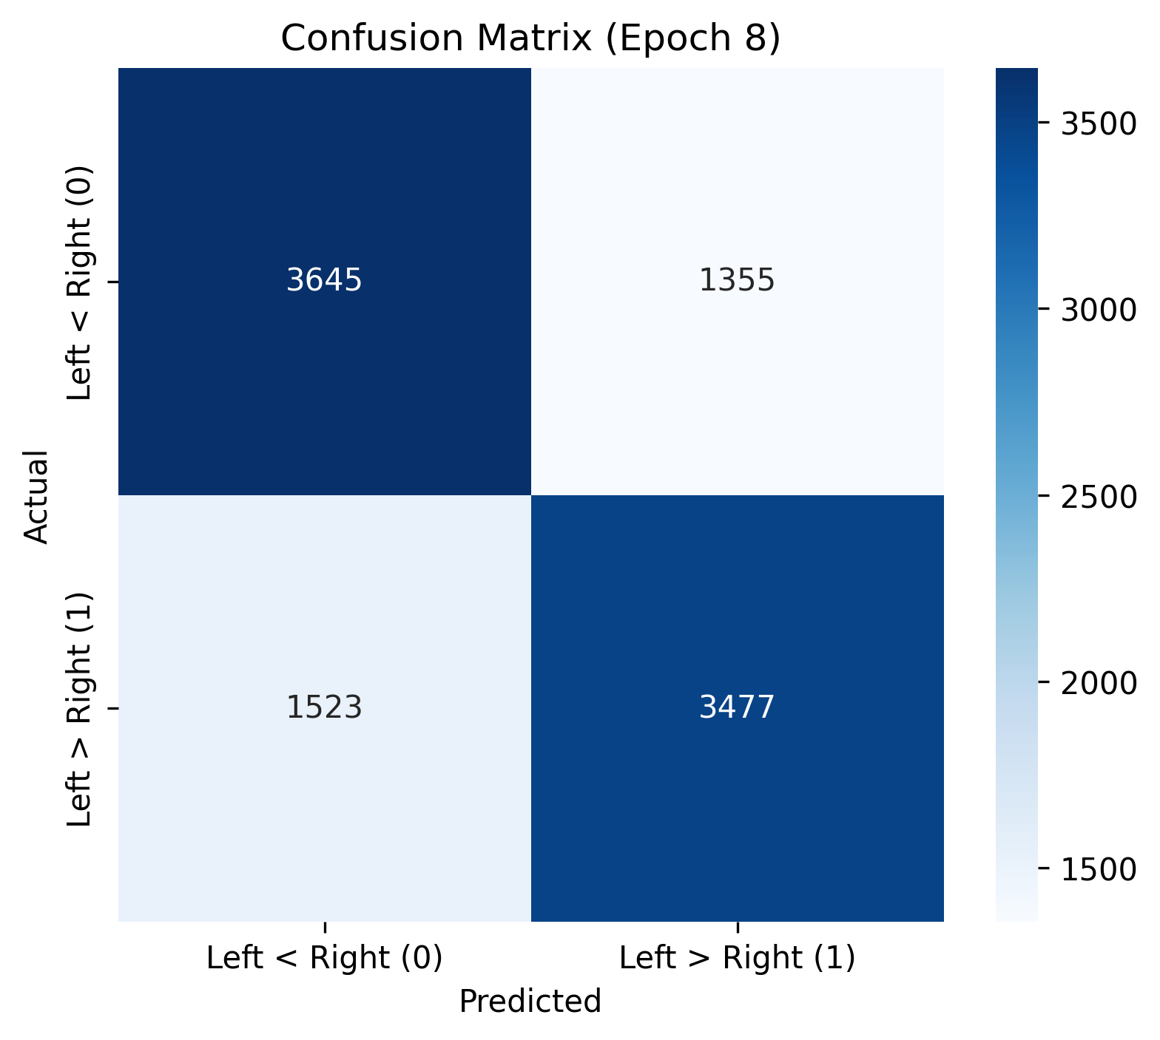

Slide 34
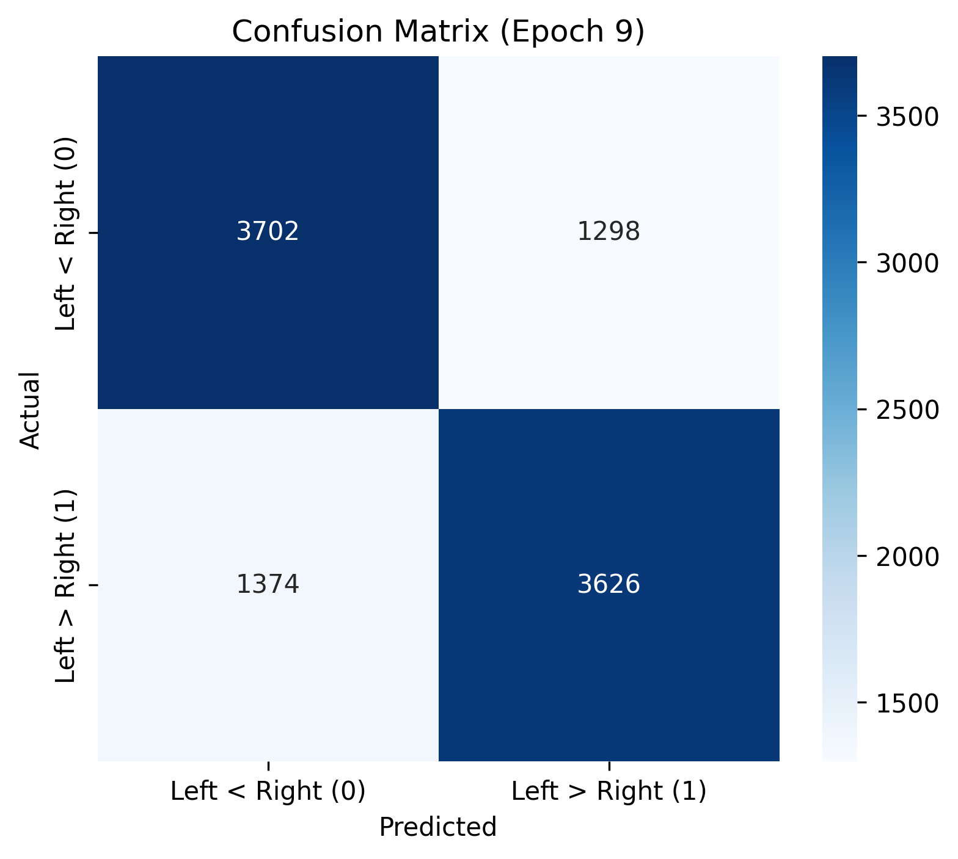

Slide 35


Slide 36


Slide 37
06
Error Analysis

Slide 38
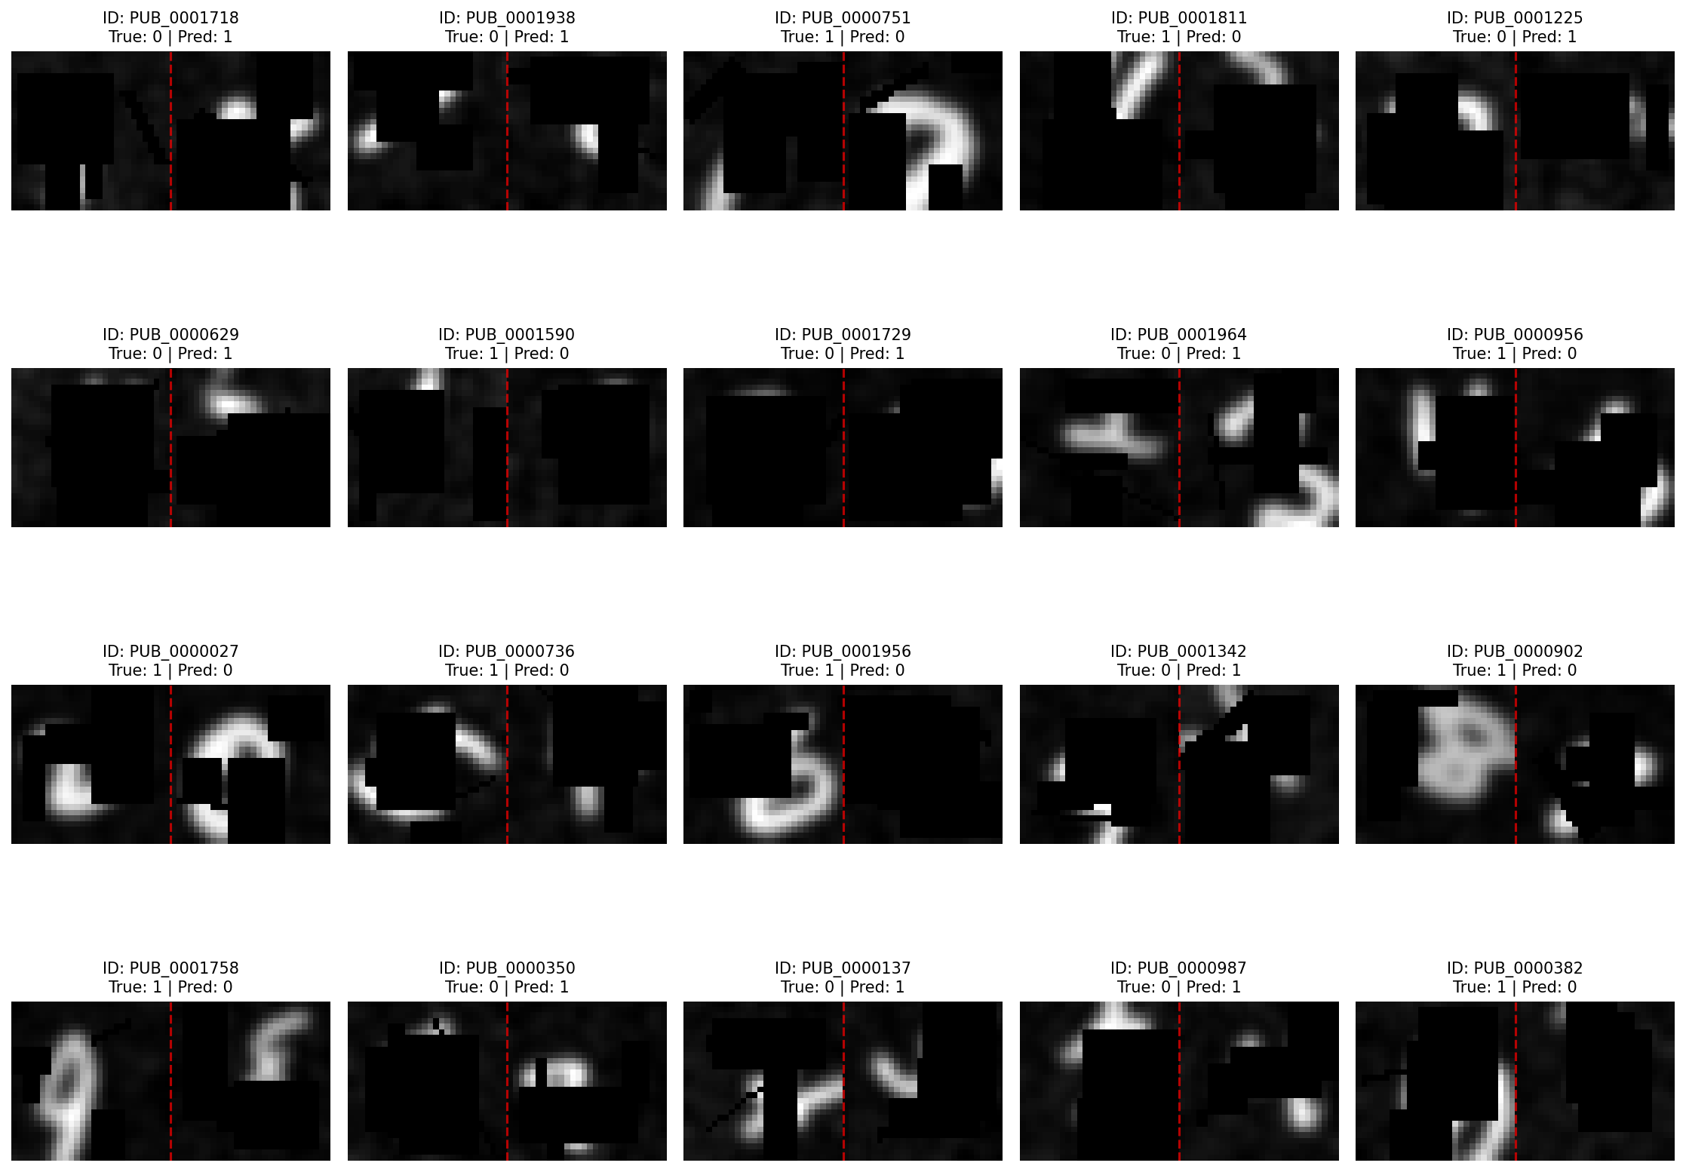

Slide 39
Analysis
-18 of them can not distinguish directly
-2 of them can be solved by script recognizing,(by recognizing its accurate number then compare), but it is not allowed in this assignment

Slide 40
07
Model efficiency and resource usage

Slide 41
Resource consumption and efficiency
Model parameters and training time
Advantages of mixed precision
The model has only 504K parameters and takes 7 minutes and 40 seconds to train on a 16 vCPU+16 GB cloud instance. It can be completed without a GPU, and the single forward inference time is less than 5 ms, making it suitable for edge deployment.
Mixed precision significantly saves memory, verifies that small models can also achieve high results, and improves the applicability of models in resource-constrained environments.

Slide 42
08
AI Tool Instructions

Slide 43
Tool used: Deepseek
Usage scenarios:
◦ Code structure optimization suggestions
◦ Model architecture design reference
◦ Error debugging and documentation assistance
◦ Review and learning of some important concepts
Principles of use:
All core logic and codes are original, and AI tools are only used as auxiliary

Slide 44
09
Summary and Future Work

Slide 45

Future work directions
01
Fix data augmentation issues
The next step is to fix the rotation enhancement dimension alignment problem and introduce more data enhancement strategies to improve the model's adaptability to complex inputs.
02
Trying a new comparison strategy
Comparison strategies such as feature difference and dot product are introduced, and combined with system hyperparameter search to further optimize model performance.
Enhanced visual analysis
03
By adding interpretable visualization and observing the focus areas of the residual blocks, we can further verify the basis for model decisions and continue to move towards an accuracy rate of 80%.

Slide 46

THANK YOU FOR READING！
THANK YOU

