Slide 1

API Service Development
Author: Ozan Topcu

Slide 2
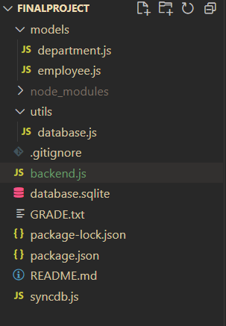
Project Overview
The main logic behind this project is to provide an API service between a company database and an end user.
The project consists of a “database.sqlite” file that stores both the user information and department information in its respective tables.

Slide 3
Technical Overview
Used Technologies:
Frameworks
Sequelize
Express.js
Middleware
Body-parser
Database
SQLite
Project Structure:
-utils
- database.js
-models
- department.js
- employee.js
- syncdb.js
- backend.js
Timetable:
Setting up the express framework: 30 mins
Setting up the database using Sequelize: 30 mins
Creating endpoints and testing them: 3 hours 30 mins
Setting up the express framework | 30m
Setting up the database using Sequelize | 1h
Creating endpoints and testing them | 3h30m

Slide 4
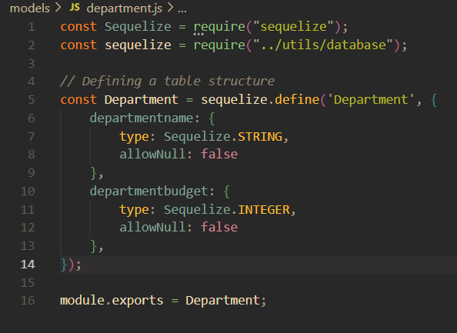
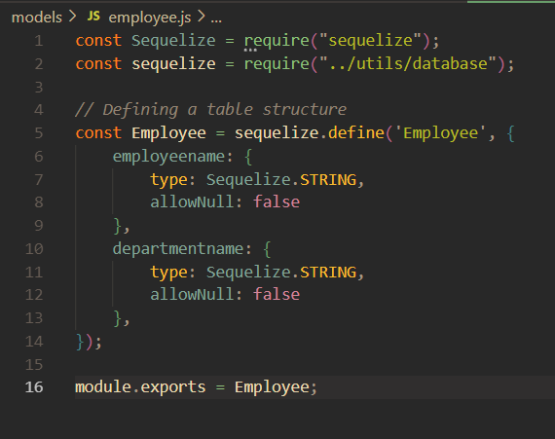
Models
These model files here define each table structure without being stuck to a single database engine format thanks to Sequelize.

Slide 5
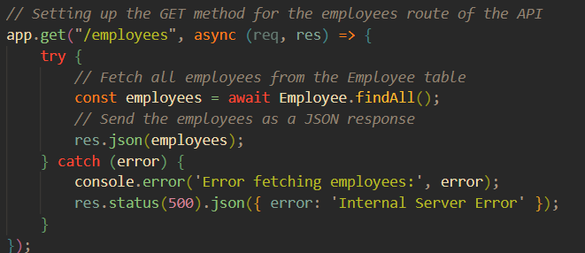
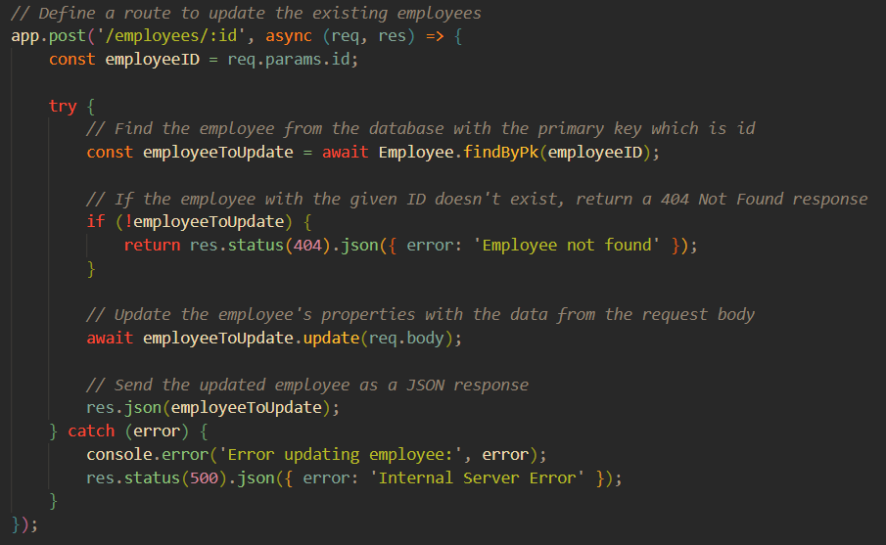
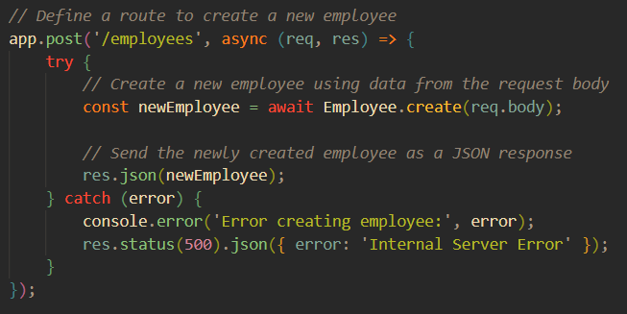
Backend.js
Examples of several HTTP requests (get, post, update)

Slide 6
Thank You

