Slide 1

ANKARA UNIVERSITY
COMPUTER ENGINEERING
INTERNSHIP INFORMATION SYSTEM
Student Number: 16290126, 16290116
Student Name SURNAME: Ozan ŞIK, Sinan Onur ÖZEN
Supervisor Name SURNAME : Kurtuluş KÜLLÜ
Ankara 20.06.2021

Slide 2

CONTENTS
1. INTRODUCTION
1.1. Problem Definition
1.2. Aim of the Project
2. MATERIAL and METHOD
3.1. Material
3.2. Method
3. EXPERIMENTS
4. CONCLUSION
REFERENCES

Slide 3
1. INTRODUCTION
1.1. Problem Definition
Due to the difficulties and communication distress on both the student and the university personnel side before the internship period, many students' internships are disrupted during this period.
Students do not report their internship days correctly and the number of internship days can be calculated incorrectly depending on the holidays.
The compulsory internship document, which is one of the most experienced problems recently, causes constant mailings.
The preparation of the document containing the internship information sent by the university personnel to the deanery is difficult.

Slide 4
1.2. Aim of the Project
System is ensured that the students can enter their internship information in the most accurately way, at the same time, the internships are approved by transferring this information to the university personnel side.
Especially, one of the most important features of the system is that it calculates whether the internship dates entered by the student and the number of working days are correct.
At the same time, each student can obtain the document with his/her number and e-mail with the "download compulsory internship document" button on their page.

Slide 5
2. MATERIAL and METHOD
2.1. Material
Our project will be a web-based application for ease of access. Development for the web application is done over Node.js. Certain modules (Express.js, Handlebars.js, 2 JWToken, etc.) are used to facilitate some parts of the project. If deemed necessary in the system, modules will be added.
The data received from the user that needs to be recorded are stored on the MySQL database. Files are kept with the blob structure on MySQL.
In order to navigate the front-end of the system, the router method in the Express.js module of Node.js was used at the back-end. Visualization was provided within the site with CSS files. Bootstrap 4.0.0 links combined on html files along with CSS files for the front-end part of the system.

Slide 6
2.2. Method
During the development process, the Agile Development method was applied to the project. With the weekly presentations that we made with our mentor, new requirements were determined and implemented each week.
During the project development stages, the source code of the project was shared over GitHub. Thus, an effective working area was created among the group members.
System was started over a reliable link. The system has enabled the joint use of two computers with this link. In this way, the errors of the system were detected and resolved.

Slide 7
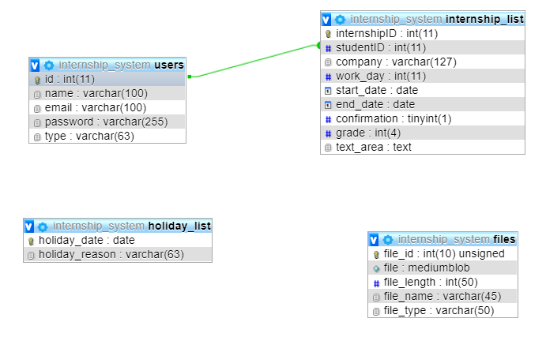
3. EXPERIMENTS
After entering the required information of the students or people with permission in the system, the MySQL database was used to keep this information. In addition to this semester, another table was created in which the compulsory internship document is kept.

Slide 8
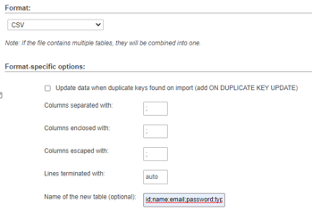
The internship data that was done before was in the excel file. These data were imported via phpmyadmin.
After that, the excel file to be imported is determined. The first line to be transferred can be specified from "partial import ".
Secondly, the csv file must be opened in the text document because it is necessary to know which punctuation mark separates the columns.

Slide 9
Students in the table can be found easily with the search section on the admin page.

Slide 10
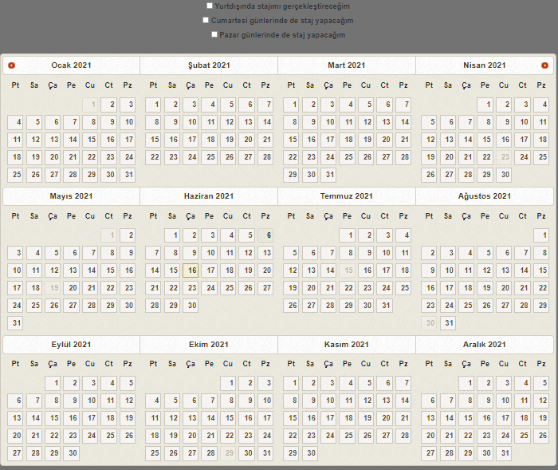
When the student clicks on the button to add internship information, holidays are transferred to a list in the background.
First and last dates taken from the user are saved in the variable. All dates between these days are determined and kept in a list.
After these operations are done, if the system detects an error, a text document is displayed.

Slide 11
4. CONCLUSION
This system provides convenience to the University by calculating workdays according to holidays.
Students have easy access to compulsory internship documents. At the same time, functions, where university personnel can download the excel file to be sent to the dean's office, were implemented.
Visuality has been added to our system. Thus, the user was provided to use the system comfortably.
A few internship data belonging to the last year were uploaded to the system, and errors in the system were identified and resolved.

Slide 12
REFERENCES
“About Node.js” www.nodejs.org/en/about/ Retrieved 01 January 2021
Starkey, James. "The true story of BLOBs". email. Archived from the original on 23 July 2011. Retrieved 19 January 2006.
Conway, M.-L., & Foskey, R. 2015. Apprentices thriving at work: looking through an appreciative lens. Journal of Vocational Education & Training, 67(3), 332–348. https://doi.org/10.1080/13636820.2015.1054863
Y Yannuar et al 2018 IOP Conf. Ser.: Mater. Sci. Eng. 434 012301
December 2018IOP Conference Series Materials Science and Engineering 434(1):012301

Slide 13

ANKARA UNIVERSITY
COMPUTER ENGINEERING
THANK YOU
Student Number: 16290126, 16290116
Student Name SURNAME: Ozan ŞIK, Sinan Onur ÖZEN
Supervisor Name SURNAME : Kurtuluş KÜLLÜ

