Slide 1
视觉基础大模型的架构
By 智魔老师

Slide 2
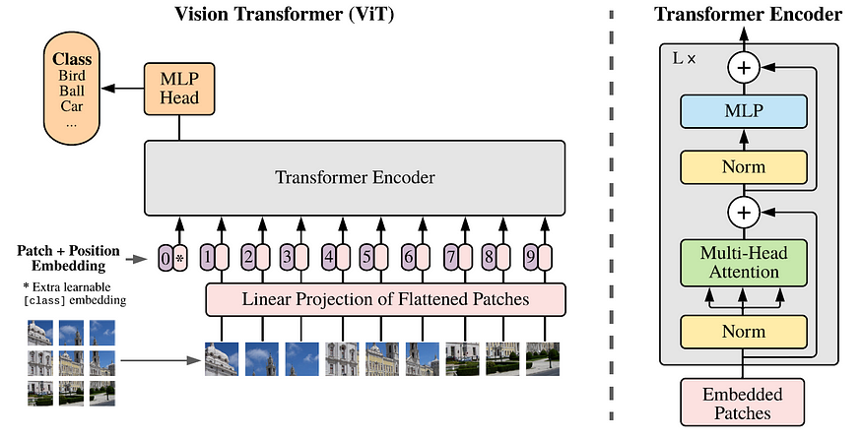

Vision Transformer (ViT)
Dosovitskiy A, Beyer L, Kolesnikov A, et al. An image is worth 16x16 words: Transformers for image recognition at scale. ICLR 2021.

Slide 3
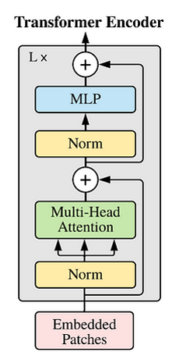
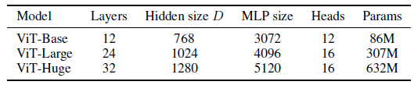
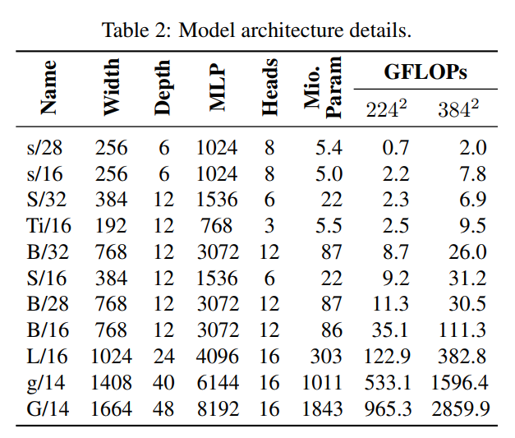
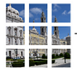
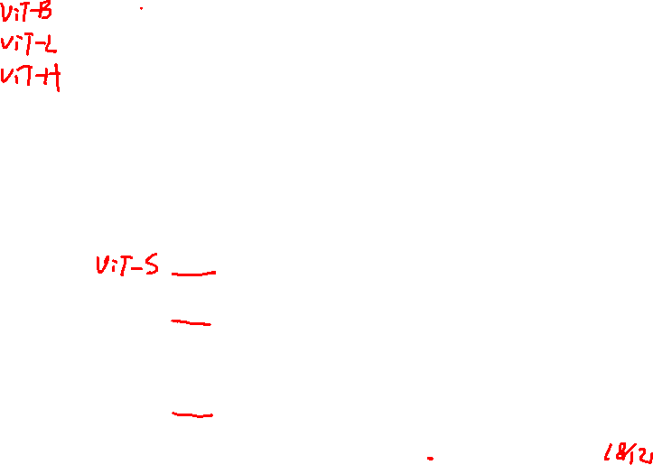
Vision Transformer (ViT)

Slide 4
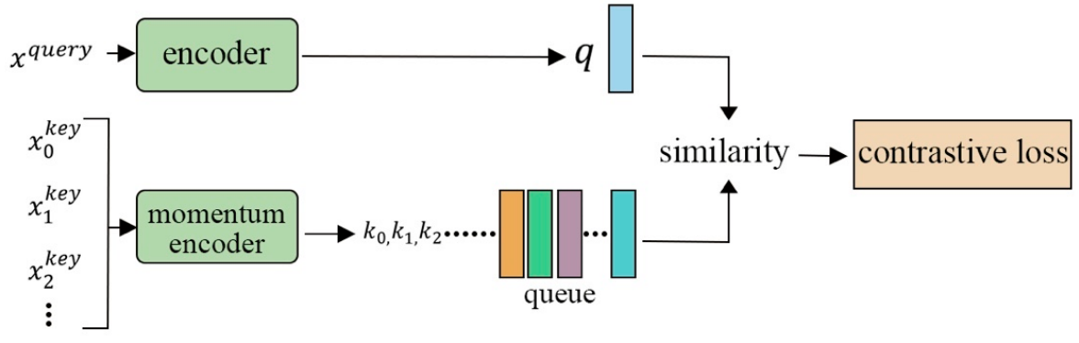
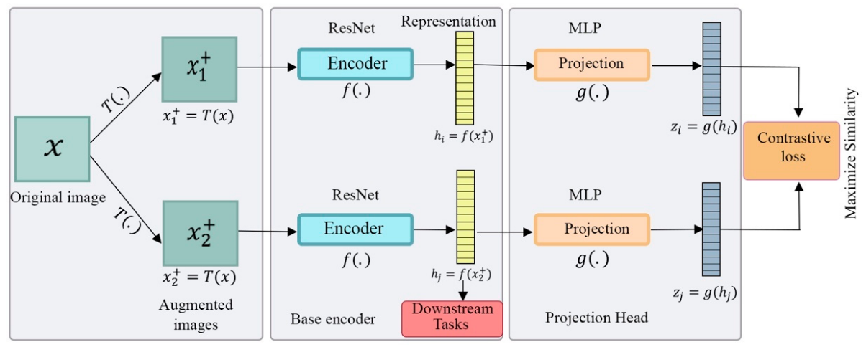
MoCo v1
MoCo v3
基于ViT架构的自监督学习
MoCo v2：更多数据增强+SimCLR中的映射层
SimCLR
Chen X, Xie S, He K. An empirical study of training self-supervised vision transformers. ICCV, 2021.

Slide 5
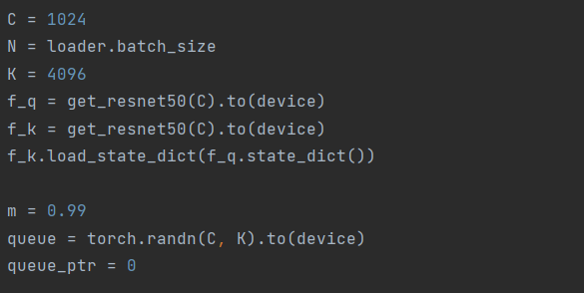
MoCo v1
MoCo v3
基于ViT架构的自监督学习
MoCo v3：
1）取消内存银行，由大batch代替
删除
Chen X, Xie S, He K. An empirical study of training self-supervised vision transformers. ICCV, 2021.

Slide 6
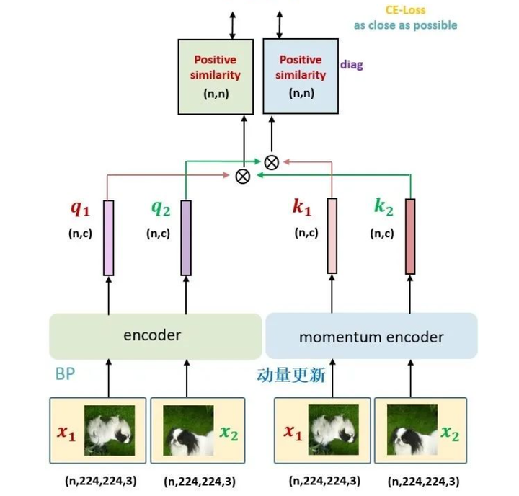




MoCo v1
MoCo v3
基于ViT架构的自监督学习
MoCo v3：
2）双向的对比loss
删除
$$ctr(q_{1},k_{2})$$
$$ctr\left(q_{1},k_{2}\right)+ctr(q_{2},k_{1})$$
Chen X, Xie S, He K. An empirical study of training self-supervised vision transformers. ICCV, 2021.

Slide 7
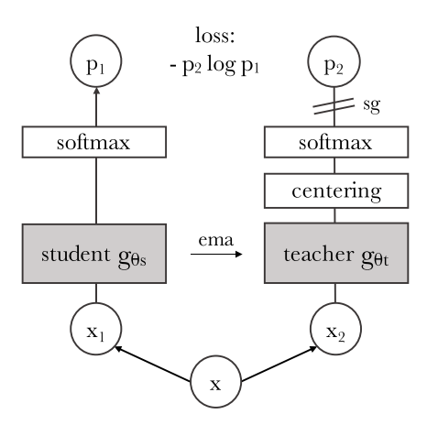



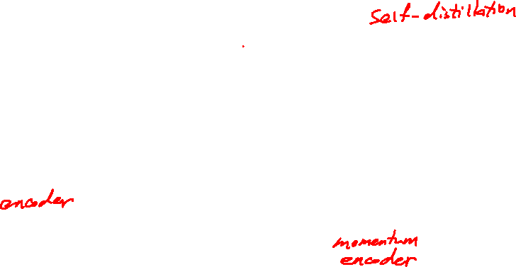
基于对比学习
基于掩码重建
DINO
Knowledge distillation with no labels
Caron M, Touvron H, Misra I, et al. Emerging properties in self-supervised vision transformers. ICCV, 2021.

Slide 8
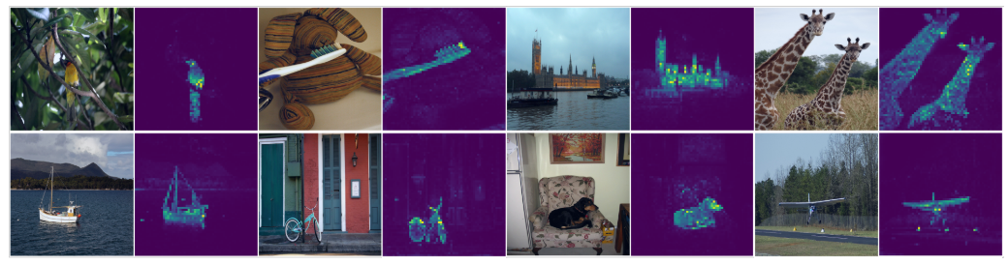
DINO
可视化-最后一层中的[CLS]
无监督学习到类别相关特征
Caron M, Touvron H, Misra I, et al. Emerging properties in self-supervised vision transformers. ICCV, 2021.

Slide 9
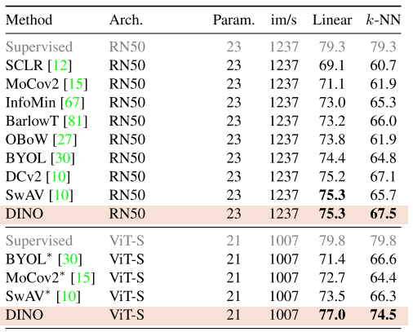
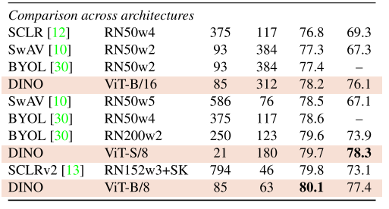
DINO
ImageNet上自监督实验
Caron M, Touvron H, Misra I, et al. Emerging properties in self-supervised vision transformers. ICCV, 2021.

Slide 10
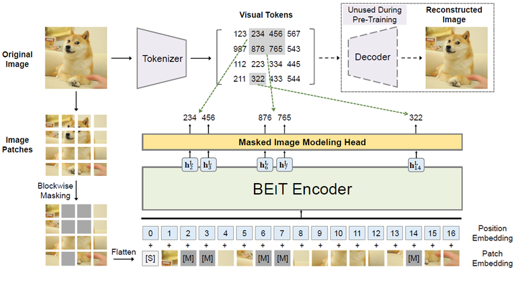
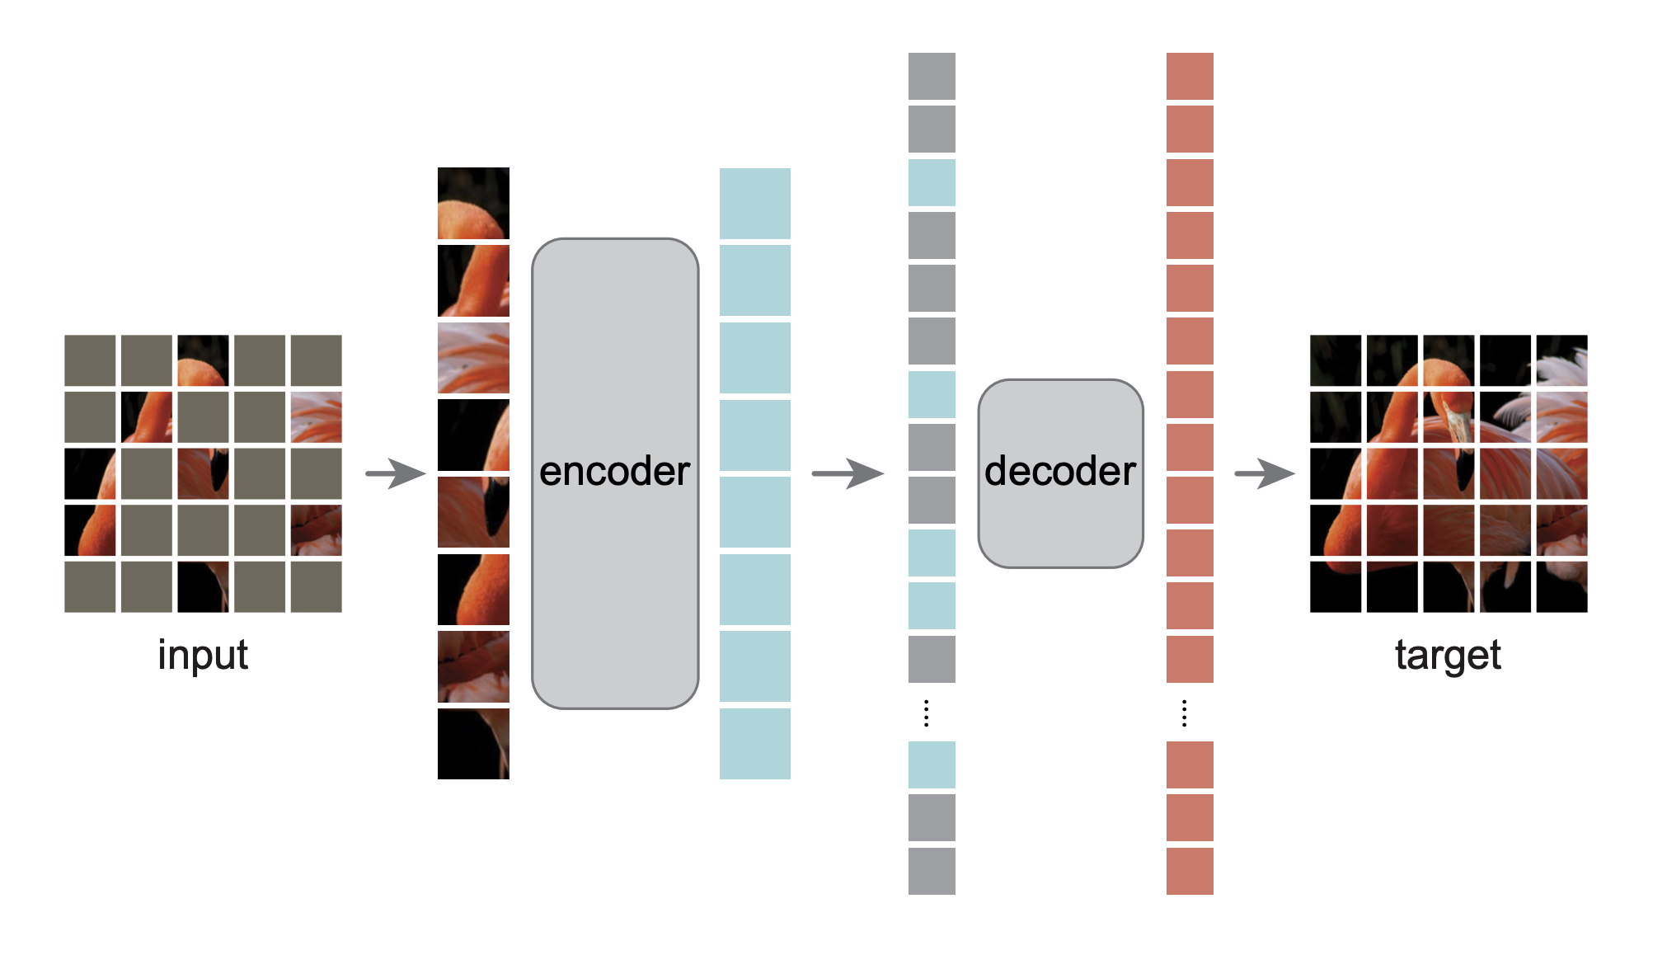

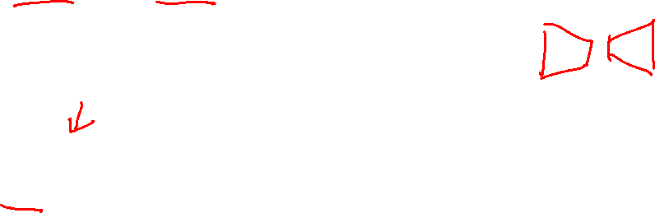
基于对比学习
基于掩码重建
MAE
网络结构
BEiT
He K, Chen X, Xie S, et al. Masked autoencoders are scalable vision learners. CVPR, 2022.

Slide 11
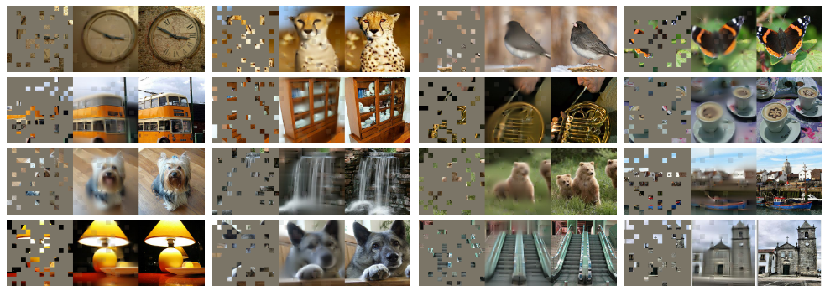
MAE
重建结果
He K, Chen X, Xie S, et al. Masked autoencoders are scalable vision learners. CVPR, 2022.

Slide 12
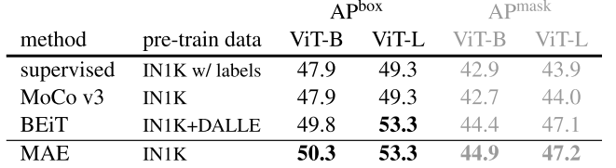
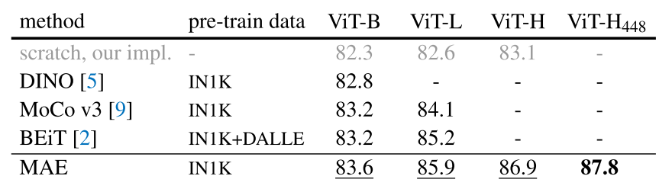
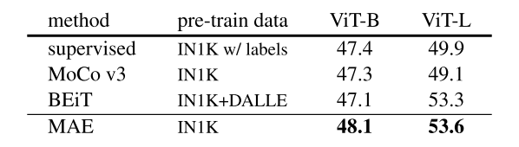
MAE
实验结果
检测-COCO
分类-ImageNet
分割-ADE20K
He K, Chen X, Xie S, et al. Masked autoencoders are scalable vision learners. CVPR, 2022.

Slide 13
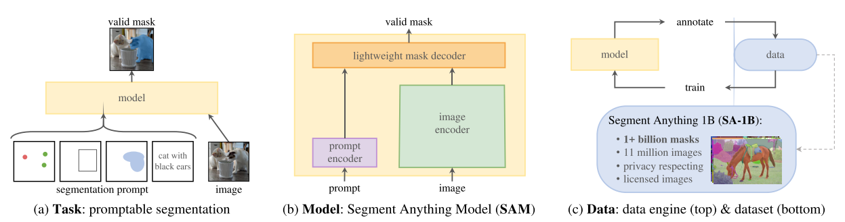
SAM (Segment Anything Model)
网络结构
Focal loss + Dice loss
Kirillov A, Mintun E, Ravi N, et al. Segment anything. arXiv, 2023.

Slide 14
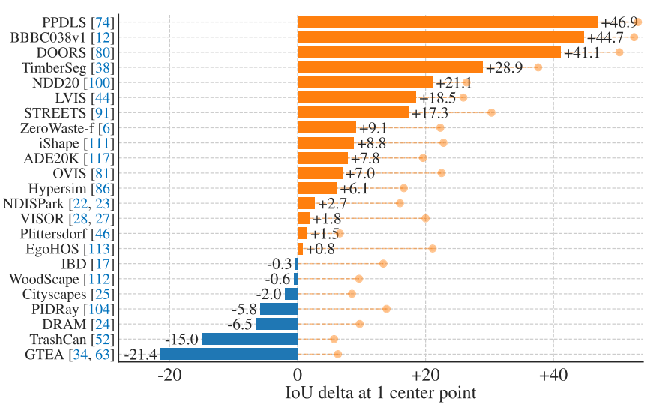
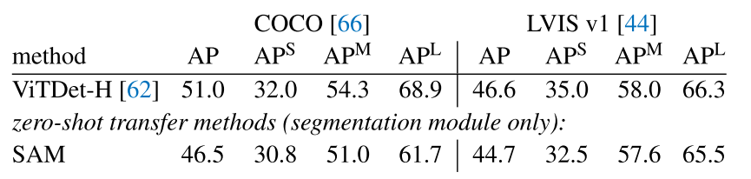
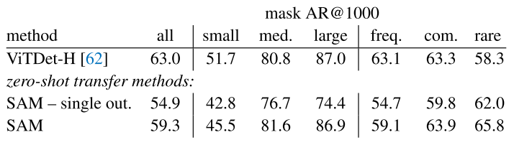

SAM (Segment Anything Model)
实验结果
Point预测Mask (vs RITM)
实例分割
目标检测
Kirillov A, Mintun E, Ravi N, et al. Segment anything. arXiv, 2023.

Slide 15
总结
ViT
MoCo v3
DINO
MAE
SAM
骨干网络
自监督基础模型
分割基础模型

