Slide 1
下游任务迁移与视觉提示
By 智魔老师

Slide 2
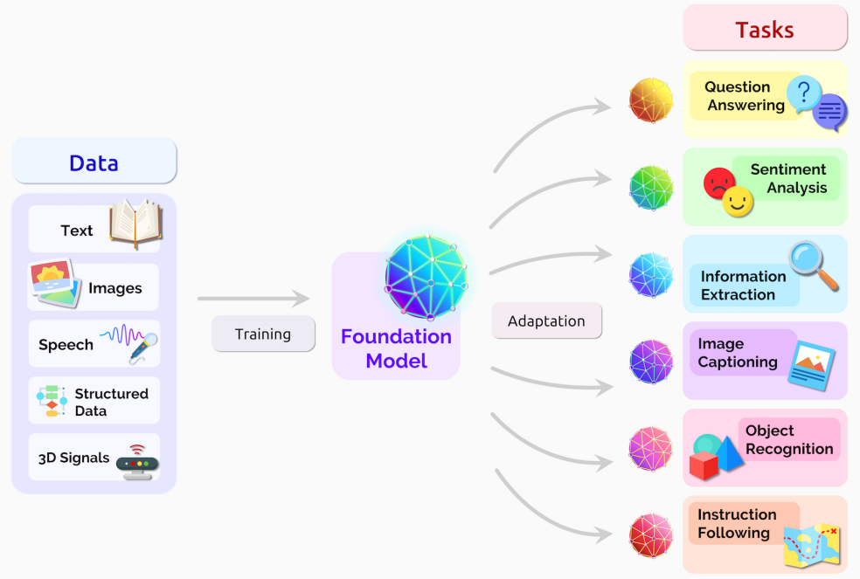
多种下游任务
一个基础模型
Bommasani R, Hudson D A, Adeli E, et al. On the opportunities and risks of foundation models[J]. arXiv preprint arXiv:2108.07258, 2021.

Slide 3
视觉基础模型的迁移方法
Linear
Probing
Finetune
Adapter
Prompt

Slide 4

线性探测 (Linear Probing)
The method where only a new linear classifier is trained on top of a frozen pre-trained model, keeping the original model's parameters unchanged
Backbone
Head
OR
Text

Slide 5
微调 (Finetune)
The method that adjusts the parameters of a pre-trained model throughout all of layers to adapt it to a specific task
Backbone
Head
OR
Text

Slide 6
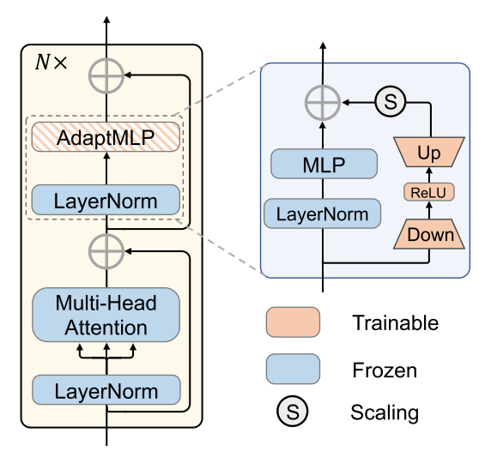
Adapter
The technique where small, trainable modules are inserted into a pre-trained model
Backbone
Head
OR
Text
Adapter
Chen S, Ge C, Tong Z, et al. Adaptformer: Adapting vision transformers for scalable visual recognition. NIPS, 2022.

Slide 7
视觉基础模型的迁移方法
Linear
Probing
Finetune
Adapter
Prompt
1）不改变原模型，迁移到下游任务
2）更少的参数量
3）few/zero-shot能力

Slide 8
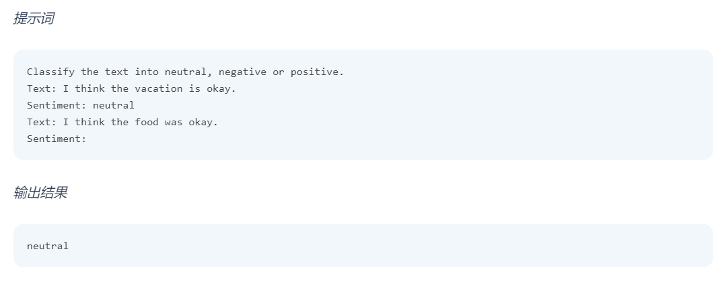
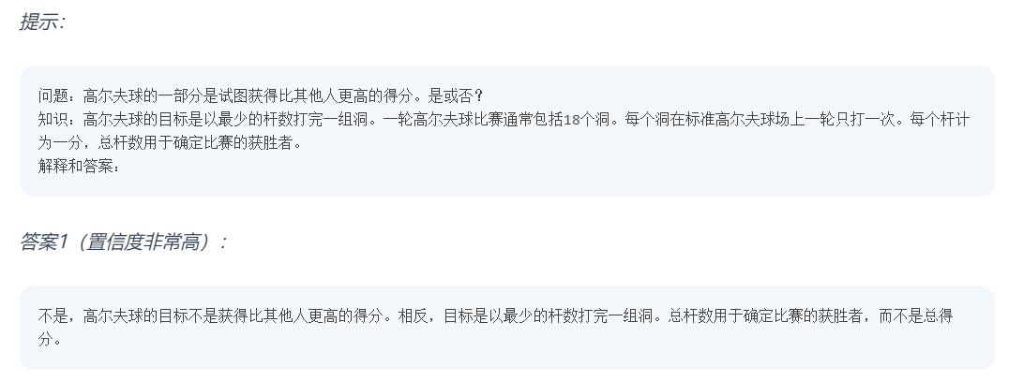
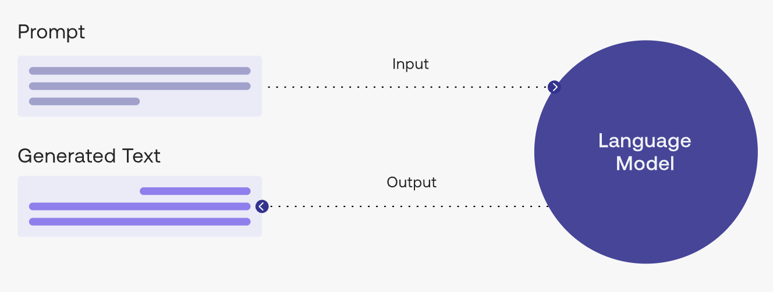
提示（Prompt）
定义：Additional information or hints provided to a model to guide its behavior or help it perform a specific task
NLP中的Prompt
Prompt engineer教程：https://www.promptingguide.ai/

Slide 9
视觉提示 (Visual Prompt)
Additional information or hints provided to a model to guide its behavior or help it perform a specific task
OR
Text
Backbone
Head
Visual Prompt

Slide 10
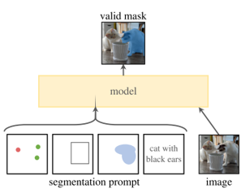
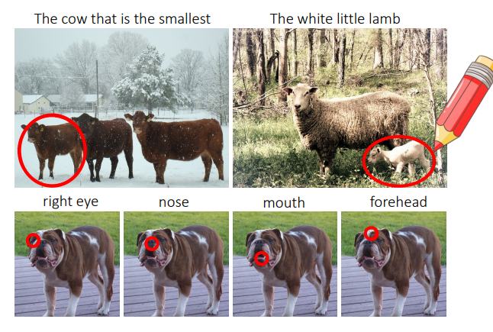
SAM
视觉提示 (Visual Prompt)
基于标注的Prompt
基于学习的Prompt
Backbone
Head
Circle
Shtedritski A, Rupprecht C, Vedaldi A. What does clip know about a red circle? visual prompt engineering for vlms[J]. arXiv preprint arXiv:2304.06712, 2023.

Slide 11
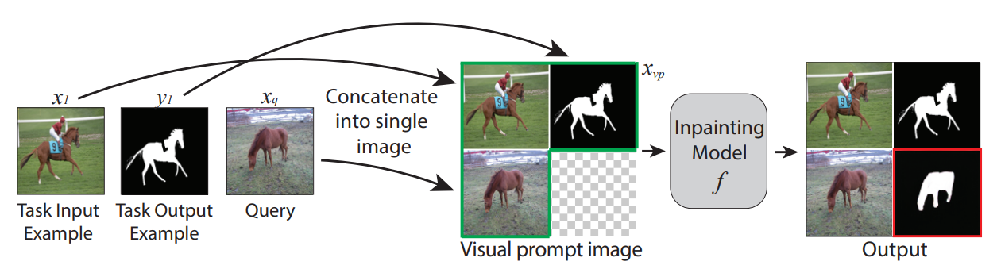
视觉提示 (Visual Prompt)
基于标注的Prompt
基于学习的Prompt
Backbone
Head
Examples
Bar A, Gandelsman Y, Darrell T, et al. Visual prompting via image inpainting[J]. Advances in Neural Information Processing Systems, 2022, 35: 25005-25017.

Slide 12
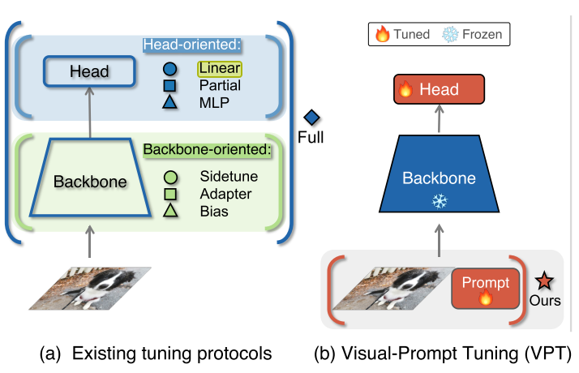
视觉提示 (Visual Prompt)
基于标注的Prompt
基于学习的Prompt
Backbone
Head
Learnable
Vector
Jia M, Tang L, Chen B C, et al. Visual prompt tuning[C]//European Conference on Computer Vision. 2022: 709-727.

Slide 13
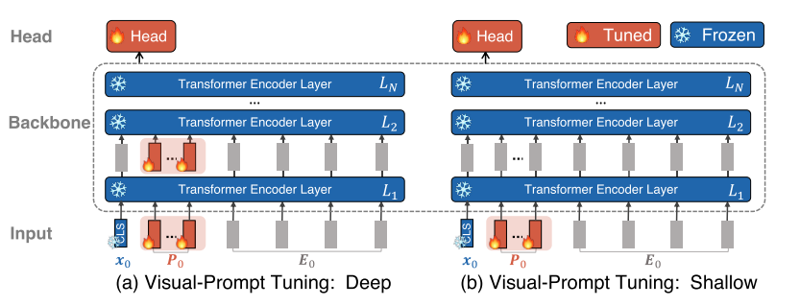
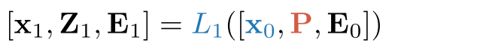
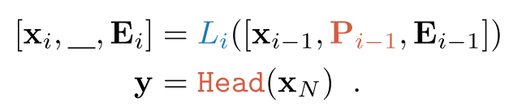
视觉提示 (Visual Prompt)
基于标注的Prompt
基于学习的Prompt
Jia M, Tang L, Chen B C, et al. Visual prompt tuning[C]//European Conference on Computer Vision. 2022: 709-727.

Slide 14
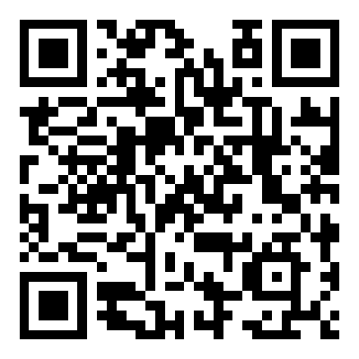

总结
Linear
Probing
Finetune
Adapter
Prompt
手写AI
THU智能魔术师

