Slide 1
Samsung Innovation Campus
Hotheads
Hale Afra Iris
Ozge Ozkaya
Gozde Gozutok
Toyan Unal

Slide 2
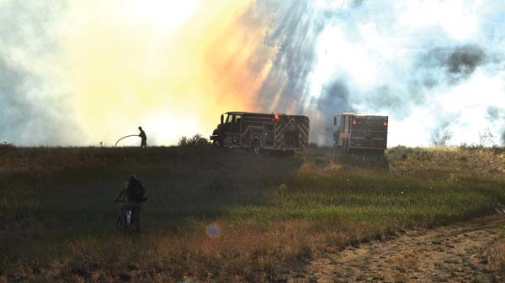
Wildfire Forecasting
for​ Wildfire Preparedness
This Photo by Unknown author is licensed under CC BY-SA-NC.

Slide 3
Outline
Background
Objectives
SDG Relation
Dataset
Methodology
Outputs
Usability
Next Steps

Slide 4
Background
Wildfires effect lives in various aspects
Wildfires' can be detected at early-stages to get prepared
Early-stage prediction provides prevention from massive loss

Slide 5
Objectives
Building a machine learning model that predicts the probability of wildfires for given areas
Supporting and warning disaster risk reduction/management teams at early-stages

Slide 6


SDG Relation

Slide 7
Dataset
+150k weather and wildfire data based on Turkey
Wildfire data source: NASA
Weather data source: National Centers for Environmental Information
Time interval: 2010 – 2015
Focusing on the temperature, precipitation, wind speed and so on

Slide 8
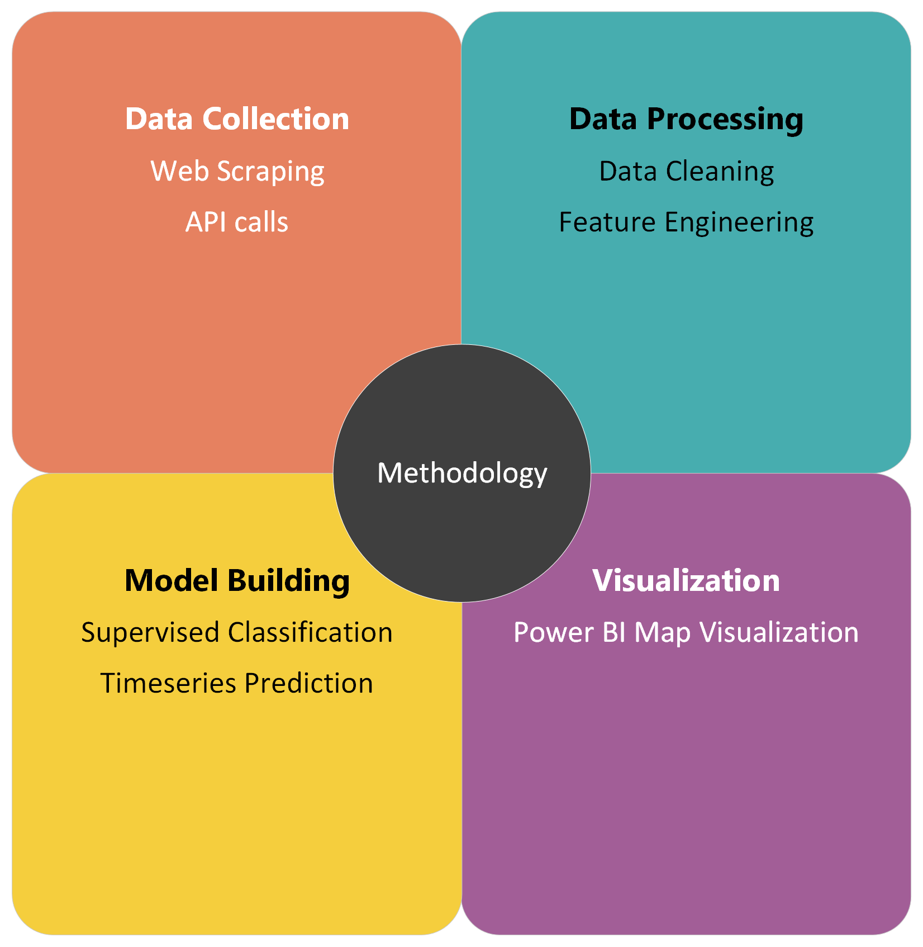

Slide 9
Outputs
Comprehensive dataset on Turkey Weather and Wildfire for studies
80% accuracy to classify fire occurrence based on:
Daily Temperature (min, max, average)
Daily Precipitation
Daily Average Wind Speed
Daily Visibility in Miles
Daily Dew Point
Daily Maximum Sustained Wind Speed
Quarter of the year
Power BI dashboard(visualization of 2015)

Slide 10
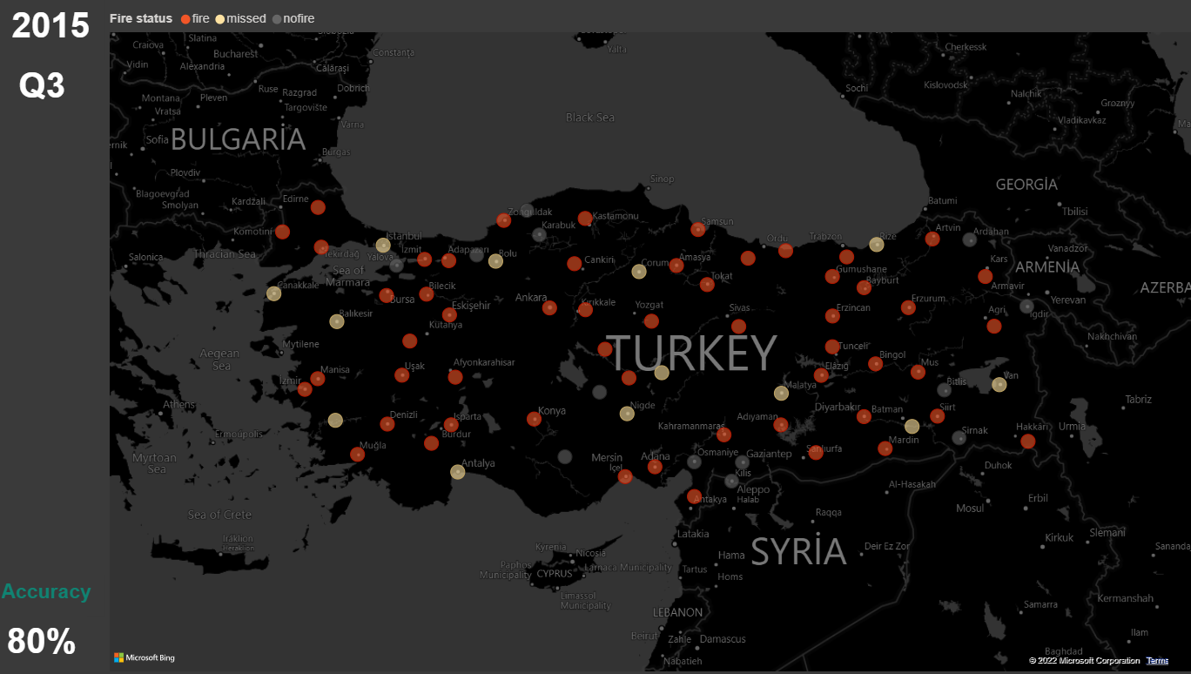

Slide 11
Usability
Adaptable for any area with required information
Easy to implement to any kind of software environment
Can focus on Turkey only
Open source and open for improvement

Slide 12
Next Steps
Strengthening the model with environmental data aspects such as population, usage intensity of the forests etc.
Predict the brightness risk
Building visualization systems for specific areas
Building applications to warn authorities as well as the citizens about the wildfire risk

Slide 13
Thank you!

