Slide 1

Matplotlib

Slide 2
Matplotlib
Visualizing data is crucial to quickly understanding trends and relationships in your dataset.
Matplotlib is one of the most popular libraries for plotting with Python.

Slide 3
Matplotlib
Matplotlib is known as the “Grandfather” of plotting and visualization libraries for Python.
Many other visualization libraries are built directly off of Matplotlib (e.g. seaborn and pandas built-in visualization).

Slide 4
Matplotlib
Matplotlib is heavily inspired by the plotting functions of the MatLab programming language.
It allows for the creation of almost any plot type and heavy customization.

Slide 5
Matplotlib
This ability to heavily customize a plot comes at a trade-off for beginners, since it can be confusing to learn the Matplolib syntax at first.
This is mainly due to the fact that there are actually two separate approaches to creating plots, functional based methods and OOP based methods.

Slide 6
Matplotlib
This Matplotlib section seeks to clear up any confusion by clearly separating out these two approaches.
Matplotlib Basics
Functional Method
Matplotlib Figures and Subplots
OOP Method

Slide 7
Matplotlib
Topics Covered
Matplotlib Basics and Functions
Matplotlib Figures
Matplotlib Subplots
Matplotlib Styling
Exercise Questions and Solutions

Slide 8
Matplotlib
Specialized plot types such as histograms won’t be covered with matplotlib, since we will later learn how to use seaborn to easily create statistical plots.
It is important to learn matplotlib first however, since seaborn builds directly off of Matplotlib.

Slide 9
Matplotlib
Throughout this section we will be referencing the excellent Matplotlib online documentation:
https://matplotlib.org/
As well as the gallery of example plots and codes (very useful!)
https://matplotlib.org/gallery.html

Slide 10
Matplotlib
Two main goals with Matplotlib:
Be able to plot out a functional relationship:
y = 2x
Be able to plot out a relationship between raw data points:
x = [1,2,3,4]
y = [2,4,6,8]

Slide 11
Let’s get started!

Slide 12
Matplotlib Basics

Slide 13
Matplotlib
The most basic way to use Matplotlib is through the function plot calls:
plt.plot(x,y)
These function calls are simple to use, but don’t allow for very high degrees of control.

Slide 14
Matplotlib
We recommend using these simple plt.plot() calls for quickly visualizing relationships and data.
Later on we will explore the more robust OOP Matplotlib Figure API.

Slide 15
Matplotlib
Note!
There are slight differences in displaying plots within a notebook versus running a python script.
If you are running .py scripts instead of .ipynb notebooks, you will need to add the plt.show() command discussed in this video.

Slide 16
Matplotlib
Figure Object
PART ONE : UNDERSTANDING THE FIGURE

Slide 17
Matplotlib
The more comprehensive Matplotlib OOP API makes use of a Figure object.
We then add axes to this Figure object and then plot on those axes.
This allows for very robust controls over the entire plot.

Slide 18
Matplotlib
Let’s quickly visually build an understanding of the Figure object before coding it with Python…
Note:
The Figure object we’re about to show is technically not visible until you add axes to it.

Slide 19
Matplotlib
plt.figure()
<Figure size 432x288 with 0 Axes>

Slide 20
Matplotlib
plt.figure(figsize=(10,10))
<Figure size 720x720 with 0 Axes>

Slide 21
Matplotlib
fig = plt.figure()
Blank canvas, waiting for a set of axes for plotting.
<Figure size 432x288 with 0 Axes>

Slide 22
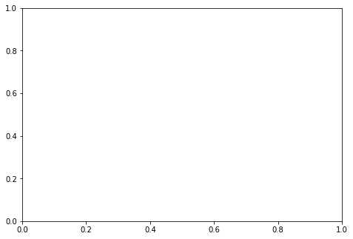
Matplotlib
fig = plt.figure()
axes = fig.add_axes([0, 0, 1, 1])

Slide 23
Matplotlib
fig = plt.figure()
axes = fig.add_axes([0, 0, 1, 1])
FIGURE

Slide 24
Matplotlib
fig = plt.figure()
axes = fig.add_axes([0, 0, 1, 1])
(x,y)
Lower Left Corner of Axes
(0,0)
FIGURE

Slide 25
Matplotlib
fig = plt.figure()
axes = fig.add_axes([0, 1, 1, 1])
(x,y)
Lower Left Corner of Axes
(0,1)
FIGURE

Slide 26
Matplotlib
fig = plt.figure()
axes = fig.add_axes([ 0.5, 0.5, 1, 1])
(x,y)
Lower Left Corner of Axes
(0.5,0.5)
FIGURE

Slide 27
Matplotlib
fig = plt.figure()
axes = fig.add_axes([0, 0, 1, 1])
(width,height)
of Axes
FIGURE

Slide 28
Matplotlib
fig = plt.figure()
axes = fig.add_axes([0, 0, 1, 1])
(width,height)
of Axes

Slide 29
Matplotlib
fig = plt.figure()
axes = fig.add_axes([0, 0, 0.5, 0.5])
(width,height)
of Axes
FIGURE

Slide 30
Matplotlib
fig = plt.figure()
axes = fig.add_axes([0, 0, 0.5, 0.5])
(width,height)
of Axes

Slide 31
Matplotlib
fig = plt.figure()
axes = fig.add_axes([0, 0, 0.5, 1])
(width,height)
of Axes
FIGURE

Slide 32
Matplotlib
fig = plt.figure()
axes = fig.add_axes([0, 0, 0.5, 1])
(width,height)
of Axes

Slide 33
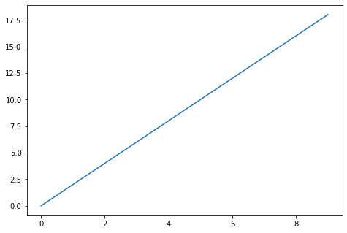
Matplotlib
fig = plt.figure()
axes = fig.add_axes([0, 0, 1, 1])
axes.plot(x, y)

Slide 34
Matplotlib
fig = plt.figure()
axes = fig.add_axes([0, 0, 1, 1])
axes.plot(x, y)

Slide 35
Matplotlib
fig = plt.figure()
axes = fig.add_axes([0, 0, 1, 1])
axes.plot(x, y)

Slide 36
Matplotlib
fig = plt.figure()
axes = fig.add_axes([0, 0, 1, 1])
axes.plot(x, y)

Slide 37
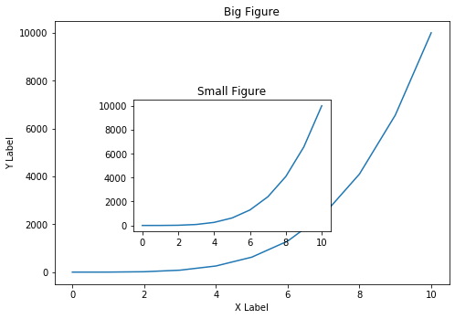
Matplotlib
This methodology allows us to add in multiple axes as well as move and resize the axes.

Slide 38
Matplotlib
In theory we could set axes side by side using plt.figure() calls, but typically it is easier to use plt.subplots() function calls for this.
We’ll explore multiple side by side plots in a future lecture, for now let’s explore the Figure object methodology for Matplotlib!

Slide 39
Matplotlib
Figure Object
PART TWO: IMPLEMENTING FIGURES AND AXES

Slide 40
Matplotlib
Figure Object
PART THREE: FIGURE PARAMETERS

Slide 41
Matplotlib SubPlots

Slide 42
Matplotlib
In theory we could create a Figure object and then manually add and arrange sets of axes to line up multiple plots side by side.
However, Matplotlib comes with a pre-configured function call plt.subplots() that automatically does this for us!

Slide 43
Matplotlib
The plt.subplots() call allows us to easily create Figure and Axes objects in side by side formations.
The plt.subplots() command returns a tuple containing the Figure canvas and then a numpy array holding the axes objects.

Slide 44
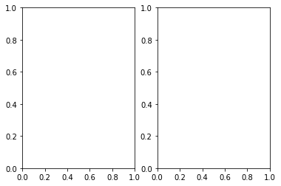
Matplotlib
fig, axes = plt.subplots(nrows=1, ncols=2)

Slide 45
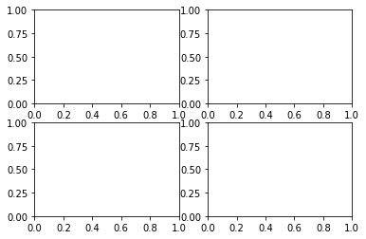
Matplotlib
fig, axes = plt.subplots(nrows=2, ncols=2)

Slide 46
Matplotlib
plt.subplots() returns a tuple which by common convention we label (fig,axes):
fig
This is the entire Figure canvas.
axes
This is a numpy array holding each of the axes according to position in the overall canvas.

Slide 47
Matplotlib
Let’s explore how to use plt.subplots() to easily create and align multiple plots!

Slide 48
Matplotlib Styling
PART ONE: LEGENDS

Slide 49
Matplotlib
Matplotlib offers very robust styling functions that allow us to edit colors, legends, line widths, markers, and much more!
Note: Due to the wide amount of possible variations, we will be copying and pasting from the lecture notebook to save typing time in the video.

Slide 50
Matplotlib
Main Styling Discussed:
Legends
Visual Styling
Colors
Editing Lines
Colors, Widths, Styles
Editing Markers
Colors, Size, Styles, Edges

Slide 51
Matplotlib
Let’s begin with adding legends!

Slide 52
Matplotlib Styling
PART TWO: VISUAL STYLING

Slide 53
Additional Matplotlib Commands

Slide 54
Matplotlib
Matplotlib is a huge library!
We’ve added a notebook with some additional concepts you may want to explore on your own.
We don’t use these concepts in the course however, so feel free to skip this notebook for now.

Slide 55
Matplotlib
An important note is that almost any Matplotlib question you can think of already has an answer in StackOverflow or an example in the Matplotlib gallery.
Leverage these many examples to your advantage and do not waste energy and time into memorizing esoteric commands!

Slide 56
Matplotlib
Section

Slide 57
Matplotlib Exercises
Solutions

