Slide 1
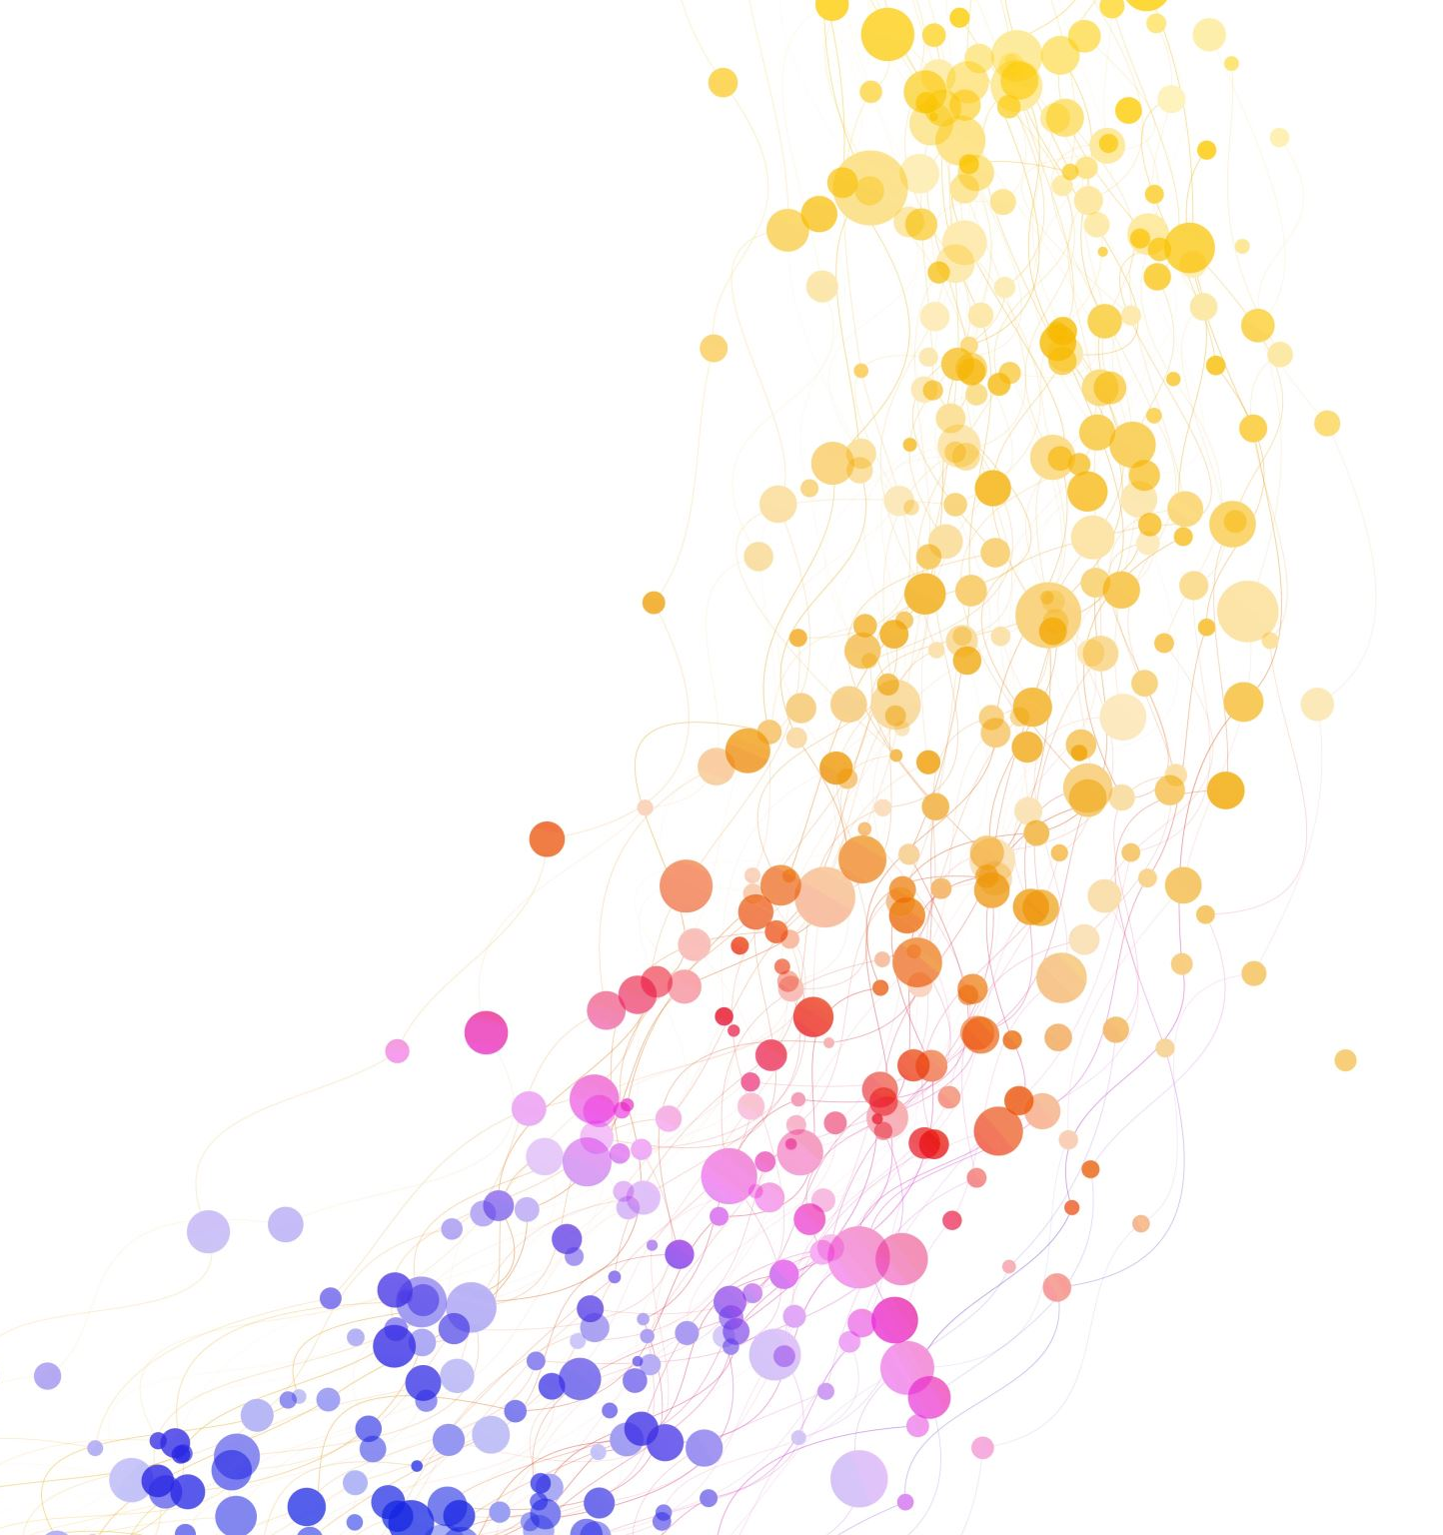
CHURN CUSTOMER
Ozioma Njoku
Mariam Adegoke

Slide 2

INTRODUCTION
The banking sector of today is highly competitive, customer retention is of utmost importance, and losing customers (churn) can have significant financial implications for banks. By employing machine learning algorithms, we can analyze data to forecast the probability of a customer leaving the bank and implement proactive strategies to retain these valuable customers.

Slide 3

Proposal
Our proposed solution involves the following steps
Data Collection
Data Preparation
Feature Engineering
Model Selection
Model Training and Evaluation
Actionable Insights

Slide 4
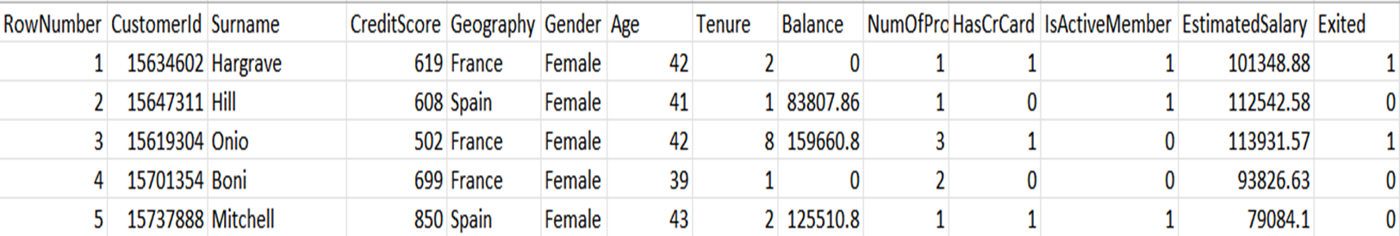
Dataset
Notes:
RowNumber: The index of the record in the database
Customerid: The unique identifier of each customer
Surname : customers last name
Creditscore: ratings of the customer
Geography : country of location
Gender: female or male
Age. Age of the customer

Slide 5

Recommended Solution
Our proposed solution will help the bank to-
Reduce customer churn,
Increase customer loyalty
Improve customer satisfaction
Reduce expenses
Moreover, it will also help the bank to identify patterns and trends in customer behavior, which can be used to develop targeted marketing campaigns and product offerings.

Slide 6
Model Selection
Logistic regression in the primal space and with different kernel
SVM in the RBF and with different Kernels
Random Forest

Slide 7
Hyperparameter
Hyperparameters are set by the user and define the behavior of the model, such as the learning rate, the number of layers in the neural network, or the number of trees in a random forest.
The selection of hyperparameters is a crucial step in machine learning, as they can significantly affect the optimize its performance on a given task.
This process often involves trying out different combinations of hyperparameters and evaluating the model's performance using metrics such as accuracy, precision, recall, and F1 score.

Slide 8
Limitations
The data seems to be a snapshot of a specific date, but it's not clear what that date is or why it's relevant
Some customers have exited but still have a balance in their account, which could mean they have left a specific product but not the bank as a whole.
The definition of an "active member" is unclear, and it would be helpful to know if there are different levels of activity.
Providing transaction counts in terms of both credits and debits could be more informative than just listing the number of products a customer has.
The model is good at predicting customers who might leave, but it still misses some of them. To improve, we can train the model with more data later. For now, we can focus on keeping the customers who might leave.

Slide 9

Summary
Based on the results of our code, the RF model performed the best. Utilizing this model can enable us to take action before customers leave, which has the potential to assist the bank in maintaining its customer base, capital, and increasing efficiency.

Slide 10




Recommendations
Improve customer service
Personalize the customer experience
Incentivize customer loyalty
Simplify account management
Develop customer relationships
Enhance security

