Slide 1
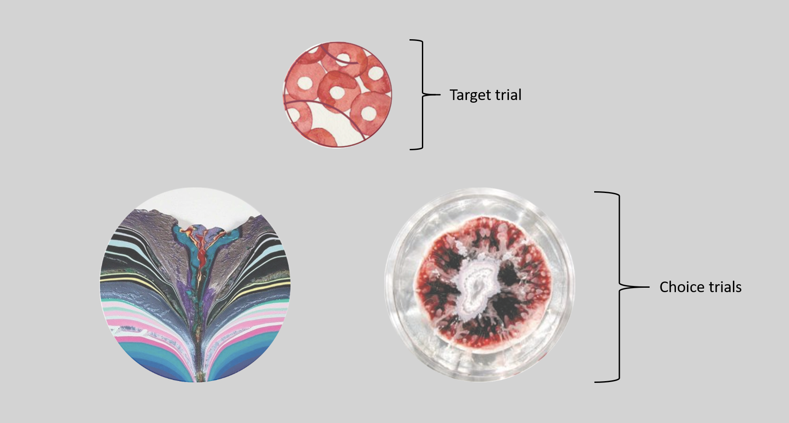

Slide 2
Overview:

Slide 3
Your task is to make a decision between two choice trials based on the target trial.
When you choose the lucky choice trial, you might receive a correct response. When you choose the unlucky choice trial, you might receive an incorrect response.
Through trial-and-error, you will learn which target stimuli is associated with which choice trial.
You will have a maximum of 3 seconds to make your choice for each trial. Please try to respond within this time limit.
After you make your decision, the target trial and your chosen trial will be displayed on the screen.
Following this display, you will receive feedback. The feedback will appear after a fixed delay, either a short delayed period or a long delayed period. Each target trial is associated with one of these delay durations.
After the feedback, you will receive performance feedback in the form of the words "correct" or "incorrect" along with a scenery image.
Remember to base your decisions on the target trials and try to learn which choice trial is more likely to lead to a rewarding outcome.

Slide 4
Example:
First, for each event, you will see target trial and choice trials.

Slide 5
You need to make a decision between choice trials.
Please response within 3 seconds.

Slide 6
Then, you will see the target trial and your chosen trial.

Slide 7
After either short delay or long delay, you will see feedback along with a scenery image.

Slide 8
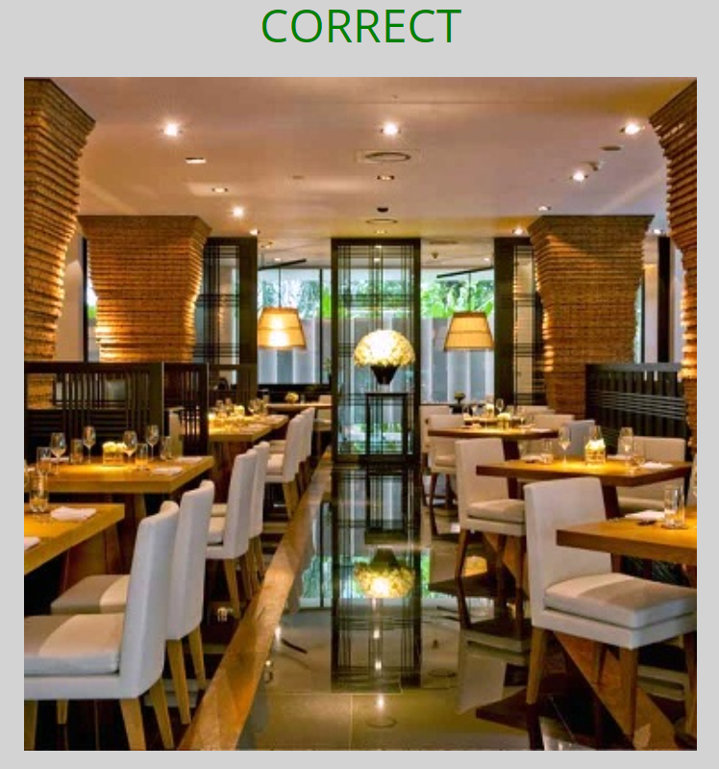
For some choice trial, you may response correctly.

Slide 9
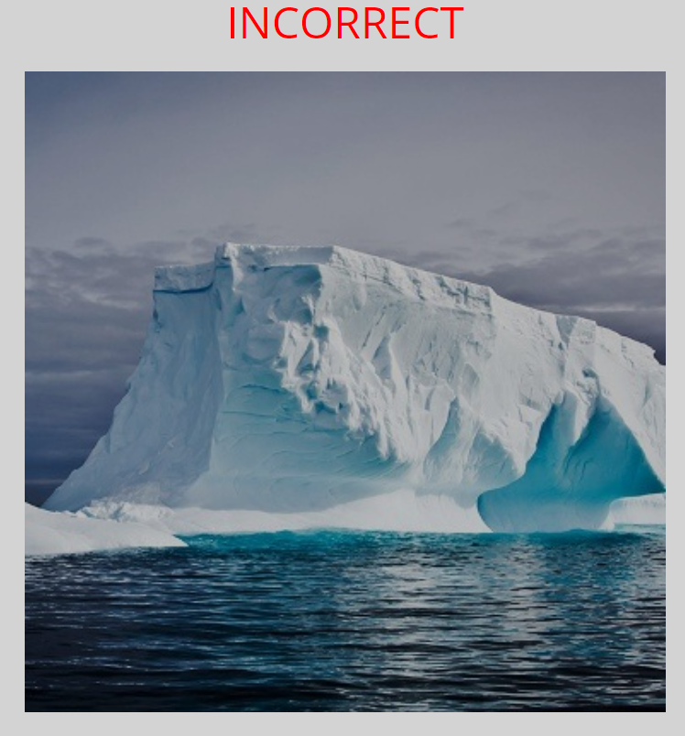
For some choice trial, you may response incorrectly.

Slide 10
Each target trial has one best response that works almost all of the time.
If you didn’t response within 3 seconds, you will continue with the new trials.
In this task, there will be a multiple target trials. Your goal is to try to learn associations with choice trials.

Slide 11

Example Timeline of The Experiment:
Variable Duration
You need to make a choice between choice trials.
You will display target trial and your chosen trial.
Short or long delay.
Feedback will be displayed.

Slide 16
In this task, your goal is to learn the associations between target trial and choice trials.
In each trial, the probabilities of the associations are such that each target trial predicts one of the two choice trials with a rewarding outcome in 80% of the trials and with the other choice trial in 20% of the trials.
Your task is to make a decision between the two choice trials based on the target trial.
You will have a maximum of 3 seconds to make your choice for each trial. Please try to respond within this time limit.
After you make your decision, the target trial and your chosen trial will be displayed.
Following this display, you will receive feedback. The feedback will appear after a fixed delay of either short delayed period or long delayed period. Each target trial is associated with one of these delay durations.
After feedback duration window, you will receive performance feedback in the form of the words "correct" or "incorrect" along with a scenery image.
Remember to make your decisions based on the target trials and try to learn which choice trial is more likely to lead to a rewarding outcome.

