Slide 1

ME430: HEAT EXCHANGERS § DESIGN SHELL AND TUBE HEAT EXCHANGER DESIGN FOR OLYMPIC POOLS
Instructor: Dr. Barbaros ÇETİN
Yunus ÖZKAN-21703421
Hami Bahadır BİLİR-21502846

Slide 2
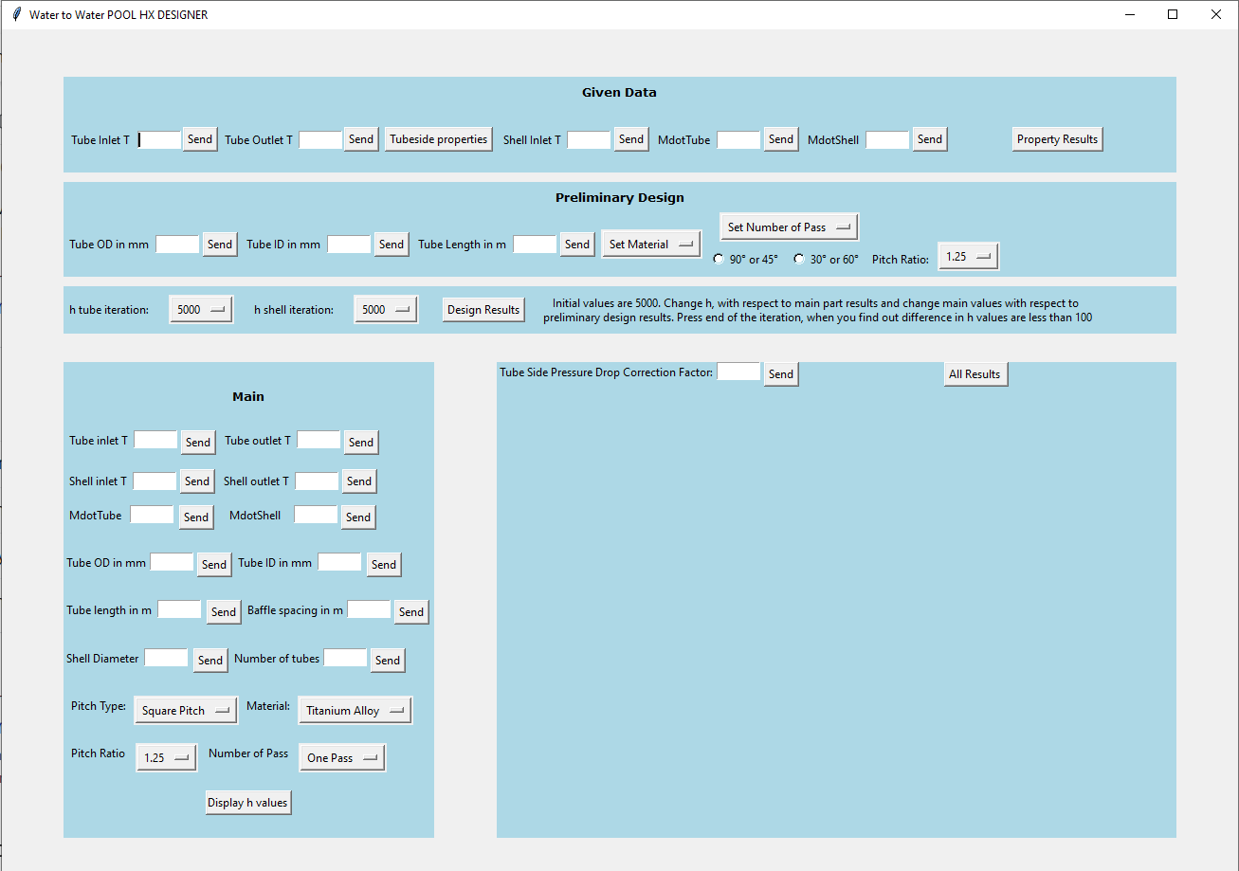
We are not limited to our design since we wrote a desktop app to create water – water shell and tube exchanger for Pools.
Since we have fixed outer temperature, our program is about manually iterating the overall design until design reaches an accurate result, while providing industry standards.
Program suggested to be used after reading instructions.
Figure 1: User Interface of Pool Heat Exchanger Designer program.

Slide 3
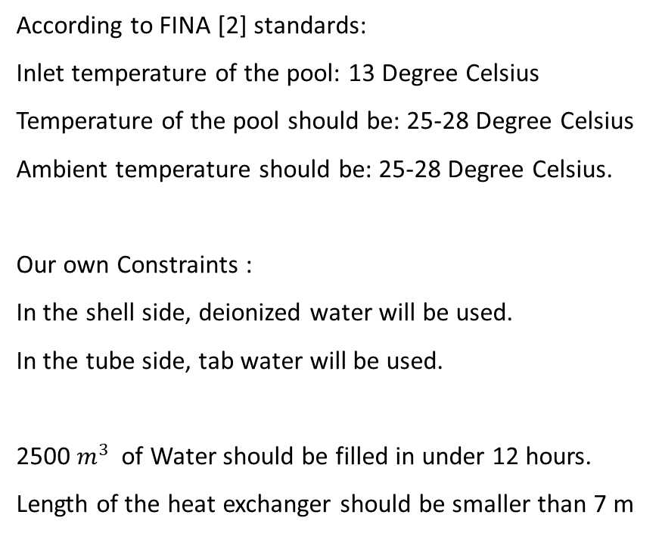
Constraints:
This program is written according to TEMA standards.
Tubes and shell should be picked from TEMA table.
Tube side and shell side fluid is water.
Maximum working pressure on both sides are 6 bar.
According to TEMA [1]:
0.0666 < (Shell diameter/Tube length) < 0.2
1.25 < Pitch/Outer diameter of tube < 1.5
According to FINA [2] standards:
Inlet temperature of the pool: 13 Degree Celsius
Temperature of the pool should be: 25-28 Degree Celsius
Ambient temperature should be: 25-28 Degree Celsius.
Our own Constraints :
In the shell side, deionized water will be used.
In the tube side, tab water will be used.
2500 $m^{3}$ of Water should be filled in under 12 hours.
Length of the heat exchanger should be smaller than 7 m

Slide 4
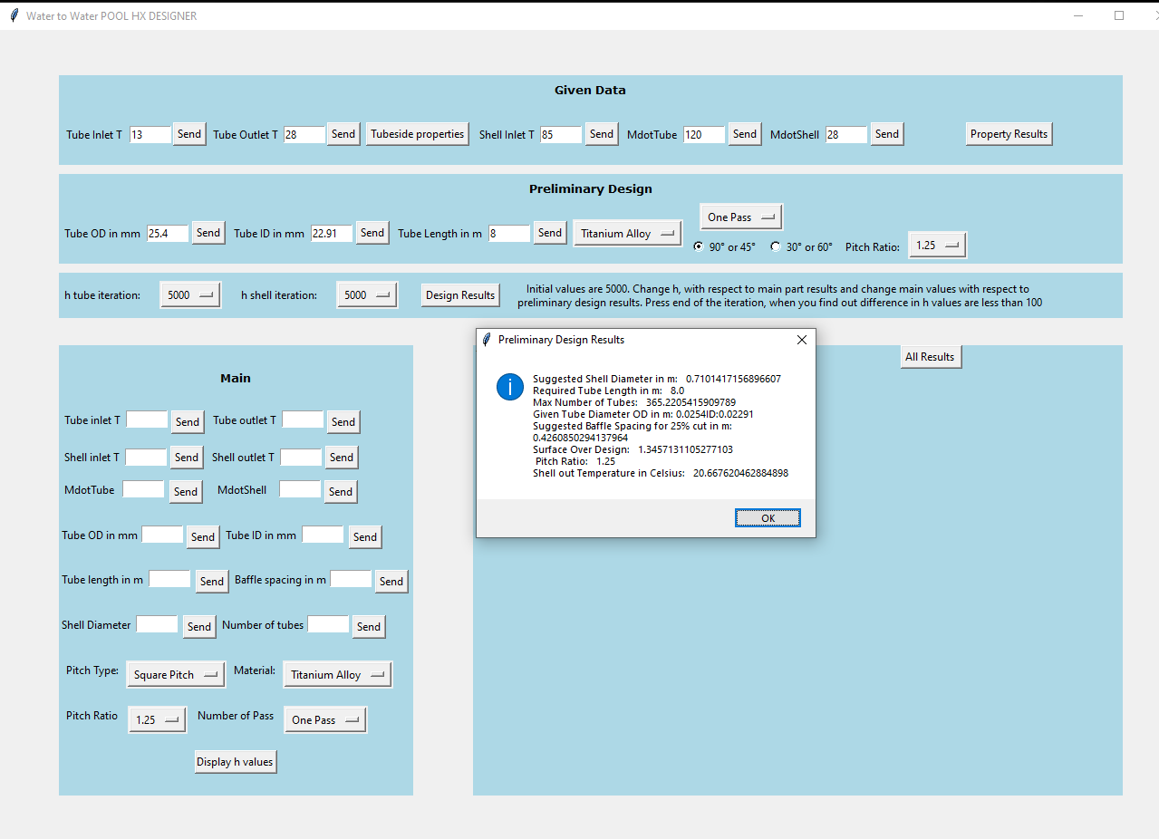
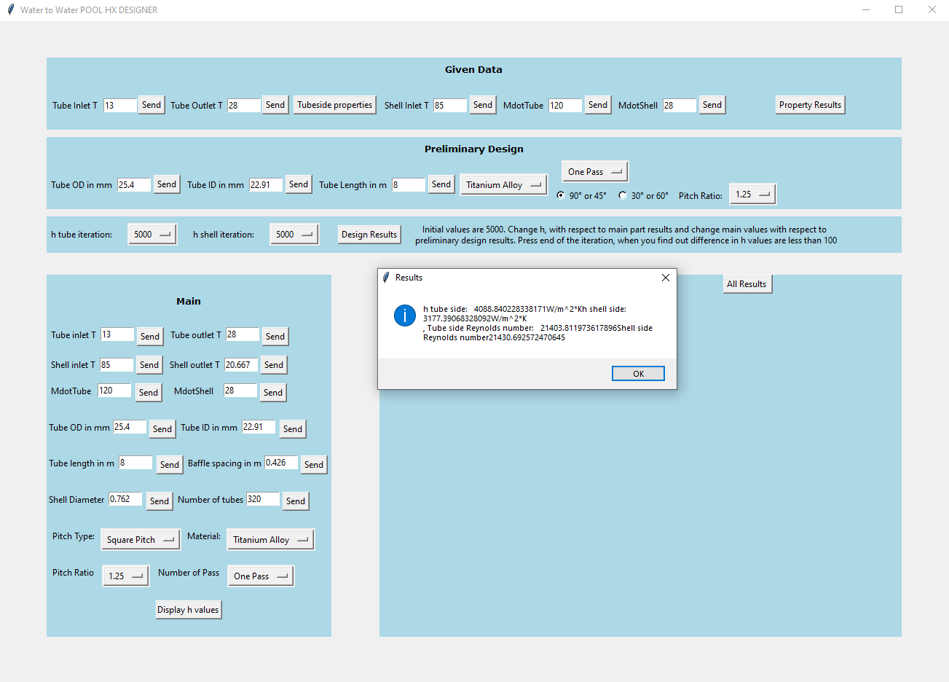
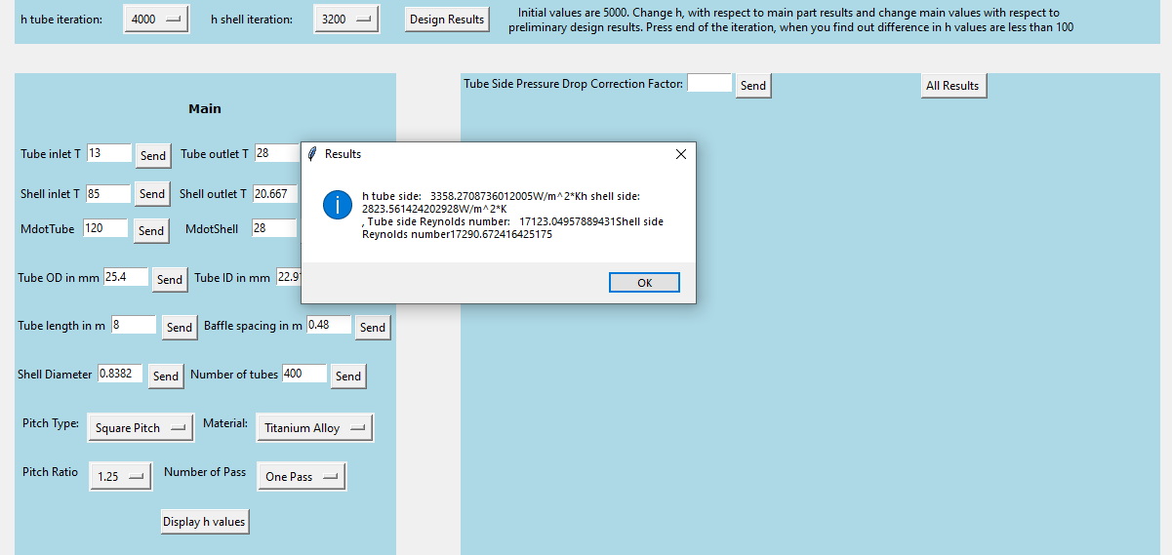
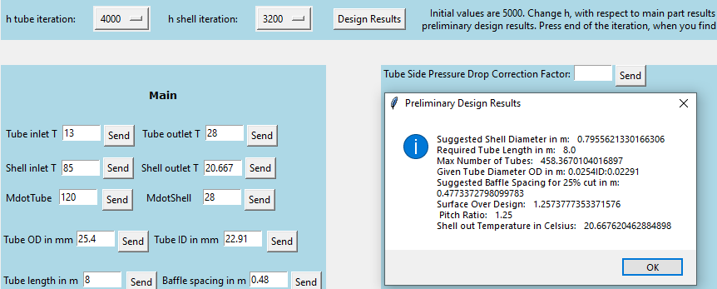
Figure 2: Application of design iteration of the program.

Slide 5
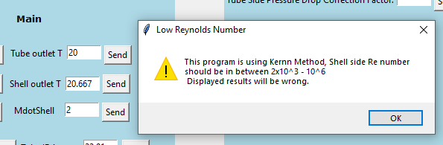
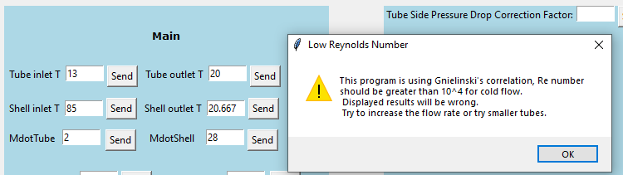
Most mistakes are tolerated by the program.
In this example, mass flow rates written incorrectly. Program gives an error. There are lots of other error types.
Mass flow rates are in kg/s. Units are described in instructions; however, it will also be corrected in future versions of the program.
Figure 3: Some Error Examples.

Slide 6
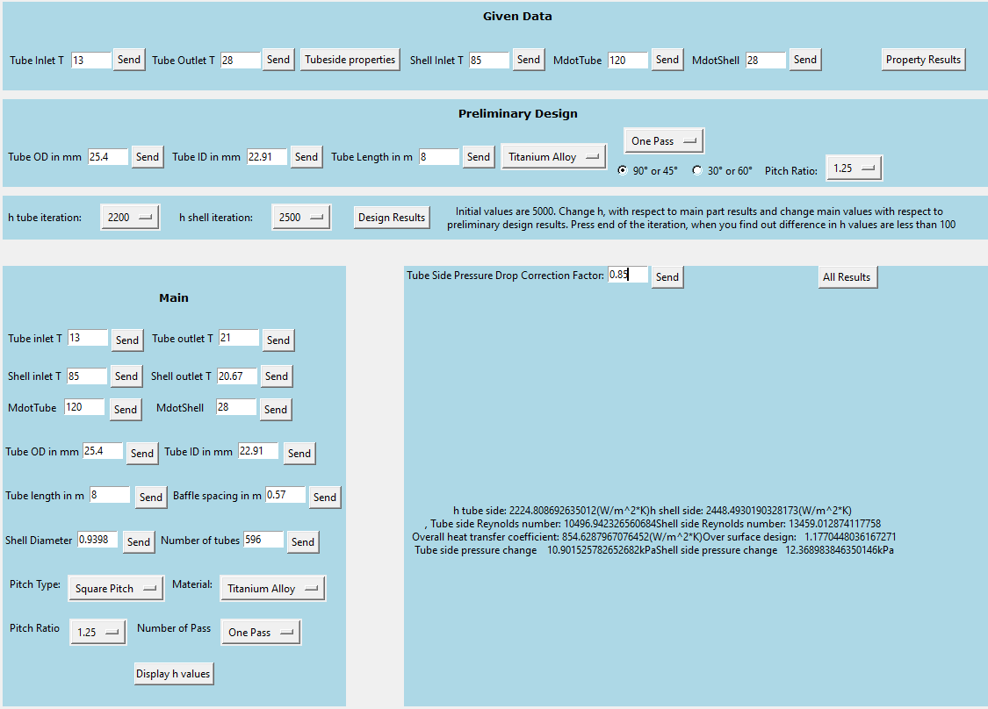
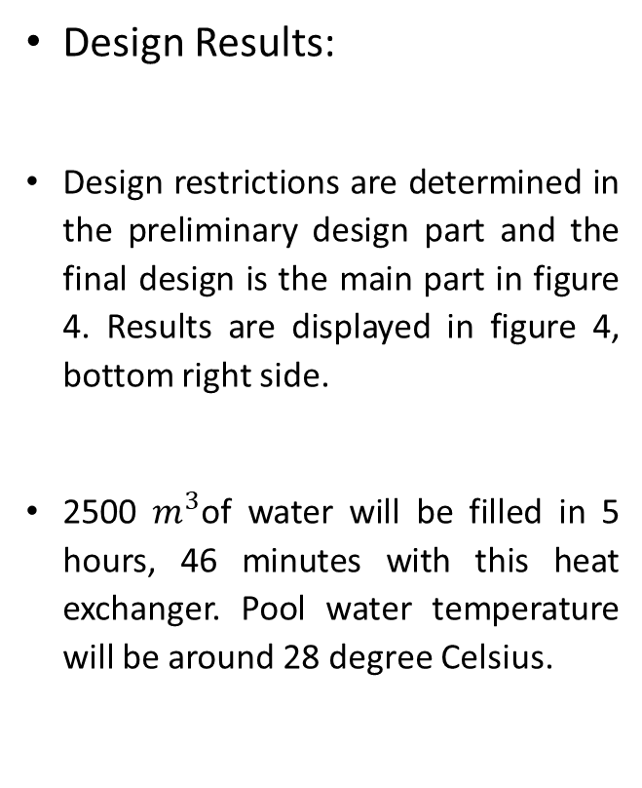
Design Results:
Design restrictions are determined in the preliminary design part and the final design is the main part in figure 4. Results are displayed in figure 4, bottom right side.
2500 $m^{3}$of water will be filled in 5 hours, 46 minutes with this heat exchanger. Pool water temperature will be around 28 degree Celsius.
Figure 4: Design results

Slide 7
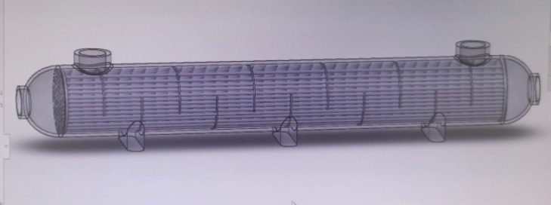
Figure 5: SolidWorks drawing of the design
Thank You For Listening!

Slide 8
References:
[1] “STANDARDS OF THE TUBULAR EXCHANGER MANUFACTURERS ASSOCIATION” [Online]. Available: http://www1.frm.utn.edu.ar/electromecanica/materias%20pagina%20nuevas/INSTALACIONES%20TERMICAS%20MECANICAS%20Y%20FRIGORIFICAS/material/apuntes/TEMA_9TH_EDITION_2007.pdf
[2] “Swimming Pool Certificate Guide February 2020 - FINA.” [Online]. Available: https://resources.fina.org/fina/document/2021/01/19/da8798f0-e89f-4e8c-9e21-5452c16a55dd/fina_swimming_pool_certificate_guide_february_2020_1.pdf. [Accessed: 10-May-2022].

