Slide 1
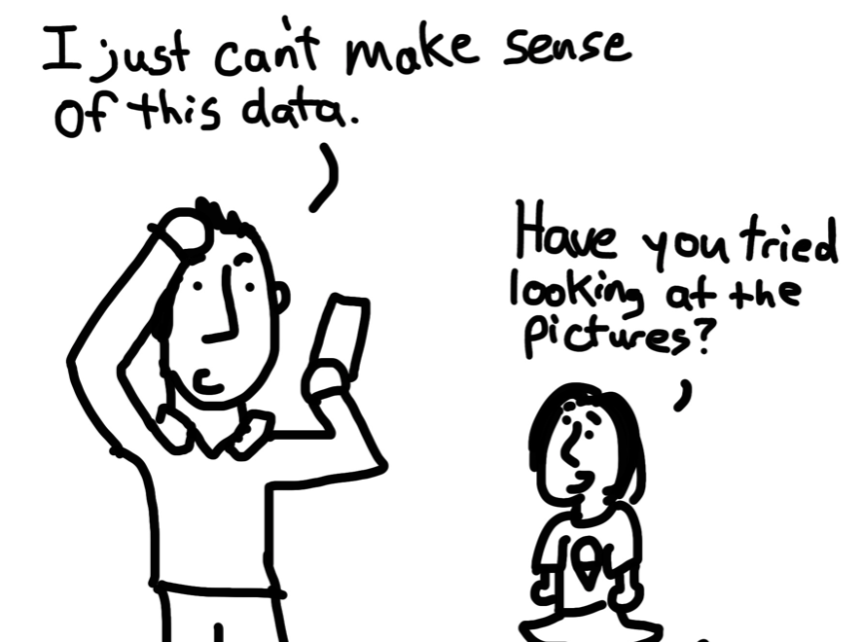
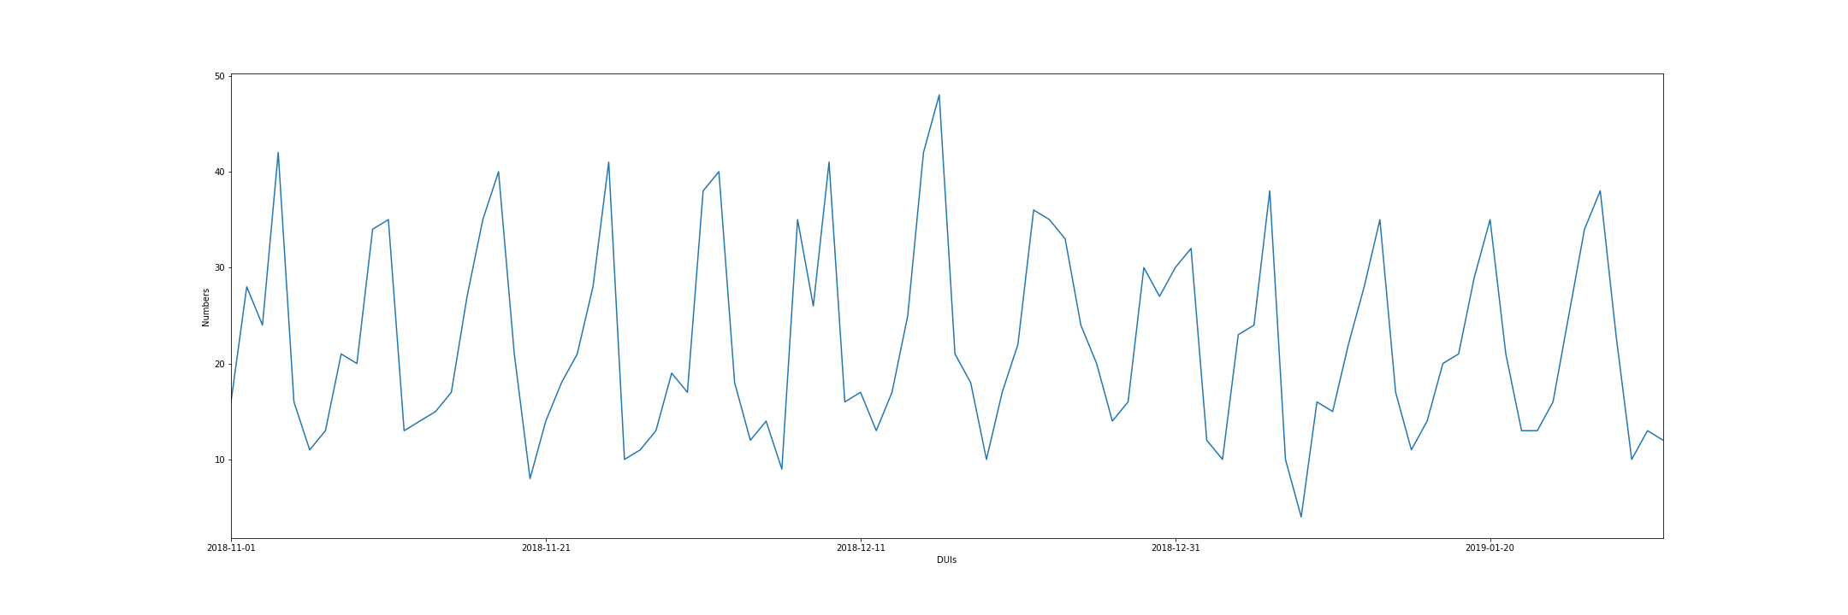
Possible Reasons for Increased Trend of Crimes
Trying to make sense

Slide 2
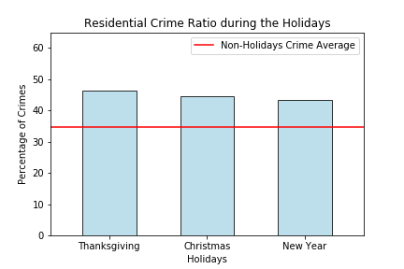
Increased Trend of Property Crimes During Holidays

Slide 3
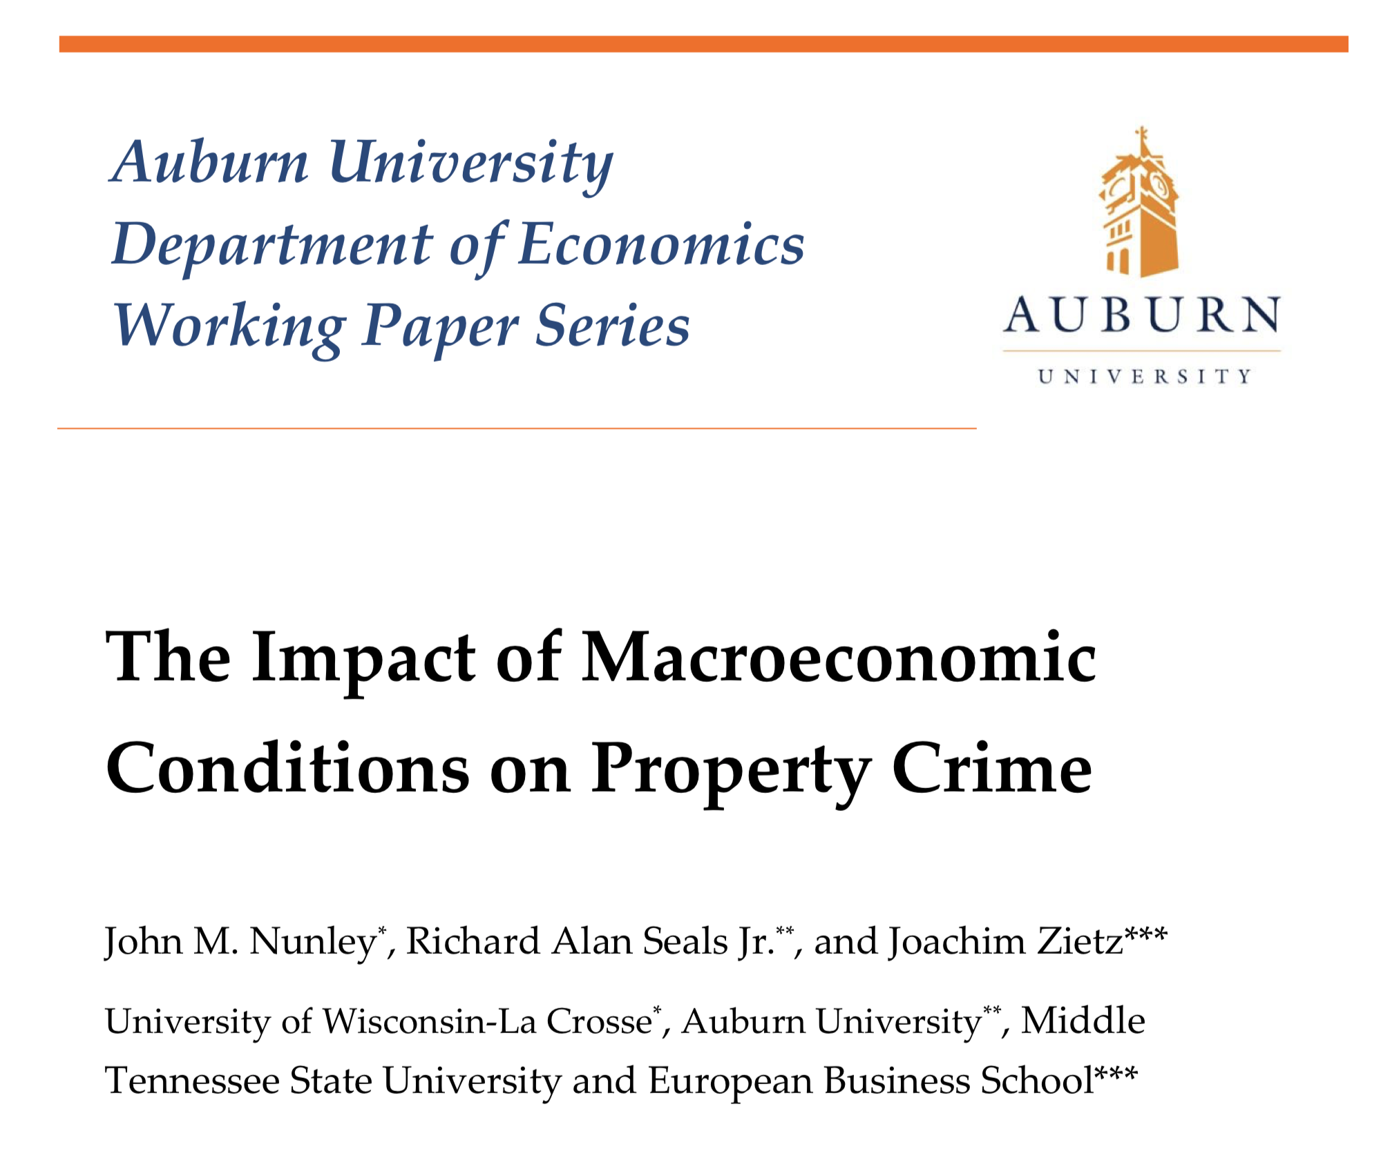
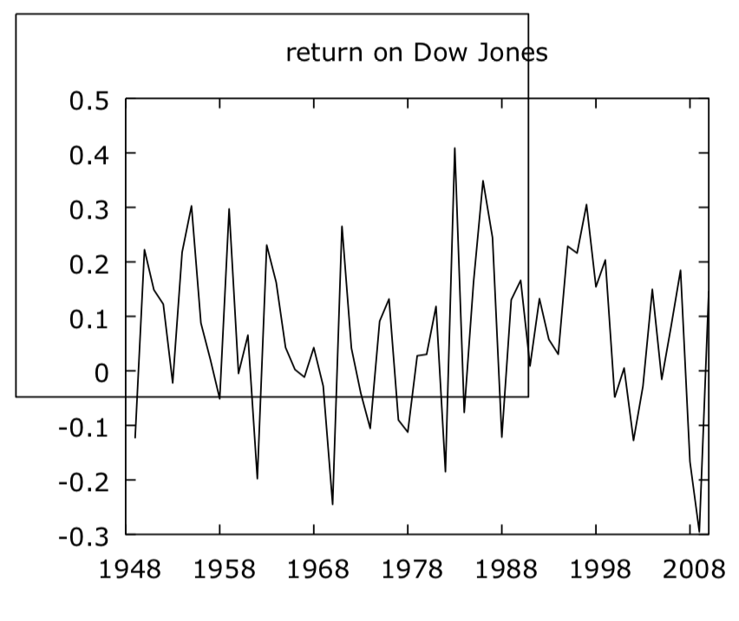

Slide 4
Impact of Macroeconomic Conditions on Crime
Literature: Macroeconomic variables had significant impact on crime
Phase 1: Dow Jones stock market index
Phase 2: Inflation rate
Phase 3: Unemployment rate

Slide 5


Impact of Macroeconomic Conditions on Crime
Literature: Macroeconomic variables had significant impact on crime
Phase 1: Dow Jones stock market index
API
API

Slide 6
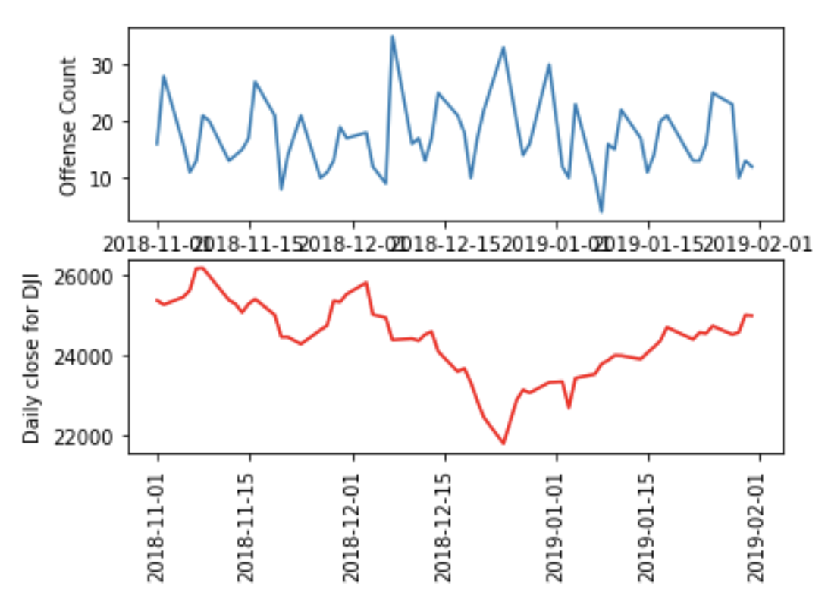
Impact of Macroeconomic Conditions on Crime
Literature: Macroeconomic variables had significant impact on crime
Phase 1: Dow Jones stock market index

