Slide 1
BookNest
Discover books recommended by students at your university
Ozodbek Tursunaliyev · Student ID 57264
Akademia WSB — Android + Firebase Team Project (individual)

Slide 2
Problem & Target Users
• The problem:
– Students struggle to find relevant book recommendations from peers in similar subjects
– They waste time on generic lists that don't match academic interests
• Target users:
– University students (18–30), undergraduate and graduate
– Read for both academic enrichment and leisure
• Our solution:
– A peer-driven feed of book recommendations + a personal reading list

Slide 3
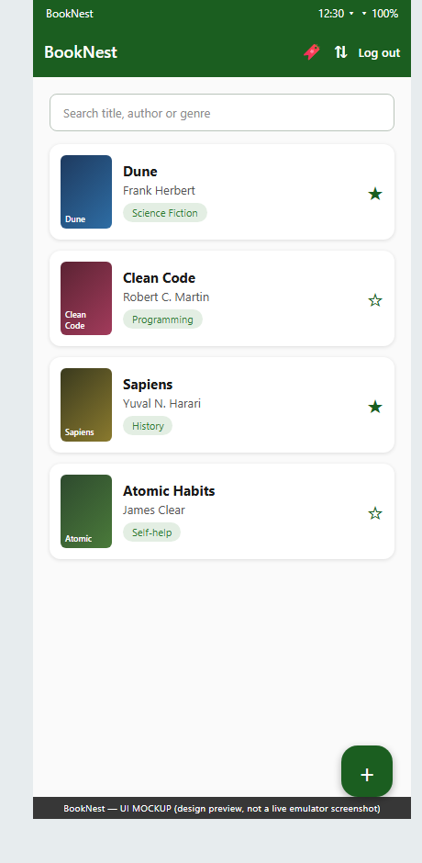
Solution Overview
• A social book-recommendation app for one campus
• Sign in, browse peer recommendations in real time
• Recommend books with a cover, genre and description
• Save books to a personal Want-to-Read list
• Built on Firebase (Auth, Firestore, Storage)

Slide 4
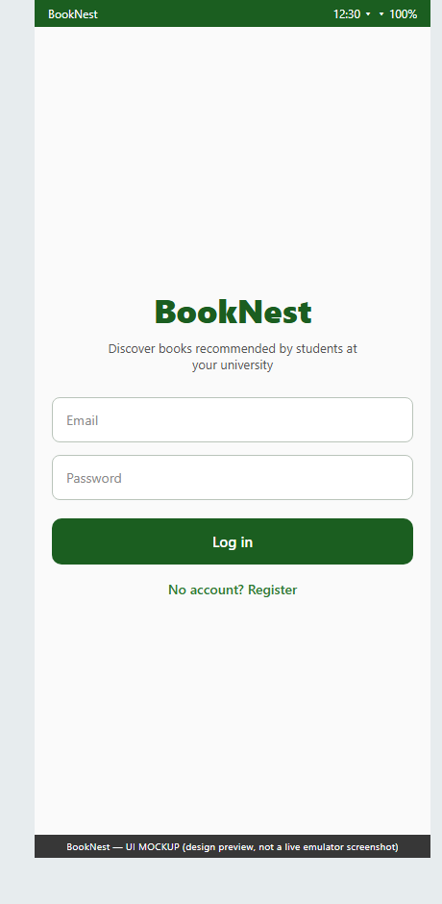
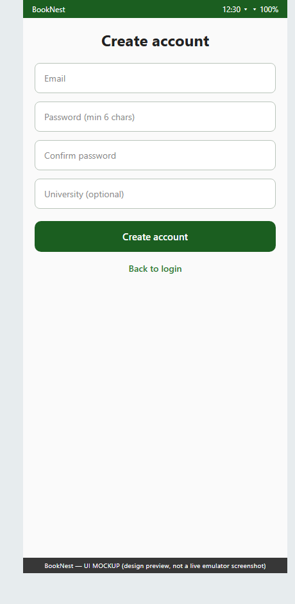
Live Demo — Accounts
Register → land on the feed → log out → log back in (session persists)

Slide 5
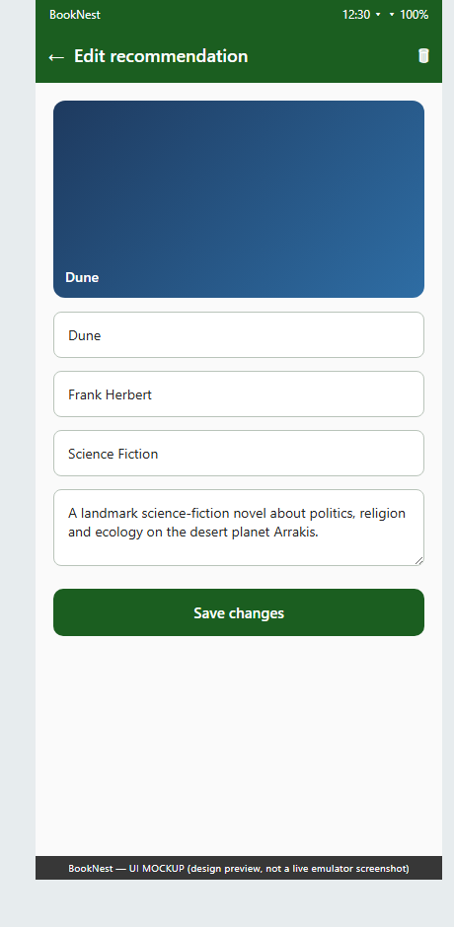
Live Demo — Browse, Add, Edit, Delete
Real-time Firestore list; owner-only edit & delete with confirmation

Slide 6
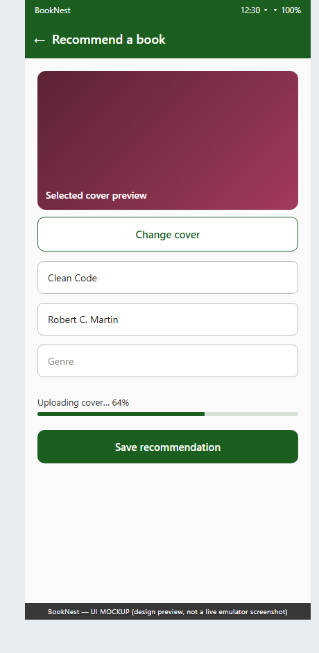
Advanced Feature — Firebase Storage
Pick a cover → upload with progress → stored URL shown via Coil
• Why Storage:
– Cover images give instant visual recognition in the feed
• Flow:
– Gallery pick → preview → upload (progress bar) → URL saved to Firestore
– Cover deleted from Storage when the book is deleted
• Secured:
– Authenticated writes only, images < 5 MB (storage.rules)

Slide 7
Architecture
• Android client — Kotlin + Jetpack Compose (Material 3), MVVM
• State via StateFlow; async Firebase calls via coroutines
• Firebase backend (serverless, Spark free tier):
– Authentication — email/password
– Cloud Firestore — users, books, savedBooks (real-time listeners)
– Firebase Storage — book_covers/
• Clean layering: UI → ViewModel → pure logic (util) → data models
• Pure logic is unit-tested on the JVM (no emulator needed)

Slide 8
Data Model — 3 Firestore Collections
• users:
– userId, email, displayName, university, createdAt
• books:
– bookId, title, author, description, genre, coverImageUrl, recommendedBy, recommenderName, createdAt
• savedBooks:
– savedId, userId, bookId, title, author, status, savedAt
• Security rules:
– Authenticated access; only the recommender can edit/delete their books

Slide 9
Testing
• 17 JUnit unit tests, all passing (./gradlew test)
– ValidatorsTest — email, password, password-match, book-input rules
– BookFiltersTest — search by title/author/genre, sorting, combined
• Logic kept as pure functions (util/) → fast JVM tests, no emulator
• Manual end-to-end testing of login → CRUD → cover upload each lab

Slide 10
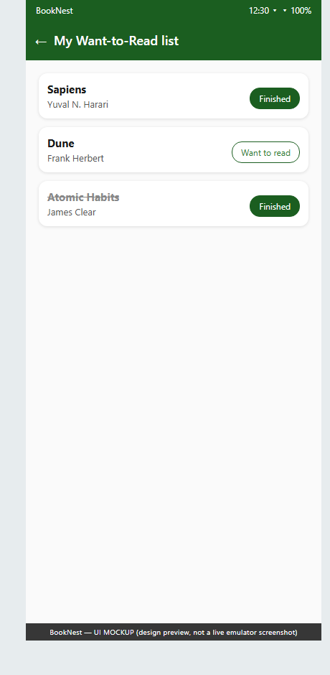
Usability Testing & Improvements
• Structured think-aloud test (Lab 3 protocol)
• Fixed: upload progress bar (was silent)
• Fixed: add-book validation with inline errors
• Fixed: bookmark toggles filled/outline
• Fixed: friendly empty-state message
• Backlogged: genre dropdown

Slide 11
Challenges & Solutions
• Firestore 'permission denied' → wrote authenticated security rules
• Blank cover URL → await downloadUrl before writing the document
• Remote covers not loading → INTERNET permission + Coil
• Back button returned to login → popUpTo(0) clears the back stack
• Solo work, no peer review → unit tests + structured self-usability test

Slide 12
Results & Reflection
• All deliverables met across Labs 1–3, delivered solo
• Working auth, CRUD, 4 extensions, Storage feature, 17 tests
• What went well: clean layering made testing & extensions fast
• What was hard: Firebase rules and the first Compose setup
• Future: genre dropdown, anti-spam Cloud Function, profile pictures, UI tests

Slide 13
Thank you — Questions?
github.com/Ozodiy/booknest-app
Trello board + full reports in /docs
BookNest · Ozodbek Tursunaliyev · 57264

