Slide 1
GB
GymBuddy
Log your workouts. Find your training partner.
Team Project – Mobile Application in the Cloud · Lab 1
Aida Ismayilova (57689) · Ozodbek Tursunaliyev (57264) · Elturan Valizada (58990)

Slide 2
What is GymBuddy?
An Android app backed by the cloud
• Gym + Buddy: your workout log and your training partner finder in one app.
• Log: record each workout (type, duration, notes) and see your history and weekly progress.
• Find: post or join open training sessions, so you never have to train alone.
• Cloud: everything is stored in Firebase, so your data follows you to any phone.
Why the name?
“Buddy” is the gym word for a training partner. People who train with a partner skip fewer sessions – so the name says what the app is for: staying consistent, together.

Slide 3
The problem
One sentence: who has what problem, and why it matters
“Gym-goers forget what they trained and struggle to find training partners, so progress stalls and motivation drops.”
• Today: workouts live in notes apps, memory or nowhere; partners are found by chance.
• Impact: no visible progress and no accountability lead to people quitting.
• Our answer: a simple cloud log plus a place to arrange sessions with others.

Slide 4
MVP features
Sprint 1 = Labs 1–2, the rest is planned for later
# | Feature | Sprint
1 | Register, log in, log out, auto-login (Firebase Authentication) | Sprint 1 (Lab 1)
2 | List my workouts | Sprint 1 (Lab 2)
3 | Add, edit and delete a workout (detail/edit screen) | Sprint 1 (Lab 2)
4 | Weekly stats calculated by a Cloud Function | Later (Lab 3)
5 | Find a partner: create and join training sessions | Later
Limits we respect: 5 screens (incl. login and register) and max. 3 Firestore collections.

Slide 5
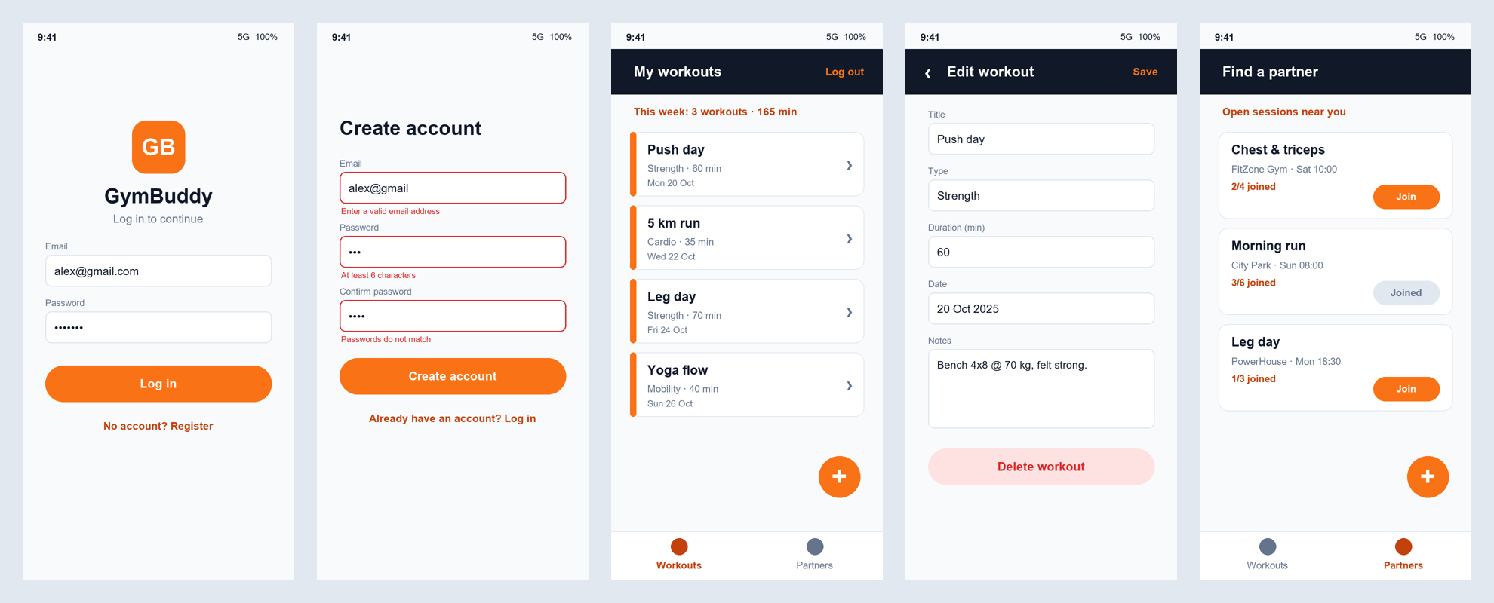
How the app will look
5 screens: Login · Register · Workouts · Workout detail/edit · Partners
Concept mockups. Login, Register and a temporary Home are built in Lab 1; the rest follow in Labs 2–3.

Slide 6
Data model
Cloud Firestore · 3 collections · ownerId links every document to its owner
Collection | Fields (type)
users | uid (doc id) · email (string) · displayName (string) · createdAt (timestamp)
workouts | ownerId (string) · title (string) · type (string) · durationMin (number) · notes (string) · date (timestamp) · createdAt (timestamp)
sessions | ownerId (string) · title (string) · gym (string) · startsAt (timestamp) · maxPeople (number) · participantIds (array of string)
Security Rules (Lab 2) make sure users can only edit their own data – enforced in Firebase, not just in the app.

Slide 7
Architecture
Screens never talk to Firebase directly
UI
LoginScreen · RegisterScreen · HomeScreen · AppNavHost
Android app
Kotlin + Jetpack Compose
Firebase Authentication
email + password
Logic
AuthValidator · AuthViewModel (StateFlow)
Cloud Firestore
workouts, sessions, users
Data
AuthRepository → FirebaseAuthRepository
Cloud Functions
Lab 3 – weekly stats
Why: simple screens, and the logic (e.g. AuthValidator) can be unit-tested on the JVM in Lab 3.

Slide 8
User stories
Written as GitHub Issues, in the format required by the lab instructions
Title: As a gym-goer, I want to log in with email and password
User story
As a gym-goer, I want to log in with my email and password, so that I can access my own workouts.
Acceptance criteria
☐ Valid credentials open the home screen
☐ Wrong credentials show an error message
☐ A logged-in user skips the login screen after restart
• Format: title + user story + acceptance criteria checklist.
• Labels: user-story plus android / firebase / ui.
• Board: Sprint 1 issues in the Sprint 1 column, others in Backlog; each has an assignee.
• Closing: the PR says “Closes #issue”, so the issue moves to Done on merge.

Slide 9
Sprint 1 backlog
Each story has acceptance criteria and an assignee
User story | Labels | Assignee
As a gym-goer, I want to register and log in with email and password | user-story · android · firebase | Ozodbek
As a gym-goer, I want to see a list of my workouts | user-story · android · ui | Elturan
As a gym-goer, I want to add a workout | user-story · android · firebase | Aida
As a gym-goer, I want to edit or delete a workout | user-story · android · firebase | Elturan
Backlog: weekly stats Cloud Function, find a partner (sessions).

Slide 10
Team and roles
Everyone writes code – roles say who is accountable for a decision
Aida Ismayilova
Student ID 57689
Product Owner + Developer
Problem statement, MVP, user stories and priorities; owns the board content.
Ozodbek Tursunaliyev
Student ID 57264
Tech Lead + Developer
Data model, architecture, Android and Firebase setup, auth feature.
Elturan Valizada
Student ID 58990
QA / DevOps + Developer
Repository, branch ruleset, PR reviews, board hygiene, testing.
Three people cover four roles: all three are Developers; the commit history will show everyone.

Slide 11
Our GitHub workflow
How we work together
Issue on the board
Feature branch
Small commits
Pull request
Review + approve
Squash merge → Done
• Protected main: ruleset protect-main – pull request required, no force push, no deletion.
• Board columns: Backlog · Sprint 1 · In progress · In review · Done.
• Templates: pull request template with “Closes #issue” and a test checklist.
• Goal: at least two merged PRs, each reviewed by a teammate.

Slide 12
Demo plan (3 minutes)
Who shows what
Who | Shows
Aida (Product Owner) | Problem statement and MVP features
Ozodbek (Tech Lead) | Data model and architecture diagram, then the live demo: register → logout → login → restart with auto-login
Elturan (QA / DevOps) | Board, merged PRs with review comments, branch ruleset
• Expected question: “Where do you check that a user only edits their own data?” → In Firebase Security Rules (Lab 2), not only in the app.

Slide 13
What's next
Lab 1 delivers the walking skeleton
• Lab 1: repo, board, Firebase project, register / login / logout / auto-login.
• Lab 2: workouts in Firestore – list, add, edit, delete – and Security Rules.
• Lab 3: Cloud Function for weekly stats, unit tests for the validator.
• Retro – Lab 1: one issue, every member comments: went well / did not go well / we will change.
Thank you – questions?

