Slide 1

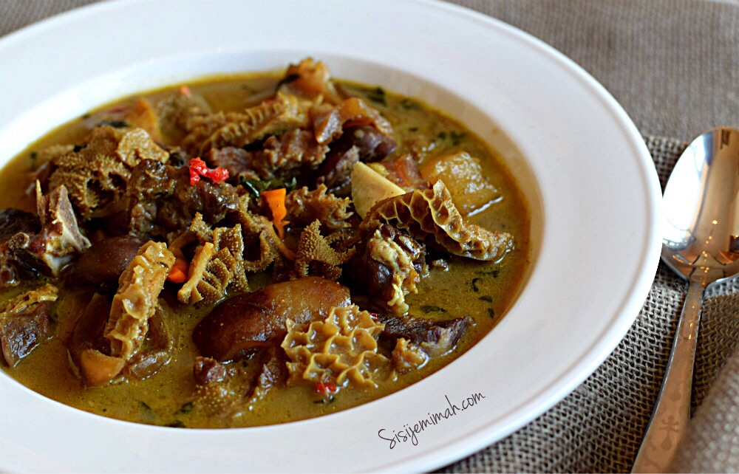
Categories ▼ About Jobs Contact
Business
Events Calendar
Market Place
People/consumer
Spotlight
News
Title comes here
Slug is meant to be very long, not that long . Probably a sentence from the actual aticle, just to give the reader a feel of what the article is about… this is just a dummy text.
Image comes here
May 5,2082
Recent Posts
Title comes here
Slug is meant to be very long, not that long … this is just a dummy text.
Read More ►

Slide 2
The first slide should give you an idea of what I meant by „UI“. Even if you want the same design as the mutterminds website you showed me. Design it with your own data in it.
Design how you want the
About
Contact
Category
Jobs
Categories
single blog post
and so on
to look.
You could search online: google, Behance, Pinterest… for ideas, typing in the
Consider where your ads should be on each page.
Design the mobile view too.
Any design software could be used not necessarily PowerPoint.

Slide 4


Slide 5


Slide 6
