Slide 1
Contemporary Technology
Created by:
Sadiksha Bhattarai

Slide 2
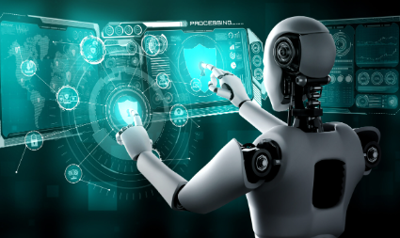
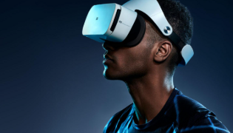
Introduction to Contemporary Technology
Contemporary technology is the modern technology we use today that makes life easier, faster, and more connected
It's all the new tools, gadgets, and systems that are changing how we live and work.
Here are some examples
Artificial Intelligence (AI)
Smartphones
Electric Vehicles (EVs)
Virtual Reality (VR)
Self-Driving Cars and Robots and many more

Slide 3

Some of the contemporary technologies
Smartphones
Laptops
Smart
TVs
Electric Cars
Video Calls
Social Media
Fitness Trackers
Online Shopping ETC

Slide 4
Importance of contemporary technology
The importance of contemporary technology is huge because it impacts nearly every part of our daily lives and society. Here’s why it’s so important:
Improves Daily Life: Technology makes tasks easier, faster, and more convenient. For example, smartphones allow us to communicate, shop, work, and entertain ourselves all from one device.
Enhances Safety and Security: Tech like surveillance cameras, biometric security, and cybersecurity helps protect our homes, businesses, and personal data from threats.
Supports Health and Medicine: Technologies like telemedicine, medical devices, and health tracking apps help people get better care and live healthier lives.
Enhances Communication: With the internet, social media, and messaging apps, we can stay connected with people worldwide instantly, breaking down distance barriers.

Slide 5


Advantages of Contemporary Technology
Makes Things Faster and Easier
Automation
Faster Work
Helps Us Stay Connected
Global Communication
Teamwork
Easy Access to Information
Free Information
Learning Anytime
Better Health and Care
Online Doctor Visits
Health Tech

Slide 6
Disadvantages of Contemporary Technology
While contemporary technology brings numerous benefits, it also has some disadvantages:
Privacy Issues: Increased use of digital platforms can lead to data breaches, identity theft, and loss of privacy.
Social Isolation: Over-reliance on technology, especially social media, can reduce face-to-face interactions, leading to feelings of isolation and loneliness.
Technology Addiction: Excessive use of technology, especially smartphones and video games, can lead to addiction, affecting mental and physical health.
Dependency: Over-reliance on technology can lead to reduced critical thinking, problem-solving skills, and self-sufficiency. And many more

Slide 7
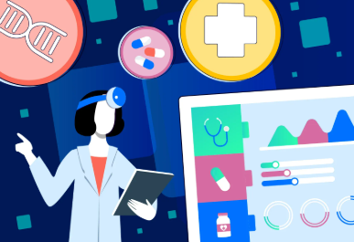

Application of Contemporary Technology
Contemporary technology (CT) has many applications across various fields. Here are some key areas where it is applied:
Healthcare
Telemedicine
Medical Devices
Education
Smart Classrooms
online learning
Communication
Social Media
Video Conferencing

Slide 8
THANKYOU

