Slide 1
Deadlock Management
Understanding and Preventing Deadlocks

Slide 2
Deadlock Management
Understanding and Preventing Deadlocks
Prepared by

Slide 3
Deadlock Management
A situation where a set of processes are permanently blocked because each process is waiting for a resource held by another process in the set.
Understanding and Preventing Deadlocks
Prepared by
Sumit Pokhrel
Suman Ghimire
Unique Pokhrel
Yaman Ghimire

Slide 4
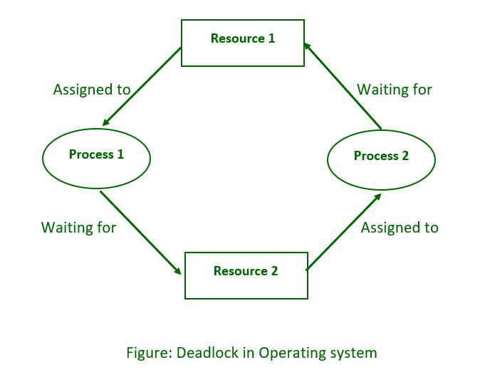
What is Deadlock?
A situation where a set of processes are permanently blocked because each process is waiting for a resource held by another process in the set.

Slide 5
What is Deadlock?
Deadlock is a situation where a set of processes are permanently blocked because each process is waiting for a resource held by another process in the set.
Notes:
In an operating system, a deadlock occurs when processes or threads enter a waiting state due to requested resources being held by other waiting processes. If this resource tug-of-war persists indefinitely, we find ourselves in a deadlock.

Slide 6
Example of Deadlock
A situation where a set of processes are permanently blocked because each process is waiting for a resource held by another process in the set.
Notes:
Example, Suman has oil and wants to make omelette and he needs a pan to make it. Sumit has a pan and wants to make a pancake but doesn’t have oil to make it. Suman wont give oil to Sumit until he make omelette and sumit wont leave pan until he makes pancakes. Now both of them cannot make anything because they don’t have enough resource

Slide 7
Example of Deadlock
Deadlock is a serious problem in concurrent systems, leading to system crashes and performance degradation.
Two processes, P1 and P2, need resources A and B. P1 holds A and wants B, while P2 holds B and wants A.
Notes:
Example, Suman has oil and wants to make omelette and he needs a pan to make it. Sumit has a pan and wants to make a pancake but doesn’t have oil to make it. Suman wont give oil to Sumit until he make omelette and sumit wont leave pan until he makes pancakes. Now both of them cannot make anything because they don’t have enough resource

Slide 8
Example of Deadlock
Two processes, P1 and P2, need resources A and B. P1 holds A and wants B, while P2 holds B and wants A.
Deadlock is a serious problem in concurrent systems, leading to system crashes and performance degradation.
Notes:
Example, Suman has oil and wants to make omelette and he needs a pan to make it. Sumit has a pan and wants to make a pancake but doesn’t have oil to make it. Suman wont give oil to Sumit until he make omelette and sumit wont leave pan until he makes pancakes. Now both of them cannot make anything because they don’t have enough resource

Slide 9
Necessary Conditions for Deadlock
Only one process can hold a resource at a time
Two processes, P1 and P2, need resources A and B. P1 holds A and wants B, while P2 holds B and wants A.
Deadlock is a serious problem in concurrent systems, leading to system crashes and performance degradation.

Slide 10
Necessary Conditions for Deadlock
Mutual Exclusion:
Only one process can hold a resource at a time
A process holding resources can request additional resources
Notes:
At least one resource must be held in a non-shareable mode. Picture a single restroom key—the person inside has exclusive access, and no one else can use it simultaneously. This exclusivity ensures that only one process can utilize the resource at any given moment.

Slide 11
Necessary Conditions for Deadlock
Hold and Wait
A process holding resources can request additional resources
Resources cannot be forcibly taken away from a process.
Only one process can hold a resource at a time
Notes:
A process currently holds at least one resource and seeks additional resources held by other processes. Imagine a chef who has the frying pan but needs the spatula held by another chef. Both chefs are stuck, waiting for their missing utensils.

Slide 12
Necessary Conditions for Deadlock
No Preemption
Resources cannot be forcibly taken away from a process.
A chain of processes exists where each process is waiting for a resource held by the next process in the chain
A process holding resources can request additional resources
Notes:
Resources can only be released voluntarily by the process holding them. There’s no snatching or grabbing—only polite requests. If a process clings to a resource, it won’t let go until it’s ready.

Slide 13
Necessary Conditions for Deadlock
Circular Wait
A chain of processes exists where each process is waiting for a resource held by the next process in the chain
Resources cannot be forcibly taken away from a process.
Notes:
Each process waits for a resource held by another process, creating a circular chain. It’s like a dance where everyone partners up, but no one can move because they’re all waiting for their next dance partner.

Slide 14
Deadlock Prevention Techniques
Allow resource sharing only when necessary.
Use semaphores or mutexes to ensure exclusive access.

Slide 15
Deadlock Prevention Techniques
Mutual Exclusion:
Allow resource sharing only when necessary.
Request all resources needed at once before starting execution.

Slide 16
Deadlock Prevention Techniques
Hold and Wait:
Allow processes to voluntarily release resources when finished.
Request all resources needed at once before starting execution.
Allow resource sharing only when necessary.
Use semaphores or mutexes to ensure exclusive access.

Slide 17
Deadlock Prevention Techniques
No Preemption
Number resources and order acquisition requests.
Use Banker's Algorithm to ensure safe resource allocation
Allow processes to voluntarily release resources when finished.
Allow resource sharing only when necessary.
Use semaphores or mutexes to ensure exclusive access.

Slide 18
Deadlock Prevention Techniques
Circular Wait:
Number resources and order acquisition requests.
Use Banker's Algorithm to ensure safe resource allocation
Notes:
Yaman le sikauxa bankers algorithm teslai refer garera xodne

Slide 19
Deadlock Avoidance Techniques
Tracks resource allocation and available resources.
Predicts potential deadlocks before resource allocation.
Only allocates resources if it guarantees no deadlock.

Slide 20
Deadlock Avoidance Techniques
Banker's Algorithm:
Order resources based on a hierarchy.
Processes can only request resources in ascending order
Tracks resource allocation and available resources.
Predicts potential deadlocks before resource allocation.
Only allocates resources if it guarantees no deadlock.
Notes:
J padeko xas vande vai. Confidence ma. Talai matra tha xa tyo k ho vanera

Slide 21
Deadlock Avoidance Techniques
Resource Ordering:
Order resources based on a hierarchy.
Processes can only request resources in ascending order
Tracks resource allocation and available resources.
Predicts potential deadlocks before resource allocation.
Only allocates resources if it guarantees no deadlock.
Notes:
Pad vamneko thye padis hola ni. Priorityy hierarchy ko aadhar ma process execute garxa van
Top priority to low priority(ascending order ma execute garxa). Aba malai vanna de( Sumit)

Slide 22
Deadlock Detection and Recovery
Use resource allocation graphs or other algorithms to identify deadlocked processes.
Resource Ordering:
Tracks resource allocation and available resources.
Predicts potential deadlocks before resource allocation.
Only allocates resources if it guarantees no deadlock.
Order resources based on a hierarchy.
Processes can only request resources in ascending order

Slide 23
Deadlock Detection and Recovery
Detection
Terminate one or more processes involved in the deadlock.
Rollback processes to a previous state.
Preempt resources from processes.
Use resource allocation graphs or other algorithms to identify deadlocked processes.
Order resources based on a hierarchy.
Processes can only request resources in ascending order
Notes:
A graph with nnodesa and lines which represent the resource usage and flow in system

Slide 24
Deadlock Detection and Recovery
Recovery
Terminate one or more processes involved in the deadlock.
Rollback processes to a previous state.
Preempt resources from processes.
Use resource allocation graphs or other algorithms to identify deadlocked processes.
Notes:
Create backup
Priority basis preemption]
Termination of process

Slide 25
Importance of Effective Deadlock Management
Effective management is vital for preventing system crashes and ensuring smooth operation
Use resource allocation graphs or other algorithms to identify deadlocked processes.
Terminate one or more processes involved in the deadlock.
Rollback processes to a previous state.
Preempt resources from processes.
Recovery

Slide 26
Importance of Effective Deadlock Management
System Stability
Techniques like resource allocation graphs, timeouts, and preemption help resolve deadlocks
Effective management is vital for preventing system crashes and ensuring smooth operation
Use resource allocation graphs or other algorithms to identify deadlocked processes.

Slide 27
Importance of Effective Deadlock Management
Deadlock Resolution
Proper management minimizes deadlocks’ impact on system efficiency
Techniques like resource allocation graphs, timeouts, and preemption help resolve deadlocks
Effective management is vital for preventing system crashes and ensuring smooth operation
Use resource allocation graphs or other algorithms to identify deadlocked processes.
Notes:
Timeout preemption sets a GIVEN TIME TO EACH PROCESS AND TERMINATEES THEM AS SOON THE TIME COMPLETES

Slide 28
Importance of Effective Deadlock Management
Performance Improvement
Proper management minimizes deadlocks’ impact on system efficiency
Effective management is vital for preventing system crashes and ensuring smooth operation
Techniques like resource allocation graphs, timeouts, and preemption help resolve deadlocks
Use resource allocation graphs or other algorithms to identify deadlocked processes.
Notes:
Proper management of deadlock like resource allocation and data flow monitoring can prevent deeadlock

Slide 29
Conclusion
Effective management is vital for preventing system crashes and ensuring smooth operation
Use resource allocation graphs or other algorithms to identify deadlocked processes.
Performance Improvement
Deadlocks are a major challenge in concurrent systems. Understanding the conditions for deadlock is crucial for effective management. Various techniques exist for preventing, avoiding, and recovering from deadlocks.
Proper management minimizes deadlocks’ impact on system efficiency

Slide 30
Conclusion
Deadlocks are a major challenge in concurrent systems. Understanding the conditions for deadlock is crucial for effective management. Various techniques exist for preventing, avoiding, and recovering from deadlocks. Choosing the appropriate technique depends on the specific system and its resource requirements.
Effective management is vital for preventing system crashes and ensuring smooth operation
Use resource allocation graphs or other algorithms to identify deadlocked processes.
Performance Improvement
Proper management minimizes deadlocks’ impact on system efficiency

